Slide 1
A Study of Climate Change Variables on Select Cold, Cool and Warm Water Fish of Lake Ontario
Barbara J. McKay Archibald
Advisor: Dr. Joseph Bishop
18 December, 2012

Slide 2
Outline
introduction
objectives
methods
timeline
credits

Slide 3
Introduction:
Climate Change and Species
climate change
  carbon dioxide (CO₂) and other green house gasses¹
  0.74º C last 100 years¹
  projected 1.1º – 6.5º C by 2100²
species
  changes in range, frequency, and phenology of species¹
Notes:
(IPCC 2007a)
(ACC 2010)

Slide 4
Species Impact
observed:
  99 bird, butterfly and herbs species shift north average 6.1 km/decade (±2.4 km)³
  172 species of herbs, trees, shrubs, butterflies and amphibians have a mean shift to earlier spring events 2.3 days/decade⁴
  north-west Europe: an increase in plants that prefer hot conditions over last 30 years; decline in cold tolerant plants⁴
Notes:
3. (Parmesan and Yohe 2003)
4. (IPCC 2007b)

Slide 5
Species Impact
projected:
  increase temp. 1.5º-2.5º C = 20-30% extinction
  mid-century eastern Amazonia may see replacement of tropical forest with savanna⁵
fish:
  short term studies: El Niño, La Niña, eruptions
  climate change studies: ocean, freshwater⁶
trend: warm water fish warm periods, cool and cold water fish in cold periods⁶
Notes:
5. (IPCC 2007b)
6. (Casselman 2002)

Slide 6
Gap Analysis Program (GAP)
“keep common species common”
  model species habitat availability to id gaps in species protection⁷
national program 1989
  Scott 1980’s⁷
model habitat
  terrestrial vertebrates
  other terrestrial species
  aquatic species⁸
Notes:
7. (Scott et al. 1993)
8. (Kremen et al. 1993; Scott et al. 1993; Butterfield et al. 1994; Fertig and Thurston 2001; Allen et al 1989; Gerrera 2002; Sowa et al. 2005; McKenna and Castiglione 2010; USGS 2012)

Slide 7
GAP Process
Land cover and species layers
Model potential habitat distribution and biodiversity
Protected lands
Gaps in protection
Notes:
Layers: land cover, species location. 2. Analyze: Model animal habitat using relationship between land cover and species location, model biodiversity using multiple species models to estimate species richness 3. Add protected lands. 4. Analyze for Gaps in protection: Unprotected lands, High species richness, Unprotected/ little protected species (Scott 1993)

Slide 8
Aquatic GAP
assess biodiversity of aquatic species, their habitats, and distribution and find gaps in protection in aquatic communities⁹
draws from multiple habitat variables
two types
  riverine
  coastal¹⁰
Notes:
9. (Morrison et al. 2003; Sowa et al. 2005; USGS 2012)
10. (Sowa et al 2005, 2007, McKenna and Castigline 2010)

Slide 9
Objective
model impact of climate change on freshwater fish of Lake Ontario
  importance ecological and economic
  use current and modeled future climate data
  model population size and range
  three fish species: cold, cool and warm water fish¹¹
expectation:
  current data indicate fish group by preferred habitat
  projected populations will shift.
    warm water species will increase and species range will change
    cool and cold water species will drop in number and range will shrink
Notes:
11. (Casselman 2002, Lantry 2011)

Slide 10
Method: Framework
ALUs
  summer water circulation patterns
  Bathymetry
COZs
  Following shoreline features
  rivers with stream orders 8+
  stream order of 5+
  5 meter Isobaths
AHAs
  fetch (E)
  Cost distance to nearest large river
  ±50% subaquatic vegetation (SAV)
  Isobath: 0 to 5, 5 to 10, and 10 plus
Spatial Cell: 90 m x 90 m sample cells¹²
Coarse
Zone
Subzone
Region
***Subregion***
Coastal or Open Water Zone (COZ)
Aquatic Lake Unit (ALU)
Aquatic Habitat Area (AHA)
Spatial Cell (Raster)
Fine
Scale
Notes:
12. (Strahler 1957, Sly and Bush 1992; Maxwell et al. 1995; Beletsky, J. Saylor and D. Scwab 1999; McKenna and Castiglione 2010; and Castiglione, personal communication)

Slide 11
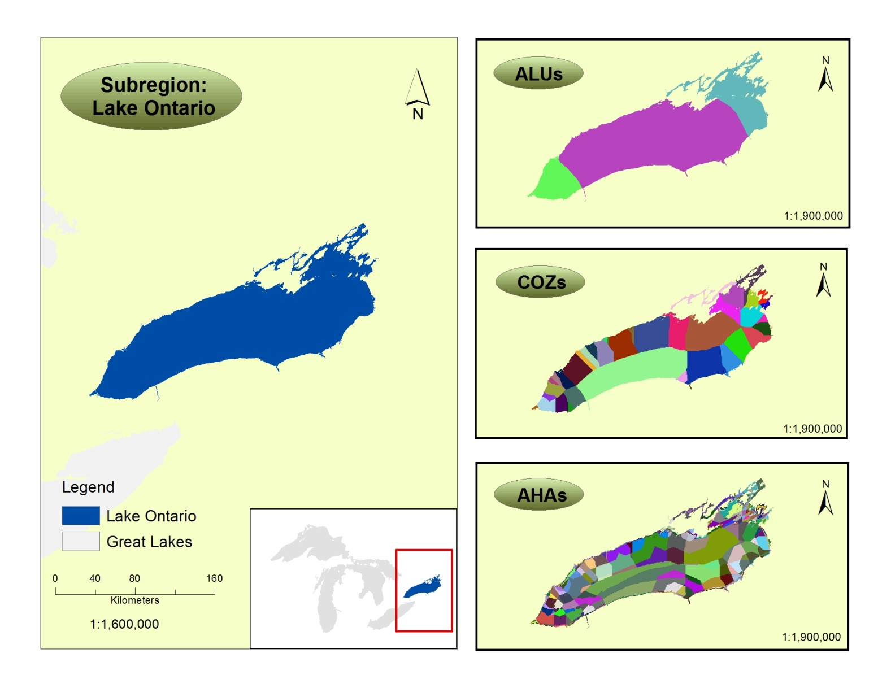
Aquatic GAP Framework from Subregion to Aquatic Habitat Area
Notes:
Data source (McKenna and Castiglione unpublished)

Slide 12
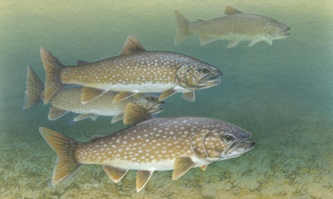
Framework to Classification
Zone
Subzone
Region
Subregion
ALU
COZ
AHA
Spatial Cell
Zone
Subzone
Region
Subregion
Ecological Lake Unit (ELU)
Aquatic Ecological System (AES)
Fisheries Conservation and Management Unit (FCMU)
Spatial Cell
Notes:
(McKenna and Castiglione 2010)
Fish image– (<a href="http://www.public-domain-image.com/fauna-animals-public-domain-images-pictures/fishes-public-domain-images-pictures/trout-fishes-pictures/lake-trout-fishes-salvelinus-namaycush.jpg.html" title="Lake trout fishes salvelinus namaycush">Lake trout fishes salvelinus namaycush</a> by Knepp Timothy, U.S. Fish and Wildlife Service)

Slide 13
Original Aquatic GAP
consider 22 habitat variables to build fish models
drill through layers to mine variables associated with fish survey sites➔ flat file¹³
Fish Survey site | Fish X | Fish Y | Fish Z | Habitat Variable 1 | Habitat Variable 2 | …. | Habitat Variable 22
1 | X₁ | Y₁ | Z₁ | H¹₁ | H²₁ | … | H²²₁
2 | X₂ | Y₂ | Z₂ | H¹₂ | H²₂ | … | H²²₂
3 | X₃ | Y₃ | Z₃ | H¹₃ | H²₃ | … | H²²₃
Notes:
13. Castiglione, personal communication

Slide 14
Original A-GAP
consider 22 habitat variables
drill through layers to get variables➔ flat file
conduct CCA → most influential variables
build Neural Network Model → model predicts fish frequency/location
NNM → predict fish species using the habitat variables for each spatial cell
fish populations summarized and reported at desired spatial scale¹⁴
Notes:
14. Castiglione, personal communication

Slide 15
Deriving Statistics from Spatial Cell to Higher Classification
Subregion | Lake Statistic = Statistic M and N
ALU/ELU | M = Statistic I and J |  |  |  |  |  |  |  | N = Statistic of K and L
COZ/AES | I = Statistic A and B |  |  |  | J = Statistic C and D |  |  |  | K = Statistic E and F |  |  |  | L = Statistic G and H
AHA/FCMU | Stat A |  | Stat B |  | Stat C |  | Stat D |  | Stat E |  | Stat F |  | Stat G |  | Stat H
Spatial Cell | A₁ | A₂ | B₁ | B₂ | C₁ | C₂ | D₁ | D₂ | E₁ | E₂ | F₁ | F₂ | G₁ | G₂ | H₁ | H₂
Notes:
(McKenna and Castiglione 2010)

Slide 16
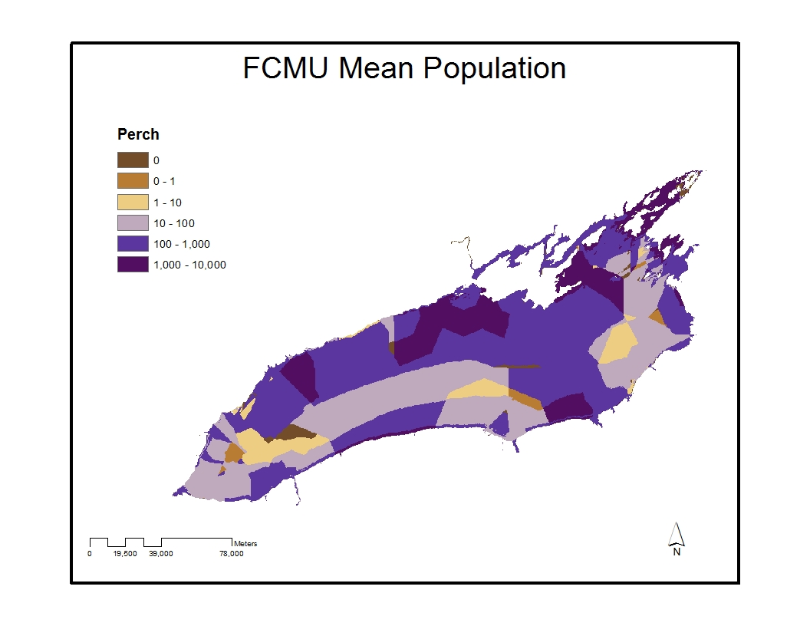
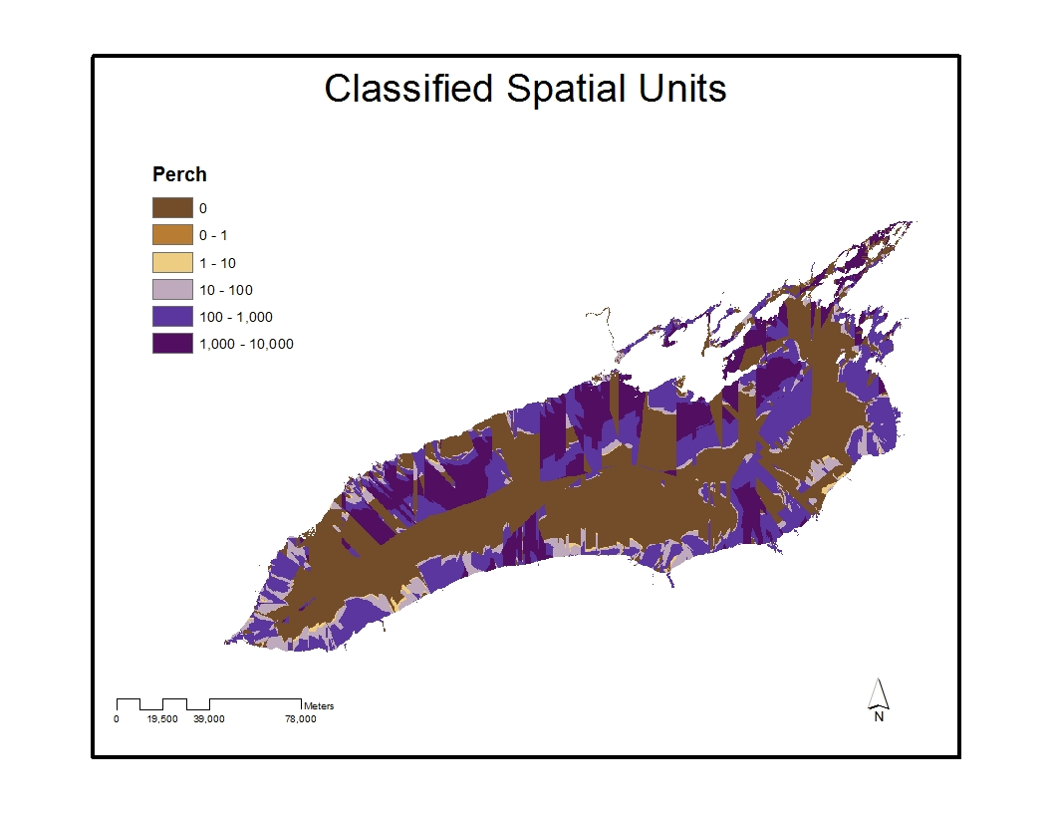
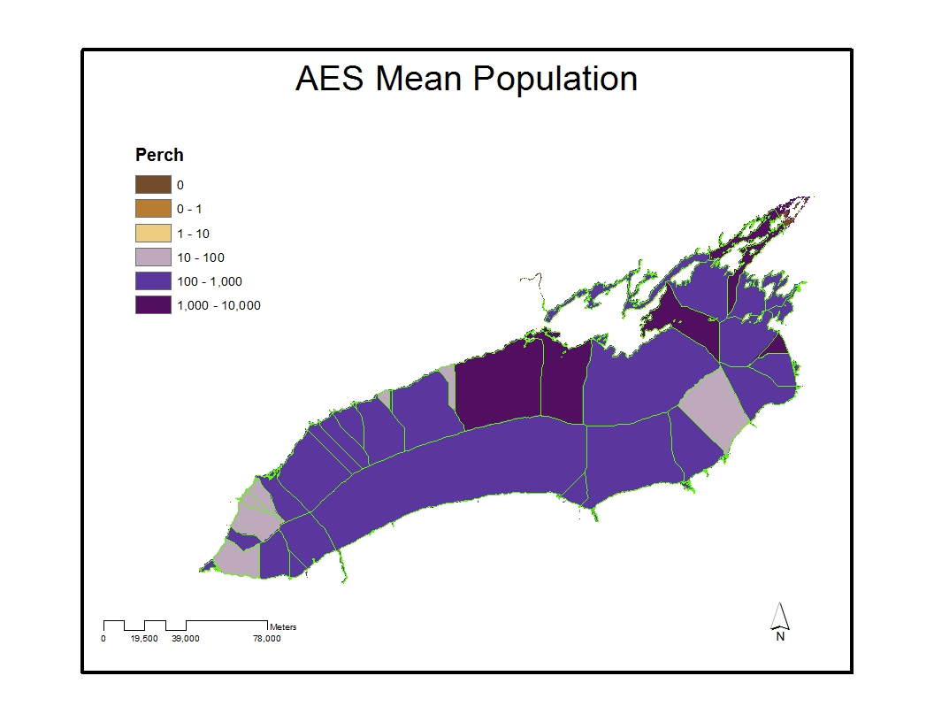
Perch Population Spatial Units to Ecological Lake Units
Notes:
McKenna and Castiglione, unpublished data

Slide 17
Project Details
continuing modeling techniques¹⁵
  expanding climate variables
  current/predicted 2020, 2050, 2080¹⁶
fish
  lake trout – cold water
  yellow perch – cool water
  smallmouth bass – warm water¹⁷
Notes:
15 (2010, Castiglione personal communication)
16 (WorldClim 2012)
17 Casselman (2002)

Slide 18
Summary of Fish Models
Time | Model | Base (McKenna and Castiglione) ¹⁸ | Base + Climate¹⁸ | Reselected habitat and Climate
Current |  | A_{l, y, s} | E_{l, y, s} | I_{l, y, s}
2020 |  | B_{l, y, s} | F_{l, y, s} | J_{l, y, s}
2050 |  | C_{l, y, s} | G_{l, y, s} | K_{l, y, s}
2080 |  | D_{l, y, s} | H_{l, y, s} | M_{l, y, s}
Notes:
18 (McKenna and Castiglione unpublished)

Slide 19
Data and Tools
Data Set | Resolution | Format
Coastal-GAP spatial unit layers | 90 m x 90 m | Raster
USGS fish survey data | 90 m x 90 m | Raster
Habitat variable data set | 90 m x 90 m | Raster
Climate variables | 1 km x 1 km | Raster
Tools:
ArcGIS 10.1¹⁹
Statistical software to perform CCA or other multivariate analysis
Neuro Shell 2 software, release 4²⁰
Array application tool for calculating and mapping fish
Notes:
19 (ESRI 2012)
20 (Ward Systems 2000)

Slide 20
Generalized Methodology
Habitat
ArcGIS: Extract Multi Values to Points
Drill for habitat and climate variables
Geo-database
GAP spatial units
Fish data
Attribute table
Climate data
Base model
MVA
Analyze climate variables for influence
MVA
Analyze mixed variables for influence
Array application tool
Apply models
Base +
climate
model
Datasets
Reselected model
Climate
variables
Mix
variables
ArcMap
Map data
Maps
ArcMap
Analyze map data
Neural Shell 2
Run neural network analysis
Conclusion: fish population & range
M & C variables

Slide 21


Model: McKenna & Castiglione Original & Base
Influential habitat variables
Statistical Software
(CCA)
Neural Shell 2
(NNA)
Relational table: habitat associated w/Fish
Habitat variables
Fish data
Relational table: habitat associated w/Fish
C-GAP spatial
framework
Array
Influential habitat
variables
ArcGIS
ArcMap
Conclusions about predicted fish populations
McKenna & Castiglione unpublished
Notes:
Purple indicates original method by McKenna and Castiglione
White and grey shows inserting McKenna and Castiglione’s pre-selected variables
Need to change results Product should be results of pop. Frequency and range analysis and protection conclusions.

Slide 22
Model: Base +Climate, and Reselected Variables
Influential climate
and /or habitat variables
Statistical Software
(MVA)
Relational table: climate associated w/Fish
Neural Shell 2
(NNA)
Habitat variables
Relational table: climate, habitat and fish data
C-GAP spatial
framework
Fish data
Array
Habitat
variables
ArcGIS
ArcMap
Conclusions about
predicted fish populations
Climate
variables
McKenna & Castiglione unpublished
WorldClim
(worldclim.org)

Slide 23
Model:
Habitat+Climate
Influential climate and/or habitat variables
Statistical Software
(MVA)
Relational table: climate, habitat and fish data
Neural Shell 2
(NNA)
Relational table: climate, habitat & associated fish
Habitat variables
Fish data
Array
ArcGIS
ArcMap
Conclusions about
Predicted Fish Populations
Climate
variables
WorldClim
(worldclim.org)

Slide 24
Output & Analysis
output
  3 fish layers per model
      [(1 base model * 1 time period ) + (1 base + climate model * 4 time periods) + (1 reselected * 4 time periods)] (3 fish species) = [1 + 4 + 4]3 = [9]3= 27 models
analysis
  compare population size and range across space and time
    evaluating fish frequency by temperature classification over time, where they occur, if they congregate and if groups shift over space and time
    evaluate shifting conservation needs

Slide 25
Implications
implications in population frequencies and species range
  what is fished, where is fished, if fished
  prey availability

Slide 26
Timeline
January 31, 2013: tie up last planning details
February 28, 2013: complete first model
May 15, 2013: complete all models
June, 2013: move
October 31, 2013: complete data analysis
December, 2013: complete writing
December, 2013: present findings

Slide 27
Credits
Gratitude
  Chris Castiglione
  Jim McKenna
  Joe Bishop

Slide 28
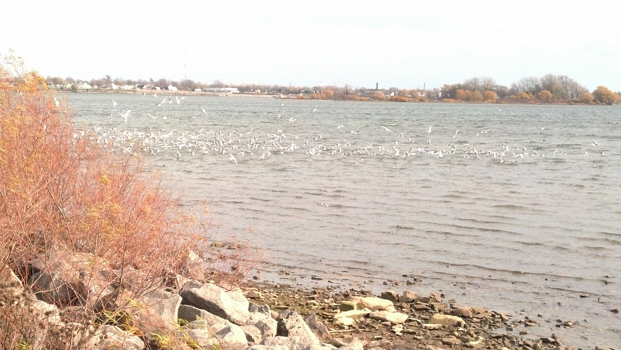
Questions?
Feeding Frenzy 11/12/2012

Slide 29
Citations
Allen, C., L. Pearlstine and D. Wojcik. 1998. Gap analysis for ant species. GAP Analysis Bulletin 7: 10-14.
ACC (America's Climate Choices: Panel on Advancing the Science of Climate Change; National Research Council). 2010. Advancing the science of climate change. National Academies Press. Washington, DC.
Beletsky, D, J. Saylor, and D. Schwab. 1999. Mean circulation in the Great Lakes. Journal of Great Lakes Research 25(1): 78-93.
Butterfield, B. R., B. Csuti, and J. M. Scott. 1994. Modeling vertebrate distributions for gap analysis. Pages 53 – 68 in R. I. Miller, editor. Mapping diversity of nature. Chapman and Hall, London.
Casselman, J. M. 2002. Effects of temperature, global extremes, and climate change on year-class production of warmwater, coolwater, and coldwater fishes in the Great Lakes Basin. American Fisheries Society Symposium 32: 39–60. Available: ftp://ftp.geobc.gov.bc.ca/.virtual/slk6ftp/pub/outgoing/requests/!age_analysis/CD1/Selected%20Age-Growth%20Publications/Climate%20and%20year-class%20production%20of%20fish,%20AFS%20Symposium,%20C.pdf.
ESRI. 2012. ArcGIS10.1. ESRI. Redlands, CA. ESRI.com
Fertig, W. and R. Thurston. 2001. Gap analysis of the flora of Wyoming. GAP Analysis Bulletin 10: 3-9.
Guerra M., E. Walker , C. Jones, S. Paskewitz, M. Cortinas, A. Stancil, L. Beck, M. Bobo, and U. Kitron. 2002. Predicting the risk of lyme disease: habitat suitability for Ixodes scapularis in the north central United States. Emerging Infectious Disease [online serial]. DOI: 10.3201/eid0803.010166. Available : http://wwwnc.cdc.gov/eid/article/8/3/01-0166.htm
IPCC (Intergovernmental Panel on Climate Change). 2007a. Climate change 2007: synthesis report. IPCC, Geneva, Switzerland. Available: http://www.ipcc.ch/pdf/assessment-report/ar4/syr/ar4_syr.pdf.

Slide 30
Citations continued
.
IPCC 2007b. Climate change 2007: Impacts, Adaptation and Vulnerability. IPCC, Geneva, Switzerland. Available: http://www.ipcc.ch/publications_and_data/publications_ipcc_fourth_assessment_report_wg2_report_impacts_adaptation_and_vulnerability.htmdf
Kremen, C., R. K. Colwell, T. L. Erwin, D. D. Murphy, R. F. Noss and M. A. Sanjayan. 1993. Terrestrial arthropod assemblages: their use in conservation planning. Conservation Biology 7(4): 796-808.
Lantry, J. 2011. Eastern basin of Lake Ontario warm water fisheries assessment, 1976-2010. In Bureau of Fisheries Lake Ontario Unit and St. Lawrence River Unit to the Great Lakes Fishery Commission’s Lake Ontario Committee. New York State Department of Environmental Conservation, Division of Fish, Wildlife and Marine Resources 2010 Annual Report. Section 4, Pages 1-24. New York State Department of Environmental Conservation. Albany, NY: Available: http://www.dec.ny.gov/docs/fish_marine_pdf/lorpt10.pdf.
Maxwell, J. R., C. J. Edwards, M. E. Jensen, S. J. Paustian, H. Parrott, and D. M. Hill. 1995. A hierarchical framework of aquatic ecological units in North America (NearcUc Zone). U.S. Department of Agriculture, Forest Service, North Central Forest Experiment Station. General Technical. Report NC-176. St. Paul, Minnesota. Morrison, S., D. Passino-Reader, D. Myers, J. McKenna, J. Stewart, B. Scudder, and K. Lohman. 2003. Great Lakes regional aquatic gap analysis —preserving biodiversity in the great lakes basin. USGS GLSC Fact Sheet 2003-1. Available: http://www.glsc.usgs.gov/_files/factsheets/2003-1%20Great%20Lakes%20Regional%20Aquatic%20GAP.pdf.
McKenna, J. and C. Castiglione. 2010. Hierarchical multi-scale classification of nearshore aquatic habitats of the Great Lakes: western Lake Erie. Journal of Great Lakes Research 36(4): 757-771.
Parmesan, C and G. Yohe. 2003. A globally coherent fingerprint of climate change impacts across natural systems. Nature 421: 37-42.
Scott, J.M., F.W. Davis, B. Csuti, R. Noss, B. Butterfield, C. Groves, H. Anderson, S. Caicco, F. D'Erchia, T.C. Edwards Jr., J. Ulliman, and R.G. Wright. 1993. Gap analysis: a geographic approach to protection of biological diversity. Wildlife Monographs 123: 1-41.

Slide 31
Citations continued
Sly, P. G. and W. D. N. Busch. 1992. A system for aquatic habitat classification of lakes. Pages 15-26 in W. D. N. Busch and P. G. Sly, editors. The development of an aquatic habitat classification system for lakes. CRC Press, Boca Raton, Florida.
Sowa, S. P., D. D. Diamond, R. Abbitt, G. Annis, T. Gordon, M. E. Morey, G. R. Sorensen, and D. True. 2005. A gap analysis for riverine ecosystems of Missouri 2005 Final Report to the USGS National Gap Analysis Program. Columbia, Missouri. Available: http://www.cerc.usgs.gov/morap/Assets/UploadedFiles/Projects/aquatic_gap/Aquatic_GAP_Final_Report.pdf.
Sowa, S., G. Annis, M. Morey, D. Diamond. 2007. A gap analysis and comprehensive conservation strategy for riverine ecosystems of Missouri. Ecological Monographs 77(3): 301–334.
Strahler, A.N. 1957 Quantitative analysis of watershed geomorphology. Transactions of the American Geophysical Union 8: 913-920.
USGS (United States Geologic Survey). 2012. National Gap Analysis Program (GAP) -- core science analytics and synthesis: our history, Available: http://gapanalysis.usgs.gov/about-gap/our-history/.
Ward Systems. 2000. NeuroShell2, release 4.0. Ward Systems Group, Inc., Frederick, Maryland. http://www.wardsystems.com.
WorldClim. 2012. WorldClim – global climate data. Available: http://www.worldclim.org/.

