Slide 1
Tracking a GIS System Monitoring Tools for an Enterprise GIS Jaclyn Meade – MGIS Candidate Jim Detwiler - Advisor

Slide 2
Project Background
Organization Stats
City of Columbus
15th Largest City in the US
Departments Include: Police and Fire, Utilities, Zoning, Development, Parks and Recreation
Infrastructure Stats
7 Databases / 400 Feature Classes
800 Desktop Users / 200 Editors
26 Servers / 30 Applications
Notes:
My Backgroud – Software Engineer
Organization Infrastructure – (We use ESRI technology, other options)
GIS Infrastructure Stats

Slide 3
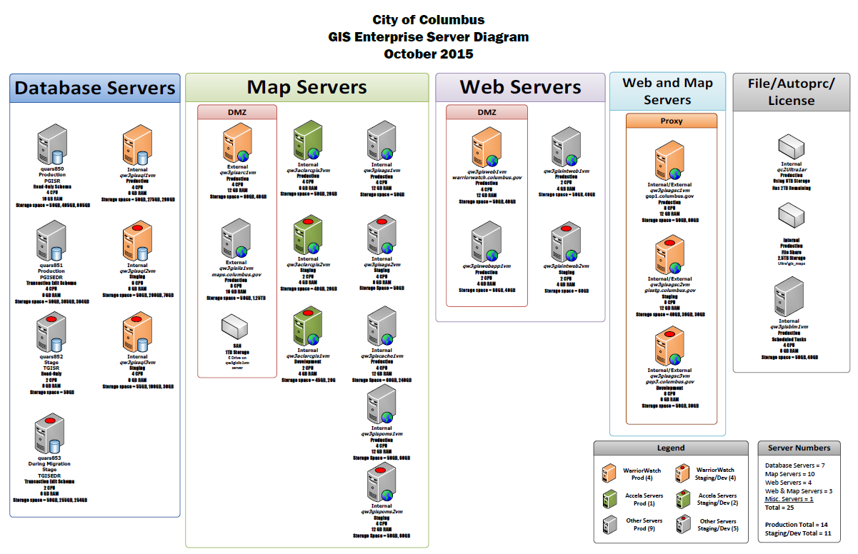
System Administration Need
Who is in my system?
What are they doing?
When are they here?
Where are they going?
How Much are they doing?
Notes:
Answer Quantitative Questions
Optimize Environment
Drive GIS Strategic Plan
Why do we do what we do

Slide 4
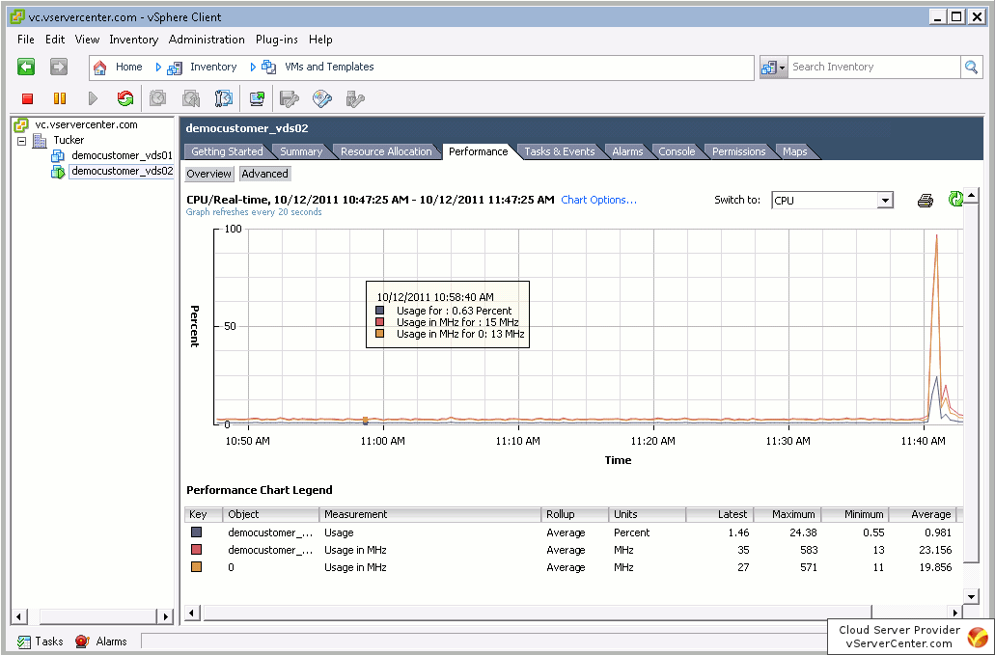
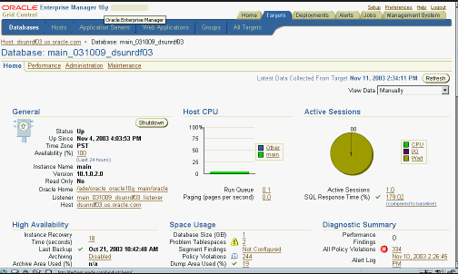
Current Tracking – Enterprise Systems
VMWare
Console to monitor virtual harware performance.
Oracle
Dashboard to monitor databases and database server resources

Slide 5
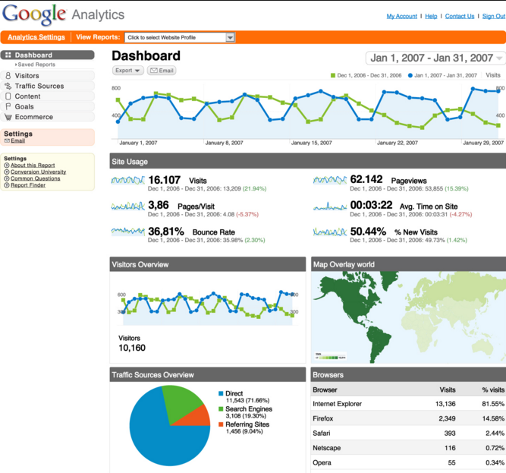
Tracking Trends - Applications
Google Analytics
Page Hits
Operating System Details
Location of User Community
Network
Time of day Charts
Live Activity
Hosted Solution
Heatmap Tracking
Click heatmaps
Mouse hover heatmaps
Session Replay
Same statistics as Google Analytics
Hosted and Self-Hosted Solutions
Notes:
Heatmap – describe what that would look like, clarify more (not what we traditonally think of)

Slide 6
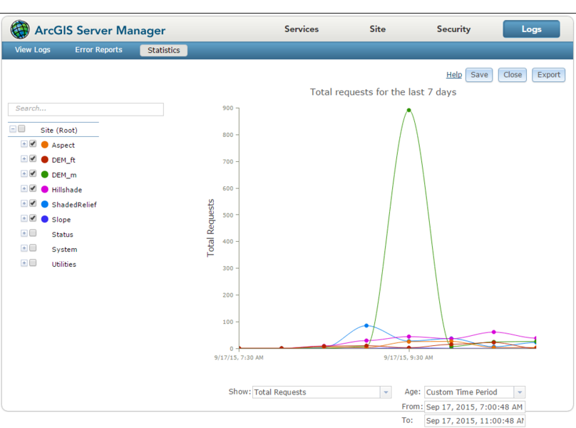
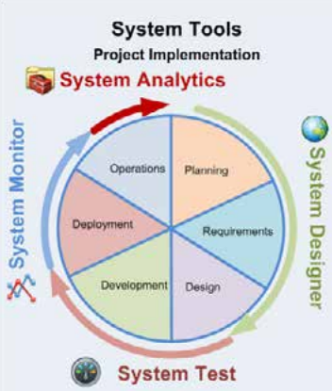
Tracking - ESRI Software
ArcGIS Server 10.3.1
Built in short term monitoring
ESRI Professional Services
Developed custom applications
and tools for managing all stages
of a GIS
Presentation System Best Practices
http://proceedings.esri.com/library/userconf/devsummit13/papers/devsummit-021.pdf
Professional Services Resources
http://www.arcgis.com/home/search.html?q=owner%3AEnterpriseImp&restrict=true
System Monitor
http://www.arcgis.com/home/item.html?id=848f48b0f88e4de7a036377197453efe
Notes:
Rest – explain what that is

Slide 7
Tracking – Other ArcGIS
Latitude Geographics - Geocortex Insight
System Status
Service Status
Trends
Dashboard
Reporting
Alarms
Vestra – Geosystem Monitor
Individual services
ArcGIS Online services
Rest Services
ArcGIS Online Feature Services
ArcGIS Online Tiled Services
http://go.geocortex.com/get-insighthttp://products.vestra.com/geosystems-monitor-features/
http://products.vestra.com/geosystems-monitor-features/
Notes:
Latitude Geographic – Cost of at least $8500 to start then $3000 for annual maintenance. Not sure cost of vestra

Slide 8
Three Phases
Track
Analyze
Action
Notes:
My Project will focus on deploying free, ready available monitoring tools. Getting into my project plan

Slide 9
Four Tracking Elements
Desktop
(License Manager)
Web Applications
ArcGIS Server
Databases

Slide 10
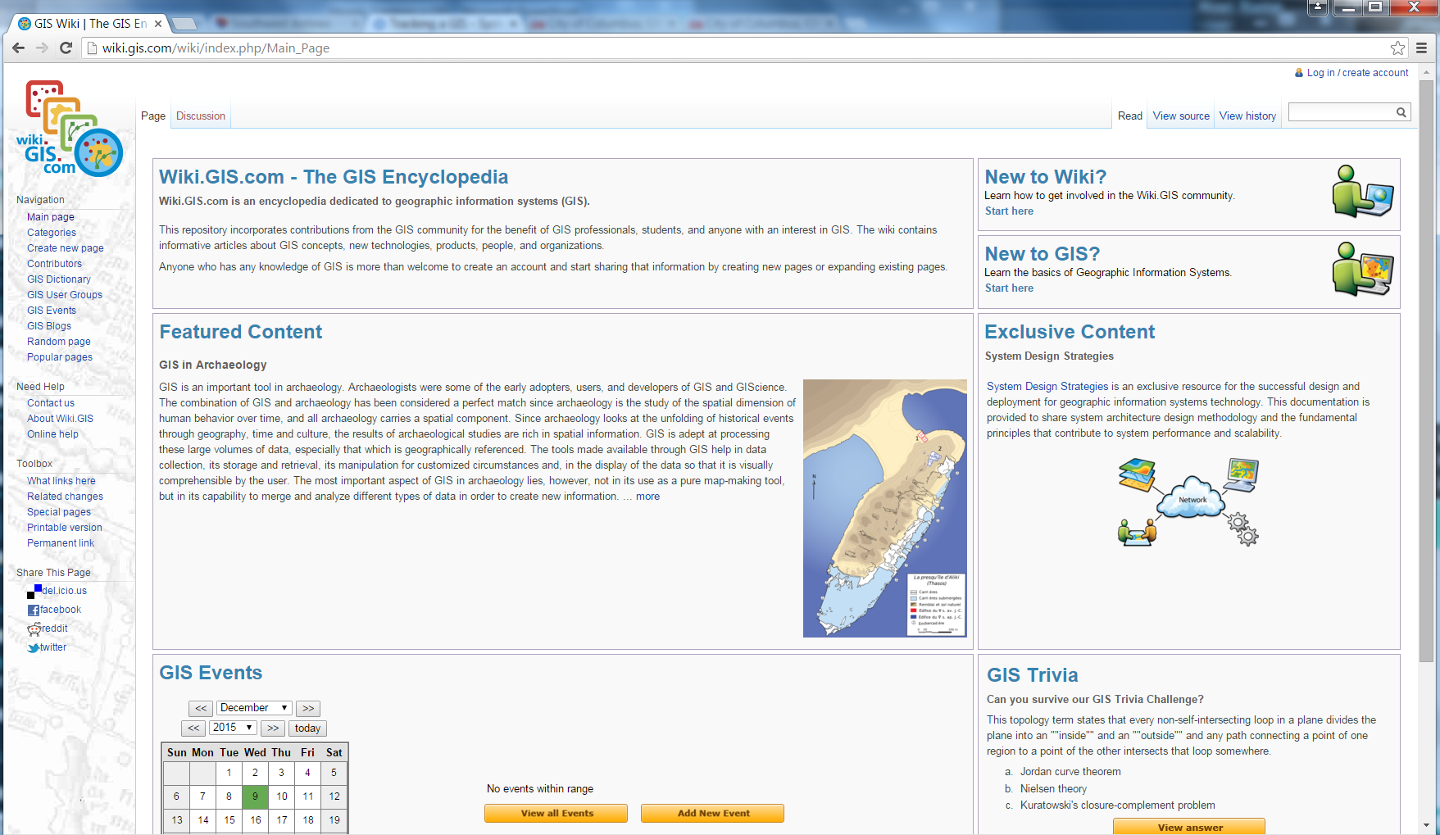
Place your screenshot here
Result
Online resource with directions, downloadable templates and my tracking result examples.
http://wiki.gis.com/

Slide 11
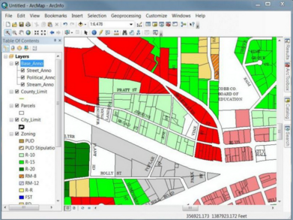
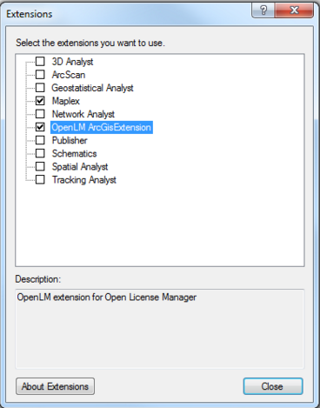
Desktop
1
License Manager Batch
Notes:
Main things I am interested in from a desktop perspective
What programs are my users using (discuss recent migration from 10.0 – 10.3.1, included over 2,000 installations of ArcReader and ArcGIS Desktop)
What is the daily license consumption/what is my to date maximum license usage? We have an ELA, but imagine how beneficial that would be to see you only ever consume 6 concurrent licenses, but you are paying ESRI for 10.
Also track extensions users use, indicate what tools your users use and guide training towards those tools

Slide 12
Desktop – Tracking Tool
License Manager Batch File
C:\Program Files(x86)\ArcGIS\License10.3\bin\lmutil.exe
lmstat parameter
Report time
Product (Extensions)
User
PC Name
Session Start
1
Notes:
Extensions – network analyst, data reviewer, publisher, schematics
Product Arc/Info, ArcReader

Slide 13
Desktop – Analysis/Action
Analysis
1
Action
Notes:
Analysis – Excel template that feed output from batch into to produce different charts broken down by user/department
Have time of day charts detailing when our most active times are
Have total consumption charts detailing average license usage and minimum license usage
Restuls – document summarizing analysis that could be provided to management to evaluate the licensing contracts and planning for future purchasing

Slide 14
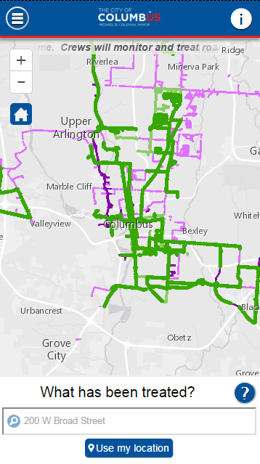
Web Applications
2
ESRI System Monitor
Heatmaptracker

Slide 15
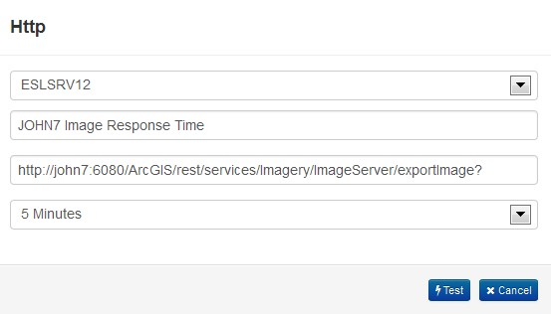
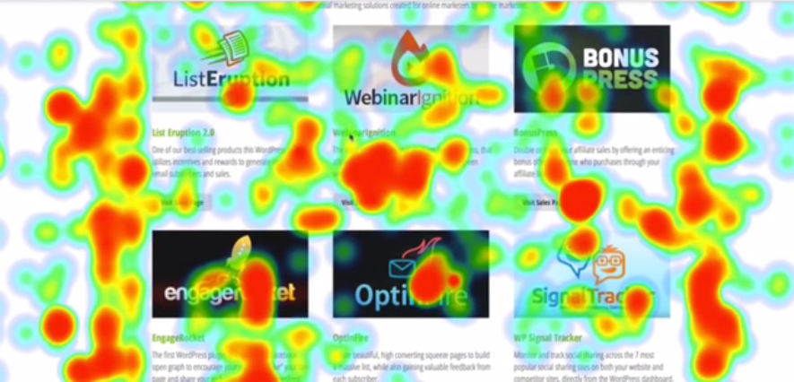
Web Applications - Tracking
2
ESRI System
Monitoring
Heatmaptracker
Notes:
http – response type and Content Length
Content length The length of the request body in octets (8-bit bytes)
Heatmap tracker is a self hosted system

Slide 16
Web Applications – Analysis/Action
Analysis Action
2
ESRI System Monitoring
Application up time
Page hits
Heatmaptracker
Click Heatmaps
Session Replays
Mode in which users connect
Notes:
Analysis – both configurations would produce reports automating monthly analysis of the bulleted points
Action -

Slide 17
ArcGIS Server
3
ESRI System Monitor

Slide 18
ArcGIS Server - Tracking
Tracking and Alerts
3
Notes:
Add arcgis server map services can measure
Explain what rest is
Throughput (Tr/Sec), Busy Time Per Transaction, Transactions, Max, Busy, and Free Instances

Slide 19
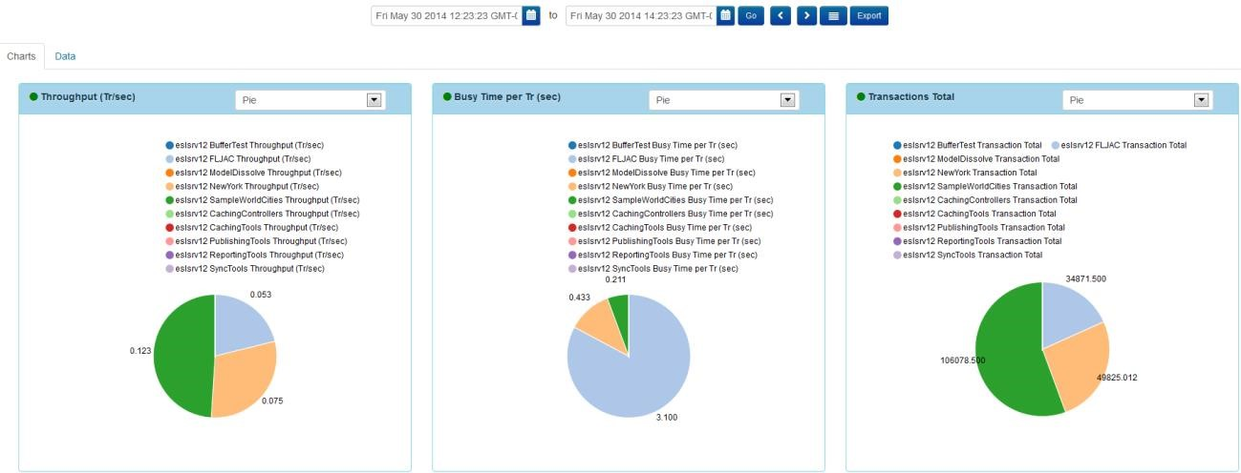
ArcGIS Server – Analysis/Action
Analysis
3
Action
Notes:
Analysis would be monthly exports of tracking details
Action – create a plan to optimize the ArcGIS Server environment based on the tracking results
Retire services not heavily used
Allocate more resources to popular services

Slide 20
Database
4
Table/User Batch

Slide 21
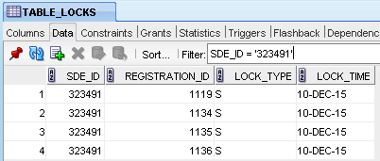
Database - Tracking
4
Notes:
Combination of 3 tables within a database gives you User, Computer and Table. Set up a batch to run on an access database that has these joins set up to write to a table, or can set up a database trigger that any time a new record is entered into the process_information table, it would trigger the join and insert into a tracking table.
PROCESS_INFORMATION
TABLE_LOCKS
TABLE_REGISTRY

Slide 22
Database – Analysis/Action
Analysis Action
4
Excel Template
Show database usage over time
List inactive tables
List most popular tables
List most active users
Any other beneficial information
Notes:
Analysis – plug in table created in tracking to get automated reports
Action – Plan to archive inactive tables. Perform additional maintenance steps to optimize most active feature classes. Create layer files for popular feature classes to provide easier access with pre-symbolized features

Slide 23
Ongoing
Track
Analyze
Action
Notes:
Project has three phases, but envision them as on-going with tracking phase continually gathering data, analysis phase continually aggregating the data into something that the action phase can use to make informed decisions.

Slide 24
Results
Notes:
Output of my project would be the online resource with templates I developed, how to’s and other beneficial information related to deploying and benefitting from tracking in your organization. Results – best practices that I found, clarify what I mean by results

Slide 25
Project Timeline

Slide 26
Thanks!
Any questions?
Jaclyn Meade – MGIS Candidate Jim Detwiler - Advisor
Notes:
Turn in final written narrative of project. Background + Lit Review + Plan of attack. 5-10 pages (before Christmas Due date)

