Slide 1
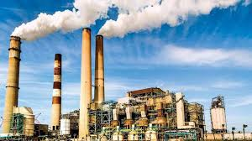
Nicholas Meray Advisor: Panagiotis Giannakis
A Proximity Analysis of Industry Siting and Income Inequality in Pennsylvania

Slide 2
Background: NIMBYISM
“not in my backyard”
Communal rejection of planned developments
Cost associated

Slide 3
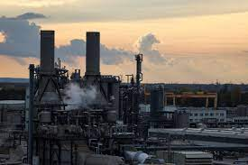
Industry Siting
Residential proximity
Which neighborhoods live in proximity
Which communities cannot afford to perform NIMBY movements

Slide 4
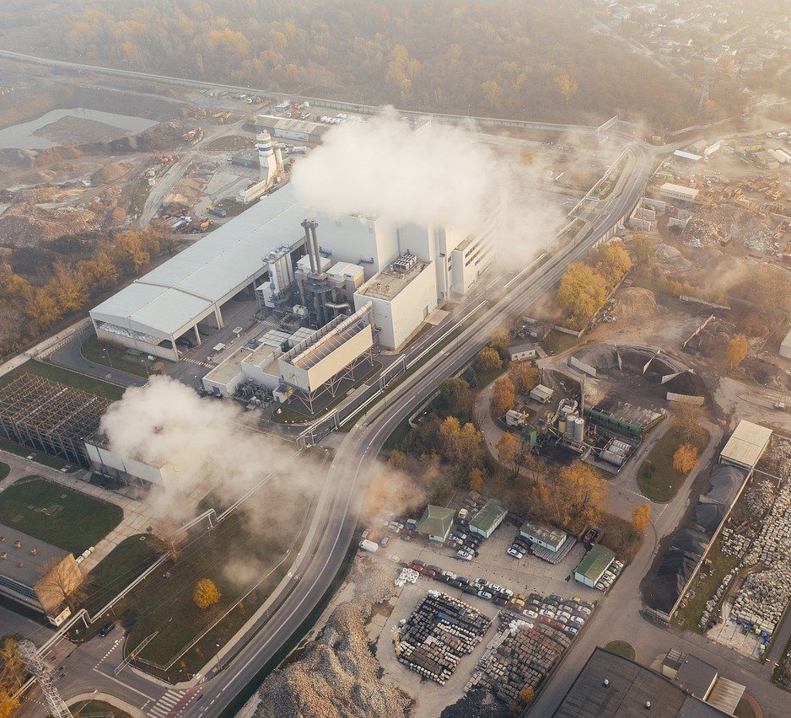
Health Impacts
Fossil fuel industry
Air Quality

Slide 5
Goals and Objectives
Determine the manpower and financial costs associated with successful NIMBY movements
Research local or regional zoning laws impacting industry site selection
Reveal potential siting differences between fossil fuel and renewable energy sites
Perform proximity analysis investigating spatial correlations between industry siting and household income of neighboring communities

Slide 6
Study Area(s)
Three of Pennsylvania’s urban counties:
Allegheny county, City of Pittsburgh
Philadelphia county, city of Philadelphia
Dauphin county, City of Harrisburg

Slide 7
Allegheny County

Slide 8
Philadelphia County

Slide 9
Dauphin County

Slide 10
Data
Environmental characteristics of electric power generation facilities (eGRID 2021), EPA :
Point locations of electric power generation sites with fuel source classifications.
Median household income by census tract, 2021 American Community Survey, U.S. Census Bureau:
Table of estimated household incomes for every census tract in all three counties.

Slide 11
Analysis Methods
Linear Regression: Map linear regression residuals for each census tract per county based on income and distance from nearest industry site.

Slide 12
Challenges and limitations
State and local laws or regulations may influence siting, these PA counties may show different results compared to other U.S. states
Results from linear regression may need more data, there are only a handful of industry sites in some counties.
Only urban counties are selected, any findings can be limited to income or development patterns in urban areas.

Slide 13
Why Study Industry Siting?
Environmental justice, negative impacts from specific industry developments and potential sources of pollution shouldn’t be burdened on communities because of income or available resources.

Slide 14
Anticipated results
The potential existence of significant spatial correlation between industry siting and lower-income communities withing three urban Pennsylvania counties.
Patterns between the distribution of hazardous and/or polluting industry siting and renewable industry siting.

Slide 15
Timeline
Capstone Proposal Presentation – April 27th
Linear Regression Analysis – May 31st
Compile Analysis Results and Review with Advisor – July 31st
Draft Project Presentation and Submit Abstract – Aug 31st
Finalize Project Presentation – Sept 30th

Slide 16
Thank You

