Slide 1
Ecosystem Services
Value Calculator
(ESVC)
Jonathan Meyers
Geog 596A
December 19, 2011

Slide 2
Outline
Capstone project goals
Ecosystem services (ES), ES valuation & benefit transfer
Existing software tools
ESVC description & benefits
Design challenges
Project timeline
Questions

Slide 3
Project Purpose & Goals
Prototype a web-based application that will allow users, including the public, government & environmental stewards, to calculate ecosystem services values for a given area. The ESVC will enhance users’ decision-making capabilities.

Slide 4
…a brief example of who would use this tool & why…
NJ Dept. of Environmental Protection/
Economic Survey of Natural Resources in State

Slide 5
Ecosystem Services
one definition...
“Ecosystem services refers to a wide range of conditions and processes through which natural ecosystems…helps sustain and fulfill human life. (Daily et al. 1997)“

Slide 6
Millennium Ecosystem Assessment (MEA)
Starting in 2001, the United Nations initiated the MEA, which was designed to assess the effects of changes to our environment (ecosystems) and to determine what scientific research was necessary to monitor and quantify the resultant impacts (MEA, 2001).
The MEA framework divides ES into four types (MEA, 2005):
Provisioning (equivalent to ecosystem goods)
Regulating
Supporting
Cultural

Slide 7
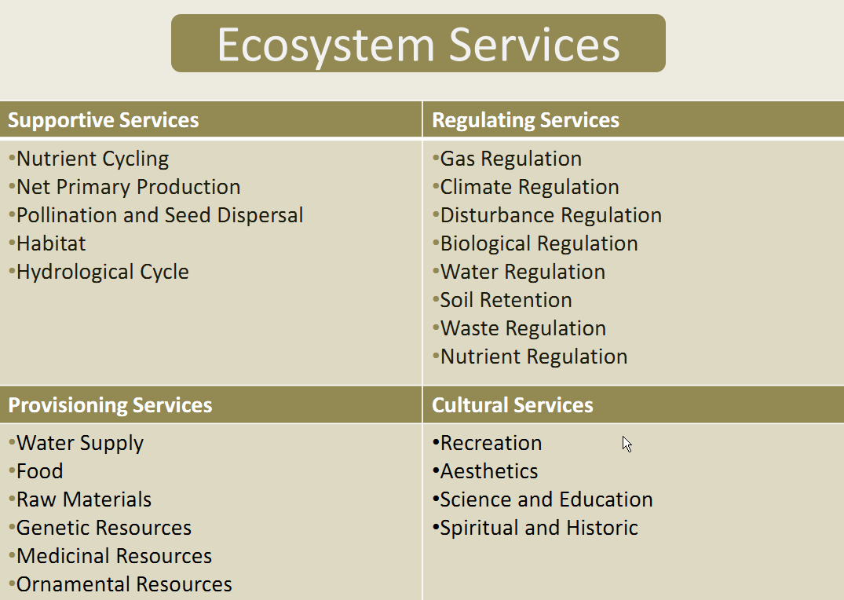
Examples of Ecosystem Services

Slide 8
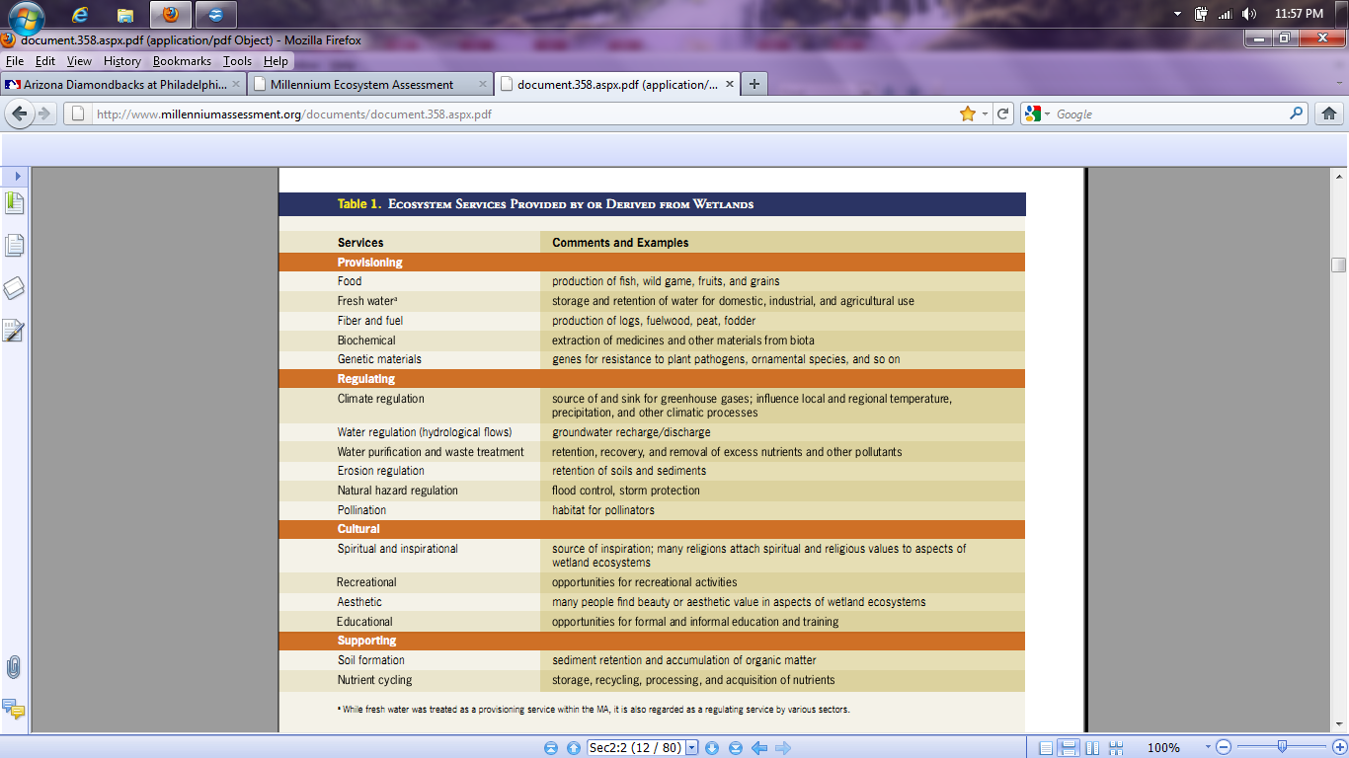
Examples of Ecosystem Services Produced or Derived from Wetlands

Slide 9
Ecosystem Services Valuation
To better understand how actions (or inaction) we take affect the environment and thus ecosystem services, scientists have quantified the value of a variety of ecosystem goods and services.

Slide 10
Ecosystem Services Valuation (cont’d)
Quantifying ecosystem services values (ESV) can be very challenging as there are many assumptions to be made, including valuation methodology.
The scale and quality of the data inputs can greatly affect the ESV.
ESV only apply to ES in a given context, i.e. place and time. For example:
  one may determine the dollar value of a recreation ES during September, 2011, located in Mercer County, NJ, using a forest polygon with an area of 125 acres.

Slide 11
Valuation methods
Avoided cost: Services allow society to avoid costs that would have been incurred in the absence of those services
Replacement cost: Services could be replaced with man-made systems
Factor income: Services provide for the enhancement of incomes
Travel cost: Service demand may require travel, whose costs can reflect the implied value of the service
Hedonic pricing: Service demand may be reflected in the prices people will pay for associated goods

Slide 12
Benefits or Value Transfer
determining ESV for a given research area requires extensive resources, including expertise and data.
users may attempt to assign ESV using the value transfer method, i.e. ESV previously determined for similar contexts are used (“transferred”) for calculations into the desired study area.

Slide 13
Benefits or Value Transfer (cont’d)
Troy and Wilson produced a decision framework for mapping ESV consisting of seven core steps:
Study area definition
Typology development (i.e. determine which indicators to measure)
Literature search & analysis
Mapping
Total value calculation
Summarize by designated geographic extent
Scenario change analysis: current vs future

Slide 14
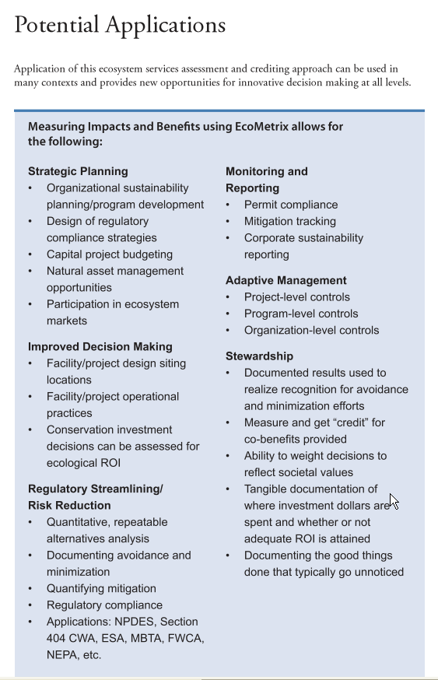
How can we use the total ES values?

Slide 15
Examples of existing tools
-open source vs propietary
-stand-alone vs software module (e.g. ArcGIS tool)
-desktop & web-based tools/databases to calculate ESV include:
Integrated Valuation of Ecosystem Services and Trade-offs (InVEST) is a GIS tool that will calculate ESV and show how different scenarios affect ESV.
Multiscale Models of Integrated Models of Ecosystem Services (MIMES) values ecosystem services.
Artificial Intelligence for Ecosystem Services (ARIES) performs ecosystem service assessments and valuations.

Slide 16
Examples of existing tools (cont’d)
web-based decision support tools
Rao et al. (2007) created a web-based decision support tool that runs models to help users assess various aspects of conservation lands.
Ghaemi et al. (2009) developed a web-based platform to support interactive planning in southern California. This tool has a unique feature that allows the users to change the land use of parcels and see the effects on the ESV of the surrounding area.
Chen et al. (2008) created a GIS desktop-based tool that estimated the ESV for all ES with a county in China and mapped the results.
The Land Use Decision Support (LUDS) tool (see http://bgis.sanbi.org) looks at effects of changes in landuse over time and space.
-The Ecosystem-Based Management Tools Network (ebmtools.org) has a searchable database of thousands of ecosystem-based management tools that users can download.

Slide 17
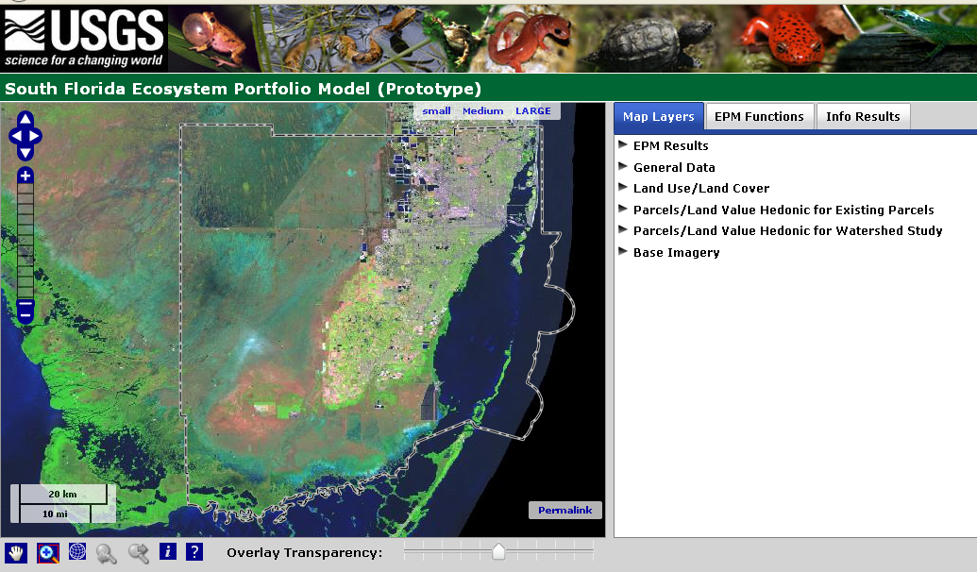
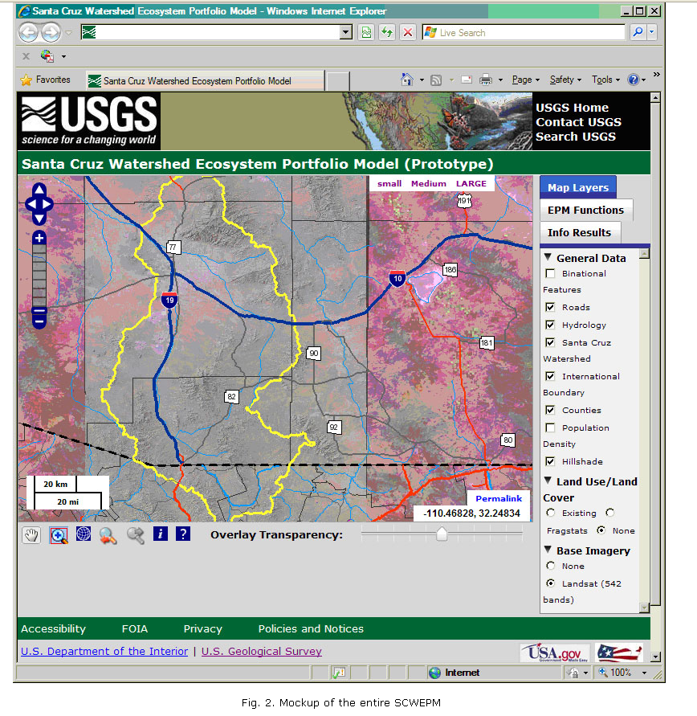
Similar Prototypes
-Analysis limited to specific area
-Limited inventory of spatial data

Slide 18
ESVC system architecture
Data
Software

Slide 19
Ecosystem Services Valuation Calculator
“standard” tools to analyze spatial data:
  Areal & linear measurement
  Feature queries
  Feature information/identification
  Multiple layer viewing
  Layer transparency

Slide 20
Advantages include:
  Easy-to-use user interface (UI)
  **Ability to upload spatial data or use mapping services found on the Web**
  **Unlimited spatial extent**
  Ability to save various scenarios to allow users to observe spatiotemporal effects

Slide 21
Additional Application Features
Access web mapping services
View layer metadata
Associate layers to ES
Associate dollar values to layer/ES pairing
Select layers used in analyses
Select AOI to use in calculation

Slide 22
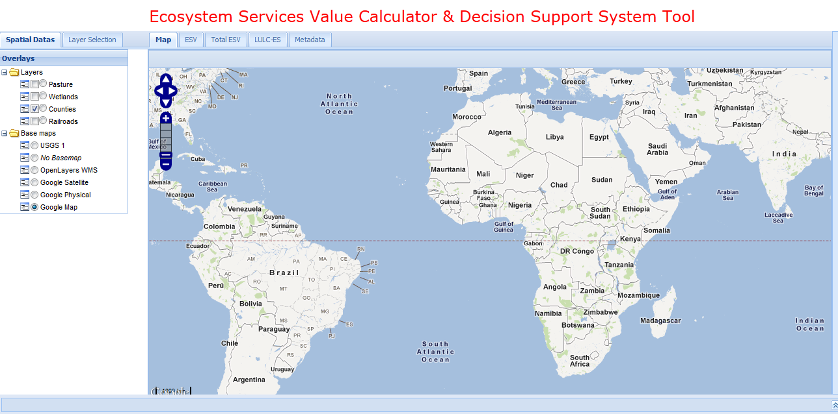
ESVC User Interface

Slide 23
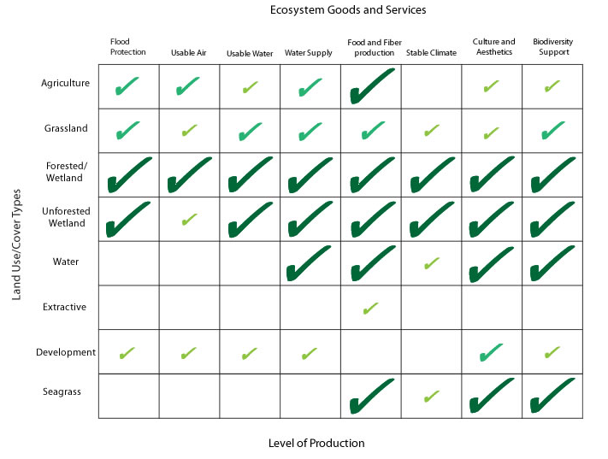
LULC/ES MATRIX

Slide 24
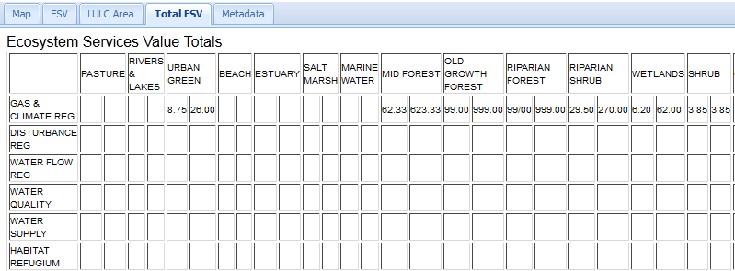

Slide 25
Challenges
Development challenges
  Programming capabilities
  Quality user interface
Production challenges
  Access to web map services
  Reliable servers/software

Slide 26
timeline
December 2011: proposal presentation
Mid-January 2012: produce working prototype of ESVC
Mid-February 2012: final presentation of application

Slide 27
Questions??
Jonathan Meyers
jzm116@psu.edu
jonathan@meyersgis.com

