Slide 1

An Automated, Multi-Criteria, Weighted Overlay Approach to Helicopter Landing Zones
Barry Y. Miller
ESRI International User’s Conference
Penn State Capstone Project
Advisor: Prof. Peter Guth, USNA
10 July 2013

Slide 2

Agenda
Introduction
Project Objectives and Goals
Study Area
Data Sources
GIS Criteria and Classifications
AHP Methodology
Results
Discussion
Summary

Slide 3

Introduction
Helicopter Landing Zone (HLZ) analysis is a common military task
Used for offensive operations, logistics
Search and rescue, medical evacuation
Little consistency in procedures and criteria
Notes:
http://www.aviationnews.eu/2009/11/17/u-s-army%E2%80%99s-black-hawk-helicopter-fleet-surpasses-1-million-flight-hours-in-iraq-and-afghanistan/

Slide 4
Purpose and Geospatial Criteria
Source | Criteria
Army FM 3-21.38 Pathfinder Operations | Minimum landing diameter, slope, surface conditions, obstacle ratios, day/night, seven categories of helicopters
FAA Aeronautical Information Manual | Diameter, slope, safe wind conditions, night landings
Wilderness Medicine , Chapter 40, by Allen, R.C., & Cooper, J.L. | Flight service ceilings for typical types of helicopters, safety factor of 50% for landing zone sizes at night
Notes:
Department of the Army. (2006). Field Manual 3-21.38: Pathfinder Operations. Washington DC: United States Army. Retrieved July 28, 2012, from http://armypubs.army.mil/doctrine/DR_pubs/DR_a/pdf/fm3_21x38.pdf
Federal Aviation Administration. (2012). Aeronautical Information Manual: Official Guide to Basic Flight Information and ATC Procedures. Washington DC: U.S. Department of Transportation. http://www.faa.gov/air_traffic/publications/ATPubs/AIM/aim.pdf
Allen, R. C., & Cooper, J. L. (2012). Wilderness Medicine (6th ed.) Chapter 40. Philadelphia: Elsevier.

Slide 5
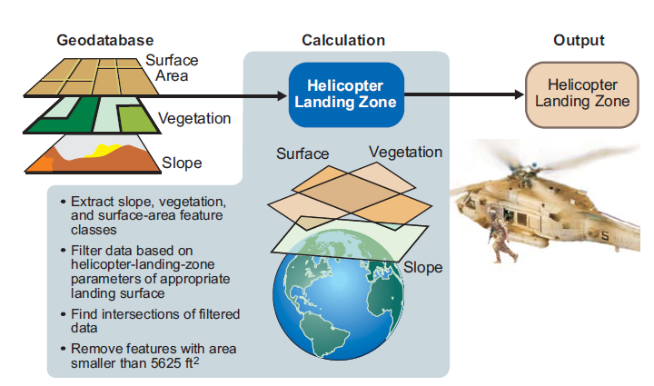
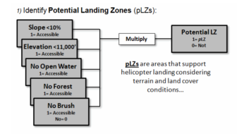
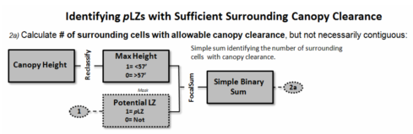
Previous techniques and Procedures Produce Go/No-Go Results
Carlton and Berry, 2011
Renner and others, 2009
Notes:
Renner, R. D., Hemani, Z. Z., & Tjouas, G. C. (2009). Extending Advanced Geospatial Analysis Capabilities. Northrop Grumman Technology Review Journal, 17(1), 96. Retrieved July 29, 2012, from http://www.is.northropgrumman.com/about/ngtr_journal/assets/TRJ-2009/SS/09SS_Renner.pdf
Carlton, D., & Berry, J. (2011, August). Assessing Wildfire Response (Part 1): Oneth by Land, Twoeth by Air. Retrieved from Beyond Mapping III Compilation of Beyond Mapping Columns Appearing in GeoWorld Magazine from 1996-2009: http://www.innovativegis.com/basis/mapanalysis/Topic29/Topic29.htm#WildfireResponse_Part1

Slide 6
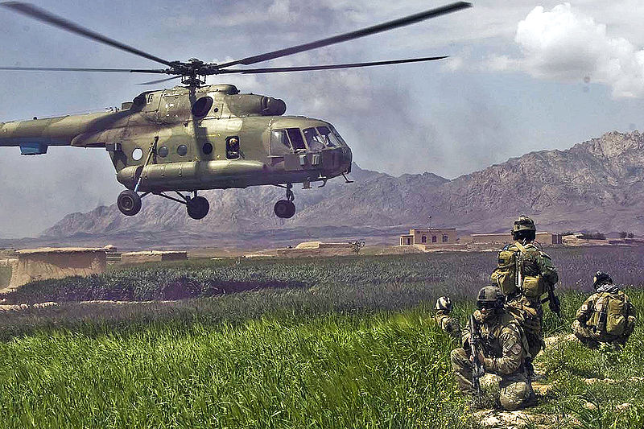
Objective and Goals
Refine HLZ analysis process with a script tool
Pre-loaded with common helicopter types and their criteria
Acceptable land cover and soil classification tables
Four categories: Highly suitable, moderately suitable, barely suitable, unsuitable
Day/night conditions
Notes:
Wikipedia. (2013, June 21). Mi-17 Helicopter Landing Picture. Retrieved from Wikipedia:
http://upload.wikimedia.org/wikipedia/commons/2/20/Mi-17Afganistan.jpg

Slide 7
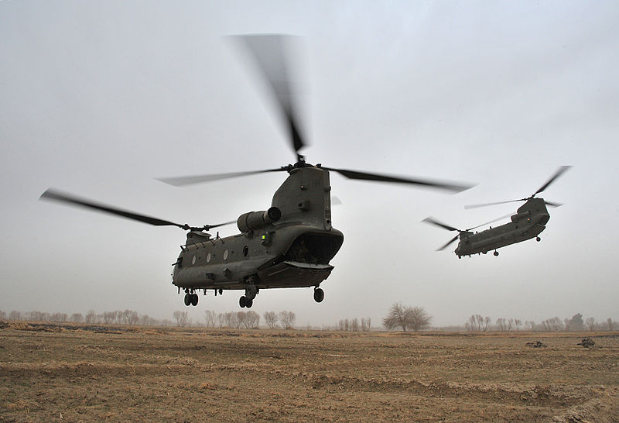
Objective and Goals Continued…
  Multi-criteria weighting, rank-order sites based on suitability
Weighting % for different environments
Script accepts user input data and automates analysis and output
Export HLZ sites in shapefile and KML format
Notes:
http://commons.wikimedia.org/wiki/File:RAF_Chinook_Helicopters_Leave_a_Landing_in_Zone_in_Afghanistan_MOD_45153559.jpg

Slide 8
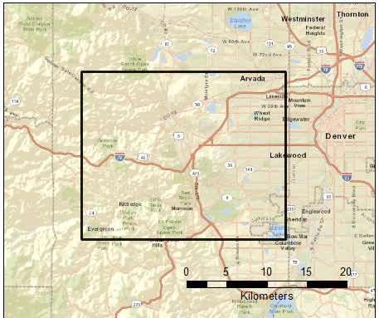
Study Area

Slide 9
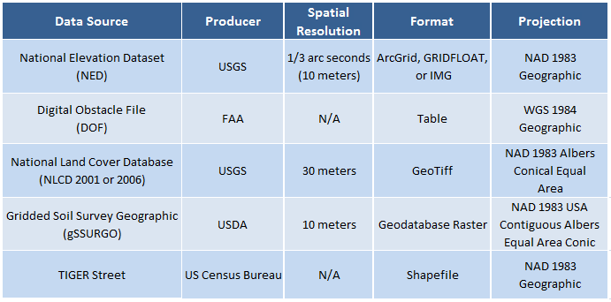
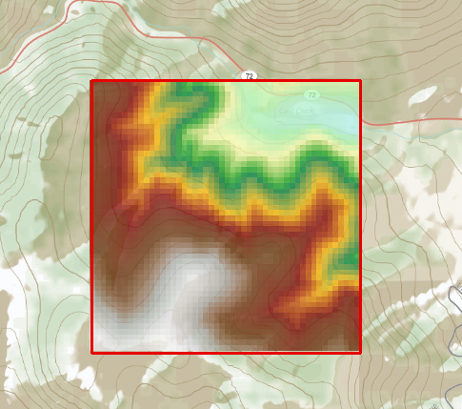
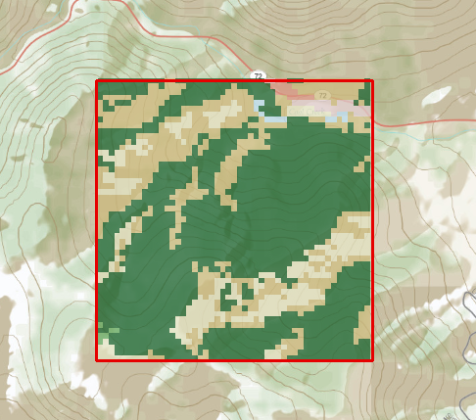




Data Sources
Notes:
United States Geological Survey. (2012, May 22). National Elevation Dataset. Retrieved from USGS: http://ned.usgs.gov
United States Geological Survey. (2012, May 22). National Land Cover Database. Retrieved from USGS: http://seamless.usgs.gov

Slide 10
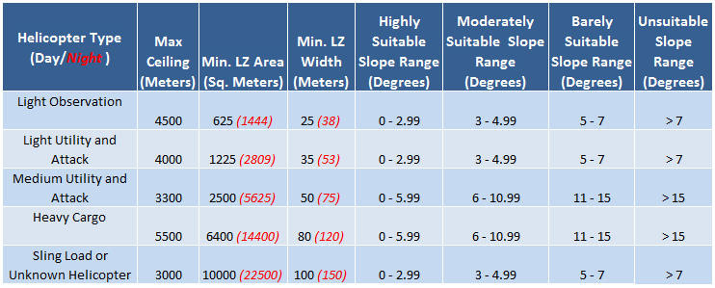
Helicopter Characteristics

Slide 11
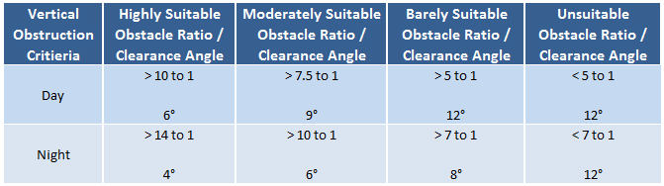
Vertical Obstructions
Notes:
Department of the Army. (2006). Field Manual 3-21.38: Pathfinder Operations. Washington DC: United States Army. Retrieved July 28, 2012, from http://armypubs.army.mil/doctrine/DR_pubs/DR_a/pdf/fm3_21x38.pdf

Slide 12
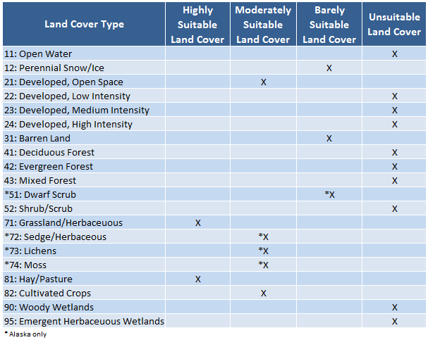
Land Cover

Slide 13
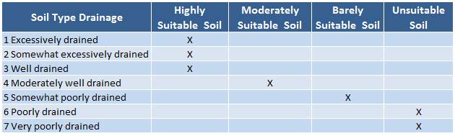
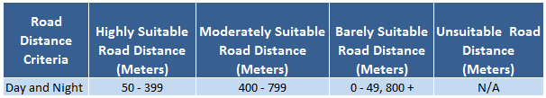
Soil and Road Proximity

Slide 14
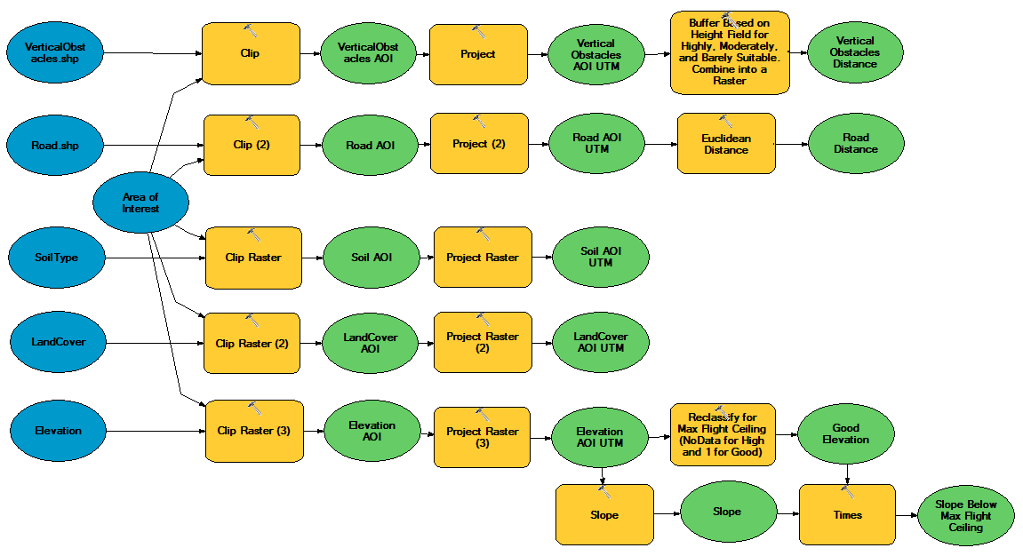
Flow Chart: Data Prep

Slide 15
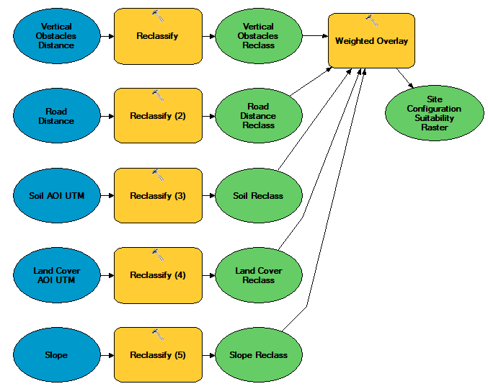
Flow Chart: Reclassify Based on Criteria
Medium helicopter
Daylight conditions
Forest environment

Slide 16
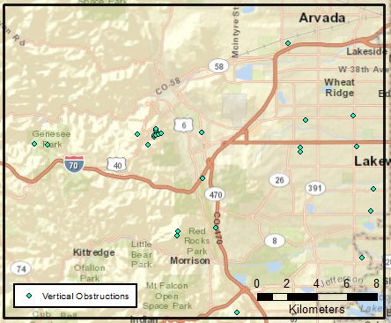
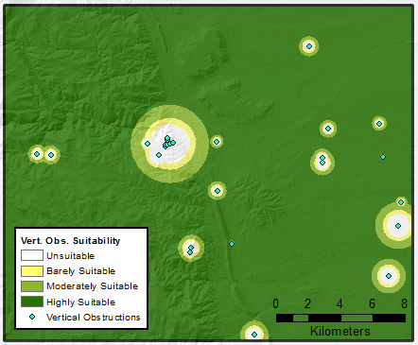
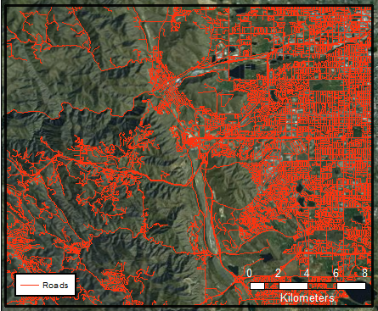
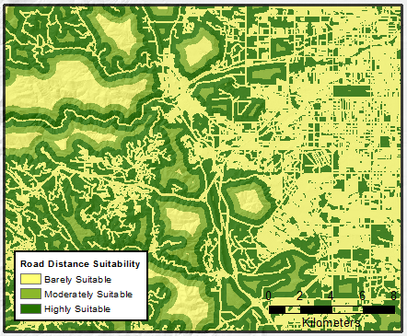
Vert. Obs.
Road Dist.

Slide 17
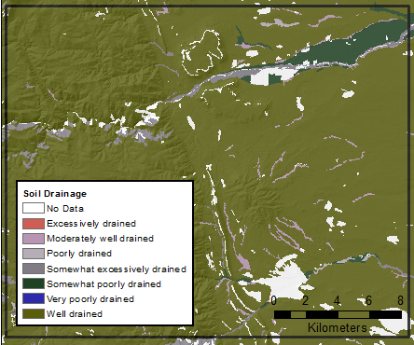
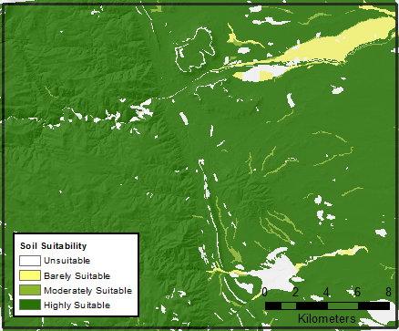
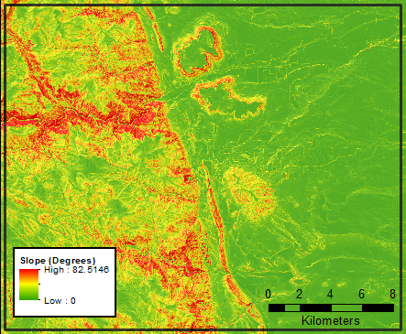
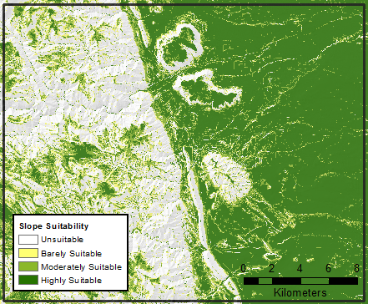
Soil
Type
Slope

Slide 18
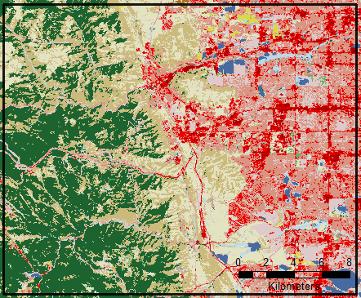
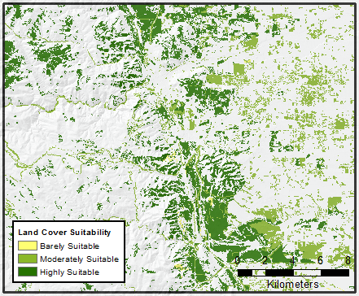
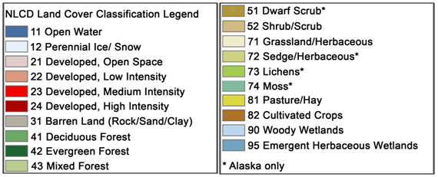
Land Cover

Slide 19
Flow Chart: Reclassify, Weighted Overlay

Slide 20
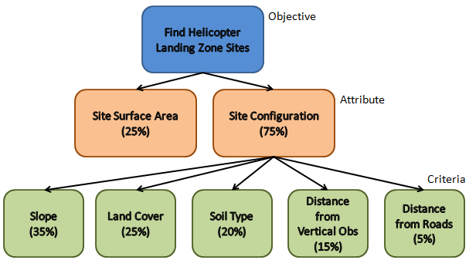
AHP: Analytic Hierarchy Process for Multi-Criteria Weighting
  Developed by Thomas Saaty in the 70’s and 80’s
  Used in geography since the mid-90’s for site suitability analysis
  Overall goal and hierarchy of objectives, attributes and criteria
Notes:
Boroushaki, S., & Malczewski, J. (2008). Implementing an Extension of the Analytical Hierarchy Process Using Ordered Weighted Averaging Operators with Fuzzy Quantifiers in ArcGIS. Computer and Geosciences(34), 399-410.

Slide 21
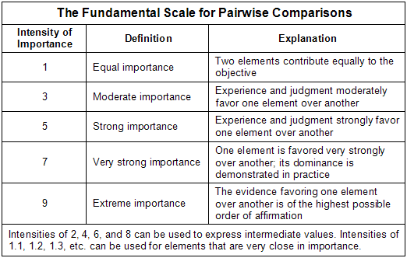
AHP: Pairwise Comparison
Compare two criteria at a time
Weaker candidate assigned a “1”, stronger candidate assigned a score of “1” to “9” based on comparative strength
Notes:
Wikipedia. (2012, September 13). Analytic Hierarchy Process Fundamental Scale. Retrieved from Wikipedia: http://en.wikipedia.org/wiki/File:AHPFundamentalScaleModerately.png

Slide 22
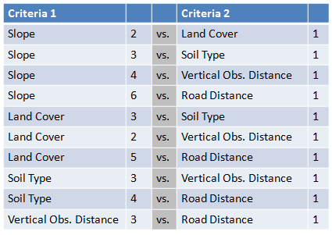
AHP: Pairwise Comparison Example

Slide 23
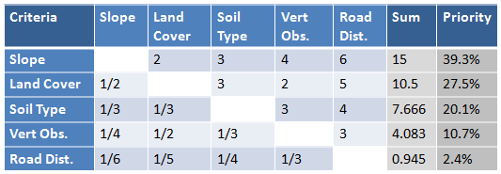
AHP: Illustrative Weighting, Forest
Notes:
Divide each sum by the total of 38.194 to get the priority percentage.

Slide 24
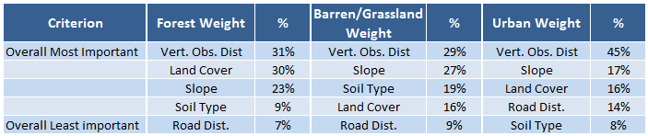
AHP: Weighting Criteria
Generated by AHP Calculator for Forest, Barren/Grassland and Urban Environments (Goepel, 2012)
Notes:
Goepel, K. D. (2012). AHP Excel Template with Multiple Inputs. Retrieved June 13, 2013, from BPMSG (Business Performance Management): http://bpmsg.com/new-ahp-excel-template-with-multiple-inputs/

Slide 25
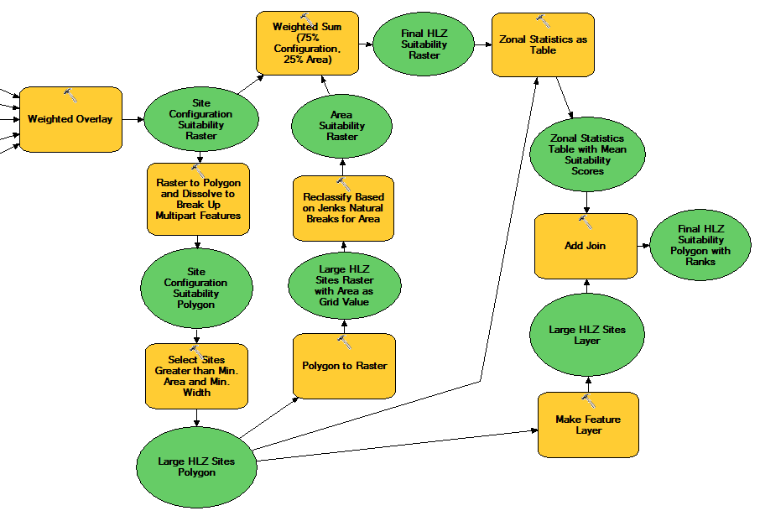
Flow Chart: Site Configuration, Site Area, Final HLZ Polygon

Slide 26
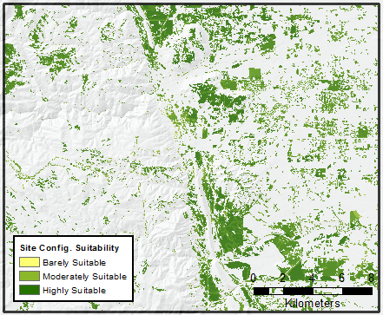
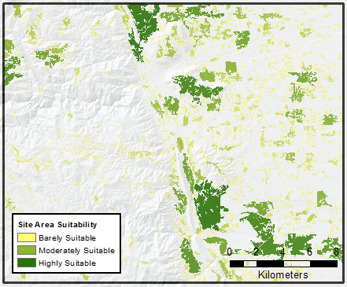
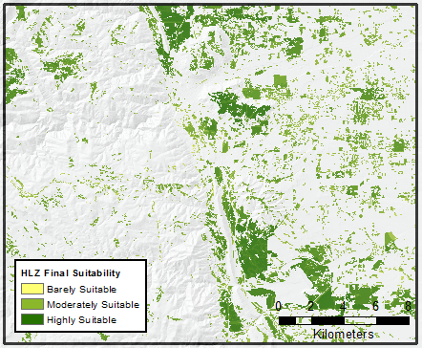
Site Configuration Suitability
Site Area Suitability
HLZ Final Suitability

Slide 27
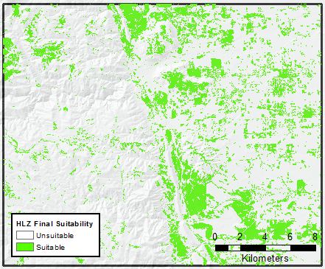
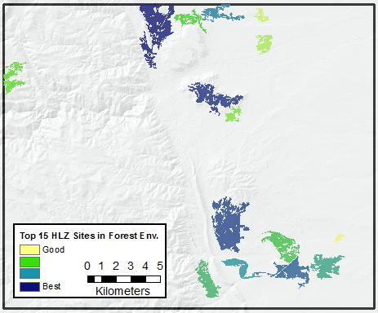
Results
Go/No-Go
2,774 Potential Sites
Sites have varying degrees of suitability
Can be rank-ordered to find the best 15 sites

Slide 28
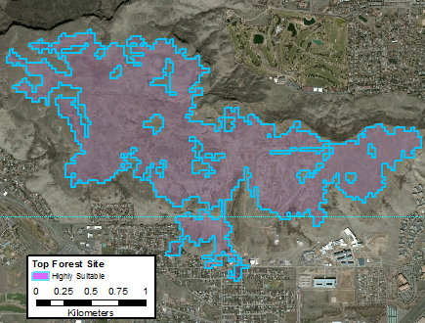
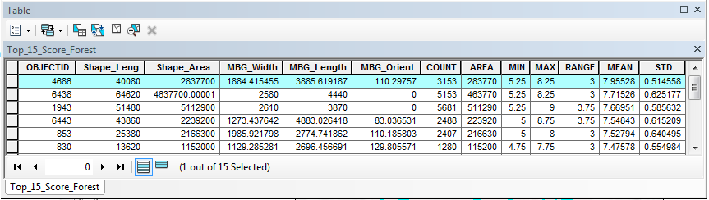
Imagery Overview of #1 Site
South Table Mountain Park is the largest and most suitable site
Flat mesa covered in grass with no vertical obstructions

Slide 29
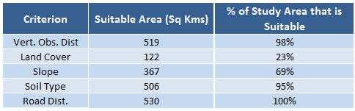
Discussion: Input Data
Land cover eliminates the most area
Vertical obstacle coverage appears incomplete with only 26 obstacles in 530 km²
Soil drainage in the area is almost all highly suitable
Soil layer has data gaps

Slide 30
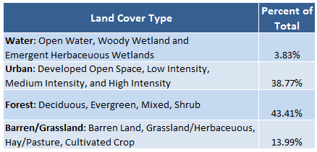
Discussion: AHP Weights for Environment
Most areas will have varied land cover
Percent of area that is urban, forest, and barren/grassland can help determine which AHP environmental weighting to pick

Slide 31
Discussion: Miscellaneous Considerations
Did not consider wind or weather conditions
Hovering vs. full touchdown landings
Only five classes of helicopters without weight, payload, and approach/departure angles
Edge effects impact analysis
Moderate resolution datasets, so results should still be verified by lidar or imagery analysis

Slide 32
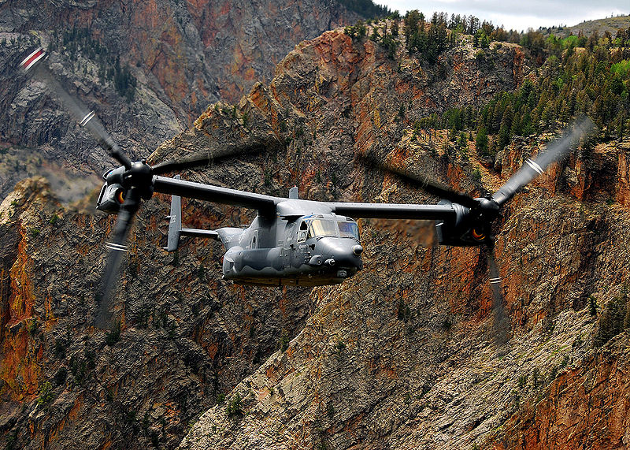
Summary
Created script with data dictionaries and automated procedures to standardize analysis
Surveyed professionals to get weightings in different environments using AHP
Progressed from go/no-go to providing rank-ordered potential HLZ sites

Slide 33
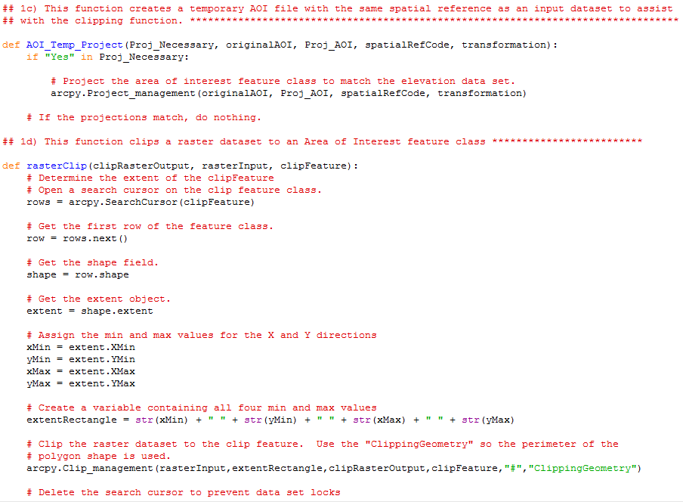
Questions?

Slide 34
References
Allen, R. C., & Cooper, J. L. (2012). Wilderness Medicine (6th ed.) Chapter 40. Philadelphia: Elsevier.
Boroushaki, S., & Malczewski, J. (2008). Implementing an Extension of the Analytical Hierarchy Process Using Ordered Weighted Averaging Operators with Fuzzy Quantifiers in ArcGIS. Computer and Geosciences(34), 399-410.
Carlton, D., & Berry, J. (2011, August). Assessing Wildfire Response (Part 1): Oneth by Land, Twoeth by Air. Retrieved from Beyond Mapping III Compilation of Beyond Mapping Columns Appearing in GeoWorld Magazine from 1996-2009: http://www.innovativegis.com/basis/mapanalysis/Topic29/Topic29.htm#WildfireResponse_Part1
Department of the Army. (2006). Field Manual 3-21.38: Pathfinder Operations. Washington DC: United States Army. Retrieved July 28, 2012, from http://armypubs.army.mil/doctrine/DR_pubs/DR_a/pdf/fm3_21x38.pdf
Environmental Systems Research Institute. (2013a). World Street Map. Retrieved June 20, 2013, from http://goto.arcgisonline.com/maps/World_Street_Map
Federal Aviation Administration. (2012). Aeronautical Information Manual: Official Guide to Basic Flight Information and ATC Procedures. Washington DC: U.S. Department of Transportation. doi:http://www.faa.gov/air_traffic/publications/ATPubs/AIM/aim.pdf
Federal Aviation Administration. (2013, June 15). Terrain and Obstacles Data Team - Digital Obstacle File. Retrieved from FAA: https://nfdc.faa.gov/tod/public/TOD_DOF.html
Goepel, K. D. (2012). AHP Excel Template with Multiple Inputs. Retrieved June 13, 2013, from BPMSG (Business Performance Management): http://bpmsg.com/new-ahp-excel-template-with-multiple-inputs/
Natural Resources Conservation Service Soil Survey Staff. (2013, June 4). Gridded Soil Survey Geographic (gSSURGO). Retrieved from United States Department of Agriculture: http://datagateway.nrcs.usda.gov/
Renner, R. D., Hemani, Z. Z., & Tjouas, G. C. (2009). Extending Advanced Geospatial Analysis Capabilities. Northrop Grumman Technology Review Journal, 17(1), 96. Retrieved July 29, 2012, from http://www.is.northropgrumman.com/about/ngtr_journal/assets/TRJ-2009/SS/09SS_Renner.pdf
United States Census Bureau. (2013). TIGER/Line Road Segments. Retrieved June 3, 2013, from USGS National Map Viewer: http://viewer.nationalmap.gov/viewer/
United States Geological Survey. (2013a). National Elevation Dataset. Retrieved June 4, 2013, from USGS: http://ned.usgs.gov
United States Geological Survey. (2013b). National Land Cover Database. Retrieved June 4, 2013, from USGS National Map Viewer: http://viewer.nationalmap.gov/viewer/
Wikipedia. (2012, September 13). Analytic Hierarchy Process Fundamental Scale. Retrieved from Wikipedia: http://en.wikipedia.org/wiki/File:AHPFundamentalScaleModerately.png

