Slide 1
Multi-Criteria Decision Analysis for Emergency Managers
Jonas Miller
Advisor: Fritz Kessler
The Pennsylvania State University

Slide 2
Scenario
Local emergency manager in Oso, Washington is concerned with the risk of mudslide from week of sustained heavy rainfall.
How can local emergency managers leverage their experience/expertise and GIS to create a initial response risk map?
How can this emergency manager identify areas with the greatest consequences of resource (natural, infrastructure, personnel) loss?

Slide 3
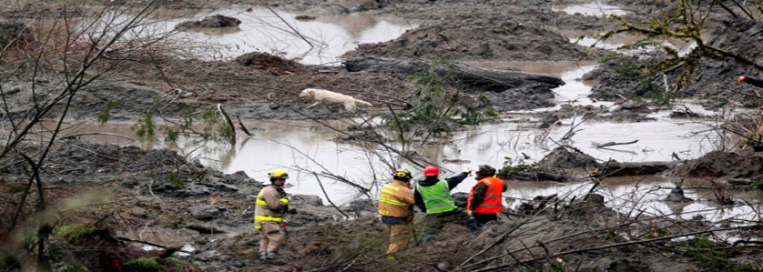
2014 Oso, Washington Mudslide
Managers could quickly assess the risks of a mudslide by overlaying relevant layers:
Topography – locations where damage would be greatest/least
Soil type – Where is the greatest probability of landslide occurrence?
Population – who will be impacted the greatest/least by a landslide?
Associated Press

Slide 4
Objective
Eavluate an “on-the fly” Multi-criteria decision analysis (MCDA) workflow with local level (municipality/county) emergency managers
The evaluation included:
Designing a customizable selection of publically available data layers
Apply overlay weights to data layers based on user’s personal subject knowledge / experience / emergency situation

Slide 5
Project Overview
Identify the need for a initial emergency response mapping tool
Review relevant literature
Describe a target user
Assess target user’s needs/capabilities
Determine available, accessible, and free data
Develop model
Test model
Validate model
Notes:
Developing the model is on going, and the next steps for the spring will be testing and validation

Slide 6
MCDA Defined
From Huang et al. (2011):
“ ‘systematic methodology’ to combine multiple factors assigns scores to inputs across possible outcomes combined by a linear weighted sum”
Huang, I., Kiesler, J. & Linkov, I. (2011). Multi-criteria decision analysis in environmental science: Ten years of applications and trends. Science of the Total Environment, 409:3578-3594.

Slide 7
Risk Defined
Risk = consequences of expected losses
Previous studies of risk mapping:
Defined risk in the form of susceptibility mapped for single hazards:
Landslides, pipeline oil spills, tropical storm impact
Maps created using overlays of multiple features related to hazard
Geomorphology, Population Density, Soil Characteristics, Hydrology
Notes:
Losses= people, resources, infrastructure, capabilities

Slide 8
Previous Studies
Jafari et al. (2010): Iranian Pipeline study incorporating complex, multifactor environmental risk factor
Poompavai et al. (2013): Indian Cyclone study introducing population-specific risk factors ‘coping’ with equally weighted categories
Jafari, J., Khorasani, N., & Danehkar, A. (2010). Using environmental sensitivity index (ESI) to assess and manage environmental risks of pipelines in GIS environment: A case study of a near coastline and fragile ecosystem located pipeline. World Academy of Science, Engineering and Technology, 44:1101-1111.
Poompavai, V. & Ramalingam, M. J. (2013). Geospatial Analysis for Coastal Risk Assessment to Cyclones. Indian Society of Remote Sensing, 41:157-176. doi:10.1007/s12524-011-0198-8.
Notes:
Jafari and others -plotted a final risk score made up of several constructed “risks” from environmental sensitivity, land use, and fragile ecosystem. This study used specific risk indicators “habitat productivity,” “hydrology”, and “permeability”
Poompavai and others: social factors- population, income, access to aid

Slide 9
Previous Studies
Alexander (2010): UK study of a emergency response mapping tool with end-user input and feedback
Ahmed (2015): User generated weighting of factors for Bangladeshi Landslides; concluded complete model requires input from both local officials and academic subject matter expertise
Notes:
Alexander: Program called KEEPER: KNOWLEDGE exchange exploratory tool for professionals in Emergency Response; mixing of science and professional in production of the tool
Ahmed: User generated models to fit local management: Foundational idea for my study. Strip down to all user generated: inspired by Web GIS, web geoprocessing avaliablity

Slide 10
Identify Target End User
Local emergency manager with basic understanding of GIS and expertise and experience in emergency / disaster response
Timeframe: within first few (up to 12) hours of a response, before state/federal resources arrive
Scope: local geographic level
Municipality, County
Notes:
Briefly explain actual response structure, role of local emergency manager

Slide 11
Review Publically Available Emergency Management Data Layers
ArcGIS Open Data: 56,470 datasets ranging from local to national scale
Dept. of Homeland Security (DHS): Homeland Infrastructure Foundation Level Data (HIFLD) Open: 267 DHS supported datasets on national scale
Notes:
accessibility

Slide 12
Creating a Risk Map
Select data from publically available layers (HIFLD or ArcGIS Open Data)
Convert to raster: Feature to Raster or Euclidian Distance (for distance based risks) Tools
Apply Reclassify Tool to achieve same scale (0-9 based on suggested ArcGIS Help/ESRI Public Safety Team workflow)
Combine reclassified layers with Weighted Overlay Tool for Final Risk Index map

Slide 13
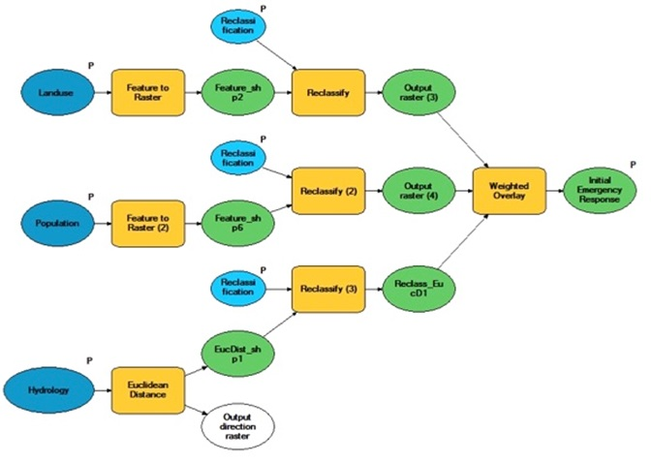
ArcGIS Workflow

Slide 14
Limitations
End user requires baseline understanding of GIS
Subjective selection of layers and weights
How the layers are combined
Type of feature (polygons/lines only)
Scale of model (work with local datasets)
Notes:
Point data: explore with interpolation techniques or density analysis?

Slide 15
User Testing
Distributed to local emergency managers in greater Philadelphia Area
8 total respondents
Mixture of Senior Emergency Managers and GIS Specialists
Example Respondent:
Delaware County Senior Emergency Manager
Experience: 20+ Years
Basic Understanding of GIS Products

Slide 16
Survey Content
Questions:
General Information/Experience/Knowledge of GIS
Explanation of Open Source Online Data
Explanation of MCDA and Example Workflow
Flooding and Hazardous Materials Release Scenarios
Selection, Ranking, and Weighting (Perceived Importance) of Layers
Feedback on Workflow Process/Survey

Slide 17
Scenarios

Slide 18
Scenario 1: Flooding
Scenario: major flooding as the result of river/stream overflow near major transportation infrastructure
Most Common Category Layers
1) Census/Population
2) Transportation Infrastructure
3) Land Use/Parcel

Slide 19
Scenario 1: Flooding
Layer | Sample Classification | Weight
Elevation | Negative slope: 10 No slope: 5 Positive slope: 1 | 0.5
Roads | Private: 1 Non-Arterial: 5 Arterial: 10 | 0.2
Population | 1-1000: 1 1000-3000: 3 3000-6000: 6 6000-9000: 9 >9000: 10 | 0.3

Slide 20
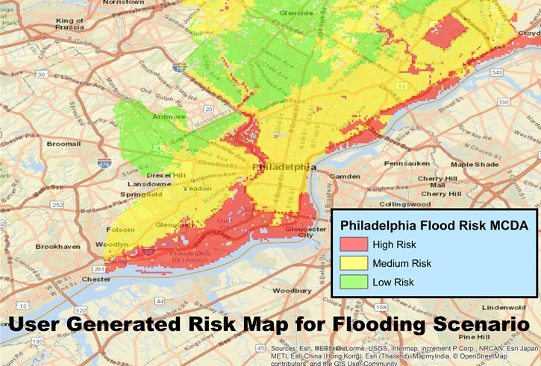
Scenario 1: Flooding

Slide 21
Scenario 2: Hazardous Materials (Hazmat) Release
Scenario: Hazmat release from a tank truck or rail car in vicinity of a populated area
Most Common Category Layers
1) Population
2) Land Use
3) Elevation

Slide 22
Scenario 2: Hazardous Materials (Hazmat) Release
Layer | Sample Classification | Weight
Population | 1-1000: 1 1000-3000: 3 3000-6000: 6 6000-9000: 9 >9000: 10 | 0.6
Land Use | Commercial: 3 Public: 5 Residential: 10 | 0.2
Elevation | Negative slope: 10 No slope: 5 Positive slope: 1 | 0.2

Slide 23
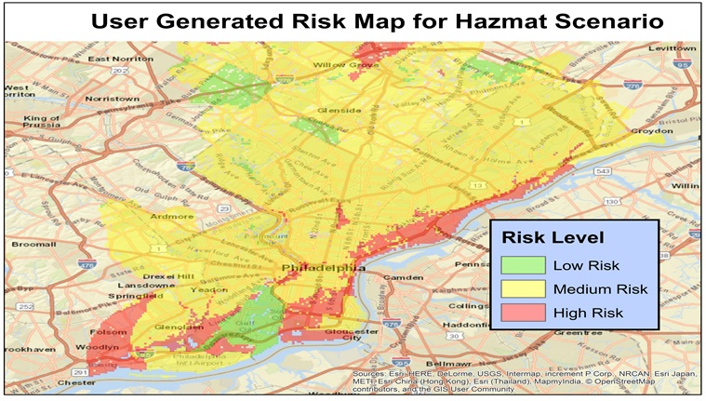
Scenario 2: Hazardous Materials (Hazmat) Release

Slide 24
Feedback from Users
Several emergency managers view GIS as a series of “products from the specialists”
Well-documented justification for selection of layers
General understanding of MCDA methodology and purpose
Critical feedback was on scenario detail (specifics of flooding and the type of hazardous material?)

Slide 25
Lessons Learned
GIS is staffed but not widely funded or utilized on local response level
City of Camden, Burlington County – Personal ArcGIS Online accounts
Evaluation method was too broad
Written survey may have made it harder to visualize intended results
Solution: GUI (graphic user interface) or use the actual ArcGIS Toolbox (dropdowns, data imports) to direct results

Slide 26
Further Research
Hosted Geoprocessing Service (in development)
Application of on-the-fly MCDA to broader GIS user base- Average personal user with access to ArcGIS Online can answer geospatial questions:
Public Transit
Traffic Safety
Real Estate
Politics
Law Enforcement

Slide 27
References
Abuzied, S., Yuan, M., Ibrahim, S., et al. Journal of Arid Environments (2016) 133: doi:10.1016/j.jaridenv.2016.06.004
Aubrecht, C., Özceylan, D., Steinnocher, K. et al. Natural Hazards (2013) 68: 147. doi:10.1007/s11069-012-0389-9.
Environmental Systems Research Institute (ESRI), (2016). ArcGIS Desktop Help 10.4 Spatial Analyst.http://resources.arcgis.com/en/help/main/10.4/index.html
U.S. Department of Homeland Security, Federal Emergency Management Agency (2013). National Response Framework, pp. 2-13.
U.S. Department of Homeland Security, Homeland Infrastructure Foundation Level Data (2016). Geospatial Management Office. Available online at https://hifld-dhs-gii.opendata.arcgis.com/.
Special Acknowledgement to the ESRI Public Safety Team for consultation and guidance of the development of the ArcGIS Workflow

Slide 28
Questions?
Associated Press

