Slide 1
Exploring Optimal GPS Signals for Autonomous Vehicles
Christopher Miller

Slide 2
Overview
Background
Motivation
Autonomous Vehicle (AV) Requirements
Methodology
Area of Concentration
Data Inputs
Obstacles with Visibility
Results
New Methodology
Solar Radiation Analysis
Viable Roads
Reflections and Conclusion

Slide 3
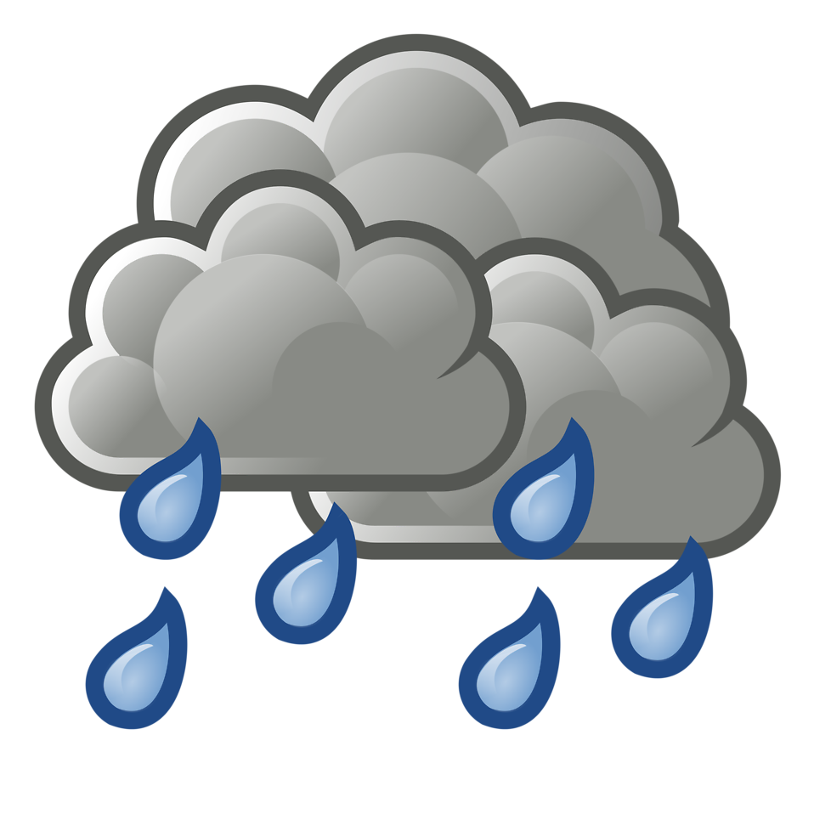

Slide 4
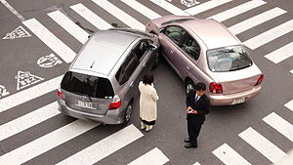
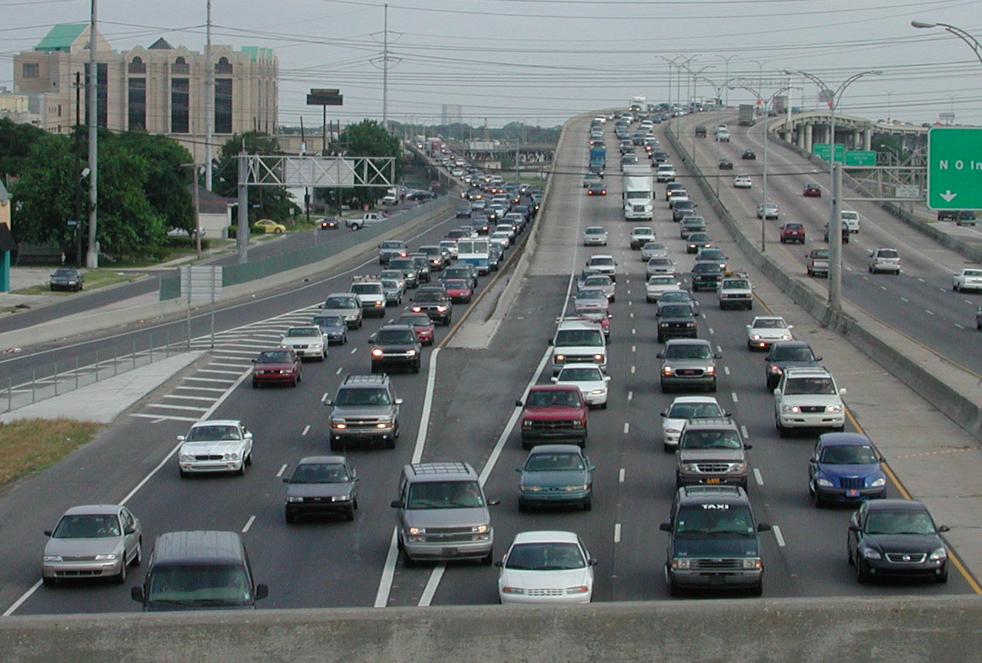
Background: Motivation
1.3 billion currently to 2 billion in 2030

Slide 5
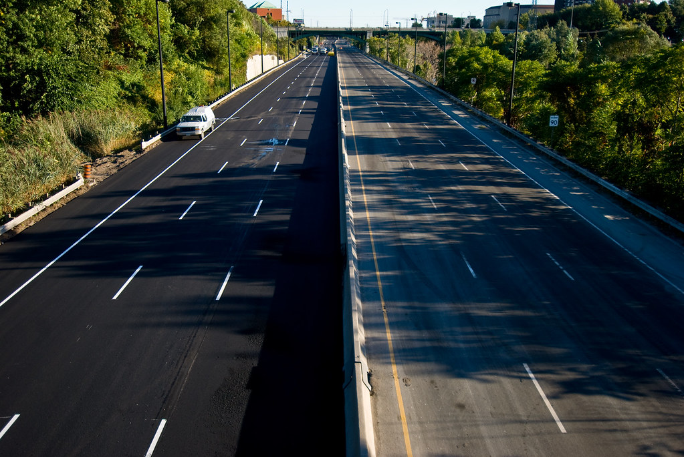
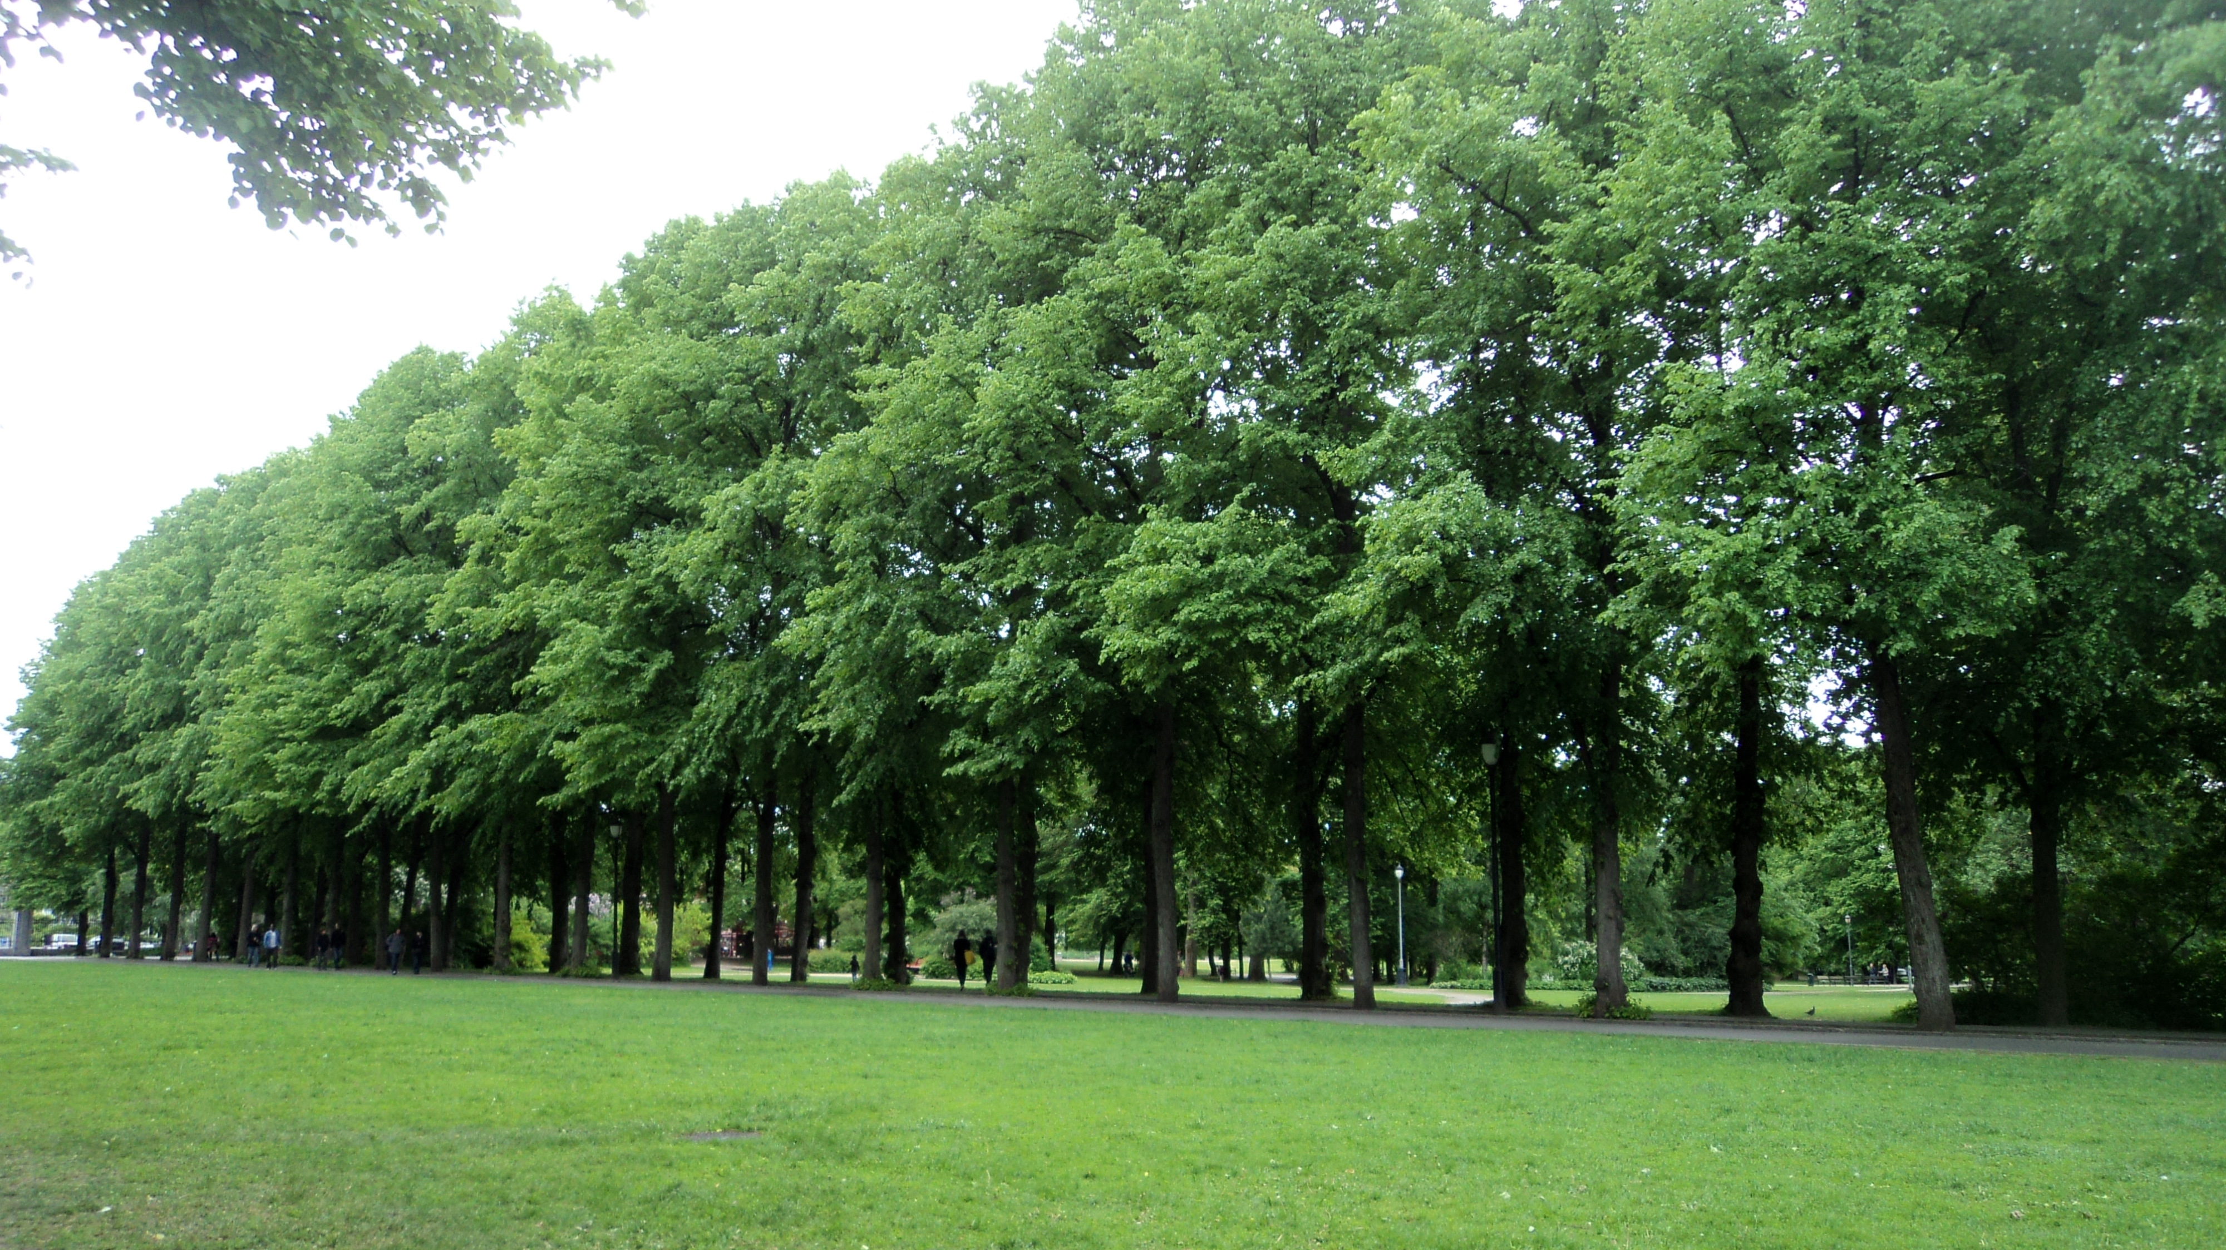
Background: Motivation

Slide 6
Background: AV Requirements
Automated Driving System:
“hardware and software that are collectively […] used specifically to describe a level 3, 4, or 5 driving automotive system” - SAE International, 2018a

Slide 7
Background: AV Requirements

Slide 8
Background: AV Requirements
Lidar System

Slide 9
Background: AV Requirements

Slide 10
Methodology: Area of Concentration
Washington, D.C.
Access to data – opendata.dc.gov
Infrastructure – future integration potential
Interest within the City –
Need to improve
Member of an initiative group

Slide 11
Methodology: Data Inputs
Visibility Tool in ArcMap
Surface elevation raster – (DSM)
digital surface model,
Observer features of satellite data,
Observer Elevation

Slide 12
Methodology: Data Inputs
Visibility Tool in ArcMap
Surface elevation raster – (DSM)
digital surface model,
Observer features of satellite data,
Observer Elevation

Slide 13
Methodology: Data Inputs
Visibility Tool in ArcMap
Surface elevation raster – (DSM)
digital surface model,
Observer features of satellite data,
Observer Elevation

Slide 14
Methodology: Data Inputs
Observer features of satellite data
Almanac – easy to use .txt files, but less accuracy and additional calculations
Broadcast Ephemerides – more accurate but harder to use
Precise Ephemerides – most accurate

Slide 15
Methodology: Data Inputs
Precise Ephemerides –
XYZ geocentric coordinates of satellites
Conversion into geodetic –
Latitude, longitude and altitude: NGS’s NCAT

Slide 16
Methodology: Data Inputs
Setup –
Observer Features: 32 GPS Satellite Locations, 3 times and 3 days => 285 coordinates*
Height: Average altitude/Visibility run
Test Run –
Observer Features: 1 Satellite Coordinate
Height: Set to 20,200,000 meters
*should have been 288 but some satellites were unavailable

Slide 17
Methodology: Data Inputs
Setup –
Observer Features: 32 Satellite Locations 3 times and 3 days => 288 coordinates
Height: Average altitude/Visibility run
Test Run –
Observer Features: 1 Satellite Coordinate
Height: Set to 20,200,000 meters (12,550 miles)

Slide 18
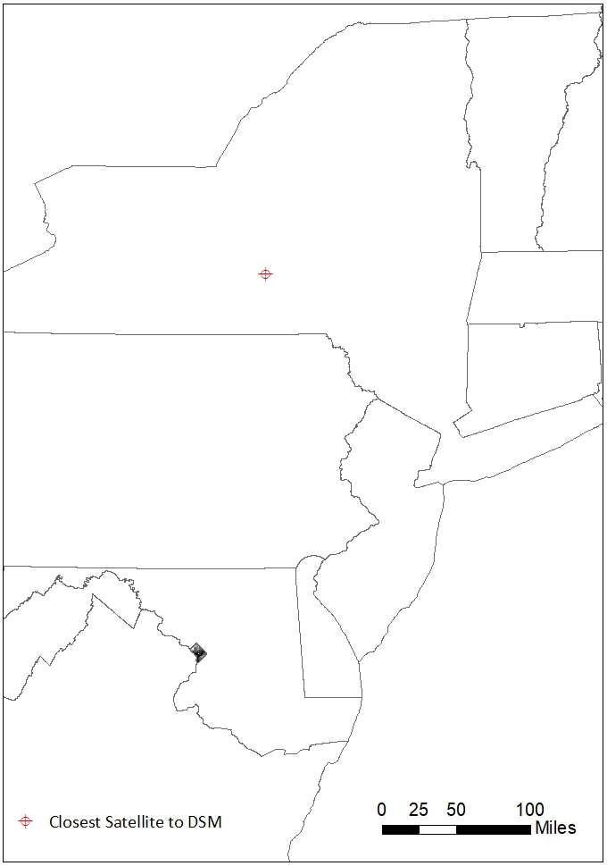
Methodology: Obstacles with Visibility
Workflow –
Visibility tool on closest satellite coordinate
259 miles

Slide 19
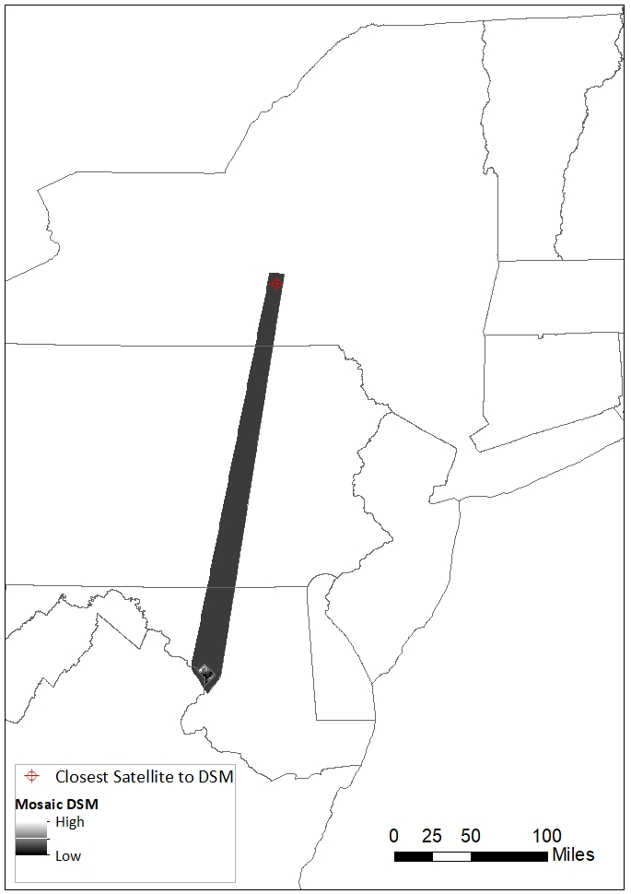
Methodology: Obstacles with Visibility
Workflow –
Visibility tool on closest satellite coordinate
Line-of-Sight Across Large Distances => Mosaic DSM

Slide 20
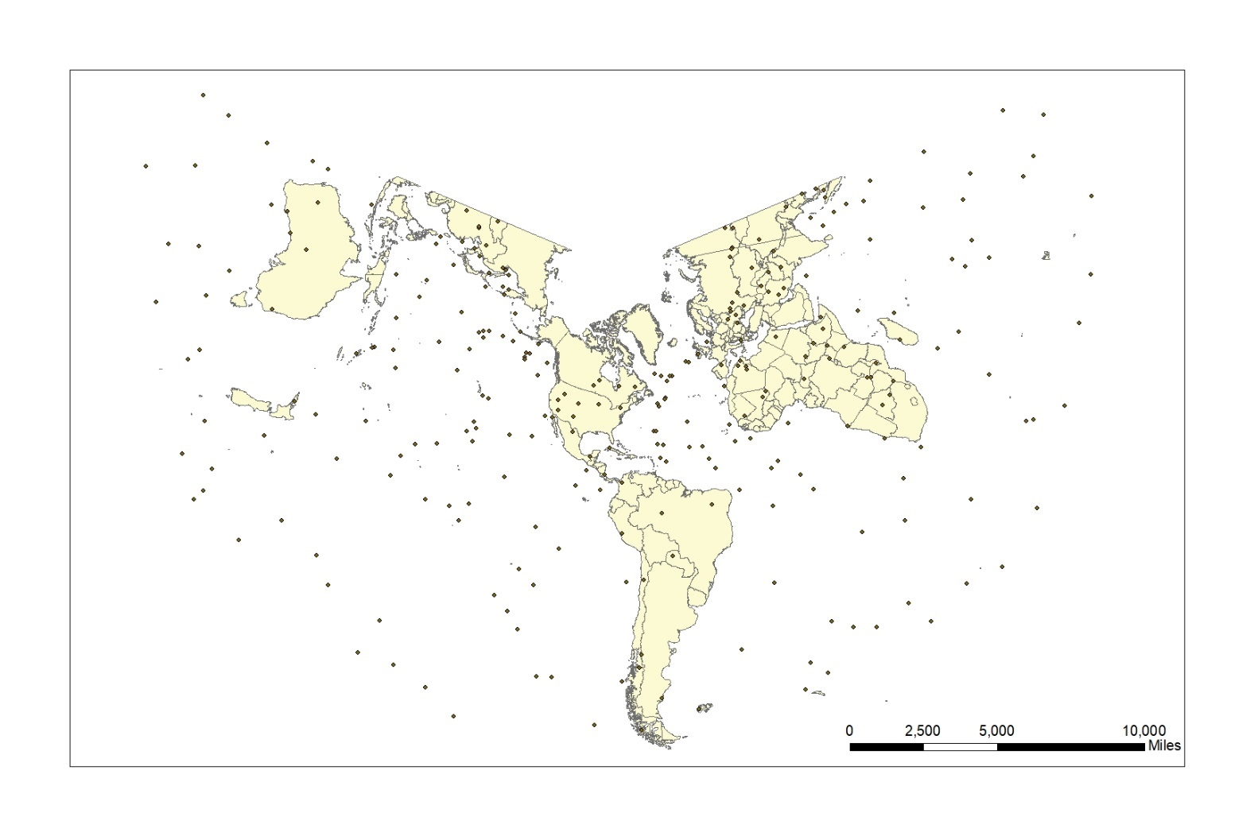

Slide 21
Methodology: Obstacles with Visibility
Workflow –
Visibility tool on closest satellite coordinate
Line-of-Sight Across Large Distances => Mosaic DSM
Observer Height Too High => Test within DSM

Slide 22
1,000 Meters
10,000 Meters
100,000 Meters

Slide 23
Results: New Methodology
Visibility Tool unable to produce results

Slide 24
Results: New Methodology
Visibility Tool unable to produce results
Alternative: Area Solar Radiation Analysis –
Inputs: DSM, Sky size and time configuration

Slide 25
Results: New Methodology
Visibility Tool unable to produce results
Alternative: Area Solar Radiation Analysis –
Inputs: DSM, Sky size and time configuration
Obstacles
“solar modeling in GIS is a very intensive geoprocessing (computational time) process” which, on a single simulation “can range from a few hours up to multiple days” (Chow, 2014)

Slide 26
Results: New Methodology
Visibility Tool unable to produce results
Alternative: Area Solar Radiation Analysis –
Inputs: DSM, Sky size and time configuration
Obstacles
Solution – Modify Resolution

Slide 27
Results: Solar Radiation Analysis
Troubleshooting Inputs
DSM Resolution | Sky Size (Resolution) | Time configuration | Result | Output Available
1-meter | 200 | 2 days: 1/5/21 until 1/6/21 | >48 hours | N
1-meter | 2,800 | 3 days | >24 hours | N
1-meter | 10,000 | 3 days | >16 hours | N

Slide 28
Results: Solar Radiation Analysis
Troubleshooting Inputs
Output Available!
DSM Resolution | Sky Size (Resolution) | Time configuration | Result | Output Available
1-meter | 200 | 2 days: 1/5/21 until 1/6/21 | >48 hours | N
1-meter | 2,800 | 3 days | >24 hours | N
1-meter | 10,000 | 3 days | >16 hours | N
10-meter | 2,800 | 3 days | 12.5 hours | Y
30-meter | 2,800 | 3 days | 1.5 hours | Y

Slide 31
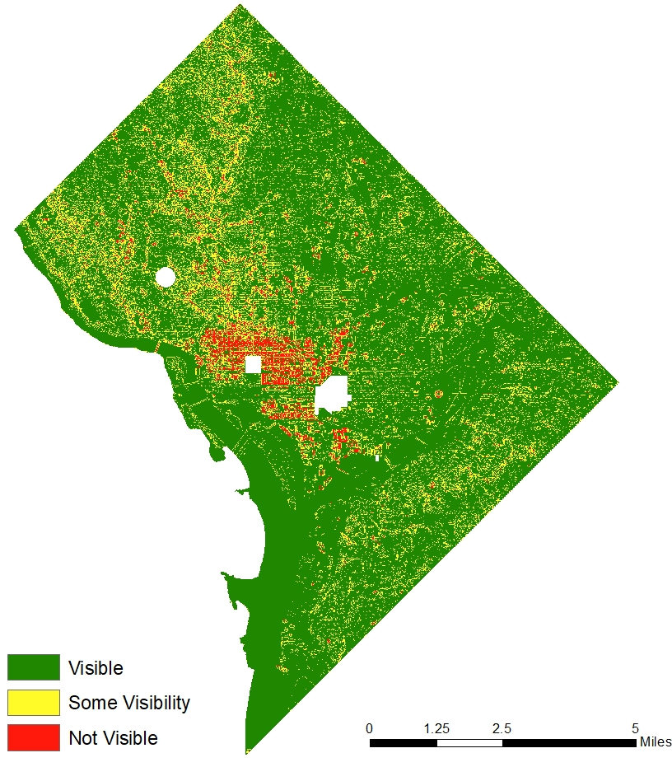
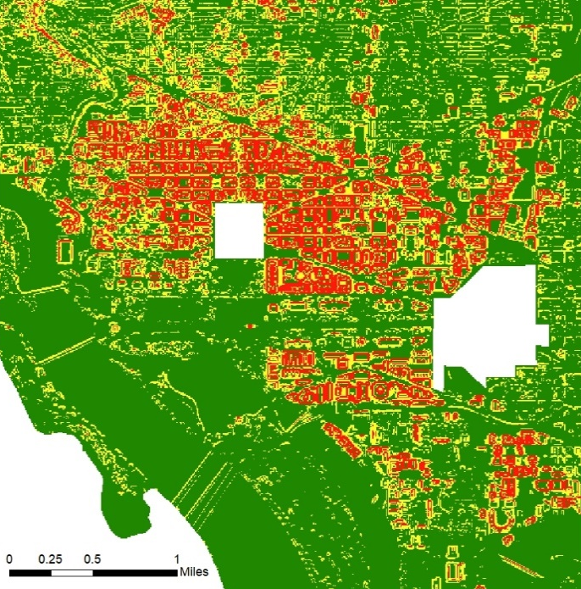
Results: Viable Roads
High Solar Radiation = Visible Area

Slide 32
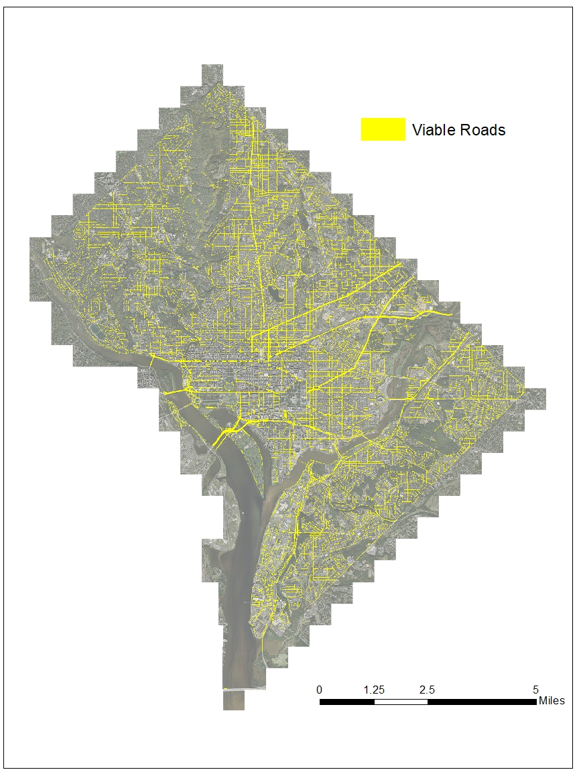
Results: Viable Roads
High Solar Radiation = Visible Area
Replicate Across all D.C. roads
Major Roads
 | Total DSM | all roads | major roads
not visible | 3% | 2% | 3%
some visibility | 18% | 17% | 13%
visible | 79% | 81% | 84%

Slide 33
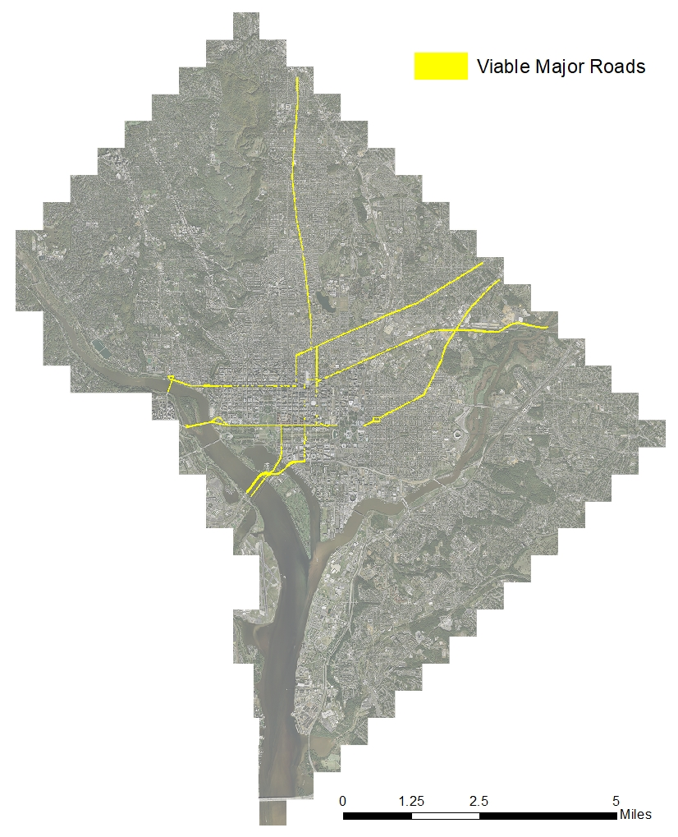
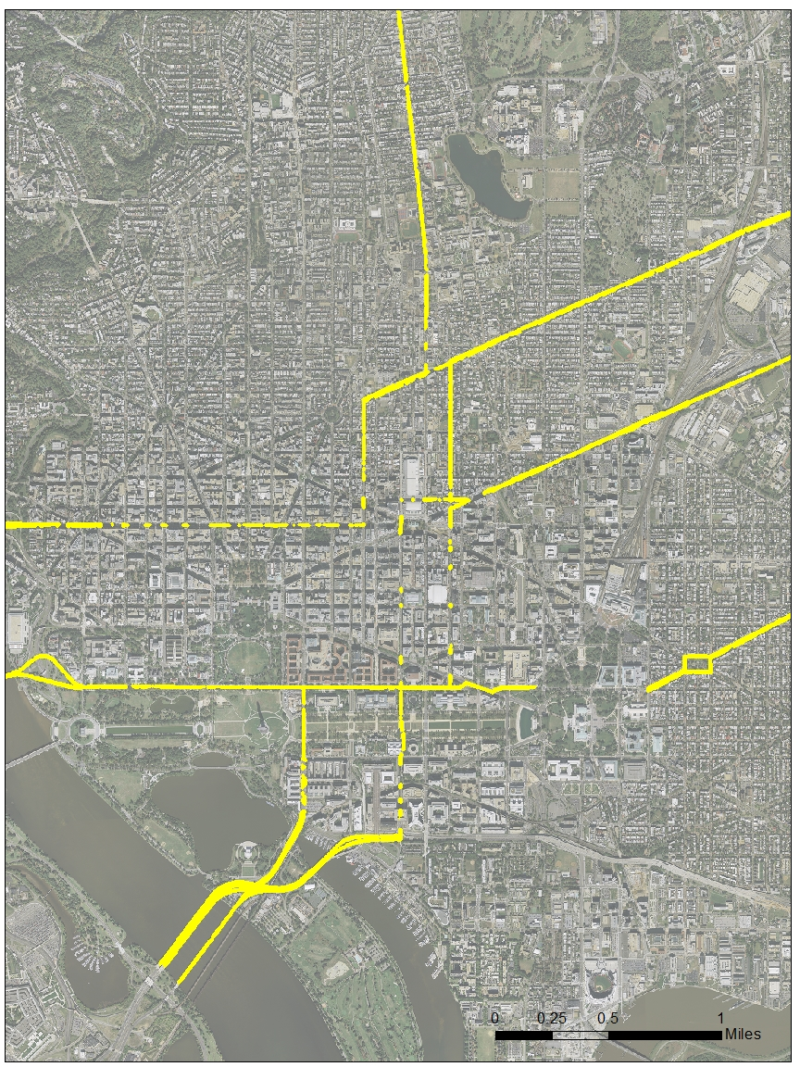

Slide 34
Results: Reflections and Conclusion

Slide 35
Results: Reflections and Conclusion
Limitations
Line-of-sight – Building Height in other cities
Other urban canopy obstructions
Opportunities
GPS Signal Enhancers
Other software, computer, users
Signal Quality Importance

Slide 36
Results: Reflections and Conclusion
Limitations
Line-of-sight – Building Height in other cities
Urban canopy obstructions
Opportunities
GPS signal enhancers
Other software, computer, users
Signal Quality Importance

Slide 37
Results: Reflections and Conclusion
Limitations
Line-of-sight – Building Height in other cities
Urban canopy obstructions
Opportunities
GPS Signal Enhancers
Other software, computer, users
Signal Quality Importance

Slide 38
Exploring Optimal GPS Signals for Autonomous Vehicles
Christopher Miller

Slide 39
References
Adali, Erkan et al. (2018). Detecting Road Lanes under Extreme Conditions: A Quantitative Performance Evaluation. 2018 6th International Conference on Control Engineering & Information Technology (CEIT). Retrieved in November 10, 2019 from https://ieeexplore-ieee-org.ezaccess.libraries.psu.edu/document/8751835.
Adjrad, Mounir, et al. (2019). Performance assessment of 3D‐mapping‐aided GNSS part 2: Environment and mapping. Navigation, Volume 66, Issue 2. Retrieved in November 10, 2019 from https://onlinelibrary-wiley-com.ezaccess.libraries.psu.edu/doi/full/10.1002/navi.289.
Chow, Annie. et al. (2014). GIS Modeling of Solar Neighborhood Potential at a Fine Spatiotemporal Resolution. Buildings. Retrieved in February, 2021 from https://www.mdpi.com/2075-5309/4/2/195/htm.
DMPED. (2019). Autonomous Vehicles Working Group. DC.gov. Retrieved on November 9, 2019 from https://dmped.D.C..gov/page/autonomous.
El-naggar, Aly. (2012). New method of GPS orbit determination from GCPS network for the purpose of DOP calculations. Alexandria Engineering Journal. Retrieved on December 9, 2019 from https://www.sciencedirect.com/science/article/pii/S1110016812000464#t0020.
ESRI. (2016a). An overview of the Solar Radiation tools. ArcMap. https://desktop.arcgis.com/en/arcmap/10.3/tools/spatial-analyst-toolbox/an-overview-of-the-solar-radiation-tools.htm.
ESRI. (2016b). Area Solar Radiation. ArcMap. https://desktop.arcgis.com/en/arcmap/10.3/tools/spatial-analyst-toolbox/area-solar-radiation.htm.
Federal Highway Administration. (2007). Mitigation Strategies for Design Exceptions. Department of Transportation. Retrieved on April 20, 2021 from https://safety.fhwa.dot.gov/geometric/pubs/mitigationstrategies/chapter3/3_lanewidth.cfm.
Filgueira, A. et al. (2017). Quantifying the Influence of Rain in Lidar Performance. Measurement, Volume 95. Retrieved on October 18, 2019 from https://www-sciencedirect-com.ezaccess.libraries.psu.edu/science/article/pii/S0263224116305577.
Gossling, Stefan. (2017). The Automotive System. The Psychology of the Car, Chapter 1, Pages 1-18. Retrieved on October 24, 2019 from https://www-sciencedirect-com.ezaccess.libraries.psu.edu/science/article/pii/B9780128110089000016.
Germroth, Matthew. et al. (2005). GIS and Satellite Visibility: Viewsheds from Space. 2005 ESRI International User Conference. Retrieved on December 9, 2019 from https://proceedings.esri.com/library/userconf/proc05/papers/pap1615.pdf.
GPS.gov. (2021). Space Segment. U.S. Air Force. Retrieved February, 2021 from https://www.gps.gov/systems/gps/space/.

Slide 40
References (continued)
IGS. (2019). Access to Products. International GNSS Service. Retrieved on December 9, 2019 from https://kb.igs.org/hc/en-us/articles/115003935351.
Jin, Shuaggen, et al. (2014). GNSS Remote Sensing: Theory, Methods and Applications, Chapter 1, page 5. Springer Science and Business Media Dordrecht. Retrieved on December 4, 2019 from https://link-springer-com.ezaccess.libraries.psu.edu/book/10.1007%2F978-94-007-7482-7.
Kim, Dong, et al. (2019). Simple-Yet-Effective SRTM DEM Improvement Scheme for Dense Urban Cities Using ANN and Remote Sensing Data: Application to Flood Modeling. Integrated Flood Management: Concepts, Methods, Tools and Results. Retrieved on April 19, 2021 from https://www.mdpi.com/2073-4441/12/3/816/htm.
Luettel, Thorsten, et al. (2012). Autonomous Ground Vehicles—Concepts and a Path to the Future. IEEE, Special Centennial Issue. Retrieved on December 4, 2019 from https://ieeexplore-ieee-org.ezaccess.libraries.psu.edu/document/6179503.
Monaghan, Ryan. (2006). GPS Satellite Position Estimation from Ephemeris Data by Minimum Mean Square Error Filtering Under Conditions of Selective Availability. Retrieved on December 11, 2019 from http://citeseerx.ist.psu.edu/viewdoc/download?doi=10.1.1.297.6452&rep=rep1&type=pdf.
Navigation Center. (2019). GPS ALMANACS, NANUS, AND OPS ADVISORIES ARCHIVES. U.S. Department of Homeland Security. Retrieved on December 8, 2019 from https://www.navcen.uscg.gov/?Do=gpsArchives&exten=txt.
NCPC. (1998). PART I: HISTORICAL BACKGROUND ON THE HEIGHT OF BUILDINGS ACT. National Capital Planning Commission. Retrieved on December 10, 2019 from https://www.ncpc.gov/heightstudy/docs/Historical_Background_on_the_Height_of_Buildings_Act_(draft).pdf.
NGS. (2019a). NGS Coordinate Conversion and Transformation Tool (NCAT). NOAA. Retrieved in December, 2019 from https://www.ngs.noaa.gov/NCAT/.
NGS. (2019b). API for NGS’s Coordinate Conversion and Transformation Tool (NCAT). NOAA. Retrieved in December, 2019 from https://geodesy.noaa.gov/web_services/ncat/index.shtml.
Open Data D.C. (2019). 2018 Lidar – Digital Surface Model – Mosaic. District of Columbia GIS Program. Retrieved in November, 2019 from https://app.box.com/s/qedupea6k9cldn3l4b4eg9c2ajhtbxri.
Peng, D.J. (2014). The Effect of GPS Ephemeris on the Accuracy of Precise Orbit Determination of LEO Satellite-borne GPS. Chinese Astronomy and Astrophysics, Volume 33, Issue 2. Retrieved in December, 2020 from https://www-sciencedirect-com.ezaccess.libraries.psu.edu/science/article/pii/S0275106209000447#.
SAE International. (2018a). Taxonomy and Definitions for Terms Related to Driving Automation Systems for On-Road Motor Vehicles. Surfaced Vehicle Recommended Practice. Retrieved on November 11, 2019 from https://www.sae.org/standards/content/j3016_201806/preview/.

Slide 41
References (continued)
SAE International. (2018b). SAE International Releases Updated Visual Chart for Its “Levels of Driving Automation” Standard for Self-Driving Vehicles. Retrieved on November 8, 2019 from https://www.sae.org/news/press-room/2018/12/sae-international-releases-updated-visual-chart-for-its-%E2%80%9Clevels-of-driving-automation%E2%80%9D-standard-for-self-driving-vehicles
Sickle, Jan Van. (2019). Geocentric Datum. GEOG 862: GPS and GNSS for Geospatial Professionals, Lesson 5: Geodetic Datums. Retrieved on December 11, 2019 from https://www.e-education.psu.edu/geog862/node/1798.
U.S. Census Bureau. (2019). Route Type Codes and Definitions. Census.gov. Retrieved on April 20, 2021 from https://www.census.gov/library/reference/code-lists/route-type-codes.html.

