Slide 1
User-Defined Layer Selection and Weighting for Initial Emergency Response Risk Mapping
Jonas Miller
Advisor: Fritz Kessler

Slide 2
Scenario
Local emergency manager in Oso, Washington is concerned with the risk of mudslide from week of sustained heavy rainfall.
How can local emergency managers leverage their experience/expertise and GIS to create a initial response risk map?
How can this emergency manager identify areas with the greatest consequences of resource (natural, infrastructure, personnel) loss?

Slide 3
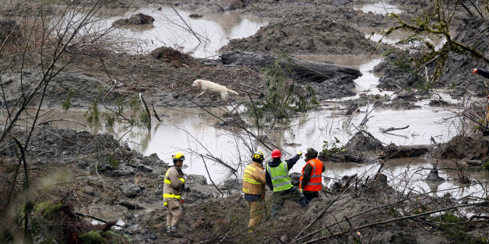
2014 Oso, Washington Mudslide
Associated Press
Managers could quickly assess the risks of a mudslide by overlaying relevant layers:
Topography – if a landslide occurs where will it be worst?
Soil type – after heavy rain, where will a landslide occur?
Population – who will a landslide affect?

Slide 4
Objective
Create a simple risk analysis mapping tool in ArcGIS Desktop
Intended use by local initial emergency responders and managers
Include a customizable selection of data layers (publically available)
Apply overlay weights that is based on subject knowledge / experience

Slide 5
Project Methodology
Identify the need for a initial emergency response mapping tool
Review previous applicable studies
Describe a target user
Assess target user’s needs/capabilities
Determine available, accessible, and free data
Develop model
Test model
Validate model

Slide 6
Risk Defined
Risk = consequences of expected losses
Previous studies of risk mapping:
Defined risk in the form of susceptibility mapped for single hazards:
Landslides, pipeline oil spills, tropical storm impact
Maps created using overlays of multiple features related to hazard
Geomorphology, Population Density, Soil Characteristics, Hydrology

Slide 7
Previous Studies
Jafari (2010): Iranian Pipeline study incorporating complex, multifactor environmental risk factor
Poompavai (2012): Indian Cyclone study introducing population-specific risk factors (‘coping’) with equally weighted categories

Slide 8
Previous Studies
Alexander (2010): UK study of a emergency response mapping tool with end-user input and feedback
Ahmed (2015): User generated weighting of factors for Bangladeshi Landslides; concluded complete model requires input from both local officials and academic subject matter expertise
Notes:
Explain why these are unlike previous studies

Slide 9
Target End User
Local emergency manager with basic understanding of GIS and expertise and experience in emergency/disaster response
Timeframe: within first few (up to 12) hours of a response, before state/federal resources arrive
Scope: local geographic level
Municipality, County

Slide 10
Publically Available Emergency Management Data
ArcGIS Open Data: 56,470 datasets ranging from local to national scale
Dept of Homeland Security (DHS): Homeland Infrastructure Foundation Level Data (HIFLD) Open: 267 DHS supported datasets on national scale
Notes:
accessibility

Slide 11
Creating a Risk Index
Select data from publically available layers (HIFLD or ArcGIS Open Data)
Convert to raster: Feature to Raster or Euclidian Distance (for distance based risks) Tools
Apply Reclassify Tool to achieve same scale (0-9 based on suggested ArcGIS Help/ESRI Public Safety Team workflow)
Combine reclassified layers with Weighted Overlay Tool for Final Risk Index
Notes:
Select three applicable risk indicator layers
Download Data from ArcGIS Online Open Data or HIFLD Open
Convert to Raster
Reclassify Raster (1-10) based on highest geospatial risk from user experience/subject knowledge (ESRI Public Safety Team)
Combine using user-generated weights (0-1)

Slide 12
ArcGIS Workflow

Slide 13
Example: Colorado Wildfire
Layers:
USA Urban Areas (HIFLD)
Fish and Wildlife Service Critical Habitat (ArcGIS Open Data)
Historical Fire Perimeters (HIFLD)
Weights
w = 0.3 – Urban Areas (Population) Layer
w = 0.2 – Historical Fire Layer
w = 0.5 – Critical Habitat Layer

Slide 14
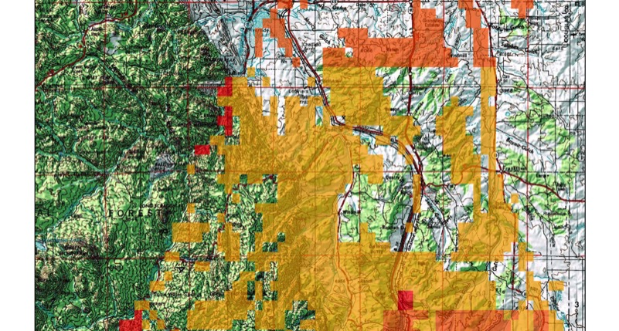
Douglas County, CO Wildfire Initial Response Risk Map

Slide 15
Limitations
End user requires baseline understanding of GIS
Subjective selection of layers and weights
How the layers are combined
Type of feature (polygons/lines only)
Scale of model (work with local datasets)

Slide 16
Future Plans
GEOG 596B Timeline
Fully automate model
User testing
Validate with historical disaster/incident data
Make tool available as Web Hosted Geoprocessing Tool on ArcGIS Online (in partnership w/ESRI Public Safety Team)
Tentative Conference Presentations:
Tugis – University of Towson, March 2017
PA GIS Conference, May 2017

Slide 17
References
Abuzied, S., Yuan, M., Ibrahim, S., et al. Journal of Arid Environments (2016) 133: doi:10.1016/j.jaridenv.2016.06.004
Aubrecht, C., Özceylan, D., Steinnocher, K. et al. Natural Hazards (2013) 68: 147. doi:10.1007/s11069-012-0389-9.
Environmental Systems Research Institute (ESRI), (2016). ArcGIS Desktop Help 10.4 Spatial Analyst.http://resources.arcgis.com/en/help/main/10.4/index.html
Jafari, J., Khorasani, N., & Danehkar, A. (2010). Using environmental sensitivity index (ESI) to assess and manage environmental risks of pipelines in GIS environment: A case study of a near coastline and fragile ecosystem located pipeline. World Academy of Science, Engineering and Technology, 44, 1101-1111.
Poompavai, V. & Ramalingam, M. J Indian Soc iety of Remote Sensing (2013) 41: 157. doi:10.1007/s12524-011-0198-8.
U.S. Department of Homeland Security, Federal Emergency Management Agency (2013). National Response Framework, pp. 2-13.
U.S. Department of Homeland Security, Homeland Infrastructure Foundation Level Data (2016). Geospatial Management Office. Available online at https://hifld-dhs-gii.opendata.arcgis.com/.
Special Acknowledgement to the ESRI Public Safety Team for consultation and guidance of the development of the ArcGIS Workflow

Slide 18
Questions?
Associated Press

