Slide 1
GIS in Helicopter Landing Zone Analysis: Scripting An Automated, Multi-Criteria, Weighted Overlay Approach
Barry Y. Miller
GEOG 596A: HLZ
Capstone Project Proposal, 26 September 2012
Notes:
http://www.militaryphotos.net/forums/showthread.php?137525-Colombian-Choppers

Slide 2
Agenda
Background
Existing Research, Techniques and Procedures
Project Objectives and Goals
Proposed Methodology
Project Deliverables
Presentation Venue
and Timeline

Slide 3
Background
Helicopter Landing Zone analysis is a common military intelligence problem
Used for planning an initial invasion, search and rescue, logistics, and medical evacuation
Little consistency in procedures and criteria
Notes:
http://www.aviationnews.eu/2009/11/17/u-s-army%E2%80%99s-black-hawk-helicopter-fleet-surpasses-1-million-flight-hours-in-iraq-and-afghanistan/

Slide 4
Existing Research, Techniques and Procedures
Many sources for purpose and geospatial criteria
Army Field Manual 3-21.38 Pathfinder Operations
Minimum landing diameter, slope, surface conditions, obstacle ratios, day/night, seven categories of helicopters
Federal Aviation Administration Aeronautical Information Manual
Diameter, slope, safe wind conditions
US Army Corps of Engineers Waterways Experiment Station FTHEL Computer Program
Slope, soil strength, microrelief, full-touch vs. hover
Notes:
Department of the Army. (2006). Field Manual 3-21.38: Pathfinder Operations. Washington DC: United States Army. Retrieved July 28, 2012, from http://armypubs.army.mil/doctrine/DR_pubs/DR_a/pdf/fm3_21x38.pdf
Federal Aviation Administration. (2012). Aeronautical Information Manual: Official Guide to Basic Flight Information and ATC Procedures. Washington DC: U.S. Department of Transportation. http://www.faa.gov/air_traffic/publications/ATPubs/AIM/aim.pdf
Parks, J. A. (1976). Automated Procedure for Evaluating Sites for Suitability as Helicopter Landing Zones (Vol. 1: Descriptions and Instructions for Use of Computer Programs). Alexandria: U.S. Army Material Development and Readiness Command.

Slide 5
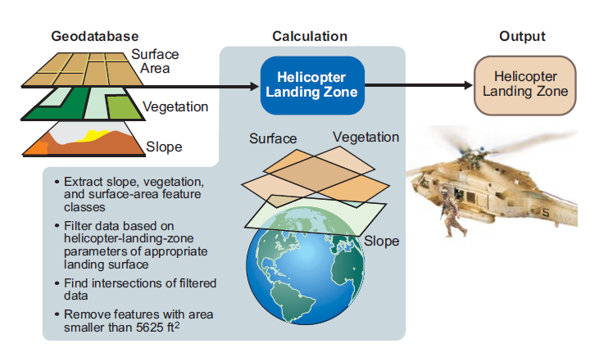
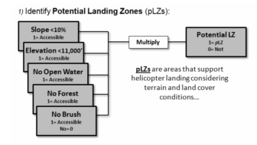
Existing Research, Techniques and Procedures
Little modern scientific research but many examples of different techniques and procedures
Notes:
Renner, R. D., Hemani, Z. Z., & Tjouas, G. C. (2009). Extending Advanced Geospatial Analysis Capabilities. Northrop Grumman Technology Review Journal, 17(1), 96. Retrieved July 29, 2012, from http://www.is.northropgrumman.com/about/ngtr_journal/assets/TRJ-2009/SS/09SS_Renner.pdf
Carlton, D., & Berry, J. (2011, August). Assessing Wildfire Response (Part 1): Oneth by Land, Twoeth by Air. Retrieved from Beyond Mapping III Compilation of Beyond Mapping Columns Appearing in GeoWorld Magazine from 1996-2009: http://www.innovativegis.com/basis/mapanalysis/Topic29/Topic29.htm#WildfireResponse_Part1

Slide 6
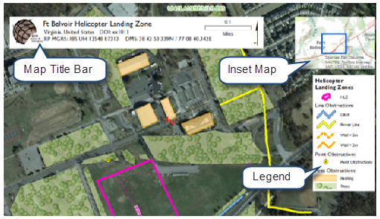
Existing Research, Techniques and Procedures
No scripts or tools found on ESRI online resources
Simple models found on NGA/DIA sites
Existing methods provide a go/no-go result
Notes:
Environmental Systems Research Institute. (2012, August 30). Helicopter Landing Zones. Retrieved from ArcGIS Resources: http://resources.arcgis.com/en/communities/defense-and-intelligence/01vr00000012000000.htm

Slide 7
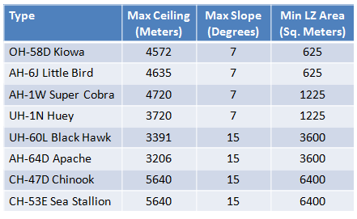
Project Objective and Goals
Refine HLZ analysis process with a script tool
Pre-loaded with common helicopter types and their criteria
Highly suitable, moderately suitable, and barely suitable
Acceptable land cover and soil classification tables
Day/night conditions

Slide 8
Project Objective and Goals
Multi-criteria weighting
Potential Sites will be rank-ordered based on suitability
Weighting % for different environments
Script will accept user provided input data and automate the analysis and output
Provide potential HLZ sites in shapefile and KML format
Rank-ordered so an analyst can find the most ideal sites

Slide 9
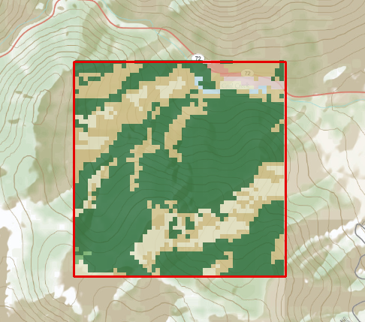
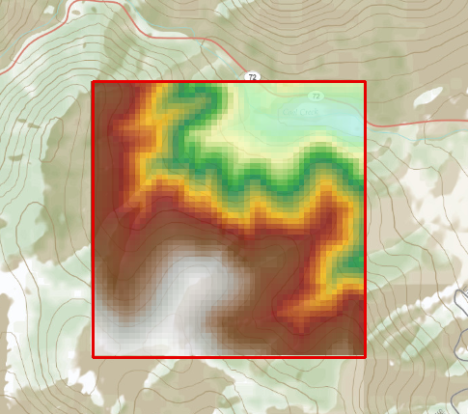
Proposed Methodology: User Inputs
National Elevation Dataset
National Land Cover Database
Roads
Vertical obstructions
Area of Interest
Environment
Day/Night Conditions
Will run with a minimum of elevation and AOI
May incorporate LIDAR LAS data
Notes:
United States Geological Survey. (2012, May 22). National Elevation Dataset. Retrieved from USGS: http://ned.usgs.gov
United States Geological Survey. (2012, May 22). National Land Cover Database. Retrieved from USGS: http://seamless.usgs.gov

Slide 10
Proposed Methodology
Script tool will automatically determine the appropriate UTM zone for the analysis
Project the data into the WGS 1984 datum and the UTM zone
Data dictionaries will store the HLZ site criteria for each helicopter platform
Criteria will be different for day or night conditions
Weights will change based on user-specified environment: Temperate Forest, Desert, Mixed Urban, or Generic

Slide 11
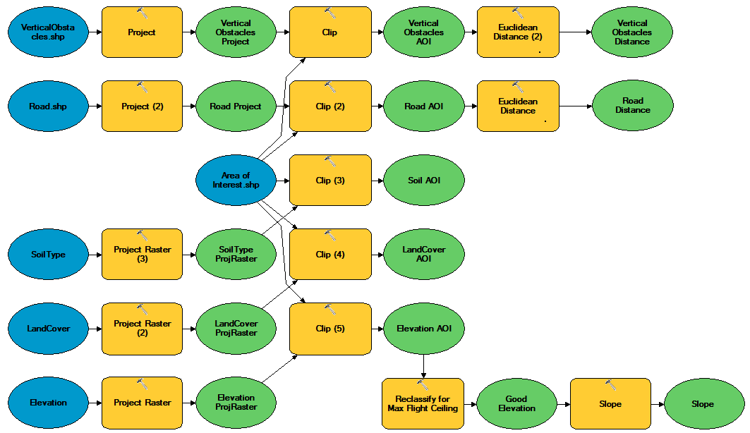
Proposed Methodology

Slide 12
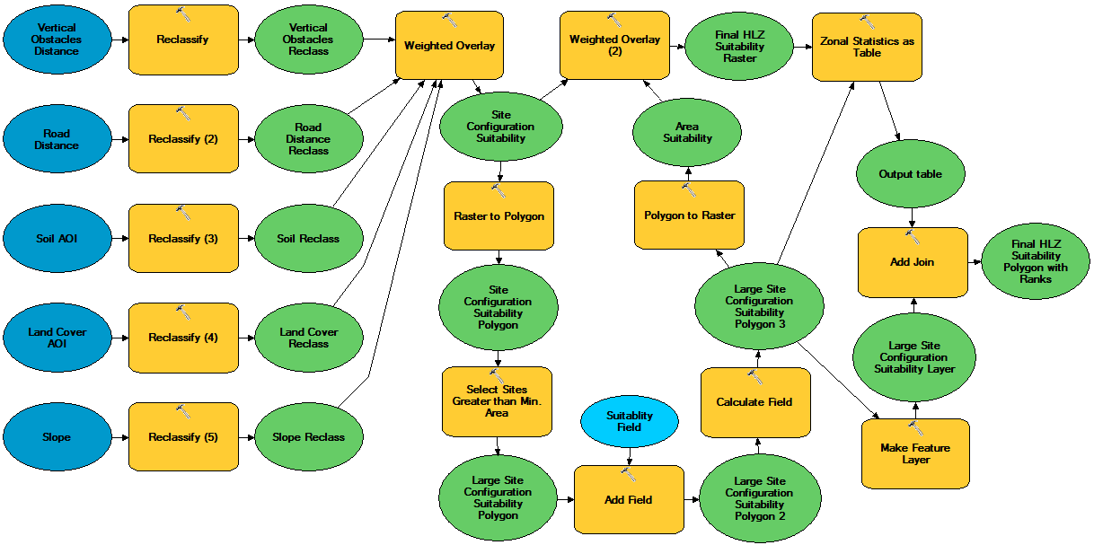
Proposed Methodology
Reclassified into highly, moderately, and barely suitable. Unsuitable values will become NoData.
Notes:
-Reclassify values stored in data dictionaries.
-Thin areas will also be removed.

Slide 13
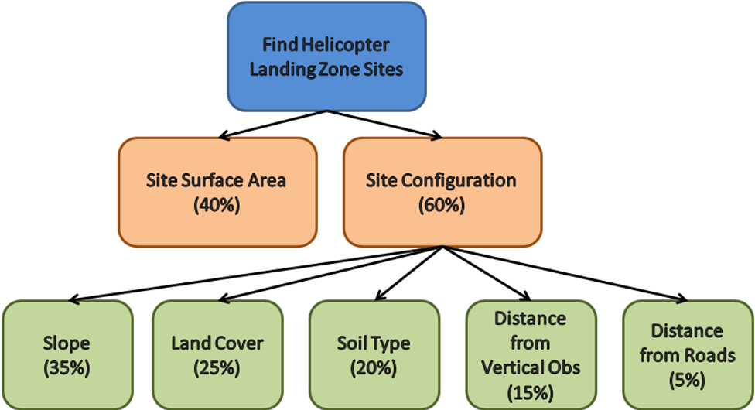
Proposed Methodology: AHP
Analytic Hierarchy Process for Multi-Criteria Weighting
Developed by Thomas Saaty in the 70’s and 80’s
Used in geography since the mid-90’s for site suitability analysis
Overall goal and hierarchy of objectives, attributes and criteria
Notes:
Many studies for solar farms, wind mills, and other sites available.

Slide 14
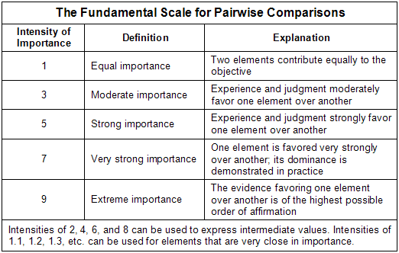
Proposed Methodology: Pairwise Comparison
Compare two criteria at a time
Weaker candidate assigned a “1”, stronger candidate assigned a score of “1” to “9” based on comparative strength
Notes:
Wikipedia. (2012, September 13). Analytic Hierarchy Process Fundamental Scale. Retrieved from Wikipedia: http://en.wikipedia.org/wiki/File:AHPFundamentalScaleModerately.png

Slide 15
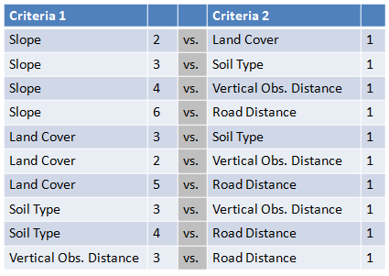
Proposed Methodology: Pairwise Comparison
Notes:
Will survey US Marine, US Army, and NGA geospatial analysts as well as pilots.

Slide 16
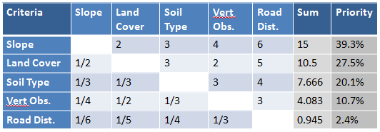
Proposed Methodology: Pairwise Comparison
Priority Weighting for Five HLZ Criteria in a Temperate Forest (Illustrative Values Only)
Notes:
Divide each sum by the total of 38.194 to get the priority percentage.

Slide 17
Project Deliverables
Well-documented script tool with appropriate value list filters
Detailed help documentation
Data dictionaries with appropriate criteria
Test data in various environments
15-20 minute presentation
10-15 page research paper detailing methodology and criteria

Slide 18
Presentation Venue and Time Line
Plan to present at the ESRI International User’s Conference from 8-12 July, 2013 in San Diego, CA.
Proposed Time Line
9/26/2012: Present my project proposal for peer review
10/01/2012: Input peer review comments into capstone proposal
10/26/2012: Submit abstract to ESRI selection committee
03/01/2013: Finish gathering survey results for criteria weighting
05/01/2013: Complete ArcGIS Python Script
05/15/2013: Sign-up for GEOG 596B: Individual Studies – Capstone
06/01/2013: Complete project paper
06/15/2013: Complete project presentation
06/15 to 07/07/2013: Rehearse presentation
07/08 to 07/12/2013: Presentation at ESRI IU Conference

Slide 19
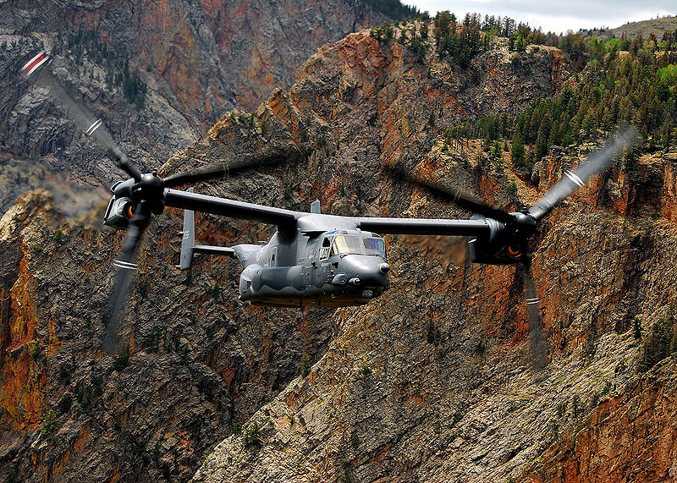
Summary
Background
Existing Research, Techniques and Procedures
Project Objectives and Goals
Proposed Methodology
User Inputs
Flow Charts
AHP/Pairwise Comparison
Project Deliverables
Presentation Venue and Timeline

