Slide 1
Analyzing the Impact of Hurricane Catastrophe on the Communities of Tampa Bay
Author: James Montgomery
Advisor: Doug Miller

Slide 2
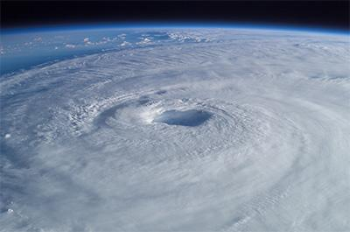
Presentation Outline
Background
Goals and Objectives
Data Sources
Proposed Methodology
Anticipated Results
Project Timeline

Slide 3
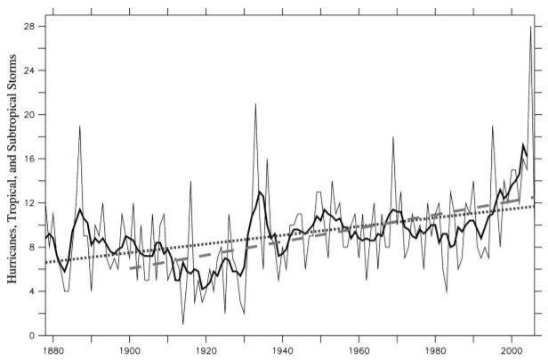
Hurricanes: An Omnipresent Issue for Coastal Communities
Number One Contributor to Disaster Losses
Anthropogenic Climate Change Correlation
Apparent Increase in Event
Increase Strength Unclear
Migration Increases Societal Risks
Storm Year
Figure 1: Trend in storm count 1880-2006, Vecchu and Knutson 2008.

Slide 4
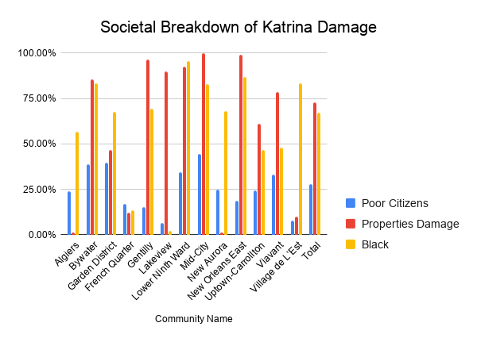
An Issue for All: Disproportionately So for Some
Hurricane Katrina
Broad Media Coverage
Public Outcry
Green and Colleagues Study
Higher Damage in Poorer/Minority Areas
Exacerbated Recovery Differences
Data Derived from Green, et al 2013

Slide 5
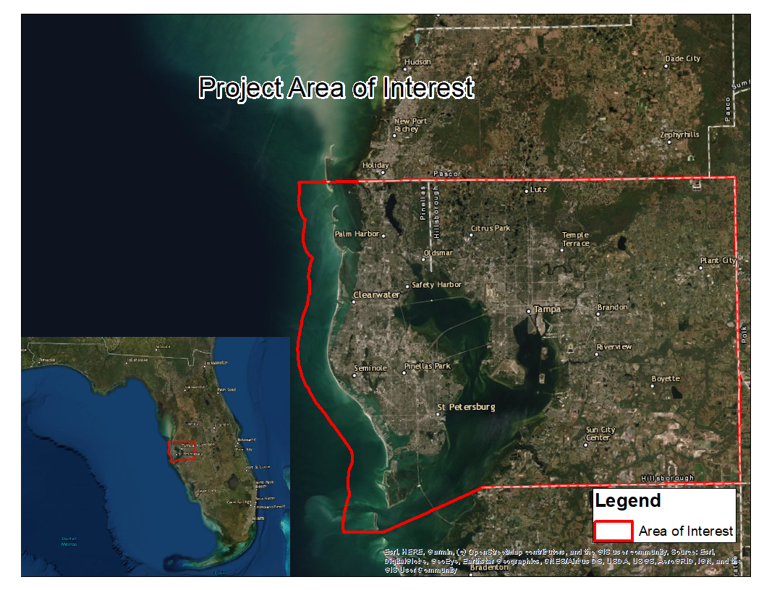
Risk to Tampa Bay
Diverse Communities
High Population Density
Hydrography of the Bay
Generally Low Ground Elevation
Sensitive Infrastructure

Slide 6
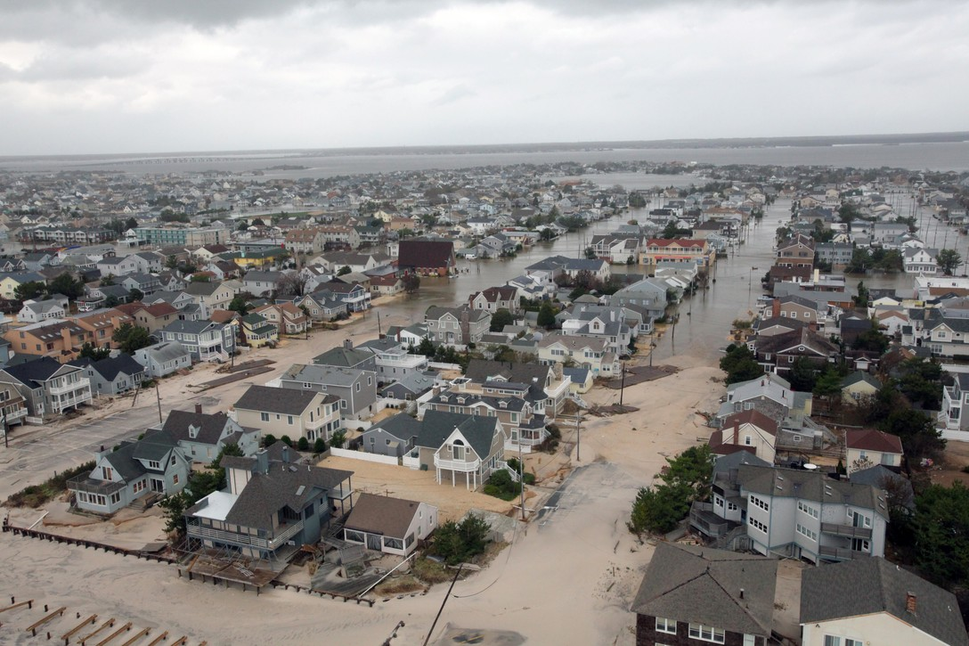
Goals and Objectives
Community Risk Database
Postgres Based
Multiscale
Multi-Risk
Actionable
Identify Potential Trends Resiliency
Locate At-Risk Communities

Slide 7
Data Sources
Florida DOR NAL Parcel Data
Department of Revenue Real Property DB
SLOSH Model
Maximum of Maximum (MOM)
Outputs Maximum Surge Value per Cat
JRC Flood Damage Factor Table
Building Code to Construction Quality Lookup Table
U.S. Census Block Groups and Associated Demographic Data
USGS/NOAA DEM
Windborne Debris Region

Slide 8
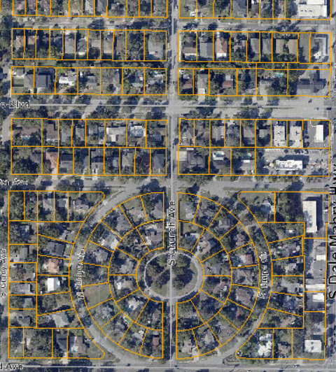
Department of Revenue Parcel Files
Name, Address, Legal Databases (NAL)
Representative of Land Ownership
Helpful fields
Structure Type
Construction
Value
Standard Format

Slide 9
Depth-to-Loss Ratio Table
European Commission Joint Research Centre Report
Average for Global Regions
North America
Canada
U.S.A
Calculates the average expected damage
Water Depth(m) | Damage Factor
0 | 0.2
0.5 | 0.44
1 | 0.58
1.5 | 0.68
2 | 0.78
3 | 0.85
4 | 0.92
5 | 0.96
6 | 1

Slide 10
Flood Risk Data Analysis
Elevation Raster
Parcel Data
Intersection
Parcel Data with Surge Height
Zonal Statistics
(Max)
SLOSH Output
Preprocessing
Damage Ratio Table
Calculate Surge Depth
Census Block Groups
Final Property Impact Database
Property Impact Level
Spatial Join

Slide 11
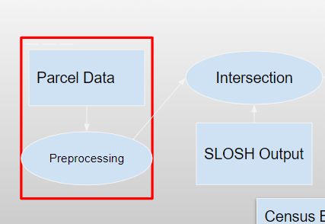
Parcel Data Preprocessing
Download Parcels
Union County Files
Assign a Unique ID
Map Complex Fields
Remove Extraneous Fields
Normalize the Parcel Database

Slide 12
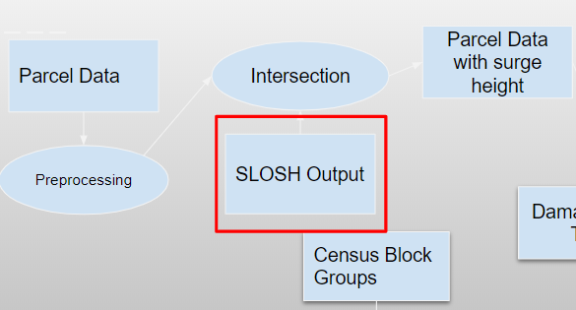
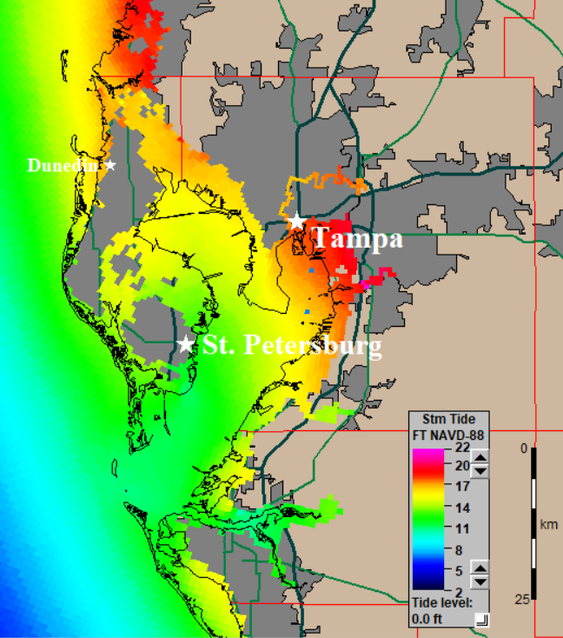
SLOSH Outputs
5 Model Run
Mean Tide Level
Category 1-5
Merge Outputs
Load to Postgres

Slide 13
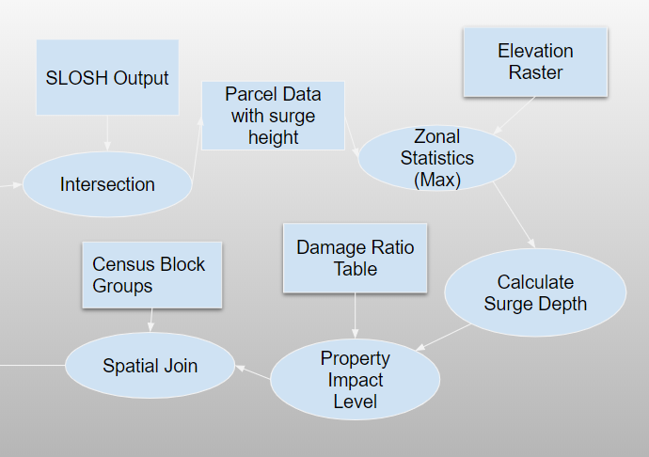
Spatial Analysis
Intersect for Raw Surge Height
Verify Location is Submerged
Increase Accuracy
Remove False Positives
Calculate Damage Level
Link to Demographics

Slide 14
Wind Risk Data
Analysis
Census Block Groups
WBD Region
Building Quality Table
Create Spatial Relationships
Census Blocks
Windborne Debris Region
Establish Building Quality
Establish Data in Final Table
Links to Flood Table
Spatial Join
Spatial Join
Spatial Join
Parcel Data
Final Wind Risk Database

Slide 15
Property Impact Database Analysis
Losses by Category
Income Level
Education Level
Race
Pinpoint Communities
Potential at Risk
Safe

Slide 16
Expected Results
Property Vulnerability Database
Actionable Database
Easily Updatable
Reproducible
Risk Correlation
Race
Income
Education

Slide 17
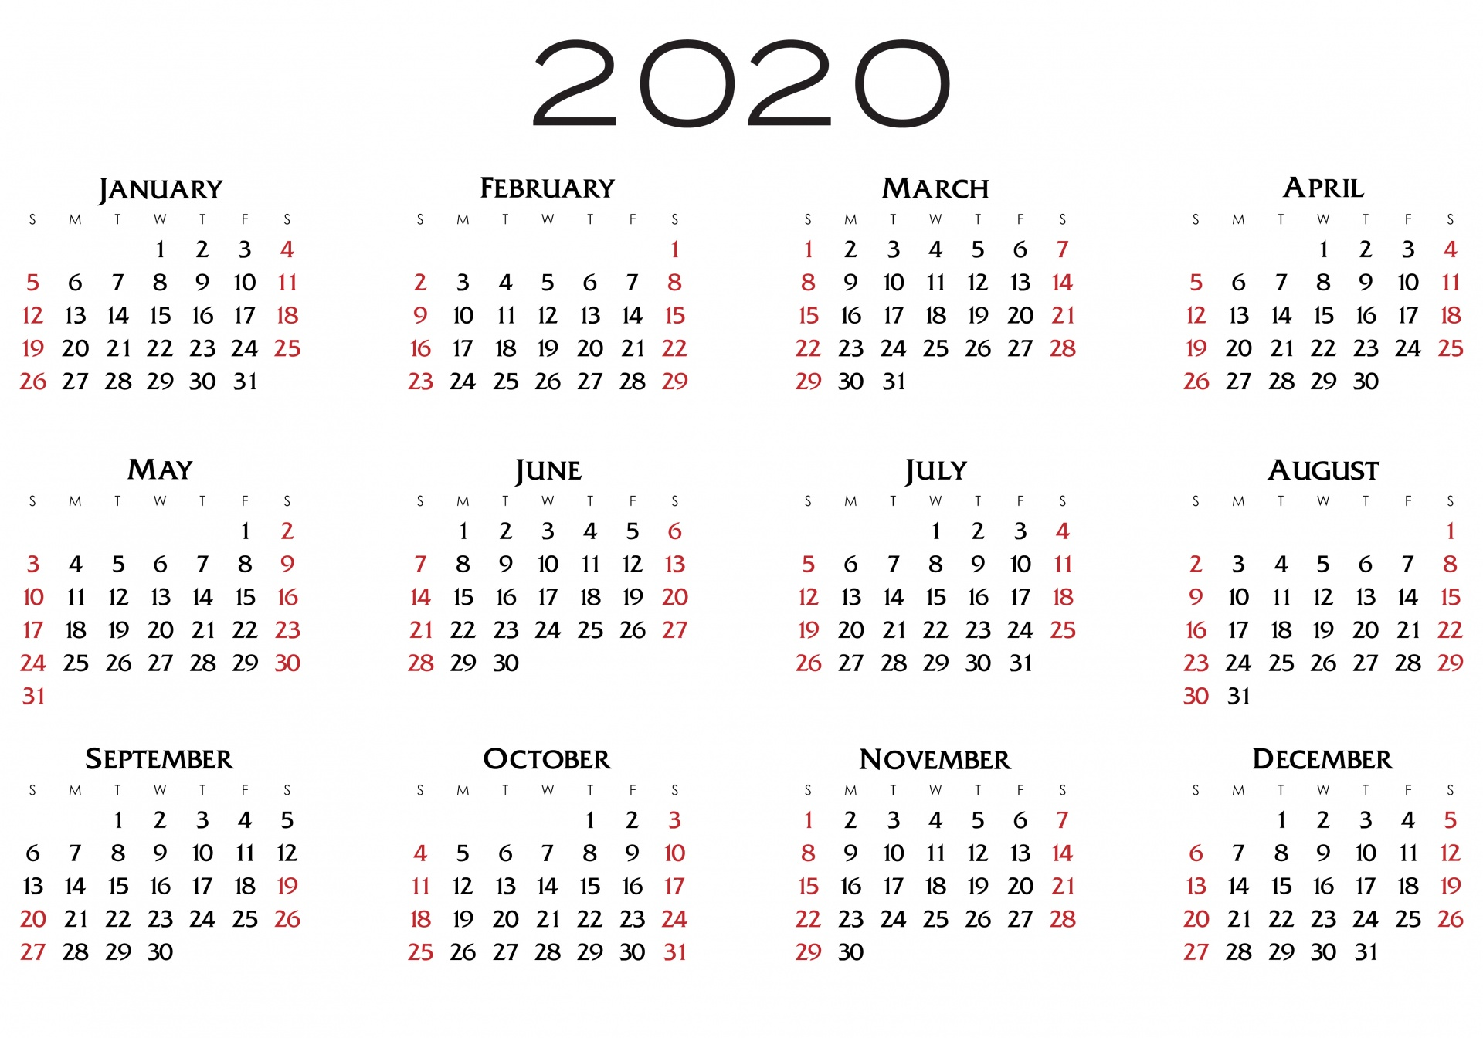
Project Timeline
May 2020
Download Data
Import
June-July 2020
Process Data
Analyze Results
August-September 2020
Prepare results for presentation
October 8th-10th- Presentation at GIS in the Rockies

Slide 18
Works Cited
Applied Research Associates, Inc., “2008 Florida Residential Wind Loss Mitigation Study” Florida Office of Insurance Regulation
Contract Number IR018, 2008. https://www.floir.com/siteDocuments/ARALossMitigationStudy.pdf retrieved April 2020.
Borden, K.A., Cutter, S.L. Spatial patterns of natural hazards mortality in the United States. Int J Health Geogr 7, 64 (2008).
https://doi.org/10.1186/1476-072X-7-64
Bouwer, Laurens M. “Have Disaster Losses Increased Due To Anthropogenic Climate Change?” Bulletin of the American Meteorological Society, 2011
v. 92 no. 1 pp. 39–46.
Cutter, Susan & Emrich, Chris. (2005). Are Natural Hazards and Disaster Losses in the U.S. Increasing?. Eos, Transactions American Geophysical Union.
86. 10.1029/2005EO410001.
Gabe, Thomas, et al. "Hurricane Katrina: Social-demographic characteristics of impacted areas." Washington, DC: Congressional Research Service,
Library of Congress, 2005
Green, R.D., Kouassi, M. & Mambo, B. Housing, Race, and Recovery from Hurricane Katrina. Rev Black Polit Econ 40, 145–163 (2013).
https://doi.org/10.1007/s12114-011-9116-0
Huizinga, J., de Moel, H., and Szewczyk, W.: Global flood depth-damage functions. Methodology and the database with guidelines, Technical Report
EUR 28552 EN, European Commission – Joint Research Centre, https://doi.org/10.2760/16510, 2017.
J.E. Minor, J.R. McDonald, K.C. Mehta, The tornado: an engineering-oriented perspective, National Oceanic and Atmospheric Administration Technical
Memorandum ERL NSSL-82, US Department of Commerce, 1977.
R.H. Simpson, H. Riehl. The Hurricane and its Impact. Louisiana State University Press, Baton Rouge (1981)
W.H. Gray, Likely increase in intense landfalling hurricanes in the coming decades, Paper presented at the 12th. Annual Hurricane Conference, Dallas,
TX, 1990.
Weinkle, J., Landsea, C., Collins, D. et al. Normalized hurricane damage in the continental United States 1900–2017. Nat Sustain 1, 808–813 (2018).

