Slide 1
Environmental Change & Impact Due to Marcellus Shale Well Pad Drilling:
Lycoming & Washington Counties, Pennsylvania
American Association of Geographers Annual Meeting
April 10, 2021
Keith Moodhe, MGIS Penn State Student
Advisor, Pat Kennelly
1
Notes:
Hello everyone, I am Keith Moodhe, a Masters in GIS student at Penn State and today I will be presenting the results of my capstone project:
“Environmental Change & Impact Due to Marcellus Shale Well Pad Drilling: Lycoming & Washington Counties, Pennsylvania.”
My advisor for this study is Patrick Kennelly.

Slide 2
Presentation Outline:
Goals/Objectives
Background
Study Area
Previous Studies
Data Sources
Methods
Results
Conclusion
2
Notes:
This presentation is organized into several sections shown here.
I will begin with the study’s goals and objectives and follow with short segments on the background, study area, and previous studies.
After touching on my data sources and general methodology, the main focus will be on the results of the study. Finally, I will wrap up with a summary of my findings and possible future work.

Slide 3
1. GOALS & OBJECTIVES
Determine change in land cover type and amount over time near well pads
Identify any correlations among geographical factors and well pad placement (i.e. slope, proximity to infrastructure, soil type)
Verify production per unit disturbed area on well pad has increased
3
Notes:
GOALS AND OBJECTIVES:
The main purpose of this study is to determine change in land cover type associated with petroleum wells, specifically Pennsylvania Marcellus shale gas wells, on multi-well pads.
I will quantify the amount of change by type and over the available data time period.
I am also investigating if there are any geographical factors that are influencing the placement of these well pads, such as slope, proximity to roads, and soil type.
Lastly, I will verify the natural gas production per unit of disturbed area has increased over the study area.

Slide 4
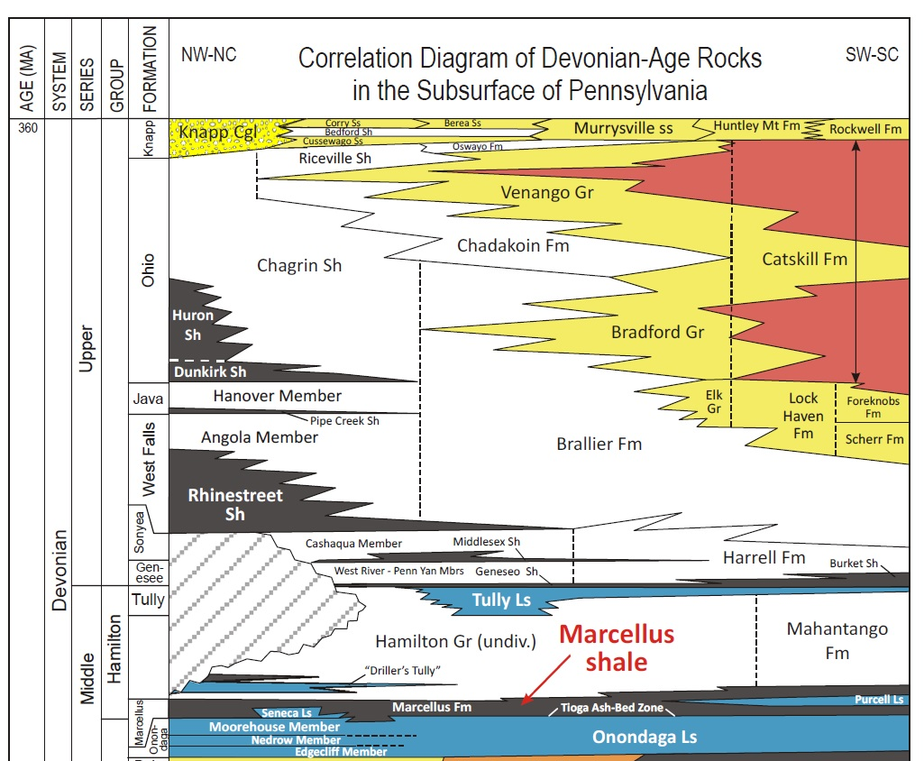
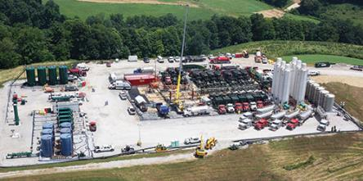
2. BACKGROUND
Marcellus Shale
Appalachian Basin
Middle Devonian marine black shale (interbedded limestone)
Source rock/reservoir, dry (methane) and wet (other liquid gases) natural gas produced
Shale/horizontal drilling began in 2005
Shift to multi-well pad drilling in 2008
Single well can produce over 10 billion cubic feet natural gas (plus other liquids) over lifetime (~30 years)
Source: DCNR 2010
Source: Pickett 2015
4
Notes:
BACKGROUND
The Marcellus Shale is a geologic formation found in the Appalachian Basin of the eastern United States, consisting mainly of marine black shale.
The Marcellus is both a source rock, producing hydrocarbons that migrate to other layers, as well as its own reservoir, containing vast amounts of natural gas and other liquid gases.
The reservoir gases are tightly held in the rock itself and were largely unattainable until the advent of hydraulic fracturing ( or artificially breaking the rock in situ with high pressure water and other material).
Beginning around 2005, this emerging and “unconventional” extraction technique coupled with the rise of horizontal drilling (which utilizes a long lateral portion of the well to increase contact with the producing formation), caused a great increase in well activity in parts of Pennsylvania.
In addition, by 2008, many well pads (which are the physical footprint area of the well) began to incorporate more than one well, due to the versatility of horizontal well drilling.
And for reference, a single well can produce over 10 billion cubic feet of natural gas over its lifetime.

Slide 5
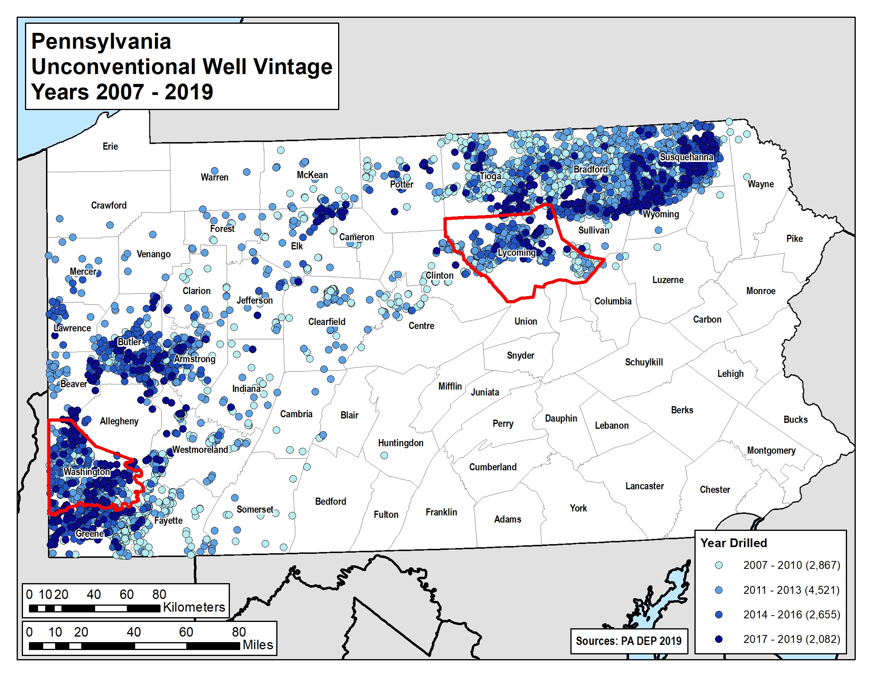
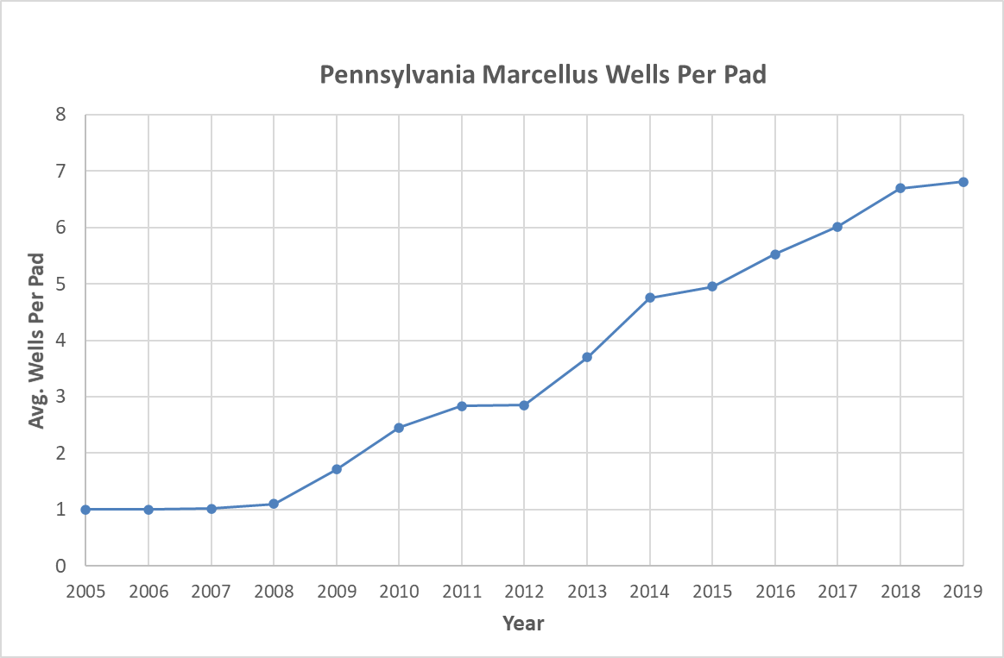
*12,000+ wells in PA since 2005
5
Notes:
The map on this slide shows the surface locations of over 12,000 unconventional Marcellus shale wells drilled in Pennsylvania from 2005 to 2019, the last complete year of records at the time of this study.
Wells are colored by vintage, with lighter blues for 2010 and older wells, and increasingly darker blues for more recent wells.
Most wells are located in the southwestern and northeastern portion of the state due to more favorable depth, thickness, and maturity of the rock.
For my analysis, I chose to focus on a single county in each of these regions, Washington County in the southwest and Lycoming County in the northeast, which I will discuss on the next slide.
Finally, this graph of the average wells per pad over time demonstrates the shift in well pad drilling, from single well pads in the early years to an average of over 7 wells per pad in 2019.

Slide 6
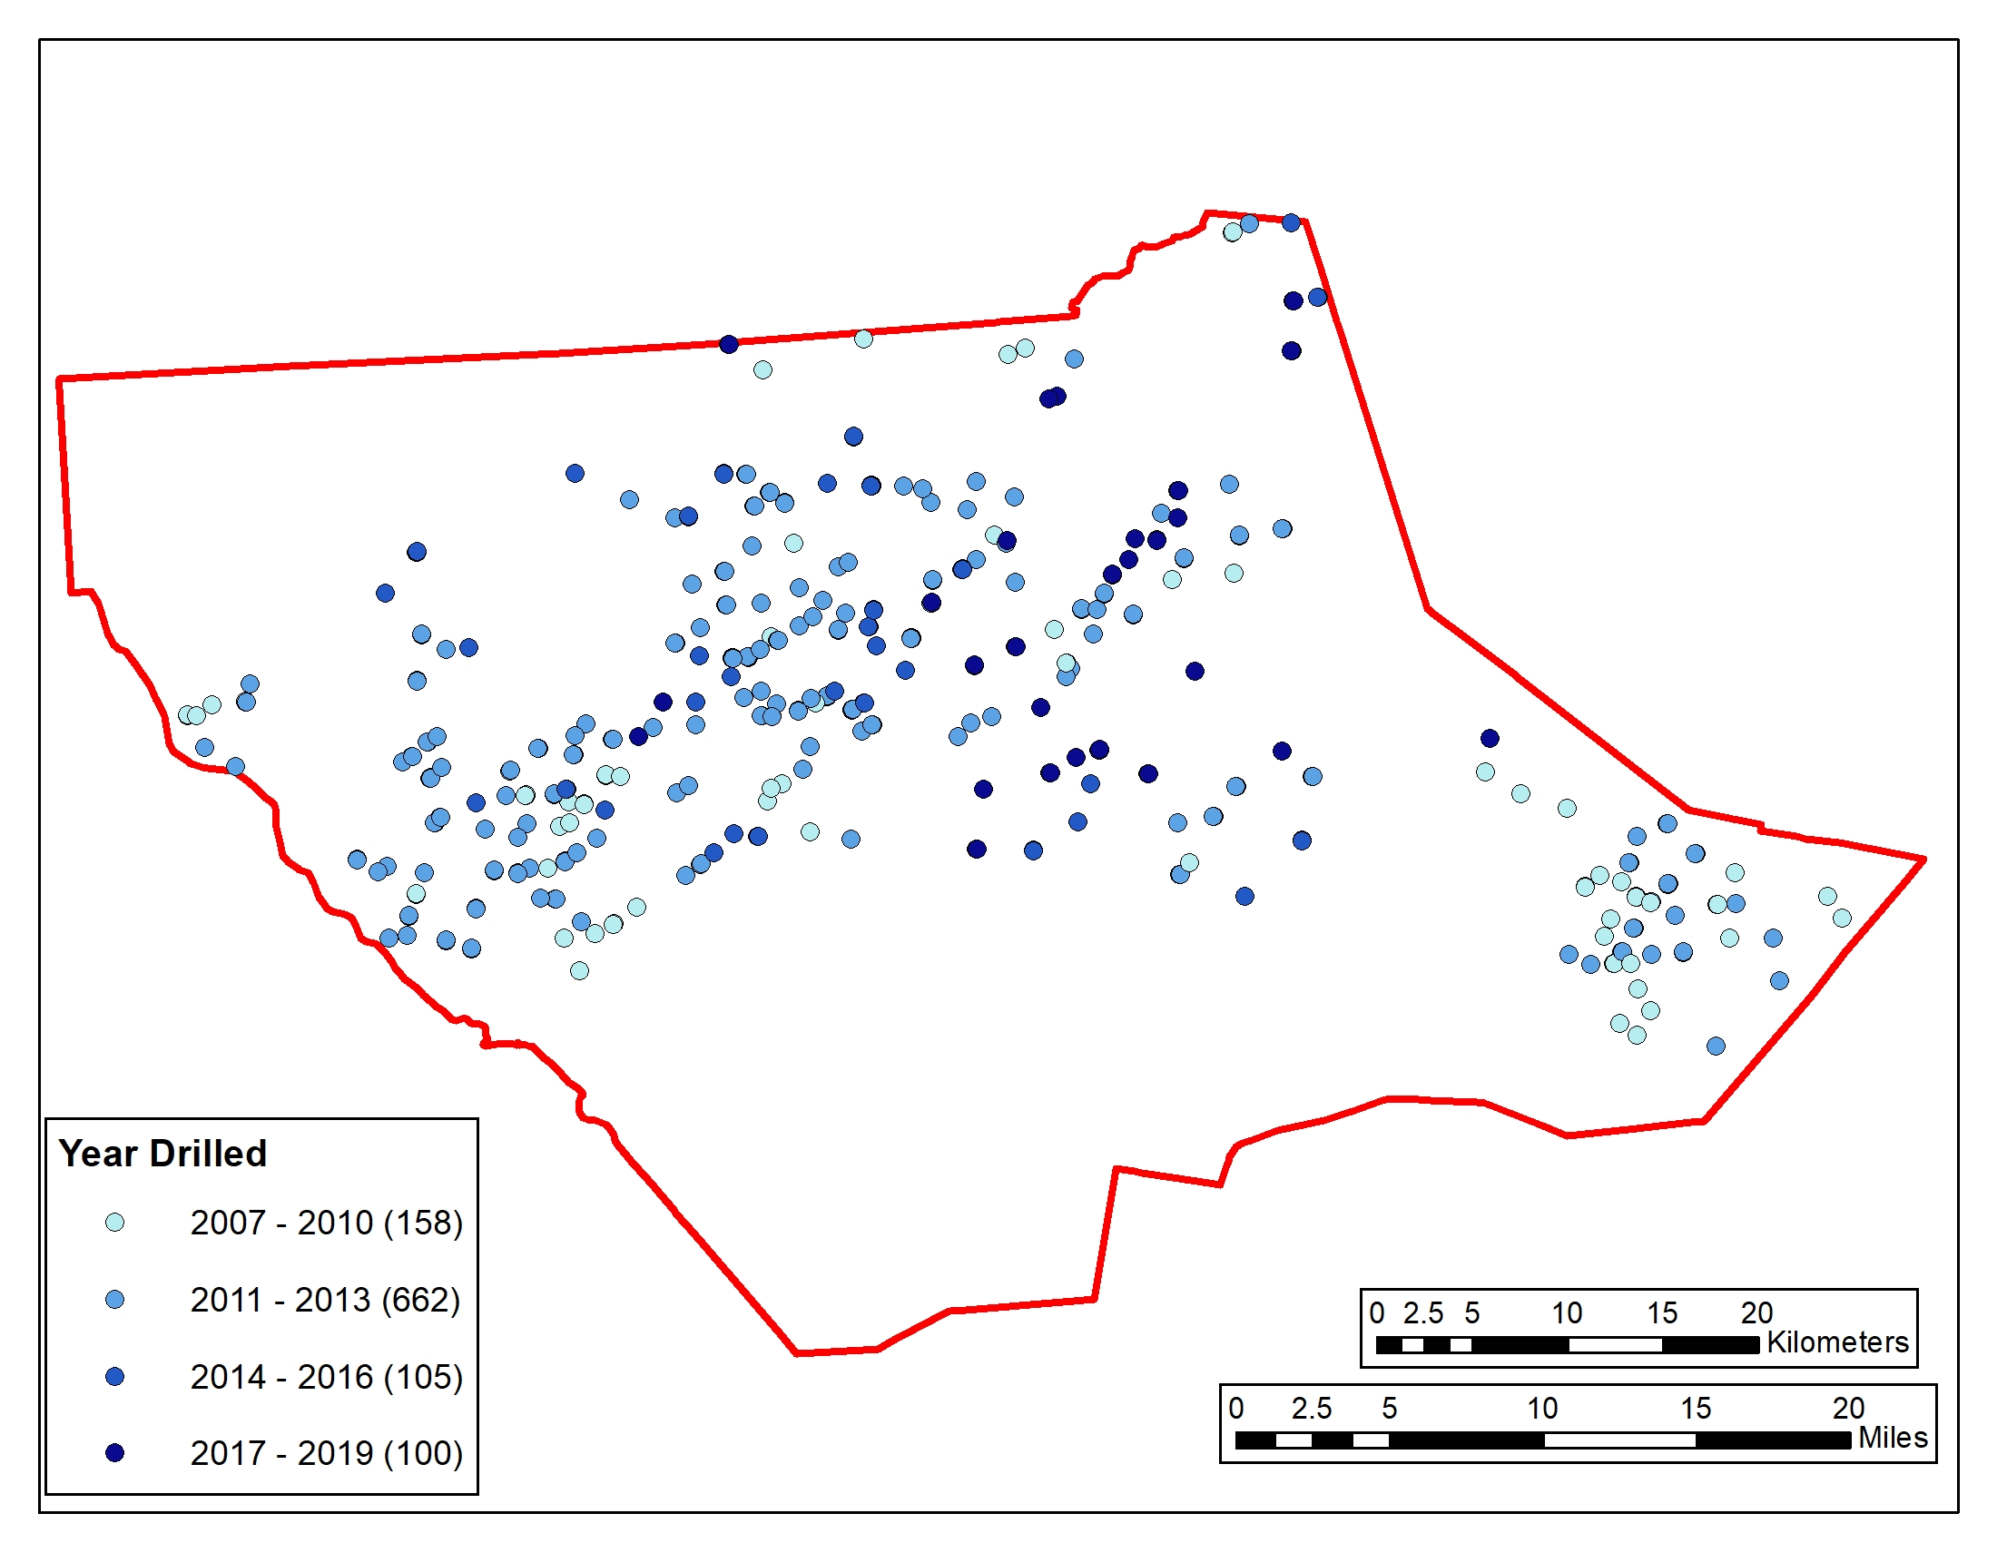
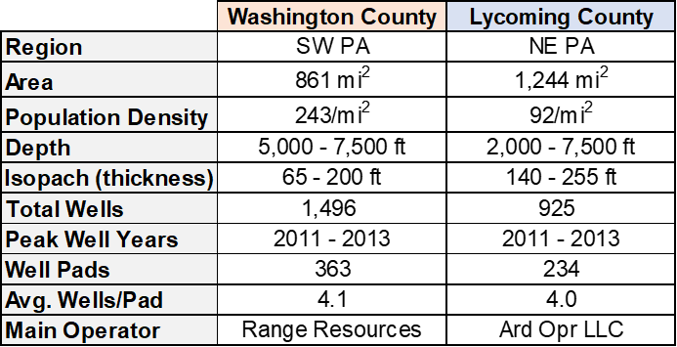
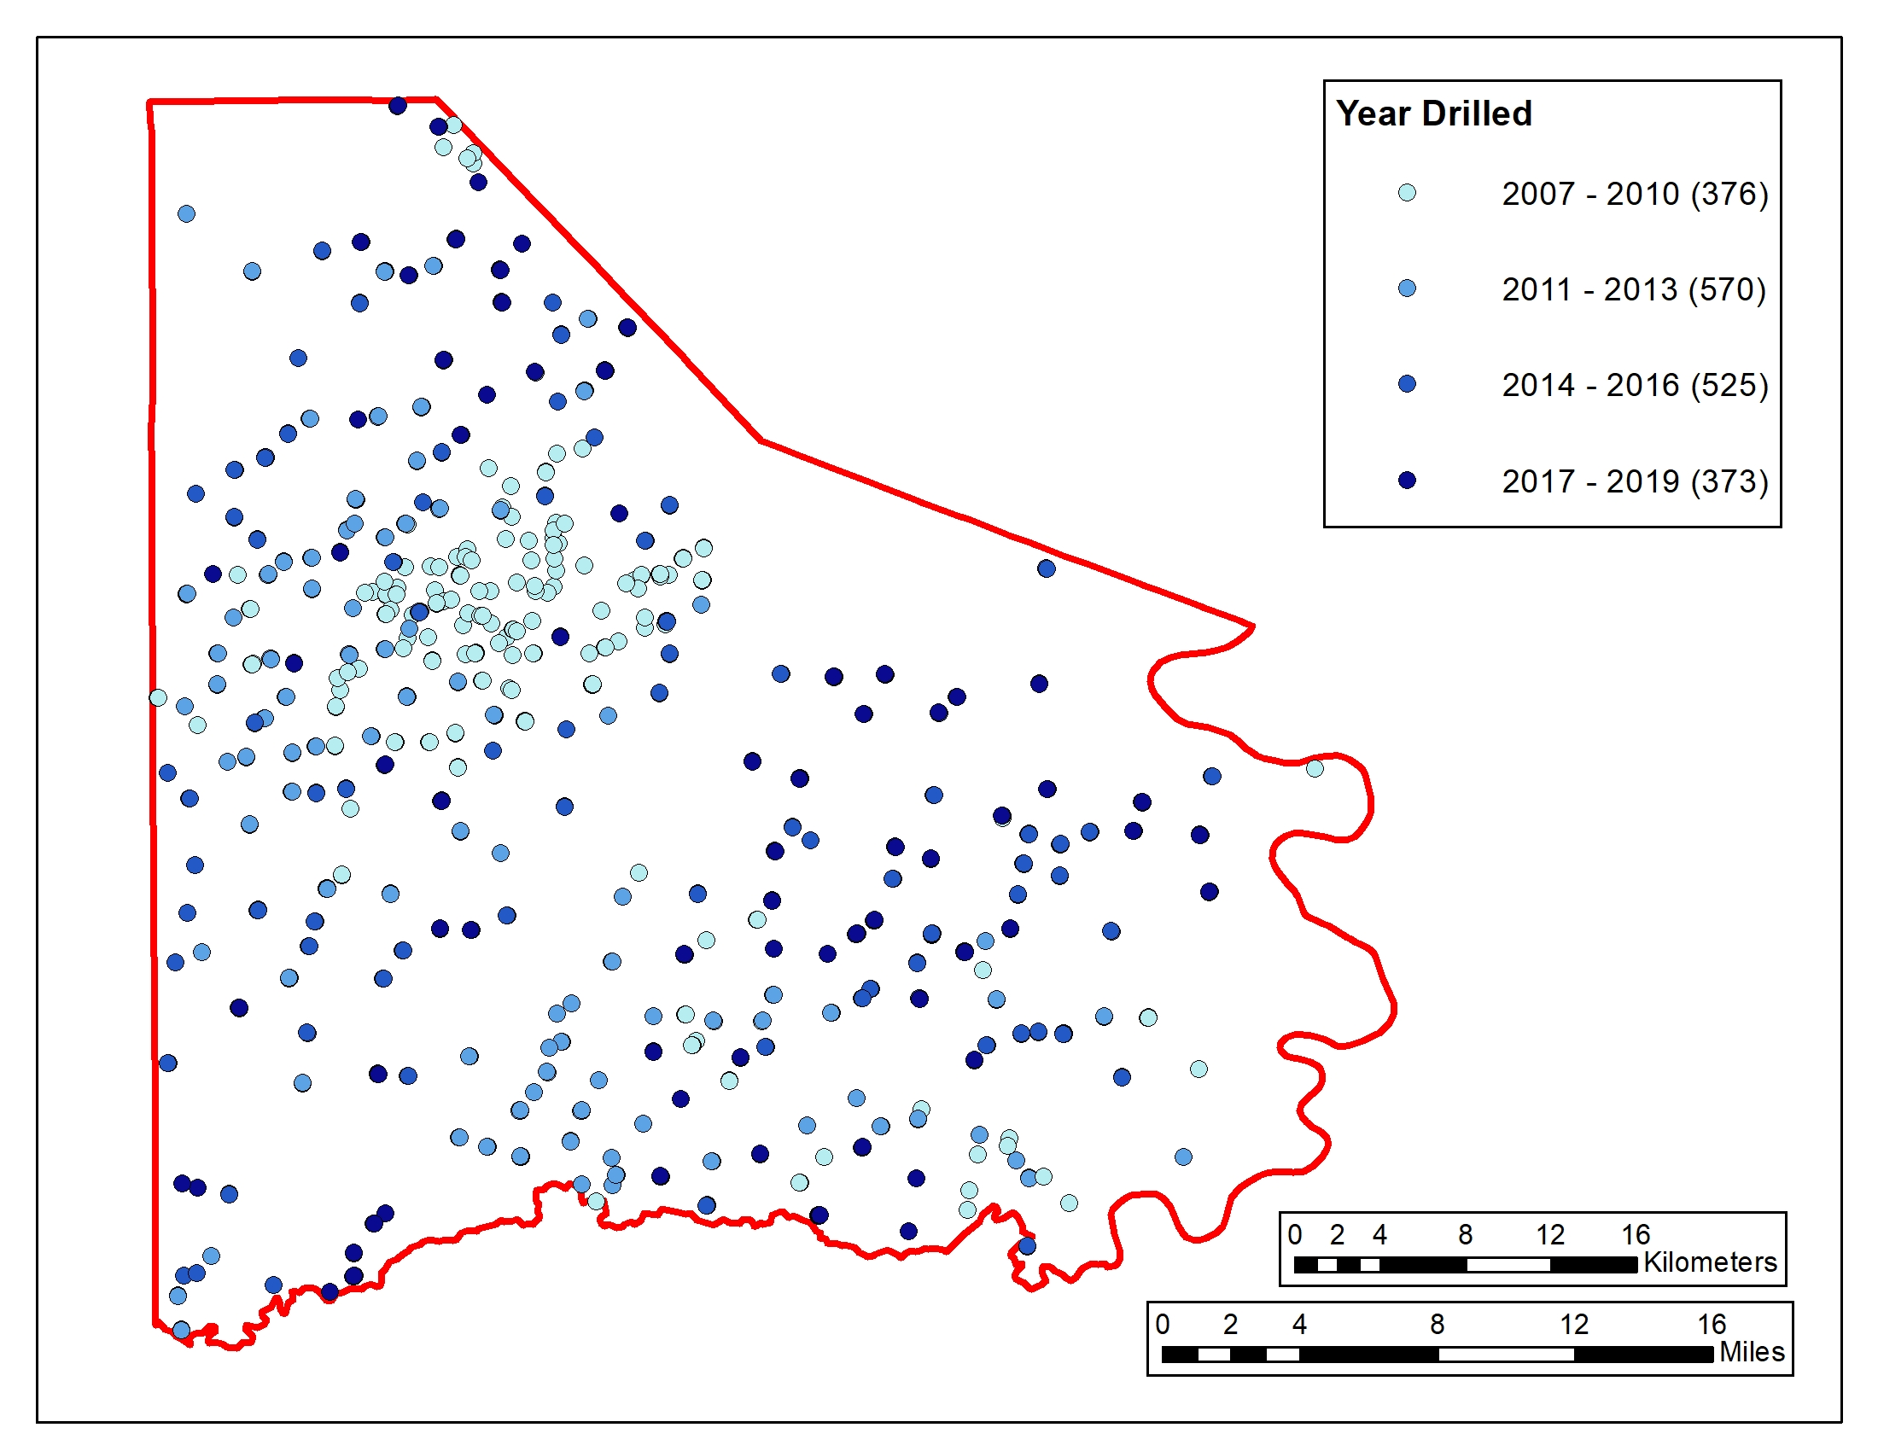
LYCOMING COUNTY
3. STUDY AREA
Marcellus Shale Play = 58,000 mi² (24,000 mi² in PA)
WASHINGTON
COUNTY
6
Notes:
STUDY AREA
This slide briefly summarizes some key details of the two study areas, along with reference maps for both Lycoming and Washington county.
I chose these two counties for both their similarities and differences. Both counties include wells from nearly all vintages, thus giving a full snapshot of the development of the Marcellus shale over time.
Activity peaked in both regions during 2011-2013 and the average wells per pad is similar (at 4.1 vs 4.0).
Conversely, Lycoming is more rural overall compared to the more developed Washington County and I was interested in how this could affect land cover change.

Slide 7
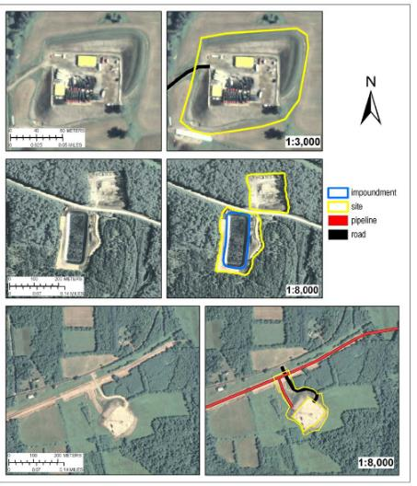
4. PREVIOUS STUDIES
Landscape disturbance from aerial imagery in Bradford/Washington Counties, PA (Slonecker et al. 2012)
Habitat and aquatic species effects due to Marcellus drilling (Keller et al. 2017)
Quantifying land cover change in the Haynesville Shale (Unger et al. 2015)
Slonecker et al. 2012
7
Notes:
PREVIOUS STUDIES
Before beginning my analysis, I researched several existing studies that focused on either land cover change and/or the effects of Marcellus drilling.
A few are highlighted here, including a study by Slonecker et al in 2012 that utilized aerial imagery in Bradford and Washington counties to identify disturbance. Digitization and feature extraction was performed on oil and gas disturbed areas from 2004 to 2010, some example maps are depicted in the figures at right.
Additional work by Keller et al in 2017 studied the effects of well pad densities on aquatic species populations, generally finding little to no impact as pads were typically placed far from water sources.
A third study by Unger et al 2015 utilized Landsat data to track land changes in the Haynesville Shale gas field across Louisiana and Texas for six vintages between 1984 and 2011, finding well pad areas were highly fragmented.

Slide 8
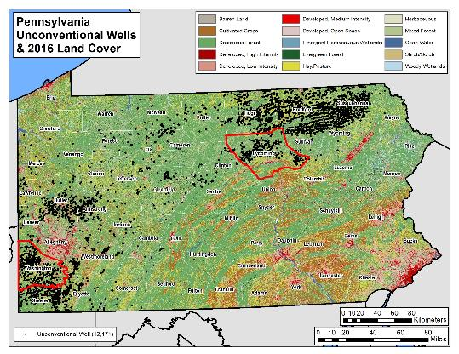
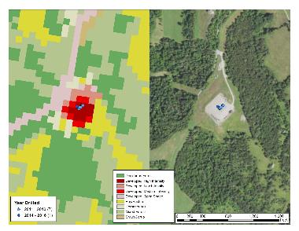
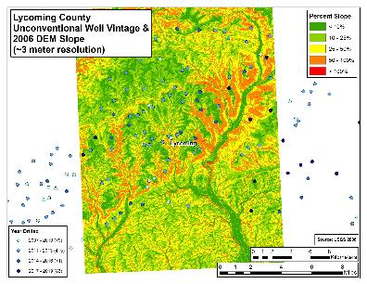
5. DATA SOURCES
Unconventional well data (PA Department of Environmental Protection)
Digital elevation model data (USGS)
Land cover/land use data (National Land Cover Database)
Aerial imagery (NAIP)
Soil survey (USDA)
Roads (Penn DOT)
*LIMITATIONS
Lack of high-res (1 m) and recent LiDAR data in Washington County (3 m still adequate)
Land Cover data only through 2016 (30 meter), but have multiple prior years
8
Notes:
DATA SOURCES:
This project incorporated various free and public online data sources that were processed using ArcGIS and Microsoft Excel and Access software.
The unconventional well and pad location and production data was accessed via the Pennsylvania Department of Environmental Protection.
Digital elevation models through the United States Geological Survey.
Land cover/land use data was extracted for 5 vintages from 2004 through 2016 from the National Land Cover Database.
Aerial imagery via the National Agriculture Imagery Program.
Soil survey data through the United States Department of Agriculture.
And state and local roads data from the Pennsylvania Department of Transportation.

Slide 9
6. METHODS
Subset Data
Quantify Land Change
Calculate land cover area changes by category for each time interval
Analyze Correlations
Identify trends over time between both counties
Compare geographic factors (proximity to slope, roads, soils)
Production
Buffer well pad area (150 meters)
Compute production at well pad
Clip land cover and other datasets to well pad areas
Calculate production efficiency per unit disturbed area
Determine average disturbed area
9
Notes:
METHODS:
This flow chart summarizes the methodology in achieving my objectives.
After downloading and preparing my spatial and tabular data, I began buffering the well pad point locations to 150 meters. This distance was selected based on data observation, essentially the typical maximum extent of a wellpad’s footprint over the surrounding area.
I then used these polygons to clip the landcover and other datasets.
Next, I calculated change by landcover category and over time.
I continued my analysis in determining if any geographic factor correlations and trends were present.
Lastly, I calculated the average production at the well pad and per unit disturbed area.

Slide 10
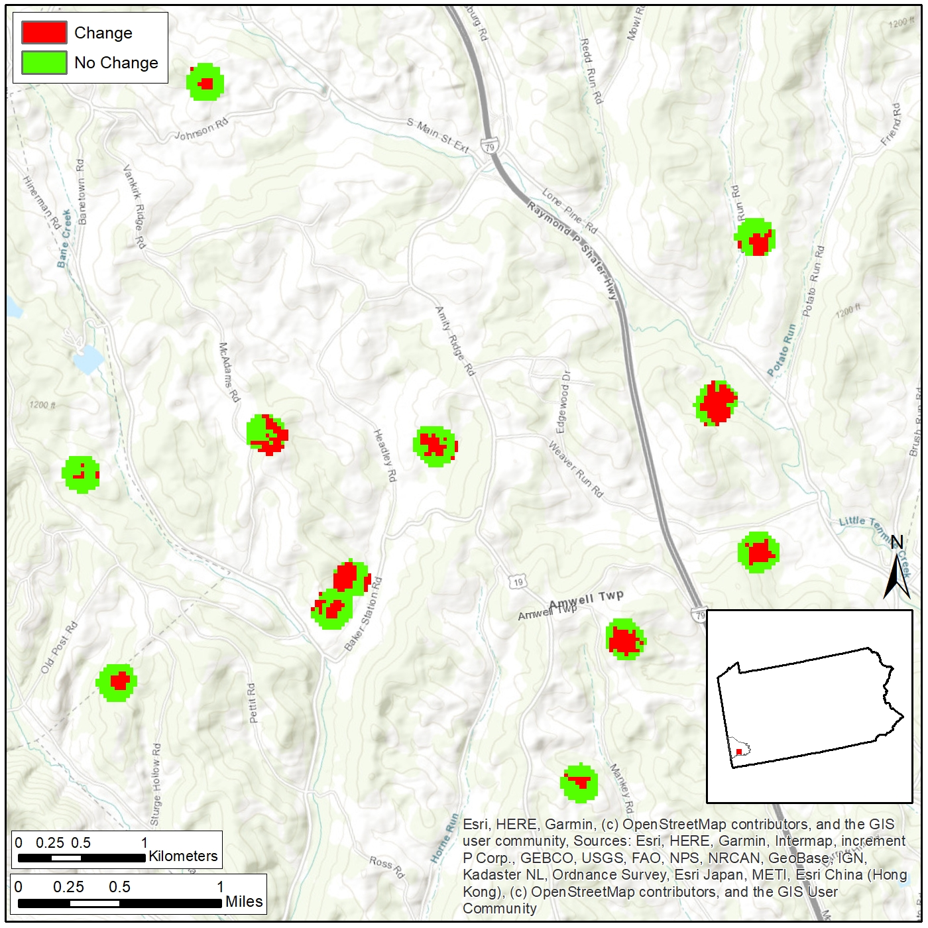
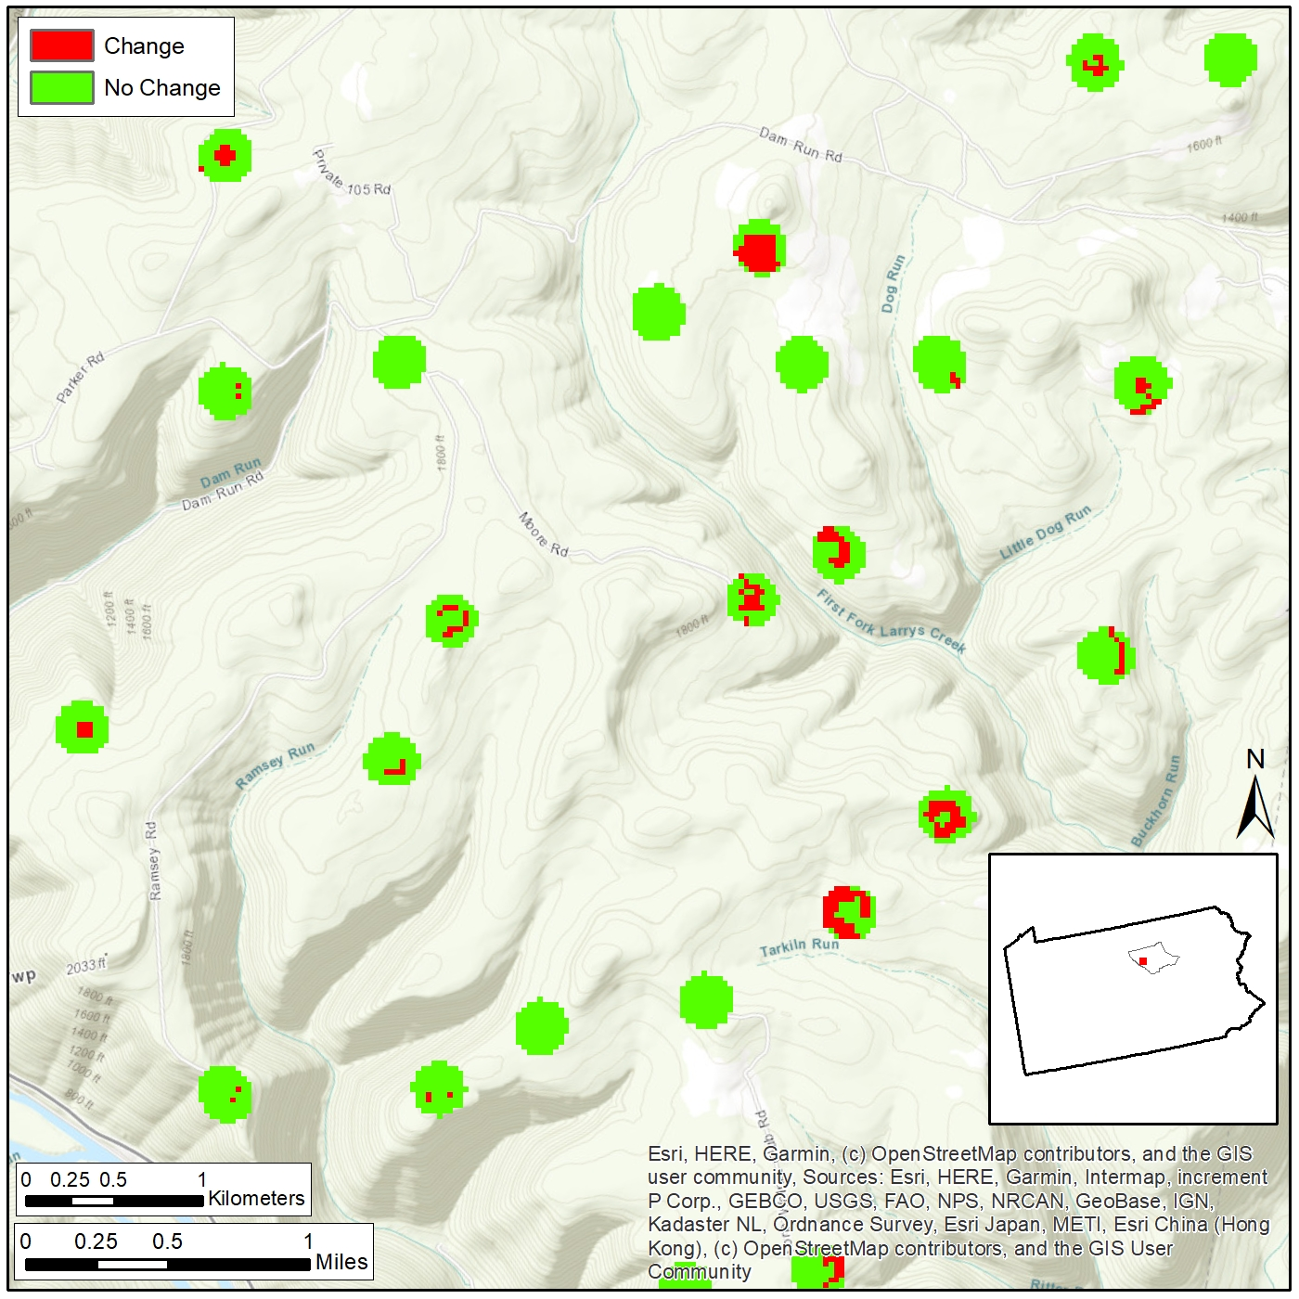
7. RESULTS: 2004-2016 Well Pad Land Cover Change
Washington County
Lycoming County
*Existing developed land
11
Notes:
RESULTS:
Due to the well pad areas being quite small in relation to the extent of the counties themselves, I am showing example areas on the two county maps here to illustrate my findings.
The map on the left shows a typical area in Washington County where the circular areas depict the well pad and buffer. Green areas show no change in land cover type from 2004 to 2016 while red areas indicate a change, usually from non-developed to developed class.
As expected, the highest amount of change is generally concentrated in the center of the pad.
The map on the right shows an area in Lycoming County at the same scale. While most pads showed some change over the study interval, a significant portion had very little to no change.
Surprisingly, it was found that most of these areas were already developed in some form.

Slide 11
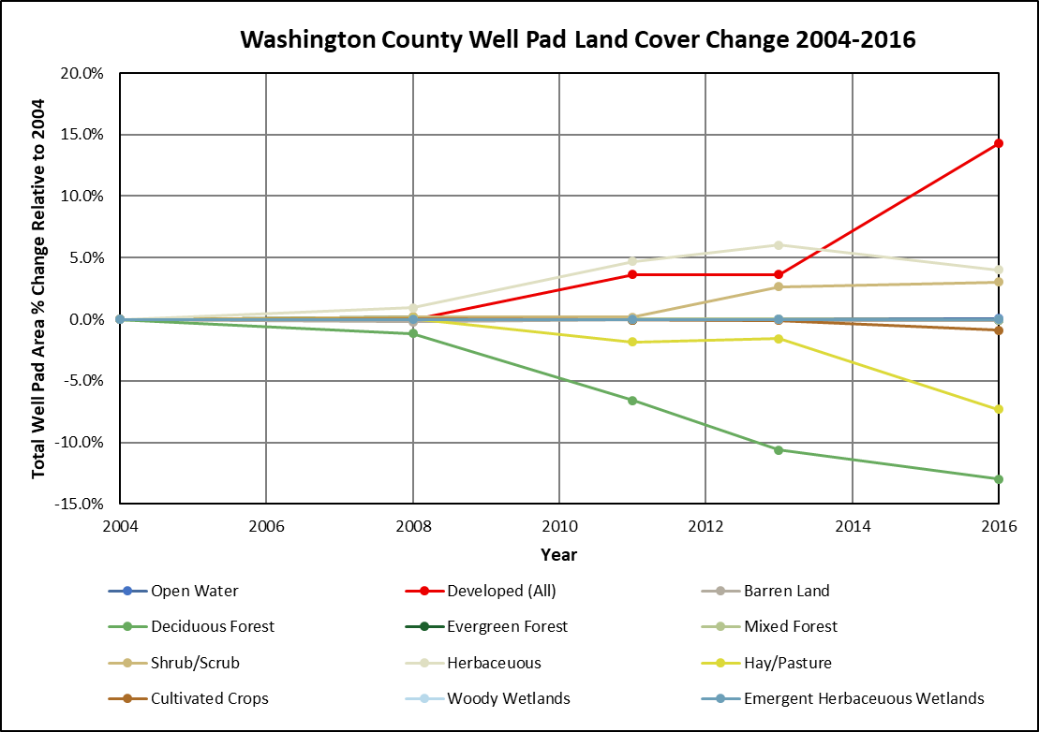
Washington Well Pad Land Cover Change 2004 - 2016
Total Well Pad Area = 27.6 km²
Increase:
Developed (All) +14.3% (+3.9 km²)
Herbaceous +4.0% (+1.1 km²)
Shrub +3.0% (+0.8 km²)
Decrease:
Deciduous Forest -13.0% (-3.6 km²)
Hay/Pasture -7.3% (-2.0 km²)
*Well pad area = 150m buffer around well(s) surface location(s)
11
Notes:
This slide depicts the well pad land cover change I calculated for Washington County, for the available data years 2004 to 2016.
In all, buffered well pad areas totaled 27.6 square kilometers from 363 well pads and 1,496 wells.
The greatest positive land cover type change was that of developed land at 14.3% increase in total well pad area.
The greatest negative land cover type change was that of deciduous forest and hay/pasture, at a loss of 13.0 and 7.3%, respectively.

Slide 12
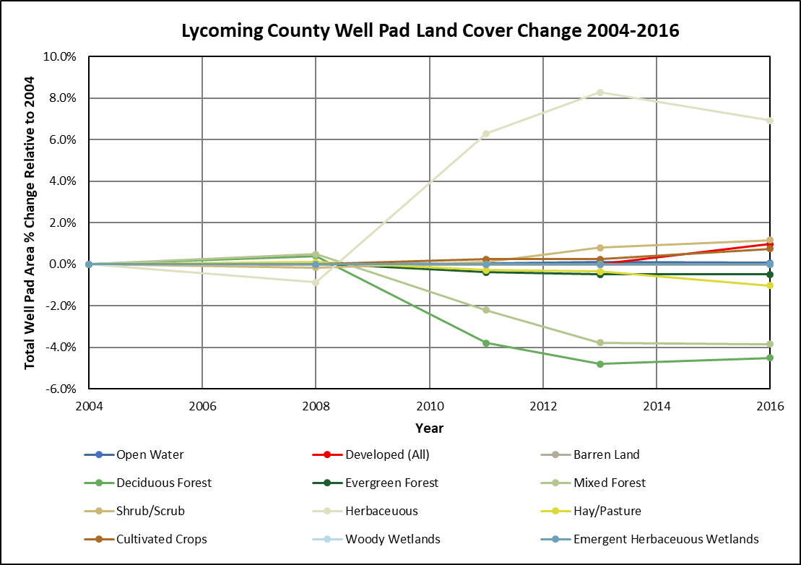
Lycoming Well Pad Land Cover Change 2004 - 2016
Total Well Pad Area = 17.8 km²
Increase:
Herbaceous +6.9% (+1.2 km²)
Decrease:
Deciduous Forest -4.5% (-0.8 km²)
Mixed Forest -3.8% (-0.7 km²)
Developed (All) increased just 1.0% (0.2 km²)
*Well pad area = 150m buffer around well(s) surface location(s)
12
Notes:
This slide depicts the well pad land cover change I calculated for Lycoming County for the available data years 2004 to 2016.
In all, buffered well pad areas totaled 17.8 square kilometers from 234 well pads and 925 wells.
The greatest positive land cover type change was that of herbaceous land at 6.9% increase in total well pad area.
The greatest negative land cover type change was that of deciduous forest and mixed forest at a loss of 4.5 and 3.8%, respectively.
Note that developed land of any type only increased 1.0%, or just 0.2 square kilometers.

Slide 13
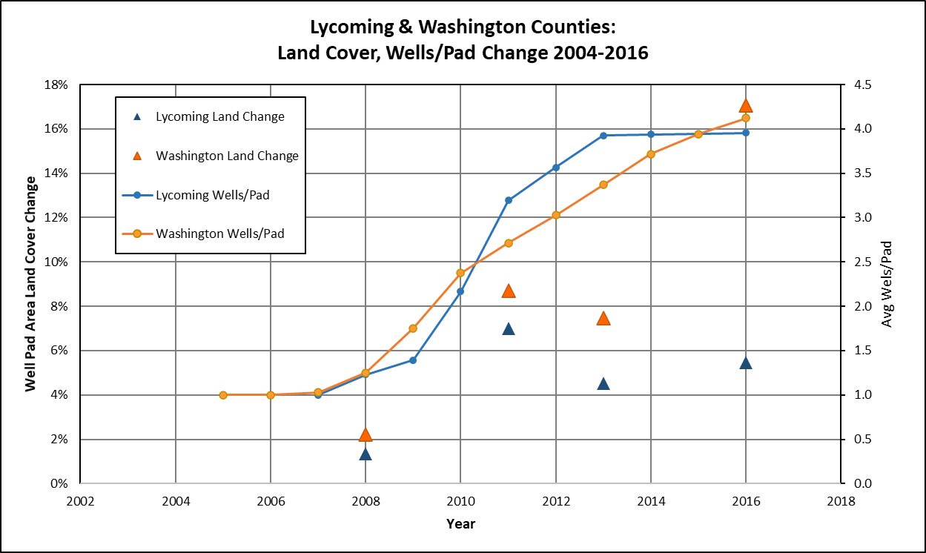
13
Notes:
This chart shows the land over change percentage for each assessed year as large blue triangles for Lycoming County and large orange triangles for Washington County.
The annual average wells per pad are shown as light blue and light oranges lines, respectively.
Lycoming County shows a moderate increase in land cover change in 2011 at 7% and just over 3 wells per pad , then flattens out to 5% change even though wells per pad increased to almost 4.
Washington County has a similar increase/plateau trend except land cover change jumps to 17% in 2016, though not as many wells were drilled this year.

Slide 14
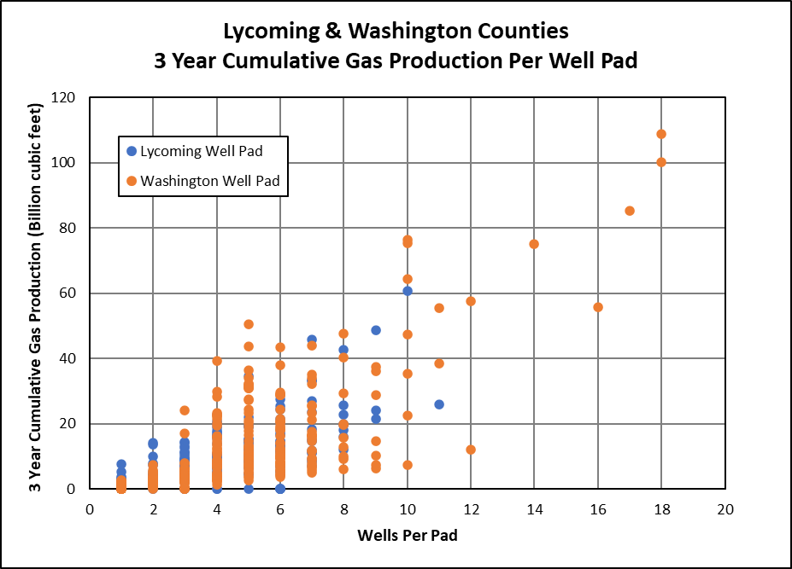
Lycoming/Washington 3 Year Cumulative Gas Production
Per Well Pad
Lycoming
9.4 Bcf/pad
3.95 wells/pad
Washington
11.1 Bcf/pad
4.12 wells/pad
Approximate full well life production (~3x to 5x)
*Bcf = billion cubic feet
14
Notes:
This chart shows the relationship between wells per pad on the x-axis with the 3-year cumulative gas production on the y-axis.
The 3 year cum of production per well was used to normalize production from both older and newer wells and can be used as a general indicator of the life of the well. After 20-30 years, the well may produce 3 to 5 times this amount.
Both counties clearly show an increase in production as wells per pad increases.
Both counties average around 4 wells per pad across all years, with Washington County having slightly higher production per pad at 11.1 vs 9.4 billion cubic feet.

Slide 15
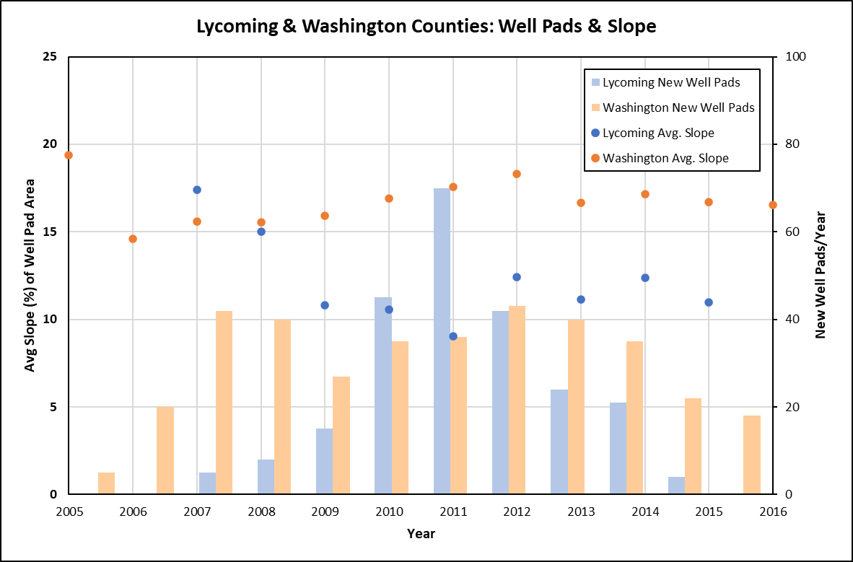
Slope: Lycoming & Washington Well Pads
Slight decrease in well pad slope over time in Lycoming County
15
Notes:
SLOPE:
In addition to land cover change and production, I also investigated if there were any geographic trends in the placement of wells and well pads.
This chart shows time in years on the x-axis with the average slope (in percent) of the well pad terrain on the left primary y-axis. The number of new well pads drilled each year are displayed on the right secondary y-axis as orange and blue columns.
Washington County well pad slopes, presented as orange circles, show no real significant change in slope, hovering between 15 and 19%.
Lycoming County well pad slopes, presented as blue circles, appear to show a slight decrease in slope from 17% in 2007 to just over 10% by 2015.

Slide 16
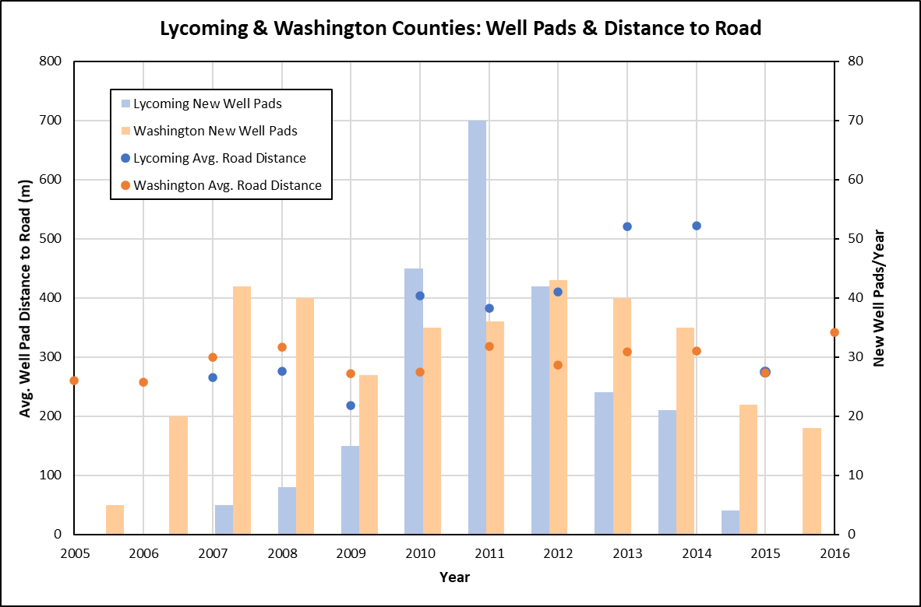
Road Proximity: Lycoming & Washington Well Pads
Slightly more remote wells over time in Lycoming County
16
Notes:
ROAD PROXIMITY:
This chart shows time in years on the x-axis with the average distance (in meters) of the well pad center to the nearest road on the left primary y-axis. The number of new well pads drilled each year are displayed on the right secondary y-axis as orange and blue columns.
Washington County road distances, presented as orange circles, show no real significant change in proximity, averaging between 250 to 350 meters.
Lycoming County road distances, presented as blue circles, do show an increase in distance from less than 300 meters prior to 2010 to just over 500 meters by 2014.

Slide 17
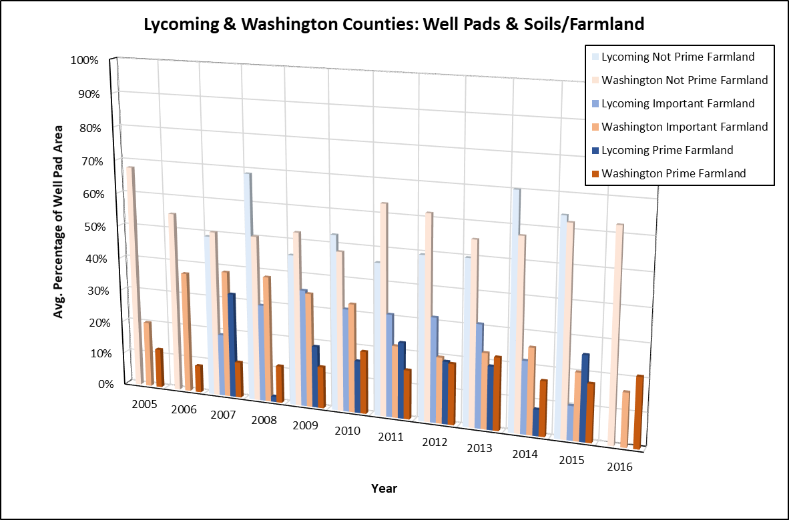
Soils & Farmland: Lycoming & Washington Well Pads
No strong correlations with well pads targeting/ avoiding soil types
17
Notes:
SOILS & FARMLAND:
While not the primary focus of my study, I did look at soil survey data at well pad locations to determine if any trends were present, such as if operators were avoiding or targeting specific types.
Due to the complexity and multitude of soil types, I chose to analyze them in terms of their farmland favorability, an attribute provided in the source dataset.
Non-prime farmland is depicted as pale blue and orange columns for Lycoming and Washington counties respectively, while increasingly bolder hues show important farmland and then prime farmland. The area percentage of these types are shown on the y-axis.
Across all years, most of the well pad areas in both counties had been classified as non-prime farmland, and there appears to be no strong correlation over time.

Slide 18
8. CONCLUSION
Both counties lost forest, gained developed/herbaceous land
Change per unit production is mitigated with pad drilling – need less surface disturbance for increased production
Lycoming: Multi-well pad = 1,009 Bcf/km² land change
1st well on pad = 241 Bcf/km² land change
Washington: Multi-well pad = 631 Bcf/km² land change
1st well on pad = 124 Bcf/km² land change
Wells have also become more productive over time (longer laterals, better completion techniques)
Geologic and operator/lease differences
Application of methods statewide and compare to future land cover assessments
18
Notes:
CONCLUSION:
Based on the results of my land cover analysis, both Lycoming and Washington counties lost forest land in and around well pads while gaining developed and herbaceous land cover.
However, the land change per unit production has been mitigated with pad drilling as less surface is disturbed by drilling many wells on the same pad versus multiple separate pads.
Ultimately, in Lycoming County over 1,000 billion cubic feet of gas was produced from 3-year totals of multi-well pads per square kilometer of land change. The total production for just the first well on the pad would only amount to 241 bcf so more resource was able to be extracted without disturbing additional land in the form of more well pads.
A similar result is shown in Washington County, though at lower ratios, with a well pad average of 631 bcf per square kilometer versus a single well at 124 bcf.
It should be noted that wells have generally become more productive over time, with longer laterals and better completion techniques.
There are also differences in geology and operators and leases across the study area which can affect production and well pad placement, though this is beyond the scope of this project.
Still, the application of these analysis methods could be applied to the rest of the state (or other states) and also compared to future land cover assessments.

Slide 19
REFERENCES
Abramov, A. (2019). Optimization of well pad design and drilling – well clustering. Petroleum Exploration and Development. Retrieved on March 13, 2020 from: https://www.sciencedirect.com/science/article/pii/S1876380419600418.
Arthur, D. and Cornue, D. (2010). Technologies reduce pad size, waste. The American Oil & Gas Reporter. Retrieved on March 13, 2020 from http://www.all-llc.com/publicdownloads/AOGR-0810ALLConsulting.pdf.
Brasier, K. et al. (2014). The Marcellus Shale Impacts Study: Chronicling Social and Economic Change in North Central and Southwest Pennsylvania. The Center for Rural Pennsylvania. Retrieved on March 24, 2020 from https://www.rural.palegislature.us/documents/reports/The-Marcellus-Shale-Impacts-Study.pdf.
DOE (n.d.). Footprint Reduction. U.S. Department of Energy Office of Oil & Natural Gas. Retrieved on March 13, 2020 from: https://www.energy.gov/sites/prod/files/2016/08/f33/Footprint%20Reduction.pdf.
EIA (2016a). Appalachian Basin Map Data: Marcellus play boundaries, structure and isopachs. U.S. Energy Information Administration. Retrieved on March 25, 2020 from https://www.eia.gov/maps/map_data/Marcellus_Play_Boundary_Elevation_Isopach_EIA.zip.
EIA (2017). Marcellus Shale Play: Geology Review. U.S. Energy Information Administration. Retrieved on March 19, 2020 from: https://www.eia.gov/maps/pdf/MarcellusPlayUpdate_Jan2017.pdf.
Frazier, R. (2018). Bringing the forest back after shale gas. The Allegheny Front. Retrieved on March 25, 2020 from https://www.alleghenyfront.org/restoring-well-pad-pa/.
Gant (2011). Multi-Well pads in the Marcellus Shale. Gant News. Retrieved on March 19, 2020 from https://gantdaily.com/2011/10/24/multi-well-pads-in-the-marcellus-shale/.
Hanson, L., Habicht, S., Faeth, P. (2016). Potential Environmental Impacts of Full-development of the Marcellus Shale in Pennsylvania. CNA. Retrieved on March 25, 2020 from https://www.cna.org/cna_files/pdf/MarcellusPA_FullReport.pdf.
Jantz, C.A., Kubach, H.K., Ward, J.R., Wiley, S., Heston, D. (2014). Assessing Land Use Changes Due to Natural Gas Drilling Operations in the Marcellus Shale in Bradford County, PA. The Geographic Bulletin. Retrieved on March 22, 2020 from https://www.semanticscholar.org/paper/Assessing-Land-Use-Changes-Due-to-Natural-Gas-in-in-Jantz-Kubach/a5c01956580edb886d7cf7f14e65b7e75e8fd4d9#paper-header.
Jones, N. et al. (2015). The energy footprint: How oil, natural gas, and wind energy affect land for biodiversity and the flow of ecosystem services. BioScience. Retrieved on March 13, 2020 from https://academic.oup.com/bioscience/article/65/3/290/236920.
Keller, D.H., Horwitz, R.J., Mead, J.V., Belton, T.J. (2017). Natural gas drilling in the Marcellus Shale region: well pad densities and aquatic communities. Hydrobiologia. Retrieved on March 24, 2020 from https://www.researchgate.net/publication/313538232_Natural_gas_drilling_in_the_Marcellus_Shale_region_well_pad_densities_and_aquatic_communities.
19

Slide 20
REFERENCES (Cont’d)
Litvak, A. (2018). These days, oil and gas companies are supersizing their well pads. Pittsburgh Post-Gazette. Retrieved on March 19, 2020 from: https://www.post-gazette.com/business/powersource/2018/01/15/These-days-oil-and-gas-companies-are-super-sizing-their-well-pads/stories/201801140023.
Marcellus Drilling News (2018). Supersize Me! Marcellus/Utica Well Pads Now Host Up to 40 Wells. Retrieved on March 26, 2020 from https://marcellusdrilling.com/2018/01/supersize-me-marcellus-utica-well-pads-now-host-up-to-40-wells/.
McLean, C. (2019). Smaller pad sizes driving lower Haynesville rig efficiency. BTU Analytics. Retrieved on March 13, 2020 from: https://btuanalytics.com/smaller-pad-sizes-driving-lower-haynesville-rig-efficiency/.
NAIP (2020). NAIP ArcGIS REST Services. Retrieved on March 19, 2020 from: https://gis.apfo.usda.gov/arcgis/rest/services.
NLCD (2011). National Land Cover Database. U. S. Geological Survey (amended 2014). National Geospatial Data Asset (NGDA). Retrieved on March 24, 2020 from http://www.pasda.psu.edu/uci/DataSummary.aspx?dataset=3141.
Nunez, C. (2020). How has fracking changed our future? National Geographic. Retrieved on March 13, 2020 from https://www.nationalgeographic.com/environment/energy/great-energy-challenge/big-energy-question/how-has-fracking-changed-our-future.html.
Pickett, A. (2015). Leading Operators Improve Efficiency and Effectiveness of Multiwell Pad Operations. The American Oil & Gas Reporter: Retrieved on March 13, 2020 from https://www.aogr.com/magazine/cover-story/leading-operators-improve-efficiency-and-effectiveness-of-multiwell-pad-ope.
Salehi, B. et al. (2014). Well site extraction from Landsat-5 TM imagery using an object- and pixel-based image analysis method. International Journal of Remote Sensing. Retrieved on March 13, 2020 from: https://www.researchgate.net/publication/270591023_Well_site_extraction_from_Landsat-5_TM_imagery_using_an_object-_and_pixel-based_image_analysis_method.
Slonecker, E.T. et al. (2012). Landscape Consequences of Natural Gas Extraction in Bradford and Washington Counties, Pennsylvania, 2004-2010. United States Geological Survey. OFR 2012-1154. Retrieved on March 25, 2020 from https://pubs.usgs.gov/of/2012/1154/of2012-1154.pdf.
Unger, D. et al. (2015). Quantifying land cover change due to petroleum exploration and production in the Haynesville Shale region using remote sensing. International Journal of Applied Geospatial Research. Retrieved on March 13, 2020 from: https://scholarworks.sfasu.edu/cgi/viewcontent.cgi?referer=https://www.google.com/&httpsredir=1&article=1043&context=spatialsci.
USGS (1999). National Elevation Dataset 30m County Mosaics for Pennsylvania. U.S. Geological Survey. Retrieved on March 23, 2020 from http://www.pasda.psu.edu/uci/DataSummary.aspx?dataset=103.
Wolaver, et al. (2018). An approach for evaluating changes in land-use from energy sprawl and other anthropogenic activities with implications for biotic resource management. Environmental Earth Sciences. Retrieved on March 13, from: https://nri.tamu.edu/media/1860/wolaver-et-al-2018.pdf.
WVSORO (2019). Why Multiple Horizontal Wells from centralized well pads should be used for the Marcellus Shale. West Virginia Surface Owners’ Rights Organization. Retrieved on March 24, 2020 from https://wvsoro.org/multiple-horizontal-wells-centralized-well-pads/.
20

Slide 21
QUESTIONS?
21
Notes:
Thank you!

