Slide 1
Predictive Analysis of corrosive soil properties on water mains
Ryan Moore
Advisor: Doug Miller
Penn State

Slide 2
outline
Introduction
Background
American Water Works Association 10P System
Previous Studies
Objectives
Digital Proxies
Limitations
Methods
Preprocessing, Analysis, and Postprocessing
Anticipated Results
Timetable

Slide 3
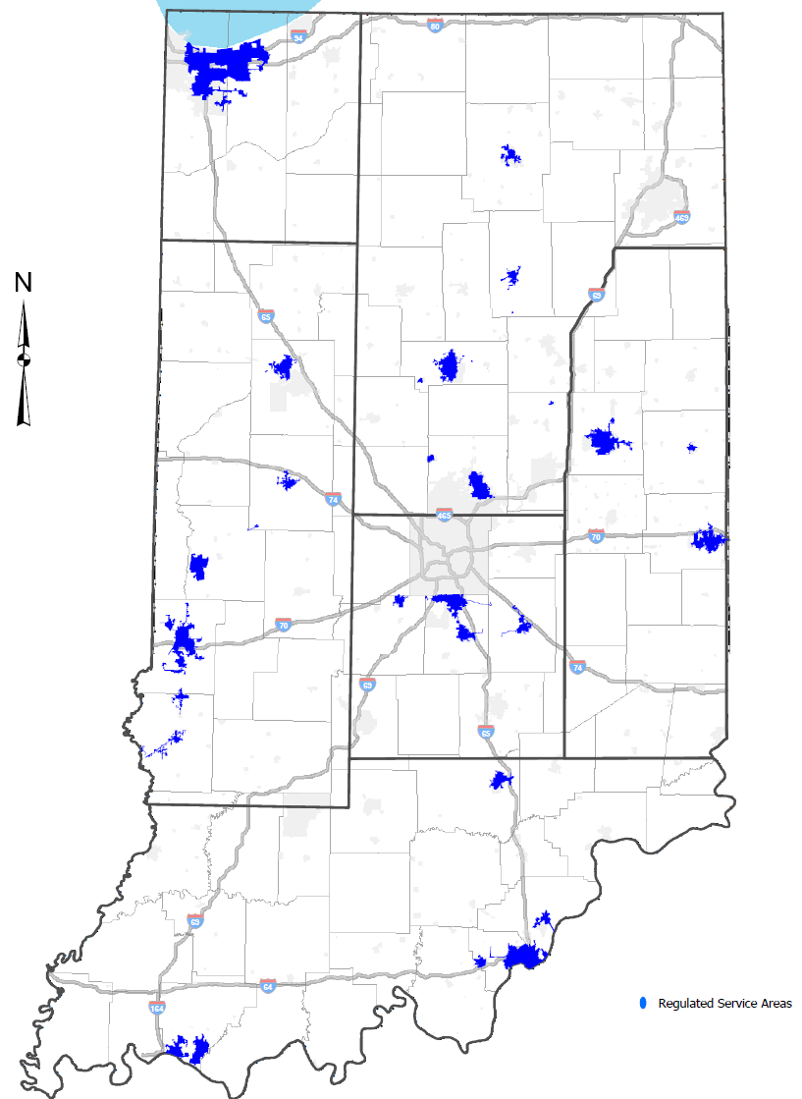
introduction
Water main breaks cost money, time, and resources
Indiana American Water (INAW) replaces old mains
to reduce the number of outages
INAW already uses predictors to assess which mains
should be replaced next
Age of pipe
Material
Diameter, etc.
Notes:
Quickly explain who INAW is… serve just over 800,000 residents of Indiana

Slide 4
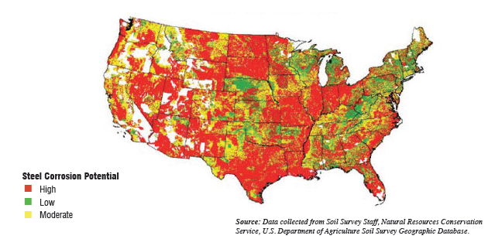
Background
Folkman and Duran have published studies that show the effect of soil properties on metallic pipes
“Cast iron pipe has 20x more breaks in highly corrosive soils than in low corrosive soils” -Folkman
“Ductile iron pipe incurs almost 10x more failures in corrosive soils” -Folkman
Notes:
Figure shows USDA soil corrosivity map – All of Indiana is considered HIGH
Duran related soil corrosion to soil texture – sand, silt, clay. Sandy soils result in lower corrosion rates due to air / water circulation

Slide 5
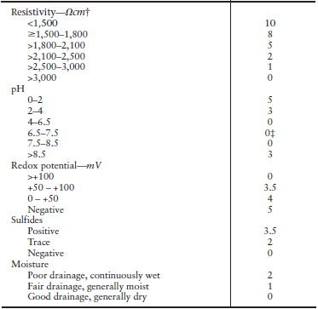
Background
American Water Works Association (AWWA) has
developed the 10P soil evaluation system
Designed to test soil corrosivity
Ranks soil from 0 – 10
Higher numbers = More Corrosive
A few downfalls
Hudak, et al. showed the highest number of
breaks in the Dalco soil series
Study showed higher break rate in PVC pipes
Soil Property Value
Notes:
Draw attention to Property and Value columns – give short soil example
A soil with Resistivity = 2,000 , pH level of 3, redox potential of 200, with traces of sulfides and fair drainage would score a 10 = highly corrosive to metallic pipes
Downfalls – must have physical soil sample, need the knowledge and equipment of how to test
Interesting to note Hudak study of PVC breaks….

Slide 6
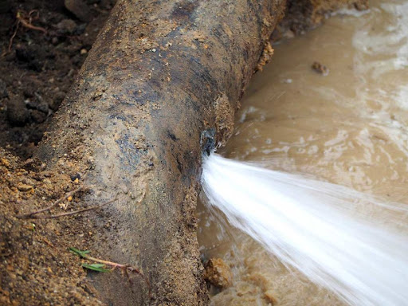
Objectives
Determine water main break hotspots
Determine which soil properties show a strong correlation to water main breaks
Compare AWWA soil system properties to
strongly – correlated soil properties
Relate ‘digital proxies’ to SSURGO dataset

Slide 7
Objectives
What is SSURGO (Soil Survey Geographic Database)?
National Cooperative Soil Survey (NRCS) dataset
Derived from walking the land and taking laboratory measurements
Scales ranging from 1:12,000 to 1:63,360
Intended for planning and management by landowners, townships, and counties

Slide 8
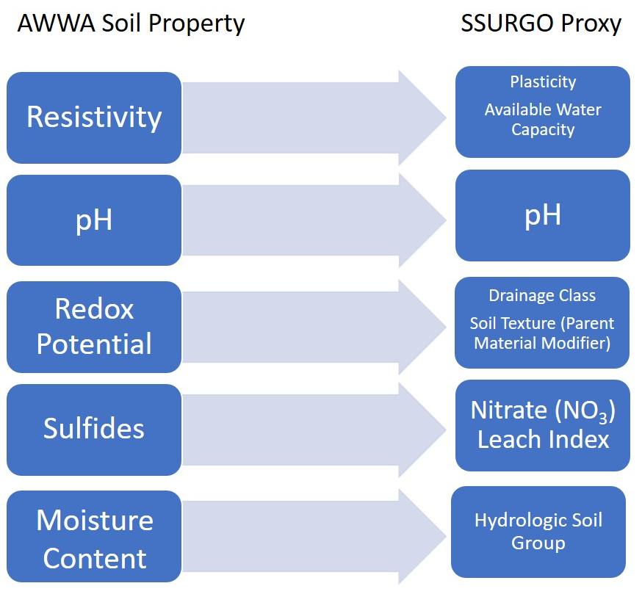
digital proxies
The AWWA 10P system uses these properties:
Resistivity
pH
Redox Potential
Sulfides
Moisture Content (% of clay fines)
Using previous research, ‘digital proxies’ can
be found that are available in the SSURGO
database
Notes:
Resistivity: Determined by the moisture content and the concentration of the different ions and their mobilities
pH: Determined by the contents of carbonic acid, minerals, organic and inorganic acids, and by industrial wastes or acid rain
Redox = Oxidation – Reduction Potential: Determined by the oxygen concentration of the soil moisture
Sulfides: Group of minerals that are compounds of one or more metallic elements combined with the nonmetallic element sulfur
Moisture Content: Can be inferred from % of fines content and used as a surrogate measure for drainage characteristics

Slide 9
digital proxies
Resistivity Plasticity and Available Water Capacity
Osman, et al. (2013)
Stated, “…silty soil samples are characterized by higher plasticity index and lower resistivity values whereas sandy soil samples have lower plasticity index and higher resistivity values.”
Jusoh (2017)
Showed a strong correlation between moisture content and resistivity.
“The relationship model depicts a trend where resistivity value increases in function with decrement of the moisture content.”
Notes:
Resistivity – Determined by the moisture content and the concentration of the different ions
Osman showed an inverse relationship between plasticity index and resistivity values
Jusoh showed an inverse relationship between resistivity and moisture content

Slide 10
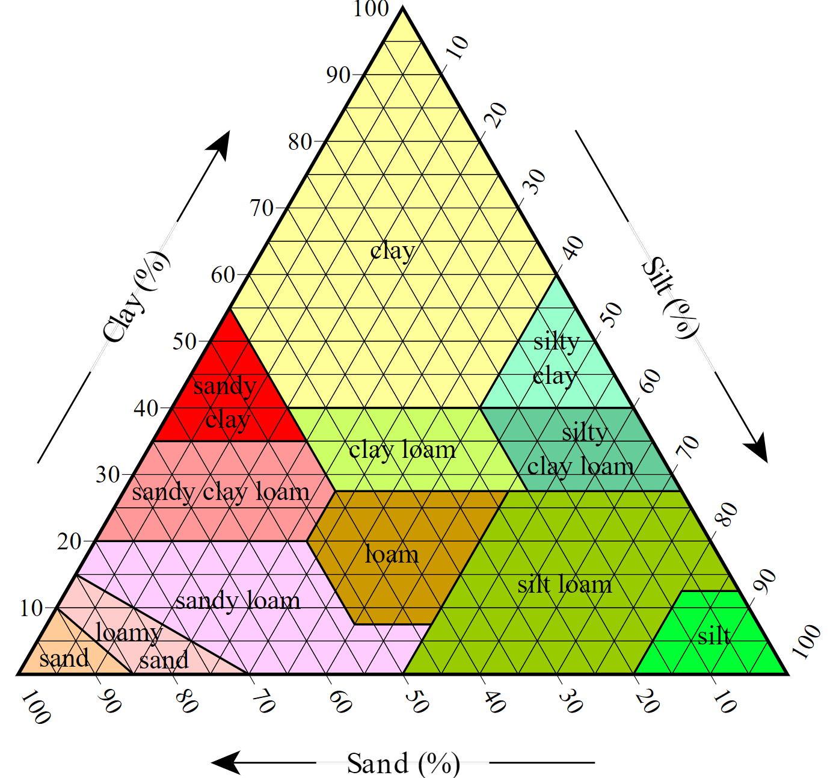
digital proxies
pH pH
Shabangu’s (2015) study showed lower pH values (<5) should be considered acidic to pipelines if not mitigated
Redox Potential Drainage Class and Soil Texture
Challenging
Hasan and Hossain’s (2019) study on metal culverts
showed promising results using these two parameters
May not show strong correlation
Notes:
Ph – Detemined by the contents of carbonic acid, minerals, organic and inorganic acids, and by industrial wastes or acid rains
Ph aligns perfectly in an AWWA soil property
Oxidation-Reduction Potential – determined by the oxygen concentration of the soil moisture
Redox – that’s okay if we don’t see a strong correlation…

Slide 11
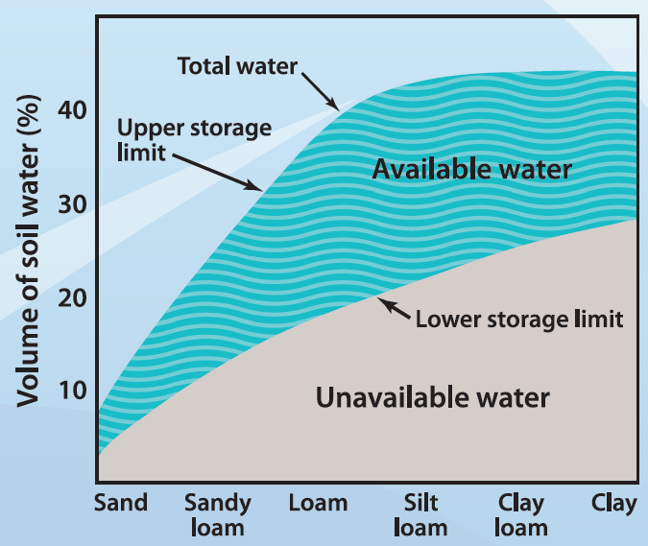
digital proxies
Sulfides Nitrate (NO₃) Leach Index
Also challenging – most sulfide measurements require instrumentation
Kolling and Priezel (1995)
“High concentrations of NO₃⁻ in the seepage
water are accompanied by low SO₄⁻
concentrations.”
Moisture Content Available Water Capacity
Liu, et al. (2010)
Moisture content can be aggregated from the
soil type and percent of clay fines.
Lahatte and Pradhan’s workflow
Redox Potential proxies are similar
Notes:
Sulfides – Is a group of minerals that are compounds of one or more metallic elements combined with the nonmetallic element sulfur
Kolling – Inverse relationship between Nitrates and Sulfides
Moisture Content - % of clay fine
Lahatte and Pradhan’s GIS workflow takes the two SSURGO datasets and creates a dataset similar to the USDA soil texture chart

Slide 12
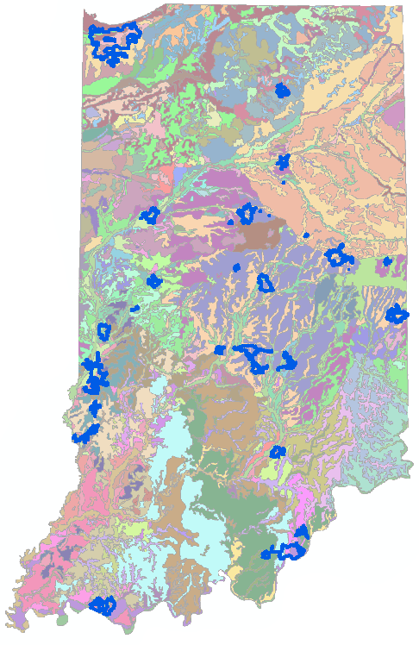
Limitations
Must keep in mind that these 7 digital proxies MAY NOT show a strong correlation to actual main break data!
This a study in soil geography NOT in site-specific analysis!

Slide 13
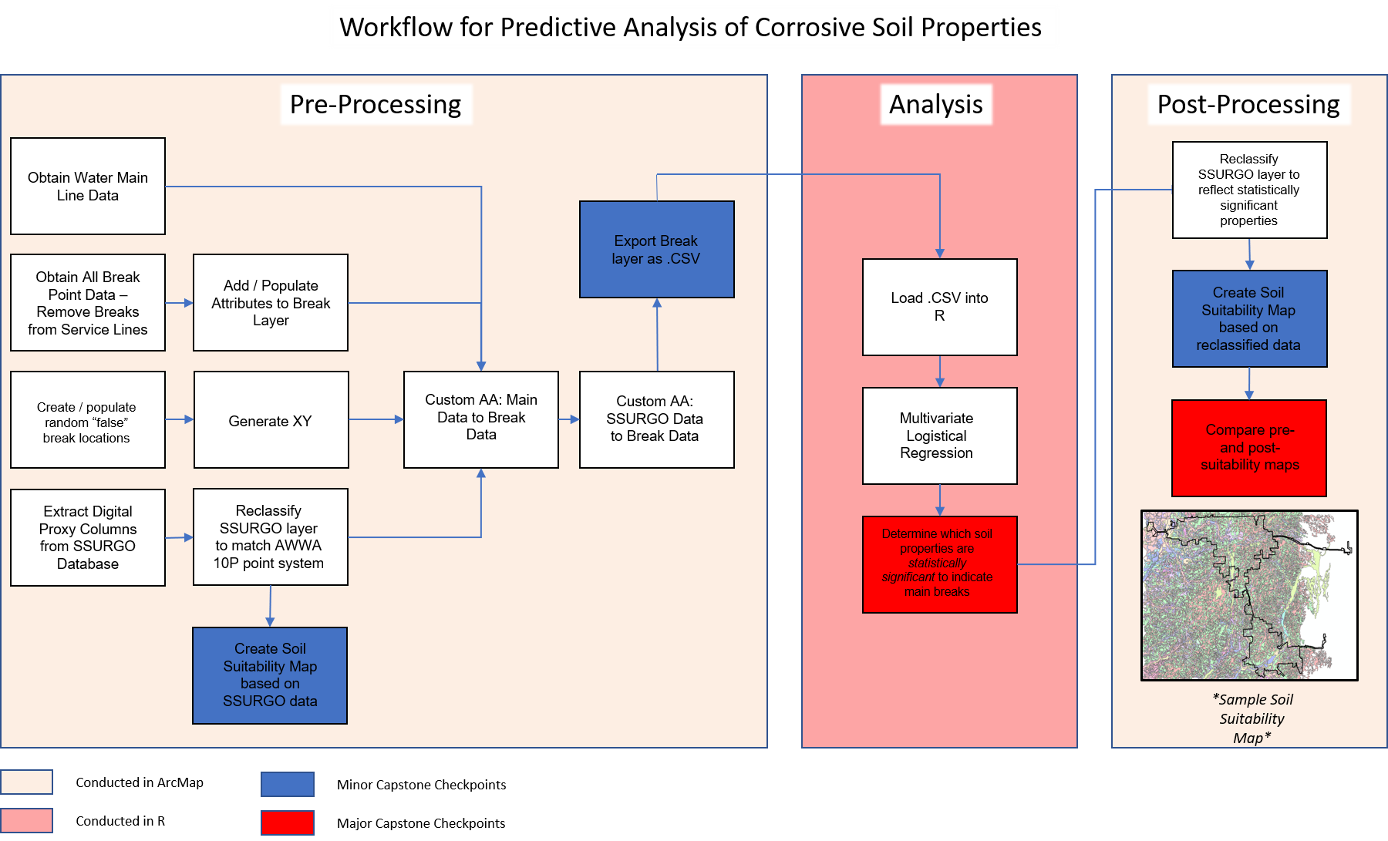
Methods
Notes:
3 Steps – Pre Processing, Analysis, Post Processing

Slide 14
Pre-processing
Data gathering
Data Preparation
“False” break locations
Create 1st Soil Suitability Map from
SSURGO properties
Attribute Assistant to populate data
Export .csv into R

Slide 15
Pre-processing
Data gathering
Data Preparation
“False” break locations
Create 1st Soil Suitability Map from
SSURGO properties
Attribute Assistant to populate data
Export .csv into R

Slide 16
Pre-processing
Data gathering
Data Preparation
“False” break locations
Create 1st Soil Suitability Map from
SSURGO properties
Attribute Assistant to populate data
Export .csv into R

Slide 17
Pre-processing
Data gathering
Data Preparation
“False” break locations
Create 1st Soil Suitability Map from
SSURGO properties
Attribute Assistant to populate data
Export .csv into R
Notes:
**** CHECK SPACING ON PREVIOUS SLIDES****
****Expand Graphic******

Slide 18
Pre-processing
Data gathering
Data Preparation
“False” break locations
Create 1st Soil Suitability Map from
SSURGO properties
Attribute Assistant to populate data
Export .csv into R

Slide 19
Analysis
“Meat and Potatoes” of analysis
Multivariate Regression
Step-wise
Logistic
Use coefficients to determine which proxies show
statistical significance to indicate main breaks
May require additional regression steps to predict
water main breaks
Notes:
***1st step at regression*** “to predict water main breaks”

Slide 20
Analysis
“Meat and Potatoes” of analysis
Multivariate Regression
Step-wise
Logistic
Use coefficients to determine which proxies show
statistical significance to indicate main breaks
May require additional regression steps to predict
water main breaks
Notes:
***1st step at regression*** “to predict water main breaks”

Slide 21
Analysis
“Meat and Potatoes” of analysis
Multivariate Regression
Step-wise
Logistic
Use coefficients to determine which proxies show
statistical significance to indicate main breaks
May require additional regression steps to predict
water main breaks
Notes:
***1st step at regression*** “to predict water main breaks”

Slide 22
Post processing
Reclassify SSURGO properties that show significance
Create 2nd Soil Suitability Map
Compare Soil Suitability Maps
Comparison would show how site-specific tests MAY
differ from remote testing with digital data

Slide 23
Post processing
Reclassify SSURGO properties that show significance
Create 2nd Soil Suitability Map
Compare Soil Suitability Maps
Comparison would show how site-specific tests MAY
differ from remote testing with digital data

Slide 24
Post processing
Reclassify SSURGO properties that show significance
Create 2nd Soil Suitability Map
Compare Soil Suitability Maps
Comparison would show how site-specific tests correlate
with soil suitability map
Notes:
2nd suitability map is what INAW COULD use in their current modelling

Slide 25
Anticipated results
Some SSURGO proxies may show strong correlation
Some proxies may not!
Predict that pH and Moisture Content will have strongest correlation
At some level, the Soil Suitability Map will add strength to the INAW Prediction Model

Slide 26
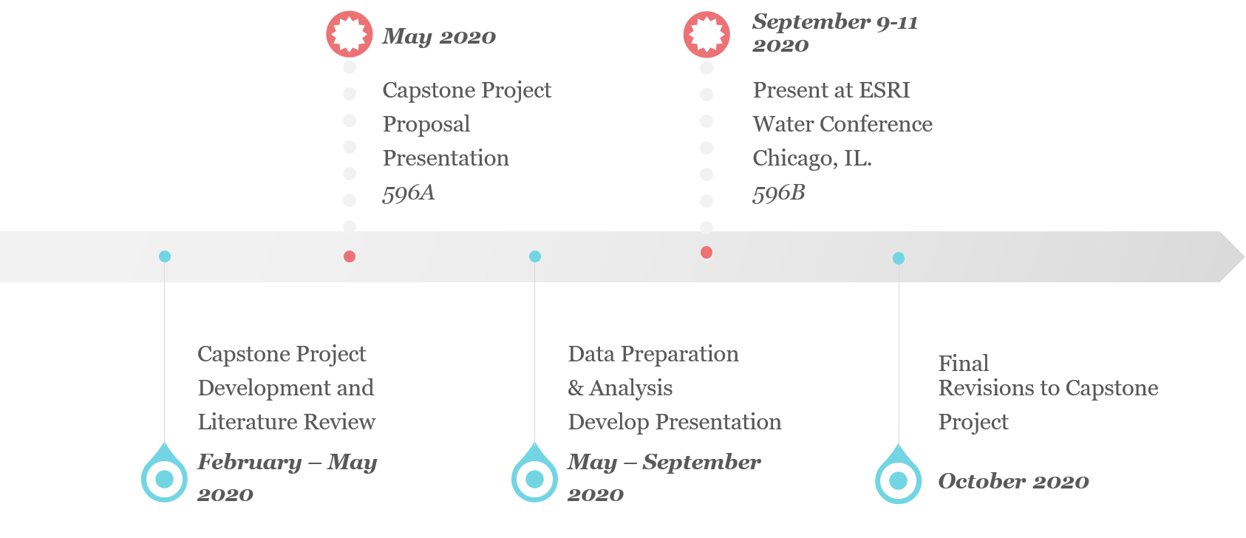
timeline

Slide 27
References
ANSI/AWWA, 1999. C105/A21.5. America National Standard for Polyethylene Encasement for Ductile-Iron Pipe Systems. Catalog No. 43105.
Bonds, R., Barnard, L., Horton, M., and Oliver, G. 2005. Corrosion and corrosion control of iron pipe: 75 years of research, Journal AWWA, June 2005. pg: 88-98.
Duran, Bernardo III. “Estimating Galvanized Steel’s Service Life in Soil.” American Galvanizers Association, August 30, 2011. https://galvanizeit.org/education-and-resources/resources/technical-faq-dr-galv/estimating-galvanized-steels-service-life-in-soil. Accessed 21 February 2019.
Folkman, Steven. 2018. Water Main Break Rates in the USA and Canada: A Comprehensive Study, Mechanical and Aerospace Engineering Faculty Publications, 2018, Paper 174.
Hasan, M. and Hossain, Z. 2019. An Overview of Corrosion Risk of Metal Culverts in Arkansas, MATEC Web of Conferences, Volume 271. pg: 1-4
Hudak, P., Sadler, B., and Hunter, B. 2000. Analyzing Underground Water-Pipe Breaks in Residual Soils. Water and Wastes Digest, Accessed 22 February 2019. <https://www.wwdmag.com/water/analyzing-underground-water-pipe-breaks-residual-soils>
Jusoh, Hisyam. 2017. The Correlation between Resistivity and Soil Properties as an Alternative to Soil Investigation. Indian Journal of Science and Technology, Volume 10. pg: 1-5.
Kolling, C., and Prietzel, J. 1995. Correlations between Nitrate and Sulfate in the Soil Solution of Disturbed Forest Ecosystems. Biogeochemistry, Volume 31(3). pg: 121-138
LaHatte, W. C., and N. R. Pradhan. 2016. Analysis of SURRGO data and obtaining soil texture classifications for simulating hydrologic processes. ERDC/CHL CHETN-X-3. U.S. Army Engineer Research and Development Center.
Liu, Z., Sadiq, R., Rajani, B., and Najjaran, H. 2010. Exploring the Relationship between Soil Properties and Deterioration of Metallic Pipes Using Predictive Data Mining Methods. Journal of Computing in Civil Engineering, Volume 24(3). pg: 289-301.
Najjaran, H., Sadiq, R., and Rajani, B. 2010. Modeling Pipe Deterioration using Soil Properties – An Application of Fuzzy Logic Expert System. Institute for Research in Construction, pg: 1-10.
Osman, S., Siddiqui, F., and Behan, M. 2013. Relationship of Plasticity Index of Soil with Laboratory and Field Electrical Resistivity Values. Applies Mechanics and Materials, Volumes 353-356. pg: 719-724.
Shabangu, T., Ponnle, A., Adedeji, K., Abe, B., Olubambi, P., and Jimoh, A. 2015. Effects of Soil Properties on Corrosion of Buried Steel Pipeline: A Case Study of Rand Water Pipelines, South Africa. AFRICON 2015, pg: 1-5.

Slide 28
Questions?

