Slide 1
An Analysis of the Survey Decay Term in NOAA's Hydro Health Model Using Historic Bathymetric Datasets
Nicholas Morgan
GEOG 596A: Peer Review Presentation
Summer Term 2018
Advisor: Karen Schuckman

Slide 2
Capstone Project Outline
Background
  Hydrography
  NOAA Office of Coast Survey (OCS)
  Technology
  Survey Site Prioritization
  The Problem
  The Proposed Solution
Methodology
  Data and Materials
  Analysis and Methods
    Related Work
  Challenges and Limitations
Timeline
References

Slide 3
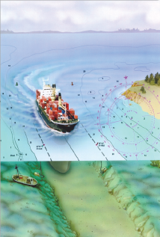
Hydrography
What is Hydrography?
  The measurement of the physical features underneath bodies of water and the shoreline surrounding it.
Why is it Important?
  Hydrographic surveys are generally performed for the purpose of safe maritime navigation.
  Hazards exist to navigation that affect human safety, the nation’s economy, and the environment
  Commercial vessels are always looking to maximize size.
    Little under keel clearance
  Charts must hold up in the court of law
(NOAA)

Slide 4
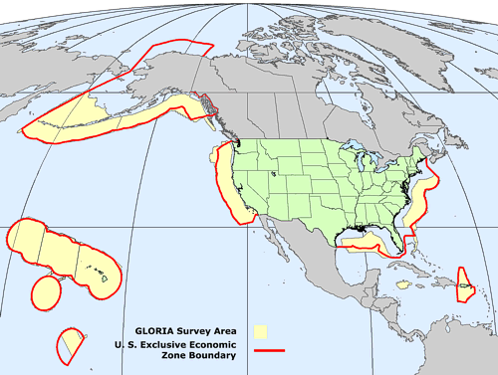
Organization and Mission Background
Creation of US Coast and Geodetic Survey
  President Thomas Jefferson, 1807
    Commerce/Security (NOAA)
  Coast and Geodetic Survey Act of 1947 (NOAA)
  UN Laws of the Sea Part V – Exclusive Economic Zone
    Defined offshore limit, 200 NM from territorial land (UN)
Delineation of the US Exclusive Economic Zone (EEZ)(USGS)

Slide 5
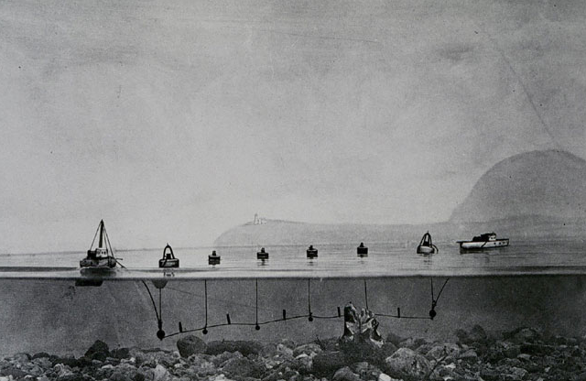
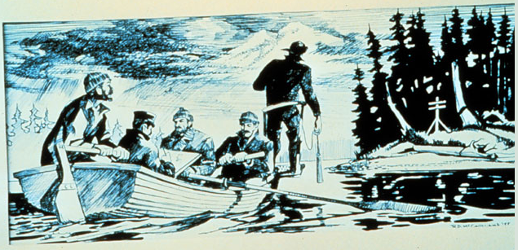
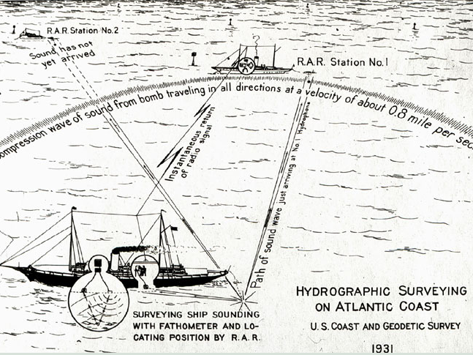
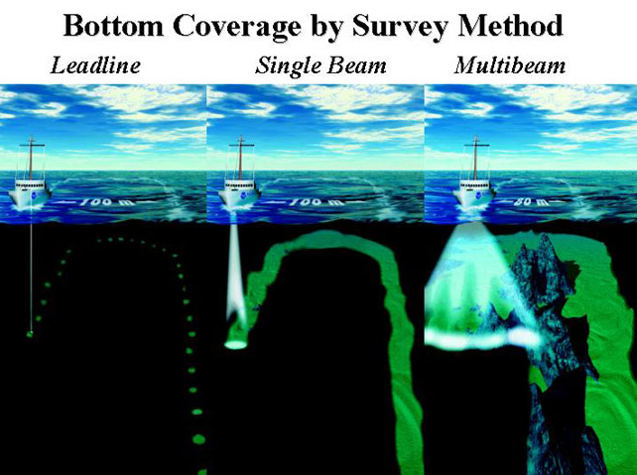
Hydrographic Technology Background
Gathering Bathymetric Soundings
  Leadline
  Wiredrag
  Single Beam Sonar
  Multibeam Sonar
Positioning
  Sextant
  Radio Acoustic Ranging
  Shoran/Loran
  GPS
(NOAA)
Notes:
-Important why?

Slide 6
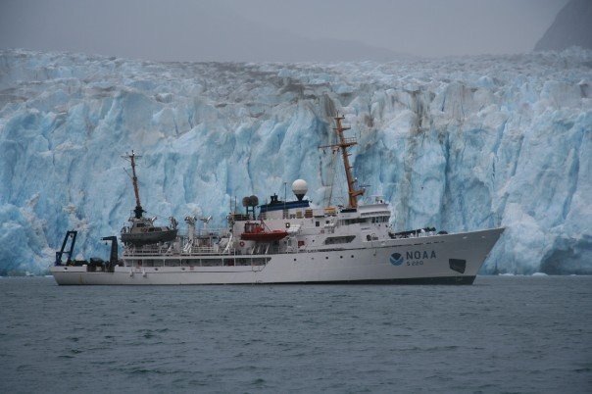
Survey prioritization
Coast Survey’s Resources
  NOAA Fleet is 16 ships, only 4 of which are dedicated to hydrographic work
  6 Navigation Response Teams for emergency response and urgent requests
  Contracting of Commercial Survey Companies
Small amount of resources to fulfill the requirement – Must prioritize!
National Hydrographic Survey Priorities (NHSP)
The Hydro Health Model (HHM)

Slide 7
National Hydrographic Survey Priorities
What’s Navigationally Significant?
  Offshore limit based on depth
  Other factors include the draft of typical vessel traffic and potential for underwater obstructions.
Prioritization Categories:
  Critical
  Emerging Critical
  Priority 1-5
  Completed (Any survey after 1993)
Contains “Resurvey Areas” that are defined in a subjective manner.
(NOAA 2012)

Slide 8
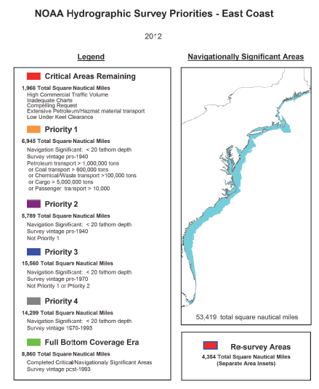
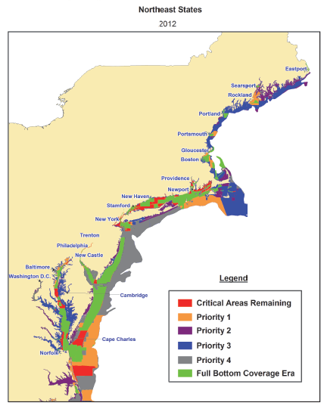
NHSP (Continued)
NHSP Output
(NOAA 2012)

Slide 9
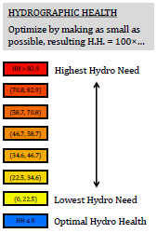
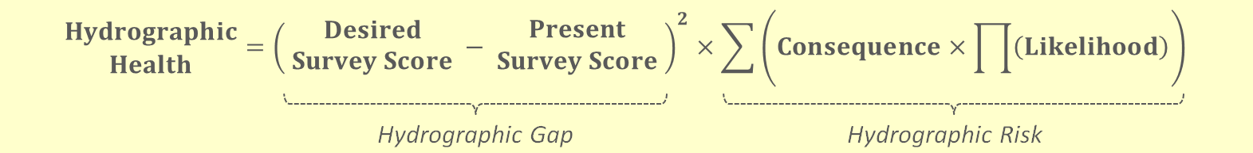
The Hydro Health Model
Currently in development.
A spatial data driven model that combines risk assessment and gap analysis to determine survey priorities.
Leverages more comprehensive use of GIS (ArcMap, Python)
Uses the “Hydrographic Risk” and “Hydrographic Gap” to determine “Hydrographic Health” of an area
Decay Term resides in “Present Survey Score” of Hydrographic Gap
Fandel et al (2017)

Slide 10
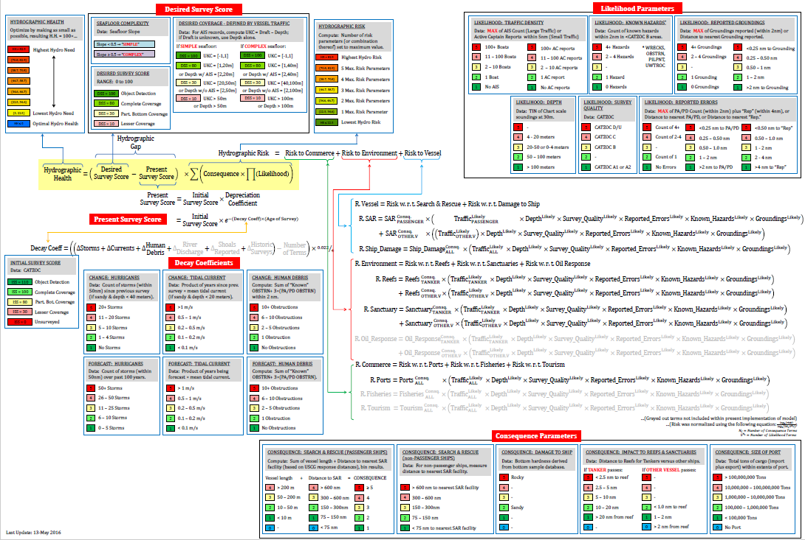
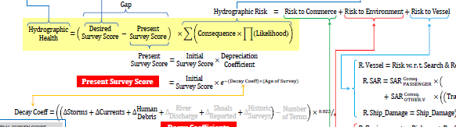
(NOAA 2016)

Slide 11
Project Statement
The Hydrographic Health Model is a new prioritization tool in development by NOAA’s Office of Coast Survey to provide guidance for determining survey priorities.
The intent of this project is to provide some analysis and recommendations on the usefulness of the decay term in Office of Coast Survey’s Hydro Health Model.
This decay term is intended to represent how the accuracy of a survey decays over time. The function is used in the calculation of an area’s “Survey Score” which is the output of the Hydro Health Model.

Slide 12
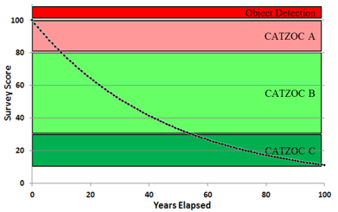
Present Survey Score
How do you assign a survey a score?
  A function of the Initial Survey Quality (CATZOC)
  Changeability of the area (how dynamic the seafloor is)
  Amount of time elapsed since surveyed.
Decay term is used to describe the changeability over time.
Decay Term = e-(Decay Coefficient)x(Age of Survey)
Image courtesy of NOAA
Fandel et al (2017)

Slide 13
The Problem
The exponential decay function was chosen as a reasonable guess as to how a survey degrades over time. Is it?
The proposed solution
Compare historic bathymetric datasets with the most current survey to determine how much change has occurred.

Slide 14
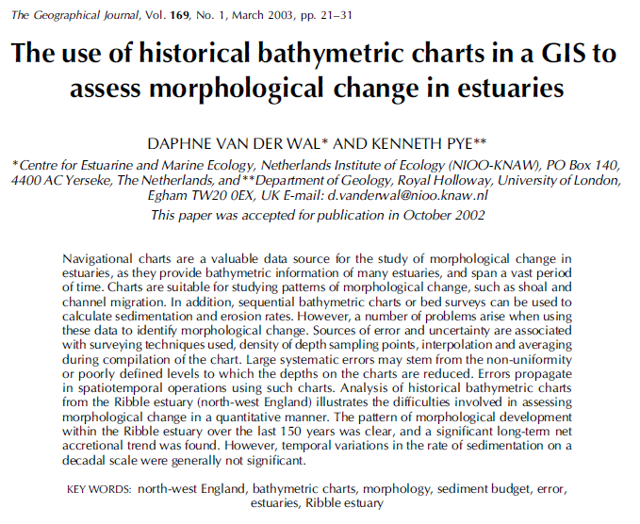
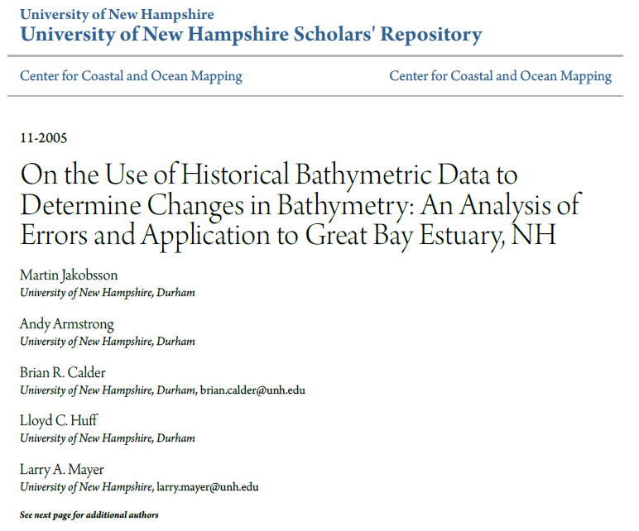
Proposed Methodology
Prior work using historic bathymetric datasets
  Wal and Pye (2003)
  Jakobsson et al (2005)
Jakobsson et al most applicable
Hydrographic Smooth Sheets
Triangulated Irregular Network (TIN)
Differencing

Slide 15
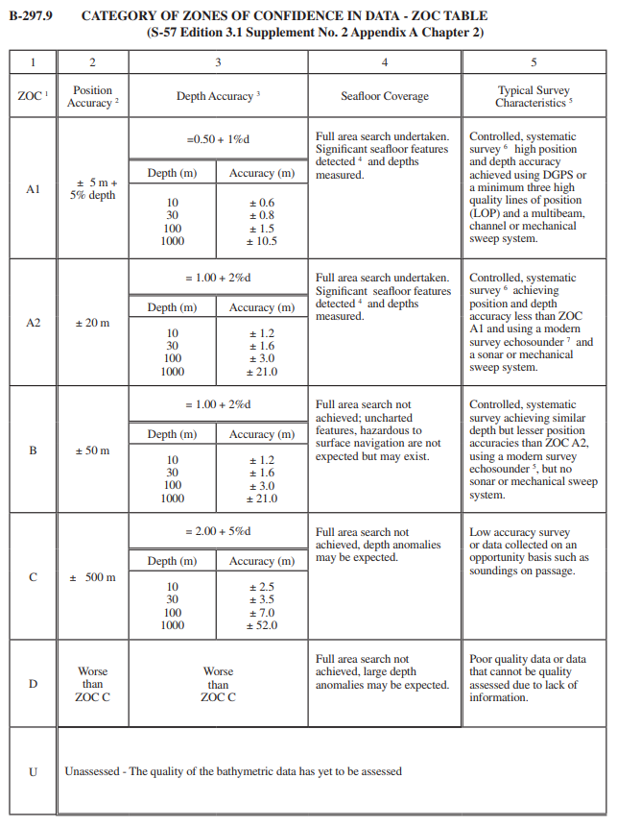
Proposed Methodology (cont.)
Categorize difference surface based on CATZOC level. (Actual Decay)
Use formula for Present Survey Score (using decay term) to model CATZOC
  Purely a function of time
Analyze where discrepancies occur
IHO (2013)

Slide 16
Data and Materials
National Center for Environmental Information (NECI)
  Bathymetric Data Viewer
The Approaches to Chesapeake Bay was chosen as the area of study.
  Area has been resurveyed many times over the past 100+ years
  Has seafloor bottom type consistent with most of the east coast (loose sediment, sandy).
  Decay term was developed with this bottom type assumption.
  Potential to look at other areas along the east coast if time available
ArcGIS will be used for performing analysis of data

Slide 17
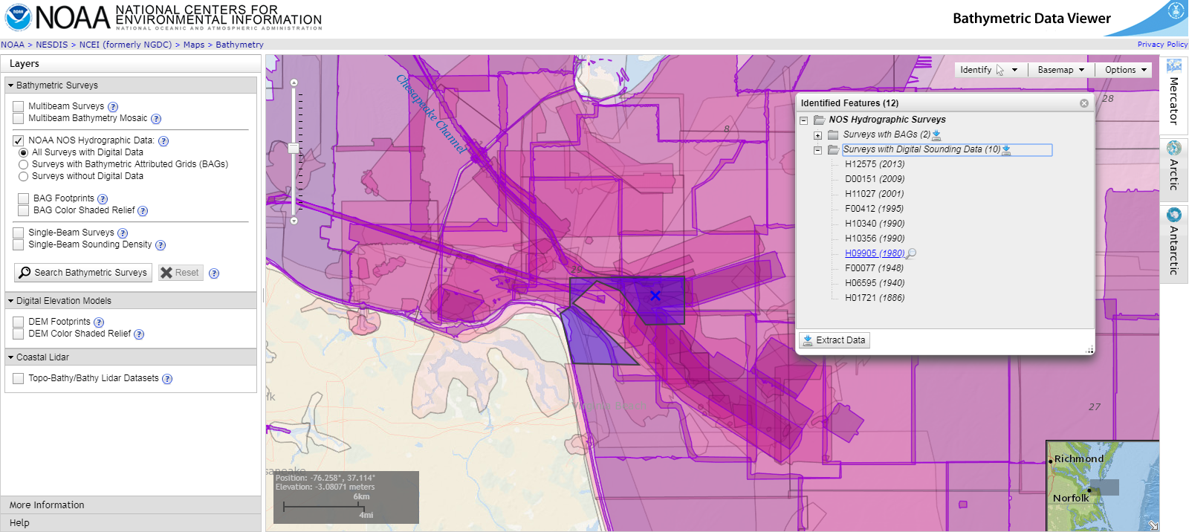
Data
Hydrographic Smooth Sheets
Point features in .xyz format
Shoal bias sounding selection
(Image from NOAA)

Slide 18
Challenges and Limitations
Only analyzing the decay function in one area. Preferably this model would be used for all EEZ
Constrained by overlap of historic data (needed for differencing)
Determining uncertainty
  Comparing datasets that used different methods, datums, technologies, and density of data.
  Monte Carlo Simulations in Jakobsson et al (2005)
Deciphering the Hydro Health Model – Complex!
Scope of Statistics
  How far to take statistical analysis?
  Reasonableness vs Statistical Significance
CATZOC is a coarse method of describing survey quality. Find way to determine actual Survey Score from historic datasets?

Slide 19

Timeline:
596A Completion (Proposal)
July 2018
Dataset Finalization
September 2018
Present at US Hydro 2019
March 19, 2019
October 2018
Differencing and Accuracy Analysis
Deadline to Submit Abstract for US Hydro 2019
October 31st 2019
Register and Submit Final Paper
January 1st
Formulate Results
December 2018

Slide 20
Acknowledgements
Karen Schuckman, Advisor Penn State MGIS Program
NOAA’s Office of Coast Survey for Historical Information
Christy Fandel,Office of Coast Survey, Hydrographic Surveys Division
Patrick Keown,Office of Coast Survey, Hydrographic Surveys Division

Slide 21
References
Bathymetric Data Viewer. (n.d.). Retrieved July 25, 2018, from https://maps.ngdc.noaa.gov/viewers/bathymetry/
Fandel, C., Gonsalves, M., Keown, P., Allen, C., Hick, L., & Gallagher, B. (2017). Hydrographic Health: A National Overview. Lecture presented at US Hydrographic Conference in TX, Galveston. Retrieved from http://ushydro2017.thsoa.org/wp-content/uploads/2017/04/1-FandelEtAl_HydroHealth_USHydro2017.pdf
History of Hydrographic Surveying. (n.d.). Retrieved from https://nauticalcharts.noaa.gov/learn/history-of-hydrographic-surveying.html
International Organization for Standardization. (2013). Regulations of the IHO for International (INT) Charts and Chart Specifications of the IHO (Edition 4.4.0). Retrieved from https://www.iho.int/iho_pubs/standard/S-4/S-4_e4.4.0_EN_Sep13.pdf
Jakobsson, Martin; Armstrong, Andy; Calder, Brian R.; Huff, Lloyd C.; Mayer, Larry A.; and Ward, Larry G. (2005). On the Use of Historical Bathymetric Data to Determine Changes in Bathymetry: An Analysis of Errors and Application to Great Bay Estuary, NH.
International Hydrographic Review,1016. http://scholars.unh.edu/ccom/1016
NOAA History - NOAA Legacy/Historic Documents - Act of Feb 10, 1807. (n.d.). Retrieved from http://www.history.noaa.gov/legacy/act1.html
NOAA Hydrographic Survey Priorities: 2012 Edition(Rep.). (2012). Retrieved May 01, 2018, from https://nauticalcharts.noaa.gov/publications/docs/national-hydrographic-survey-priorities/nhsp-full document-2012.pdf
Paskevich, V., Wong, F., O'Malley, J., Groome, M., Gutmacher, C., & Stevenson, A. (n.d.). USGS OFR 2010-1332: Exclusive Economic Zone and GLORIA surveys. Retrieved July 25, 2018, from https://pubs.usgs.gov/of/2010/1332/htmldocs/figures/figure01-eez.html
PREAMBLE TO THE UNITED NATIONS CONVENTION ON THE LAW OF THE SEA. (n.d.). Retrieved July 25, 2018, from http://www.un.org/depts/los/convention_agreements/texts/unclos/part5.htm
Van Der Wal, D., & Pye, K. (2003). The use of historical bathymetric charts in a GIS to assess morphological change in estuaries. The Geographical Journal,169(1), 21-31. doi:https://doi.org/10.1111/1475-4959.04943

