Slide 1
A Comparison of Digital Elevation Models for Delineating Depressions That Could Lead to Sinkhole Development
John “Sam” Morter
Advisor: Dr. Patrick Kennelly
GEOG 596A: Capstone Peer Review
Fall 2013

Slide 2
Overview
Background
Problem
Goal and Objective
Study Area and Environment
Data
Methodology
Anticipated Results
Timeline
References

Slide 3
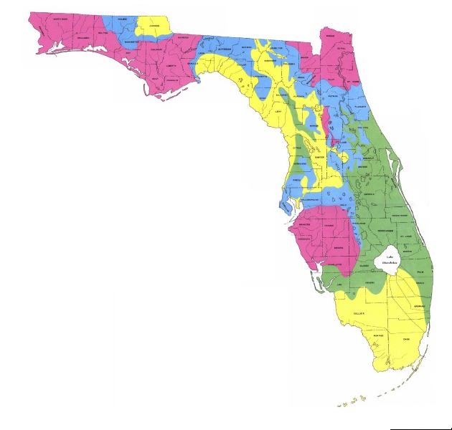
Background – The Cause of Sinkholes
Sinkholes are a natural geologic hazard that occur over time in soluble bedrock, also known as karst landforms.
Sinkholes have occurred throughout Florida.
Sinkhole Distribution in Florida
Recently, sinkhole damage has become a major concern for many Florida residents.
As a result, several studies are underway by State and Federal Agencies to map the sinkhole risk.
* Provided by Florida Geological Survey Map Series No. 110

Slide 4
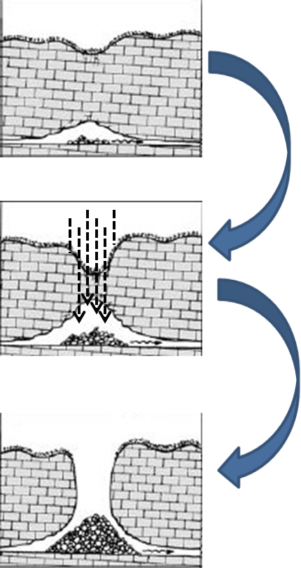
Background – The Cause of Sinkholes
Rainwater mixes with surface matter to form carbonic acid and drains though the surface.
A complex hydrologic system - the aquifer, contributes to the erosion process.
Eventually, the underground erosion becomes so extensive that the surface can no longer support itself and a sinkhole appears.
One thing that all sinkholes have in common, is the dissolution of the foundation that supports the surface.
(Beck, 1986)

Slide 5
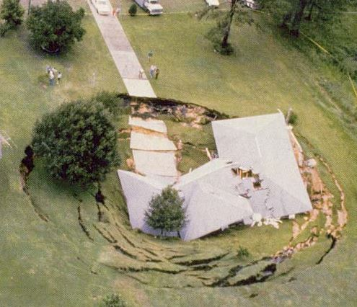
Background – The Cause of Sinkholes
The two basic types of sinkholes most commonly found in Florida are cover-subsidence and cover-collapse.
(Tihansky, 1999)
Cover- subsidence sinkholes typically form gradually as the surface is made of sand and loose sediments that spall and slide in to openings in the carbonate rock.
www.saveoursuwannee.org

Slide 6
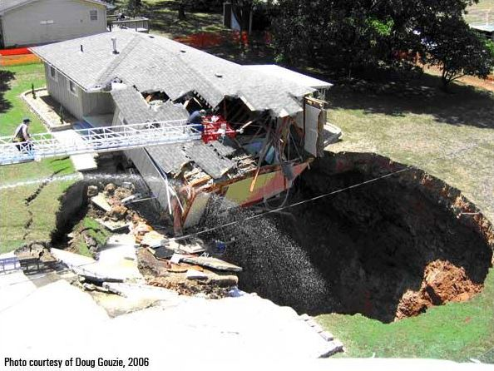
Background – The Cause of Sinkholes
Cover collapse sinkholes occur In areas where the overburden is mostly comprised of clay, or other firm sediments. The underground cavity eventually breaches the surface resulting in an abrupt collapse.
(Tihansky, 1999)
Cover-collapse sinkholes are the type often reported on by the news media and most people envision when they hear the word sinkhole.

Slide 7
Problem
Where sinkholes are going to occur is difficult to predict.
The identification of sinkhole formation is a difficult task.
Identifying closed depressions, or saturation zones.
Digital Elevation Models (DEMs) may be useful in some circumstances.
Light Direction and Ranging (LiDAR) data are a challenge to collect and process.
Stereo imagery extracted DEMs may be a viable solution.

Slide 8
Goals
The goal of this study is to analyze and compare various resolution DEMs of the Suwannee County region and delineate all closed depressions that could be considered indicative to the formation of sinkholes.
A key objective in this study is to also create a custom stereo imagery derived elevation model and evaluate and compare it against the other DEMs.

Slide 9
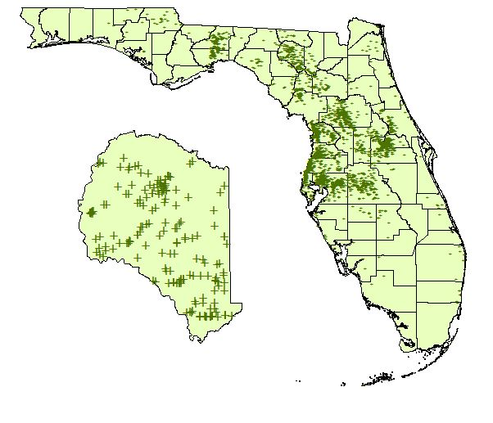
Study Area and Environment
For the purposes of this study, I will concentrate on Suwannee County, Florida. Since the 1960’s, 193 sinkholes have been reported in this county.
Suwannee County

Slide 10
Study Area and Environment
Suwannee county is exceptionally prone to sinkhole activity due to the permeability of its soil and the high rate of groundwater recharge. After Tropical Storm Debby in June 2012, this county experienced over a hundred sinkholes within a week.
Suwannee County

Slide 11
Data
Florida Geological Society’s Sinkhole Index
National Elevation Data (NED) Set 1/9 (~3 meter spatial resolution)
NED Set 1/3 (~10 meter spatial resolution)
NED Set 1 (~30 meter spatial resolution)
High resolution (1 foot) stereo aerial imagery
Closed Topographic Depressions – Florida

Slide 12
Methodology
Extracting elevation data from aerial stereo imagery
Step 1 – Preprocess and import in to SOCET GXP
Step 2 – Triangulation
Step 3 – Run NGATE
Step 4 – Perform ITE
Step 5 – Mosaic Tiles
www.socetgxp.com
(Aerial Index from the FDOT)

Slide 13
Methodology
Processing DEMs in ArcGIS Spatial Analyst
NED 1
NED 1/3
NED 1/9
Stereo Derived DEM
“Fill” in ArcMap Spatial Analyst
Subtract original DEM from “Filled” DEM
Select and re-classify
Export to Polygon

Slide 14
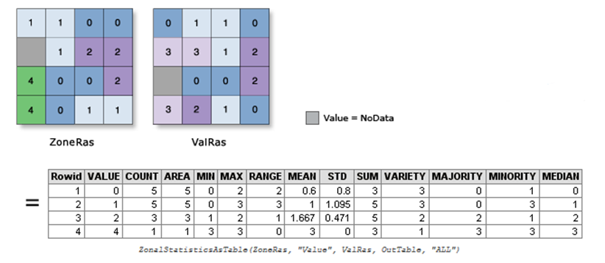
Methodology
Final Step – Analyze and report results
Perform Zonal Statistical Analysis utilizing the “true” depressions and each “candidate” depression
Compute statistics on correlation rates for each DEM and points from the Florida Sinkhole Index

Slide 15
Anticipated Results
Results of this study will be different sets of products that delineate closed depressions/saturation zones in the Suwannee County region based on each DEM.
Products will include maps, shapefile/kmz data layers, spreadsheets, graphs and 3D visualizations.
It is anticipated that the results of this study will help contribute to the overall effort of mapping sinkhole vulnerability on multiple scales and possibly even be incorporated in to the State’s comprehensive report.

Slide 16
Timeline
2014
January
February
March/April
Beyond…
Acquire DEMs from USGS
Receive Stereo Imagery from FDOT
Secure license from BAE for SOCET GXP
Begin initial screening and preprocessing of all data
Derive DEMs from Stereo
Create “Fill-difference” rasters
Analyze with Zonal Stats
Produce maps, shapefiles, kmz overlays and graphs
Produce report and presentation slides
Present report at National conference
Submit case study to Florida Geological Survey
If unable to present prior to end of first quarter… Present report at the first available National conference
Follow-up with FGS and FDEP

Slide 17
References
Arthur, J. D., Baker, A. E., Cichon, J. R., Wood, A. R., & Rudin, A. (2005). Florida Aquifer Vulnerability Assessment (FAVA): Contamination potential of Florida’s principal aquifer systems. Report submitted to the Division of Water Resource Management, Florida Department of Environmental Protection. Tallahassee: Division of Resource Assessment and Management, Florida Geological Survey.
Beck, B. F., & Sinclair, W. C. (1986). Sinkholes in Florida: an introduction. Florida Sinkhole Research Institute, College of Engineering, University of Central Florida.
Djokic, D. (2008), Comprehensive Terrain Processing Using Arc Hydro Tools, Environmental Systems Research Institute (ESRI) website. http://downloads.esri.com/blogs/hydro/ah2/arc_hydro_tools_2_0_overview.pdf, (accessed 14 Oct 2013).
Doctor, D. H., & Doctor, K. Z. (2012). Spatial analysis of geologic and hydrologic features relating to sinkhole occurrence in Jefferson County, West Virginia. Carbonates and Evaporites, 27(2), 143–152.
Doctor, D.H. and Young, J.A. (2013). An evaluation of automated GIS tools for delineating karst sinkholes and closed depressions from 1-meter LIDAR-derived digital elevation data. In: Land L, Doctor DH, Stephenson JB, editors, Sinkholes and the Engineering and Environmental Impacts of Karst: Proceedings of the Thirteenth Multidisciplinary Conference, May 6-10, Carlsbad, New Mexico: NCKRI Symposium 2. Carlsbad (NM): National Cave and Karst Research Institute, p. 449-458.
Fleury, S., Carson, S., & Brinkmann, R. (2008). Testing Reporting Bias in the Florida Sinkhole Database. The Southeastern Geographer, 48(1), 38-52.
Gutierrez, F., Cooper, A. H., & Johnson, K. S. (2008). Identification, prediction, and mitigation of sinkhole hazards in evaporite karst areas. Environmental Geology, 53(5), 1007-1022.
Rahimi, M., Alexander, E. (2013), Locating Sinkholes in LiDAR Coverage of a Glacio-Fluvial Karst, Winona County, MN, Proceedings of the Thirteenth Multidisciplinary Conference, May 6-10, Carlsbad, New Mexico: NCKRI Symposium 2. Carlsbad (NM): National Cave and Karst Research Institute, p. 469-480.
Tihansky, A. B. (1999). Sinkholes, west-central Florida. Land Subsidence in the United States, Galloway D., Jones, DR, and Ingebritsen SE, eds., United States Geological Survey Circular, 1182, p. 121-140.
Bell, F. G., & Culshaw, M. G. (2005). Sinkholes and subsidence: Karst and cavernous rocks in engineering and construction. Springer.
Tihansky, A. B., & Knochenmus, L. A. (2001). Karst features and hydrogeology in west-central Florida—a field perspective. US Geological Survey Karst Interest Group, Proceedings US Geological Survey Water-Resources Investigations, St Petersburg, FL, 198-211.
Zisman, E. D. (2001). A standard method for sinkhole detection in the Tampa, Florida, area. Environmental & Engineering Geoscience, 7(1), 31-50.

Slide 18
Questions?
Thanks for your time and patience!

