Slide 1
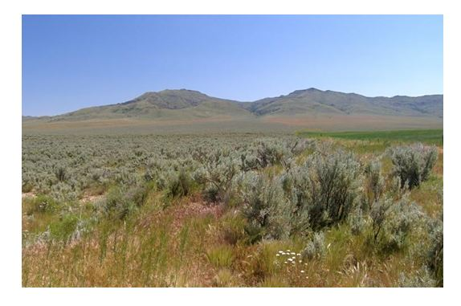
Refining an Automated Model for Basic Landform Classification
An ArcGIS and Python Approach
By Josh Moss
Patrick Kennelly Academic Advisor

Slide 2
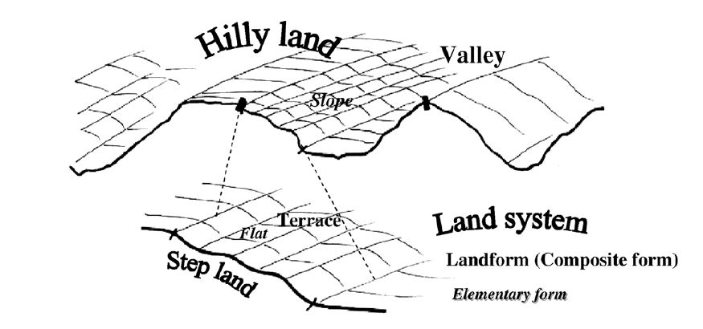
What are Landforms?
Landforms are categories of structure that can be derived from observable differences in the three-dimensional geometry of the Earth’s surface
Landforms are familiar: plains, mountains, hills, plateaus, etc.
Despite this familiarity, mapping landforms objectively has been an elusive goal for geomorphologists
Minar 2008

Slide 3
The Challenges of Landform Mapping
Removing subjectivity from the process
Identifying proper break points using geomorphological theory
Staggering variety of the Earth’s surface
Landforms as objects: fiat or bona fide?
Automating complex processes for practical use by land planning and environmental professionals
Lack of an objective standard against which to validate landform maps or classification systems

Slide 4
Why Classify Landforms? The Uses for Landform Classification
Land use planning (Zawawi 2014)
Landslide susceptibility mapping (Dikau 1990, Pike 1988)
Precision agriculture (Klingseisen 2007)
Soil condition modeling (Schmidt 2004)
Forest management (MacMillan 2004, Zawawi 2014)
Broad framework for mapping ecological units and habitats (MacMillan 2004)
Generalized constant spatial variable against which to perform spatially based analyses in disciplines such as anthropology, archaeology, geology, geomorphology, biology, ecology, and other natural sciences

Slide 5
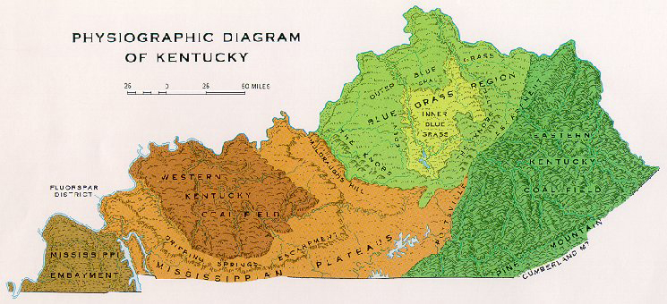
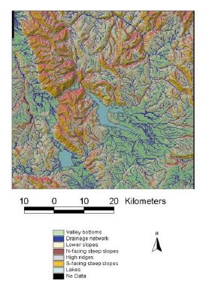
The History of Geomorphometrical Mapping
US Forest Service 2015
Burrough 2000

Slide 6
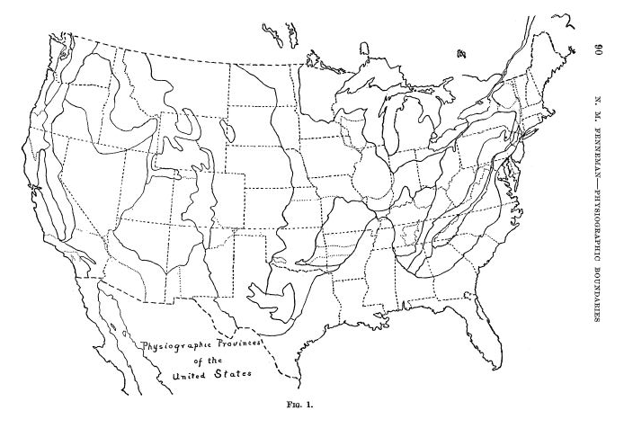
“The Atlantic Coastal Plain is a well marked province, but the hilly topography of it’s landward margin is superficially more like that of the adjacent Piedmont than like the featureless flats near the coast. It is, however very much more nearly related to the latter, into which it grades without crossing any significant line of division.” (Fenneman 1914)
Fenneman 1914

Slide 7
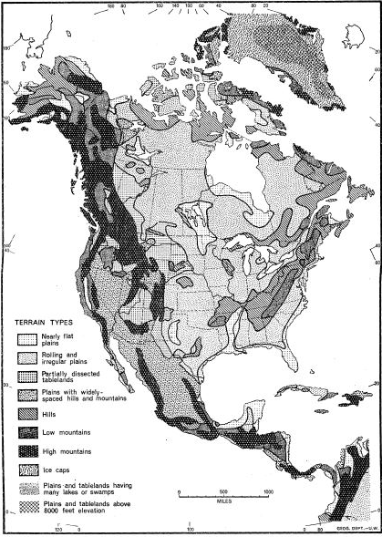
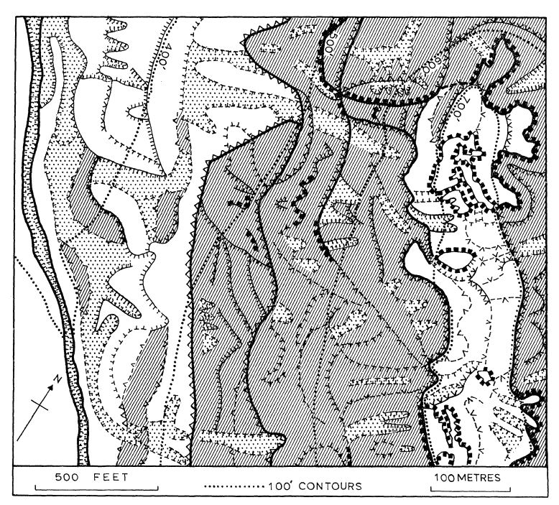
Lines of Division – Break Points and Mathematics
Hammond 1954
Savigear 1965

Slide 8
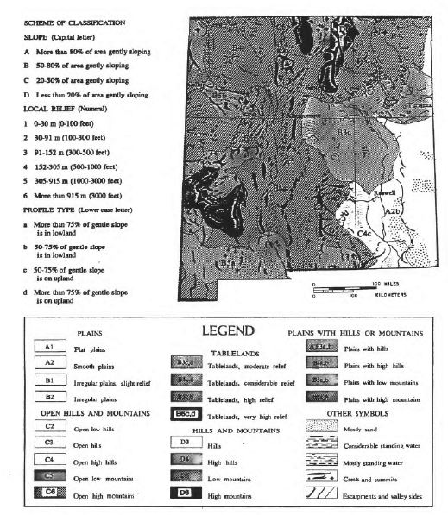
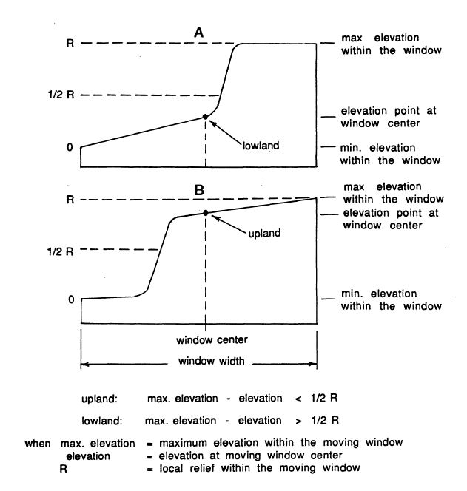
Hammond’s Moving Window

Slide 9
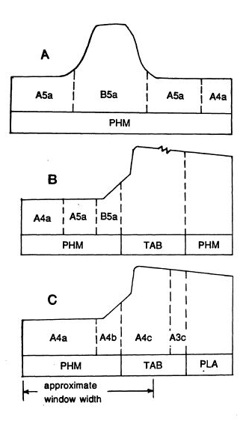
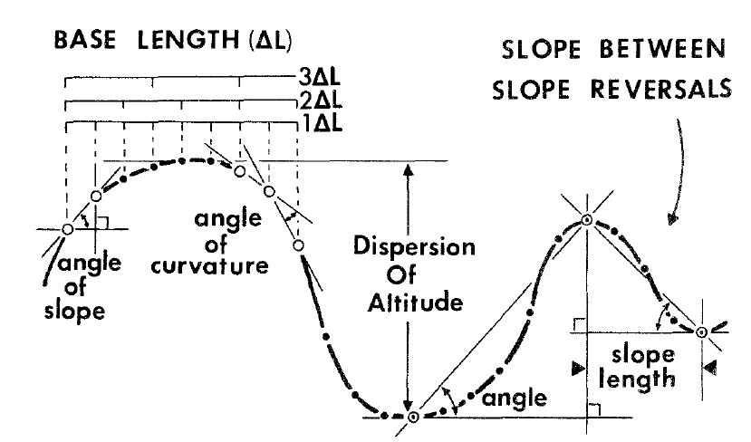
Extracting Metrics from DEMs
Pike 1988
Profile curvature is one of the most important geometrical properties of terrain derived from early digital elevation model (DEM) data used by Pike (above) and Dikau (left) to identify breakpoints for landform classification
and in the case of their studies, locate areas susceptible to landslides.
Dikau 1990

Slide 10
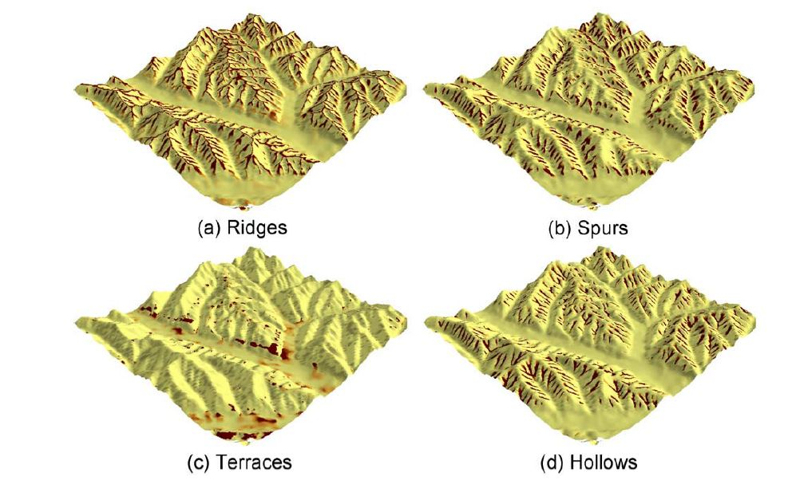
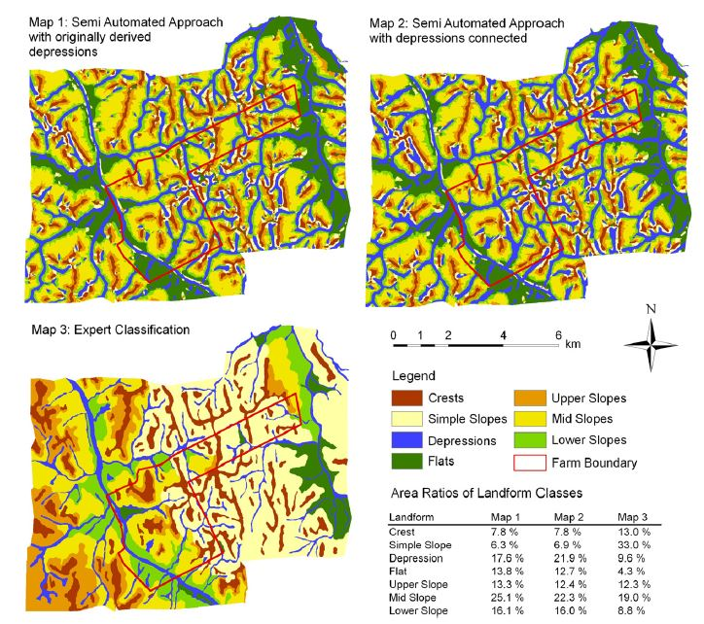
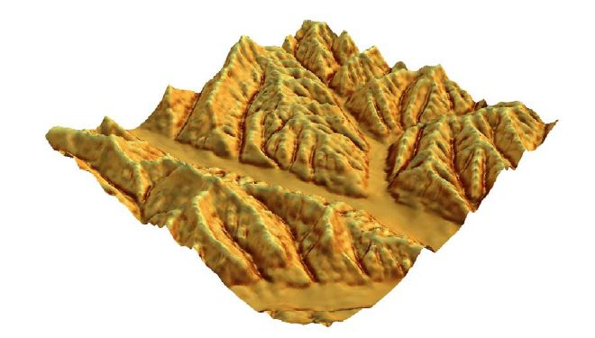
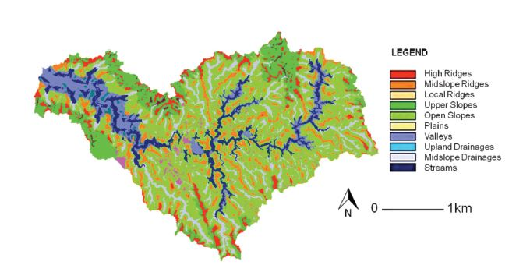
Automating Landform Extraction
Klingseisen 2007
Schmidt 2004
Zawawi 2014

Slide 11
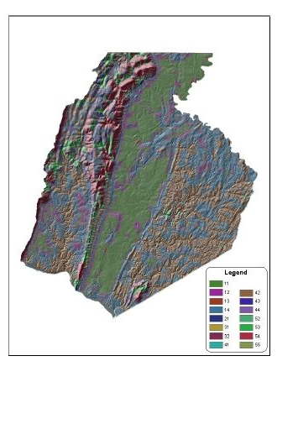
Landform Classification Modeling and ArcGIS
11 Flat or nearly flat plains
12 Smooth plains with some local relief
13 Irregular plains with low relief
14 Irregular plains with moderate relief
21 Tablelands with moderate relief
31 Plains with hills
32 Plains with high hills
41 Open very low hills
42 Open low hills
43 Open moderate hills
44 Open high hills
52 Low hills
53 Moderate Hills
54 High hills
56 High mountains
Morgan 2005

Slide 12
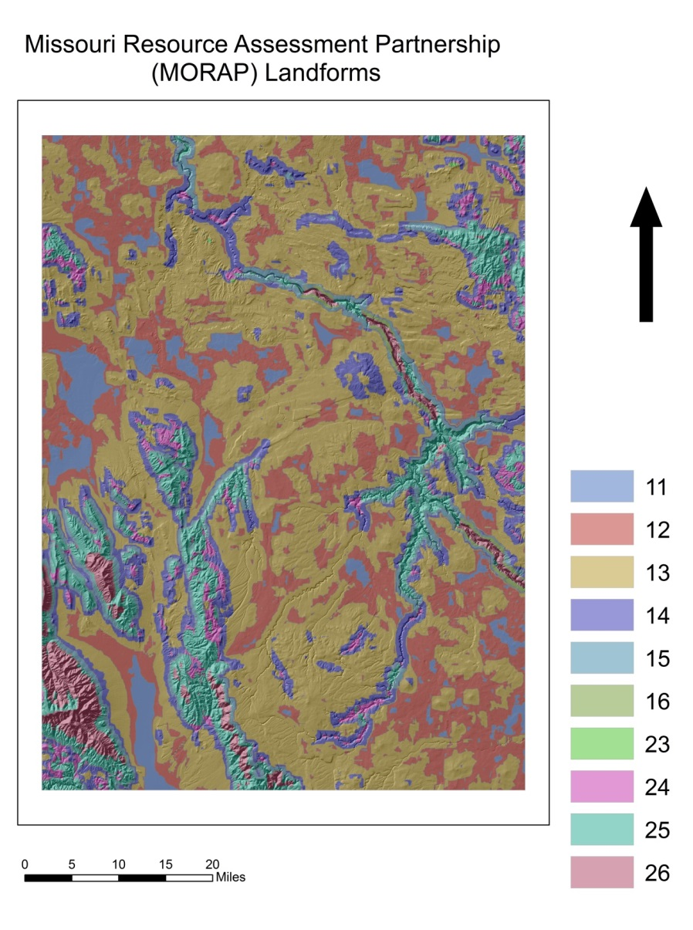
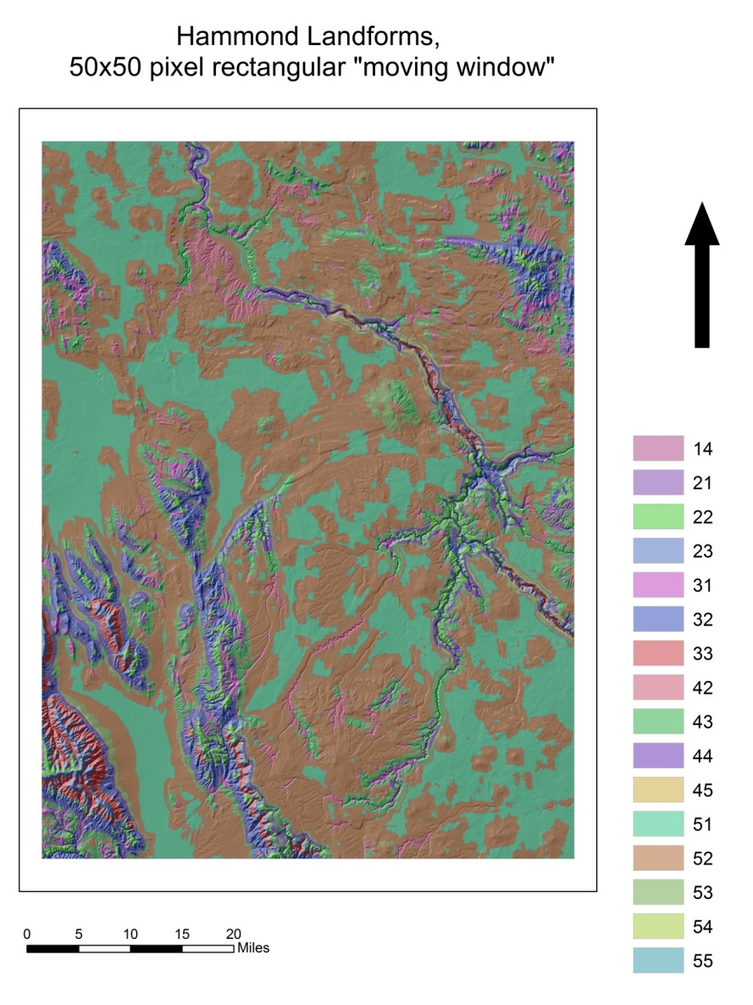
Testing the Models

Slide 13
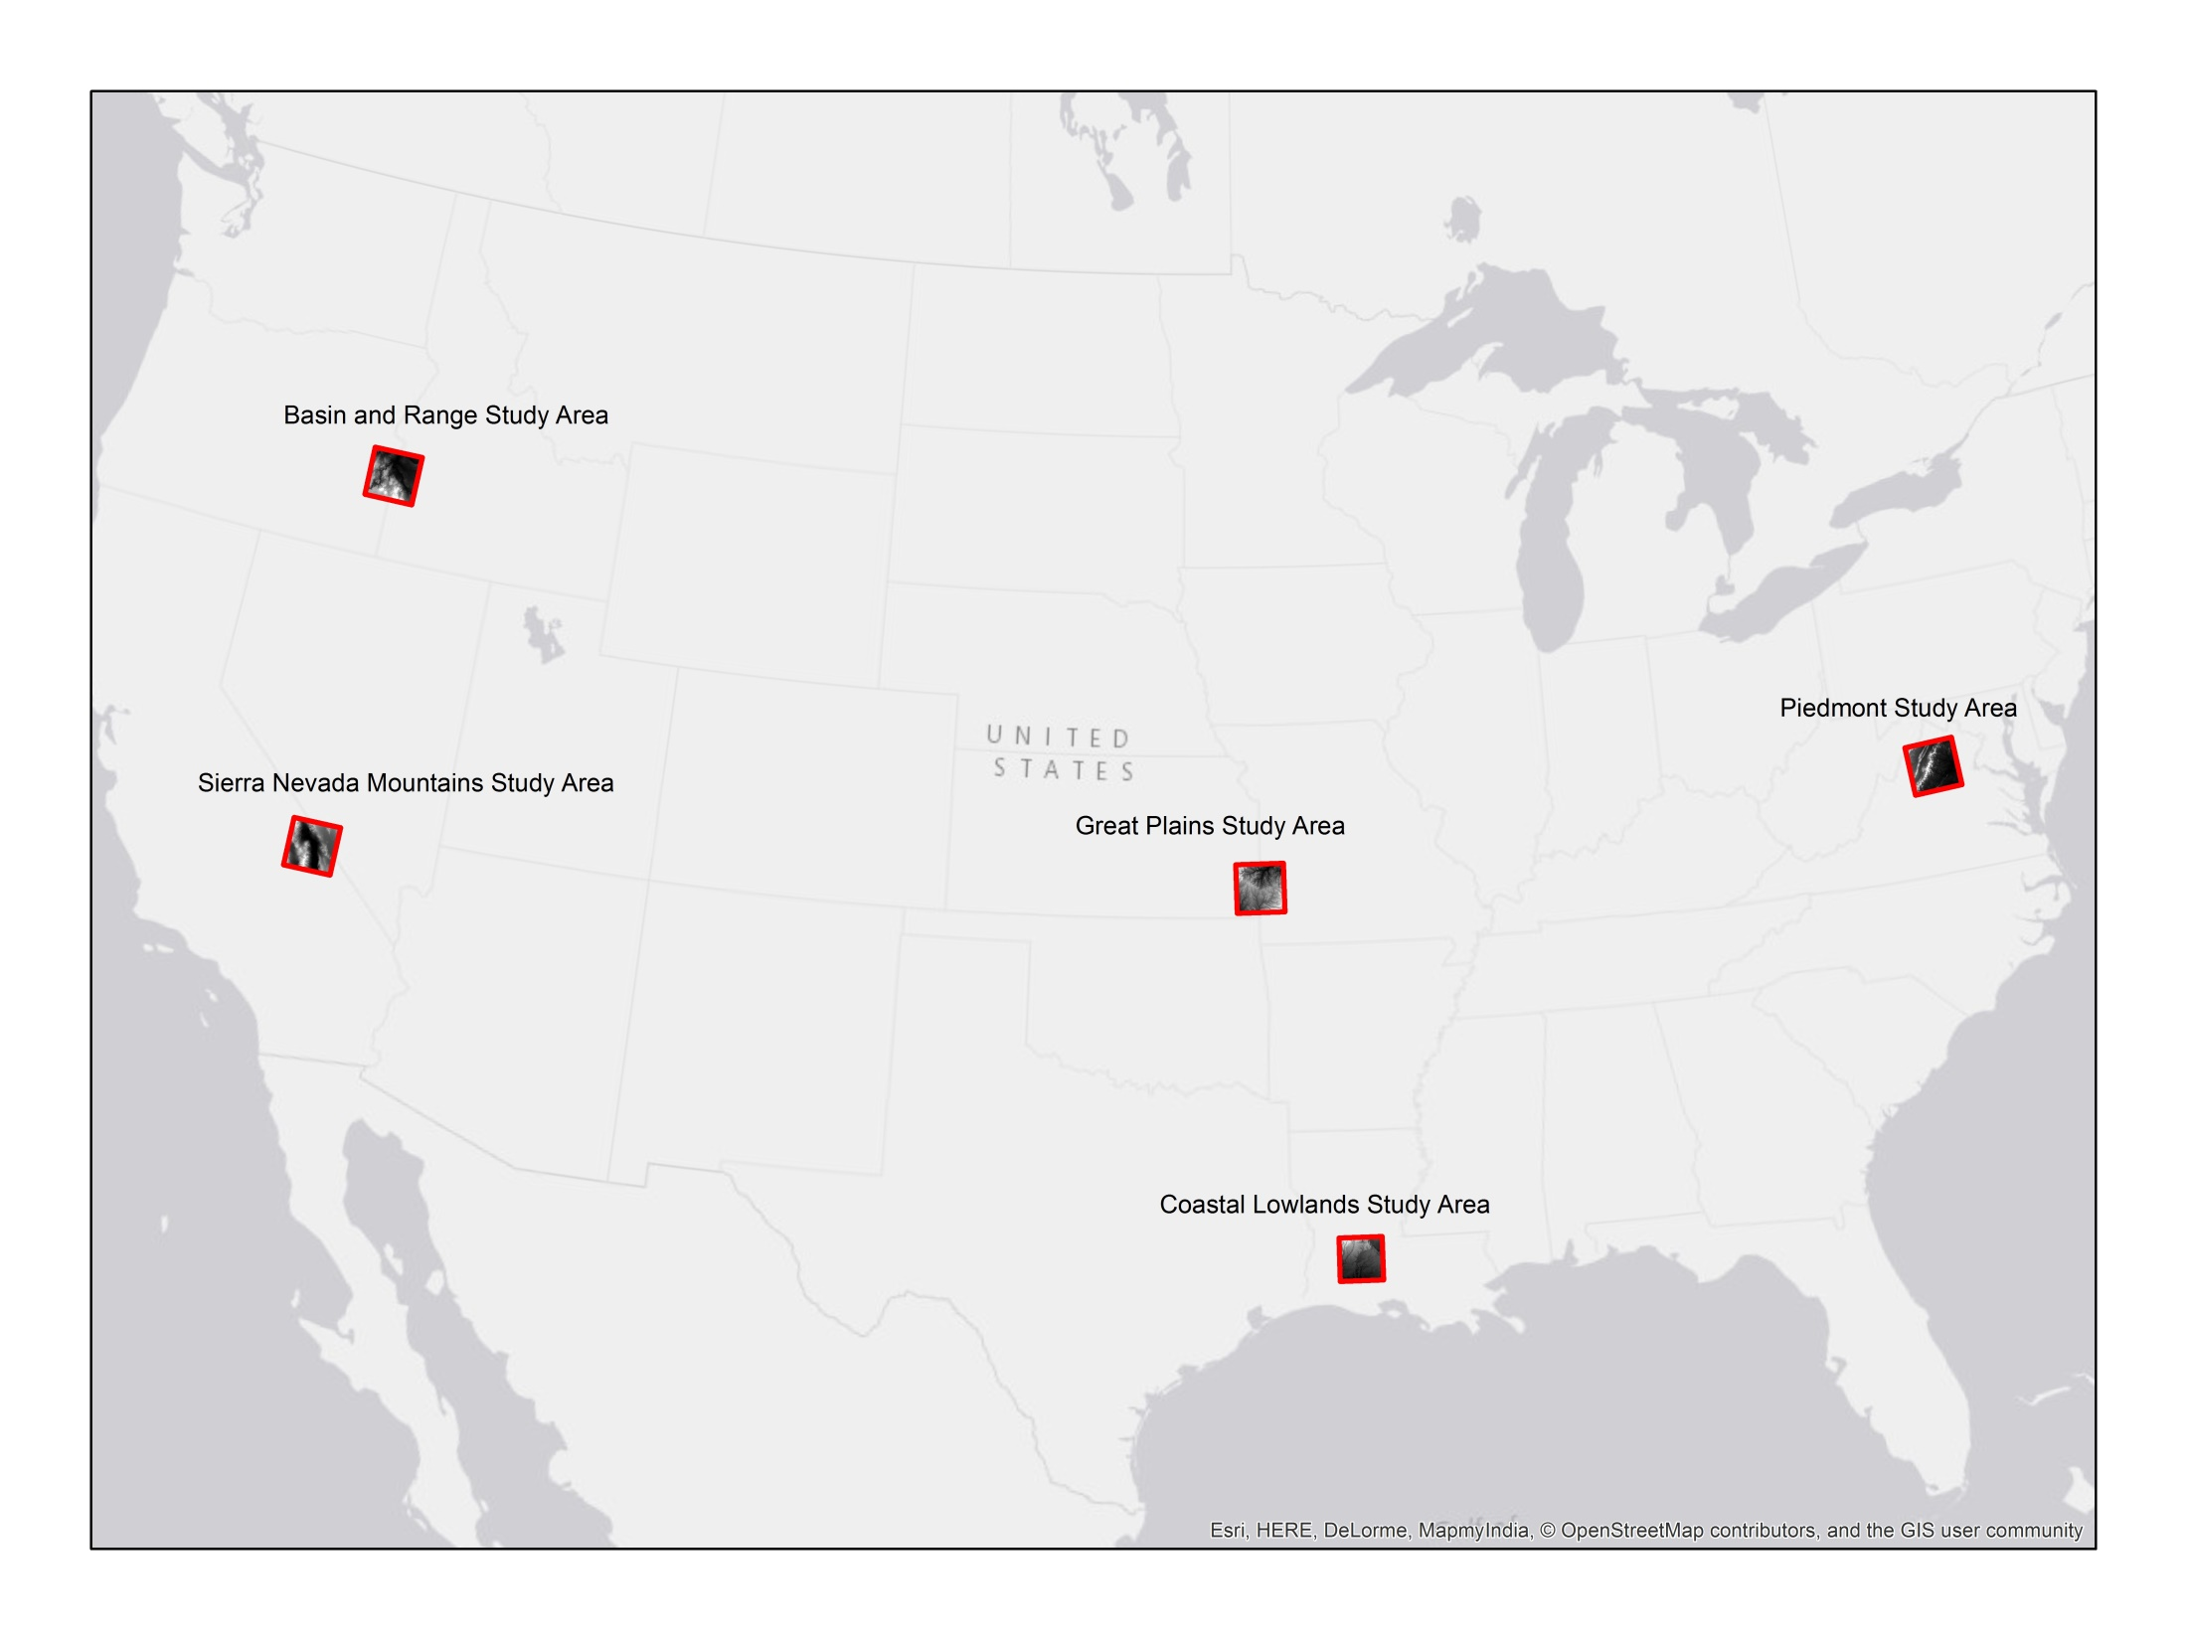

Slide 14
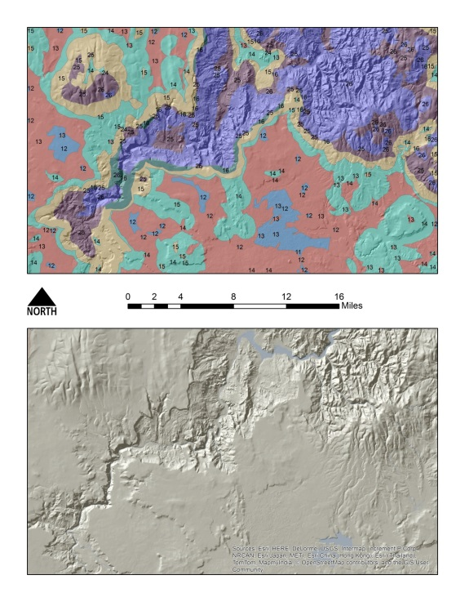
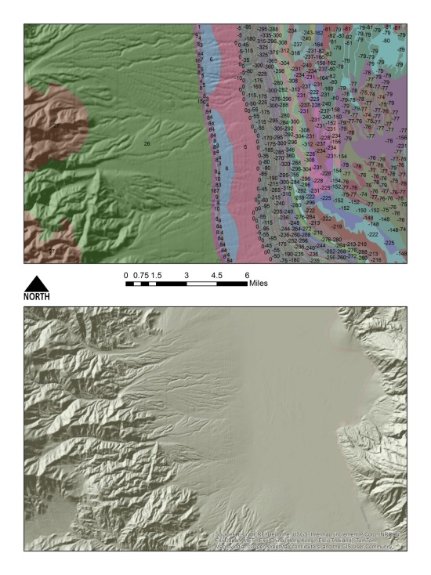
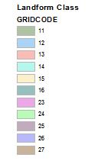
Major Errors
-Model conflates concave and convex areas of extreme relief, coding both as “Mountains”
-Model fails to correctly process DEMs containing cells with negative integer values (below sea level areas)

Slide 15
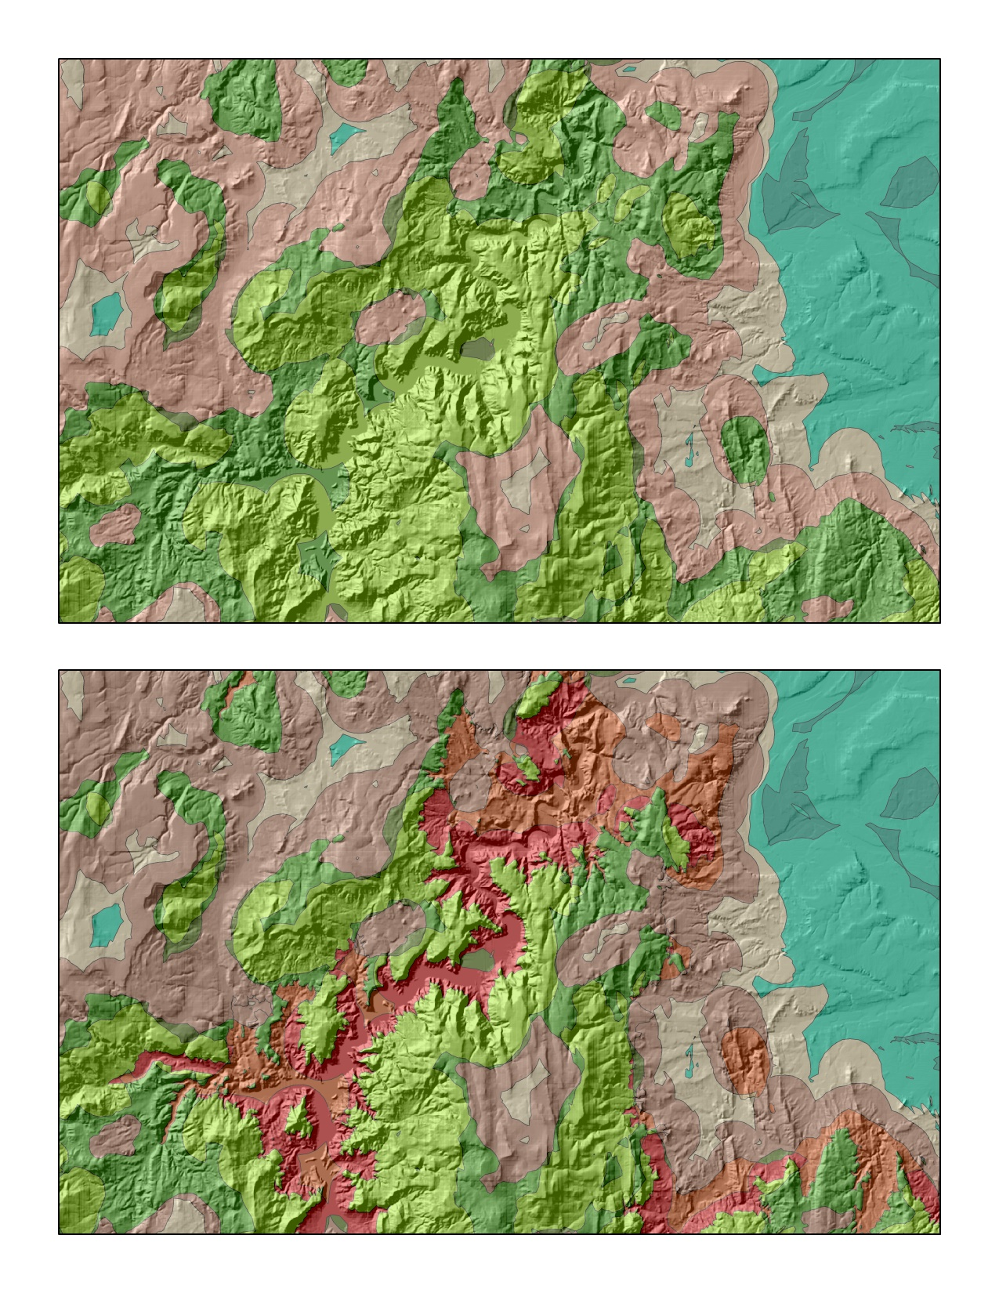
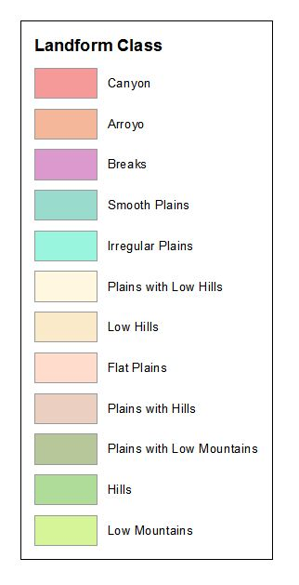
Peaks and Canyons

Slide 16
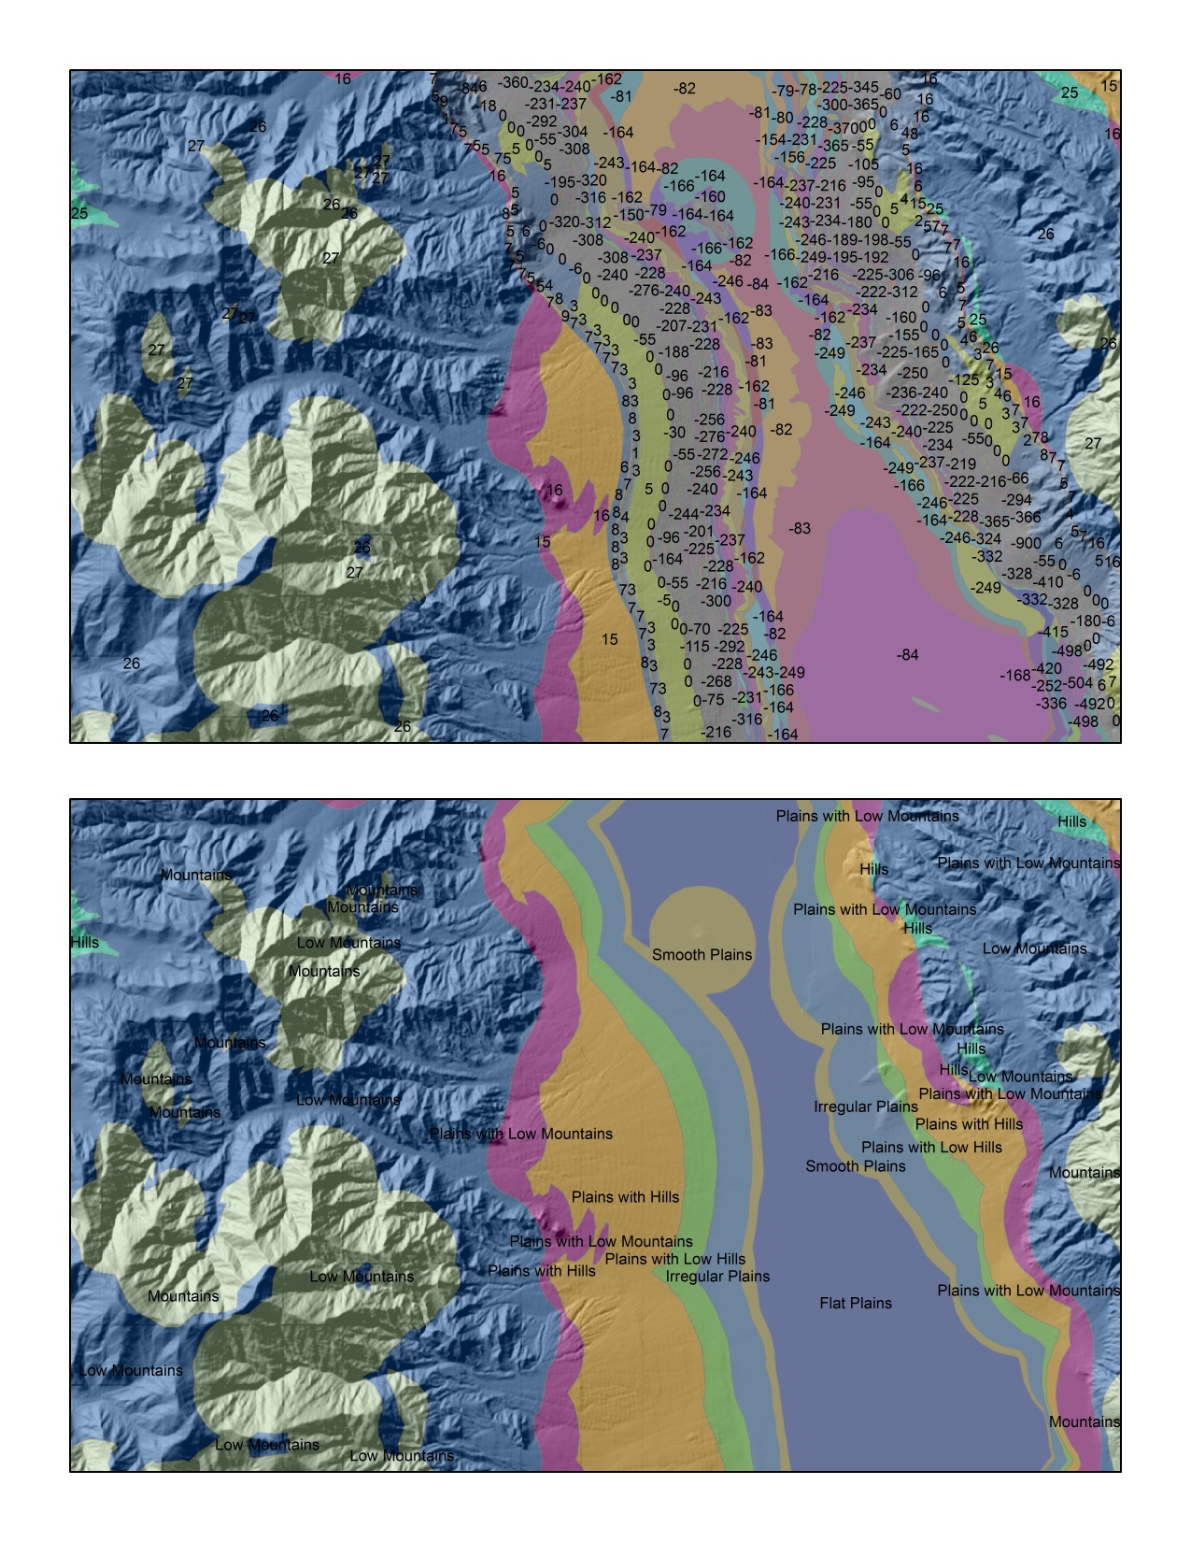
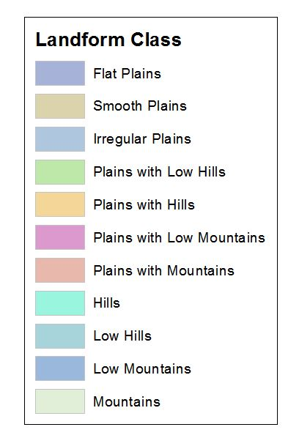
Negative Integer Cells

Slide 17
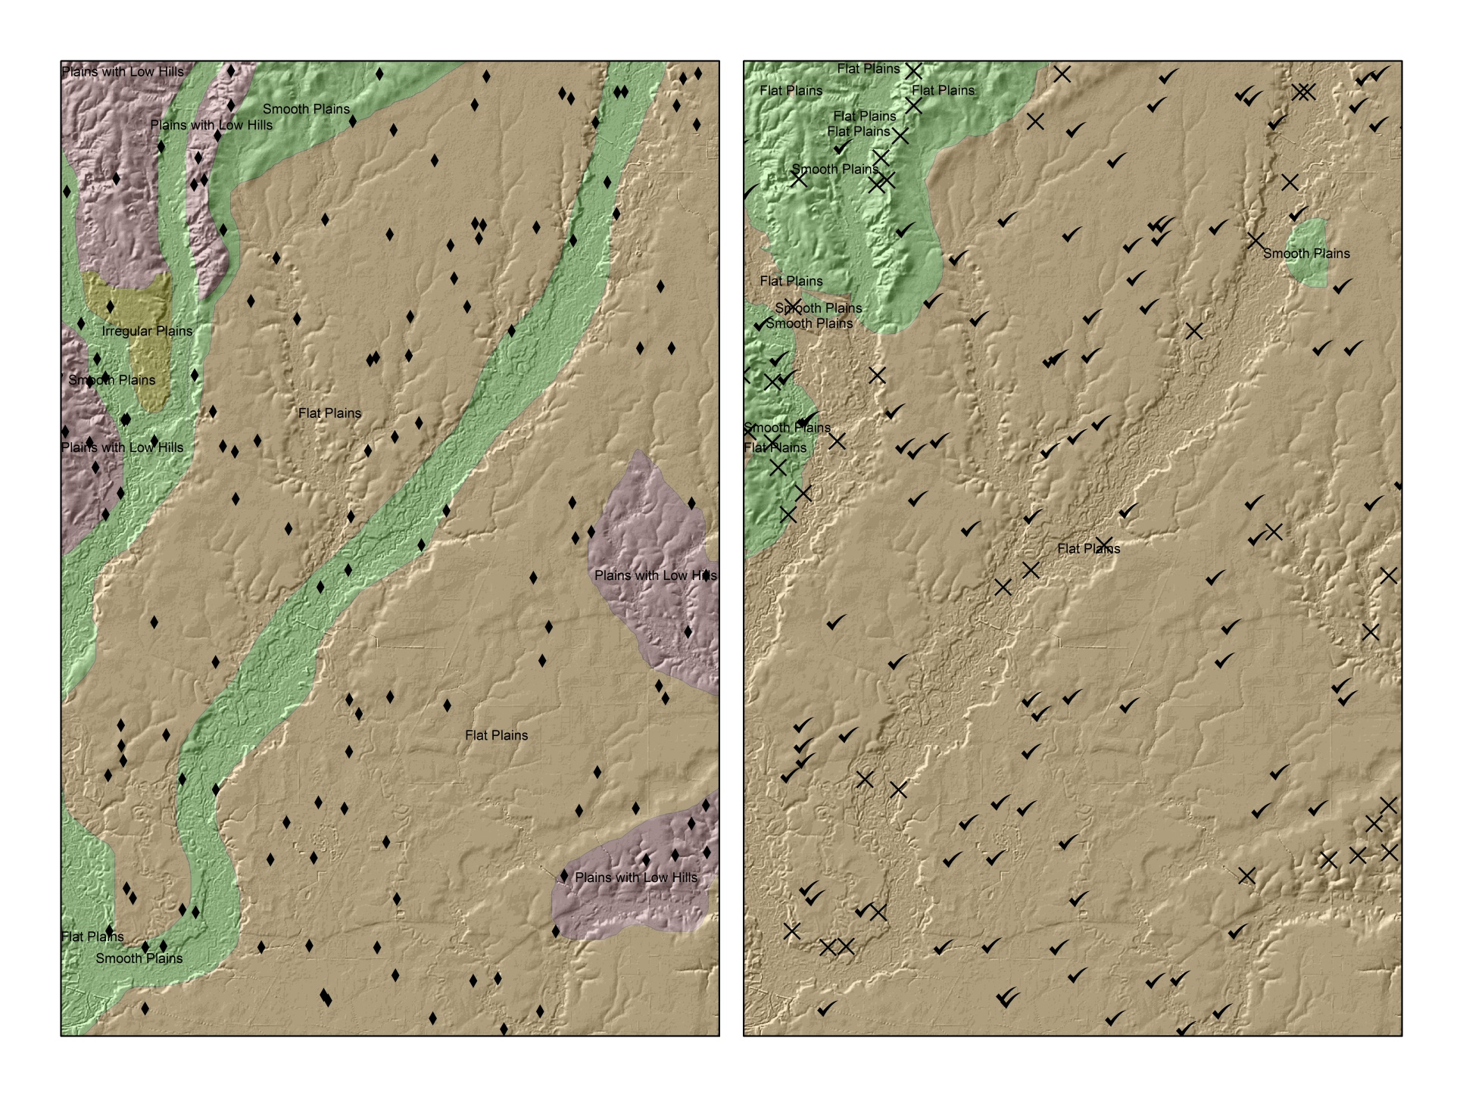
Model Verification

Slide 18
Photo Interpretation Methods
Photographic interpretation was guided by the landform classes defined in Morgan (2005) and Dikau (1991)
The 3D capabilities of Google Earth was be used to confirm mapping decisions, along with the following ancillary data:
National Agricultural Imagery Program (NAIP) aerial photography
USGS state geologic maps
USGS topographic maps
Soil Survey Geographic Database (SSURGO) data
National Hydrologic Dataset (NHD) data

Slide 19
ERROR MATRIX RESULTS
LFMapper Heads-up > | Arroyo | Breaks | Canyon | Flat Plains | Hills | Irregular Plains | Low Hills | Low Mountains | Mountains | Plains With Hills | Plains With Low Hills | Plains With Low Mountains | Plains With Mountains | Rough Plains | Rugged Plains | Smooth Plains | TOTAL | Percent Correct
Arroyo | 0 | 4 | 3 | 0 | 1 | 0 | 10 | 0 | 0 | 8 | 2 | 2 | 0 | 0 | 2 | 2 | 34 | 0
Breaks | 0 | 0 | 0 | 0 | 0 | 0 | 0 | 0 | 0 | 0 | 2 | 0 | 1 | 0 | 0 | 0 | 3 | 0
Canyon | 0 | 3 | 5 | 0 | 1 | 0 | 10 | 0 | 0 | 0 | 1 | 0 | 0 | 0 | 2 | 0 | 22 | 22%
Flat Plains | 0 | 0 | 0 | 784 | 0 | 30 | 0 | 0 | 0 | 3 | 73 | 0 | 0 | 0 | 0 | 120 | 1010 | 77%
Hills | 0 | 3 | 1 | 0 | 45 | 1 | 62 | 9 | 0 | 37 | 13 | 17 | 1 | 6 | 18 | 1 | 214 | 21%
Irregular Plains | 8 | 0 | 0 | 90 | 0 | 420 | 2 | 0 | 0 | 53 | 303 | 12 | 1 | 75 | 24 | 161 | 1149 | 36%
Low Hills | 0 | 0 | 0 | 0 | 0 | 0 | 1 | 0 | 0 | 6 | 2 | 0 | 1 | 0 | 2 | 1 | 13 | 7%
Low Mountains | 0 | 18 | 0 | 3 | 180 | 19 | 82 | 282 | 95 | 28 | 13 | 14 | 4 | 11 | 21 | 2 | 772 | 36%
Mountains | 0 | 0 | 0 | 0 | 0 | 1 | 0 | 24 | 45 | 0 | 0 | 0 | 0 | 0 | 0 | 0 | 70 | 64%
Plains With Hills | 1 | 5 | 2 | 27 | 18 | 78 | 28 | 1 | 0 | 69 | 42 | 13 | 3 | 42 | 17 | 21 | 367 | 18%
Plains With Low Hills | 5 | 1 | 0 | 41 | 0 | 74 | 23 | 0 | 0 | 55 | 56 | 37 | 8 | 58 | 27 | 25 | 410 | 13%
Plains With Low Mountains | 0 | 3 | 1 | 8 | 3 | 20 | 3 | 3 | 0 | 4 | 2 | 1 | 0 | 7 | 3 | 10 | 68 | 1%
Plains With Mountains | 0 | 0 | 0 | 0 | 0 | 1 | 0 | 0 | 0 | 0 | 0 | 0 | 0 | 0 | 0 | 0 | 1 | 0
Rough Plains | 0 | 0 | 0 | 0 | 0 | 0 | 0 | 0 | 0 | 0 | 0 | 0 | 0 | 0 | 0 | 0 | 0 | 0
Rugged Plains | 0 | 0 | 0 | 0 | 0 | 0 | 0 | 0 | 0 | 0 | 0 | 0 | 0 | 0 | 0 | 0 | 0 | 0
Smooth Plains | 2 | 0 | 0 | 131 | 0 | 352 | 0 | 0 | 0 | 40 | 61 | 0 | 0 | 7 | 0 | 269 | 862 | 31%
TOTAL | 16 | 37 | 12 | 1084 | 249 | 996 | 221 | 319 | 140 | 303 | 570 | 96 | 19 | 206 | 116 | 612
Percent Correct | 0 | 0 | 41% | 72% | 18% | 42% | 0 | 88% | 32% | 22% | 10% | 1% | 0 | 0 | 0 | 43%
Total Observations: 5,000
Total Observations in Agreement: 1,977
Percentage Correct: 39%
Klingseisen et al. , in their 2007 paper “Geomorphometric Landscape Analysis Using a Semi-Automated GIS Approach” in the journal Environmental Modeling & Software, used a similar approach to test the “accuracy” of their landform mapping software application “LANDFORM 2” against a heads-up expert classification of the landforms in their study area and achieved a percentage correct of 43%.

Slide 20
RESULTS CONTINUED
STUDY AREA | PHYSIOGRAPHIC REGION | PERCENT AGREEMENT | HEADS UP POLYGON COUNT | AUTOMATED POLYGON COUNT | HEADS UP LANDFORM CLASSES REPRESENTED | AUTOMATED LANDFORM CLASSES REPRESENTED
VIRGINIA | PIEDMONT | 22% | 153 | 1218 | 11 | 10
CALIFORNIA | SIERRA NEVADA MOUNTAINS | 28% | 163 | 1126 | 13 | 11
KANSAS | GREAT PLAINS | 51% | 33 | 882 | 3 | 3
LOUISIANA | COASTAL LOWLANDS | 73% | 34 | 158 | 5 | 3
OREGON | BASIN AND RANGE | 21% | 157 | 2951 | 12 | 12
COMBINED STUDY AREAS | ALL OF THE ABOVE | 39% | 540 | 6335 | 16 | 14

Slide 21
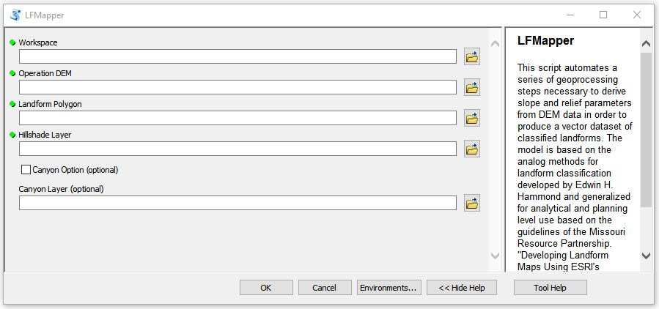
CONCLUSIONS
A standard, widely distributed data set of classified landforms accepted by the discipline of geomorphology would be a more ideal control group against which to verify the output of LFMapper than my heads-up classification.
While not perfect and not as advanced as some current methods, LFMapper presents something that did not exist before: an easily distributed, mathematically rigorous, research based application for ArcGIS that classifies landforms with minimal input from the user.

Slide 22
Further Work
Supervised Classification (Veronesi & Hurni 2014)
Pattern Recognition Classification (Jasiewicz & Stepinksi 2012)
Fuzzy Sets & Systems (Burrough, Van Gaans & MacMillan 2000), (MacMillan, Pettapiece, Nolan, & Goddard 2000), (Schmidt & Hewitt 2004)
Verify LFMapper against other current automated landform classification methods

Slide 23
LFMapper Access
“LFMapper” toolbox file and python source code are available at lfmapper.blogspot.com. Please feel free to visit the site, download and use the tool, and download and improve the source code. The bibliography and write-up for this project are also hosted there.

Slide 24
Works Cited
Burrough, P.A, P.F.M Van Gaans, R.A. MacMillan. "High-Resolution Landform Classification Using Fuzzy k-Means" Fuzzy Sets and Systems 113 (2000) 37-52
Dikau, Richard, Earl E. Brabb, Robert M. Mark. "Landform Classification of New Mexico By Computer" Open-File Report Number 91-634. 1990. USDI USGS.
Dikau, Richard. “The Application of a Digital Relief Model to Landform Analysis in Geomoprhology” Three Dimensional Applications in Geographical Information Systems (1989) 51-77
Fenneman, Nevin M. “Physiographic Boundaries Within the United States” Annals of The Association of American Geographers, Vol. 4, (1914) pp. 84 – 134
Hammond, Edwin H. “Analysis of Properties in Land Form Geography: An Application to Broad-Scale Land Form Mapping” Annals of the Association of American Geographers, Vol. 54, No. 1 (Mar. 1964) pp. 11 – 19
Hammond, Edwin H. “Small-Scale Continental Landform Maps” Annals of the Association of American Geographers, Vol. 44, No. 1 (Mar. 1954) pp. 33 – 42
Jasiewicz, Jaroslaw, Tomasz F. Stepinski. “Geomorphons – A Pattern Recognition Approach to Classification and Mapping of Landforms” Department of Geography, University of Cincinnati, Cincinnati, OH 45221-0131, USA, Geoecology and Geoinformation Institute Adam Mickiewicz University, Dziegielowa 27, 60-680 Poznan, Poland
Klingseisen, Bernhard, Graciela Metternicht, Gernot Paulus. "Geomorphometric Landscape Analysis Using a Semi-Automated GIS Approach" Environmental Modeling & Software xx (2007) 1-13
MacMillan, R.A., R. Keith Jones, David H. McNabb. "Defining a Heirarchy of Spatial Entities for Environmental Analysis and Modelling using Digital Elevation Models (DEMS)" Computers, Environment and Urban Systems 28 (2004) 175-200
MacMillan, R.A., W.W. Pettapiece, S.C. Nolan, T.W. Goddard. “A Generic Procedure for Automatically Segmenting Landforms into Landform Elements Using DEMs, Heuristic Rules and Fuzzy Logic” Fuzzy Sets and Systems 113 (2000) 81 – 109
Minar, Jozef, Ian S. Evans. "Elementary Forms for Land Surface Segmentation: The Theoretical Basis of Terrain Analysis and Geomorphological Mapping" Geomorphology 95 (2008) 236-259
Morgan, John M., Ashley M. Lesh. "Developing Landform Maps Using ESRI's ModelBuilder". (paper presented at the ESRI user conference, 2005)
Pike, Richard J. “The Geometric Signature: Quantifying Landslide Terrain Types from Digital Elevation Models” Mathematical Geology 20 (1988) (5) 491-511
Savigear, R. A. G. “A Technique of Morphological Mapping” Annals of the Association of American Geographers, Vol. 55, No. 3 (Sept. 1965) pp. 514 - 538
Schmidt, Jochen, Allan Hewitt. “Fuzzy Land Element Classification from DTMs Based on Geometry and Terrain Position” Geoderma 121 (2004) pp. 234 - 256
US Forest Service, 2015, Daniel Boone National Forest Website History section (http://www.fs.usda.gov/detail/dbnf/learning/history-culture/?cid=stelprdb5291202) accessed 7/17/2015 by Josh Moss
Veronesi, F., L. Hurni. “Random Forest with Semantic Tie Points for Classifiying Landforms and Creating Rigorous Shaded Relief Representations” Geomorphology 224 (2014) 152-160
Zawawi, Azita Ahmad, Masami Shiba, Noor Janatun Naim Jemali. “Landform Classification for Site Evaluation and Forest Planning: Integration between Scientific Approach and Traditional Concept” Sains Malaysiana 43 (3) (2014): 349 – 358

