Slide 1
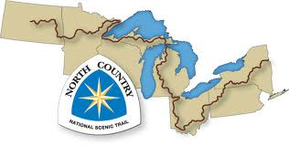
NCT Maintenance GIS
Jesse Mourer
Advisor: Jan Wallgrün

Slide 2
Overview
Background
The Problem
Current Systems
Goals and Objectives
Methodology
Application Description
Project Time Line
Anticipated Results
Problems Encountered

Slide 3
Background
NCT a 4,600 mile hiking trail
Bismarck North Dakota to Finger Lakes New York
Focusing on North Country Trail National Scenic trail
Butler County PA
My family has been very involved for several years in trail development and maintenance.
280 miles in PA
40 miles in Butler County
4 miles adopted
Confronted with many of the maintenance problems encountered

Slide 4
The Problem
Many Hiking trails maintained by volunteer groups
Communicating with a large diverse group to perform maintenance
Small problems can turn into large ones with out immediate attention
No good system for hikers or volunteers to report problems
No way for hikers to know what they may encounter

Slide 5
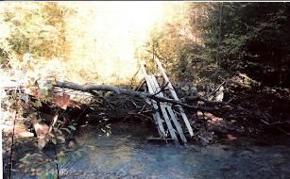
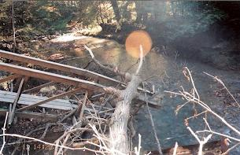

Slide 6
Current Systems
National Scenic Trails
North Country Trail – Email system
Appalachian Trail – Email system
Pacific Crest Trail – Message board

Slide 7
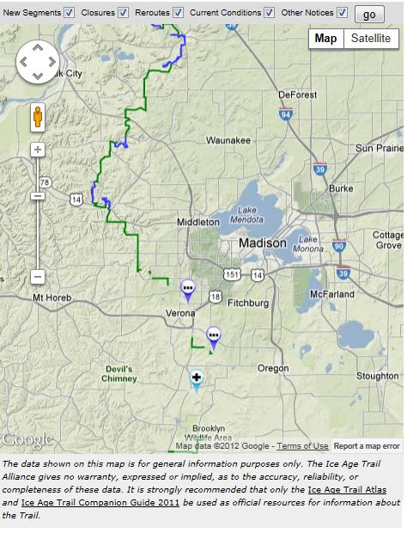
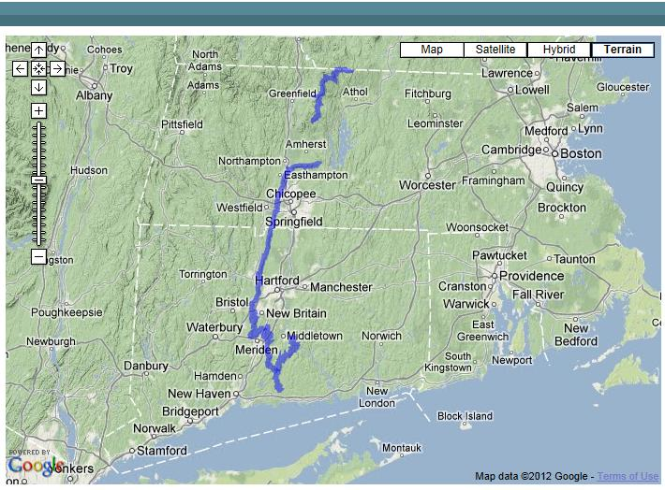
Current Systems
Ice Age Trail – Map displaying changes
New England Trail – Map displaying trail

Slide 8
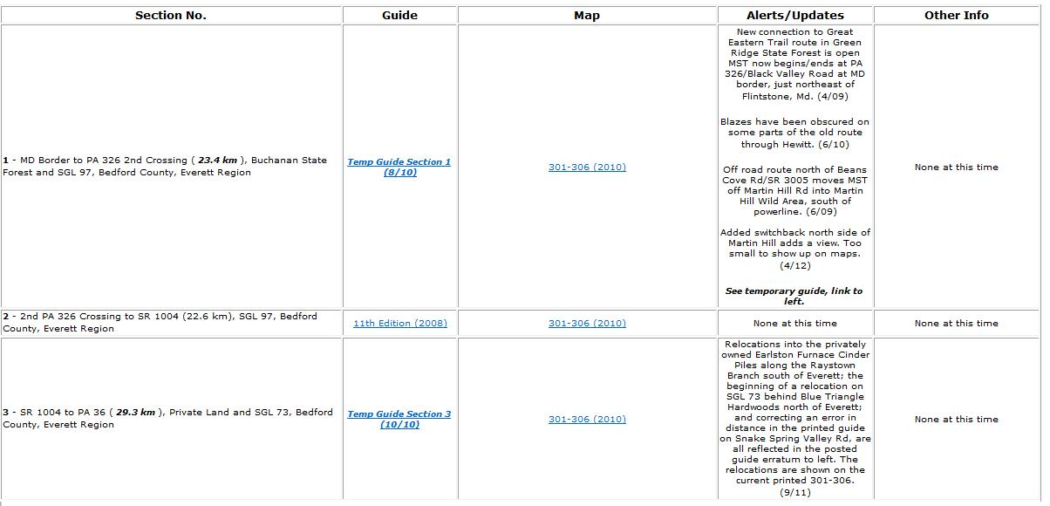
Current Systems
Local Trails
Mid-State trail – Message Board
Baker Trail – Email
Alleghany Front Trail - Email
Quehanna Trail - Email

Slide 9
Goals and Objectives
Develop a web mapping app for NCT
Butler County
Allow hikers to report areas in need of maintenance
Immediately notify the volunteer responsible for maintenance in that area
Allows other volunteers to see the area of concern
Alert hikers of possible problems
Increase the web presence of NCT
Let the hikers feel vested in the trail

Slide 10
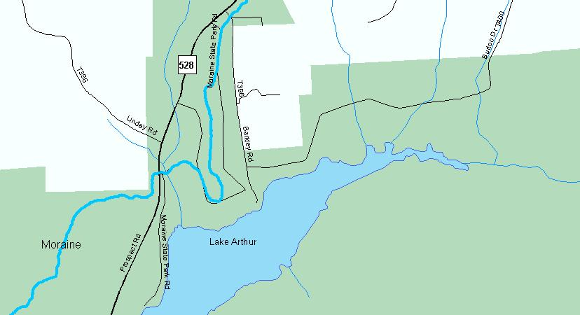
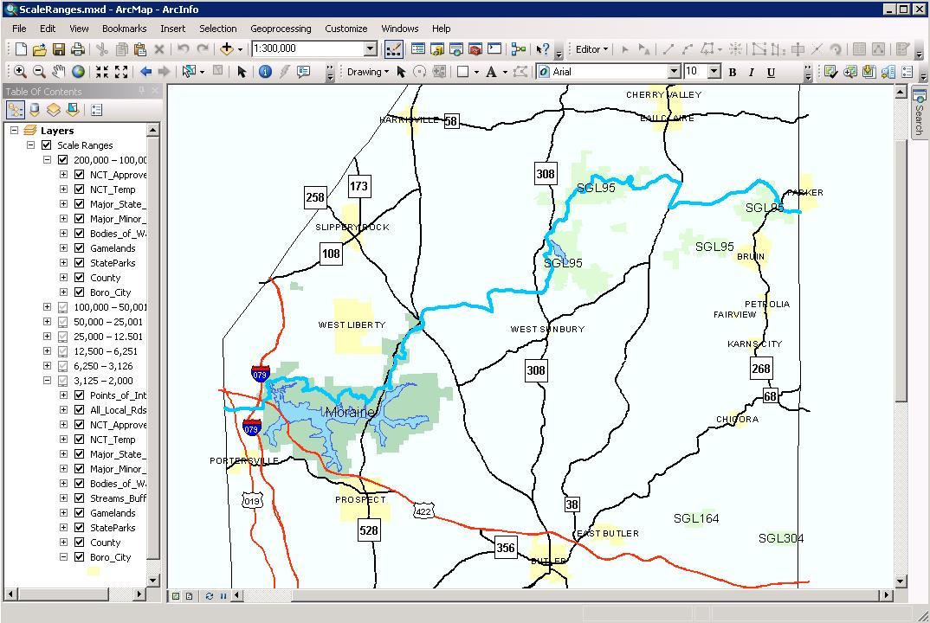
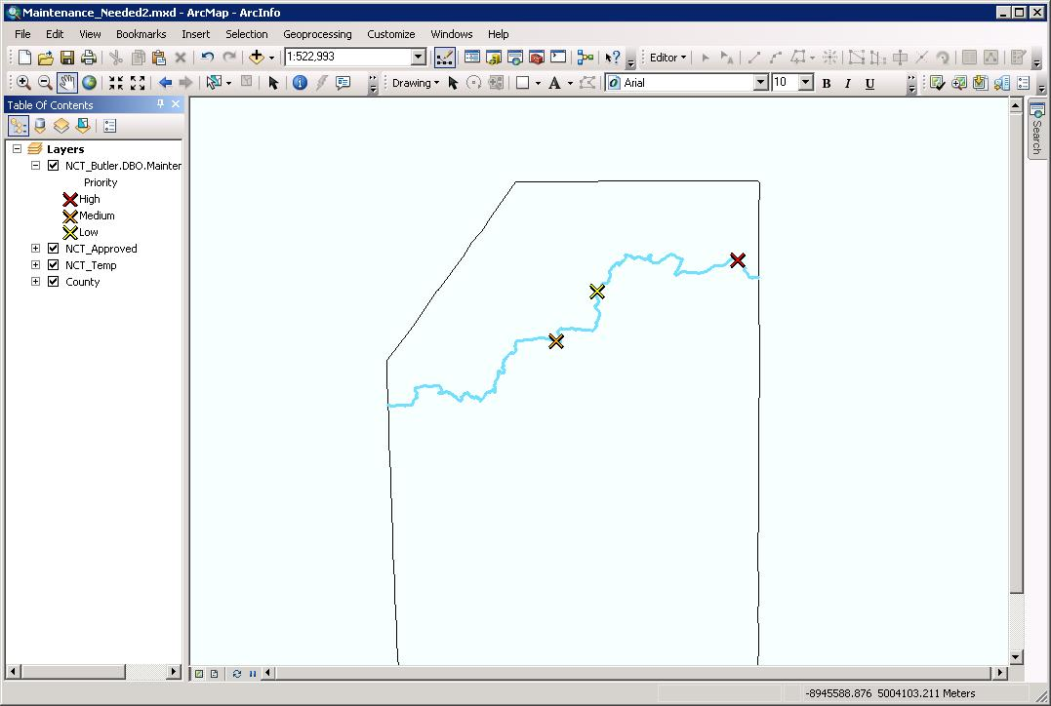
Methodology
Creating the map and editable layers
ArcMap10
Created two different maps
Feature layer map and Tile layer map

Slide 11
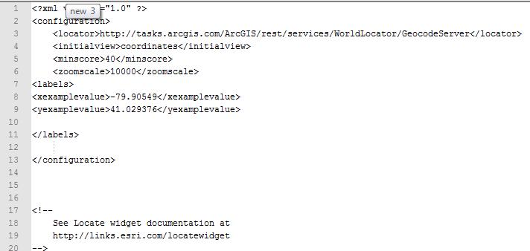
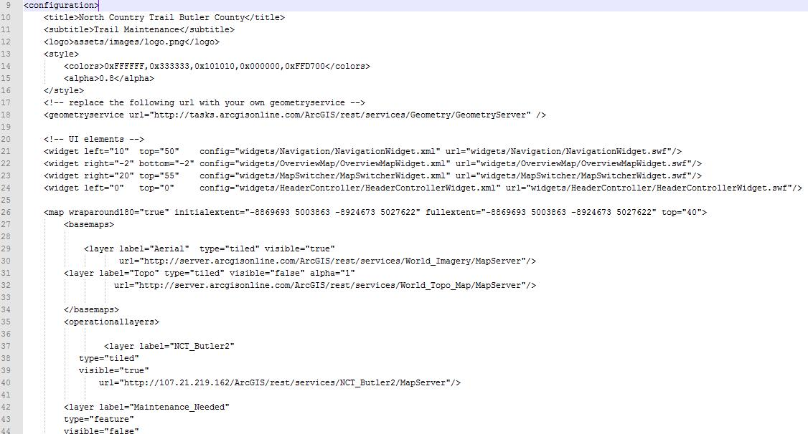
Methodology
Publishing the Map
Flexviewer

Slide 12
Methodology
Create a web page for hosting the map
Beta testing for the mapping app
Will work with the butler chapter of the NCT
Questionnaire of users
Determine benefits and difficulties encountered
Rework the system
Re-launch the system
Questionnaire of users
Determine if problems have been addressed

Slide 13
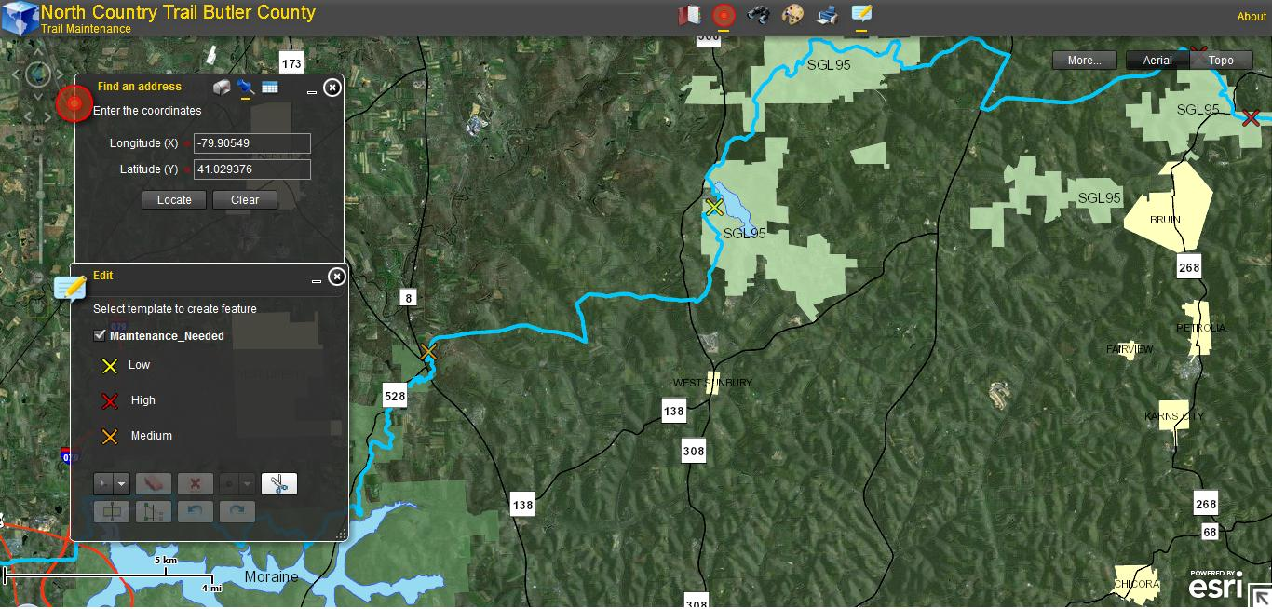
Application Description
Allow hikers to log into a web page
Help prevent false reports
Hikers will see a map of the NCT

Slide 14
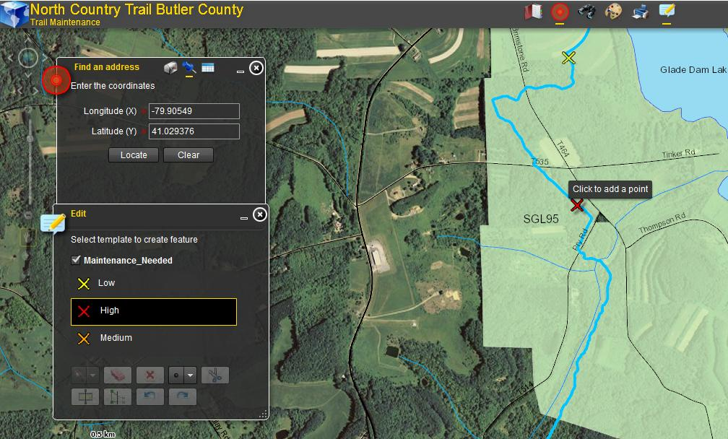
Application Description
Hikers will then click on the section of the trail were they encountered the problem

Slide 15
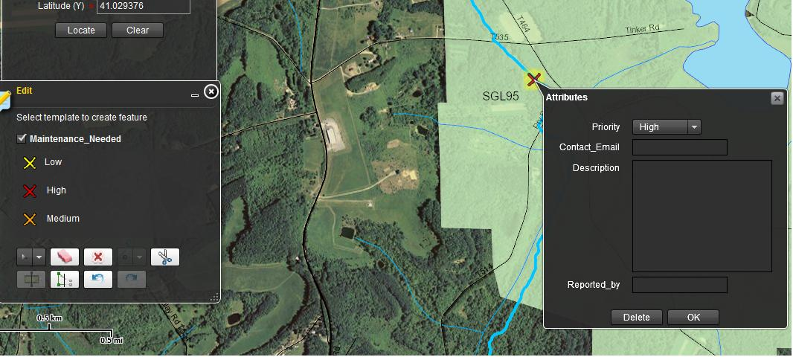
Application Description
They will be able to select the priority of the problem
Type a description
Add in contact info

Slide 16
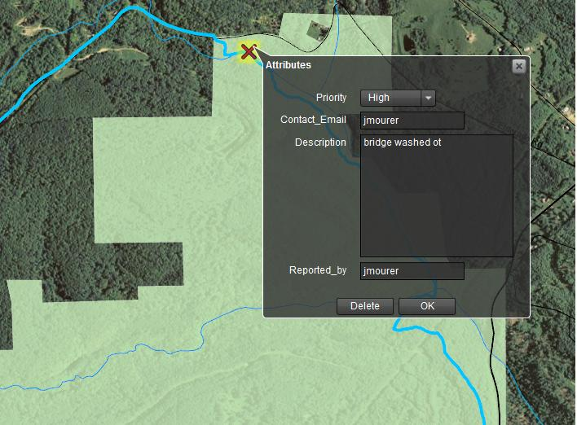
Application Description
Hikers will be able to view the map and see areas of problem
Allowing them to avoid areas of concern

Slide 17
Project Time Line
Develop web app – July 2012
Beta testing app – Aug through Oct 2012
Questionnaire/replies – Nov 2012
Re-working of App – Dec 2012 – March 2013
Little use of trail

Slide 18
Project Time Line
Re-launch and testing – April – June 2013
Questionnaire – July 2013
Present at the North Country Trail Association Annual Conference – July/August 2013

Slide 19
Anticipated Results
Speed the process of trail maintenance
More convenient way of reporting trail problems
Allow volunteers to determine the location of problems
Volunteers working on more than just their sections
Other chapters in PA and other states utilizing the system

Slide 20
Problems Encountered
E-mail trail adopters
An automatic e-mail is sent
Trouble doing this using flexviewer
Funding
Declining Funding for NPS
100 Million in 2011
Highest cut in Construction
Declining Funding in Membership and Donations

Slide 21
Questions? Thank you

