Slide 1
Automating the Vermont Agency of Transportation Highway Performance Monitoring System Submittal
David Narkewicz (din5014@psu.edu)
MGIS Capstone
GEOG 596A – Summer 2018
The Pennsylvania State University
Advisor: Jim Detwiler (jed124@psu.edu)

Slide 2
Today’s Agenda
Who am I?
What is the Highway Performance Monitoring System?
Vermont Agency of Transportation’s Structure
Vermont Agency of Transportation’s Current Highway Performance Monitoring System Process
Project Literature Review
Project Goals
Project Methodology
Expected Results
Timeline
Tentative Presentation Venues

Slide 3
Who am I?
David Narkewicz
The Pennsylvania State University
B.S. Meteorology, Minor GIS; 2011
Postbaccalaureate Certificate in GIS; 2013
Masters of GIS; Expected 2019
State of Vermont Agency of Transportation (VTrans) – 4 Years
Asset Management Unit – Data Management Section
GIS Professional III
Recently served as the Highway Performance Monitoring System Technician for 3 years

Slide 4
What is the Highway Performance Monitoring System?
HPMS
Developed in 1978 by Federal Highway Administration (FHWA)
FHWA mandates each state submit roadway condition & performance data yearly on all public roads
Extent
Condition
Performance
Use
Operating Characteristics
Key source of data for Conditions & Performance (C&P) Report to Congress which is used to determine apportionment of Federal-aid funds
Reassessed in 2010 to center around GIS
Currently 70 different data items are reported

Slide 5
HPMS Data Types and Items
Geometric
Lane Width
Median Type
Median Width
Shoulder Type
Right Shoulder Width
Left Shoulder Width
Peak Parking
Widening Obstacle
Widening Potential
Curve Classification
Terrain Type
Grade Classification
Percent Passing Sight Distance
Inventory
Functional System
Urban Code
Facility Type
Structure Type
Access Control
Ownership
Through Lanes
Peak Lanes
Counter Peak Lanes
Right Turn Lanes
Left Turn Lanes
Speed Limit
Managed Lane Operations Type
Managed Lanes
Toll Charged
Toll Type
County Code
Maintenance & Operations
Directional Through Lanes
Pavement
Present Serviceability Rating
Faulting
Cracking Length
Climate Zone**
Soil Type**
International Roughness Index
Surface Type
Rutting
Cracking Percent
Year of Last Improvement
Year of Last Construction
Last Overlay Thickness
Thickness Rigid
Thickness Flexible
Base Type
Base Thickness
Route
Route Number
Route Signing
Route Qualifier
Alternative Route Name
Special Networks
Strategic Highway Network
National Highway System
National Truck Network
Future National Highway System
Traffic
Annual Average Daily Traffic Unit
Single Unit Truck and Bus AADT
Percent Peak Single-Unit Truck and Buses
Combination Truck AADT
Percent Peak Combination Trucks
K-factor
Directional Factor
Future AADT
Signal Type
Percent Green Time
Number of Signalized Intersections
Number of Stop-Sign Controlled Intersections
Number of Intersections, Type-Other
Capacity
Notes:
How segmentations work: Functional class

Slide 6
HPMS Reporting
Key annual HPMS submittal dates
April 15th (Interstate) and June 15th (Non-Interstate)
Last full year’s data
2018 submittal is 2017 data
Mileage must be consistent with Certified Public Road Mileage signed by States’ Governors annually
Submittal includes:
Linear referencing system (LRS) data
Roadway inventory/attribute data
HPMS submittal must be transmitted to FHWA via web-based application

Slide 7
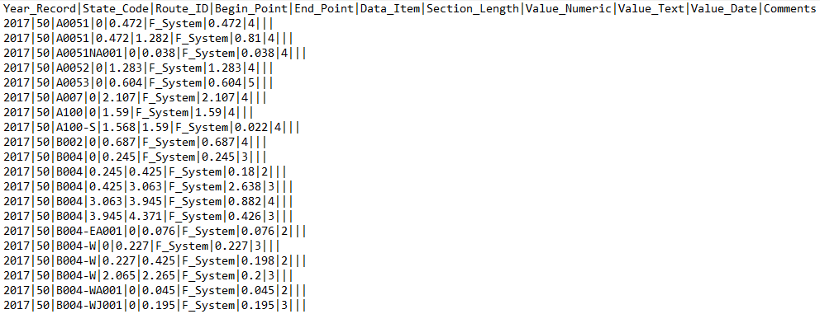
HPMS Data Software Standard
Text file with values separated by ‘|’
Content
Year_Record
State_Code
Route_ID
Begin_Point
End_Point
Data_Item
Section_Length
Value_Numeric
Value_Text
Value_Date
Comments (Optional)

Slide 8
VTrans Unit Structure
5 Data Owners
Mapping Unit
Manages and maintains the official record of all public roadways in the state
Pavement Unit
Manages and maintains the official pavement statistics for the state
Structures Unit
Manages and maintains the official bridge data for the state
Traffic Unit
Manages and maintains the official traffic statistics for the state
Asset Management – HPMS Technician
Responsible for all data items not owned by other units

Slide 9
VTrans Data Structure
Primary GIS software vendor used by Vermont is Esri
Data resides in ArcSDE relational database
multiuser relational geodatabase that can be edited and used simultaneously by many users
SQL server based
HPMS technician has active connections to other units data through the ArcSDE environment
Non-Esri based data is transferred to HPMS technician through Excel files and emails

Slide 10
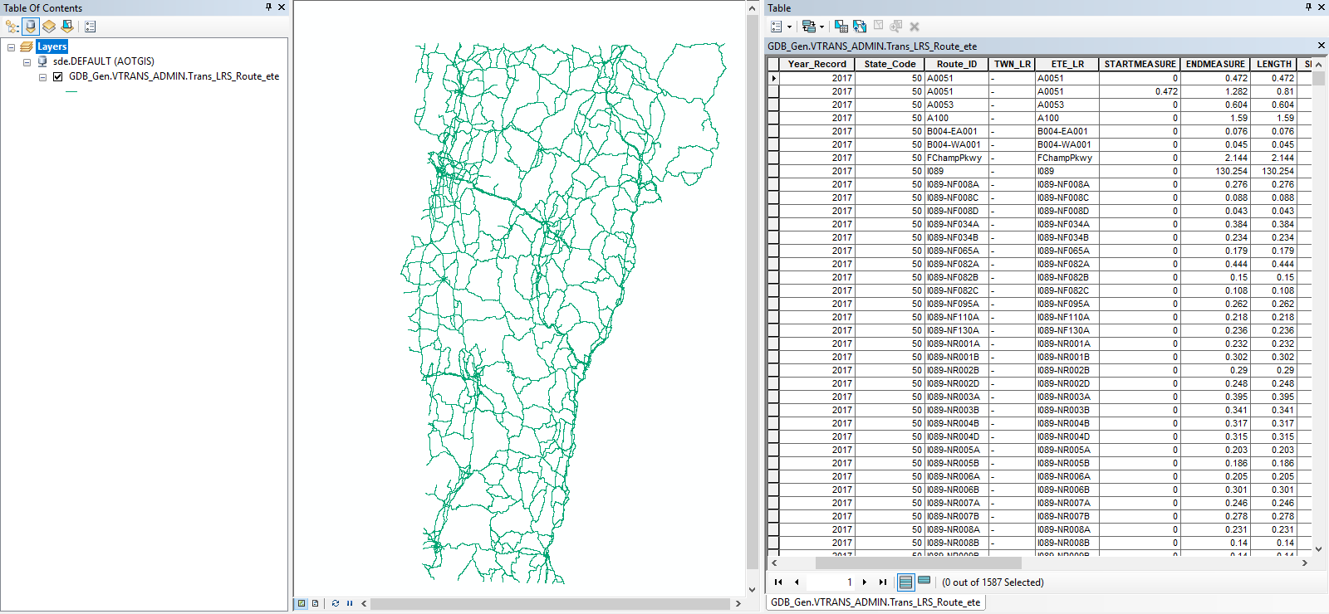
ArcSDE Data Example
Vermont's Official LRS

Slide 11
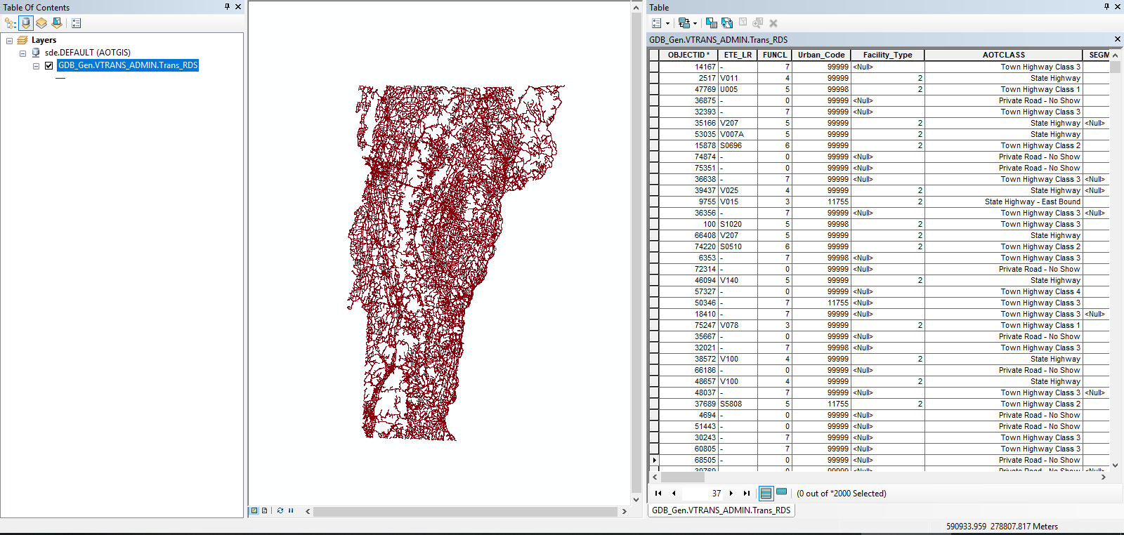
ArcSDE Data Example(Continued)
Vermont's Official Road Centerline

Slide 12
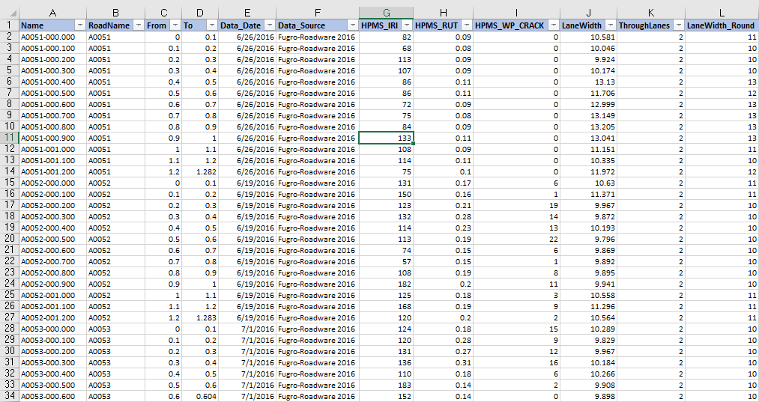
Excel Data Example
Pavement data is stored in a pavement management software
exported to Excel

Slide 13
VTrans Current HPMS Process
Manual
Time consuming
Requires HPMS technician to manually set up and run each step of the process for each data item
Requires HPMS technician to transfer each data item’s process results into the HPMS software standard for upload

Slide 14
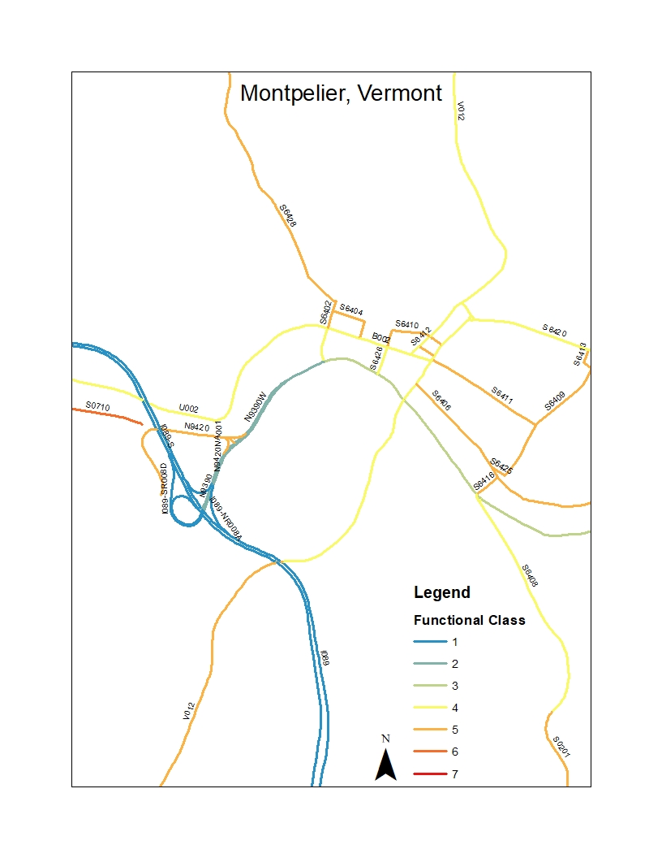
HPMS Data Item Process Example
Functional Class
Assigned roadways according to the service they provide in relation to the total roadway network
Interstate
Principal Arterials – Other Free/Expressway
Principal Arterial
Minor Arterial
Major Collector
Minor Collector
Local
Notes:
Slow down, break it down.

Slide 15
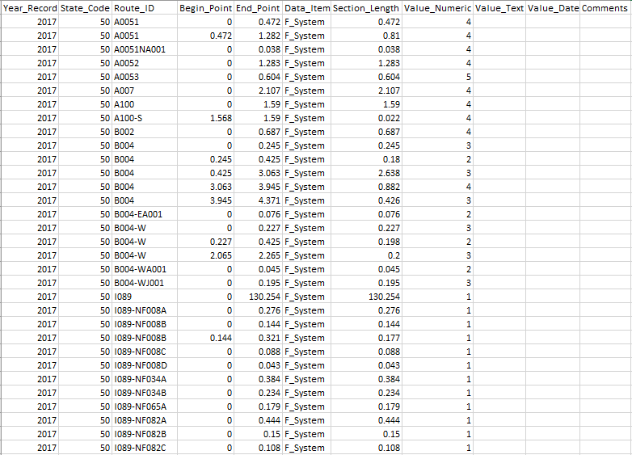
HPMS Data Item Process Example (Continued)
Layers: LRS, Road Centerline
Select Road Centerline by attributes
Functional Class greater than 0
LRS Code Value has a valid value
Export selection to new shapefile
FUNCL
Dissolve FUNCL by Functional Class and LRS Code fields.
FUNCL_Dissolve
Locate Features Along Routes with FUNCL_Dissolve and LRS
GIS_Functional_Class
Export GIS_Functional_Class To Excel
Excel_Functional_Class
Format Excel_Functional_Class into HPMS Software standards and upload

Slide 16
Project Literature Review
Limited discussion on automating HPMS
2016 AASHTO GIS-T Symposium Presentation
Going Off on a Tangent!
Texas Department of Transportation (TXDOT)
Python script to automate the processing of curve classification of roadway segments based on GIS centerline data
Scripts posted to GitHub
http://www.gis-t.org/uploads/441%20Jason_Kleinert_curves_hamster_GIST_2016%20(1).pdf
VTrans plans to leverage TXDOT finding in this project

Slide 17
Project Goal
Automate each data item’s processing
Technology
ArcGIS for Desktop
Python 2.7
Create scripts that run on demand and are scheduled to run on a server
The result will require minimal set up and monitoring from the HPMS technician to produce HPMS software ready files for each data item

Slide 18
Project Methodologies
Break data items into groups of scripting difficulty
Identify owners of data items
Identify data item database
Identify extent of data available for data items
Identify if processing can be scripted with Python

Slide 19
Scripting Difficulty Groups
Transfer – 12 Data Items
These data items are in the HPMS Software structure but not format. A transfer script will process these data items from their current format into the HPMS software format.

Slide 20
Scripting Difficulty Groups
Easy – 12 Data Items
These data items will require a small number of script steps to process the base data into the HPMS structure, then transfer them into the HPMS software format.

Slide 21
Scripting Difficulty Groups
Hard – 15 Data Items
These data items will require numerous script steps to process the base data into the HPMS structure, then transfer them into the HPMS software format.

Slide 22
Scripting Difficulty Groups (Continued)
Difficult – 5 Data Items
These data items have readily available base data, but they do not cover the full extent required for HPMS
These scripts will process the data available and identify gaps in coverage
The HPMS technician will be responsible for filling in the gaps in coverage by visually inspection
Visual inspection data are captured from project plans, VTrans Video Logs (http://vtrans.vermont.gov/working/videologs), and field visits.
Once data collection is complete the transfer script will transfer the data into the HPMS software format.

Slide 23
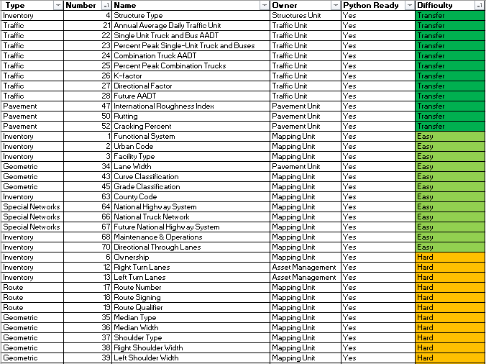
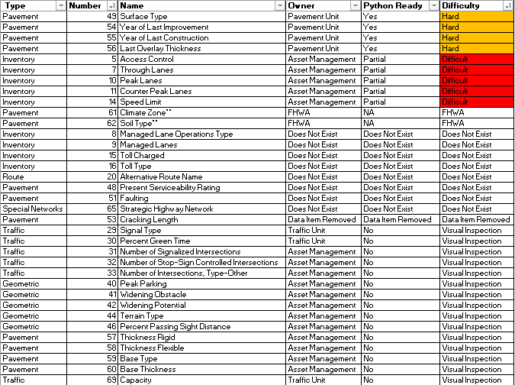
Data Item Assessment Breakdown

Slide 24
Project’s Expected Results
Reduce HPMS technician time setting up data processes
Reduce HPMS technician time monitoring data processing
Decrease the probability of process failures
Increase data quality
Allow HPMS technician to multi-task as processes run on a separate server
Increase time available for correcting data validation errors

Slide 25
Project Timeline
8/01/18 – Start Scripting
9/30/18 – Complete transfer and easy data item scripts
11/15/18 – Complete hard data item scripts
12/15/18 – Complete difficult data item scripts
1/01/19 – Implement scripts for 2018 HPMS submittal
Spring/Summer 2019 – Geog 596B presentation and final paper submittal

Slide 26
Tentative Presentation Venues
American Association of State Highway and Transportation Officials (AASHTO) GIS for Transportation Symposium
April/May 2019
http://www.gis-t.org/
Northeastern Arc Users Group
May 2019
https://www.northeastarc.org/
Vermont’s Annual Conference for GIS and Data Science Professionals
June 2019
https://www.geodatsci.com/

Slide 27
Questions?
More information on HPMS
FHWA HPMS Webpage
https://www.fhwa.dot.gov/policyinformation/hpms.cfm
HPMS Field Manual
https://www.fhwa.dot.gov/policyinformation/hpms/fieldmanual/hpms_field_manual_dec2016.pdf

