Slide 1
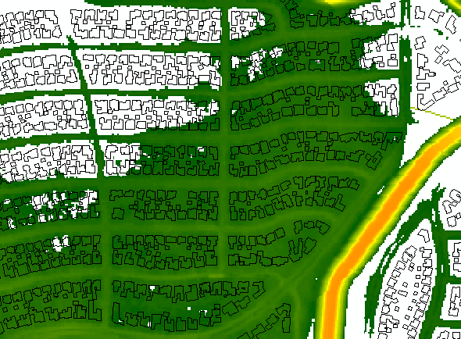
Inundation Analysis of Houston
Geog 596A Peer Review
Capstone Proposal By: Larry T. Nierth
Graduate Advisor: Dr. Patrick Kennelly
May 2013

Slide 2
Presentation Outline & Topics
Background Information
Goals and Objectives
Methodology
Anticipated Project Results
Project Timeline
Future Project Use
GEOG 596A
Larry T. Nierth

Slide 3
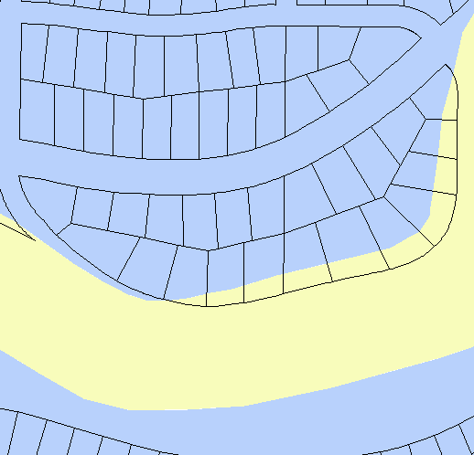
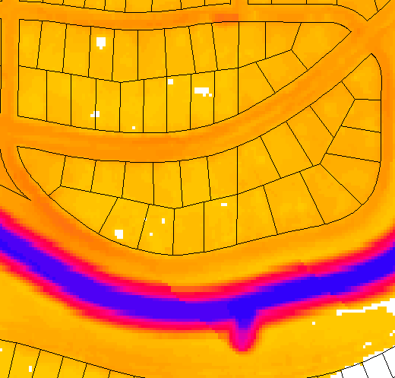
Background information:
Existing websites for flooding information
What information would be helpful that is not currently available?
Vs.
Polygon
Raster
Floodway
GEOG 596A
Larry T. Nierth

Slide 4
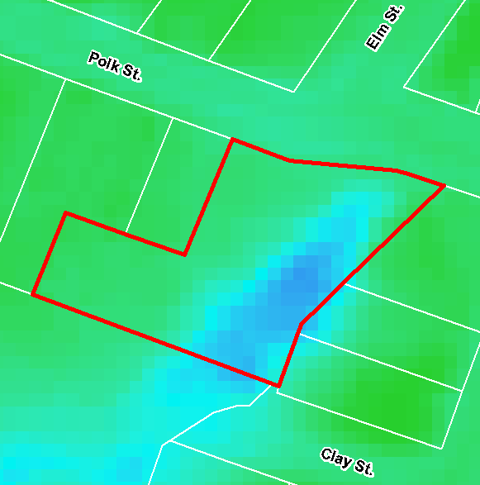
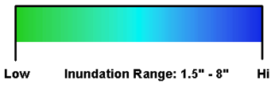
Goals and Objectives:
Determine flood depths and flooded percentages of all effected parcels in the study area
Water Depth
Flooded
100%
GEOG 596A
Larry T. Nierth

Slide 5
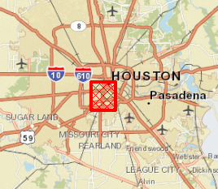
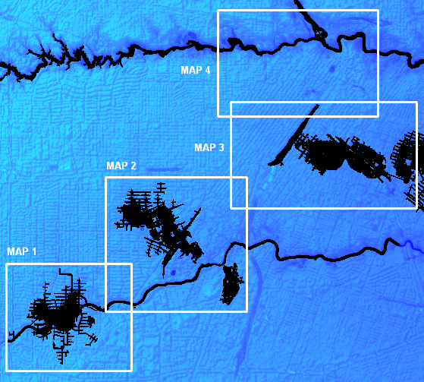
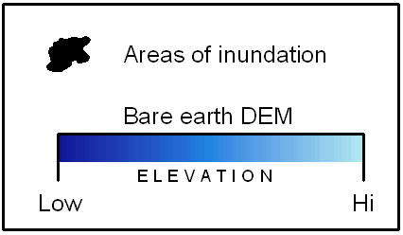
Goals and Objectives:
Generate a map set of the findings
GEOG 596A
Larry T. Nierth

Slide 6
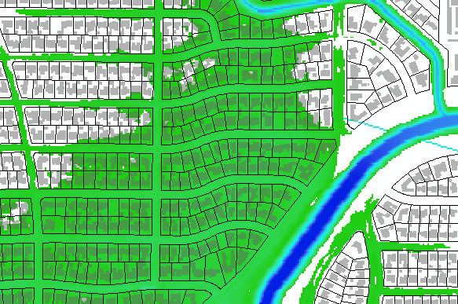
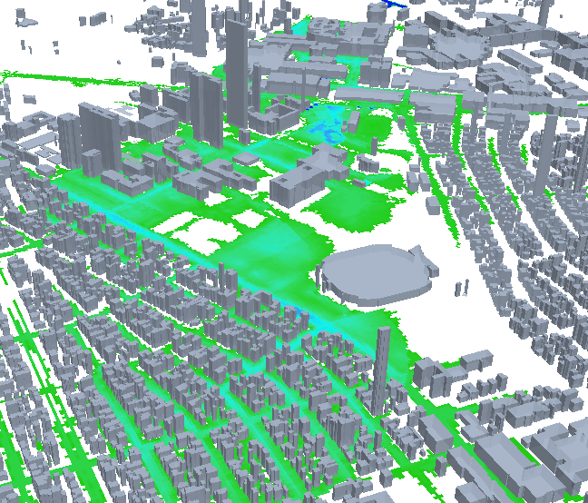
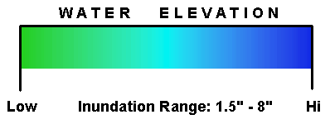
Goals and Objectives:
Incorporate 3D models of the floods for visualization
Inundation
GEOG 596A
Larry T. Nierth
Water Depth

Slide 7
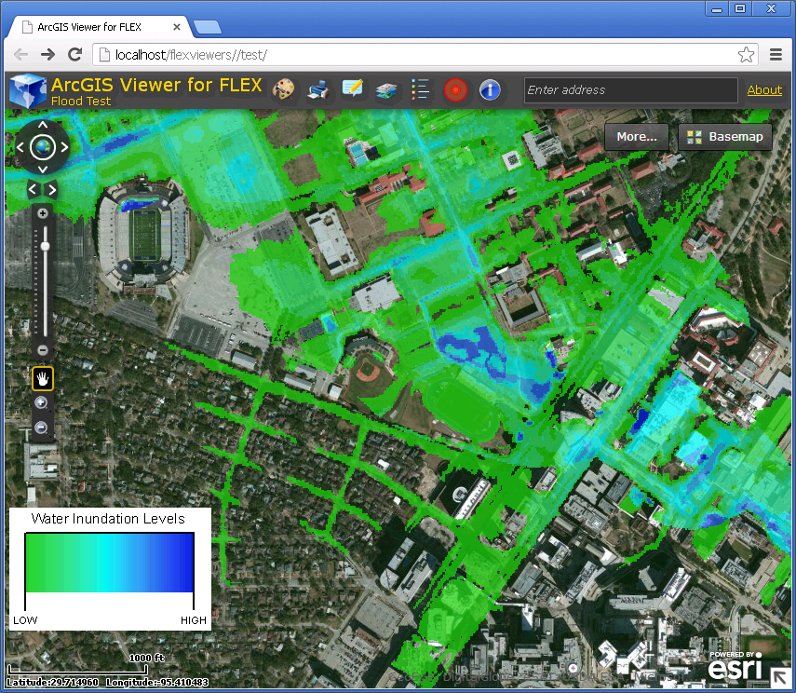

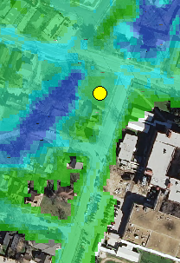
Goals and Objectives:
Publish the inundation data online while enabling crowd sourcing for citizens of Houston to input their own observations
GEOG 596A
Larry T. Nierth

Slide 8
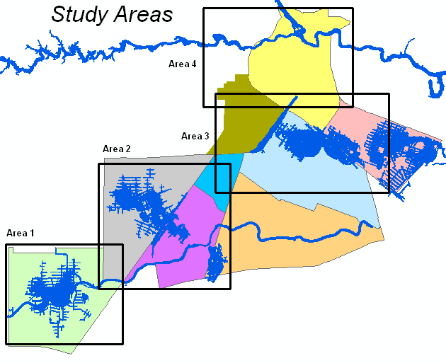
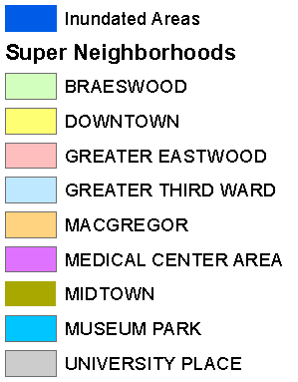
Methodology:
Finalize study area locations
GEOG 596A
Larry T. Nierth

Slide 9
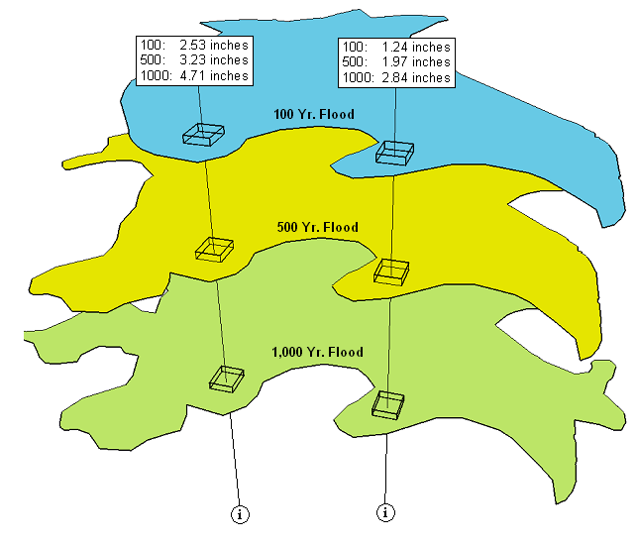
Methodology:
Generate raster inundation grids in ArcGIS with Hazus-MH for 100, 500, and 1,000 year flood event scenarios
3-meter resolution
inundation rasters
GEOG 596A
Larry T. Nierth

Slide 10
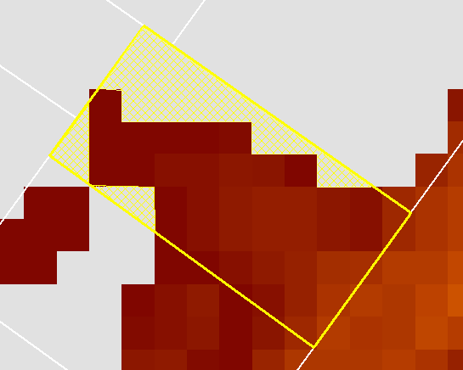
Methodology:
Determine parcels effected for each scenario, percent total of each parcel’s area effected, and their actual MAX inundation value.
Max depth:
1.13”
1,316 SQFT.
3,713 SQFT.
Parcel is
74% Flooded
GEOG 596A
Larry T. Nierth

Slide 11
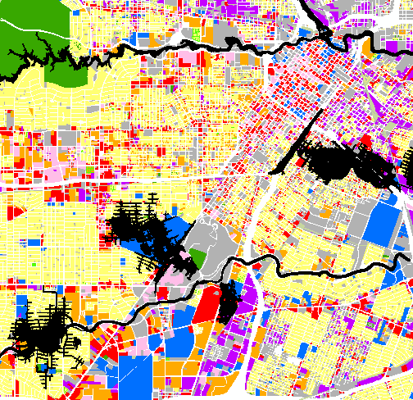

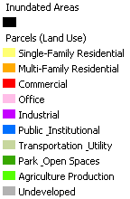
Methodology:
Aggregate inundation totals by land use code and generate maps summarizing the findings.
Average Single-
Family Residential
flood depth for 100
yr. flood?
Sum total of all flooded
Commercial property
for 500 yr. flood?
What land use type
Is the most flooded in
each scenario?
GEOG 596A
Larry T. Nierth

Slide 12
Methodology:
Create Adobe Flex application using ArcGIS Server and CloudBuilder, hosted in the cloud with Amazon.
Allow crowd sourcing of citizen observations by enabling editable a point feature web service within the web map application.
Citizens will be able to access the website and search
for their address of enter coordinates of their homes or
businesses.
After the desired location is found, they can add a point
directly onto the map and enter the amount of inundation observed (in inches).
GEOG 596A
Larry T. Nierth

Slide 13
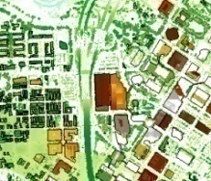
Anticipated Project Results:
Inform City of Houston citizens about flood locations and depths though increase awareness of what can really happen in these scenario based floods (including presentation at Esri UC).
Enable Houston residents to participate directly by adding their own observations to editable feature services in the inundation web application.
Gather data over time of actual flood observations from citizen inputs for use in further modeling and targeting of infrastructure improvement projects.
GEOG 596A
Larry T. Nierth

Slide 14
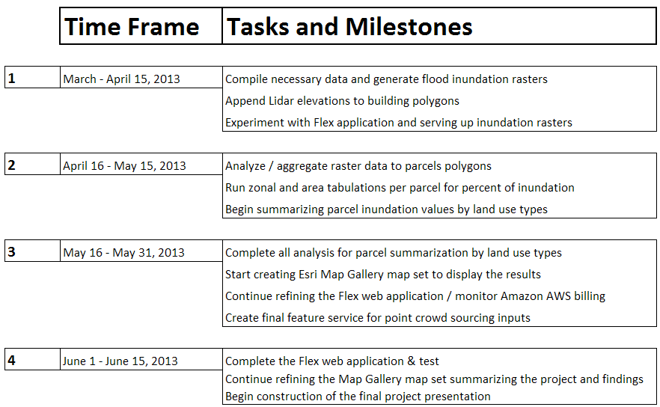
Project Timeline
GEOG 596A
Larry T. Nierth
Notes:
Specified date and time for completion – part 1

Slide 15
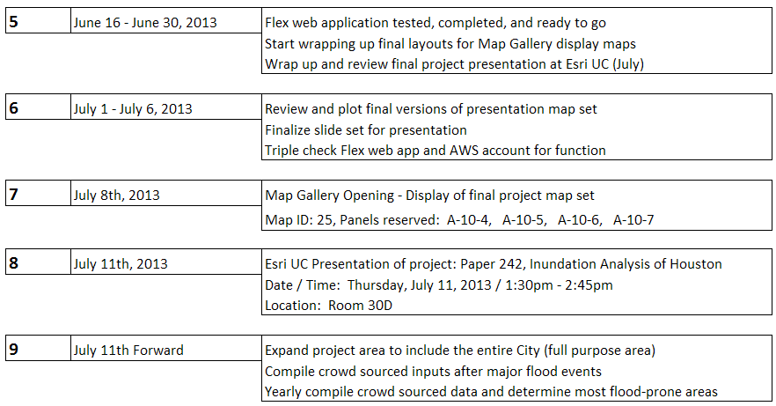
Project Timeline
Continued
GEOG 596A
Larry T. Nierth
Notes:
Specified date and time for completion – Part 2

Slide 16
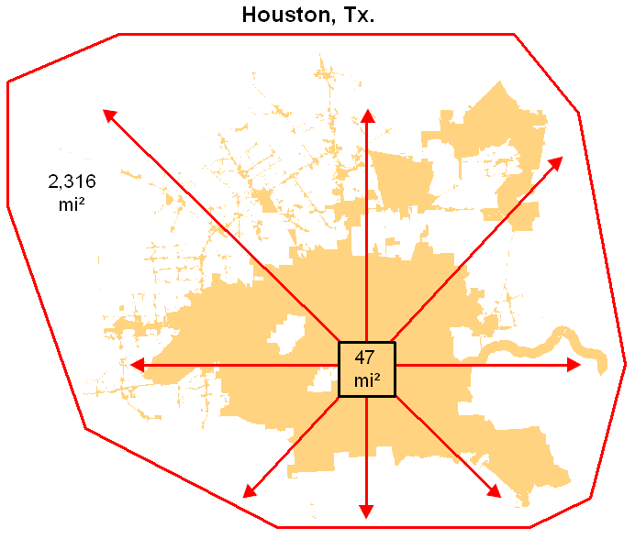
Future Project Use:
Over time, the data taken in from citizens will allow us to continuously fine tune target areas for improvement.
Crowd sourced data will be compiled to continuously get inundation averages of flood-prone areas.
Project area expansion
Scripting and automation
GEOG 596A
Larry T. Nierth

Slide 17
Acknowledgements:
Dr. Patrick Kennelly
Department of Geography, Penn State University
Sterling Quinn, MGIS
Department of Geography, Penn State University
GEOG 596A
Larry T. Nierth
Notes:
17

Slide 18
Questions?
GEOG 596A
Larry T. Nierth
Notes:
18

