Slide 1
Analysis of Remote Sensing Data for Tornado Damage Assessment
Presented by: Justin Novak
Advisor: Guido Cervone, Ph.D.
Notes:
Justin Novak
This presentation fulfills the peer review portion of my capstone project towards a Master’s in Geographic Information Systems with concentration in geospatial intelligence
Title: Analysis of Remote Sensing Data for Tornado Damage Assessment
Will be submitted by September 30th for presentation at the GEO Huntsville Symposium in Huntsville, AL on November 12-13
My advisor for this capstone is Dr. Guido Cervone
Associate Professor at PSU Department of Geography
Affiliate scientist at the research application laboratory located at the National Center for Atmospheric Research in Boulder, CO

Slide 2
Purpose
To determine which remote sensing platform is best suited for emergency management
2
Notes:
The purpose of this study was to compare and contrast various remote sensing imagery for use in readiness, response and recovery operations for areas affected by tornadoe

Slide 3
Agenda
Selection Criteria for Study Area
Study Area
Background/Historical
Datasets
Evaluation Criteria
Conclusions
3
Notes:
A brief agenda of this presentation (count to 5)

Slide 4
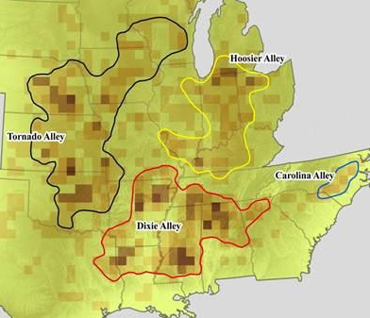
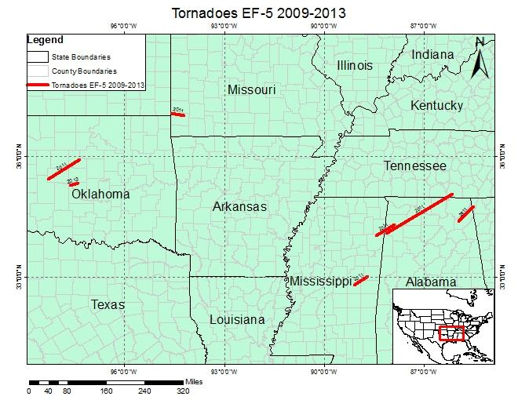
Selection Criteria for Study Area
NOAA 1950-2013 Tornado Track Dataset
EF-5 Tornadoes
Publicly Available Datasets
Source: COX, 2014
4
Notes:
First, had to select a study area that has had recent tornado damage
To select the area, analyzed the NOAA tornado track dataset, 1963-2013
Magnitude 5 tornadoes occurring in 2009-2013 were considered
Determined 7 tornadoes had occurred between 1963 and 2013
Illustrated in the map on the right
3 in Alabama occurring in 2011
1 in Mississippi occurring in 2011
1 in Missouri occurring in 2011
2 in Oklahoma occurring in 2011 and 2013
Oklahoma and Missouri storms were located in Tornado Alley in the mid-west
Alabama and Mississippi storms located in an area dubbed “Dixie Alley”
After identifying the areas, I proceeded to research publicly available for this study
Primary tool was the USGS All-Hazards Data Distribution and Earth Explorer Portals
Also research US government websites for census data for the overview maps, illustrated in the map on the right

Slide 5
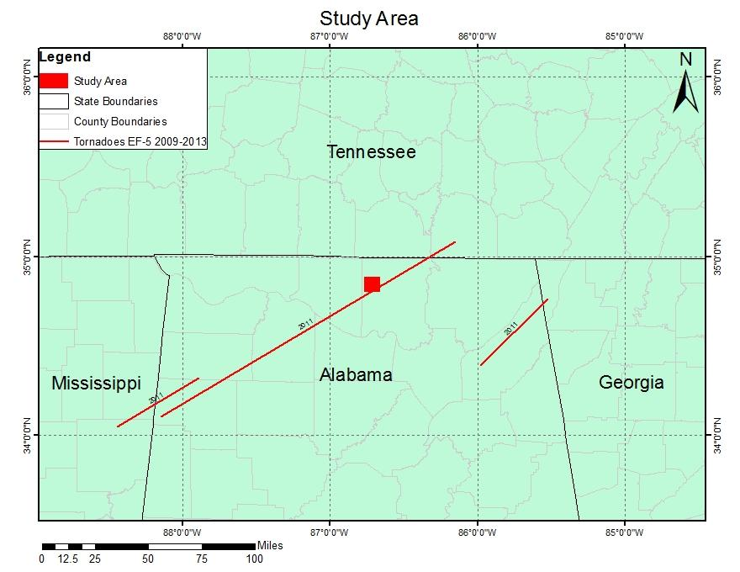
Study Area
Harvest, AL
27 April 2011
EF-5 Tornado
5
Notes:
Selected the EF-5 tornado impacting Harvest, AL on 27 April 2011 for the following reasons:
High intensity tornado, causing $1.3B in damages across it’s 132 mile long, 1.25mile wide path
Caused 145 injuries and 72 fatalities
Within NOAA dataset 1966-2013, largest area impacted by an F-5, 165 sqmi.
2nd longest track for an F-5, 21st longest for all tornadoes
2nd largest area impact by any tornado in the dataset

Slide 6
Background/Historical
Harvest, AL
Dixie Alley
Northern Alabama
Huntsville, AL #1 Tornado City (Kellogg, 2013)
Population: 5,281 (Gazetteer, 2014)
4 Major Tornadoes in Past 40 Years (NOAA, 2013)
6
Notes:
Located in northern Alabama within the north-eastern boundaries of dixie alley
Borders Huntsville, AL
ranked as the city in the US with the highest probability of having a tornado occur with 75 miles
Dr. Greg Forbes at weather.com, a foremost expert in his field
studying under Tetsuya Fujita, who developed the F-rating scale (or Fujita scale) by which the scientific community classifies a tornado’s intensity”
According to the NOAA tornado track dataset, Harvest has been the site of 4 major tornadoes in the past 40 years:
Magnitude F-5 occurring 03 April 1974
Magnitude F-4 occurring 15 November 1989
Magnitude EF-5 occurring 27 April 2011
Magnitude EF-3 occurring 02 March 2012

Slide 7
Datasets|Base Layers
Global Country Borders
TIGER/Line Shapefile
US State Boundaries
US County Boundaries
Madison County Roads
WGS84 UTM Zone 16N/15N
7
Notes:
Located a free global country boundaries shapefile from DIVA-GIS for use as a reference in national level datasets
Leveraged the Census TIGER/Line files
State and County boundaries
Roads
Used the WGS84 UTM Zone 16N projection, so all scales will be in meters and there will be limited north-south distortion .

Slide 8
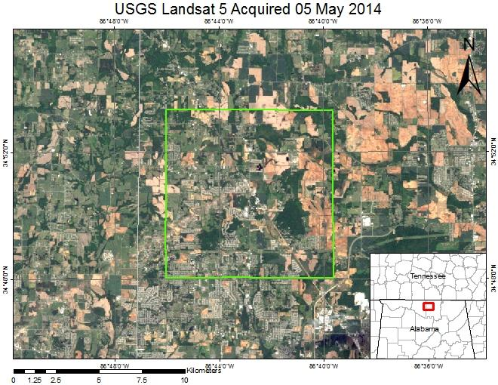
Datasets|USGS Landsat 5
USGS EarthExplorer (http://earthexplorer.usgs.gov)
7 bands (15m PAN / 30m MSI / 100m Thermal)
Evaluated Scenes
03 April 2011 (Suitable)
10 April 2011 (Cloud Covered)
19 April 2011 (Cloudy, Contrast Issues)
05 May 2011 (Suitable)
8
Notes:
Landsat is a publicly available dataset operated and distributed by USGS via the EarthExplorer Portal
Has robust spectral resolution with 7-bands ranging from visible to infrared and thermal
Moderate spatial resolution
Retrieved 4 scenes from EarthExplorer Portal
2 of the Landsat 5 scenes were suitable
2 of the Landsat 5 scenes were not suitable due to cloud cover and contrast issues
Also discovered several Landsat 7 scenes
Scan Line Corrector issue has not been resolved
Workaround involves using another scene to fill in the data gaps, mixing the vintages of the resulting image
I felt it was logical to use the fully operational Landsat 5 platform to get the best continuous data possible

Slide 9
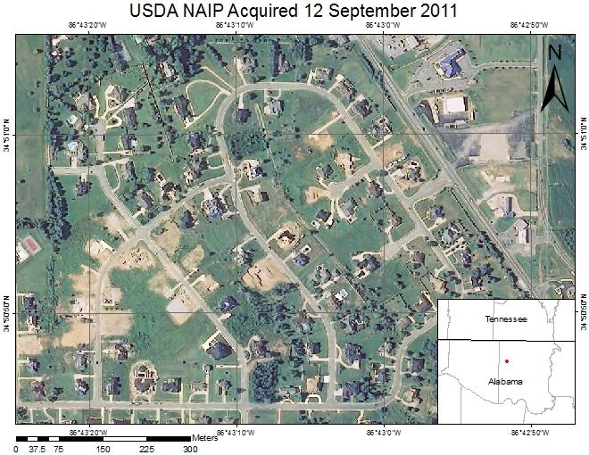
Datasets|USDA NAIP
USGS EarthExplorer (http://earthexplorer.usgs.gov)
4 band 1m color infrared orthoimagery
Evaluated Scenes
14 July 2009 (Suitable)
12 September 2011 (Suitable)
26 August 2013 (Suitable)
9
Notes:
National Agricultural Imagery Program (NAIP) is a product of the US Department of Agriculture
Retrieved from USGS EarthExplorer
Aerial sensing platform
+/- 6 meter horizontal accuracy
Spectral resolution
4-band
3 natural color (RGB) bands
1 infrared band
1m spatial resolution
Collected during leaf-on periods to sensing vegetation coverages such as crops and tree canopy
Evaluated 3 datasets, all were suitable for this study

Slide 10
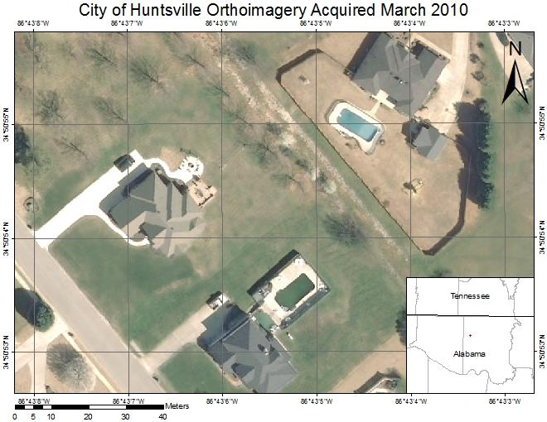
Datasets|City of Huntsville
USGS EarthExplorer (http://earthexplorer.usgs.gov)
3 band 15cm natural color
Acquired March 2010
10
Notes:
Retrieved from USGS EarthExplorer
USGS and the City of Huntsville, AL co-sponsored the collection
Spectral resolution
3-bands
natural color
Spatial resolution, 15 cm/pixel
horizontal accuracy is unknown
Collected during leaf-off period (22 March - 01 April) to focus on sensing man-made features and infrastructure that would otherwise be obscured by tree canopy
Single dataset available from March 2010

Slide 11
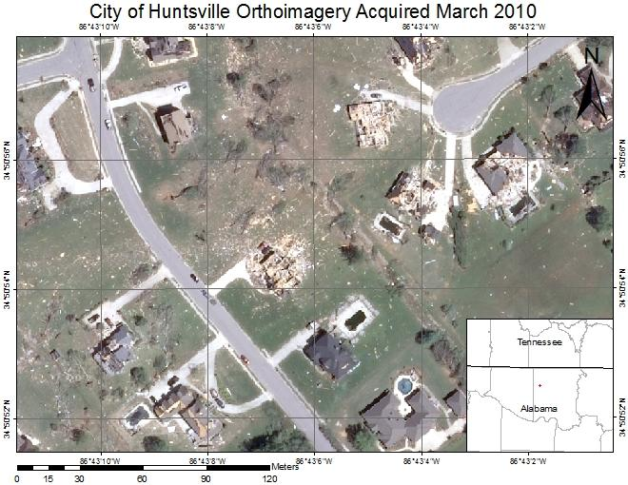
Datasets|Atlantic Group, LLC.
USGS HDDS (http://hddsexplorer.usgs.gov/)
3 band 31cm natural color
Acquired 29 April 2011
11
Notes:
Retrieved from USGS HDDS
The Atlantic Group, LLC.
Spectral resolution
3-bands
natural color
Spatial resolution, 31 cm/pixel
horizontal accuracy is unknown
Collected during leaf-off periods to focus on sensing man-made features and infrastructure that would otherwise be obscured by tree canopy
Single dataset available from 29 April 2011

Slide 12
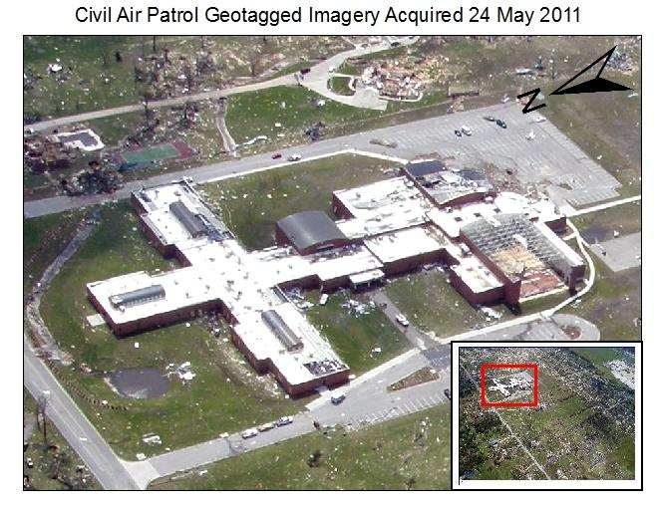
Datasets|Civil Air Patrol
USGS HDDS (http://hddsexplorer.usgs.gov/)
3 band natural color
Acquired 24 May 2011
Example Dataset from
Joplin, MO Tornado
12
Notes:
Civil Air Patrol, or CAP, is typically available for incidents that reach the state level
During research, unable to find publicly available CAP data for the Harvest tornado.
Was able to find publicly available CAP images from the Joplin, MO tornado, an EF-5 tornado of the same magnitude as the Harvest tornado
Retrieved from USGS HDDS
Spectral resolution
3-bands
natural color
Olympus SP-550UZ digital camera
Spatial resolution, varies, as the image is not georectified and is oblique in most cases
horizontal accuracy is not applicable
Collected as needed, this imagery was taken 2 days after the tornado occurred
Single dataset available from 24 May 2011
"Unfortunately, I was unable to locate publicly available CAP imagery for this study. However, I was able to find publicly available CAP imagery for the Joplin, MO storm. I was able to compare and contrast the CAP imagery with the aerial dataset produced by GeoEye. This portion of the study is strictly to compare the capabilities of CAP vs. aerial imagery and assess whether the geotagged imagery is able to be analyzed with orthoimagery datasets within a GIS."

Slide 13
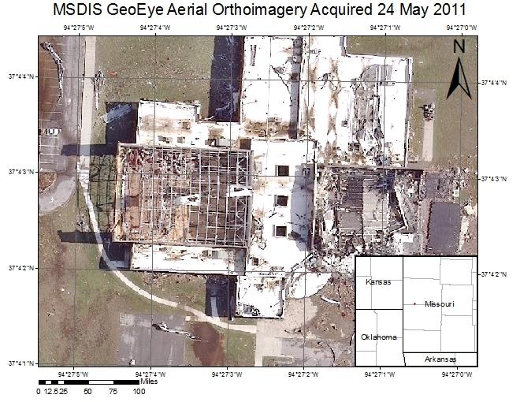
Datasets|GeoEye Aerial
USGS HDDS (http://hddsexplorer.usgs.gov/)
3 band 15cm natural color
Acquired 24 May 2011
Example Dataset from
Joplin, MO Tornado
13
Notes:
Used as a reference for the evaluation of the CAP dataset
Retrieved from USGS HDDS
GeoEye Aerial platform, company was purchased by Digital Globe in 2013
Spectral resolution
3-bands
natural color
Spatial resolution, 15 cm/pixel
horizontal accuracy is unknown
Single dataset available from 24 May 2011

Slide 14
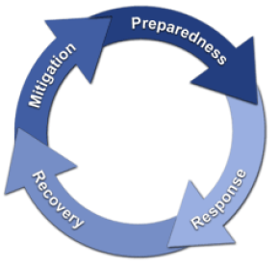
Evaluation Criteria
Emergency Management Phases
Mitigation
Preparedness
Response
Recovery
Coverage Area
Timeliness
Analysis Products
Limitations
Source: NEHRP, 2009
14
Notes:
FEMA defines 4 Emergency Management Phases
Mitigation - prework, lessen or eliminate the impact of an incident
Preparedness - planning, training and staging of material and personnel
Response - when an incident is imminent, or immediately following
Recovery - immediately following the incident, concurrent with response
Amount of are collected (Harvest tornado impacted 165 sqmi)
Timeliness or of the collection after the incident
Products that can be derived from the dataset
General limitations of the platform/sensor

Slide 15
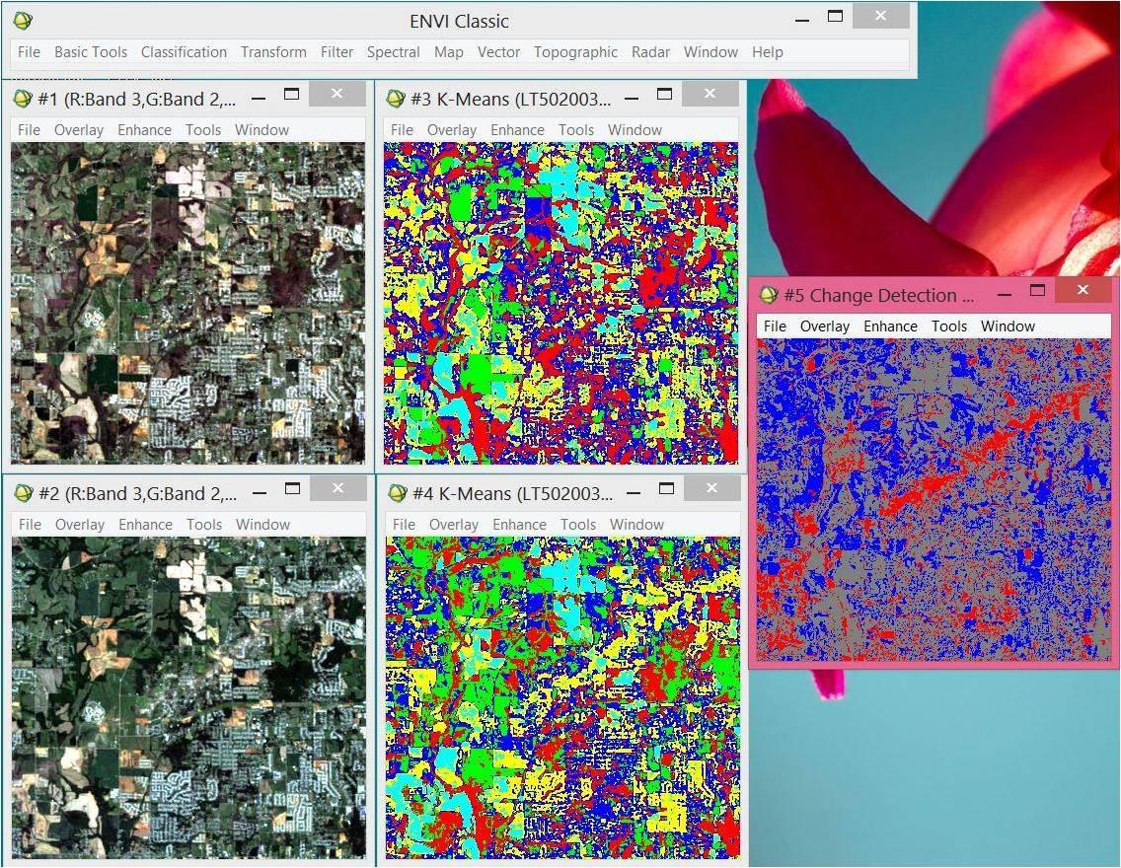
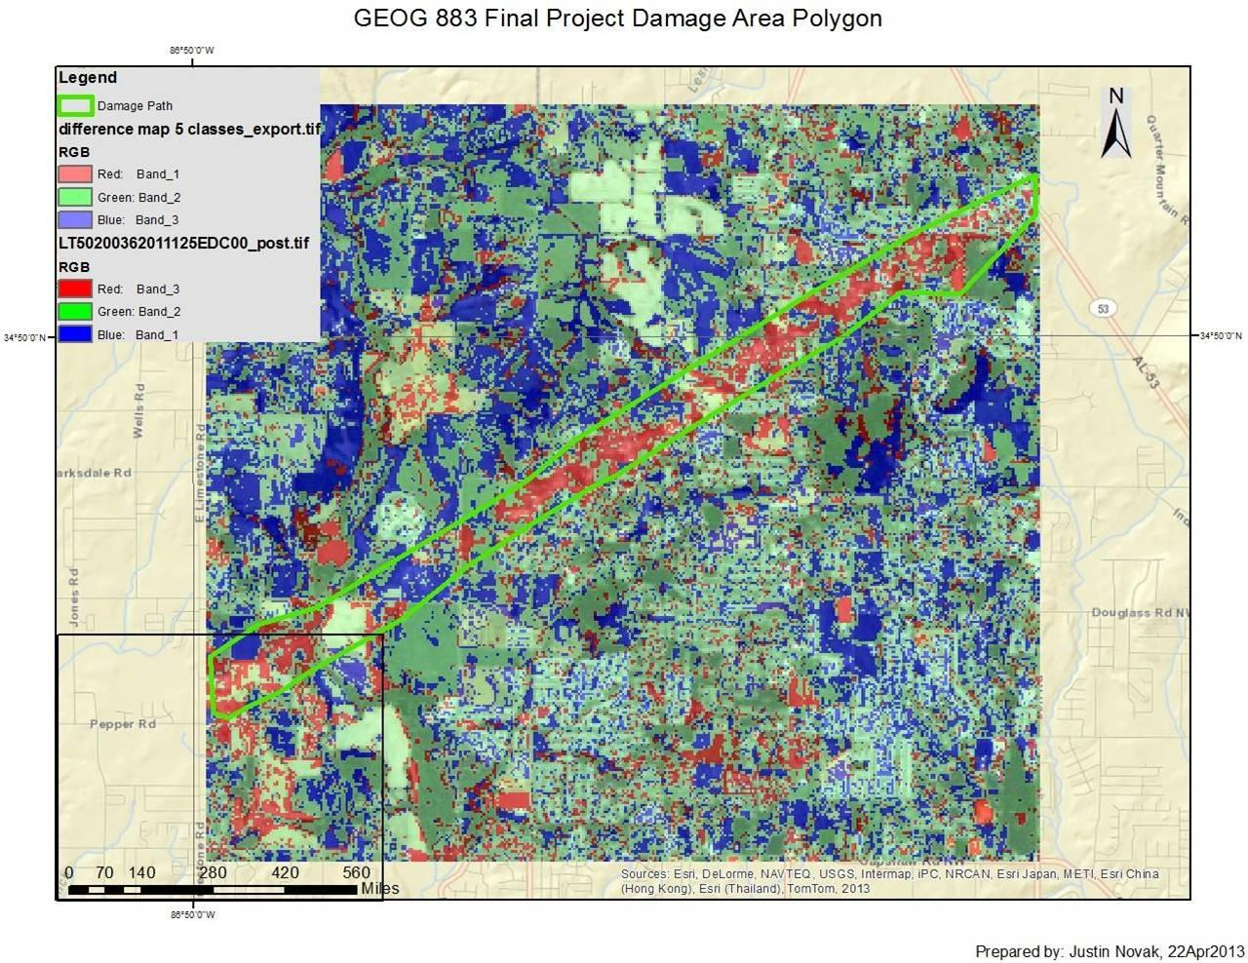
Findings|USGS Landsat
Capabilities:
Mitigation
Preparedness
Recovery
Vegetation Analysis
Limitations
Response
Timeliness
Spatial Resolution
Atmospheric Particulates
Source: Novak, 2013
15
Notes:
Capabilities
The Landsat program has been continuously imaging the earth’s surface since 1972
The Landsat series of satellites provides predictable coverage over a broad area.
Although the spatial resolution is not as fine as aerial sensors, Landsat is able to discern changes in materials such as vegetation and man-made structures over large areas due to its broad spectral resolution which is widely used in land classification
Imagery is downlinked by USGS in Sioux Falls, SD and loaded into the EarthExplorer Portal, lessening dissemination time.
I contend it would be good as a foundation map to be used in mitigation and preparedness.
I also contend it would be be ideal for to chart the progress of recovery operations for large scale incidents
Limitations
Since Landsat has a revisit rate of 8 days, 16 days for each satellite, there is an average of 4 days from the incident occurring till the location is imaged. I contend that this delay would not make Landsat suitable for response operations
For smaller incidents the spatial resolution of 15m/pixel PAN and 30m/pixel MSI may not be able to discern the affected areas
Landsat, being a satellite, is also very sensitive to atmospheric particulates obscuring the affected areas. Clouds, dust and smoke all contribute to image degradation.
Map
The graphics to the right illustrates the results of a difference map (far right) using a pre and post incident Landsat 5 scene classified by using the K-Means unsupervised classification function in ENVI.

Slide 16
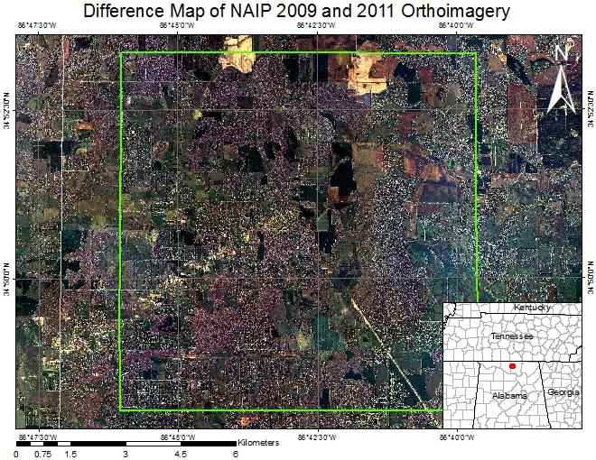
Findings|USDA NAIP
Capabilities:
Mitigation
Preparedness
Recovery
Vegetation Analysis
Limitations
Response
Timeliness
Spatial Resolution
16
Notes:
Capabilities
NAIP orthoimagery provides a uniform, state-wide high resolution base map for use in mitigation and preparation for incidents.
Using this imagery, it is possible to discern critical infrastructure such as electrical substations and towers in non-vegetation covered areas
Additionally, the infrared band in conjunction with the natural color bands allows NAIP to be used as for vegetation analysis
NAIP can be used as a base for comparison to color infrared or natural color post event aerial imagery
Limitations
With a refresh rate of 3 years it is difficult to acquire imagery immediately after an incident as is required for response and the early phases of recovery efforts
NAIP data collected in a given year is typically available early the following year which means any analysis would immediately be 6 months or more old.
Map
A difference map derived from the NAIP imagery from pre-event 2009 and post-event 2011 NAIP orthoimagery is shown on the right. This image analyzed the natural color bands.
Note the damage path from the south-east stretching to the center of the map.

Slide 17
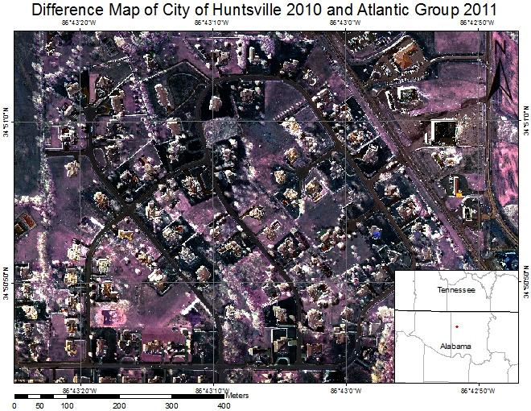
Findings|Aerial, Natural Color
Capabilities:
Mitigation
Preparedness
Response
Recovery
Spatial Resolution
Limitations
Vegetation Analysis
Coverage
17
Notes:
Capabilities
Several federal and state government agencies and private sector companies have aircraft equipped with natural color or color infrared digital mapping cameras, yielding a robust dataset for mitigation and preparedness efforts.
Private companies, such as the Atlantic Group, LLC, offer no-cost, no-obligation readiness contracts for their customers to expedite the data acquisition
Aerial systems have a mobilization time of hours and are able to be pre-staged near an anticipated incident location as part of a preparedness strategy to reduce response time for an anticipated incident. I contend this makes aerial imagery a great asset for recovery
High spatial resolution is ideal for identification of small geographic features and man-made structures
Limitations
The aerial datasets evaluated, with the exception of NAIP, did not contain an infrared channel that could have been used for vegetation analysis once the imagery is collected, the aircraft then lands and the data is transported to the processing center where photogrammetrists process the raw images into orthoimagery. The amount of processing time required is both a function of the amount of area acquired and the number of analysts processing the raw data. I contend this hinders the timeliness of this dataset.
False positives due to leaf-off compared with leaf-on (especially in the south and in the winter)
As the data is collected at a large spatial resolution, the sensor’s field of view is small compared with Landsat.
Map
Difference map derived from pre-event City of Huntsville 2010 and post-event Atlantic Group 2011 orthoimagery

Slide 18
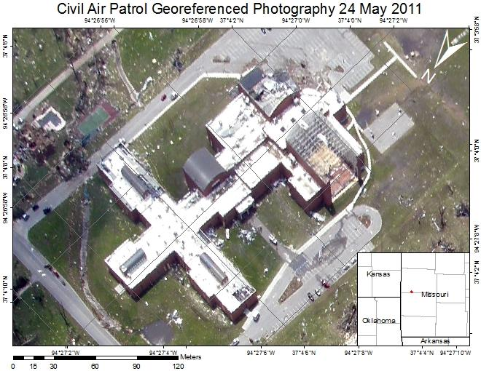
Findings|Civil Air Patrol
Capabilities:
Mitigation
Preparedness
Response
Recovery
Resolution
Limitations
Spatial Analysis
Coverage
18
Notes:
Capabilities
CAP assessment platforms are ready to assist in response and recovery operations with hours notice.
They can also be staged for imminent incidents.
Some CAP aircraft are equipped with satellite communication and can transmit the images to the Internet while still on station.
This makes CAP ideal for supporting response operations and recovery assessments
With variable zoom commercial off the shelf cameras, CAP can focus on a specific area or collect a wide area, trading ground sampling distance for field of view.
CAP can be tasked to perform pre-event collections for use in mitigation and preparedness efforts.
Limitations
Since CAP photography is geotagged and not easily georectified it is difficult to perform GIS analysis such as change detection on the imagery.
Imagery is often collected oblique and not conducive to georectification.
CAP is also an aerial platform and lacks the field of view of a satellite such as Landsat.
Map
The map on the right is an example CAP image taken of Joplin, MO. This image has been georeferenced using ArcMap. I contend that while the oblique angle is useful for assessing the damage of the structure the oblique angle of the image makes it difficult to georectify this geotagged image.

Slide 19
Conclusions
Aerial
Landsat
NAIP
Aerial or NAIP
CAP (urgent) or Aerial (analysis)
Emergency
Management
Phases
Source: NEHRP, 2009
19
Notes:
In conclusion
This presentation contends that the ideal platform to support each of the emergency management phases
These conclusion are based on the capabilities and limitations found when evaluating the dataset based on:
Coverage Area
Timeliness
Analysis Products
Limitations
Phases
Mitigation Aerial Orthoimagery
Preparedness Aerial or NAIP
Response CAP (urgent) or Aerial (analysis)
Recovery Landsat (short), NAIP (long)

Slide 20
References
Cox, John D. “'Tornado Alley' actually four regions?” Web. Copyright 2014 NBCNews.com. Updated 27 April 2010. http://www.nbcnews.com/id/36807882/ns/us_news-environment/from/ET
National Oceanic and Atmospheric Administration. “SVRGIS”. Web. Dated 18 March 2014. Accessed 20 July 2014. http://www.spc.noaa.gov/gis/svrgis.
NEHRP - National Earthquake Hazards Reduction Program, Introduction to emergency management. Dated 01 November 2009 http://training.fema.gov/EMIWeb/EarthQuake/NEH0101220.htm
Novak, Justin. “Leveraging Remote Sensing for Rapid Identification of Tornado Damage”. Penn State University, GEOG 883. Dated 22 April 2013.
U.S. Census Bureau. “2013 U.S. Gazetteer Files”. Web. Dated 08 November 2013. Accessed 20 July 2014. http://www.census.gov/geo/maps-data/data/gazetteer2013.html
20
Notes:
Listed here are the works cited for information contained in this presentation.

Slide 21
Questions?
Justin Novak
JRN145@psu.edu
21
Notes:
This concludes my presentation...I open the floor to any questions you have.

