Slide 1
Spatial Analysis of Foreclosure Sales in Connecticut: 2005 to 2013
Ryan O’Neil
Advisor: Fritz Kessler
Fall 2018

Slide 2
Overview
Why examining foreclosures is important
Background
Previous related research
What data will be used
Methodology
Thoughts about possible outcomes
Limitations
Timeline of capstone activities
Questions

Slide 3
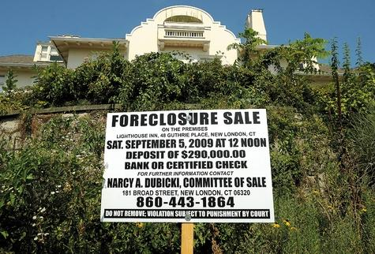
Why examine foreclosures?
Foreclosures impact people in a fundamental way – losing where they live
Can have a lasting impact on a person and a family (Davis and Shin, 2009)
Can impact government – social services safety net, tax base affected
Can result in an increase in crime (Pandit, 2011)

Slide 4
Background: Subprime Mortgage Crisis
Rise in investment in mortgage-backed securities
Rise in mortgages to people with less than ideal credit
Interest rates go up
Housing prices dropped steeply starting in 2006 – prevented refinancing of existing mortgages
Terms of adjustable rate mortgages increase
People start defaulting on their mortgages
Rise in foreclosure and foreclosure sales
Hello Great Recession!

Slide 5
Foreclosures and Population Demographics
Are foreclosures related to income?
Do areas with higher income in Connecticut see more foreclosures?
Do areas with lower income in Connecticut see more foreclosures?
Are foreclosures related to race/ethnicity?
Do areas with more white people in Connecticut experience more foreclosures?
People who are African-Americans?
People of Hispanic origin?
People of Asian-American descent?
As a whole, Connecticut’s demographics look like this
White alone, not Hispanic or Latino | 67%
African-American | 12%
Asian-American | 5%
Hispanic or Latino | 16%
Source: Census Bureau

Slide 6
Related Previous Research
Kobie and Lee (2011) found that foreclosures affect values of neighboring properties
Hall et al (2015) compares foreclosures to population (per capita)
Li (2017) examines why foreclosures are contagious
Lichtenstein and Weber (2014) found foreclosures concentrated in older African-American neighborhoods when examining Tuscaloosa County in Alabama

Slide 7
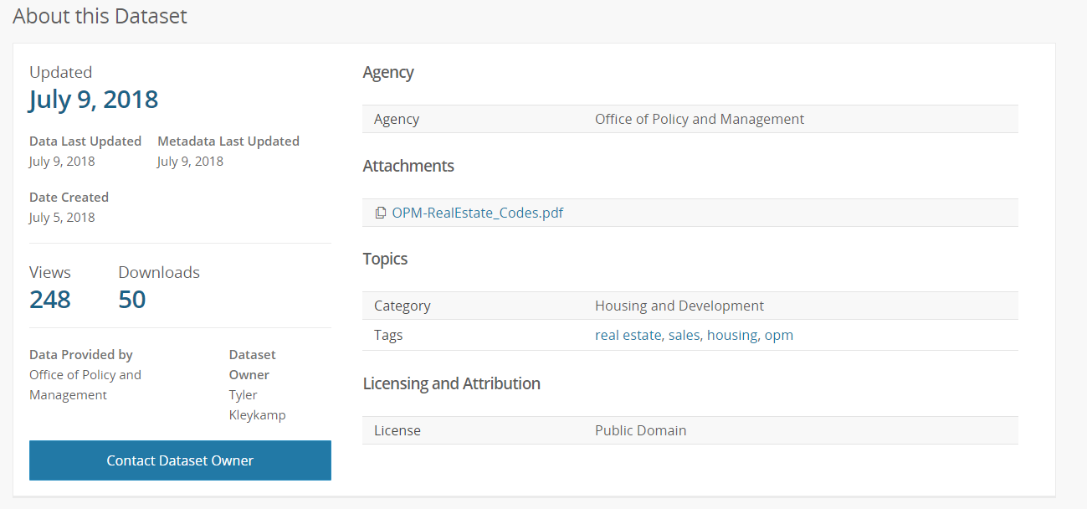
Data: Connecticut Open Data
Connecticut’s Open Data Initiative – dataset with all real estate transactions from 2001 through 2016 (data.ct.gov)
Includes residential, commercial, industrial, and other types of property
More than 800,000 records

Slide 8
Connecticut’s Open Data Initiative Foreclosure Records
Each record contains:
Listing year
Date of transaction
Street address and town
Assessed Value
Sale Price
Type of property – single unit house, multiple unit, apartment, commercial, vacant, and so forth
Type of transaction – including if it was a foreclosure sale

Slide 9
Connecticut’s Open Data: Limitations and Use
Problem with 2014 records in the original dataset – no notation about type of transaction (data manager is attempting to fix it)
As a result: selected 2005 through 2013 – before, during, and after subprime mortgage crisis
Contained addresses but need to geocode them
Total of more than 14,000 records

Slide 10
Connecticut Foreclosures Sales 2005 to 2013
Unsure about the reason(s) behind September 2011’s total of 4 foreclosure sales
Source: Connecticut Data (data.ct.gov)

Slide 11
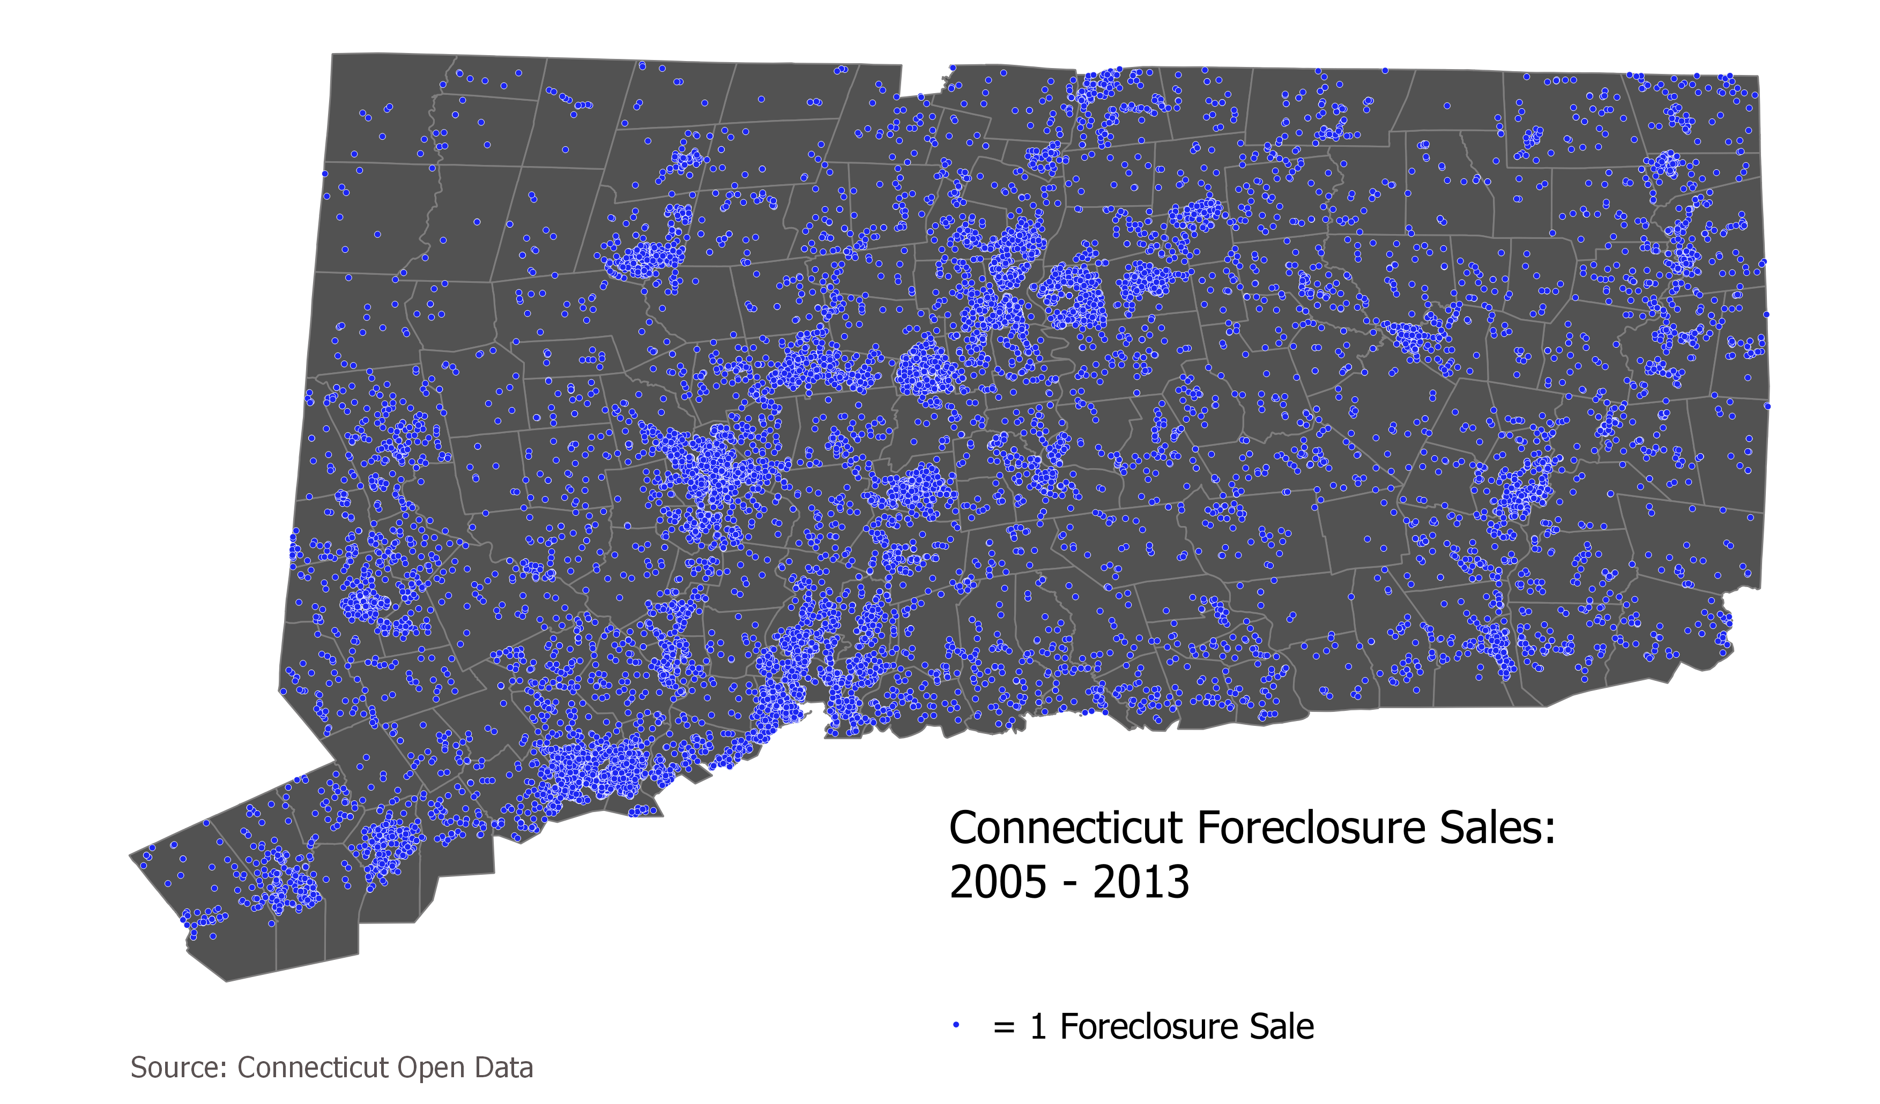
Map of All Foreclosure Sales in Connecticut

Slide 12
Methodology: Demographic Characteristics of Foreclosures
Income
Use data from Census Bureau’s American Community Survey and 2010 Census
Number of each demographic group (whites, African-Americans, Asians, and Hispanics) owning a single-unit house
Use data from Census Bureau’s American Community Survey and 2010 Census

Slide 13
Methodology: Enumeration Units
Want to avoid modifiable areal unit problem – that findings can be influenced depending on the areal unit used
Regional drainage basins (84 units) – non-population based areal unit
Towns – towns are the basic local unit in Connecticut, counties have little meaning (169 towns)
Census Tracts (833 tracts)
Census Block Groups (2,585 block groups)

Slide 14
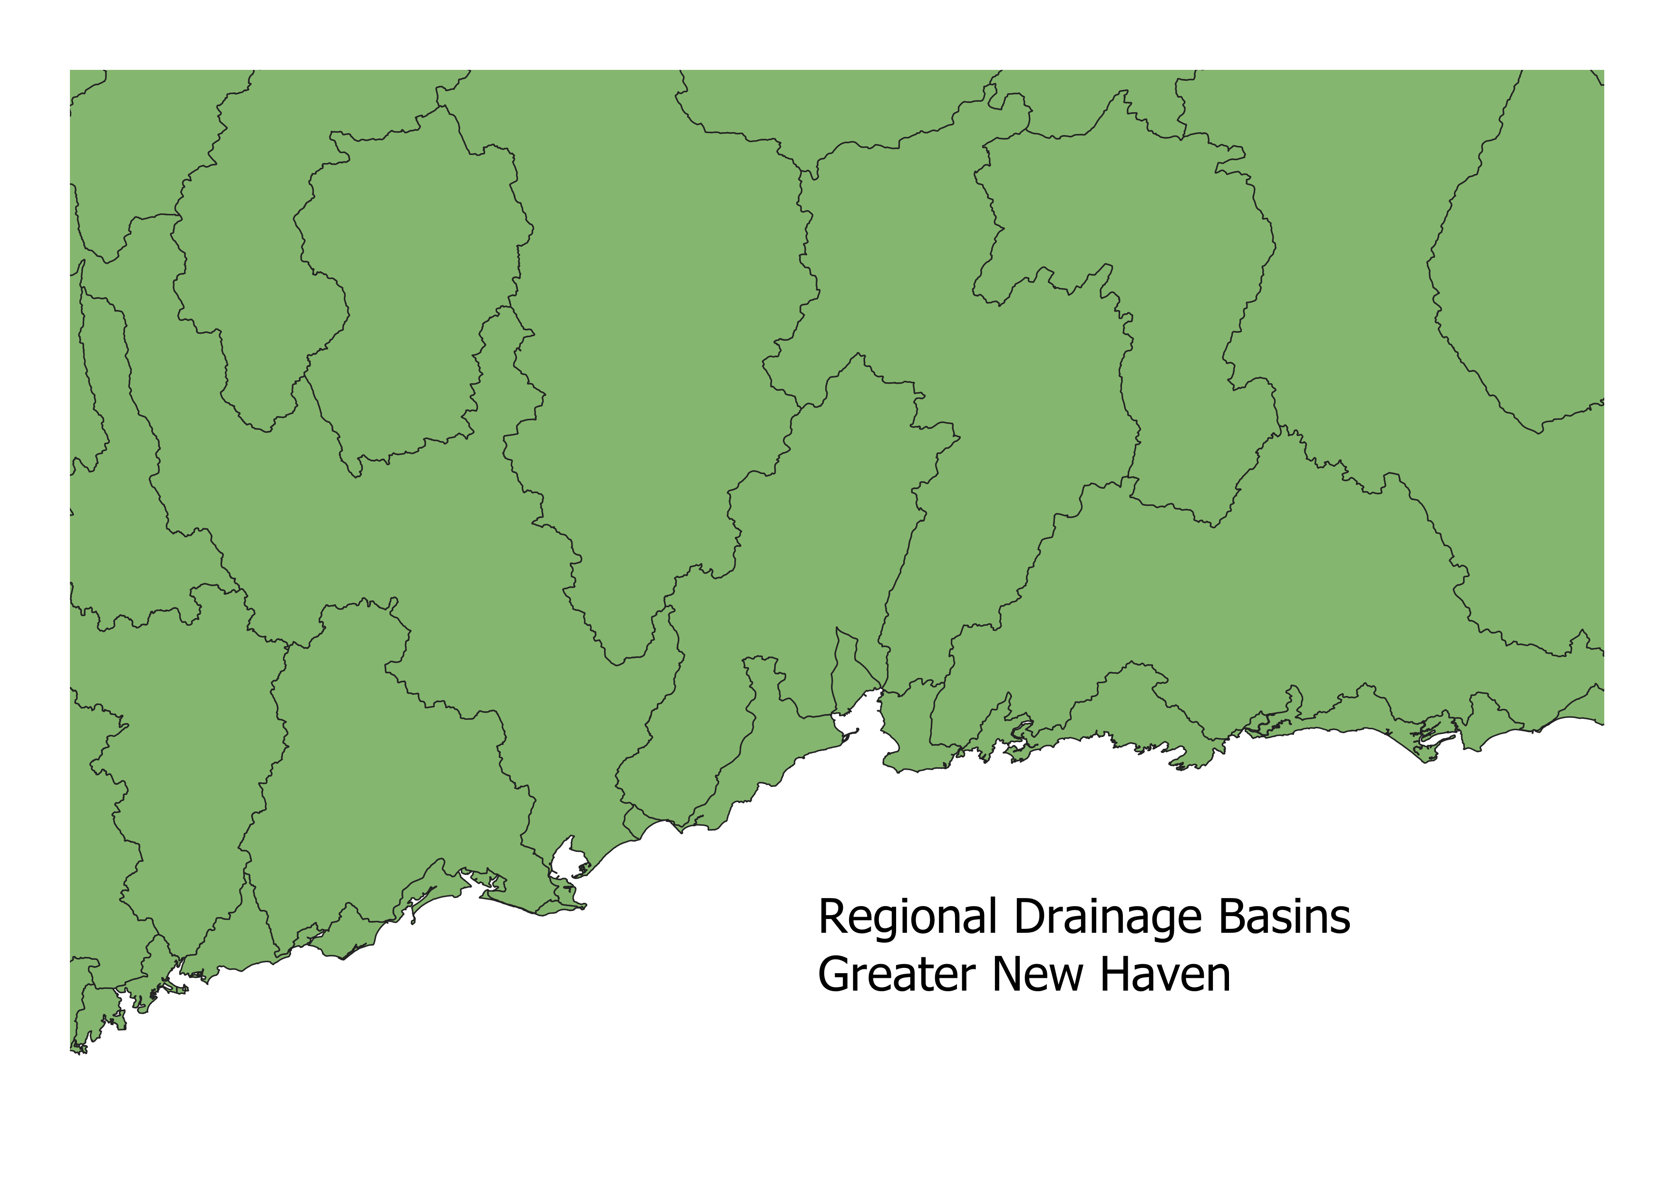
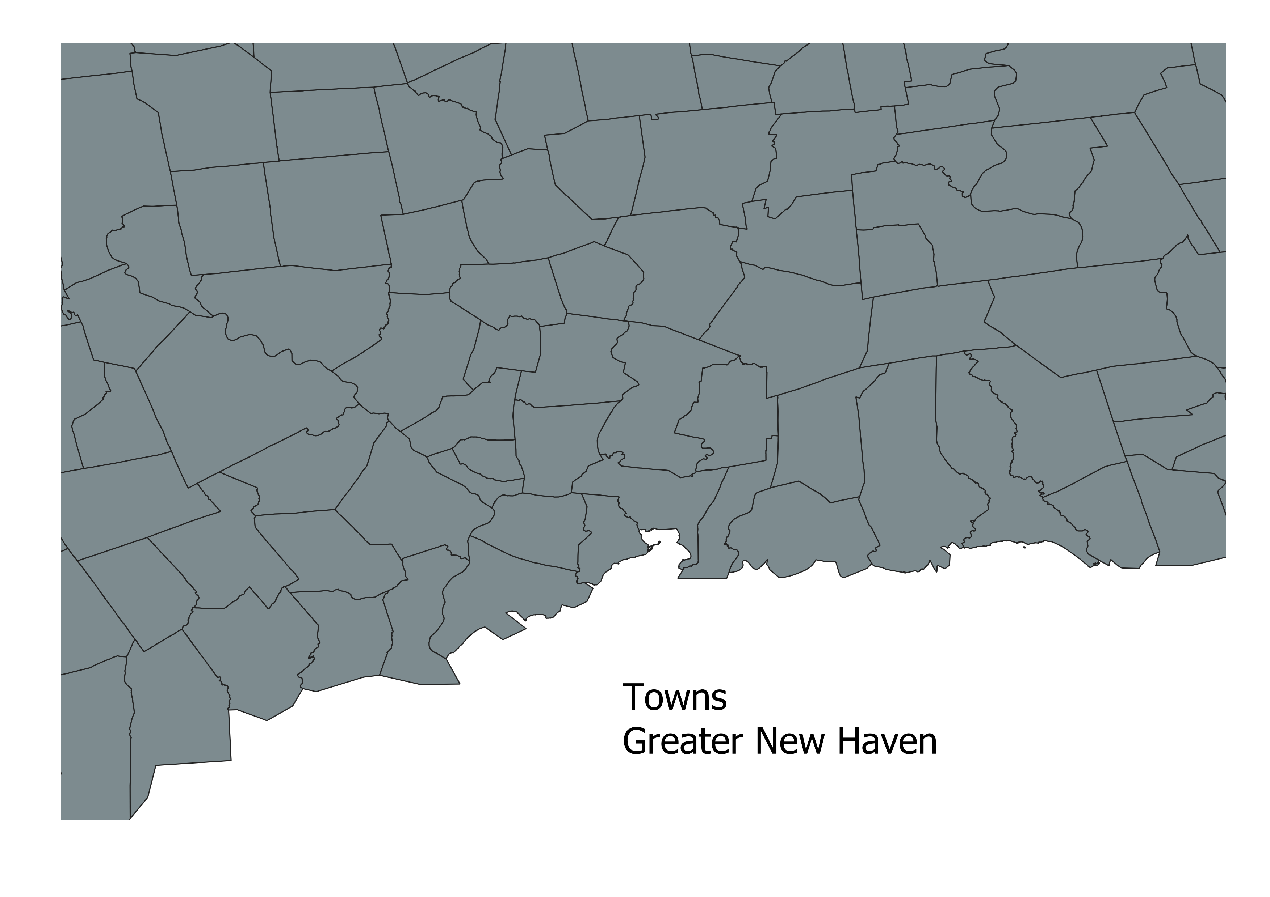
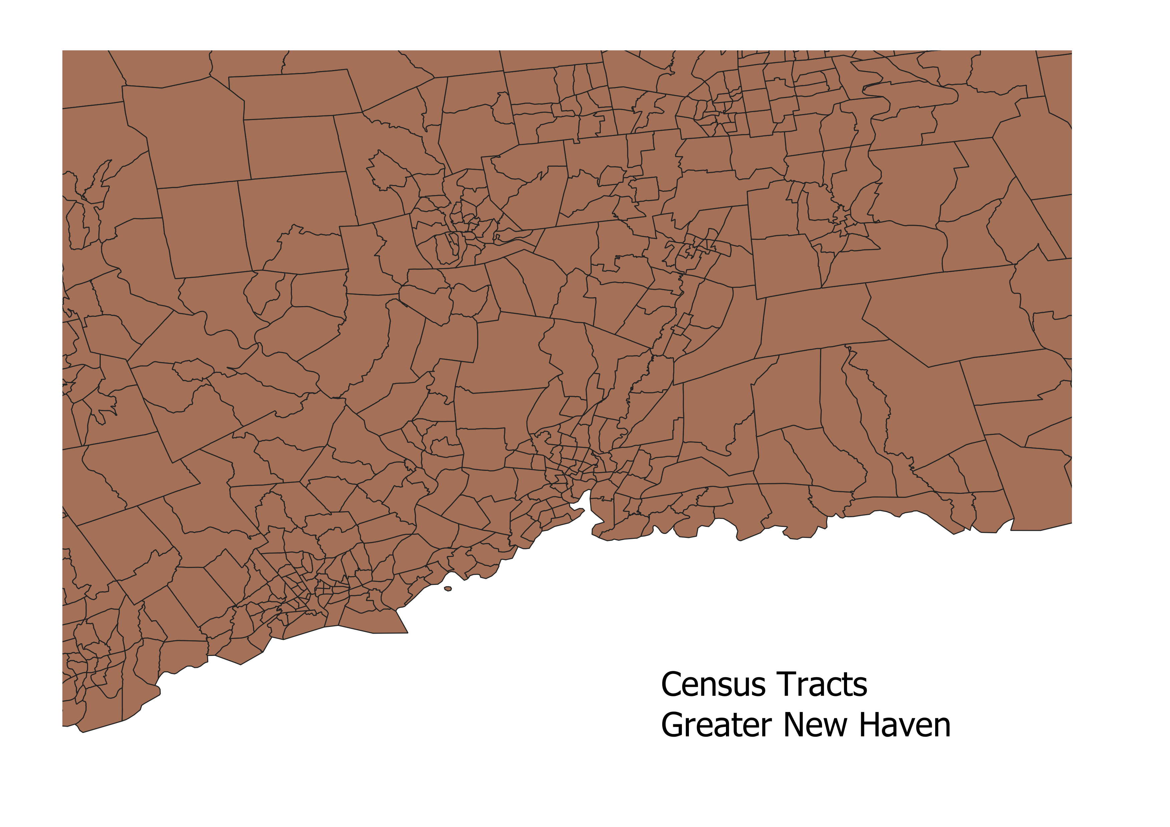
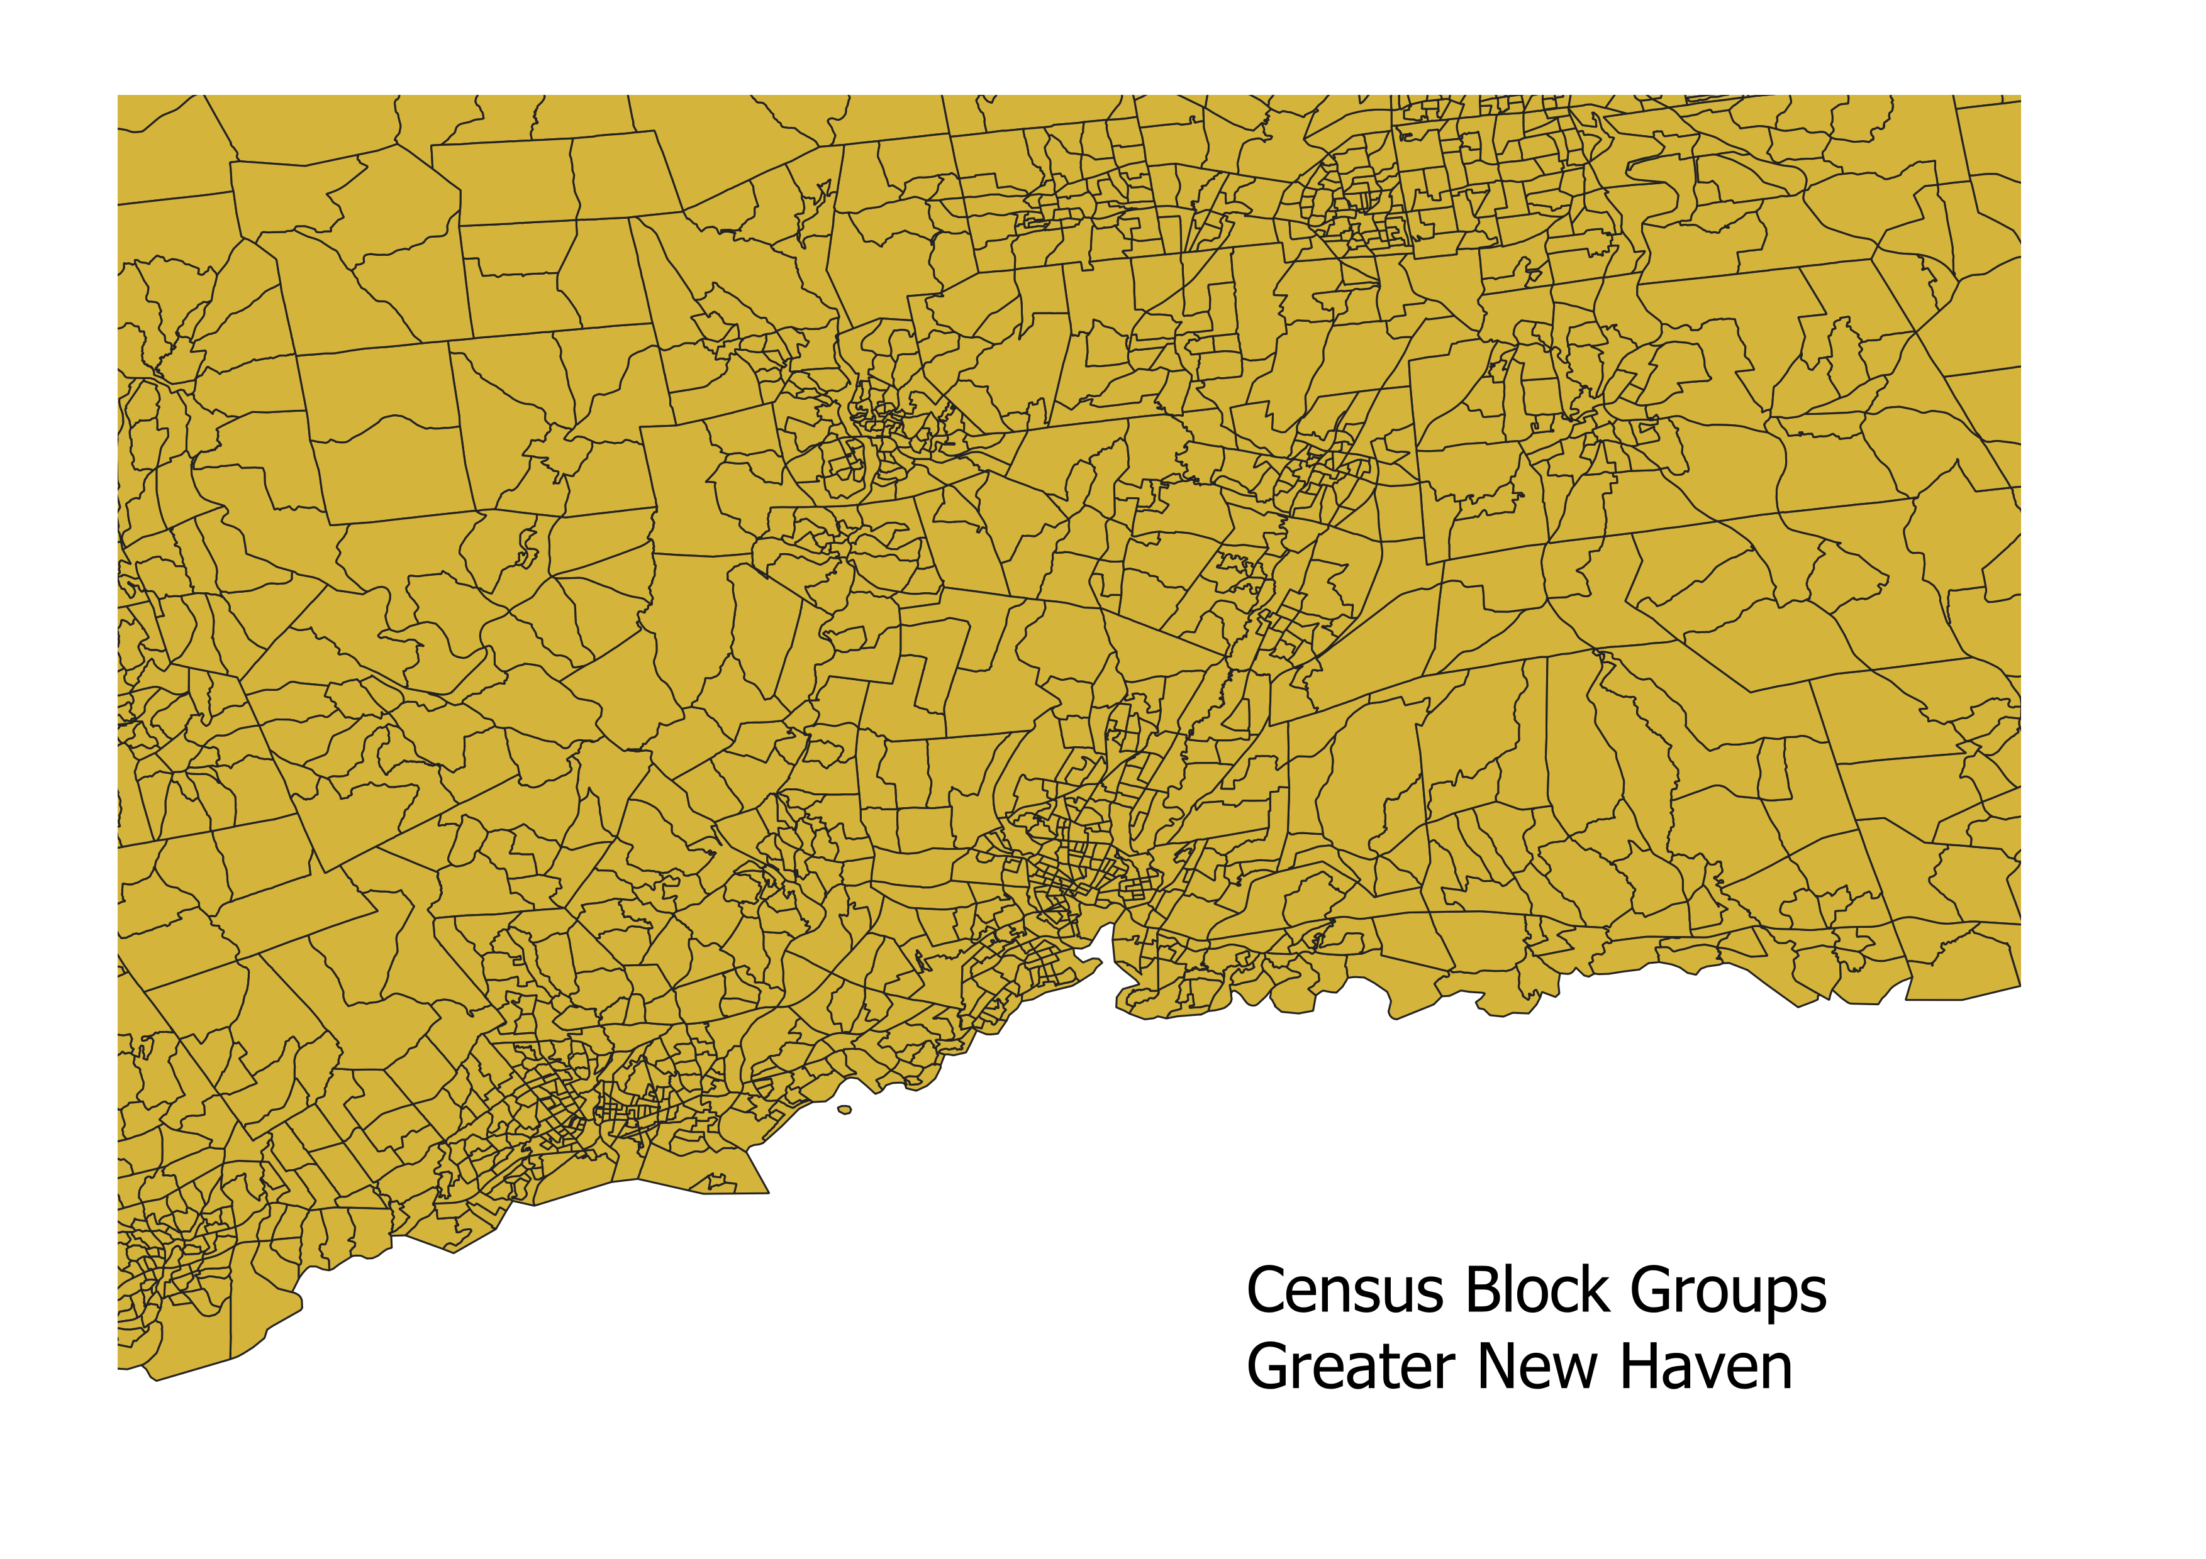
Enumeration Units around New Haven

Slide 15
Data Processing: Geocoding
Records contain addresses, necessary to geocode all 14,000+
Options
Texas A&M’s Geoservices -- https://geoservices.tamu.edu/Services/Geocode/
Census Bureau -- https://www.census.gov/geo/maps-data/data/geocoder.html
Google Maps -- https://developers.google.com/maps/documentation/geocoding/intro

Slide 16
Data Processing: Geocoding
Accuracy Testing
Selected 50 addresses in 3 towns; hand coded them via town GIS sites
Submitted the set of 50 addresses to each of the 3 services
Measured the absolute value between each lat/long and the hand-coded values, took standard deviation of those differences for each service
Standard deviation values hand-coded latitude/longitude
Texas A&M selected; also allows user to continually process addresses in batches of 2,500
Remaining addresses to be geocoded and then compiled into single CSV file.
 | Latitude | Longitude
Texas A&M | 0.000213 | 0.000501
Census Bureau | 0.000970 | 0.001230
Google | 0.000890 | 0.001965

Slide 17
Analysis
Use combination of GeoDa and R Studio
Statistical methods to be used
Global Moran’s I – GeoDa – spatial autocorrelation
Local Indicators of Spatial Association (LISA) – GeoDa – local clustering
Nearest Neighbor Hierarchical Clustering – R Studio – hot spot analysis
Perform each operation for each year using the foreclosure data
Perform each operation for demographics in 2005, 2009, and 2013 – before, during, and after the subprime mortgage crisis

Slide 18
Analysis: Example of LISA – Cluster Map

Slide 19
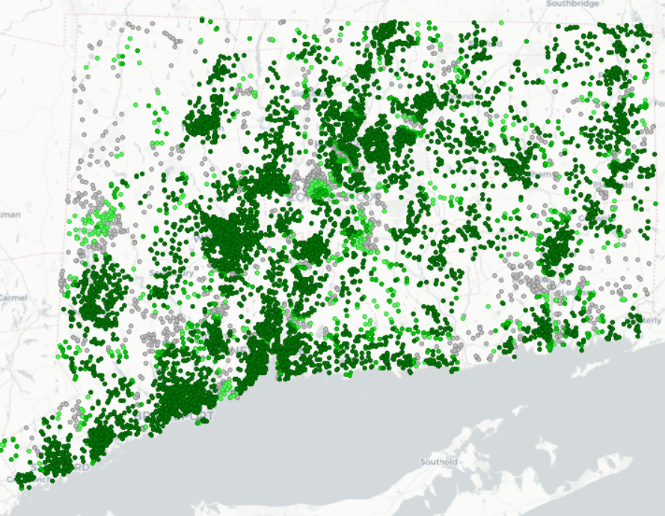
Analysis: Example of LISA – Significance Map

Slide 20
Possible Conclusions from Analysis
It seems likely that foreclosures do have hot and cold spots.
It also seems likely that race/ethnicity has an impact.
Based on thought that race has an impact, income should also have an impact

Slide 21
Limitations
2014 error in original dataset – would have included 2014, 2015, and 2016 otherwise, giving a fuller picture of post-mortgage crisis situation
Other errors/problems in the original data, known (such as the uncharacteristic drop in September 2011) and otherwise
Data doesn’t capture all foreclosures – only ones that proceeded via sale (Connecticut allows for foreclosures to happen without a sale)
While dealing with the modifiable areal unit problem as best as possible, still a limit on analysis

Slide 22
Proposed Timeline for Capstone Project
Oct – Fold peer review critiques into methodology
Nov – Update data, complete geocoding
Dec – Begin analysis
Jan – Finish analysis
Feb – Work on presentation
Mar/Apr/May – Present at conference

Slide 23
Questions
Thank you for listening and I welcome your feedback

Slide 24
References
Census Bureau, American Community Survey. Generated using American Fact Finder by Ryan O’Neil. (https://factfinder.census.gov). Last visited October 23, 2018.
Census Bureau. Quick Facts Connecticut. (https://www.census.gov/quickfacts/fact/table/ct/PST045217). Last visited October 23, 2018.
Connecticut Open Data. https://data.ct.gov/ Last visited October 23, 2018.
Connecticut GIS Data. http://magic.lib.uconn.edu/connecticut_data.html Last visited October 23, 2018.
Davis, Danne; Shin, Minsun. Contemporary Issues in Childhood Education. “The Lives of Sesame Street: The Impact of Foreclosures on Young Children”. v. 10, issue 10. (2009).
Hall, Matthew; Crowder, Kyle; Spring, Amy. The Annals of Political and Social Science, “Variations in Housing Foreclosures by Race and Place, 2005–2012”, v. 660, issue 1, 217-237. (2015)

Slide 25
References (continued)
Kobie, Timothy and Lee, Sugie, Urban Affairs Review, “The Spatial-Temporal Impact of Residential Foreclosures on Single-Family Residential Property Values”, v. 47 (1), 3-30(2011)
Li, Lingxaio. Real Estate Economics. “Why Are Foreclosures Contagious?”. v. 45 (4) 979-997. (2017).
Lichtenstein, Bronwen and Weber, Bruce. The Professional Geographer. “Old Ways, New Impacts: Race, Residential Patterns, and the Home Foreclosure Crisis in the American South”, v. 66 (3), 390-402. (2014).
Pandit, Caaminee. Sociological Insight, “The Impact of Foreclosure on Crime in American Cities”. v. 3, 82-109. (2011).

