Slide 1
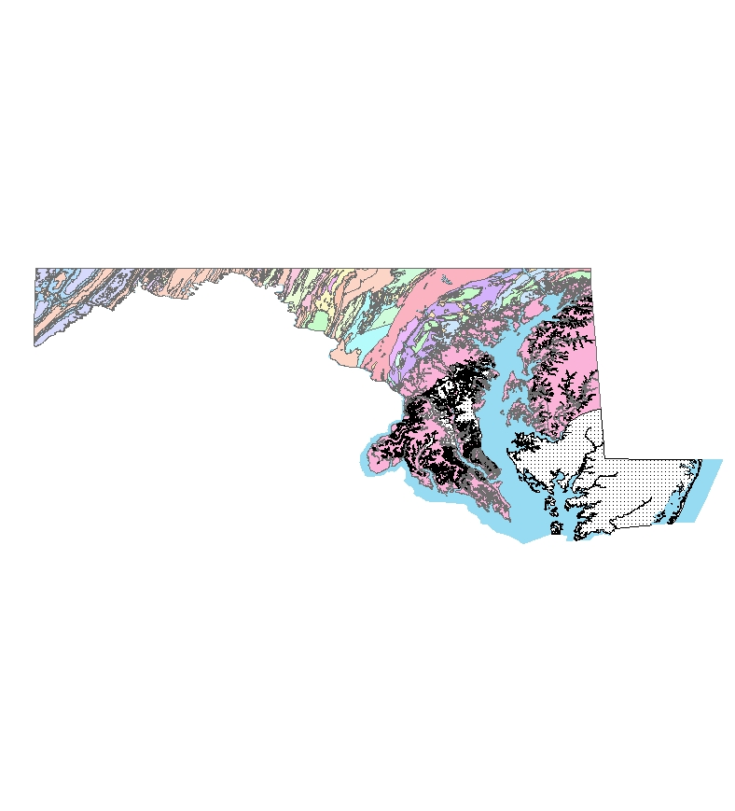
PROPOSAL FOR STATEWIDE GROUNDWATER VULNERABILITY STUDY FOR MARYLAND
By Olufunso S. Ogidan
GEOG 596A
05 January 2010
Adviser: Dr. Barry Evans

Slide 2
Outline
Background & Scope
Project Goals
Data and Data Sources
Proposed Methodology
Limitations
Questions

Slide 3
Background & Scope
Multiple cases of groundwater pollution in Maryland
Current groundwater protection programs in Maryland
Brief description of DRASTIC

Slide 4
Groundwater pollution in Maryland
Methyl Tertiary Butyl Ether (MTBE) leakages into groundwater
Currently there are 8,500 Underground Storage Tanks (UST) and 11,109 confirmed releases
Pesticide presence in groundwater system
Other potential sources of groundwater contamination-Spillage, Waste Disposal sites etc.

Slide 5
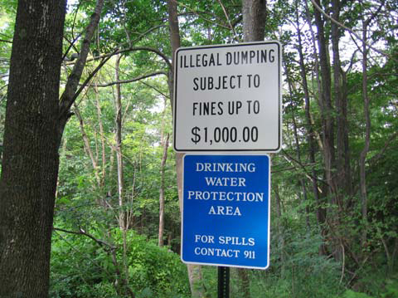
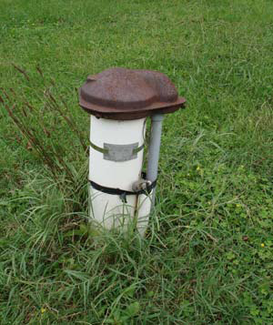
Maryland Groundwater Protection Programs
Most groundwater protection plan are implemented at the local government level
Maryland Department of the Environment (MDE) provides technical, informational and funding support to the local governments
Most programs focused on protection of the areas around wells where activities could result in contamination
Groundwater recharge areas protection
Currently there is no statewide groundwater vulnerability map

Slide 6
Description of the DRASTIC Method
The DRASTIC Model is the most widely used groundwater vulnerability assessment method available
DRASTIC utilizes seven hydrogeologic parameters to determine vulnerability to groundwater contamination
DRASTIC is an acronym that stands for the initial of the seven hydrogeologic parameter
D = Depth to groundwater
R= net Recharge
A= Aquifer media
S= Soil media
T= Topography (Slope)
I = Impact of the vadose zone
C= hydraulic Conductivity

Slide 7
Assigned Weight for DRASTIC Parameters
Each DRASTIC parameter is assigned a relative weight ranging from 1 to 5 based on their relative importance in influencing the flow of contaminants into groundwater system.
Parameters | Weight
Depth to Water | 5
Net Recharge | 4
Aquifer Media | 3
Soil Media | 2
Topography | 1
Impact of the Vadose Zone Media | 5
Hydraulic Conductivity of the Aquifer | 3
Aller, L., T. Bennett, J.H. Lehr, R.J. Petty, and G. Hackett, 1987. DRASTIC: A Standardized System for Evaluating Ground Water Pollution Potential Using Hydrogeologic Settings. EPA 600/2-87/035, Ada, OK, 163 pp.)

Slide 8
Project Goal
To Develop a statewide groundwater vulnerability map
Rank areas based on the DRASTIC vulnerability index
Identify areas with the greatest potential to groundwater pollution
Provide information on areas where targeted critical vulnerability assessment might be required

Slide 9
Data and Data Sources

Slide 10
Depth to Water
Depth to water (feet) determines the depth that contaminants have to travel before reaching the groundwater
Groundwater well data obtained from USGS
Data from1,012 groundwater wells will be used for the study
Four Year average of data will be used to estimate depth to water
Continuous depth to water surface will be interpolated from the point well data

Slide 11
Example of USGS Well Data
USGS 380408075335701 WO Fb 2
Worcester County, Maryland | Output formats
Latitude 38°04'07", Longitude 75°33'58" NAD27 | Table of data
Land-surface elevation 15 feet above sea level NGVD29 | Tab-separated data
The depth of the well is 130 feet below land surface. | Graph of data
The depth of the hole is 130 feet below land surface. | Reselect period
This well is completed in the Northern Atlantic Coastal Plain aquifer system (S100NATLCP) national aquifer.
This well is completed in the Pocomoke Aquifer (122PCMK) local aquifer.
Date | Water level, feet below land surface | Status | Date | Time | Water level, feet below land surface | Status
3/15/2005 | 16.2 |  | 4/23/2007 | 11:00 | 16.65
9/21/2005 | 18.66 |  | 9/13/2007 | 10:50 | 22.76
4/17/2006 | 17.43 |  | 4/21/2008 | 11:00 | 16.81
9/11/2006 | 18.85 |  | 9/26/2008 |  | 19.3
 |  |  | 3/30/2009 |  | 16.12
 |  |  | 9/23/2009 |  | 17.65

Slide 12
Net Recharge
Net Recharge (inch per year) is the quantity of water from precipitation that infiltrate into the ground to reach the water table
There is no existing net recharge data for Maryland
Estimated net recharge will be made from the hydrological soil group characteristics
Hydrologic soil group data was obtained from the USDA

Slide 13
Net Recharge Estimation
Hydrologic Soil Group | USDA Average Annual Recharge Volume (inches/year)*
A | 18
B | 12
C | 6
D | 3
*Rawls, W., Brakensiek, D., & Saxton, K (1982). Estimation of Soil Properties. Transactions of the American Society of Agricultural Engineers, 25(5), 1316-1320

Slide 14
Aquifer Media
Aquifer media refers to the consolidated or unconsolidated subsurface rocks that serves as the aquifer
An aquifer is a water bearing formation that can economically yield water to well
Aquifer media data was obtained from USGS

Slide 15
Soil Media
Soil Media is the upper weathered zone of the earth up to about six feet or less from the surface
Soil Media affect the infiltration and biogeochemical attenuation of contaminants
Soil media data was obtained from the USDA soil data mart
Drainage characteristics and percent loam attributes from the data will be used to estimate the DRASTIC rating for the soil media

Slide 16
Topography (Slope)
Topography is the slope variability of the land surface
Topography influence the proportion of precipitation and anthropogenic contaminants runoff or infiltrate into the ground
179 10m resolution National Elevation Dataset (NED) quadrangle data covering most of Maryland were obtained from USGS
The NED quadrangles were mosaic in ArcGIS 9.3 Spatial Analyst Tool
Slope will be calculated from the NED

Slide 17
Impact of the Vadose Zone
The vadose zone is the zone between the land surface and the regional water table
The DRASTIC ratings for the impact of the vadose zone are based on the characteristics of the unsaturated zone rock types
Vadose zone data will be estimated from the geological data
Published geological map was obtained from USGS

Slide 18
Hydraulic Conductivity
Hydraulic conductivity is the ability of an aquifer to transmit water
Hydraulic conductivity (gpd/ft²) determines the rate at which groundwater will flow under a specific hydraulic gradient in the saturated zone
Hydraulic conductivity will be estimated from the physical characteristics of the aquifer

Slide 19
Proposed Methodology

Slide 20
Weighting and Rating
Each hydrogeologic parameter will be assigned a rating between 1 and 10 based on the ranges or significant media type
Each rating will be scaled by the Weighting factors ranging from 1 to 5
The weighted ratings will be summed to obtain the DRASTIC Index D_{i}

Slide 21
DRASTIC Rating and Weighting Values for the Various Hydrogeological Parameter Setting
Depth to water (ft) |  | Recharge (in) |  | Topography (slope) % |  | Conductivity (gpd/ft²) |  | Aquifer media |  | Vadose zone material |  | Soil Media
Range | Rating | Range | Rating | Range | Rating | Range | Rating | Range | Rating | Range | Rating | Range | Rating
0-5 | 10 | 0-2 | 1 | 0-2 | 10 | 1-100 | 1 | Massive Shale | 2 | Confining Layer | 1 | Thin or absent | 10
5-15 | 9 | 2-4 | 3 | 2-6 | 9 | 100-300 | 2 | Metamorphic/Igneous | 3 | Silt/Clay | 3 | Gravel | 10
15-30 | 7 | 4-7 | 6 | 6-12 | 5 | 300-700 | 4 | Weathered metamorphic/igneous | 4 | Shale | 3 | Sand | 9
30-50 | 5 | 7-10 | 8 | 12-18 | 3 | 700-1000 | 6 | Glacial till | 5 | Limestone | 3 | Peat | 8
50-75 | 3 | >10 | 9 | >18 | 1 | 1000-2000 | 8 | Bedded Sandstone, Limestone | 6 | sandstone | 6 | Shrinking clay | 7
75-100 | 2 | DRASTIC Weight 4 |  | DRASTIC Weight 1 |  | >2000 | 10 | Massive Sandstone | 6 | Bedded limestone, Sandstone | 6 | Sandy loam | 6
>100 | 1 |  |  |  |  | DRASTIC Weight 2 |  | Massive limestone | 8 | Sand and Gravel with silt | 6 | Loam | 5
DRASTIC Weight 5 |  |  |  |  |  |  |  | Sand and gravel | 8 | Sand and Gravel with silt | 8 | Silty loam | 4
Aller, L., T. Bennett, J.H. Lehr, R.J. Petty, and G. Hackett, 1987. DRASTIC: A Standardized System for Evaluating Ground Water Pollution Potential Using Hydrogeologic Settings. EPA 600/2-87/035, Ada, OK, 163 pp.) |  |  |  |  |  |  |  | Basalt | 9 | Basalt | 9 | clay loam | 3
 |  |  |  |  |  |  |  | Karst limestone | 10 | Karsts limestone | 10 | Muck | 2
 |  |  |  |  |  |  |  | DRASTIC Weight 3 |  | DRASTIC Weight 5 |  | No shrinking clay | 1
 |  |  |  |  |  |  |  |  |  |  |  | DRASTIC Weight 5

Slide 22
DRASTIC Index
DRASTIC index will be computed by applying a linear combination of the seven parameters based on the equation below
D_{i}= D_{R}D_{W} + R_{R}R_{W} + A_{R}A_{W} + S_{R}S_{W} + T_{R}T_{W} + I_{R}I_{W} + C_{R}C_{W}
Where
D_{i} = DRASTIC Index
D, R, A, S, T, I, C = Initials of the seven hydrogeologic factors,
R= Ratings
W= Weight

Slide 23
DRASTIC Index
ArcGIS 9.3 will be used to perform the analyses and calculations
The resulting D_{i} will be ranked to generate relative groundwater vulnerability index for the state.
D_{i} will be displayed on thematic map that ranks areas within the state based on their susceptibility to groundwater pollution.
The higher the calculated DRASTIC index for an area, the greater the vulnerability of that area to groundwater contamination

Slide 24
Limitations
Some hydrogeologic parameters were estimated due to unavailability of published data
There was no available data on the spatial locations of previous groundwater contaminations in the state of Maryland
D_{i} cannot be singularly used to determine the suitability of a site for waste disposal or USTs.

Slide 25
Questions?

