Slide 1
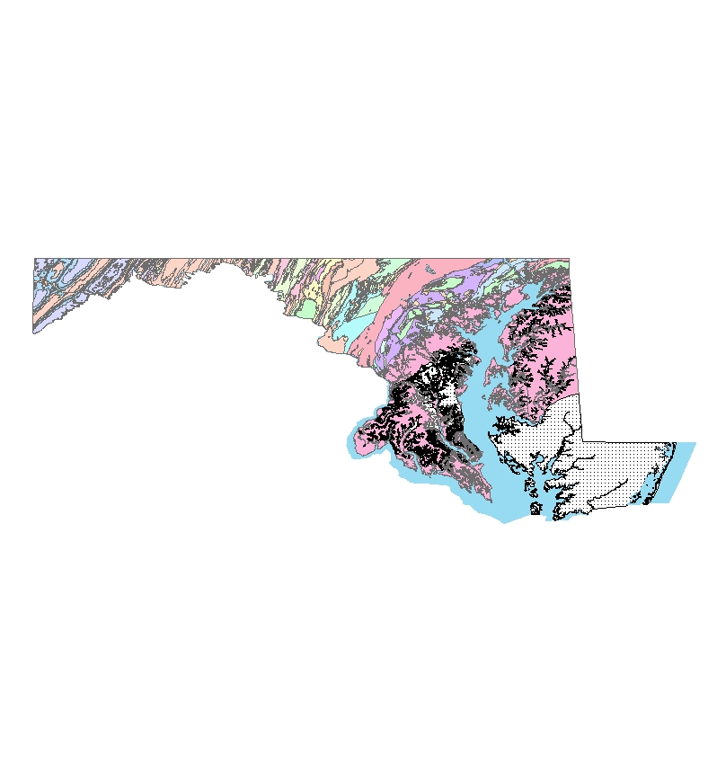
STATEWIDE DRASTIC GROUNDWATER VULNERABILITY STUDY FOR MARYLAND
By Olufunso S. Ogidan
Environmental Science Officer
U.S. Army
ADVISER: Dr. Barry Evans
24 May 2010

Slide 2
Outline
Background & Scope
DRASTIC Description
Data and Analysis
Result
Limitations
Conclusion

Slide 3
Background and Scope

Slide 4
Groundwater pollution in Maryland
Methyl Tertiary Butyl Ether (MTBE) leakages into groundwater
Currently there are 8,500 Underground Storage Tanks (UST) and 11,109 confirmed releases
Pesticide presence in groundwater system
Other potential sources of groundwater contamination-Spillage, Waste Disposal sites etc.

Slide 5
Maryland Groundwater Protection Programs
Most groundwater protection plan are implemented at the local government level
Maryland Department of the Environment (MDE) provides technical, informational and funding support to the local governments
Most programs focused on protection of the areas around wells where activities could result in contamination
Groundwater recharge areas protection
Currently there is no statewide groundwater vulnerability map

Slide 6
Project Goal
To develop a Statewide Groundwater Vulnerability map
Rank areas based on the DRASTIC vulnerability index
Identify areas with the greatest potential to groundwater pollution
Provide information on areas where targeted critical vulnerability assessment might be required

Slide 7
DRASTIC Description

Slide 8
Description of the DRASTIC Method
The DRASTIC Model is the most widely used groundwater vulnerability assessment method available
DRASTIC utilizes seven hydrogeologic parameters to determine vulnerability to groundwater contamination
DRASTIC is an acronym that stands for the initial of the seven hydrogeologic parameter
D = Depth to groundwater
R= net Recharge
A= Aquifer media
S= Soil media
T= Topography (Slope)
I = Impact of the vadose zone
C= hydraulic Conductivity

Slide 9
Assigned Weight for DRASTIC Parameters
Each DRASTIC parameter is assigned a relative weight ranging from 1 to 5 based on their relative importance in influencing the flow of contaminants into groundwater system.
Parameters | Weight
Depth to Water | 5
Net Recharge | 4
Aquifer Media | 3
Soil Media | 2
Topography | 1
Impact of the Vadose Zone Media | 5
Hydraulic Conductivity of the Aquifer | 3
Aller, L., T. Bennett, J.H. Lehr, R.J. Petty, and G. Hackett, 1987. DRASTIC: A Standardized System for Evaluating Ground Water Pollution Potential Using Hydrogeologic Settings. EPA 600/2-87/035, Ada, OK, 163 pp.)

Slide 10
Weighting and Rating
Each hydrogeologic parameter was assigned a rating between 1 and 10 based on the ranges or significant media type
Each rating was scaled by the Weighting factors ranging from 1 to 5
The summed weighted ratings produced the DRASTIC Index D_{i}

Slide 11
DRASTIC Rating and Weighting Values for the Various Hydrogeological Parameter Setting
Depth to water (ft) |  | Recharge (in) |  | Topography (slope) % |  | Conductivity (gpd/ft²) |  | Aquifer media |  | Vadose zone material |  | Soil Media
Range | Rating | Range | Rating | Range | Rating | Range | Rating | Range | Rating | Range | Rating | Range | Rating
0-5 | 10 | 0-2 | 1 | 0-2 | 10 | 1-100 | 1 | Massive Shale | 2 | Confining Layer | 1 | Thin or absent | 10
5-15 | 9 | 2-4 | 3 | 2-6 | 9 | 100-300 | 2 | Metamorphic/Igneous | 3 | Silt/Clay | 3 | Gravel | 10
15-30 | 7 | 4-7 | 6 | 6-12 | 5 | 300-700 | 4 | Weathered metamorphic/igneous | 4 | Shale | 3 | Sand | 9
30-50 | 5 | 7-10 | 8 | 12-18 | 3 | 700-1000 | 6 | Glacial till | 5 | Limestone | 3 | Peat | 8
50-75 | 3 | >10 | 9 | >18 | 1 | 1000-2000 | 8 | Bedded Sandstone, Limestone | 6 | sandstone | 6 | Shrinking clay | 7
75-100 | 2 | DRASTIC Weight 4 |  | DRASTIC Weight 1 |  | >2000 | 10 | Massive Sandstone | 6 | Bedded limestone, Sandstone | 6 | Sandy loam | 6
>100 | 1 |  |  |  |  | DRASTIC Weight 2 |  | Massive limestone | 8 | Sand and Gravel with silt | 6 | Loam | 5
DRASTIC Weight 5 |  |  |  |  |  |  |  | Sand and gravel | 8 | Sand and Gravel with silt | 8 | Silty loam | 4
Aller, L., T. Bennett, J.H. Lehr, R.J. Petty, and G. Hackett, 1987. DRASTIC: A Standardized System for Evaluating Ground Water Pollution Potential Using Hydrogeologic Settings. EPA 600/2-87/035, Ada, OK, 163 pp.) |  |  |  |  |  |  |  | Basalt | 9 | Basalt | 9 | clay loam | 3
 |  |  |  |  |  |  |  | Karst limestone | 10 | Karsts limestone | 10 | Muck | 2
 |  |  |  |  |  |  |  | DRASTIC Weight 3 |  | DRASTIC Weight 5 |  | No shrinking clay | 1
 |  |  |  |  |  |  |  |  |  |  |  | DRASTIC Weight 5

Slide 12
Data and Analysis

Slide 13
Depth to Water
Depth to water (DTW) determines the distance that contaminants have to travel before reaching the groundwater
Depth to Water was estimated from interpolation of data obtained from USGS for 490 groundwater wells in and around Maryland
An average of depth from the surface to water (in feet) over four years was used to determine Depth to water at that point
Continuous Interpolated Depth to Water surface for the state was generated by interpolation of the point data
Ratings were assigned and reclassified to generate the Depth to Water Surface

Slide 15
Net Recharge
Net Recharge (inch per year) is the quantity of water from precipitation that infiltrate into the ground to reach the water table
There is no existing statewide net recharge data for Maryland
Estimated net recharge was generated from the hydrological soil group characteristics data obtained from the USDA based on an annual precipitation of 46 inches/year
Ratings were assigned and reclassified to generate the Net Recharge Surface

Slide 16
Net Recharge Estimation
Hydrologic Soil Group | USDA Average Annual Recharge Volume (inches/year)*
A | 18
B | 12
C | 6
D | 3
*Rawls, W., Brakensiek, D., & Saxton, K (1982). Estimation of Soil Properties. Transactions of the American Society of Agricultural Engineers, 25(5), 1316-1320

Slide 18
Aquifer Media
Aquifer media refers to the consolidated or unconsolidated subsurface rocks that serves as the aquifer
An aquifer is a water bearing formation that can economically yield water to well
Aquifer media data was obtained from USGS
Ratings were assigned based on the significant media type and reclassified to generate the Aquifer media surface

Slide 20
Soil Media
Soil Media is the upper weathered zone of the earth up to about six feet or less from the surface
Soil Media affect the infiltration and biogeochemical attenuation of contaminants
Soil media data was obtained from the USDA soil data mart
Ratings were applied based on the significant soil type and drainage attribute of the media
Ratings were reclassified to generate the soil media surface

Slide 22
Topography (Slope)
Topography is the slope variability of the land surface
Topography influence the proportion of precipitation and anthropogenic contaminants runoff or infiltration into the ground
Slope was generated from the 30m Resolution Digital Elevation Model (DEM) using the slope tool of ArcGIS Spatial Analyst
Ratings were assigned to the percent slope and reclassified to generate the Slope Surface

Slide 24
Impact of the Vadose Zone
The vadose zone is the zone between the land surface and the regional water table
The DRASTIC ratings for the impact of the vadose zone are based on the characteristics of the unsaturated zone rock types
Vadose zone data was estimated from published geological data
Ratings were assigned based on the significant media type and reclassified to generate the Impact of the Vadose Zone surface

Slide 26
Hydraulic Conductivity
Hydraulic conductivity is the ability of an aquifer to transmit water
Hydraulic conductivity (gpd/ft²) determines the rate at which groundwater will flow under a specific hydraulic gradient in the saturated zone
There is no statewide hydraulic conductivity data for Maryland aquifers
Estimated Hydraulic conductivity was made from the physical characteristics of the local aquifer
Ratings were applied to the estimated hydraulic conductivities and reclassified to generate the Hydraulic Conductivity Surface

Slide 28
Result and Interpretation

Slide 29
DRASTIC Index
DRASTIC index was computed by applying a linear combination of the seven parameters based on the equation below
D_{i}= D_{R}D_{W} + R_{R}R_{W} + A_{R}A_{W} + S_{R}S_{W} + T_{R}T_{W} + I_{R}I_{W} + C_{R}C_{W}
Where
D_{i} = DRASTIC Index
D, R, A, S, T, I, C = Initials of the seven hydrogeologic factors,
R= Ratings
W= Weight

Slide 31
Interpretations
The resulting thematic map provides a relative ranking of the DRASTIC Index (D_{i}) based on susceptibility to groundwater pollution.
The higher the calculated DRASTIC index for an area, the greater the vulnerability of that area to groundwater contamination
In general, the DRASTIC Index is higher in the Eastern part of the state and around the edges of the Chesapeake Bay
Vulnerability generally reduces westward from the Chesapeake Bay with the lowest vulnerability in Garrett and Allegany counties

Slide 32
Limitations
Some hydrogeologic parameters were estimated due to unavailability of published data
There was no available data on the spatial locations of previous groundwater contaminations in the state of Maryland
D_{i} cannot be singularly used to determine the suitability of a site for waste disposal or USTs.

Slide 33
Conclusion
The DRASTIC method utilize a combination of Assigned Weighting and Rating Schemes to seven hydrogeologic parameters to generate groundwater pollution potential map
DRASTIC methodology was used to generate a statewide groundwater vulnerability map for Maryland that show areas with the greatest potential to groundwater pollution
The resulting map provide decision makers with areas where targeted critical groundwater quality and vulnerability assessments might be required

Slide 34
Questions?

