Slide 1
Hodgson Brook Watershed Analysis
Pamela Ordung
PSU Geog 596A Capstone Project
Advisor: Joseph Bishop
Notes:
Title Page

Slide 2
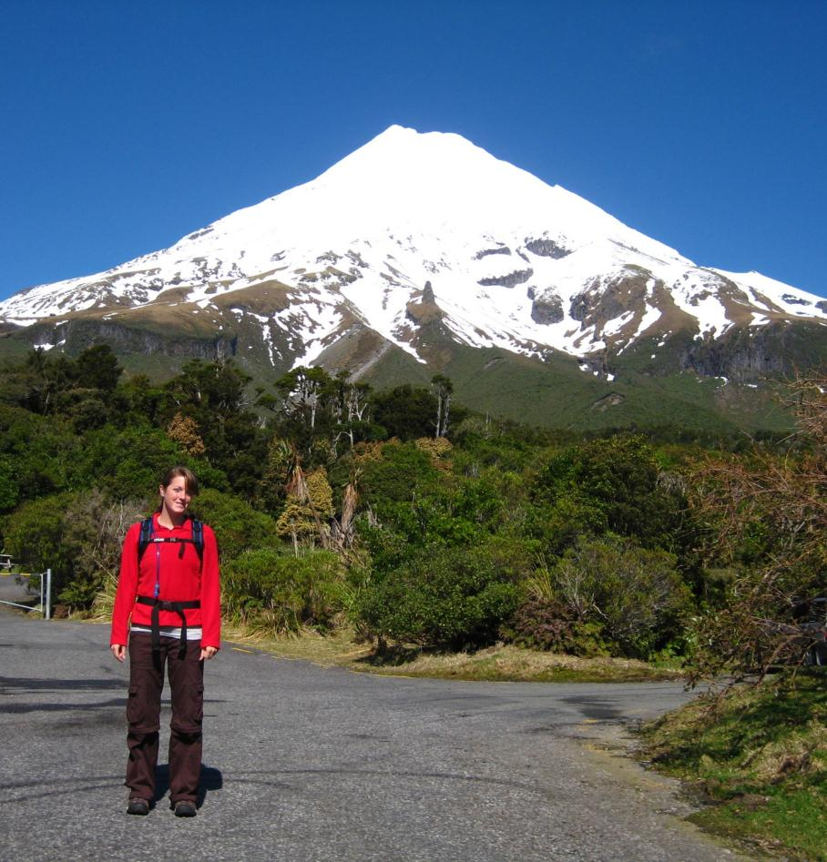
Me
GIS Technician
Love travel & hiking
Just bought my first house in Sterling, MA
Notes:
A little about myself
I’m about to hike Mt. Taranaki in New Plymouth, New Zealand

Slide 3
Presentation Outline
Background Information: Stormwater Runoff
Study Site
Regional & Local
Pollution
What has been done
Goals & Objectives
Methods & Materials
Materials
Proposed Steps
Project Implications
Proposed Timeline
References & Citations
Acknowledgements
Questions
Notes:
Go through presentation outline quickly

Slide 4
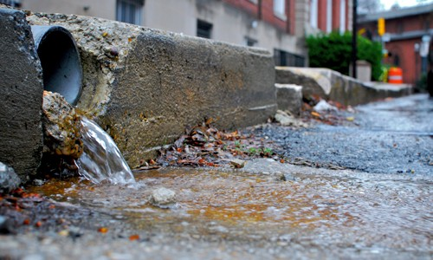
Stormwater Runoff
Pollution of streams, rivers, other water bodies
Role of Impervious surfaces
Stormwater management techniques
*Image reproduced for educational purposes only (Chesapeake Bay Program 2012)
Notes:
-background info. On stormwater runoff
-stormwater runoff can play a major role in pollution of streams, rivers, water bodies
-water usually soaks and filters through the ground, unless covered by an impervious surface
-when water flows from impervious surface directly into water source, can cause pollution because doesn’t have a chance to filter
-sw management techniques aid in keeping the waters clean, and their flow unobstructed

Slide 5
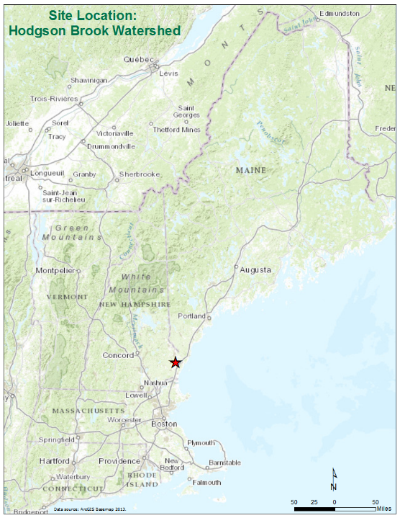
Study Site: Hodgson Brook Watershed
Covers approximately 20% of the total land area in North Central Portsmouth, NH
Notes:
-Regional Study Site

Slide 6
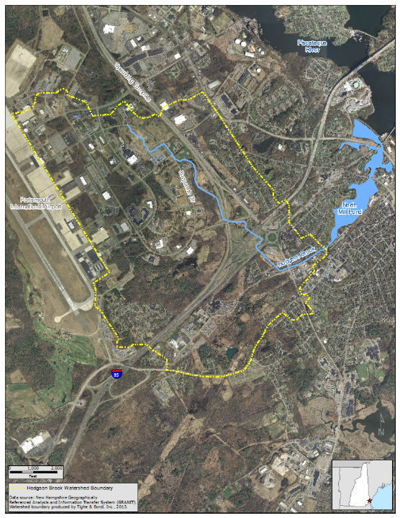
Study Site: Hodgson Brook Watershed
Nearly 55% of the watershed falls within the Pease International Tradeport
32% of the watershed is covered with impervious surfaces
Empties into North Mill Pond
Notes:
-actual study site is outlined in yellow
-The Pease International Tradeport is a former Air force Base, now it is commercial realty / office spaces (Red Hook Brewery!) and the airfield is still active ( Portsmouth International Airport)
-north mill pond is a destination for migratory birds as well as habitat for wildlife
-fresh water of north mill pond greatly affected by Hodgson brook and the amount of pollution being emptied into its waters

Slide 7
Study Site: Impervious Examples
In the 1800’s mills were built along the brook urbanizing the area and straightening the course of the brook
In the 1950’s, the building of the Pease International Air Force Base (now Tradeport) and the highway system greatly changed the Hodgson Brook’s natural course.
Water diverted into Newfields Ditch & Grafton Ditch
Now the main conveyance of stormwater is through the stormwater collection system (outlined in red)
Built over the last 100 years
Used to be abundant wetlands
Wetlands that remain today are bordered and altered by roads, railways, and parking lots
*Image reproduced for educational purposes only (D.B. Truslow Associates and the Hodgson Brook Local Advisory Committee 2004)
Notes:
Examples of urbanization w/in the watershed which leads to more impervious surfaces

Slide 8
Study Site: Pollution
Studies completed by the New Hampshire Department of Environmental Services (DES), the Hodgson Brook Local Advisory Committee (HBLAC), and the Advocates for the North Mill Pond (ANMP) have detected pollutants such as fecal coliform, nutrients, suspended sediments, metals, and organic chemicals in Hodgson Brook
Impervious surfaces play a key role in this contamination by directing runoff into the brook and surrounding wetlands
Other factors that contribute to this pollution in the watershed are due to sewage from cross connected storm drains, sewer pipes, and solid wastes such as trash and debris
Notes:
-Forms of pollution within the study site
-nutrient pollution: excess nutrients, usually nitrogen or phosphorus, stimulate algal growth. Sources of nutrient pollution include runoff from farm fields and pastures, discharges from septic tanks and feedlots, and emissions from combustion. http://en.wikipedia.org/wiki/Nutrient_pollution

Slide 9
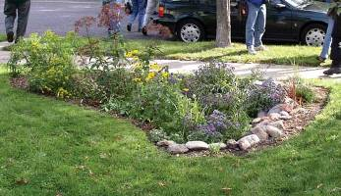
Study Site: What has been done?
Within the Pease International Tradeport
Rain gardens
Stormwater treatment wetlands
Pervious pavement
Other Suggestions from the Hodgson Brook Watershed Restoration Plan (2004)
Stormwater retrofitting
Daylighting
*Image reproduced for educational purposes only (Clean Water Services 2013)
Notes:
-SW management techniques are used to slow the rate at which water flows into a stream & divert the quantity of water that goes into a stream
-rain garden (picture): depression/hole in ground with plants in it. Allows runoff to flow into it and filter through the ground, helps control pollution
-stormwater treatment wetlands: wetlands constructed by humans – areas where runoff is directed, include wetland plants to help filter out pollution
-pervious pavement: porous pavement, allows water to filter through
-stormwater retrofitting: adding new sw management practices to older systems
-daylighting: redirection of runoff from culverts and paved channels to over ground/soil – helps return water to a more natural state, allows for water to filter through ground

Slide 10
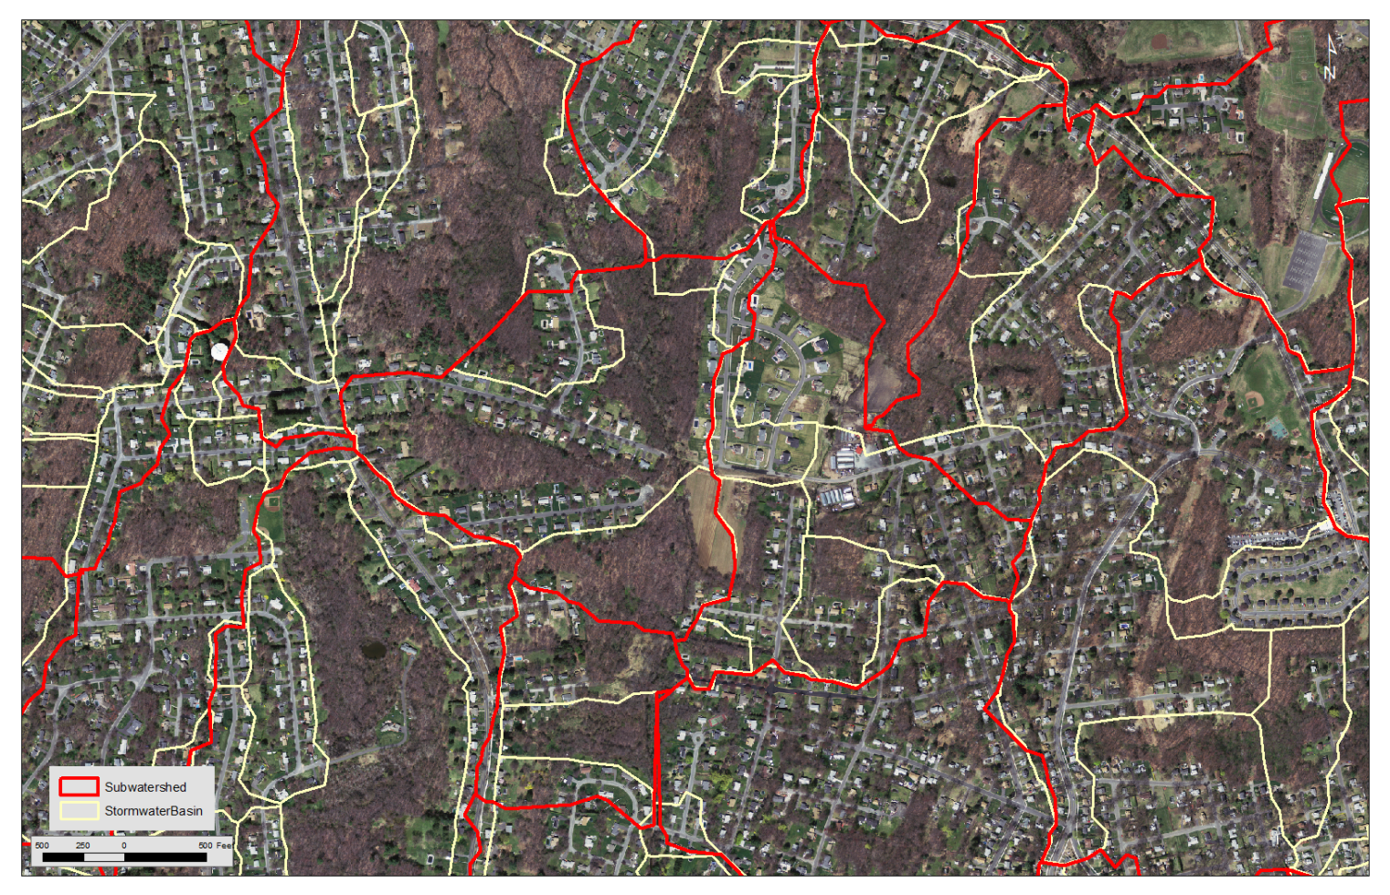
Goals & Objectives : Goal #1
Perform a watershed delineation in order to break the Hodgson Brook watershed into smaller subwatersheds and catchment areas
Create an efficient set of steps to perform this delineation
Aid in monitoring & planning done within the watershed by providing smaller, more defined study sites
Similar to a study done by Tighe & Bond (2011) for the town of West Springfield, MA
Example of the end results:
Red outlines are the subwatersheds
Yellow outlines are the Stormwater Basins, or catchment areas
*Image reproduced for educational purposes only (Tighe & Bond, Inc. 2011)
Notes:
-First Goal of the project – subwatersheds & catchment areas in efficient steps
Steps from Tighe & Bond’s study are similar to my proposed methodology – will see later on in my presentation

Slide 11
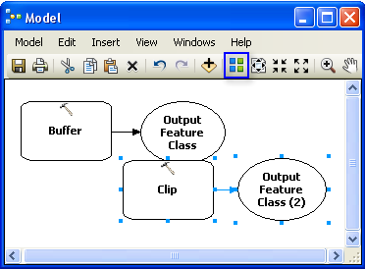
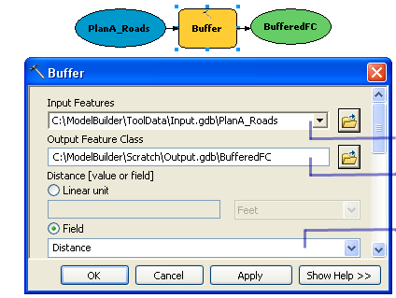
Goals & Objectives : Goal #2
Create a tool to perform the delineation using ArcGIS ModelBuilder
User will define impervious surface, model will calculate where the water will flow and from what portion of surface based on elevation data
Creates a model that is repeatable
Aid in site specific analysis
Tool can be used by the City of Portsmouth as well as groups such as HBLAC & ANMP to help in continual monitoring of stormwater quality and stormwater planning
*Images reproduced for educational purposes only (ESRI 2012)
Notes:
-2nd Goal
-An ESRI applications used to create, edit, and manage models
-models are “workflows that string together sequences of reprocessing tools, feeding the output of one tool into another tool as input.” (ESRI 2012)
Can also be used to help build workflows (image on left)
Output as input (image on right)
Repeatable

Slide 12
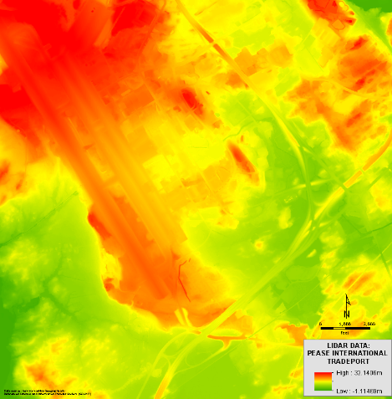
Materials
Lidar Data
A Digital Elevation Model (DEM) for the study site
2 meter resolution Coastal LIDAR Dataset collected during spring 2011 and winter 2012 is available
River and Stream dataset for Portsmouth New Hampshire
Available through New Hampshire’s GRANIT website
Existing watershed delineation
ESRI’s ArcHydro Toolset
ArcGIS ModelBuilder
Stream Layer
*Image reproduced for educational purposes only (Tighe & Bond, Inc. 2011)
Notes:
Materials needed to do this project
-existing watershed delineation to use a guide/check watersheds created from delineation

Slide 13
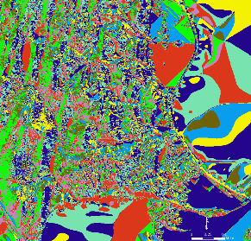
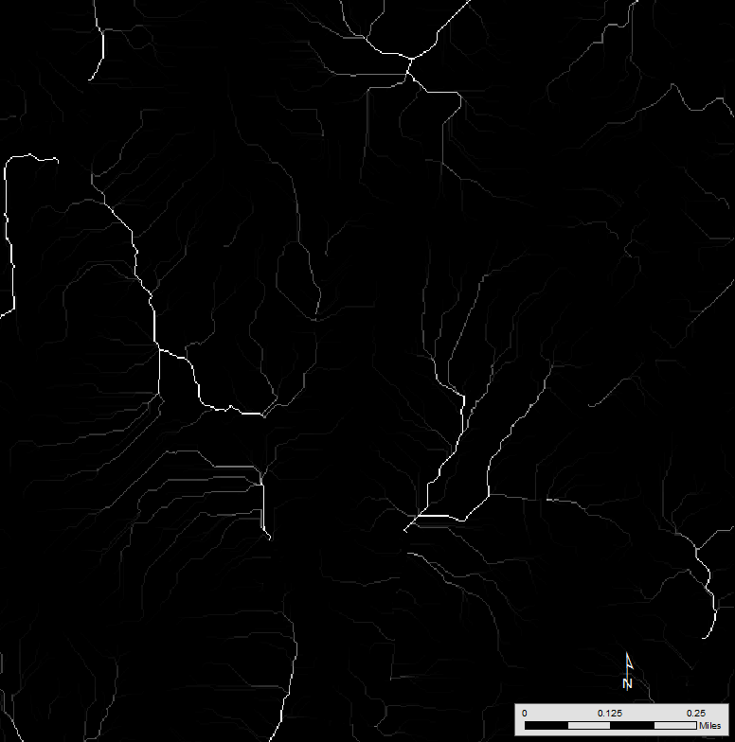
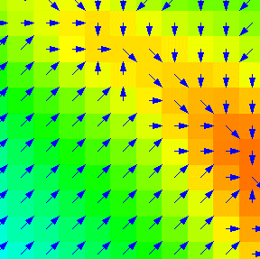
Methods
Flow Direction
DEM Reconditioning
creates a grid (raster format) of streams
Fill Sinks
Modifies elevation values so there are no areas where water is trapped and cannot flow
Flow Direction
Gives each cell in the DEM a value representing the direction of water flow
Flow Accumulation
Calculates the number of upstream cells captured by each cell in the DEM
Flow Accumulation
*Image reproduced for educational purposes only (Tighe & Bond, Inc. 2011, and ESRI 2009)
Flow Direction
Notes:
-Proposed steps to perform the delineation
-Using ArcHydro Toolset
-flow direction : Each cell in the grid has a value

Slide 14
Methods
Stream Definition
Imposes a linear feature over the DEM
Stream Segmentation
Creates a grid of stream segments, each having a unique identifier
1st and 2nd order streams
Catchment Grid Definition
Pairs the catchment areas to each stream segment
Catchment and Polygon Processing
Turns catchment areas into vector polygons instead of raster grid
Drainage Line and Point Processing
Performed to convert the stream data from raster to vector format and define the upstream catchment areas.
Stream Segmentation
Catchment Areas
*Data reproduced for educational purposes only (Tighe & Bond, Inc. 2011)
Notes:
-proposed methods continued
-Segments are defined as either head stream segments (the most upstream stream branch) or segments located between two segment junctions. All the cells in a particular segment have the same grid code that is specific to that segment. (http://forums.arcgis.com/threads/85559-Arc-Hydro-Tools-10.1-Stream-Segmentation)

Slide 15
Methods
Compare data with actual maps or aerial photos, and previous delineations
Discrepancies with the stream and flow networks might be caught
Test watershed analysis methodologies and tool on a few sites within the Pease International Tradeport.
Test the effectiveness of the tool
Examples to present to the City of Portsmouth, Hodgson Brook Local Advisory Committee, and the Advocates for North Mill Pond
Notes:
-Final Methods

Slide 16
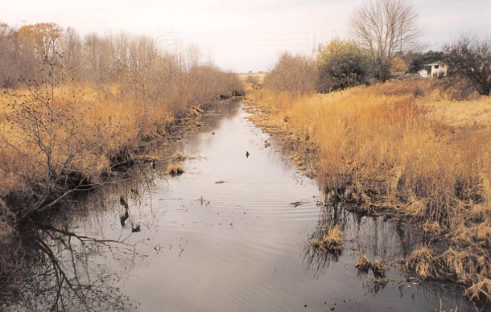
Project Implications
Knowing the flow patterns of stormwater for a specific site will allow for better stormwater management plans and treatment practices
Hodgson Brook Watershed and North Mill Pond will continue to become less polluted due to improved stormwater management practices
The tool will be used by the Hodgson Brook Local Advisory Committee, Advocates for the North Mill Pond, residents of the Pease International Tradeport, and the City of
Portsmouth, NH
*Image reproduced for educational purposes only (D.B. Truslow Associates and the Hodgson Brook Local Advisory Committee 2004)
Notes:
-future implications this project may have, how it will (hopefully) effect the Hodgson Brook watershed and North Mill Pond

Slide 17
Proposed Timeline
Winter Semester 2013:
Finish proposal for Geog 596A and present on December 18, 2013
Spring 1 Semester 2014:
Week 1: Revise proposal and project ideas/outline, based on peer reviews
Week 2-3: Watershed Delineation
Week 4-6: Trials with ModelBuilder
Week 6-8: Revise workflows and start presentation
Week 9-10: Complete final project in time for the NH Water & Watershed Conference in Plymouth, NH on March 21st 2014 (Possible, back up conference: the NEWWA 2014 spring Conference on April 2-3, 2014 in Worcester, MA)
Spring 2 Semester 2014:
Enroll in Geog 596B and complete Final Report.
Notes:
-proposed timeline to finish the project

Slide 18
References & Citations
Abdulla, M. N. 2011. Catchment Area Delineation Using GIS techniques for Bekhma Dam. Marrakech, Morocco: International Federation of Surveyors.
Brown, T. N., J. J. H. Ciborowski, T. P. Hollenhorst, G. E. Host, and L.B. Johnson. 2007. Methods for Generating Multi-scale Watershed Delineations for Indicator Development in Great Lake Coastal Ecosystems. Journal of Great Lakes Research, 33 (3): 13-26.
Brzozowski, Carol. 2010. Daylighting Streams. Stormwater: The Journal for Surface Water Quality Professionals. Accessed on December 5, 2013 from http://www.stormh2o.com/SW/Articles/Daylighting_Streams_11551.aspx.
Bug, J., P. Csafordi, A. Podor, and Z. Gribovski. 2012. Soil Erosion Analysis in a Small Forested Catchment Supported by ArcGIS Model Builder. Acta Silvatica &Llignaria Hungarica 8 (2012): 39-55.
Chesapeake Bay Program. 2012. Stormwater Runoff. Accessed on December 1. 2013 from http://www.chesapeakebay.net/issues/issue/stormwater_runoff .
Clean Water Services. 2013. Rain Gardens: celebrate rain & protect our streams. Accessed on December 5, 2013 from http://www.cleanwaterservices.org/Residents/JoinTheCycle/InYourYard/Hero/RainGarden.aspx .
D.B. Truslow Associates and the Hodgson Brook Local Advisory Committee. 2004. Hodgson Brook Watershed Restoration Plan Porstmouth, New Hampshire. Portsmouth, NH: Portsmouth Copy.
Djokic, D., and Y., Zichuan. 1999. DEM Preprocessing for Efficient Watershed Delineation. Redlands, California: ESRI. Accessed on September 19, 2013 from http://proceedings.esri.com/library/userconf/proc99/proceed/papers/pap676/p676.htm.
EPA. 2013. Weather. Water: After the Storm. Accessed on November 18, 2013 from http://water.epa.gov/action/weatherchannel/stormwater.cfm .
ESRI. 2009. ArcGIS Desktop Discussion Forums. Hydrology: Flow Direction Arrows. Accessed on December 15, 2013 from http://forums.esri.com/Thread.asp?c=93&f=982&t=287847 .
ESRI. 2012. Tutorial: Executing tools in ModelBuilder. ArcGIS Help 10.1. Accessed on October 29, 2013 from http://resources.arcgis.com/en/help/main/10.1/index.html#//002w0000007t000000.
Jones, S. H., N. Landry, and D. Morin. 2004. Hodgson Brook Watershed Monitoring Plan: A Guide for Monitoring Environmental Quality.
Pease International. 2010. A World Class Business & Aviation Industrial Park. Portsmouth, NH. Accessed on October 28, 2013 from http://www.peasedev.org/.
Notes:
References and Citations

Slide 19
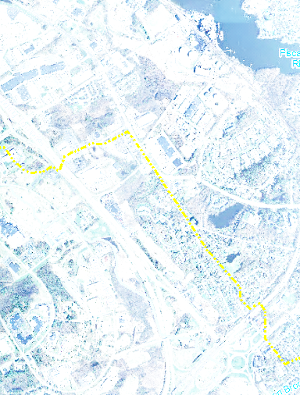
Acknowledgements
First off, I would like to thank my advisor, Joe Bishop for helping me with the many drafts of this project. I would also like to thank my boss, Nathaniel Norton and colleagues Sam Swartwout and Brad Mezquita at Tighe & Bond Inc., for their support and assistance with this project. Finally, I would like to thank Candace Dolan, Coordinator for the Hodgson Brook Restoration Project, for providing me with information about Hodgson Brook and being so enthusiastic about this project.
Notes:
Acknowlegements – thank you!

Slide 20
Questions?
Feel free to contact me with further questions if you think of them at a later date!
Pamela Ordung
pamela.ordung@gmail.com
Notes:
Any Questions?

