Slide 1

An Examination of the Nigerian Extractive Industry’s impacts on its National socio-economic stability
Christopher M. Parrett
Pennsylvania State University
Masters of Geographic Information Systems
Notes:
Self Introduction – Good Evening, my name is Chris Parrett and I will be presenting an “An Examination of the Nigerian Extractive Industry’s impacts on its National socio-economic stability” for peer review as part as the Masters in Geographic Information Systems at Penn State University.

Slide 2
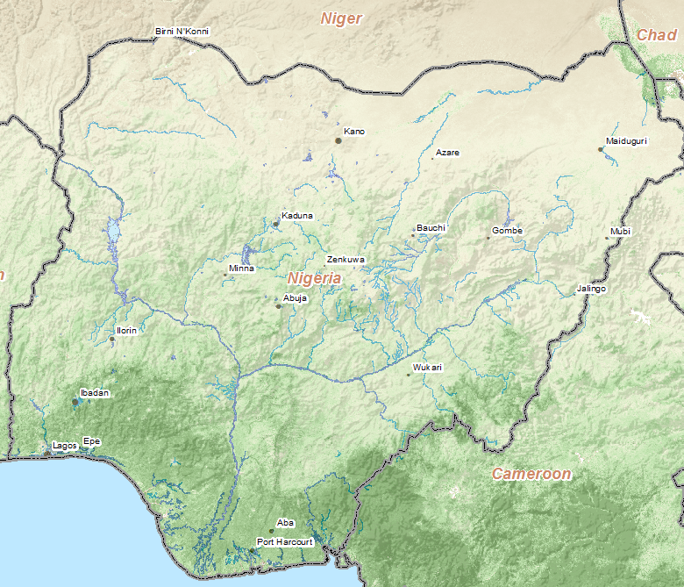
Outline
Nigeria In Recent News
Nigeria – The Key to Africa
Task and Purpose/Goals
Extractive Industries
Agricultural Industries
Analytical Methodology
Proposed Analytical Process
Physical Overview
Preliminary Explorations
Expected Challenges
Primary Data Providers
Literary References
Notes:
3) This is an brief outline for my presentation tonight.

Slide 3





Nigeria in Recent News
“…” Africa income per capita has grown 30 percent over the last decade… Projected growth over the next decade is 6 percent annually”
“…experts have identified Africa as having many of the world's fastest-growing economies”
“…the oil sector is creating distortion in the manufacturing and agricultural sectors… silently killing the economy”
U.S. Aware Of Africa's Importance To Global Security & Prosperity
“Consumer giant targets Africa's billion potential shoppers”
Notes:
Nigeria seems to be constantly in the news. Lately, the news has focused on the World’s renewed focus on the continent’s potential. In 2008, the US stood up a new combatant command to focus on building partnerships on continent. Economists are starting to take note of the potential. The over 1 billion of potential consumers _{in} Africa are attracting large corporations, and African incomes have continue to grow and are projected to continue growing. But not all the news is bright. Recently, the the Head of the Nigerian Association of Chambers of Commerce, Industry, Mines and Agriculture recently stated that the Petroleum industry is killing Nigeria's economy, specifically the agricultural sector.
http://leadership.ng/news/250613/us-aware-africas-importance-global-security-properity-nkoana-mashabane#sthash.22UKuvyt.dpuf
http://www.bbc.co.uk/news/world-africa-22847118
http://edition.cnn.com/2013/04/03/business/procter-and-gamble-africa/index.html?iref=allsearch
http://www.foreignpolicy.com/articles/2013/03/29/the_african_century_growth_democracy_governance
http://allafrica.com/stories/201302130929.html

Slide 4
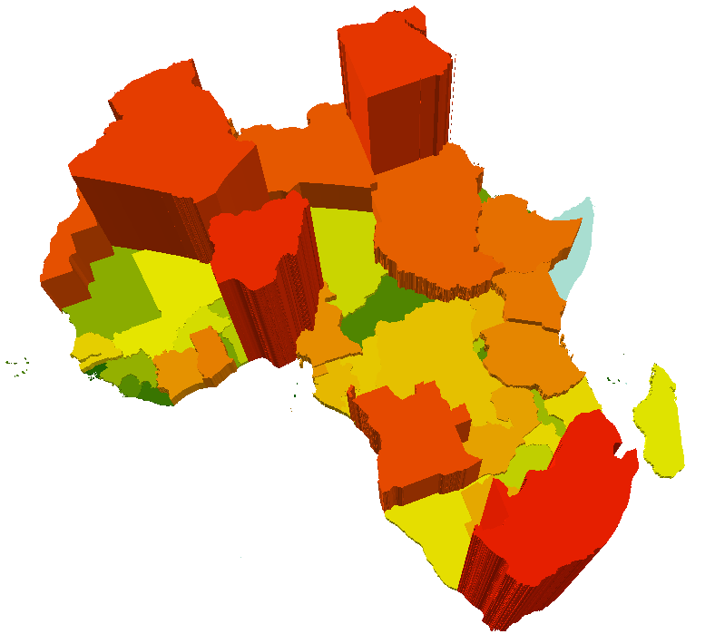
Nigeria – The Key to Africa
African Population by Country
Most populous country in Africa
  16% of the continent's total population (2012 est.)
  World's fourth largest population by 2030 (est.)
  Most densely populated regions in Africa
*Population estimates based on CIA Factbook 2012
Notes:
Nigeria can arguably be thought of as the key to the African continent, and in many respects, could be poised to be the leader of the continent.
By 2030, it is estimated that Nigeria will become the fourth most populous country in the world

Slide 5
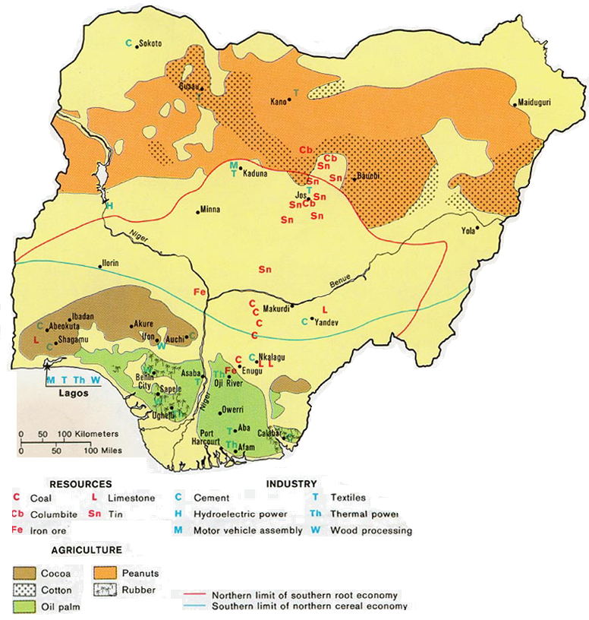
Nigeria – The Key to Africa
Most populous country in Africa
  16% of the continent's total population (2012 est.)
  World's fourth largest population by 2030 (est.)
  Most densely populated regions in Africa
Rich in natural resources
  Twelfth worldwide in total oil production
  Largest natural gas reserves in Africa
  Sixth worldwide (First in Africa) farm output
  Crude oil, coal, tin, columbite
  Palm oil, peanuts, cotton, rubber, wood,
  animal products
  Other Industries include textiles, cement,
  chemicals, fertilizer
Notes:
Nigeria is rich in natural resources and ecologic diversity.
12th WW Oil Production with the largest natural gas reserves in Africa
It is the 6th WW (leads Africa) in Farm output
It is important to note that the bulk of the agriculture occurs south of the red line, which is the northern limit of the root economy. Above that line, crops are more limited. Consequently, as you can see, the bulk of the extractive industries are in the same area as the agriculture.
Image from University of Texas, Department of Geography
Statistics from http://www.eia.gov and http://www.worldbank.org

Slide 6
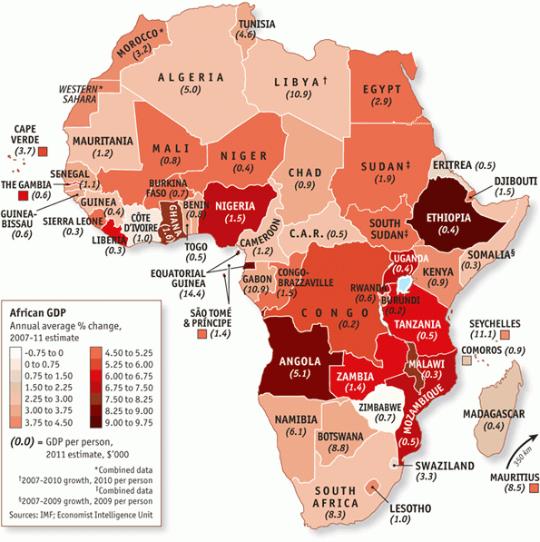
Nigeria – The Key to Africa
Most populous country in Africa
  16% of the continent's total population (2012 est.)
  World's fourth largest population by 2030 (est.)
  Most densely populated regions in Africa
Rich in natural resources
  Crude oil, coal, tin, columbite
  Twelfth worldwide in total oil production
  Largest natural gas reserves in Africa
  Sixth worldwide (First in Africa) farm output
  Palm oil, peanuts, cotton, rubber, wood,
  animal products
  Other Industries include textiles, cement, chemicals, fertilizer
Emerging markets and technology infiltrations
  GDP consistent growth of 6%
  Nigeria most connected country in Africa
Perceived instabilities have a negative effect
  Insurgencies
    Boko Haram in the North
    Movement for the Emancipation of the Niger Delta in the South
  Governmental corruption
  Result: Decrease in Foreign Investments
Notes:
Nigeria is one the leaders, and has become one of the most connected countries in Africa with over 117 million cellular subscribers, with an estimate 200 million by 2017.
The news is not all good… recent news of instability, corruption has caused a decrease in foreign investments.
http://www.economist.com/node/21541008
http://www.businessweek.com/news/2013-07-22/nigeria-lures-5-billion-from-carriers-seeing-data-boom-tech
http://nationalmirroronline.net/new/insecurity-reduces-investment-in-nigeria-to-21-per-cent-un/

Slide 7
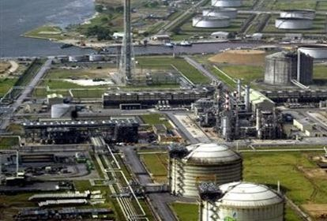
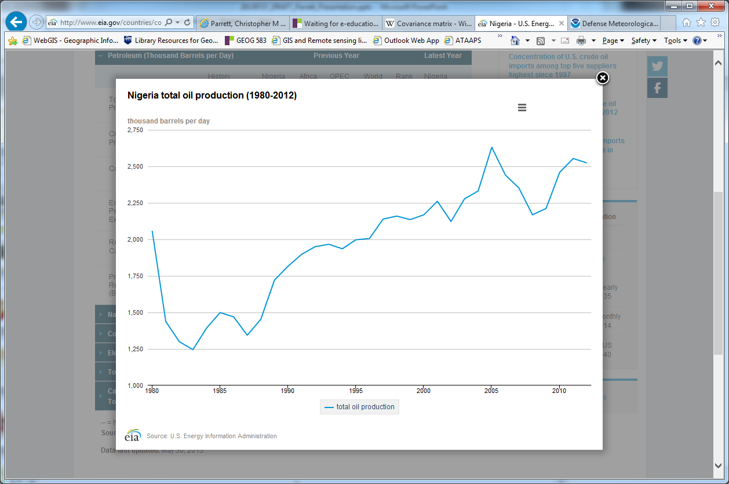
Task and Purpose/Goals
Developing the Agricultural sector is essential to Nigeria’s long term socio-economic stability - USAID Strategy 2010-2013
Examine the extractive industry’s impacts on Nigeria’s agricultural industry
  Confirm/deny direct effect of extractive industry’s expansion on agricultural industry
  Identify any secondary issues arising from the focus on extractives
Provide an objective assessment:
  Level and location of extractive industry expansion
  Level of impact, if any, on agriculture capacity
  Potential secondary issues impacting agriculture
Notes:
Bottom-line Up-Front: Developing the Agricultural sector is essential to Nigeria’s long term socio-economic stability
4) My task is the examination of the Nigerian Extractive Industry’s impacts on its agricultural industry.
5) The primary goals of my research is to determine and quantify the change in both the extractive and agricultural industries on a country-wide scale.
6) A secondary goal is to examine the distribution of these changes, and explore the issues arising from any observed imbalance or parity.
7) In doing so, I hope to provide an objective assessment of the possible effects the extractive industry has had on the agricultural industry’s development.
8) A desired output would be an objective report that organizations such as USAID could use to better assess how investments could be made.

Slide 8
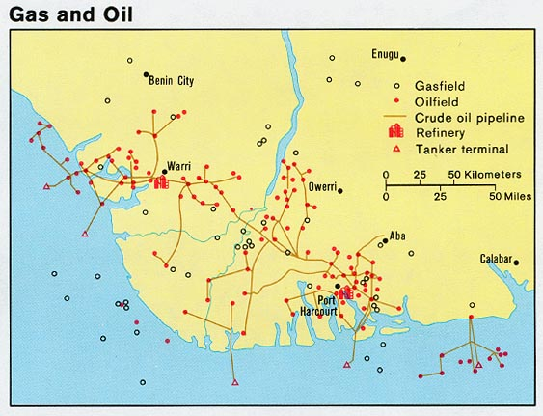
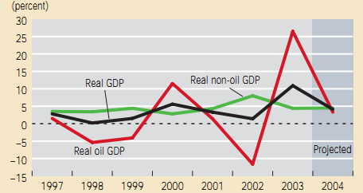
Nigerian Extractive Industries
Nigeria Nationalized Industry in 1977
  Federal government holds all mineral rights
  Small percentage of native population employed; labor traditionally imported
  Government corruption and lack of reforms
Solid mineral sector is under-developed
  Large deposits of
    Uranium
    Gold
    Tantalum-Niobium
    Lead, Zinc, Coal
  Attempts to develop large scale mining could effect agriculture
Majority is Oil/Natural Gas
  Petroleum #1 Export (98% Exports 2000)
  Bulk of resource concentrated in South
  Environmental and ecological dangers
  Recent investments to capture Natural Gas
Notes:
A quick overview of the Extractive Industry, which includes both solid and liquid resources. Nigeria is rich in solid minerals, recently finding relatively large amounts of uranium ore. However, the mining industry is severely underdeveloped and almost negligible when compared to Petroleum and Natural Gas. Nigeria is one of the few major oil-producing nations still capable of increasing its oil output. Unfortunately, petroleum has been a polarizing issue in Nigeria, and threatens not only the social fabric, but the environment and ecological diversity of the Niger Delta region.
http://eiti.org/report/nigeria/2011
http://www.revenuewatch.org/countries/africa/nigeria/extractive-industries

Slide 9
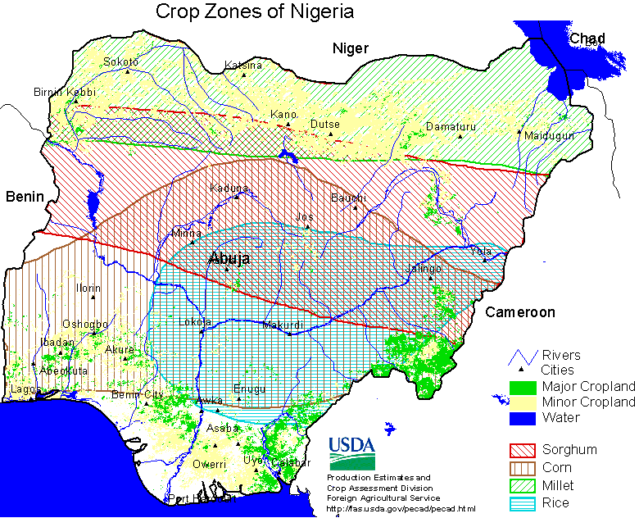
Nigerian Agriculture
GDP composition by sector
  Agriculture: 30.9%
  Industry: 43%
  Services: 26% (2012 est.)
Agriculture 70% of national employment
Traditional Agricultural Products:
  cassava (tapioca), corn, cocoa, millet, palm oil,
  peanuts, rice, rubber, sorghum, and yams.
  Total fishing catch was 505.8 metric tons.
Suffers from extremely low productivity
  Production rose by 28% during the 1990s,
  Per capita output rose by only 8.5% during
  the same decade.
Cheaper to import food than it is to grow it
  Rising Food Prices
  70% Poverty Rate
  Population growth out-pacing agricultural output
Image from http://www.usda.gov
Notes:
While Nigeria has a large agriculture output, which comprises almost a third of the GDP, it employs over 70% of the population. As you can see from the map, the bulk of the agricultural activity occurs in the south and south-east. With the north relying on grass-type crops such as sorghum and millet, with sporadic croplands. In 1990, 82 million hectares out of Nigeria's total land area of about 91 million hectares were found to be arable, although only 42 percent of the cultivable area was farmed. Much of this land was farmed under the bush fallow system, land is left idle for a period of time to allow natural regeneration of soil fertility. 18 million hectares had the potential to support crops. Most of the 20 million hectares covered by forests and woodlands are believed to have agricultural potential (USAID.com)

Slide 10
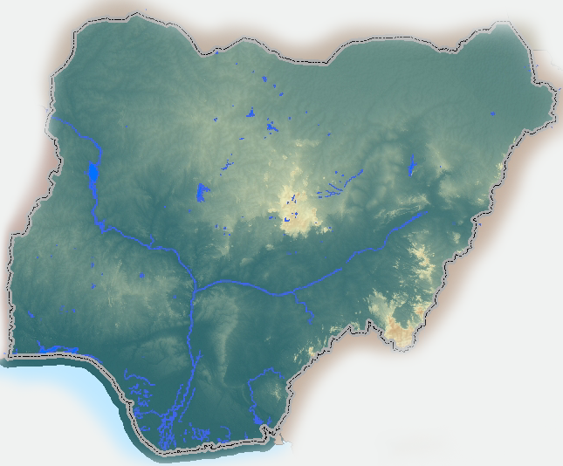
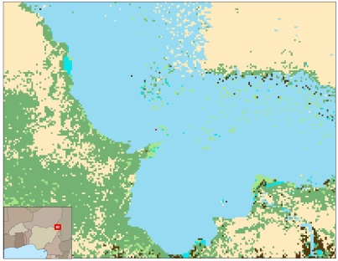
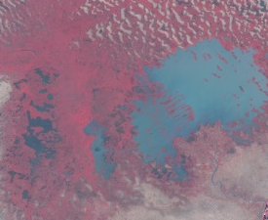
Analytical Methodology
Assess Agricultural Industries over time
  Spatial-temporal analysis of MODIS/NDVI
  Utilize existing land-cover/land-use analysis, slope data
  Identify areas of change, attempt to quantify the change
  Output: Spatial/Quantitative estimate of arable land over time
Assess Surface Water Distribution over time:
  Spatial-temporal analysis of MODIS/NDVI
  Utilize existing land-cover/land-use analysis, slope, hydrology
  Utilize NOAA/EUMETSAT Global Rainfall Estimates
  Output: Spatial/Quantitative estimate of surface water over time
Assess Extractive Industries over time
  Petroleum observables (flaring) using DMSP/VIIRs
  Identify increase/decrease in annual flaring activity
  Compare to OPEC/EIA Petroleum Production estimates
  Output: Spatial/Quantitative estimate of petroleum growth
Perform Data Analysis
  Multiple Regression Tests on Agriculture (Dependent) vs. Water, Extractives
  Identify Areas of largest spatial change in land-use
  Utilize existing LandSat, Hi-Res Imagery, Nigeria Human/Physical Geography
  Output: Focused case study examination / potential future effects
Notes:
Use coarse resolution data to identify:
Large Scale Change of agriculture using NDVI & Landcover classification
Large Scale Change of water using NDVI & Landcover classification
Large Scale Change of extractive industries using DMSP/NIIRS nighttime & Landcover classification
Identify Areas of high-probable interest
Identify Areas of high change
Use fine resolution data to confirm
Form Assessment

Slide 11
Proposed Analytical Process
NDVI
Extract By
Mask
Average
Pentadal NDVI
Create Annual NDVI Composite
Iso Unsupervised
Classification
Reclassify
Temporal
Vegetative
Change Zones (1)
Start
LCLU (2)
DMSP
Rainfall
Temporal
Vegetative Change
Statistics
Surface Water
Assessment (3)
Calculate Statistics (3)
Baseline
Inland
Water Changes
Quantitative Changes
Multiple
Regressions
Combine
Temporal
Analysis
Extracted
Time Series
Statistical
Assessment
Mining
Cadastral Layers
Nigeria
Human Geo
Landsat/ETM+
Macro
Assessment
Micro
Analysis
Spatial-Temporal
Analysis
Notes:
Important to note that I am not trying to quantify biomass, but rather make a determination whether an area exhibits a steady state VI over time. It is theorized that those areas exhibiting a large variance in VI are potential areas with agriculture, and those with a steady state / small variance VI are non-agrictultural.
Calculating the running delta of an area… calculating the average, std dev, and variance.
Potential Agricultural areas should have a seasonal changes

Slide 12
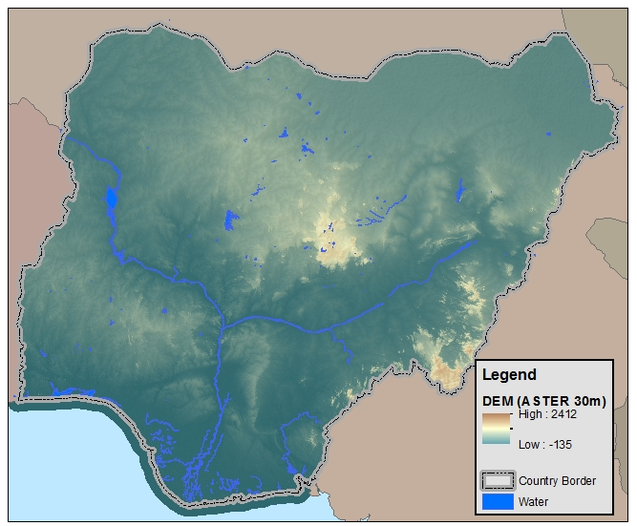
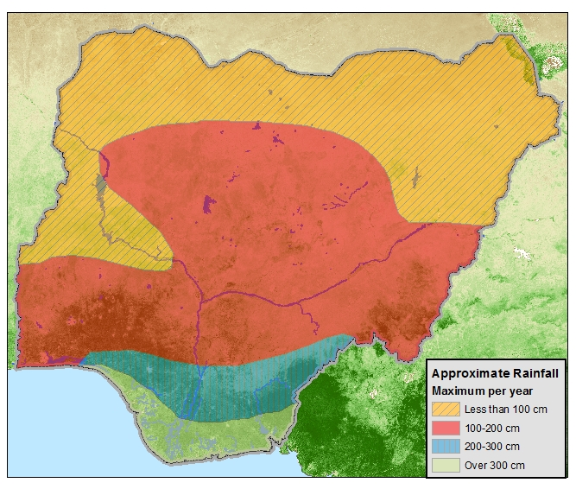
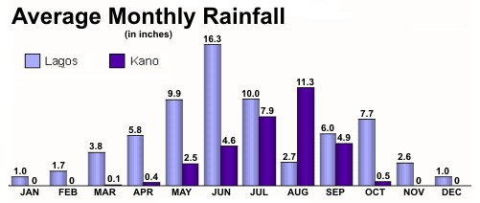
Physical Overview
Kano
500 miles
Lagos
Extensive level plains
Sporadic granite mountains
Niger River flows from NW south
Inter-Tropical Convergence Zone (ITCZ)
Notes:
Extensive level plains interrupted by occasional granite mountains
http://www.srh.noaa.gov/jetstream/tropics/images/rainchart.jpg
Because of its location just north of the equator, Nigeria's climate is characterized by the hot and wet conditions associated with the movement of the Inter-Tropical Convergence Zone (ITCZ) north and south of the equator. This is easily seen in the normal monthly rainfall for two cities, Kano and Lagos, separated by 500 miles (800 km).

Slide 13
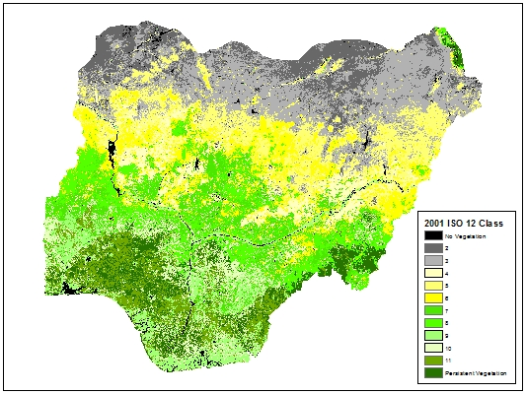
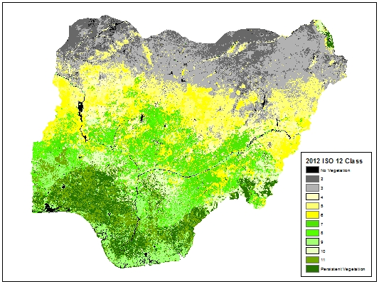
Exploratory Analysis
2001 eMODIS Composite
ESRI ISO Cluster Unsupervised
Classification (12 Classes)
Class Values
2012 eMODIS Composite
ESRI ISO Cluster Unsupervised
Classification (12 Classes)
0 1 2 3 4 5 6 7 8 9 10 11

Slide 14
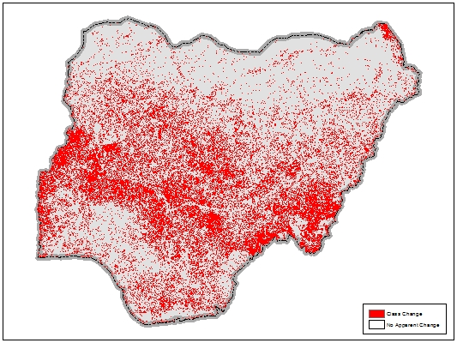
Exploratory Analysis
Class Change
No Class Change

Slide 15
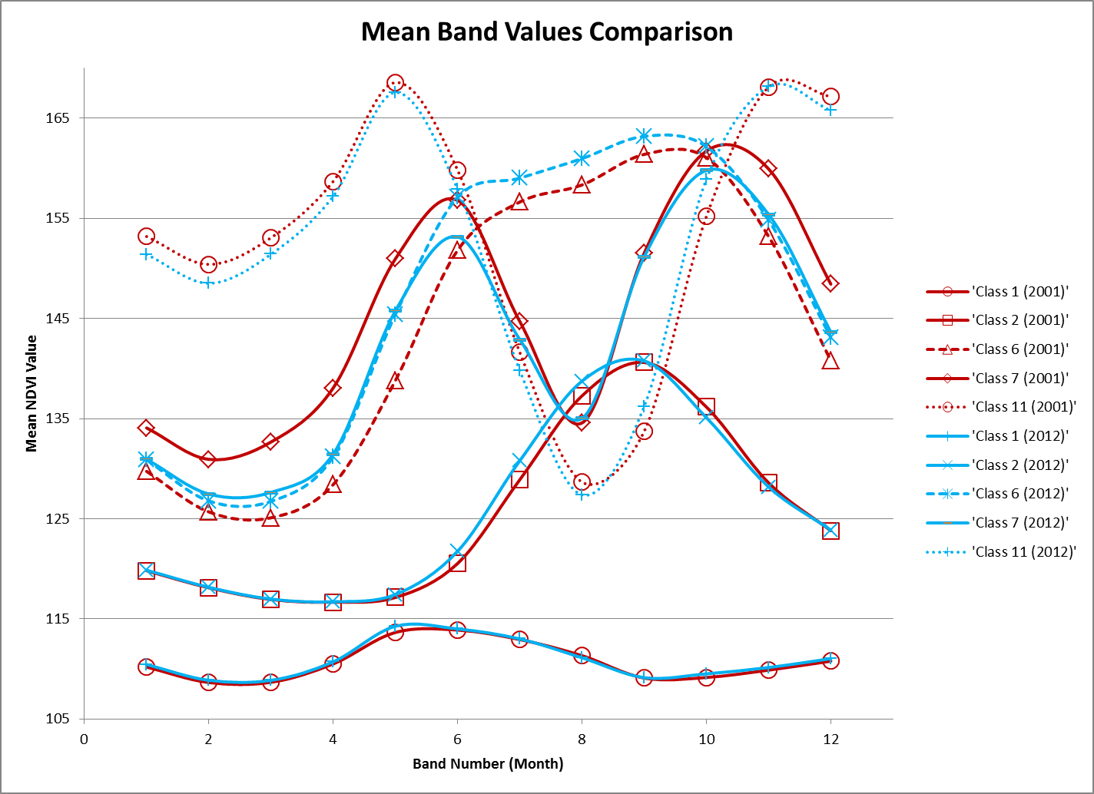
Class 11: Possible evidence of seasonal cycle. Marked drop in NDVI in August.
Class 6: Possible evidence of seasonal Cycle. Marked sustain-ment in NDVI Jun-Sep.
Class 1: Probably Bare to Sparse Vegetation. No apparent seasonal / phenologic change.

Slide 16
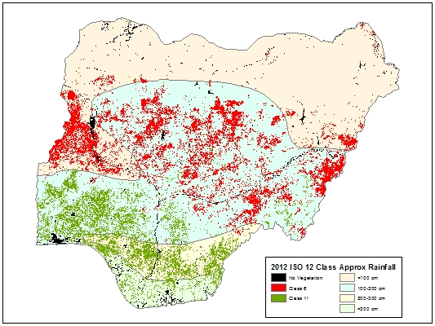
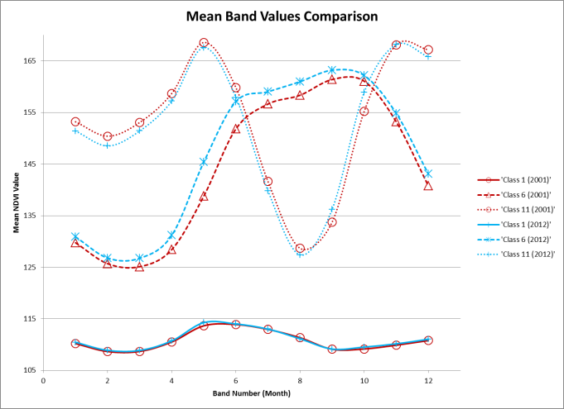
Exploratory Analysis
Class 11
Class 6
Class 1
Class 1
Class 6
Class 11

Slide 17
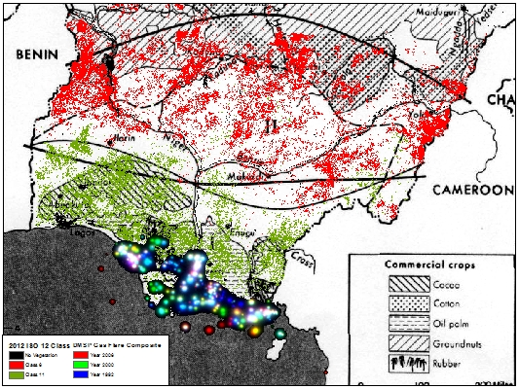
Exploratory Analysis

Slide 18
Expected Challenges
Data Availability
  Land-use/Land-cover dates and resolution
  Mineral maps outdated
  Petroleum Maps
  Historical Precipitation
Data Accuracy
  Nigerian governmental reporting
  Varying degrees / sources of land-use data
Reliance on MODIS NDVI
  Good for vegetation/non-vegetation assessments
  Not be used for quantitative bio-mass measurements
  Only available post year 2000
Landsat Data
  LS7 ETM+ SLC-Off takes a significant amount of time to collect
  LS8 OLI/TIRS has a limited archive (IOC 11APR2013)
Availability
Accuracy
Volume

Slide 19
Timeline
Peer Review Feedback (08Aug13)
Complete Macro Analysis (01Sep13)
Complete Micro Analysis (14Sep13)
Compile/Analyze Results (24Sep13)
Home Leave (24Sep-05Oct13)
Preliminary Results & Abstract (15Oct13)
Final Draft & Review (19Dec13)
Finalization (08Jan14)
ASPRS Conference
Registration
15-Nov-2013
Spring 1
Option
Final Paper Submission
13-Jan-2014
Conference
13-Mar-2014
Louisville, KY
AAG Conference Registration
23-Oct-2013
Spring 2
Option
AAG Abstract Submission
December 3, 2013
AAG Conference
April 14, 2014
August-13 | September-13 | October-13 | November-13 | December-13 | January-14 | February-14 | March-14 | April-14 | May-14
Fall 1: 14Aug-23Oct 2013
Spring 1: 08Jan-19Mar2014
Fall 2: 09Oct-19Dec 2013
Spring 2: 26Feb-07May2014

Slide 20
Primary Data Providers
Spatial Data Holdings
US Geologic Survey (USGS): MODIS, Landsat 7/ETM+, Landsat 8/OLI-TIRS, GTOPO30, ASTER
National Geographic Data Center (NGDC):DMSP, VIIRS, Flare Reporting
U.N. Food and Agriculture Organization (FAO): Land-Cover/Land-Use
Open Street Maps (OSM): Infrastructure, places, physical features
Natural Earth Data: Foundational Data
Supporting Data (Map Holdings and Statistical Data)
U.S. Energy Information Administration
U.S. Agency for International Development
U.S. Department of Agriculture
NASA Socioeconomic Data and Applications Center (SEDAC)
World Bank Data
UN FAO STAT
UN Environmental Program (UNEP)
International Monetary Fund
University of Texas, Department of Geography
Online Support
ArcGIS Online
Google Maps
Harvard Africa Map
WikiMapia.org
Current Geospatial Holdings
Russian 1:500K (100%)
ASTER 15m DEM (100%)
GTOPO 30m DEM (100%)
eMODIS (JAN01-APR13) (100%)
LS8/OLI (85%)
DMSP 2005 (100%)
OSM (100%; 01JUL13)
FAO LCLU (100%)
Total: 305 GB
Toolsets
ArcGIS 10.1
ENVI 5.0
RStudio
MS Office
GeoDA
GoogleEarth

Slide 21
Literature References
Murtala Chindo (2011). An Extensive Analysis of Mining in Nigeria Using a GIS. Journal of Geography and Geology Vol. 3, No. 1 pgs. 145-159
Ross S. Lunetta, Joseph F. Knight, J. Ediriwickrema, John G. Lyon, L. Dorsey Worthy (2006). Land-cover change detection using multi-temporal MODIS NDVI data. Remote Sensing of Environment 105 pgs142–154
William L. Stefanova, Maik Netzband (2005). Assessment of ASTER land cover and MODIS NDVI data at multiple scales for ecological characterization of an arid urban center. Remote Sensing of Environment 99 pgs 31 – 43
Louisa J.M. Jansen, Antonio Di Gregorio (2002). Parametric land cover and land-use classifications as tools for environmental change detection. Agriculture, Ecosystems and Environment 91 pgs 89–100
A. Gobin, P. Campling, J. Feyen (2002). Logistic modeling to derive agricultural land use determinants: a case study from southeastern Nigeria. Agriculture, Ecosystems and Environment 89 pgs213–228
Souleymane Pare, Ulf So ¨derberg, Mats Sandewall, Jean Marie Ouadba (2008). Land use analysis from spatial and field data capture in southern Burkina Faso,West Africa. Agriculture, Ecosystems and Environment 127 pgs 277–285
Ademola K. Braimoh, Takashi Onishi (2007). Spatial determinants of urban land use change in Lagos, Nigeria. Land Use Policy 24 pgs. 502–515
K. Lyncha, T. Binns and E. Olofin (2001). Urban agriculture under threat: The Land Security Question in Kano, Nigeria. Cities. Vol. 18, No. 3, pp. 159–171
2010 Annual Statistical Bulletin, Nigerian National Petroleum Corporation (http://www.nnpcgroup.com)
Oil and Gas in Africa, African Development Bank and the African Union, July 29, 2009

Slide 22
Questions?

