Slide 1
Predicting locations of common teasel growth in Colorado's public lands
Rebecca Patton – 596A Capstone Proposal
Adviser - Fritz Kessler

Slide 2
Outline
Introduction
Background
Prior studies
Statistical methods used in previous studies
Important site characteristics
Methodology
Research question and analysis
Sourcing data
Analytical methods and software to be used
Results/Output
Presentation of results
Way ahead
Timeline
Citations

Slide 3
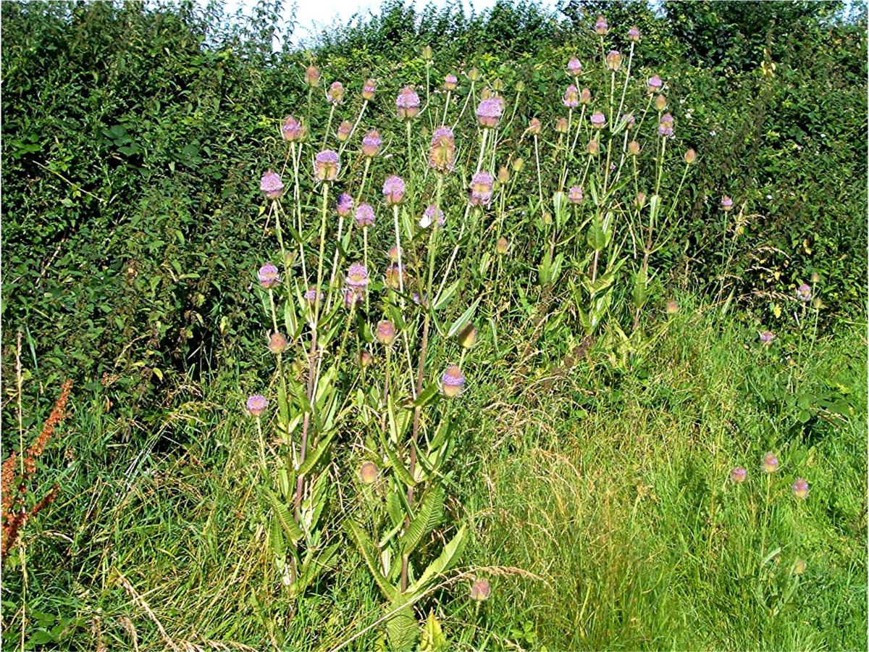
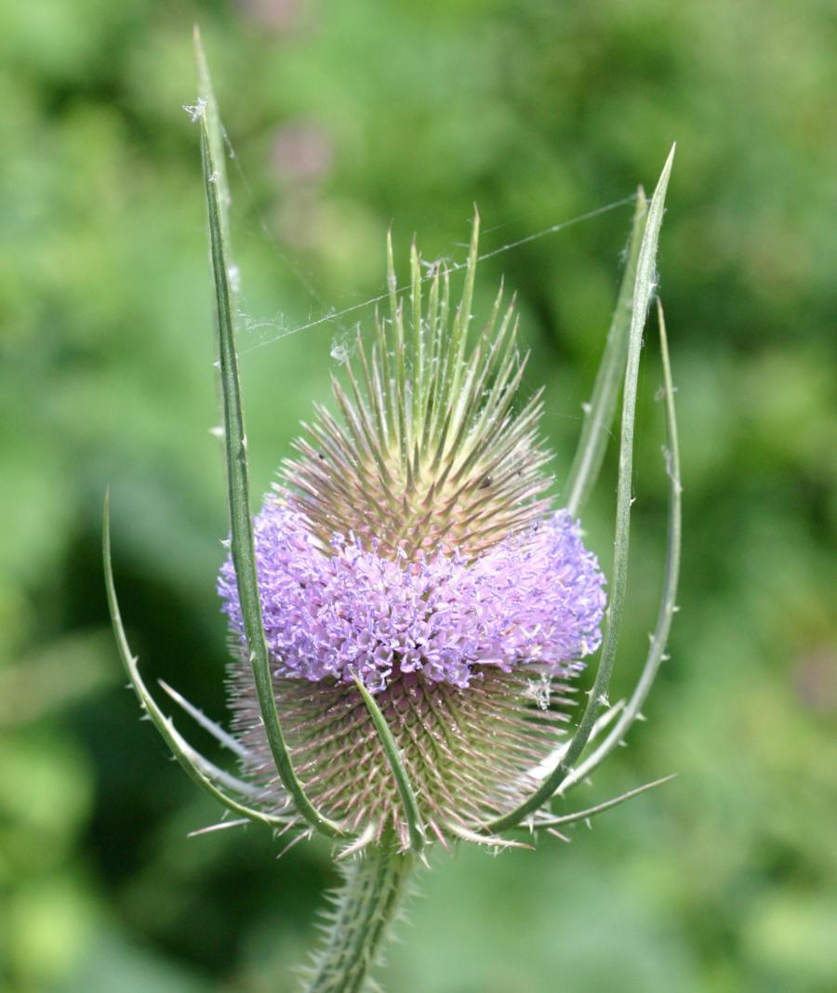
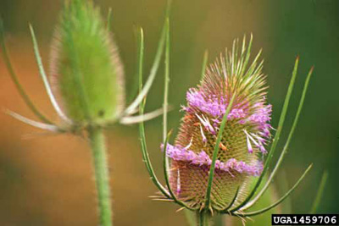
Introduction to the Common Teasel (Dipsacus Fullonum L.)
Native to Europe and temperate Asia
Introduced to North America during the 1700s
Original use was for wool processing and as ornamental
Favors disturbed sites
“Noxious weed” in several countries

Slide 4
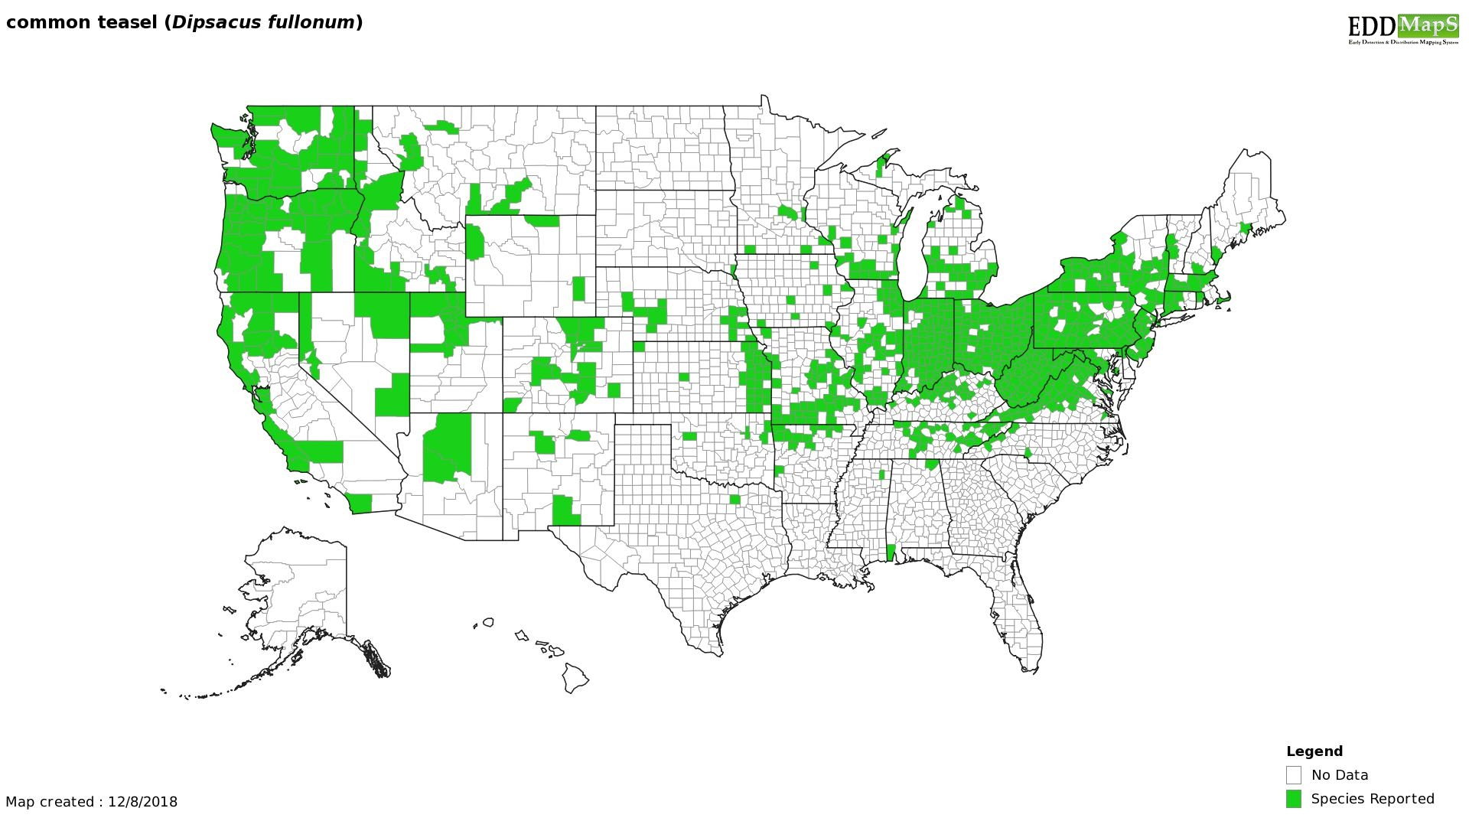
Interest to forest managers?
Spread through most of North America
Potential to become an invasive species
Spreading into valuable agricultural areas
U.S. Forest Service & National Park Service
U.S. Forest Service has tracked teasel since 2009
Most common teasel studies in the U.S. are conducted in California
Most studies focus on potential biological controls
Teasel distribution from Early Detection and Distribution Mapping
https://www.invasiveplantatlas.org/subject.html?sub=3018

Slide 5
Project objectives
What are the important site characteristics that determine where common teasel will grow in Colorado’s public lands?
Can a Python program be written to allow forest managers to easily identify possible teasel locations?

Slide 6
Prior related studies
2008 - Master’s student at San Jose State University
Used multiple logistic regression & weighted overlays
Considered 5 site characteristics
Did not include “human presence” as a factor
2016 – USFS published a study for Colorado
Used logit and probit regression analysis
Considered 6 physical site characteristics

Slide 7
Statistical methods used in previous studies
Global Moran’s I
Optimized hot spot analysis
TwoStep and Heckman method (“Heckit”)
Logistic regression models
Likelihood maps and weighted overlays
Probit regression models

Slide 8
Identifying site characteristics
Two types of site characteristics will be used to identify potential teasel locations:
Environmental characteristics
Elevation
Slope
Aspect
Proximity to water sources
Canopy cover / amount of sunlight
Temperature
Soil type
Human-related characteristics
Proximity to transportation networks
Distance from population centers
Presence of forest clearcuts and/or wetlands
Human presence

Slide 9
Research question and analysis
Question
The likelihood that common teasel will grow in a given location is related to slope, canopy cover, elevation, temperature, aspect, soil characteristics, distance to population centers, human presence, presence of clearcuts/wetlands, and proximity to water and transportation networks.
Analysis and output
Logistic regression models
Probability maps
Python program

Slide 10
Sourcing data
Where to find data? What data will be used?
U.S. Forest Service
Teasel locations, forest boundaries, waterways, transportation networks
Multi-Resolution Land Characteristics Consortium (MRLC) National Land Cover Database (NLCD)
Canopy cover
Colorado Department of Public Health and Environment
City boundaries
Colorado Information Marketplace
Contour lines
U.S. Census Bureau
Transportation networks
National Oceanic and Atmospheric Administration (NOAA)
Temperature

Slide 12
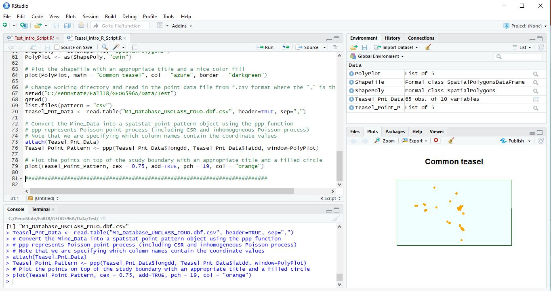
Analytical methods
Logistic regression using glm() and/or slrm() functions in Rstudio
Will predict whether common teasel is/is not present
glm() – Generalized linear model
slrm() – Spatial logistic regression

Slide 13
Predictors
Continuous
Elevation
Aspect and slope
Proximity to water sources
Canopy cover
Average temperature
Proximity to transportation networks
Distance to population center
Categorical
Soil characteristics
Human presence

Slide 14
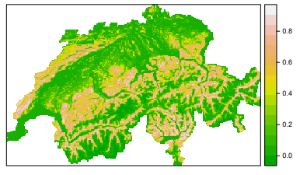
Results / Output
Probability map based on logistic regression results
Modifiable Python program to produce probability maps
Sample probability map of European crossbill distribution, created in R (Chandler, 2017)

Slide 15
Presentation of results
U.S. Forest Service Rocky Mountain Regional Office in Lakewood, CO
Estimated presentation date: July 2019

Slide 16
Way ahead
U.S. Forest Service, Rocky Mountain Regional office – is interested in a model to help locate common teasel
Found by human presence
Biased discovery
Python program will be validated by field visits

Slide 17
Capstone project timeline

Slide 18
References
Beaton, L, & Dudley, S. (2013) Tolerance of roadside and oil field populations of common teasel (Dipsacus fullonum subsp. sylvestris) to salt and low osmotic potentials during germination. AoB PLANTS, 5, doi:10.1093/aobpla/plt001
Chandler, R. (2017) Modeling and mapping species distributions. Retrieved from https://cran.r-project.org/web/packages/unmarked/vignettes/spp-dist.pdf.
Daddario, J., Bentivegna, D., Tucat, G., & Fernandez, O. (2017) Environmental Factors Affecting Seed Germination of common teasel (Dipsacus fullonum). Planta daninha, 35, http://dx.doi.org/10.1590/s0100-83582017350100065
Harizanova, V., Stoeva, A., & Rector, B. (2012) Host range testing and biology of Abia sericea (Cimbicidae), a candidate for biological control of invasive teasels (Dipsacus spp.) in North America. Journal of Hymenoptera Research, 28, 1-11, doi: 10.3897/JHR.28.3044
Huarte, H., Zorraquin, M., Bursztyn, E., & Zapiola, M. (2016) Effects of environmental factors on seed germination and seedling emergence of common teasel (Dipsacus fullonum). Weed Science, 64(3), 421-429, doi:10.1614/WS-D-15-00136.1
Rector, B., Harizanova, V., Sforza, R., Widmer, T., & Wiedenmann, R. (2006) Prospects for biological control of teasels, Dipsacus spp., a new target in the United States. Biological Control, 36(1), 1-14, https://doi.org/10.1016/j.biocontrol.2005.09.010
Shaw, P. & Shackleton, K. (2011) Carnivory in the Teasel Dipsacus fullonum – The effect of experimental feeding on growth of seed set. PLoS One, 6(3), doi:10.1371/journal.pone.0017935
Stoeva, A., Rector, B., & Harizanova, V. (2011) Biology of Leipothrix dipsacivagus (Acari: Eriophyidae), a candidate for biological control of invasive teasels (Dipsacus spp.) Experimental & Applied Acarology, 55(3), 225-232, DOI:10.1007/s10493-011-9466-0

Slide 19
Questions?

