Slide 1
Geography 596A
Final Presentation
Student: Jeremy Penton
Advisor: Ms. Karen Schuckman
July 18, 2022

Slide 2
Agenda
Introduction
Goals for 596A
Objectives
Background
Project Timeline
Progress
Anticipated Results
Possible Presentation Venue
Knowledge Acquired/Applied
Acknowledgements
Questions/Comments

Slide 3
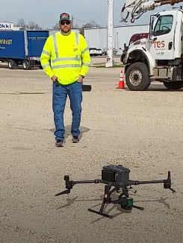
Introduction
Jeremy Penton
Married 21 years
Father of 2 high school aged boys (and 2 dogs)
Hold a bachelor degree in engineering from LSU
Work for Louisiana’s State Department of Transportation and Development
Have a Part 107 sUAS drone pilot’s license
Love working in 3D
Was extremely hesitant to go back to school!
Ms. Karen Schuckman
Photo credit: Penn State University / J. Penton

Slide 4
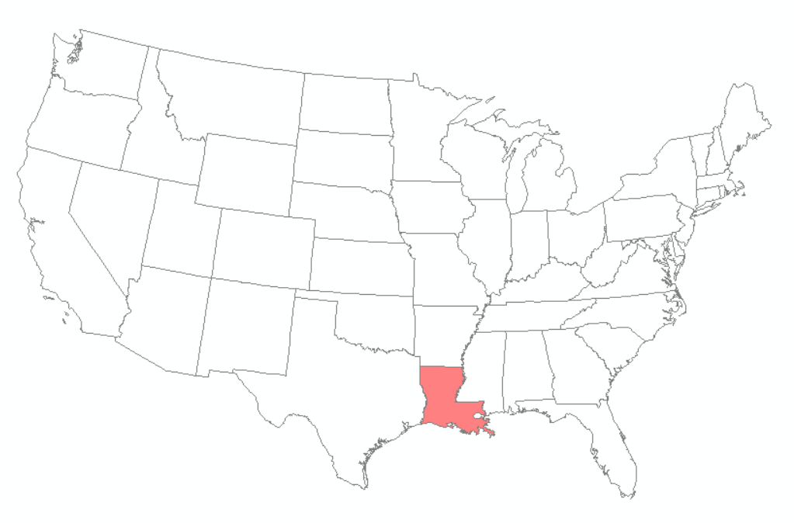
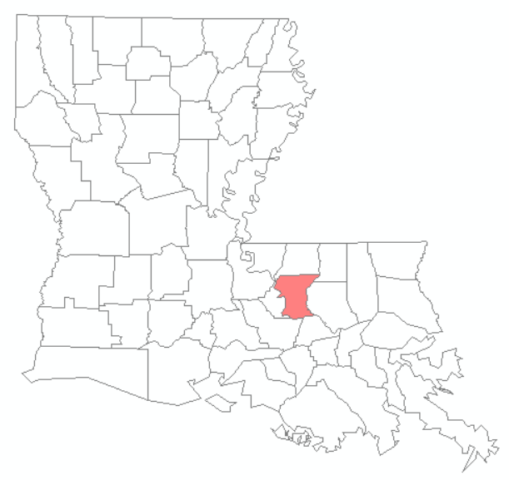
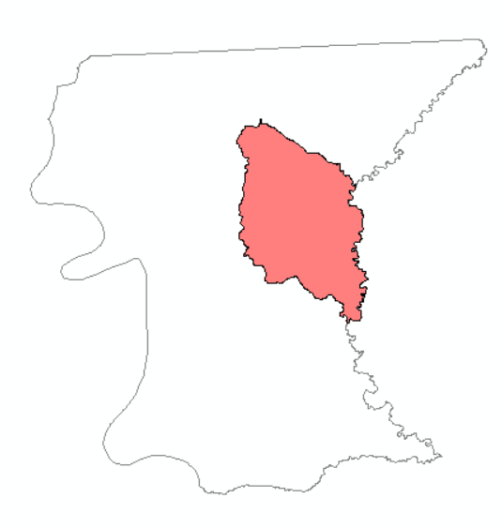
Introduction (cont.)
Born in Louisiana’s Capital, Baton Rouge
Raised just outside of Baton Rouge in the City of Central, which is the extent of my project
Not all Louisianians hunt and fish
City of Central
USA
Louisiana
East Baton Rouge Parish
Photo credit: J. Penton, nytimes.com, history.com, greatamericanrivalry.com

Slide 5
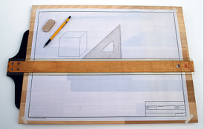
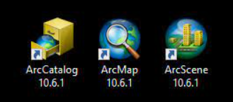
Introduction (cont.)
I’ve worked for engineering, manufacturing and environmental companies
From a large Fortune 500 company to small companies with about 20 employees
Drafting in high school, AutoCAD in college and then fell backwards into GIS about 15 years ago while working for the environmental company
Have used many softwares over the years
Swapped to the state agency and took advantage of their tuition reimbursement program
Photo credit: Wikipedia, Autodesk, ESRI

Slide 6
Goals for 596A
Successfully complete Part A of the Capstone project where the proposal is formed
Complete peer reviews on fellow classmate's work
Incorporate key points that I’ve learn throughout the program into my work
Work on an interesting project that gives back to my local community while enhancing my GIS skillset

Slide 7
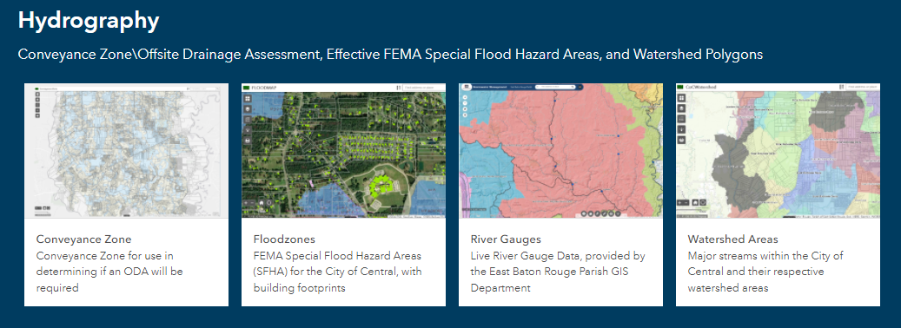
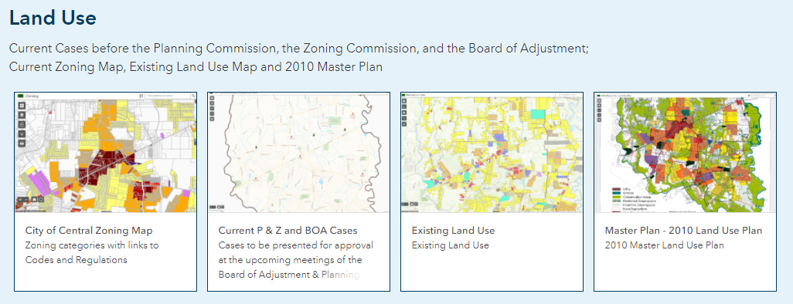
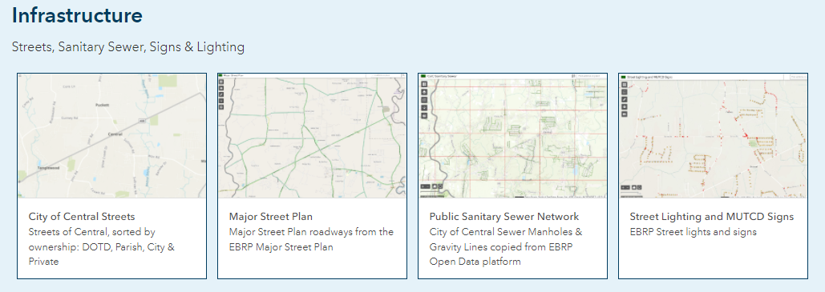
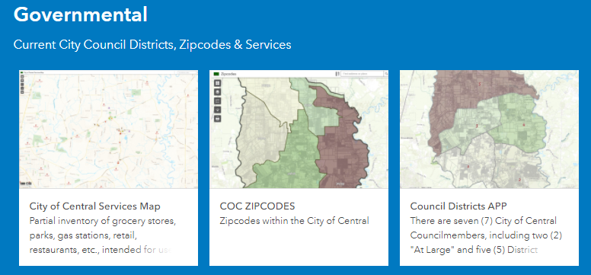
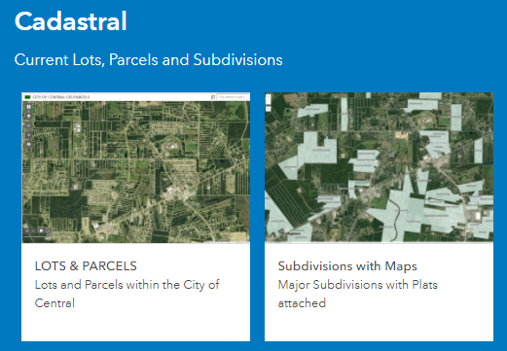
Objective
The city has a website (www.centralgov.com) that contains a lot of great information that citizens of the community can access.
One thing that stands out to me as a GIS professional is the GIS Map Portal link
Lots of 2D data, but no 3D data
MAIN OBJECTIVE: I want to build a 3D model of the city’s structures
Photo credit: The City of Central

Slide 8
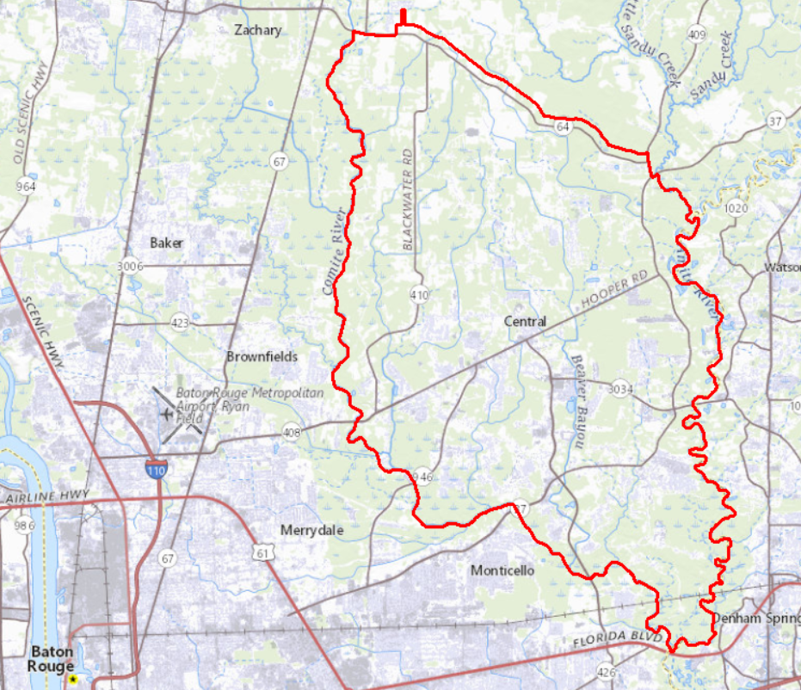
Background
The City of Central is approximately 62 square miles in size
Bordered on the west by the Comite River and the east by the Amite River
Photo credit: The Advocate, J. Penton

Slide 9
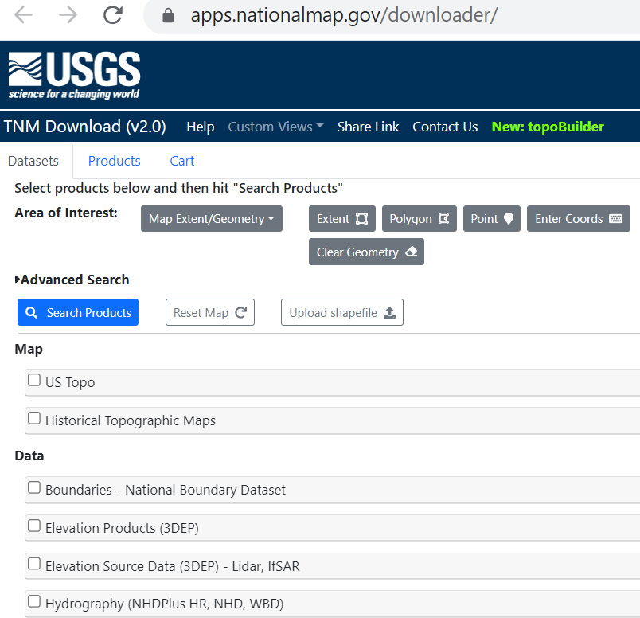
Background (cont.)
The main data that will be used comes from The National Map hosted by USGS
Date of lidar collection is March to April of 2018
Photo credit: USGS TNM

Slide 10
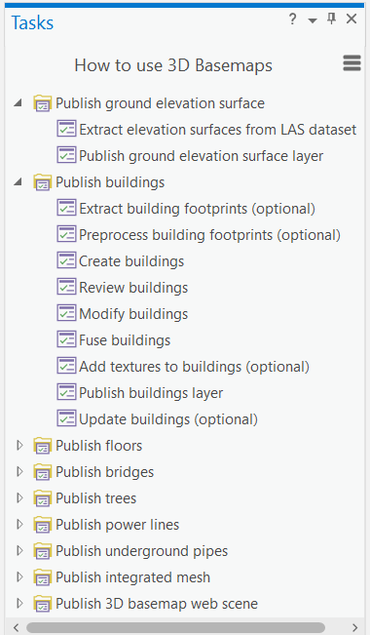
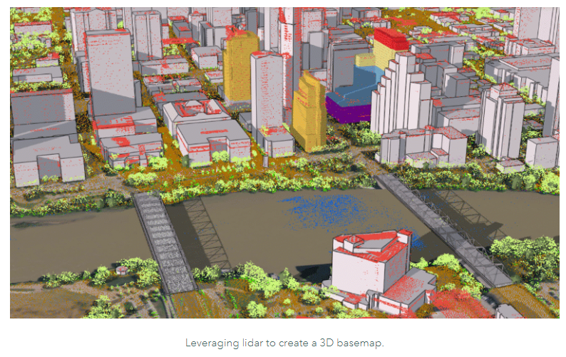
Background (cont.)
Make use of 3D Basemaps Solution from ESRI
Surfaces will be created and features will be extracted
Tasks in ArcGIS Pro guide users through repeatable workflows, improve efficiency and promote best practices
Photo credit: ESRI

Slide 11
Project Timeline
July 2022
Completion
of 596A
Current -September 2022
Data Downloads
File Organization
Feature Clean Up
October - December 2022
Begin to run 3D Basemap Solutions
Geog 871 Geospatial Technology Project Management
January 2023
Quality Check
Data
Begin 596B
February 2023
Design User Interface
March 2023
Complete 596B
Present Material
Complete MGIS Program!
Photo credit: shutterstock

Slide 12
Progress
Completed thus far:
Downloaded all lidar tiles
Downloaded, geo-referenced, mosaicked and clipped imagery
Requested and received building footprint data from the parish GIS department
Desktop ground truth 10% of the AOI
Deployed the ESRI solution and ran a small test area
Created 4 LAS datasets
Counted overlapping buildings between LASDs

Slide 13
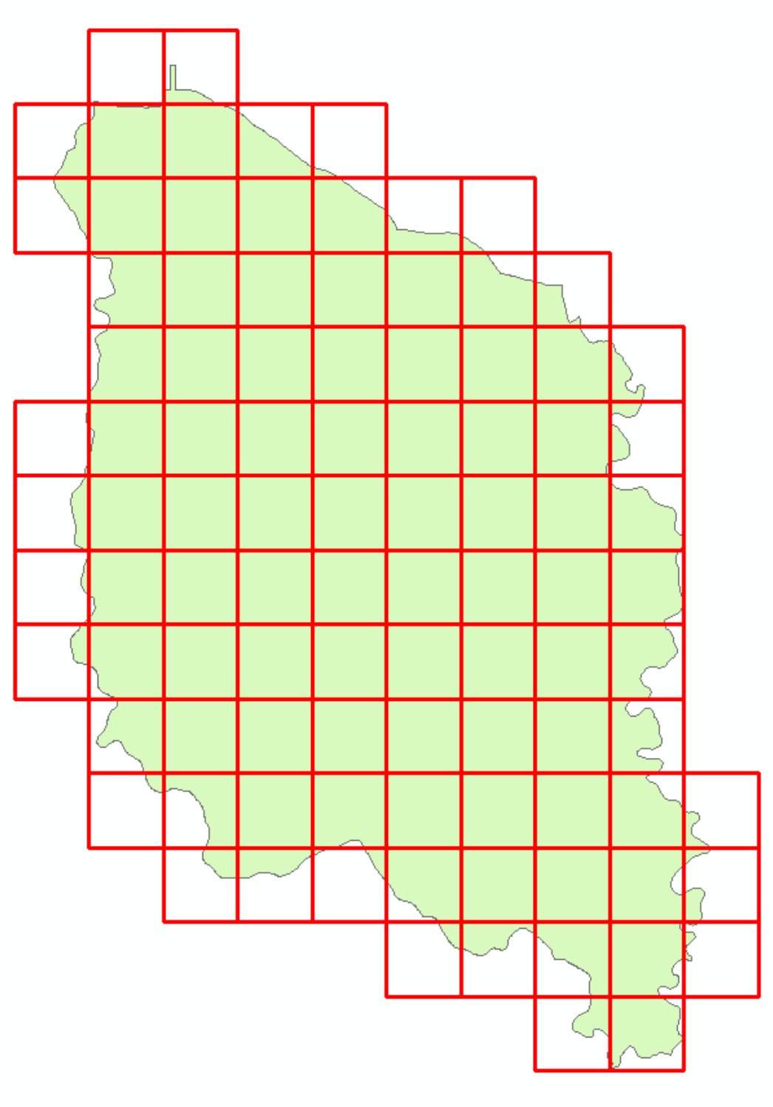
Lidar Data
(97) tiles touch the city
Tile dimensions are 1,500 m x 1,500 m
To meet USGS 3DEP specs the data needs to be QL2 or better
These tiles are QL1
Naming convention is based on the USNG
Photo credit: J. Penton

Slide 14
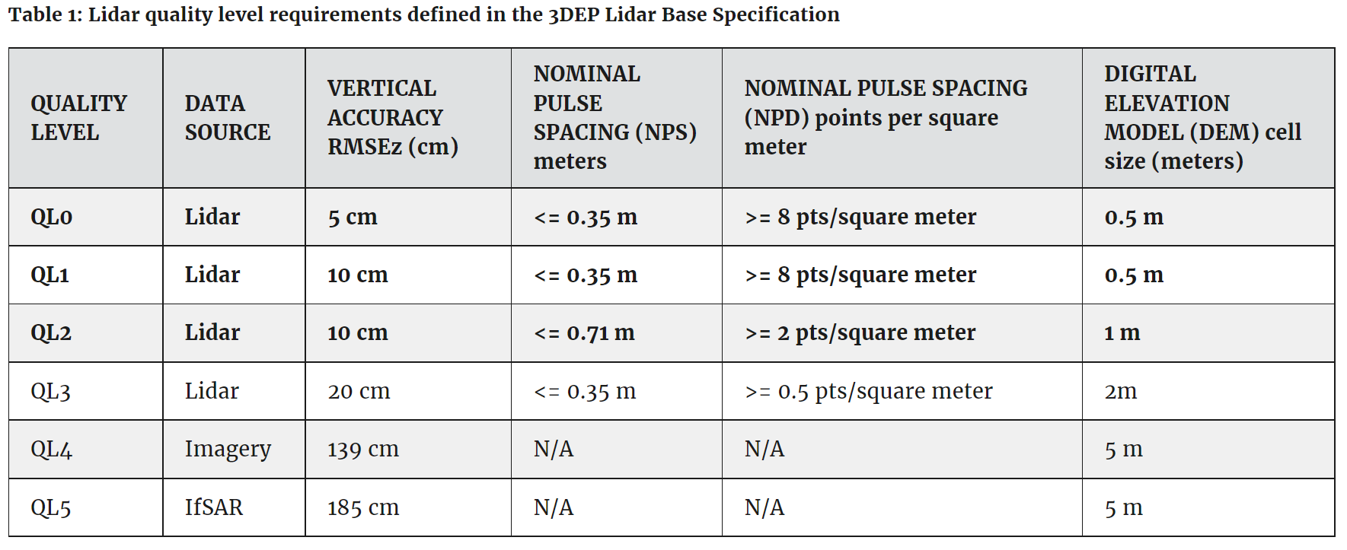
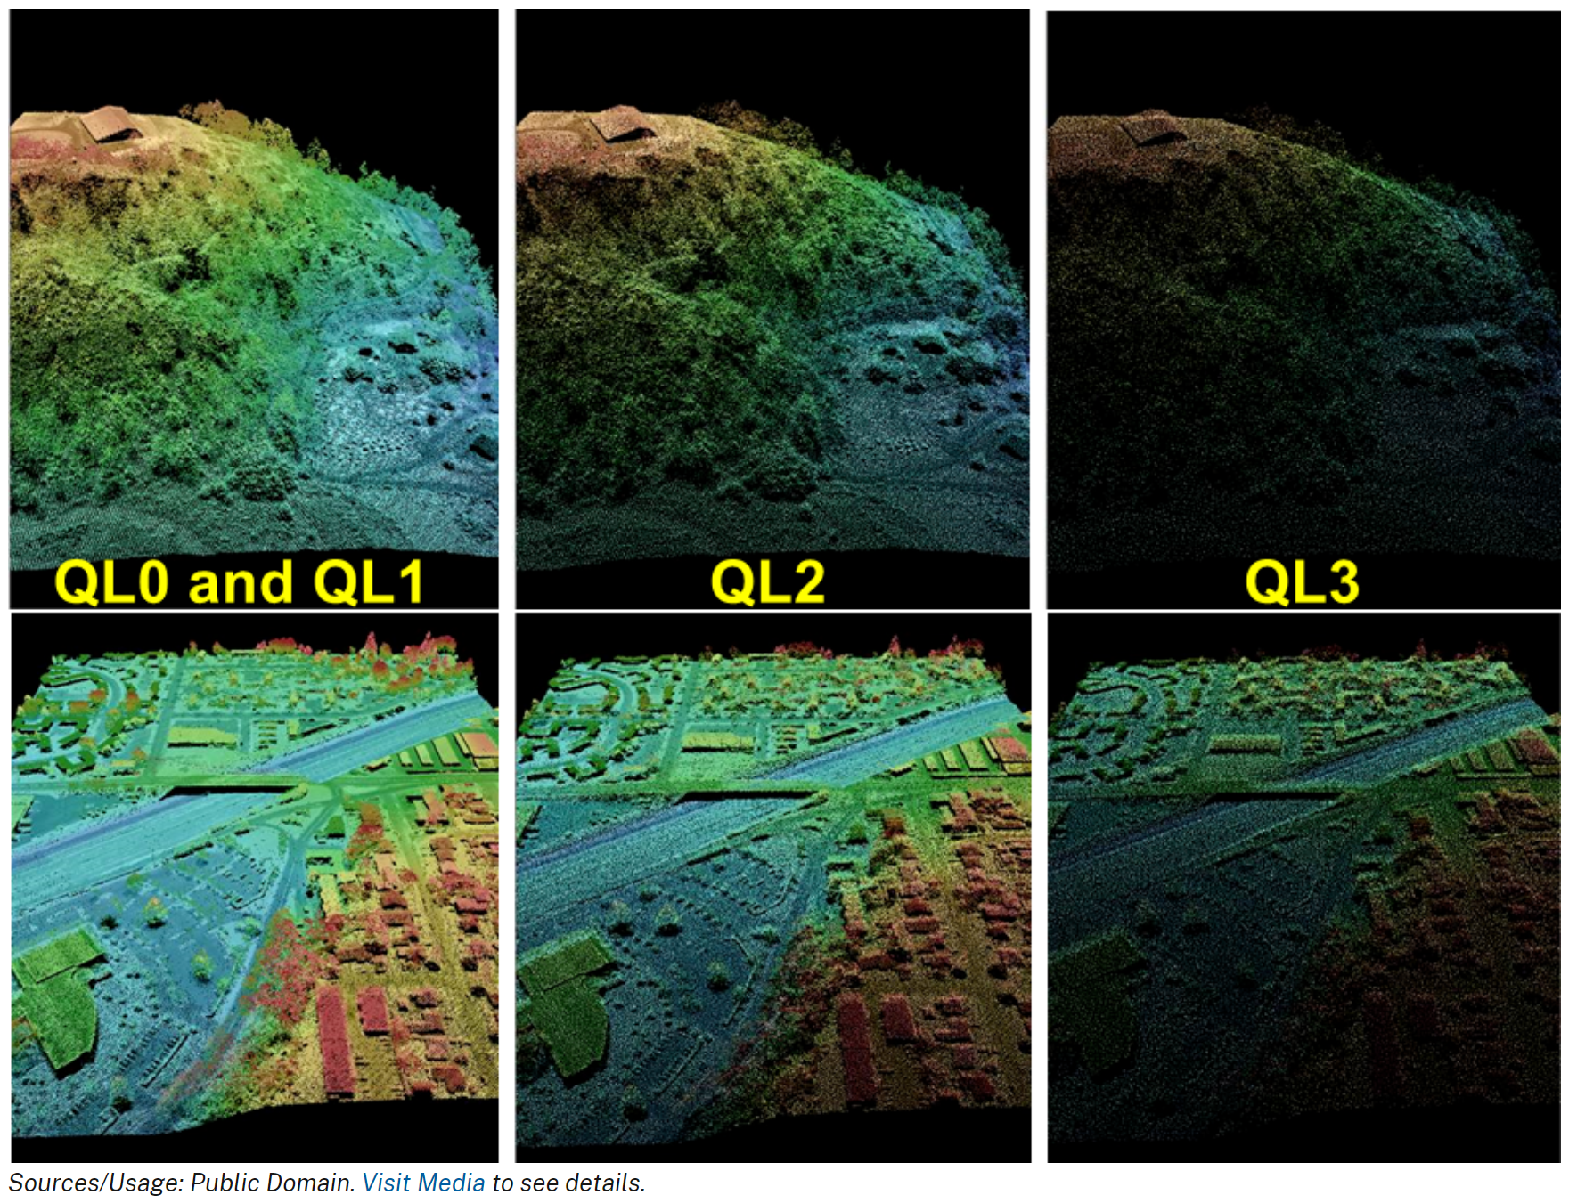
What exactly is QL1?
Quality Level 1
Photo credit: USGS

Slide 15
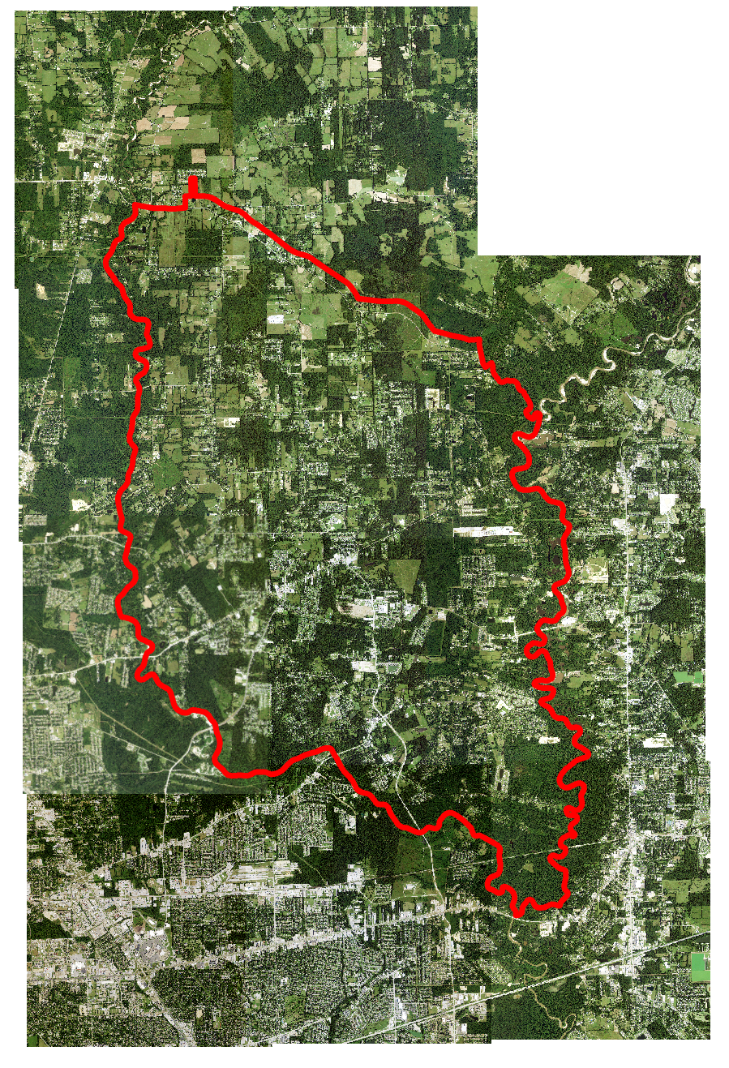
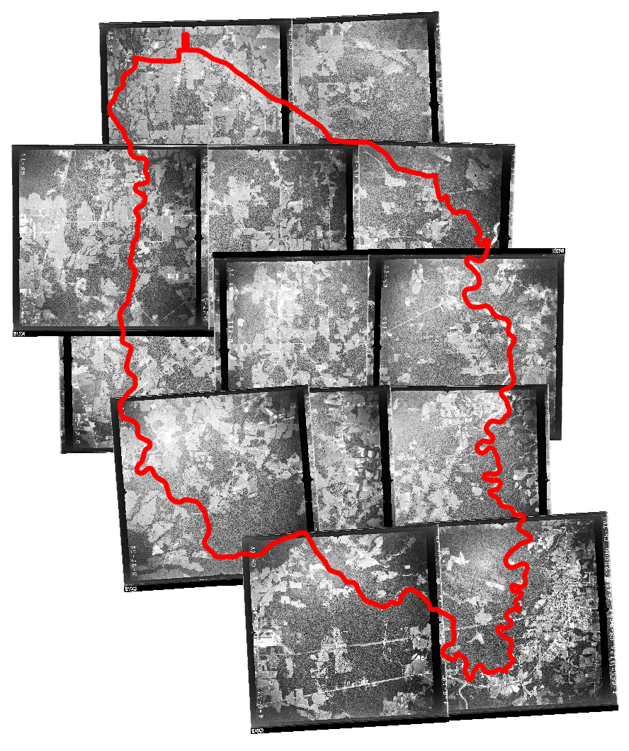
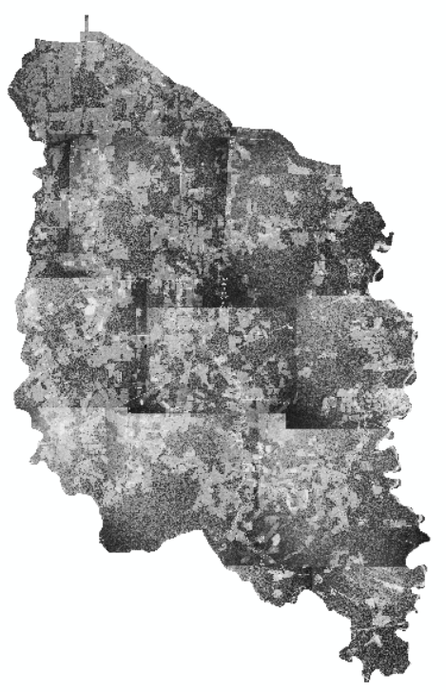
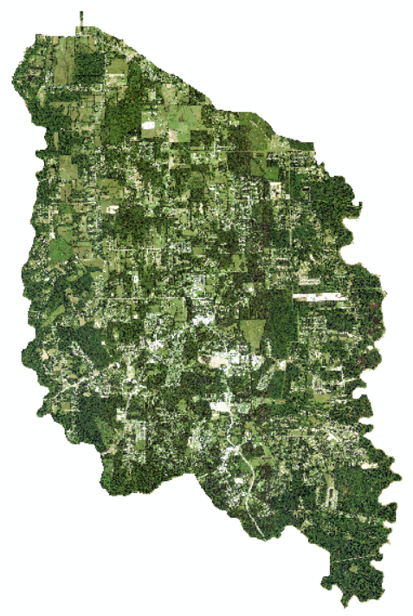
Imagery for Swipe Tool
Found 1952 imagery that was not geo-referenced so I referenced, mosaicked and clipped
Found 2017 NAIP imagery that was geo-referenced just needed to mosaic and clip
Photo credit: J. Penton

Slide 16
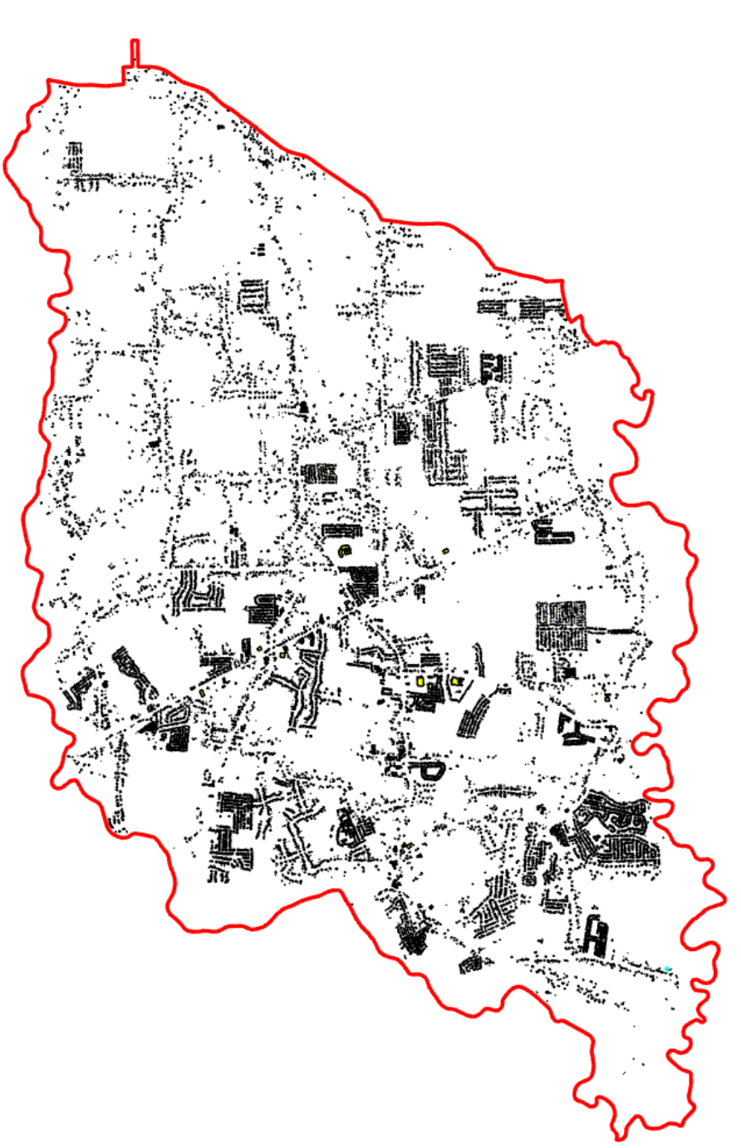
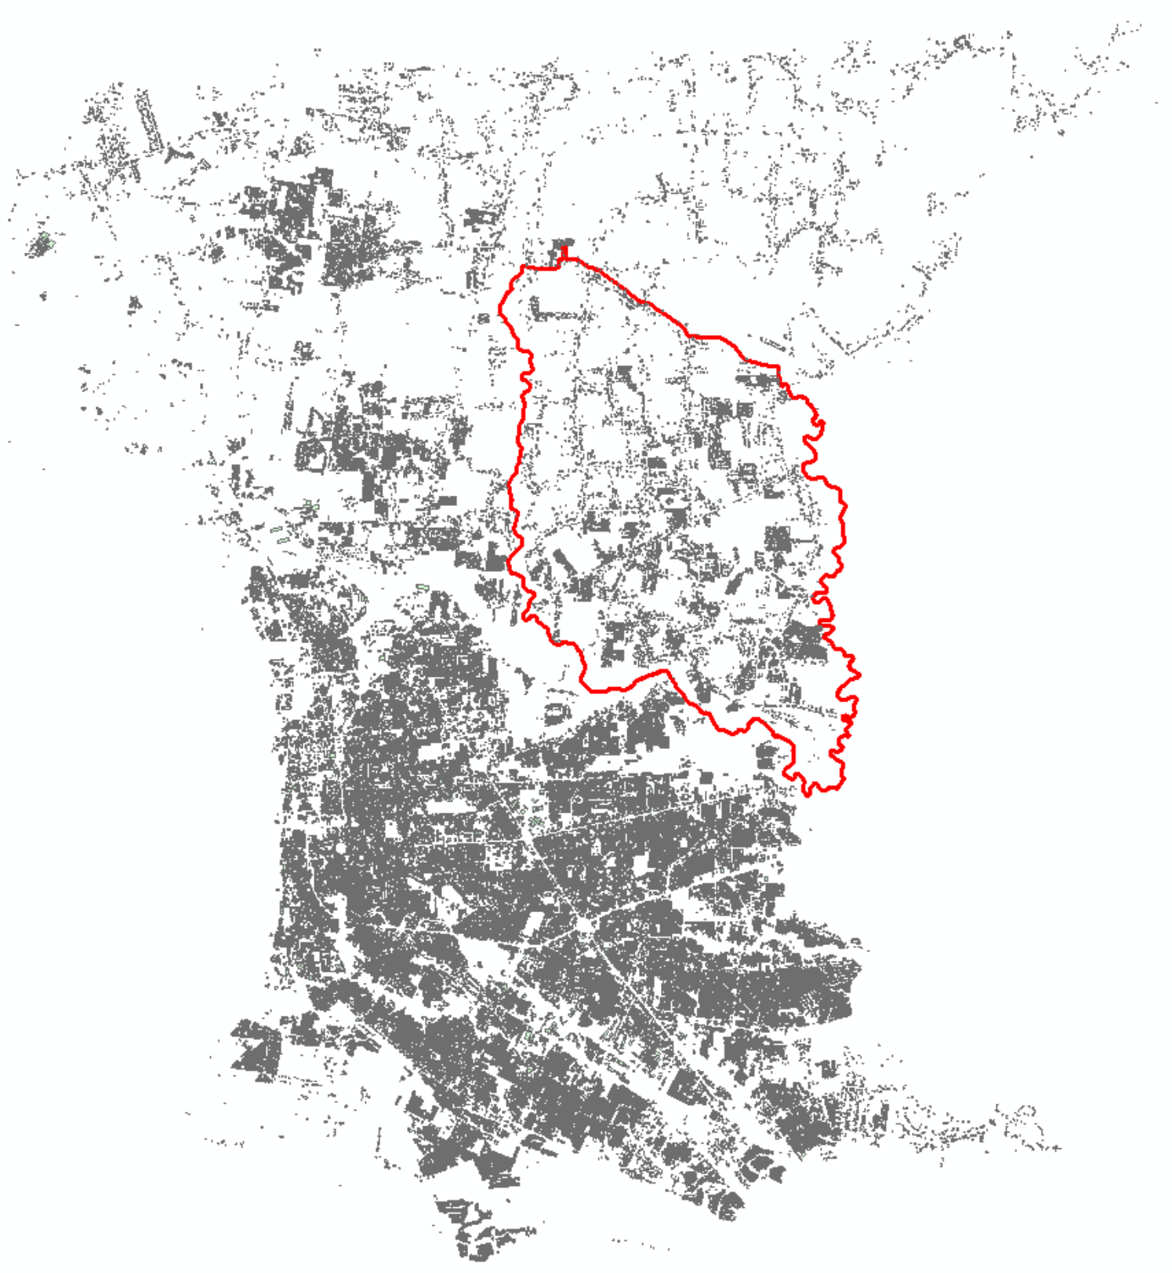
Building Footprints
Requested a snapshot in time (2017) from the parish
Clipped out building feature class to my AOI
18,720 Buildings
Photo credit: J. Penton

Slide 17
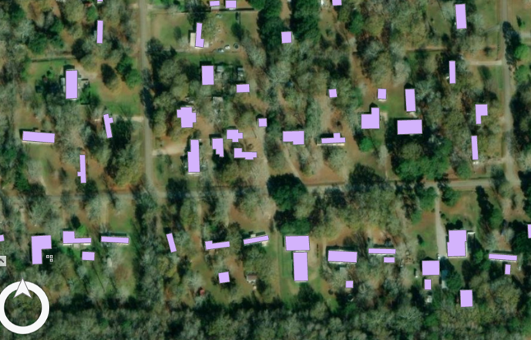
Building Footprints (cont.)
I found out, at the time, they collected smaller shed/storage type buildings
Now they don’t collect anything under 400 sf
I only wanted 900 sf or bigger. This looked like a smart choice to keep single wide trailers in the dataset
This query reduced my building count to 13,493
Photo credit: J. Penton

Slide 18
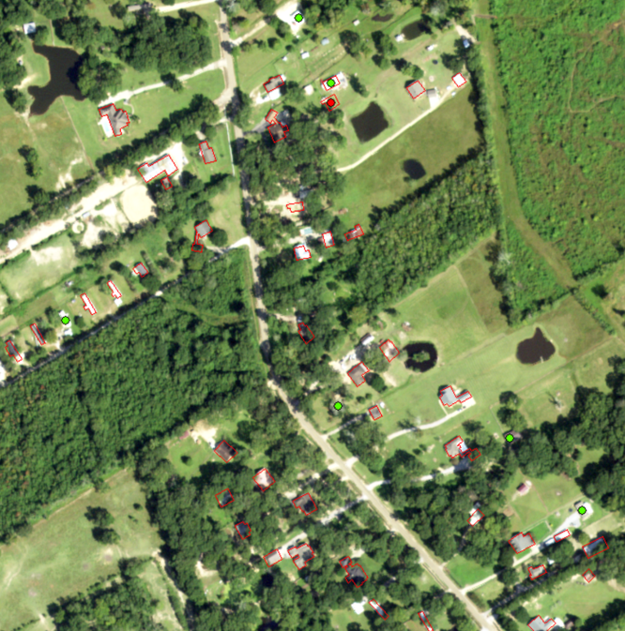
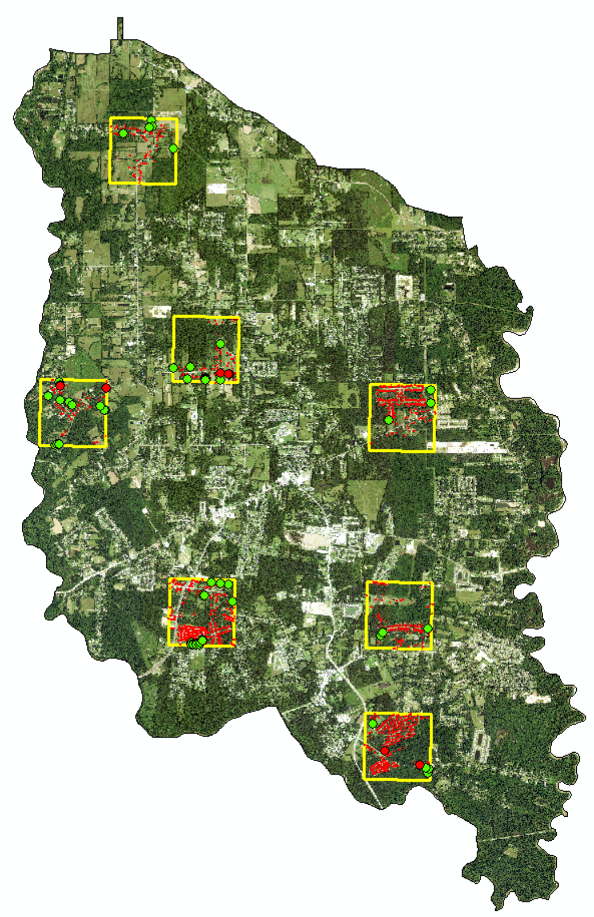
Desktop Ground Truth
Suggested to look over 10% of the area
The 2017 NAIP was perfect for this task
Randomly picked 7 tiles
Needs footprint
Needs footprint
expanded
Needs footprint
deleted
Needs footprint
Needs
footprint
Photo credit: J. Penton

Slide 19
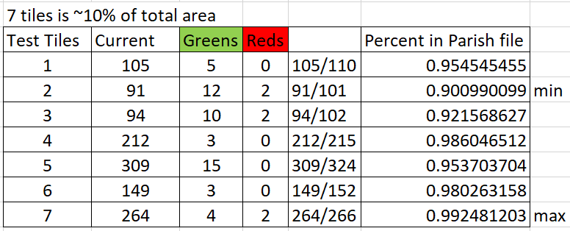
Desktop Ground Truth (cont.)
Happy with the results of 96% average of building footprints being present
Depending on time, I may review all tiles and modify building footprint feature class as needed
Once I have lidar on top of building footprints this will be more evident. The imagery and lidar won’t be an exact match. I was lucky to find data in the same year

Slide 20
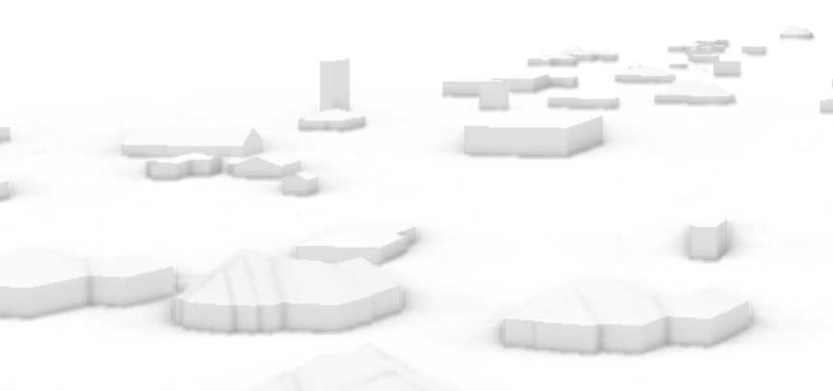
Deployed Solution on Sample Area
I ran the tile, that my home is located in, through the deployed solution
Things turned out quite nice, however there were issues
Incorrect - 60’ tall trailer
Photo credit: J. Penton

Slide 21
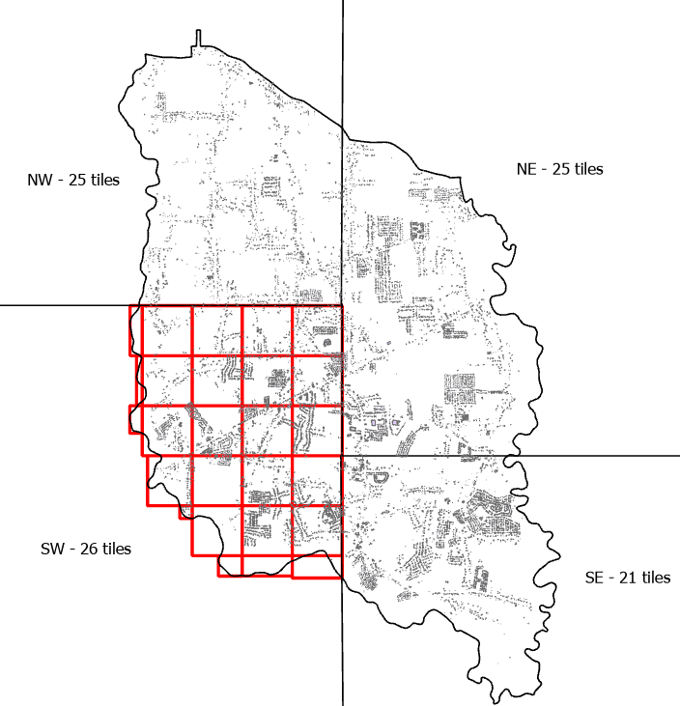
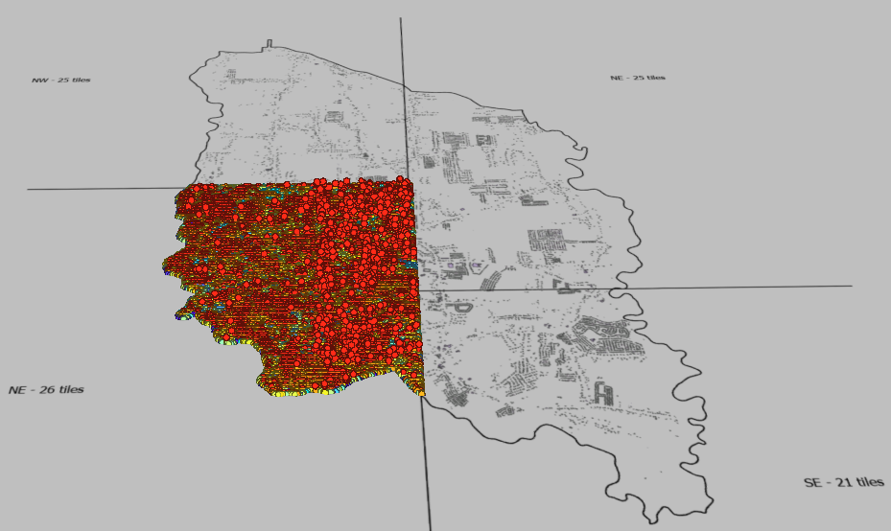
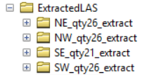
Dividing up the AOI
Crashed while trying to create 1 LASD (las dataset)
Crashed while trying to half the area into 2 LASDs
Succeeded when quartering up the data into 4 LASDs
Photo credit: J. Penton

Slide 22
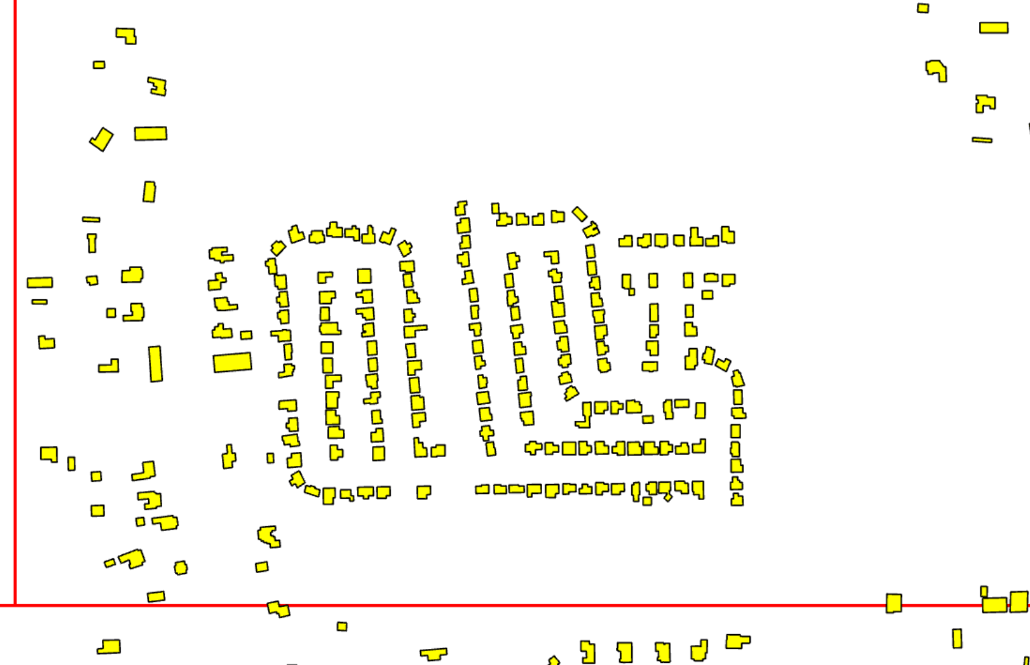
Edge Matching
Partial buildings will be created due to the (4) LASDs
Basically the buildings will be split at edges
Photo credit: J. Penton

Slide 23
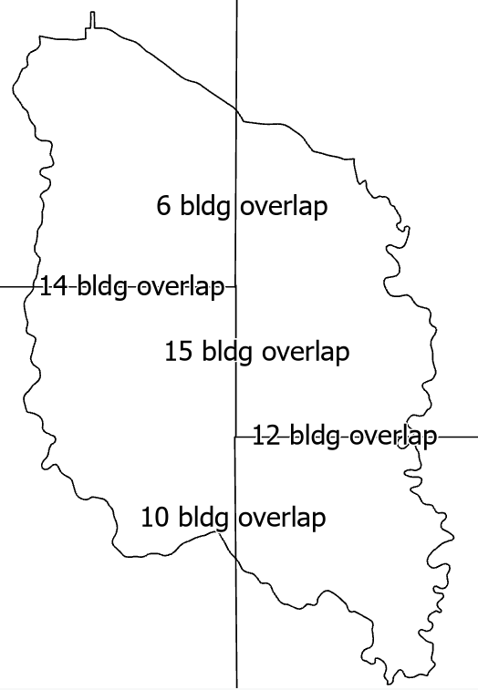
Edge Matching (cont.)
A total of (57) buildings will need modifications after multipatches are finished
Photo credit: shutterstock / J. Penton

Slide 24
Remaining
To do:
Building footprint clean up
Run 3D Basemaps solution on (4) LASDs
Troubleshoot multipatch results
Clean up building overlap
Obtain DEM from TNM for buildings to sit on
Create user interface where public can view the data (swipe tool, info tool for elevation data, 3D explorer to allow for measurements)

Slide 25
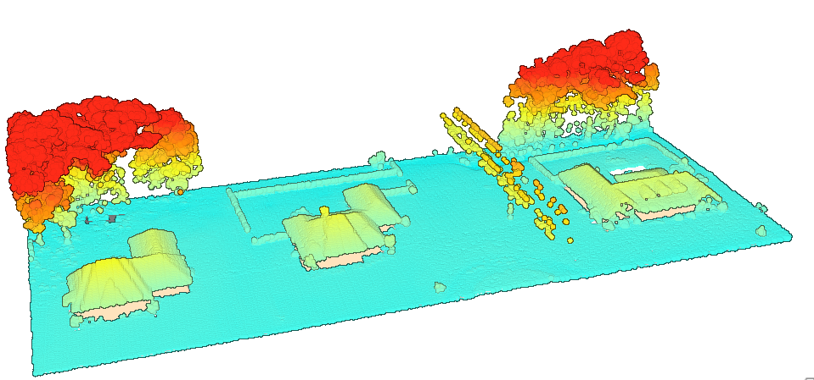
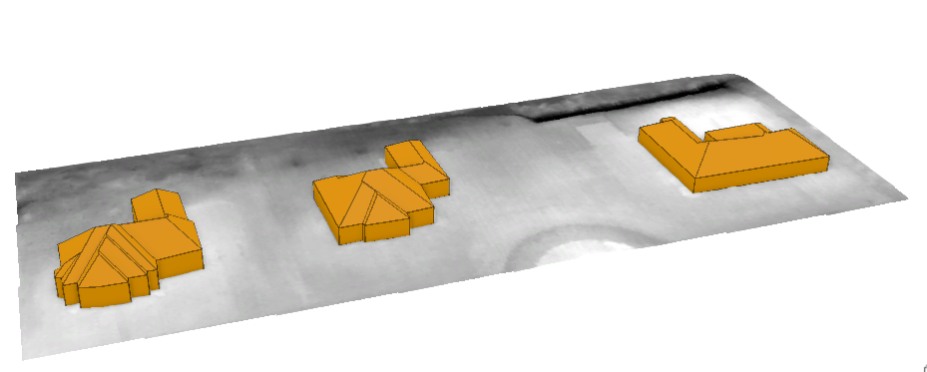
Anticipated Results
A shareable high-quality 3D model of my hometown based on lidar data
Photo credit: ESRI

Slide 26
Presentation Venues
In 2022 the ESRI Southeast User Conference was in March. This would be a good potential conference since I’ll be using their deployed solution. It may align with the end of 596B for me
In 2022 the URISA-IAAO GIS/Valuation Tech Conference was in March. It too may align with the end of 596B for me
City council meeting, if they show interest
Zoom session with peers

Slide 27
Knowledge Acquired/Applied
Geog 480 – Exploring Imagery & Elevation Data in GIS Applications
Discussed sensors
Dr. Bradley Doorn
Geog 481 – Topographic Mapping with Lidar
Lidar visualization and manipulation
Ms. Karen Schuckman
Geog 484 – GIS Database Development
Data organization is key to a successful project
Ms. Michelle Zeider
Photo credit: Penn State University

Slide 28
Knowledge Acquired/Applied
Geog 883 – Remote Sensing Image Analysis and Applications
Even though not a change detection project a swipe tool
will show evident change
Mr. Jarlath O’Neil-Dunne
Geog 861 – The Earth is Round and Maps are Flat: SRS in GIS
It’s not a good practice to blindly accepting what ArcGIS Pro says should happen. Know your projection and coordinate system. Also had Dr. Kessler for the cartography course Geog 486
Dr. Fritz Kessler
Photo credit: Penn State University

Slide 29
Knowledge Acquired/Applied
Geog 589 – Emerging Trends in Remote Sensing
I’d never heard of solutions that could be
deployed from ESRI. Reminded me of the
new trends in remote sensing course I took exploring Google Earth Engine
Dr. Douglas Miller
Geog 583 – Geospatial System Analysis and Design
Be sure to have the end user in mind when
designing the UX/UI
Dr. Marcela Suarez
Photo credit: Penn State University

Slide 30
Knowledge Acquired/Applied
Geog 586 – Geographic Information Analysis
Practice creating visualizations and presenting data
Dr. Amy Griffin
Super helpful
Quick to reply to any questions I had
Ms. Beth King
Photo credit: Penn State University

Slide 31
Acknowledgements
Always remember to give credit where credit is due
USGS TNM hosting the data
Dewberry / Precision Aerial Reconnaissance – QL1 lidar data collection/processing
East Baton Rouge Parish Government GIS department – Building footprints
ESRI White Paper: 3D Urban Mapping From Pretty Pictures to 3D GIS
ESRI 2021 UC Presentation: ArcGIS Pro – Taking Advantage of 3D
ESRI 2022 UC Presentation
ArcGIS 3D analyst: Feature Extraction from Lidar
Classifying Lidar from Trees, Lidar Canopy Height Model and 3D Tree Generation
ArcGIS Pro: 3D Tips and Tricks
ESRI Learn ArcGIS
Extract 3D buildings from lidar data
Extract roof forms for municipal development (takes you through the 3D Basemaps)

Slide 32
Questions/Comments?
jlp6399@psu.edu
My home and major powerlines (time-permitting) that will be modeled!

