Slide 1
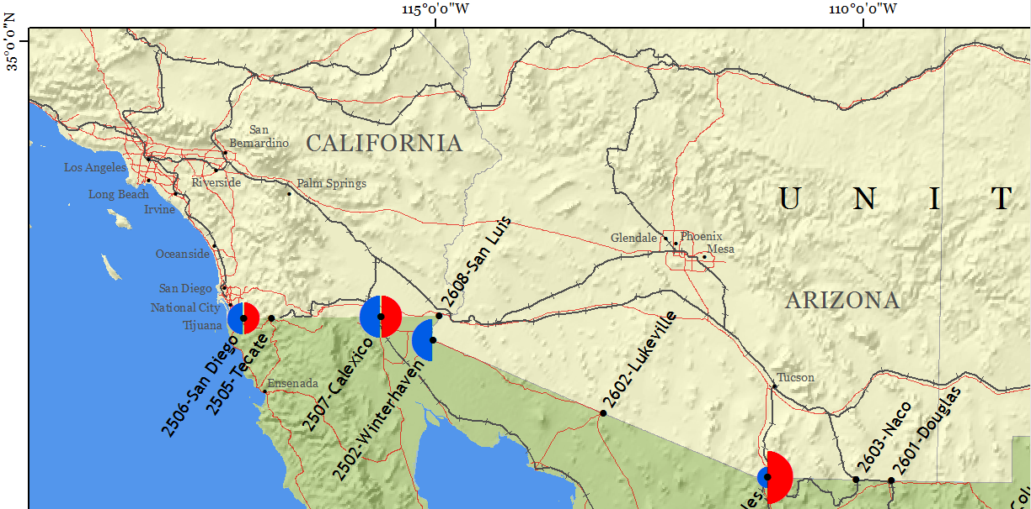
International Food Imports: Identification of Vulnerabilities and Risks
Stephen M. Perrine
Advisor - Justine Blanford, Ph.D.

Slide 2
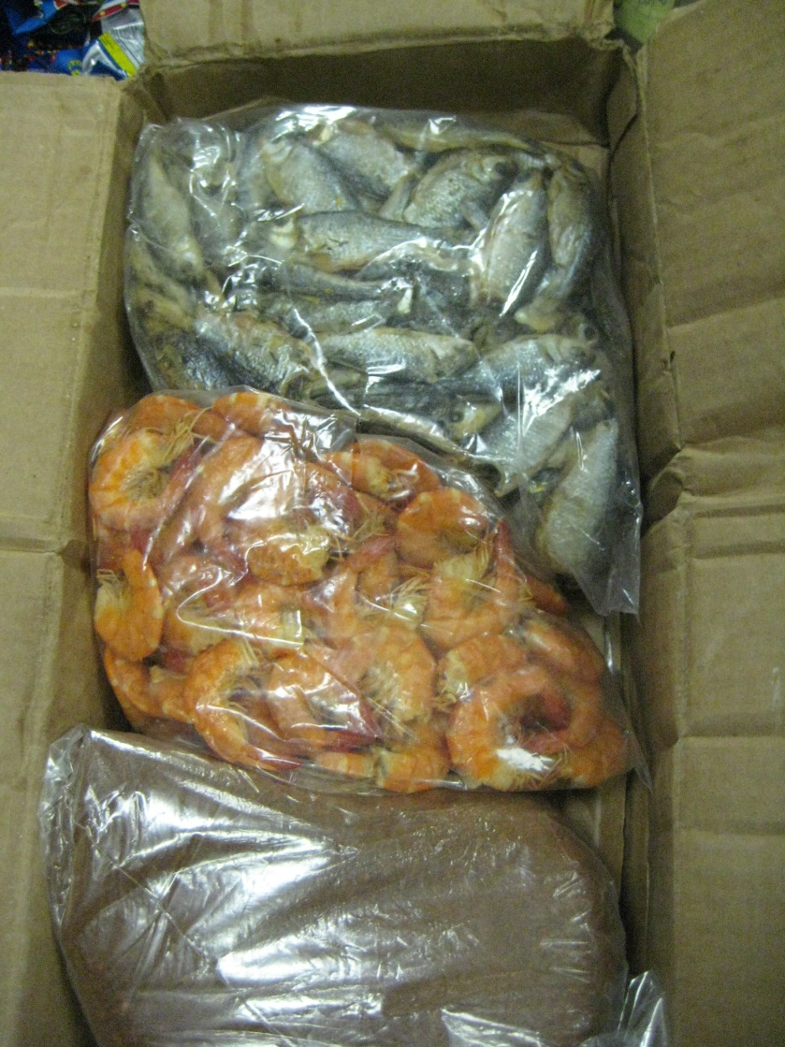
Overview
Introduction
U.S. food imports overview
Unintentional food contamination
Deliberate food contamination
Can shipping patterns reveal risks?
Methods
Preliminary Results
Questions
Partial contents of a commercial food courier’s
checked baggage, Dulles Airport 2013

Slide 3
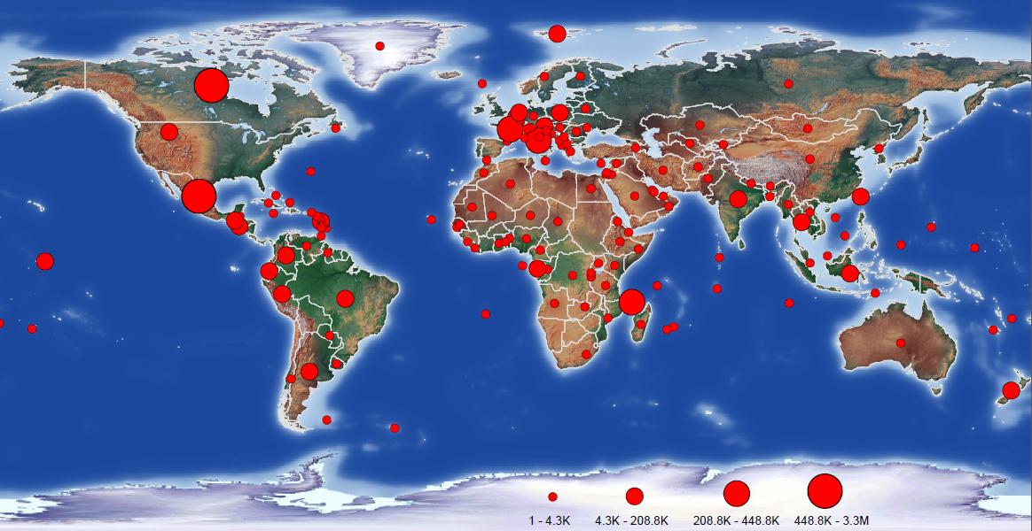
The U.S. imported food from 232 sovereign states and dependent territories in 2012
Source: FDA

Slide 4
The total dollar value of food imports in the U.S. increased 263% between 1999 and 2012
Source: USDA ERS

Slide 5
The U.S. has the safest food supply in the world, yet millions acquire foodborne illness each year
48,000,000 illnesses
128,000 hospitalizations
3,000 fatalities
$77.7 billion in healthcare (Scharff, 2012);
Businesses spend billions in recalls, lawsuits;
15 federal agencies administer food safety laws
Source: CDC

Slide 6
Most foodborne outbreaks in the U.S. are caused by Salmonella (46%) and Norovirus (99%)
Source: CDC

Slide 7
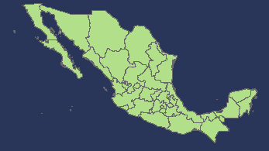
The number of foodborne outbreaks from foreign sources is increasing
2010 | fiddlehead fern
2009 | sprouts, unspecified
2009 | oysters, raw
2006 | oysters
2006 | seafood, unspecified
2006 | fish, unspecified
2006 | fruit salad
2010 | Mexican wheat snack
2009 | peppers, jalapeno
2008 | salsa, unspecified (jalapeno)
2008 | peppers, jalapeno and serrano
2006 | goat cheese/chevre, unpast
2005a | queso fresco, unpast
2005b | queso fresco, unpast
Source: CDC

Slide 8
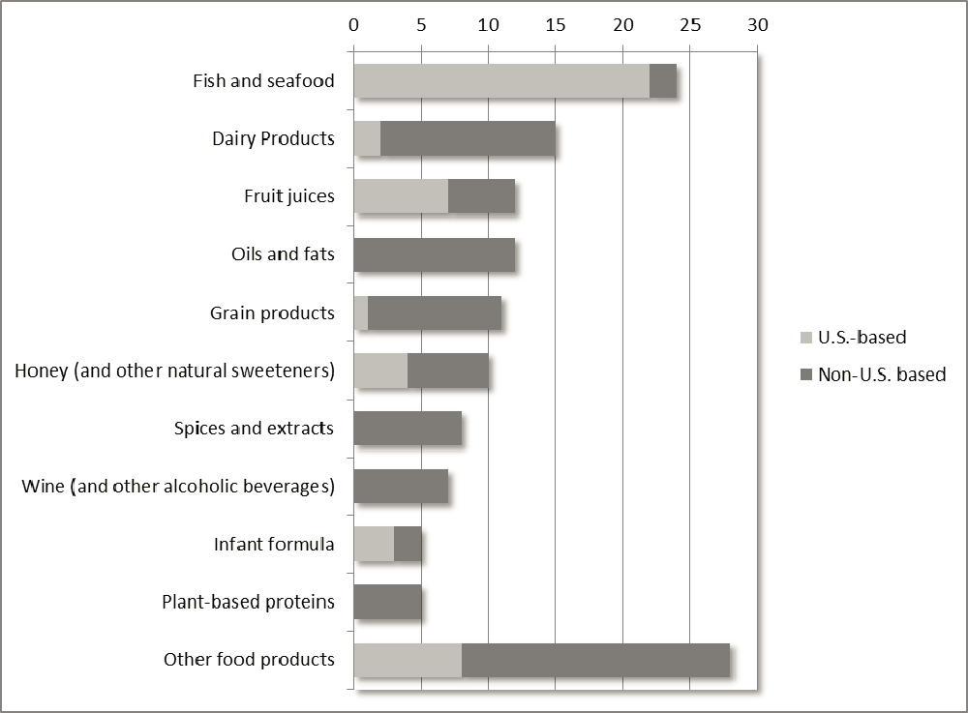
Deliberately contaminated food is difficult to detect and has serious public health consequences
Cases of
economically
motivated
adulteration
since 1980
N=137
What about
terrorism?
Everstine, 2013

Slide 9
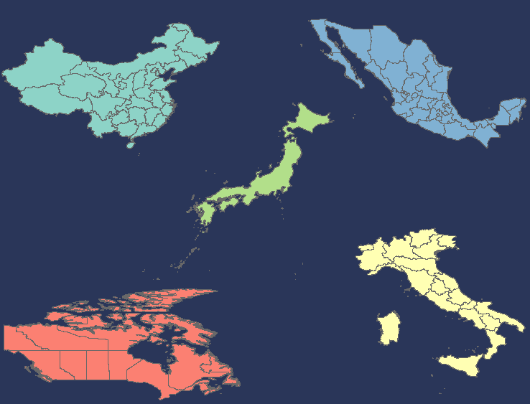
Worldwide, there are almost 450,000 food facilities registered with FDA
26,743
23,829
28,223
16,509
18,383
Source: FDA

Slide 10
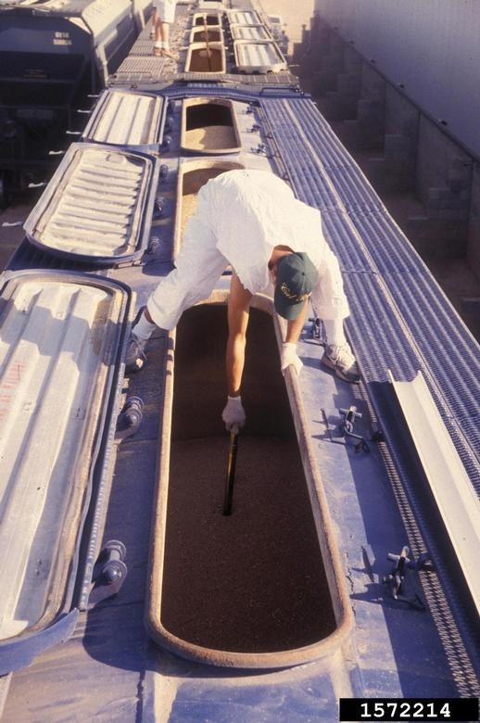
Low inspection, sampling rates = high likelihood of undetected entry of contaminated food
It is impossible to inspect and sample every imported food shipment; consequently, < 3% of food imports are inspected (Nganje et al., 2009)
FDA import staff routinely inspect and sample food for:
filth | food additives
decomposition | color additives
pesticides | microorganisms
antibiotics | chemicals/toxins
allergens | pH
Gerald Holmes, Valent USA Corporation, Bugwood.org

Slide 11
Improving food safety by identifying vulnerabilities and risks in food shipments
PREDICT - Predictive Risk-based Evaluation for Dynamic Import Compliance Targeting
Utilizes FDA entry data by evaluating food product risk and firm violation history (Nyambok, 2010)
Limitations
Relies upon complete and accurate data and a shipping history for pattern analysis. Provided data may be inaccurate on purpose.
Does not utilize all data collected - spatial analysis.

Slide 12
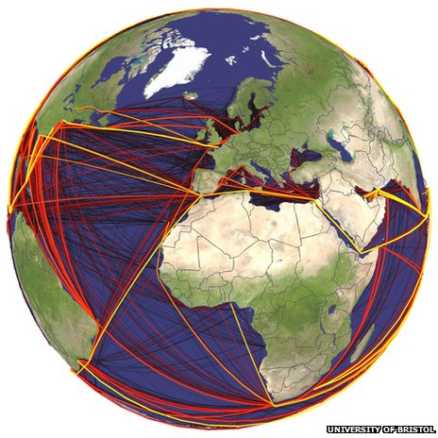
Improving food defense by understanding movement and routing
Truck carriers: what ports of entry are being used and why? Ideally – GPS tracking
Identifying high risk aquatic invasive species sources and dispersal based on global shipping routes (Seebens, Gastner & Blasius, 2013)
Predicting movements of malaria vectors on international ship and aircraft traffic (Tatem, Hay, & Rogers, 2006)
Detecting outliers in regular traffic patterns to identify abnormal behavior (Lu, Chen, & Hancock, 2009)

Slide 13
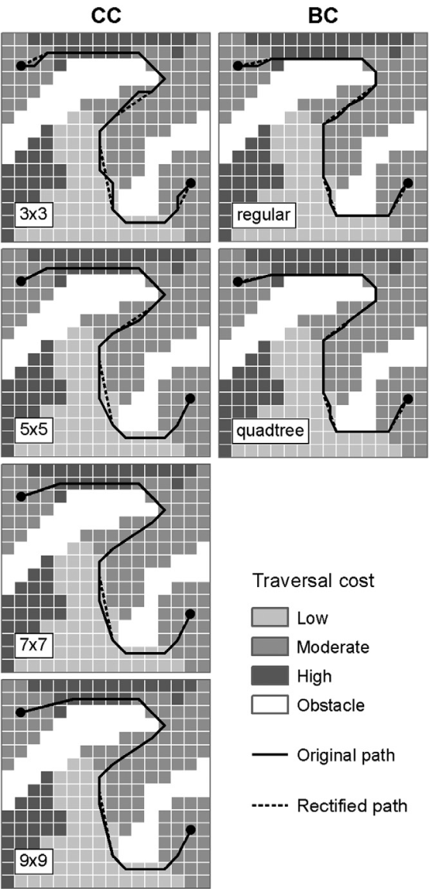
Improving food defense by understanding movement and routing through modeling
Model using least-cost path analysis (LCPA) to identify the most cost efficient route.
Least-cost route likely to be due to:
Transportation costs (Fender & Pierce, 2012)
Time/food item (Osvald & Stirn, 2008)
Other (Cattan, 2011)
H. Antikainen, 2013

Slide 14
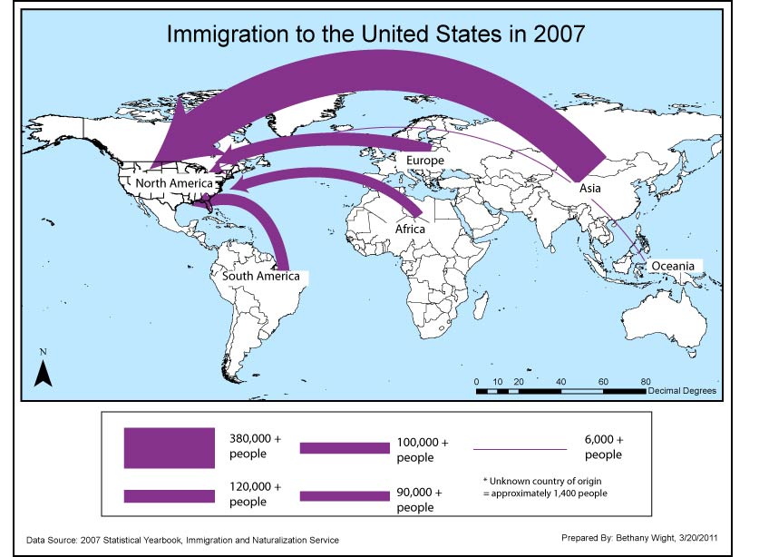
Improving food defense by visualization Cartographic flow maps
http://giswight.blogspot.com/2011/03/flow-map.html

Slide 15
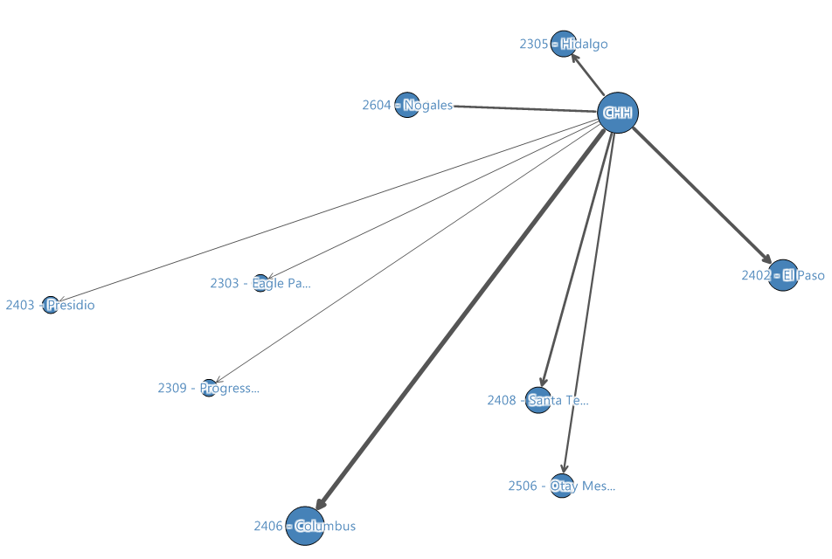
Improving food defense by visualization Information visualization
Network graph

Slide 16
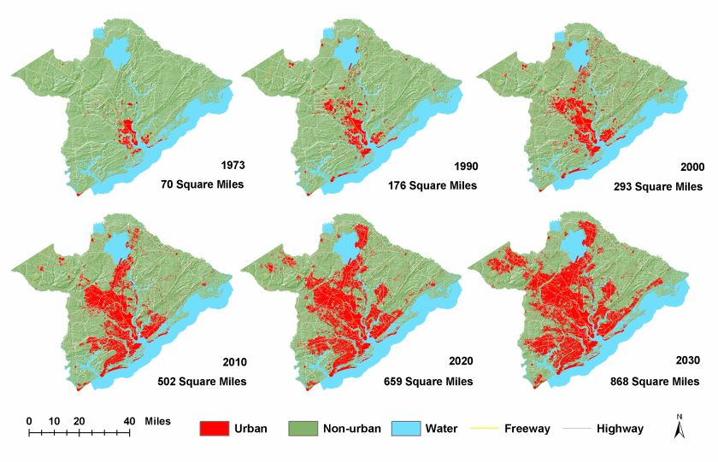
Improving food defense by visualization Time geography
http://www.ecologyandsociety.org/vol8/iss2/art2/figure4.jpg

Slide 17
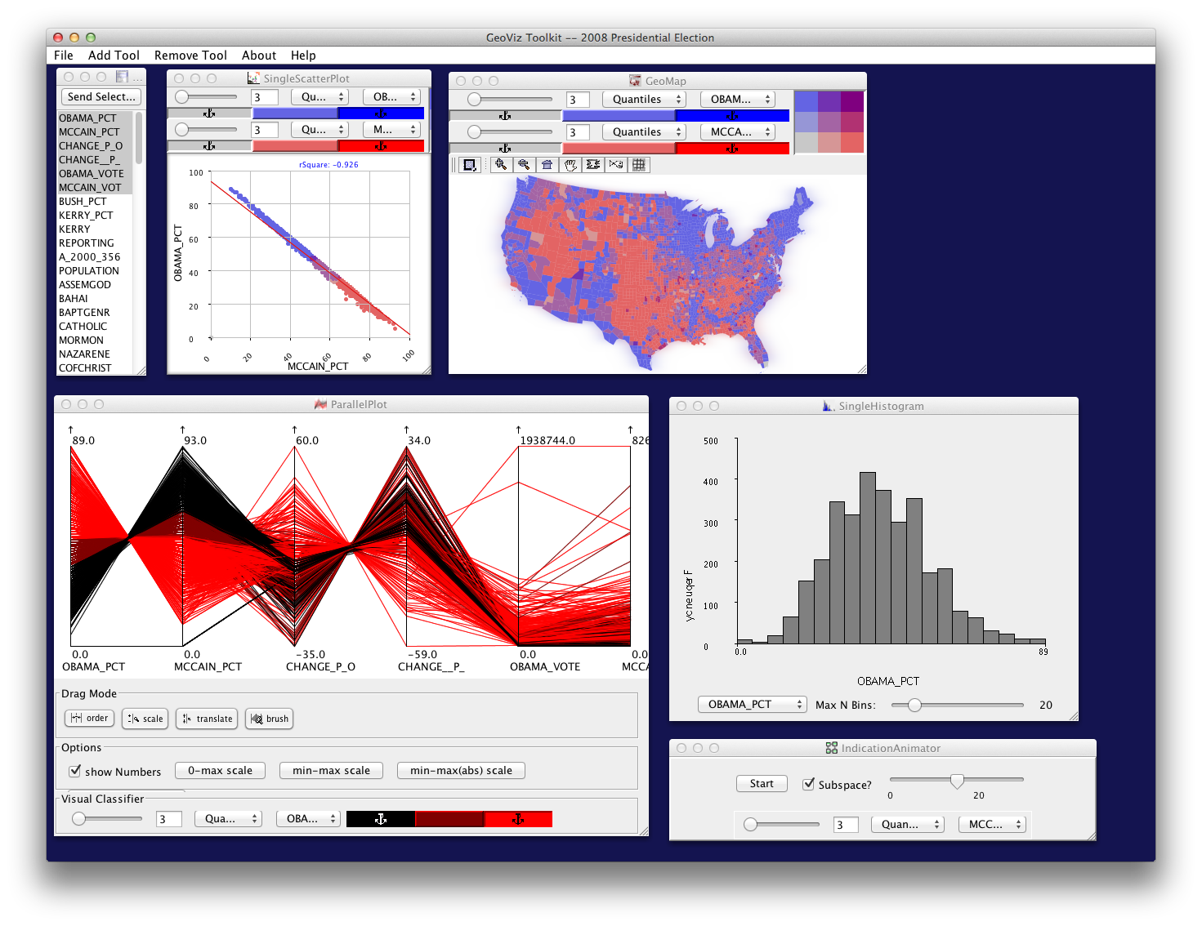
Improving food defense by visualization Geovisualization
https://www.e-education.psu.edu/geog486/node/1849

Slide 18
Can shipment patterns reveal risks?
This study will analyze one year’s data of produce imported into the USA by truck
Objectives:
Improve food defense assessments by identifying vulnerabilities
Develop new visual analytical and spatial methodologies that will help identify shipping routes and deviations from the norm
Assess the feasibility of using advanced visual analytical methods for dealing with increasing volumes of data

Slide 19
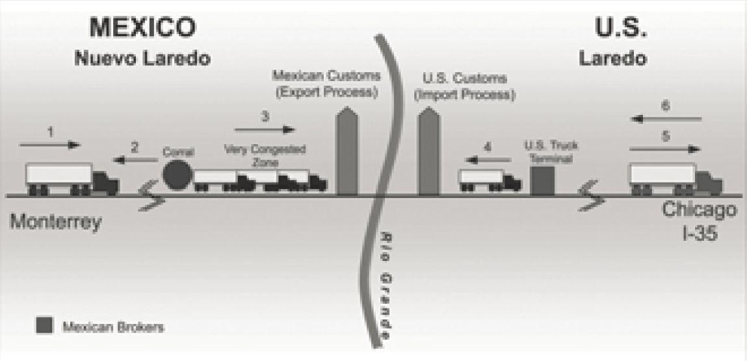
Truck cargo can be highly vulnerable to deliberate contamination en route
Haralambides & Londondo-Kent, 2004
http://www.csmonitor.com/World/Americas/2011/0412/Mexico-drug-war-s-latest-victim-the-lime

Slide 20
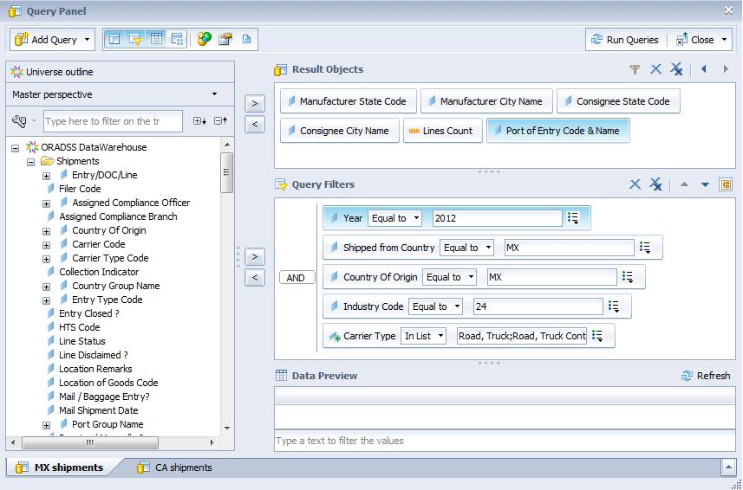
Methodology – Data

Slide 21
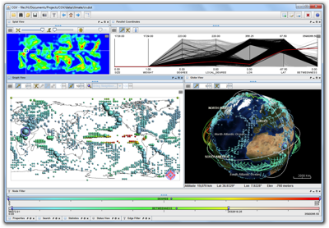
Methodology - Analysis
Connectivity between locations
XY Line
Cartographic flow
Visual Analytics
Port crossings
Identify, rank most favored border crossings
LCPA
?
D
A
C

Slide 22
Expected Results/Outcomes – based on preliminary data analysis for 2012
Several ports on each border are most frequently used
Patterns between source and destination exist
Port choice from source regions will be ranked
Results will be used to identify outlier shipments

Slide 23
2012 vegetable/vegetable product import statistics, truck carriers only
 | CANADA | MEXICO
Import lines | 279,659 | 1,022,116
Producers | 471 | < 7,787
U.S. consignees | 1,477 | 415
Ports of entry used | 39 | 23
Unique shipping routes | 8,854 | < 5,670
* Import line = unique food item (type, packaging, etc.) in a single shipment
Source: FDA

Slide 24
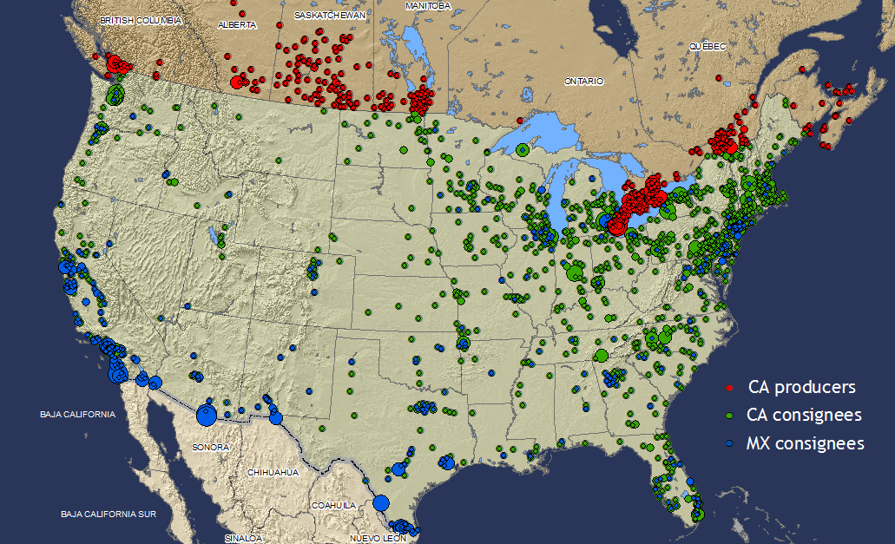
Canadian vegetable producers and CA, MX consignees, 2012

Slide 25
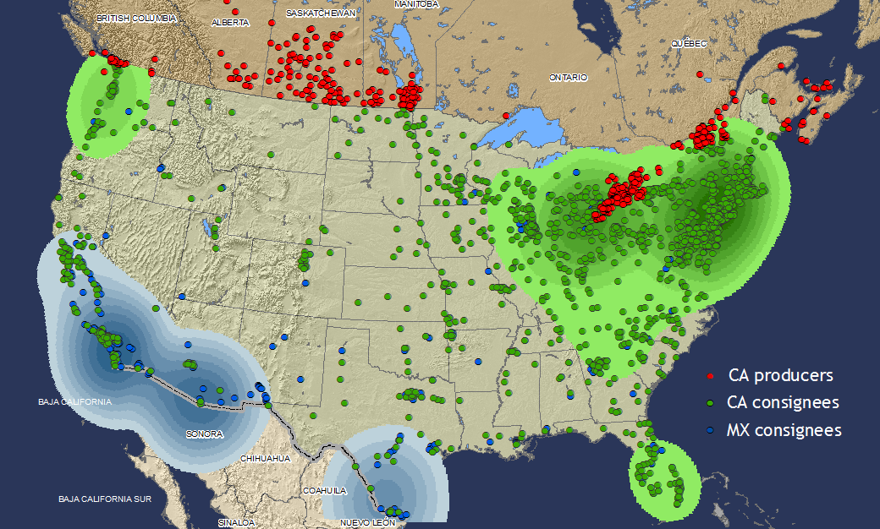
Mexican consignees are concentrated in the SW, Canadian consignees in the NE

Slide 26
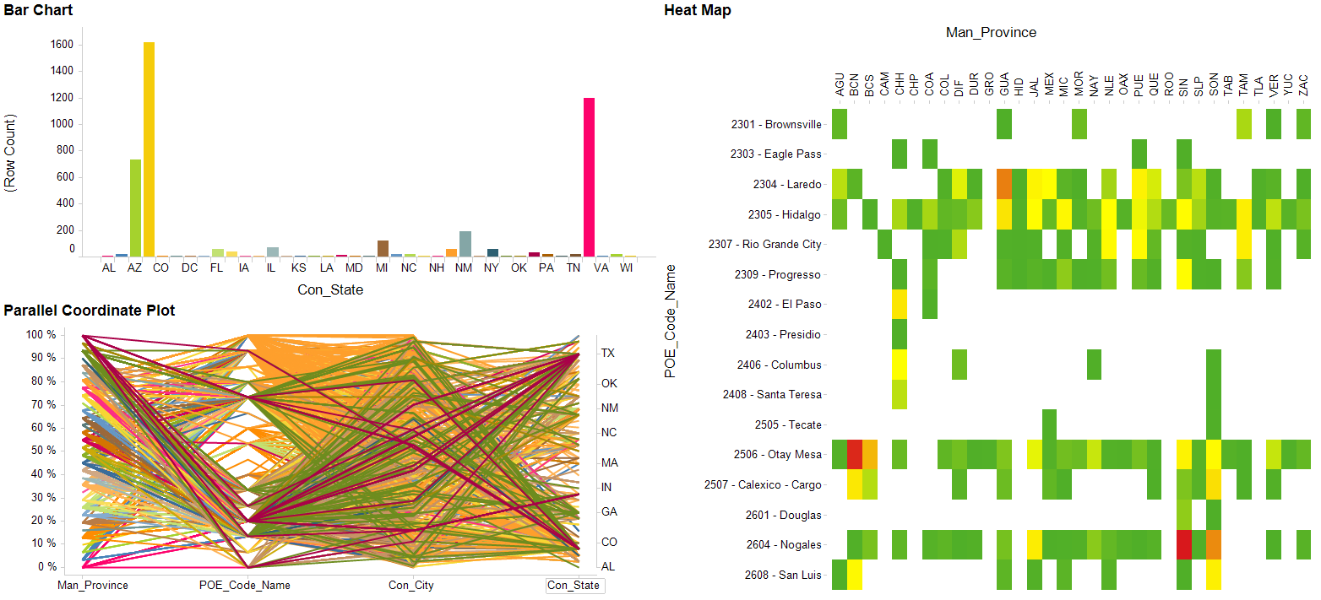
Visual Analytics All Mexican vegetable routing data, 2011 (a)

Slide 27
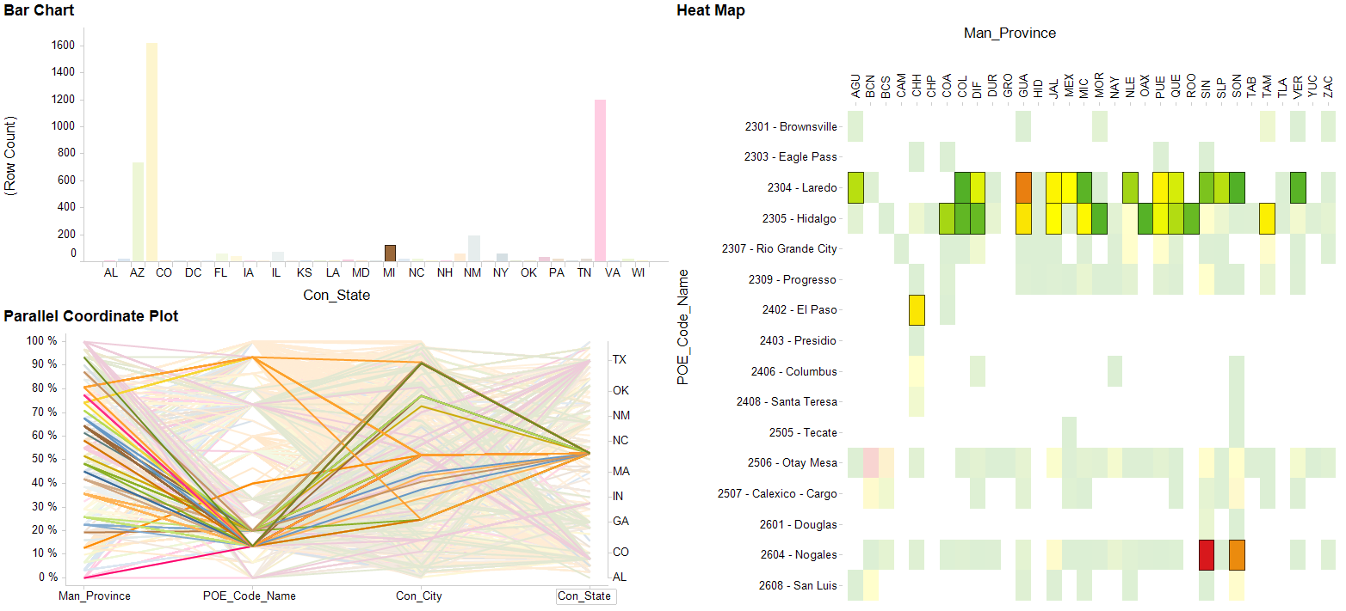
Visual Analytics All Mexican vegetable routing data, 2011 for MI (a)

Slide 28
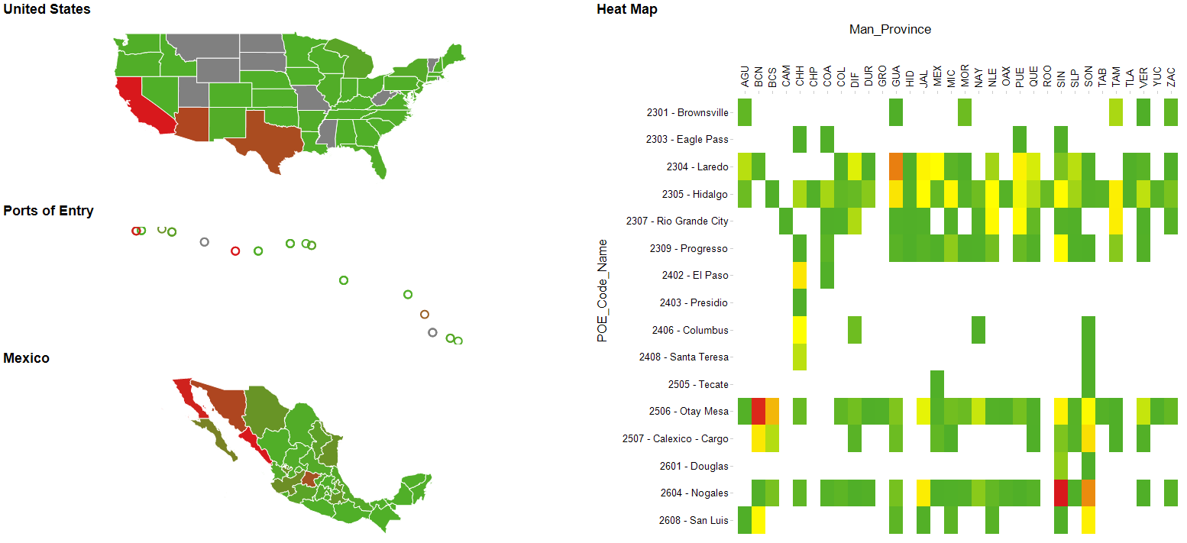
Visual Analytics All Mexican vegetable routing data (b)

Slide 29
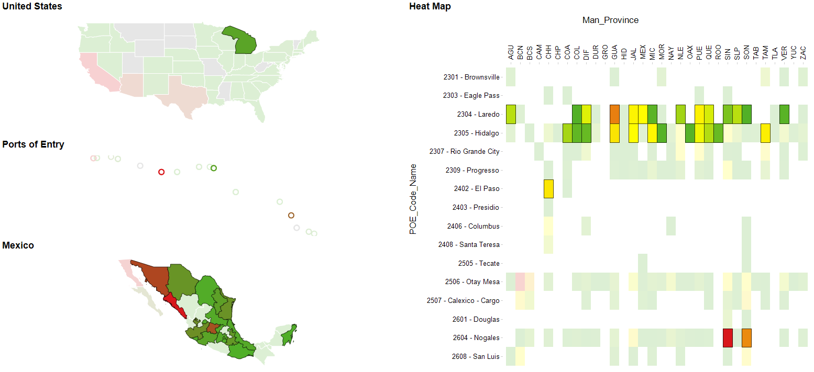
Visual Analytics All Mexican vegetable routing data, 2011 for MI (b)

Slide 30
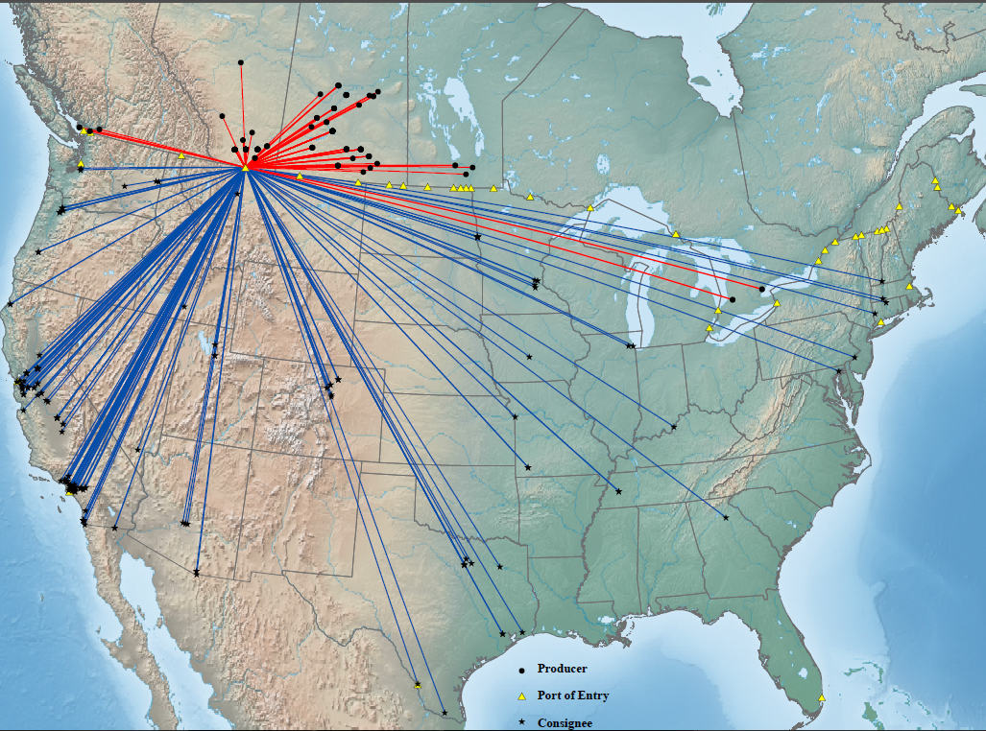
All Canadian vegetable shipments crossing the Sweetgrass, MT port of entry

Slide 31
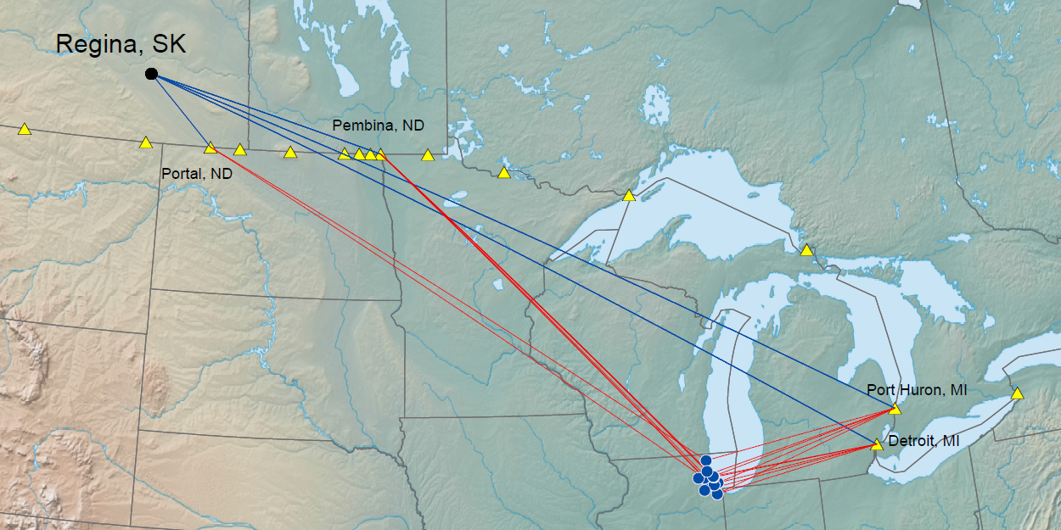
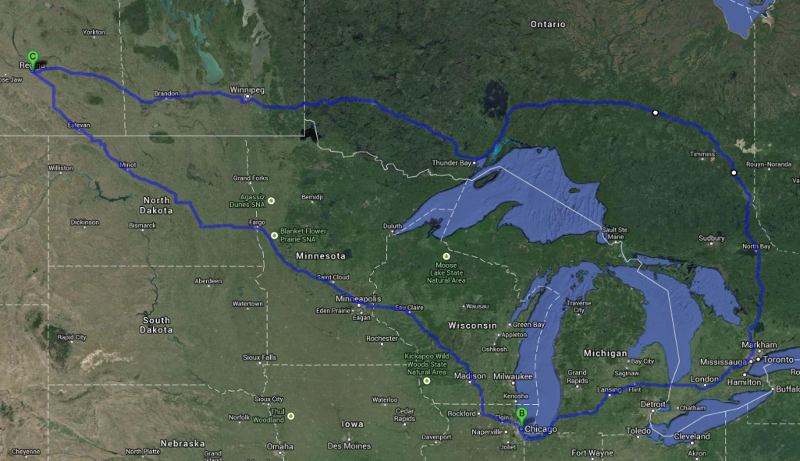
Not all shipments originating from Regina, SK follow a least cost path
2,181 mi/37 h
1,150 mi/18 h

Slide 32
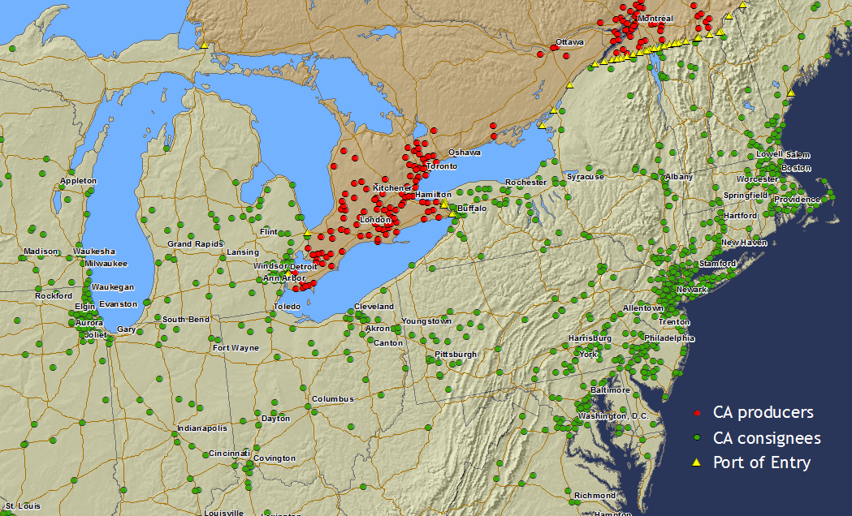
Port of entry characteristics will have to be incorporated into the LCPA cost surface

Slide 33
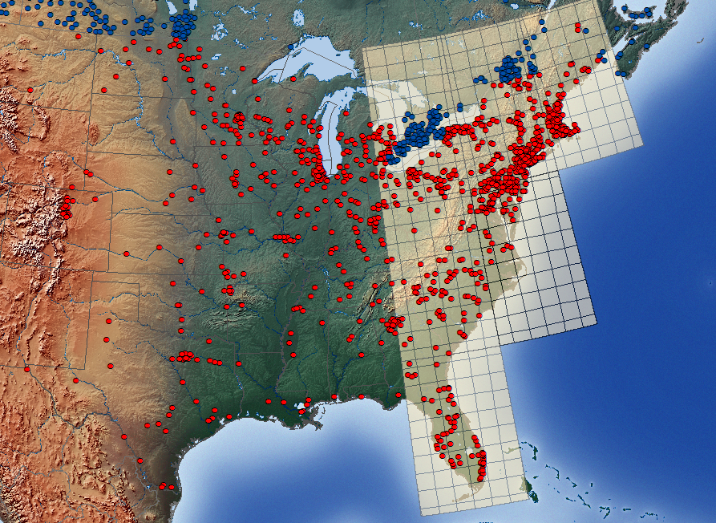
ZIP codes or the MGRS will be used to aggregate source & destination data for LCPA & port ranking

Slide 34
Problem - the manual entry of place names impedes data analysis and georeferencing
City w/no state | Nonspecific location | Case sensitivity
Loreto, BCS | Zona Ind | Saint-roch-de-l'achigan
Loreto, ZAC | Sin Nombre | Saint-Roch-De-L'Achigan
Loreto, CHH | Mexico | Saint Roch De L Achigan
Loreto, TAM | _____________ | Saint Roch Delachigan

Slide 35
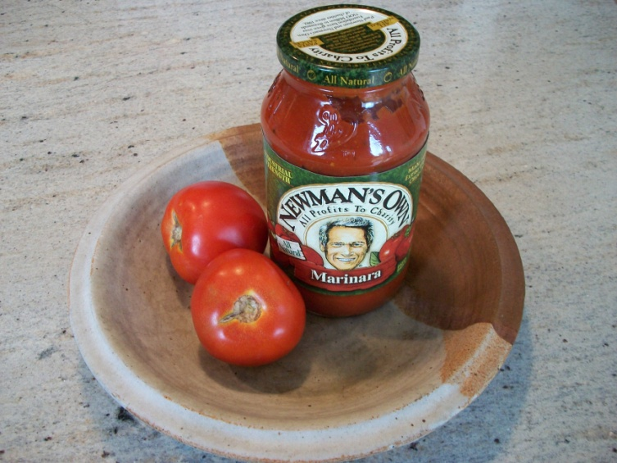
Problem - one year’s data for one food industry cannot be used to generalize all shipping patterns
Time series | Have patterns changed over time? Do patterns change throughout the year?
Food categories | Are shipment patterns for shelf stable and perishable foods different?

Slide 36
Timeline
Jun 14
Apr 14
Jan 14
Nov 13
Aug 13

Slide 37
Key References
Andrienko, N., & Andrienko, G. (2012). Visual analytics of movement: An overview of methods, tools and procedures. Information Visualization, 12(1), 3-24.
Brewster, R. M., & LeVert, R. (2005). Identifying Vulnerabilities and Security Management Practices in Agricultural & Food Commodity Transportation: American Transportation Research Institute.
Calvin, L. (2003). International Trade and Food Safety: Economic Theory and Case Studies. In J. Buzby (Ed.), Agricultural Economic Report (pp. 74-96): U.S. Department of Agriculture Economic Research Service.
Nganje, W., Richards, T., Bravo, J., Hu, N., Kagan, A., Acharya, R., & Edwards, M. (2009). Food safety and defense risks in US-Mexico produce trade. Choices, 24(2), 1-8.
Seebens, H., Gastner, M. T., & Blasius, B. (2013). The risk of marine bioinvasion caused by global shipping. Ecol Lett, 16(6), 782-790.
Tsamboulas, D., & Moraiti, P. (2008). Identification of potential target locations and attractiveness assessment due to terrorism in the freight transport. Journal of Transportation Security, 1(3), 189-207.

Slide 38
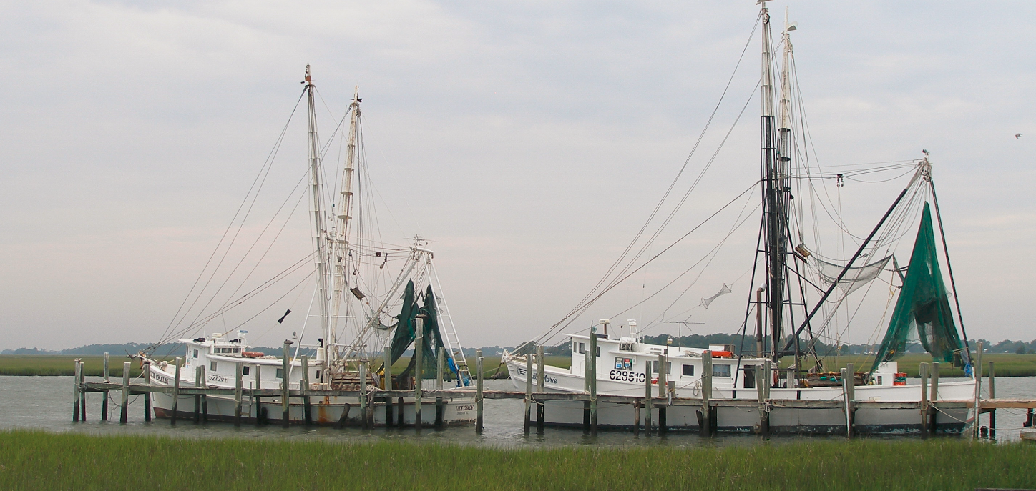
Questions?
stephen.perrine@fda.hhs.gov

