Slide 1
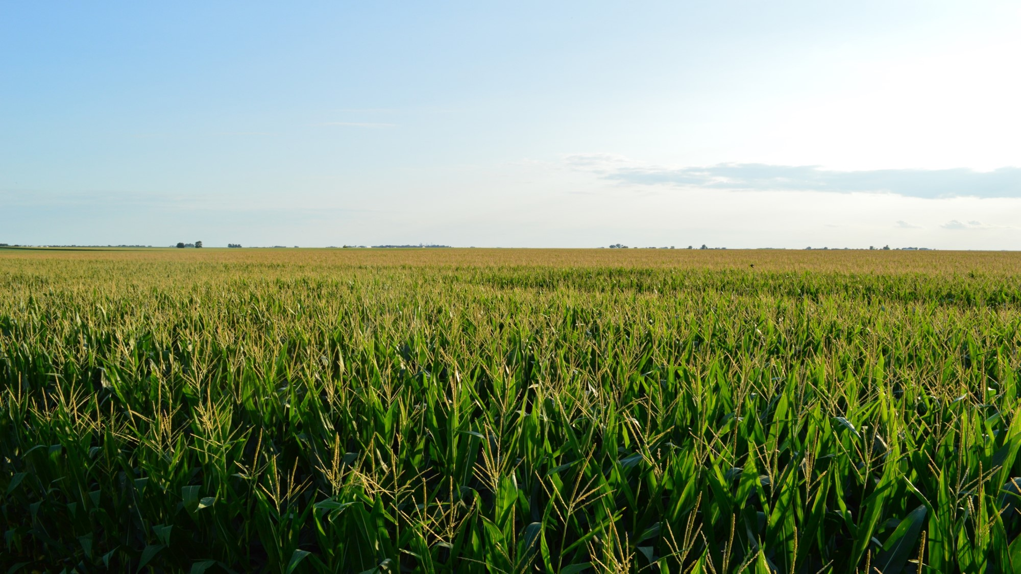
Capstone Proposal:
A FOSS Web Mapping Solution for Disparate Precision Agriculture Data
Angelo Podagrosi
Penn State University - World Campus, MGIS
November 2, 2016

Slide 2
Presentation Outline
Precision Agriculture
  Background
  Challenges
Project Objectives
  Address challenges of disparate precision agriculture data
Project Phases & Timelines
Results & Deliverables
Outline | Precision Ag | PA Challenges | Project Objectives | Project Methods | Project Phases & Results

Slide 3
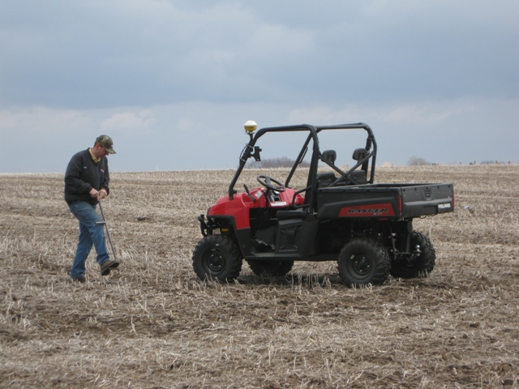
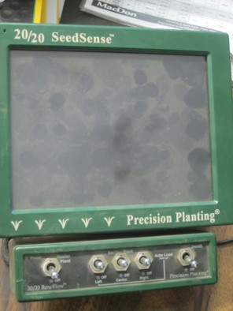
Precision Agriculture
Background
Technology
  Enabled by highly-accurate position information
Auto-steering equipment
Variable-rate technology (planting, treatments)
Yield monitors
Soil samples
Benefits of precision agriculture
Source: http://www.hullcoop.com/agronomy/grid
Source: Author
Outline | Precision Ag | PA Challenges | Project Objectives | Project Methods | Project Phases & Results

Slide 4
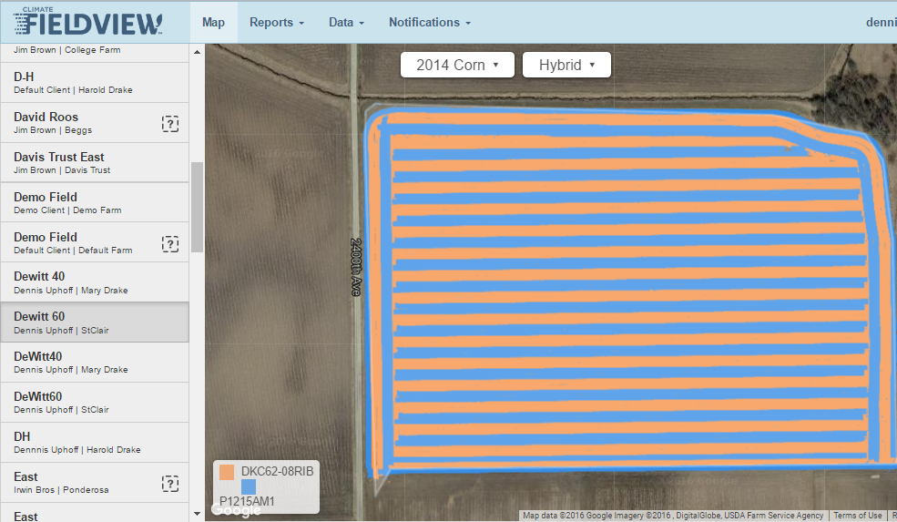
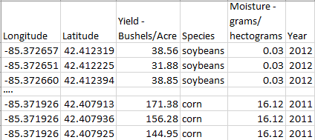
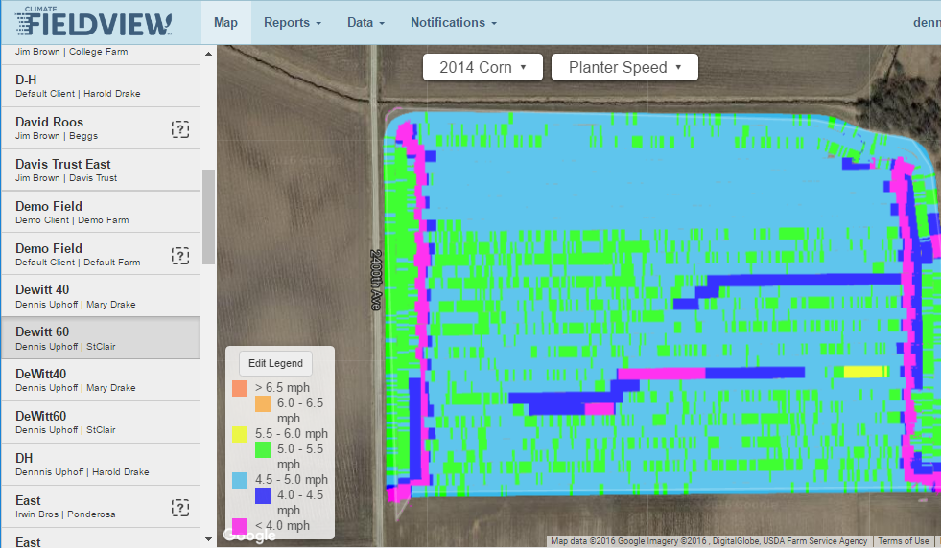
Precision Agriculture
DATA!!!
Planting: locations, density, type of seed
Treatments
Yield
Soil quality
Equipment tracks
Source: Author & https://fieldview.precisionplanting.com
Outline | Precision Ag | PA Challenges | Project Objectives | Project Methods | Project Phases & Results

Slide 5


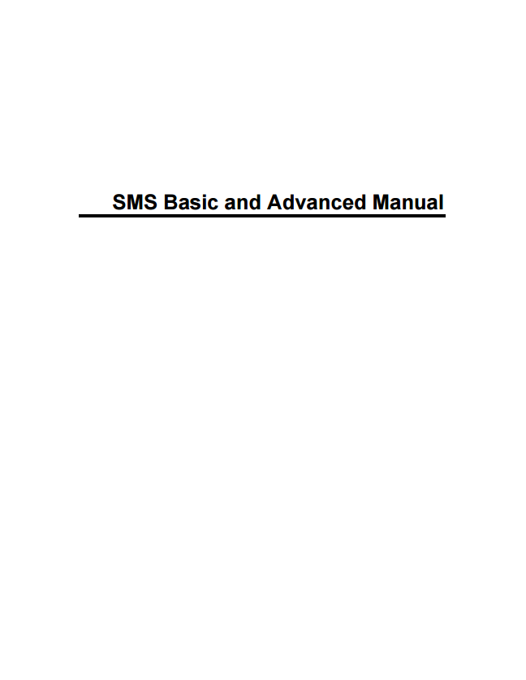
Barriers to Precision Agriculture Adoption
1) Costs
  Equipment
  Aftermarket
2) Technology
  Complexity
  Expertise
39 pages
41 pages
163 pages
Source: http://www.precisionplanting.com/PDF/FieldView_Operators_Guide.pdf, https://cloud.precisionplanting.com/pubs/?view=0Bx7V2J-P2yNZYUpneWRwRm90ZW8, https://support.agleader.com/kbp/index.php?View=afile&EntryID=1549&AttachID=3393
Outline | Precision Ag | PA Challenges | Project Objectives | Project Methods | Project Phases & Results

Slide 6
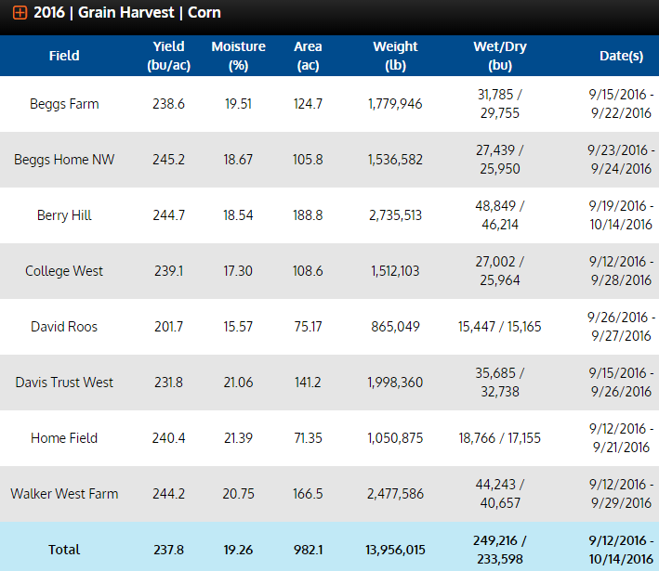
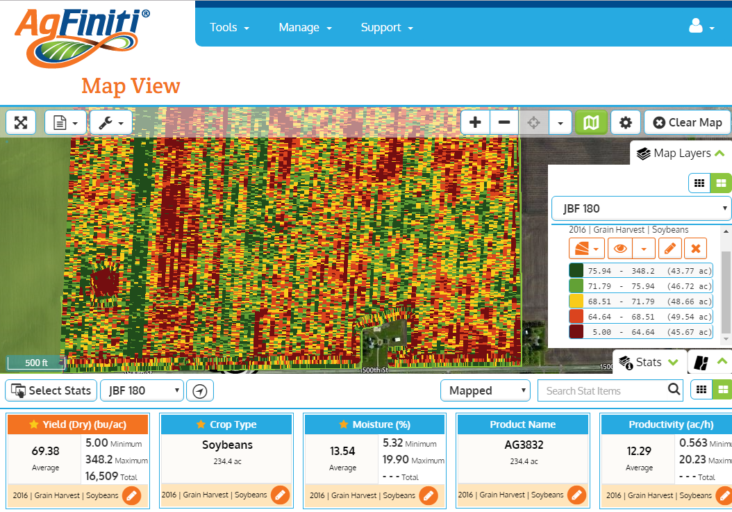
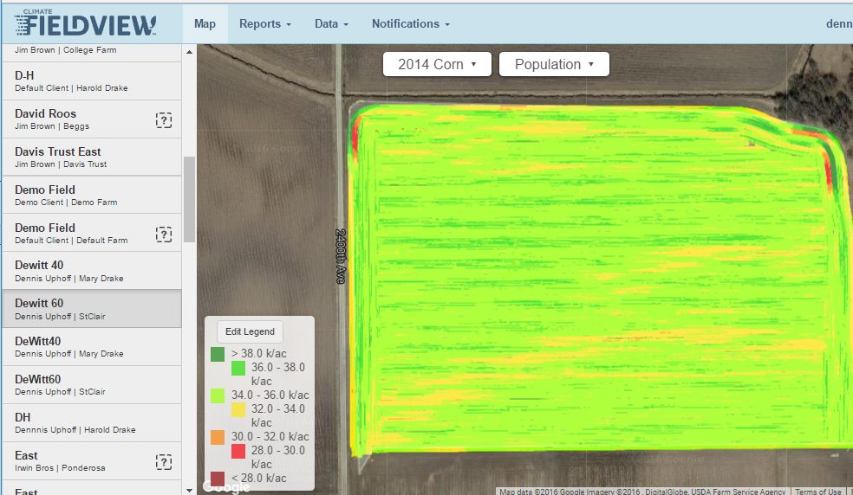
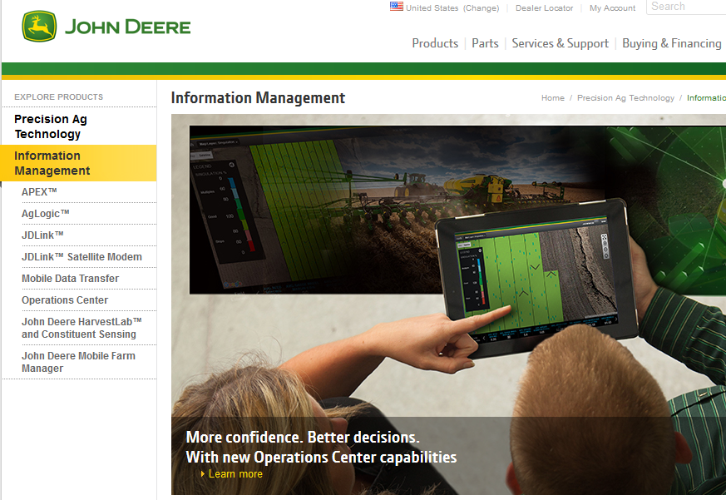
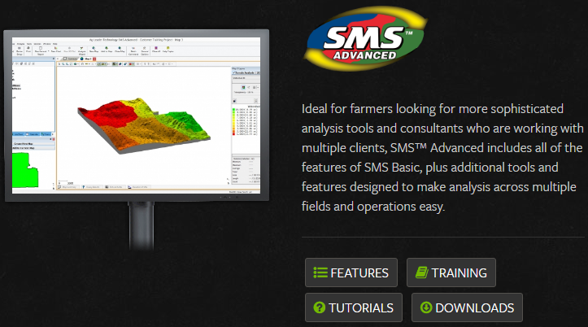
Barriers to Precision Agriculture Adoption:
3) Precision Ag. Data Challenges
Data inconsistencies and complexity
Collected using different vendor machinery
Data formats and access
Vendor viewers, portals, static reports
Challenges analyzing relationship between data
Industry attempts to address data compatibility issues
Source: Author & https://www.agfiniti.com/
Source: Author & https://www.agfiniti.com/
Source: Author & https://fieldview.precisionplanting.com
Source: https://www.deere.com/en_US/products/equipment/ag_management_solutions/information_management/information_management.page
Source: http://www.agleader.com/products/sms-software/advanced/
Outline | Precision Ag | PA Challenges | Project Objectives | Project Methods | Project Phases & Results

Slide 7
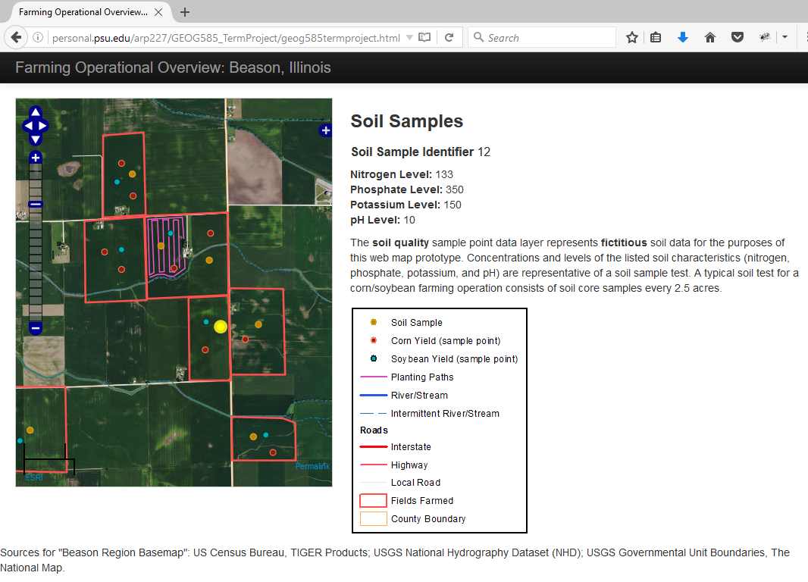
Objective of Project
Address challenges of visualizing disparate data produced by precision agriculture operations
Develop on-line mapping environment
  Free and open source (FOSS) technologies
Support independent farmer in their decision-making and analysis process
Source: Author
Outline | Precision Ag | PA Challenges | Project Objectives | Project Methods | Project Phases & Results
Notes:
Develop an on-line mapping environment, with free and open source (FOSS) technologies, to create spatial and graphical visualizations of disparate PA data from farming machinery.

Slide 8
Objectives & Capabilities
Ingest diverse precision agriculture-related data
Visualize spatially the ingested data
Generate reports and visualizations
Outline | Precision Ag | PA Challenges | Project Objectives | Project Methods | Project Phases & Results

Slide 9



Methods: Ingest Diverse Data (Objective 1)
Variety of data
  Soil samples, planting,
  yield, treatments
Data formats
Size
Export from machinery
Processing
Database & Server Elements
PostgreSQL
PostGIS
GeoServer
Sources: https://en.wikipedia.org/wiki/PostGIS, https://github.com/geoserver, http://www.opengeospatial.org/
Outline | Precision Ag | PA Challenges | Project Objectives | Project Methods | Project Phases & Results

Slide 10
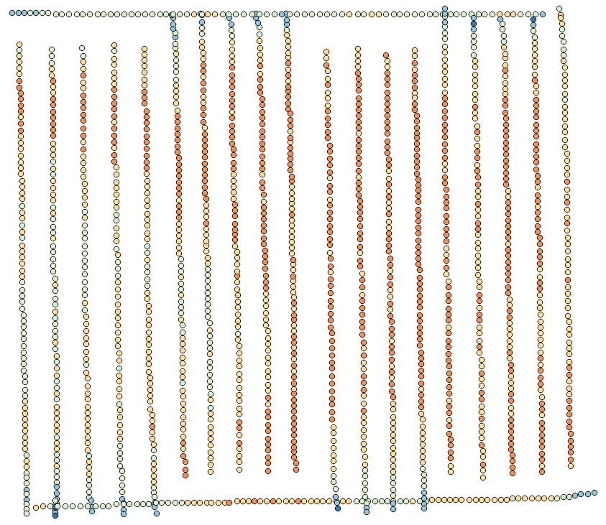
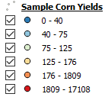
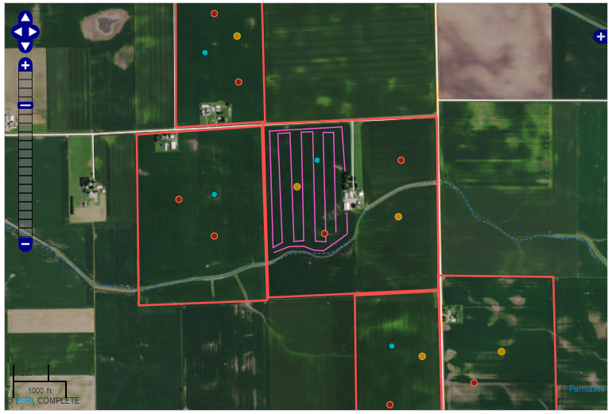
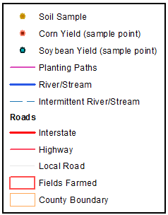

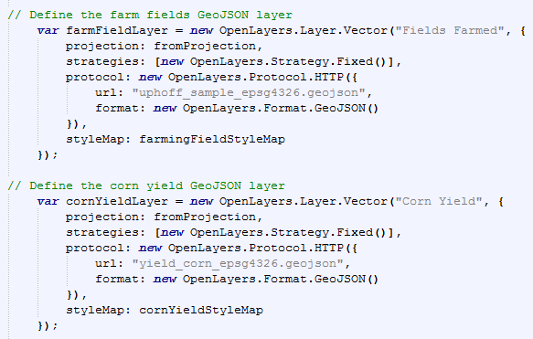



Methods: Spatial Visualization of Data (Objective 2)
Development of web map
Access data from GeoServer
Web services
  Soil survey, imagery, hydrology
Web Map Elements
Leaflet or OpenLayers3
jQuery & Bootstrap
Sources: http://openlayers.org/, http://leafletjs.com/, http://getbootstrap.com/, https://jquery.com
Outline | Precision Ag | PA Challenges | Project Objectives | Project Methods | Project Phases & Results

Slide 11
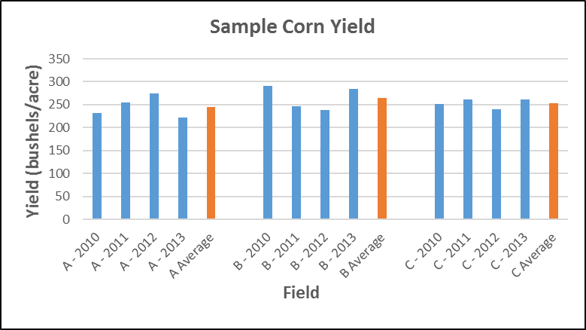



Methods: Reports & Graphical Visualizations (Objective 3)
Generate custom reports, tables, visualizations
Analyze change in yields
Relationships of farming inputs and output
Sample Yield Table Generated by User
Visualization
Plotly
D3
Bokeh
Sources: https://plotcon.plot.ly/, https://egghead.io/technologies/d3, http://bokeh.pydata.org/en/latest/
Outline | Precision Ag | PA Challenges | Project Objectives | Project Methods | Project Phases & Results

Slide 12
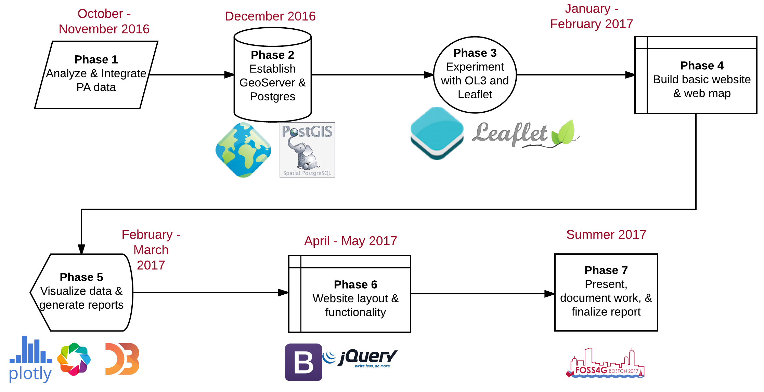
Project Phases & Timeline
Sources: https://en.wikipedia.org/wiki/PostGIS, https://github.com/geoserver, http://www.opengeospatial.org/, http://openlayers.org/, http://leafletjs.com/, http://getbootstrap.com/, https://jquery.com/, https://plotcon.plot.ly/, https://egghead.io/technologies/d3, http://bokeh.pydata.org/en/latest/
Outline | Precision Ag | PA Challenges | Project Objectives | Project Methods | Project Phases & Results

Slide 13
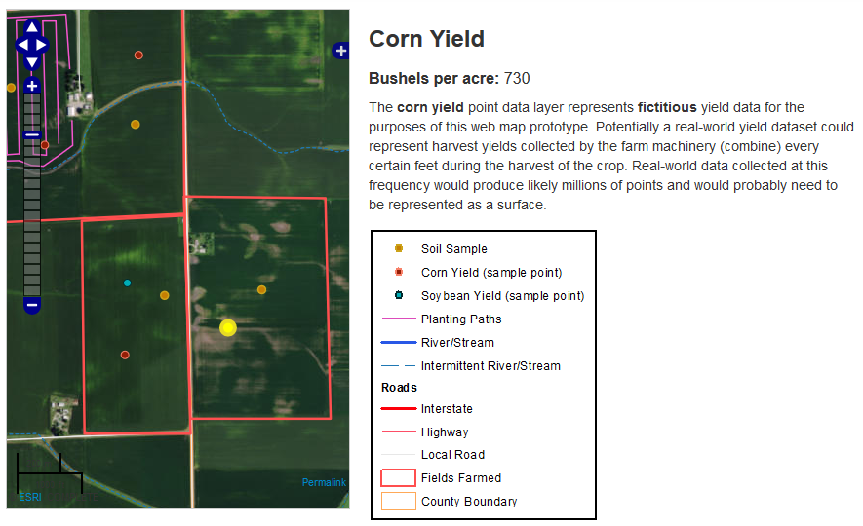
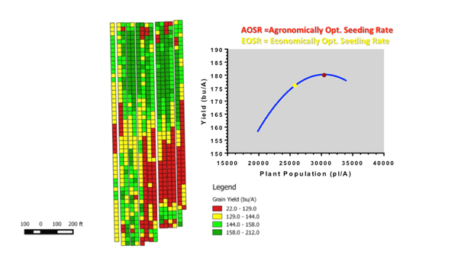
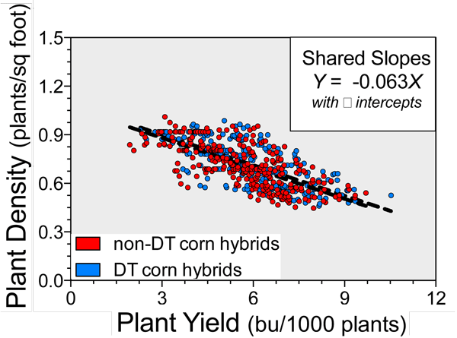
Results
Prototype application to visualize disparate data
Analyze relationships
  Soil – Seed – Yield
Source: Author
Source: https://webapp.agron.ksu.edu/agr_social/eu_article.throck?article_id=865
Outline | Precision Ag | PA Challenges | Project Objectives | Project Methods | Project Phases & Results

Slide 14

Deliverables
Open source-based web mapping and visualization application for disparate data
  No software licensing concerns
Detailed documentation of web mapping application for replication to support other industries
Potential presentation: FOSS4G: Boston Aug ‘17
Source: http://2017.foss4g.org/
Outline | Precision Ag | PA Challenges | Project Objectives | Project Methods | Project Phases & Results

Slide 15
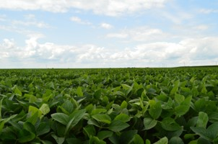
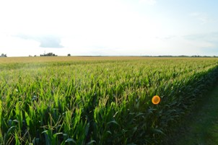
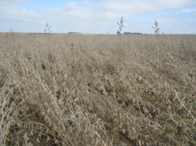
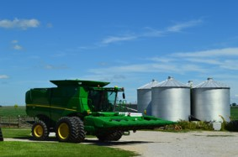
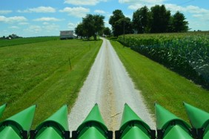
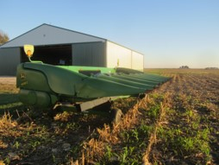
Selected References
Daberkow, S. G., & McBride, W. D. (2003). Farm and operator characteristics affecting the awareness and adoption of precision agriculture technologies in the US. Precision Agriculture, 4(2), 163–177. http://doi.org/10.1023/A:1024557205871
Erickson, B., & Widmar, D. A. (2015). Precision Agricultural Services Dealership Survey Results, 2015; sponsored by CropLife magazine and Purdue’s Center for Food and Agricultural Business. Retrieved from http://agribusiness.purdue.edu/files/file/2015-crop-life-purdue-precision-dealer-survey.pdf
Nash, E., Korduan, P., & Bill, R. (2009). Applications of Open Geospatial web services in precision agriculture: A review. Precision Agriculture, 10(6), 546–560. http://doi.org/10.1007/s11119-009-9134-0
Oliver, M. A. (2013). Precision agriculture and geostatistics. (M. A. Oliver, Ed.). London: Springer. Retrieved from http://link.springer.com/book/10.1007%2F978-90-481-9133-8
Pierpaoli, E., Carli, G., Pignatti, E., & Canavari, M. (2013). Drivers of Precision Agriculture Technologies Adoption: A Literature Review. Procedia Technology, 8(Haicta), 61–69. http://doi.org/10.1016/j.protcy.2013.11.010
Schimmelpfennig, D., & Ebel, R. (2011). On the doorstep of the information age : recent adoption of precision agriculture / David Schimmelpfennig, Robert Ebel. Usda, (80), 31. Retrieved from http://search.ebscohost.com/login.aspx?direct=true&db=agr&AN=CAT31089147&site=ehost-live&scope=cite
Usery, E. L., Bosch, D. D., Finn, M. P., Wells, T., Pocknee, S., & Kvien, C. (2009). GIS in Precision Agriculture and Watershed Management. In M. Madden (Ed.), Manual of Geographic Information Systems (pp. 1169–1198). Bethesda, MD: ASPRS.
Source: Author

Slide 16
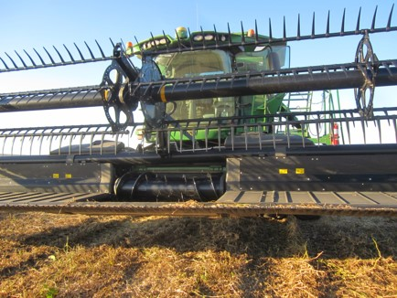
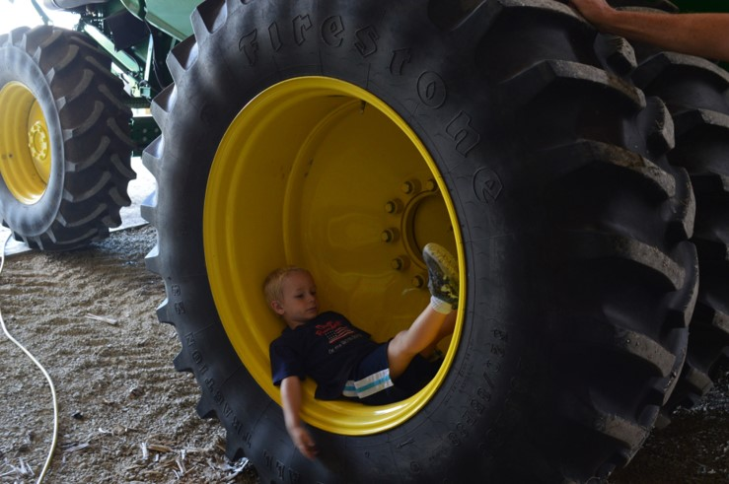
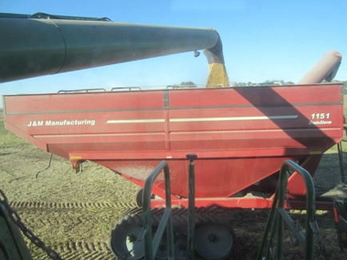
Questions
Angelo Podagrosi
angelo.podagrosi@gmail.com
Source: Author

