Slide 1
A Preliminary Geology-Based Natural Gas Resource Assessment of the Marcellus Shale for West Virginia AAPG 2013 Annual Convention & Exhibition Pittsburgh, PA
Susan Pool Ray Boswell J. Eric Lewis Jonathan P. Mathews
WVGES USDOE/NETL WVGES Penn State

Slide 2
Presentation Outline
Background
Purpose
Methodology and Data
Preliminary Results
Future Work
2

Slide 3
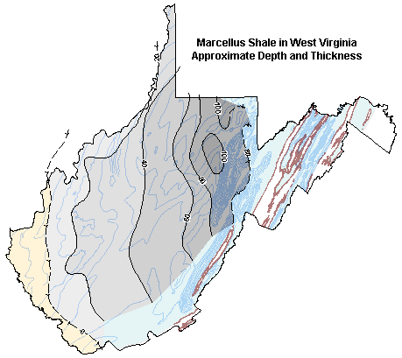
Background
Because of interest in and activity related to Marcellus Shale,
WVGES is examining basic data, much of which is new, as well as
updating and developing Marcellus-specific materials.
Example of some
current WVGES materials
which are a mix
of newer and older
data and maps.
WVGES
1980, 2012

Slide 4
Purpose
The purpose of the study is to:
Collect and investigate basic geologic data
Conduct preliminary resource assessment
Identify requirements to improve assessment
Make selected data and maps available and
provide an up-to-date web-based GIS map application
Investigate development of a framework for the State to evaluate other petroleum resources

Slide 5
Purpose
Key research questions for the project include:
How much natural gas is likely to be contained
in the Marcellus Shale underlying West Virginia?
How is the gas distributed?
How do the key parameters that affect
gas recoverability vary geographically?

Slide 6
Methodology and Data
Approaches to estimating natural gas resource volumes for continuous unconventional reservoirs include:
those that use production data
to estimate technically-recoverable resources directly
and
those that use geologic data
to estimate total original gas-in-place.

Slide 7
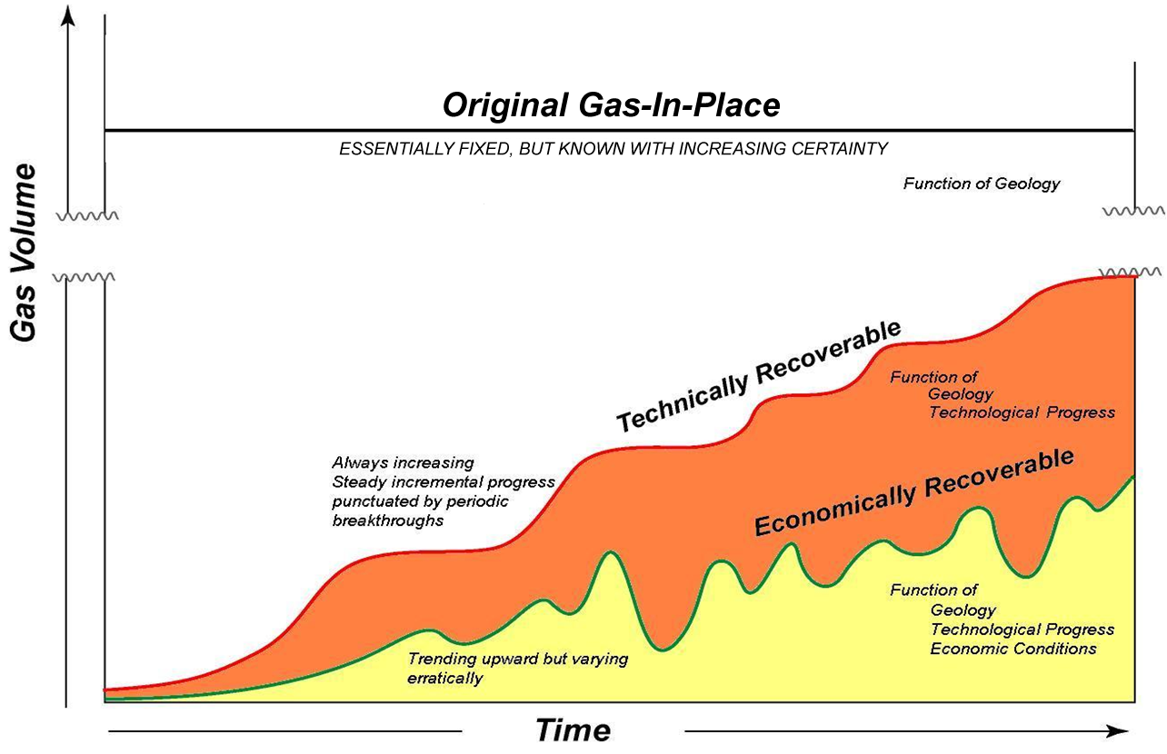
Methodology and Data
Both methods have advantages and disadvantages, but
ultimately the two approaches can be combined to obtain a fuller understanding of the resource and its potential.
By using both approaches, we may be able to estimate and capture
the evolution or recovery factors.

Slide 8
Methodology and Data
The study will be divided into 2 phases to
accomodate both approaches.
Phase 1 will use the geology-based approach to
estimate total original gas-in-place.
total original gas-in-place =
free gas-in-place + adsorbed gas-in-place
Free Gas-In-Place
GIP_{free} = (φ_{eff} * (1 – S_{w}) * H_{fm} * A_{gc}) / FVF
Adsorbed Gas-in-Place
GIP_{adsorb} = G_{c} * ρ_{fm} * H_{fm} * A_{gc}

Slide 9
Methodology and Data
Where will all of the data be obtained?
H_{fm ,} ρ_{fm ,} φ, and S_{w}
are derived from well logs
with
φ and S_{w} adjusted for V_{sh} and V_{ker}
TOC
is taken from published core-based studies
G_{c}
is determined from TOC and pressure
FVF
is derived from temperature, pressure, and gas compressibility

Slide 10
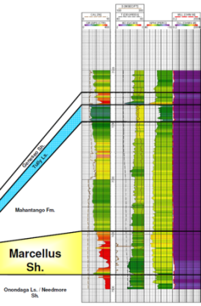
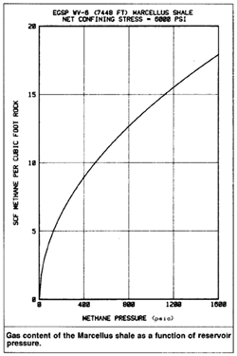
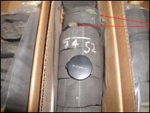
Methodology and Data
The study is being conducted using public data from:
Well logs (WVGES, IHS)
Depth / Thickness / Extent
Porosity
Resistivity
Temperature
Literature (WVGES, USGS, U.S. DOE/EGSP, WVU)
Vitrinite reflectance data
Core data
Volume of shale
Volume of kerogen
Total organic carbon
Operator reports (WVGES)
Pressure
Production volumes
Source: IGT, 1986

Slide 11
Methodology and Data
However, the study could be improved with
additional data from core related to:
Porosity
Volume of shale -
Volume of kerogen -
Total organic carbon
Gas content and
Total organic carbon-gas content functions

Slide 12
Methodology and Data:
Phase 1 Assessment Steps
Select wells
Correlate well logs
Extract data from well logs
Derive additional required data
Characterize reservoir
Estimate volumes
Correct and refine data as necessary
Marcellus Shale
Resource Assessment
Study Wells

Slide 13
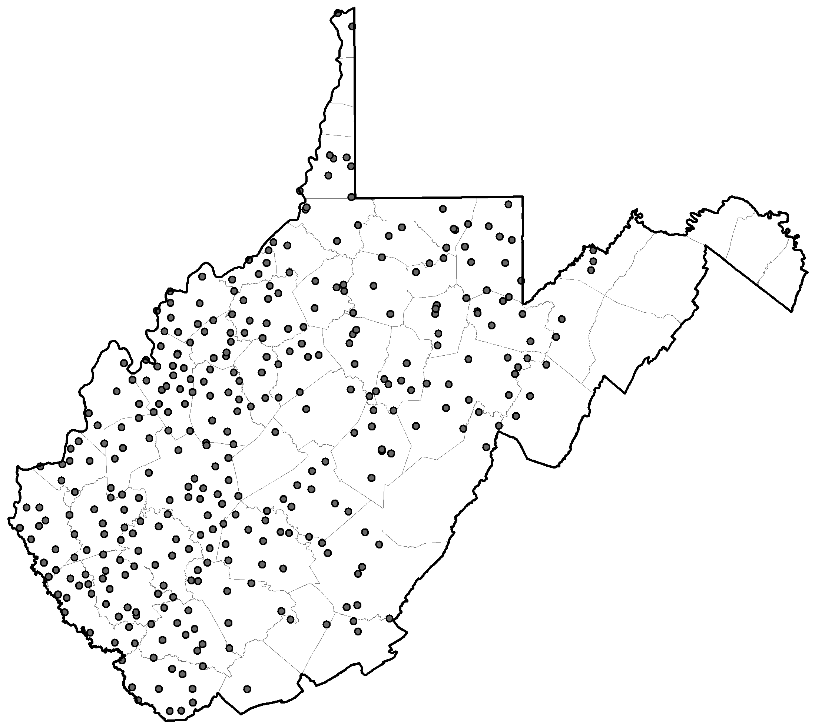
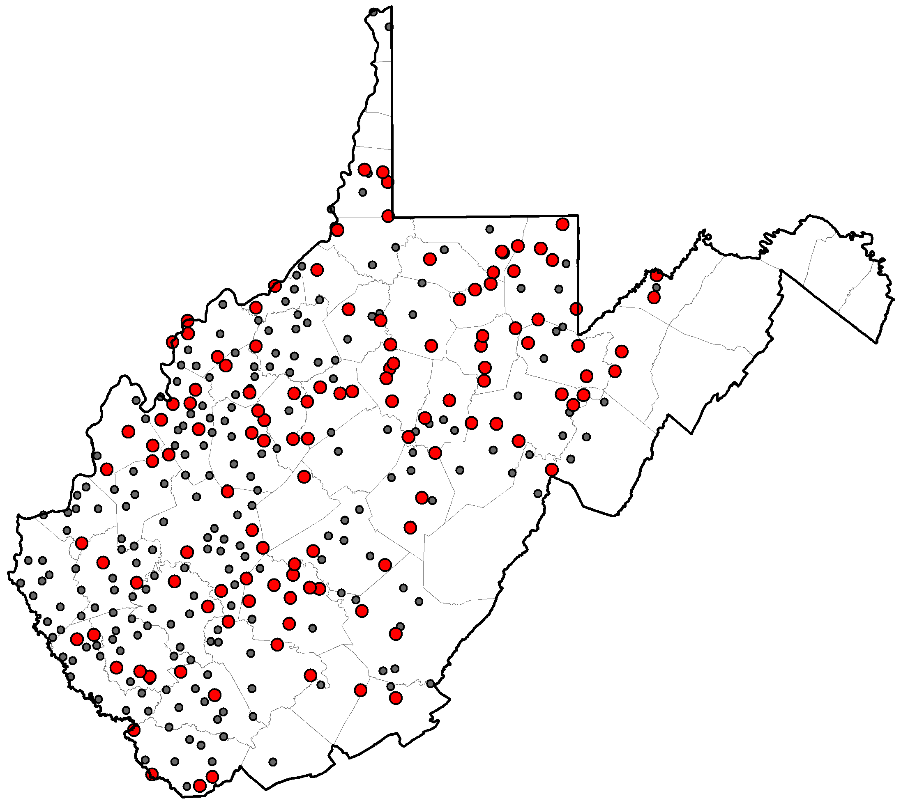
Methodology and Data:
Step 1—Select Wells
Based on
Vertical wells
Geographic distribution
Log availability
GR, POR, RES
Newest vintage
Digital data
Marcellus Shale
Reservoir Characterization
Study Wells in Gray
Marcellus Shale
Volumetric Estimation
Study Wells in Red

Slide 14
Methodology and Data:
Step 2—Correlate Well Logs
Harrell Shale (Burket Member)/
Genesee Formation (Geneseo Member)
Tully Limestone
Mahantango Formation
“Upper Marcellus-A”
“Upper Marcellus-B”
Purcell Limestone Member
“Lower Marcellus”
“transition zone”
X-section image – in development

Slide 15
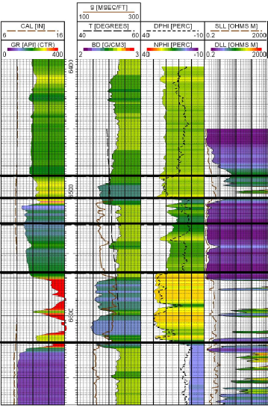
Methodology and Data:
Step 3—Extract Data from Well Logs
Depth
Thickness
Porosity
Resistivity
Temperature
Marcellus

Slide 16
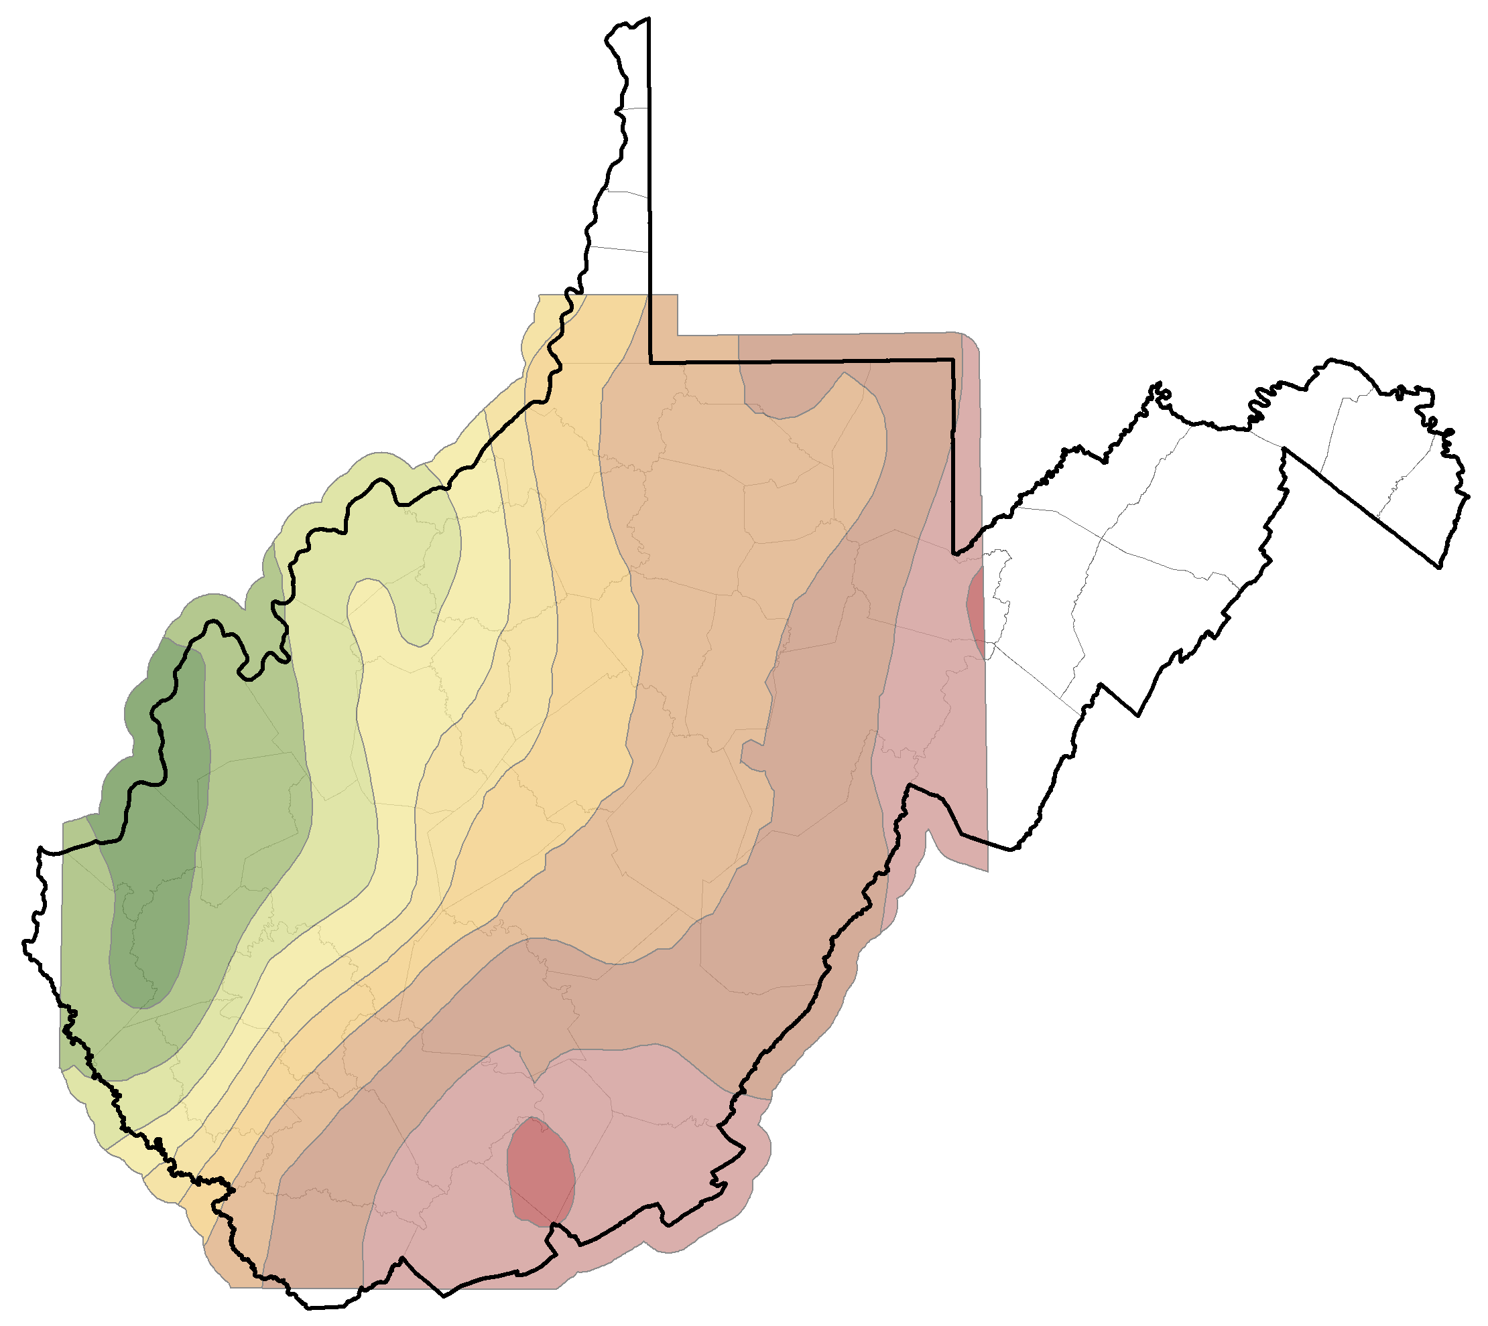
Methodology and Data:
Step 4—Derive Additional Required Data
“Upper Marcellus”
Total Organic Carbon
(in Percent)
extrapolated from data in
Wang 2012
Derive:
LOM
TOC
Marcellus Shale
Level of Organic Maturity
derived from USGS/WVGES
vitrinite reflectance data
Derived from
data in USGS/WVGES
(2005)
Extrapolated from
data in Wang
(2012)
Calibrated to
limited public
core data
EGSP WV#6
EGSP WV#7
Others
“Lower Marcellus”
Total Organic Carbon
(in Percent)
extrapolated from data in
Wang 2012

Slide 17
Methodology and Data:
Step 4—Derive Additional Required Data
“Upper Marcellus”
Volume of Shale
(in Percent)
extrapolated from data in
Wang 2012
And, derive: V_{sh}
Extrapolated from data in Wang(2012)
Calibrated to limited public core data
EGSP WV#6, EGSP WV#7, Others
“Lower Marcellus”
Volume of Shale
(in Percent)
extrapolated from data in
Wang 2012

Slide 18
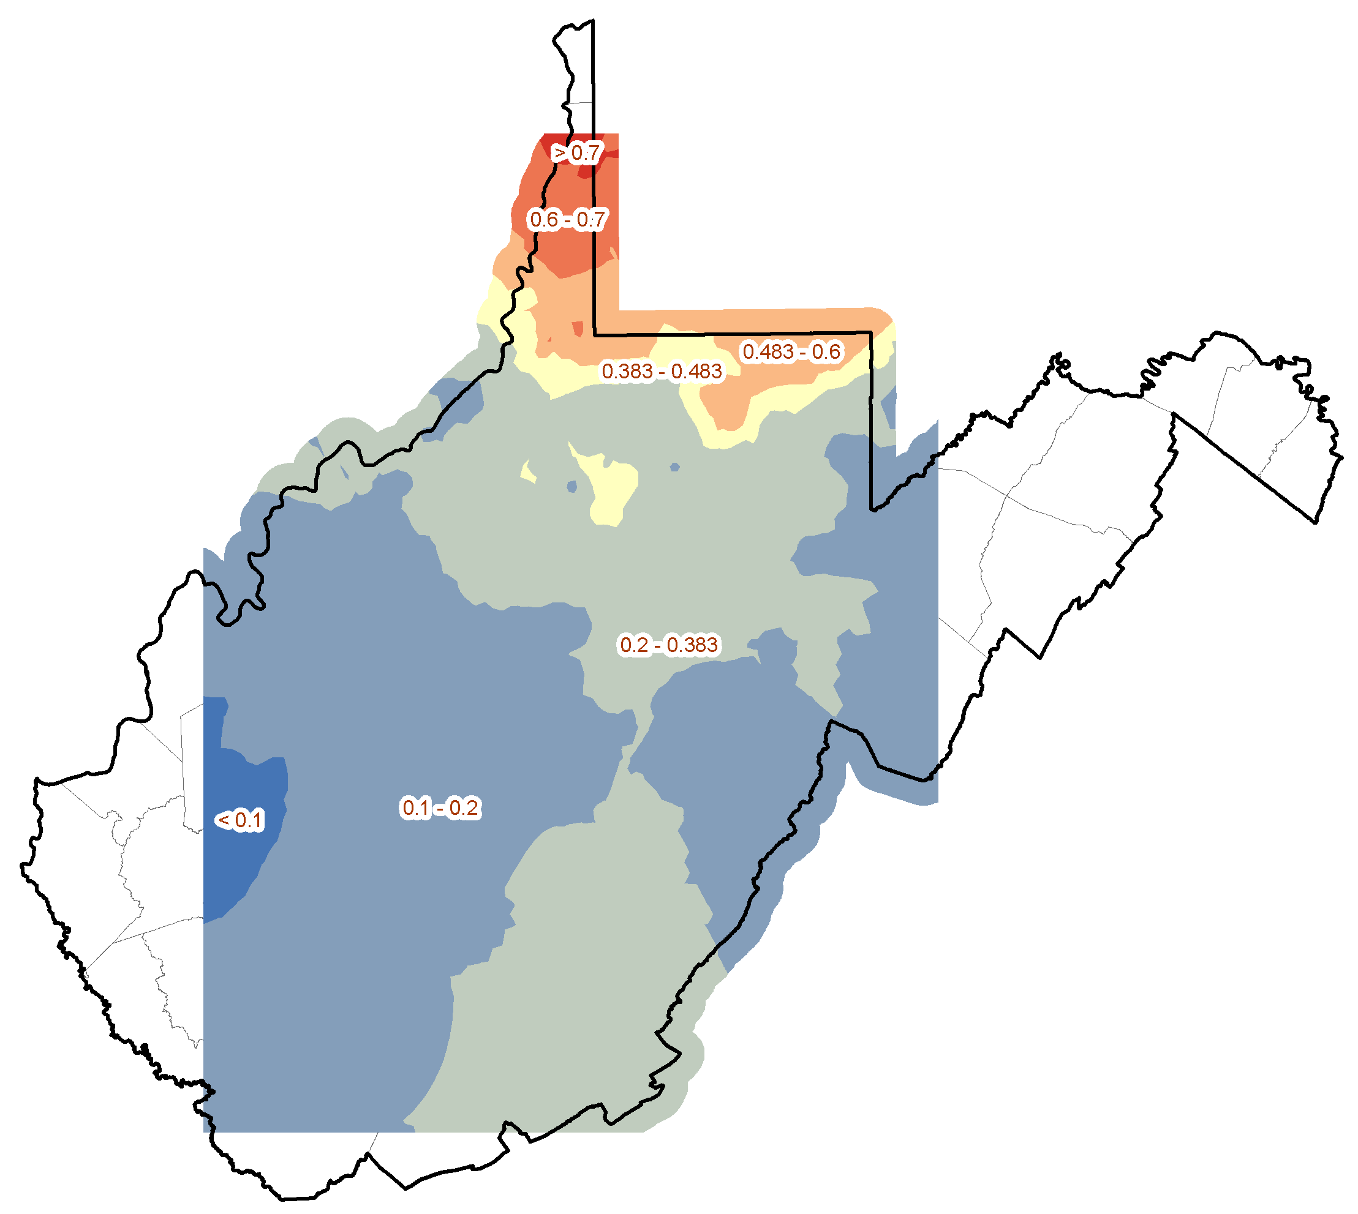
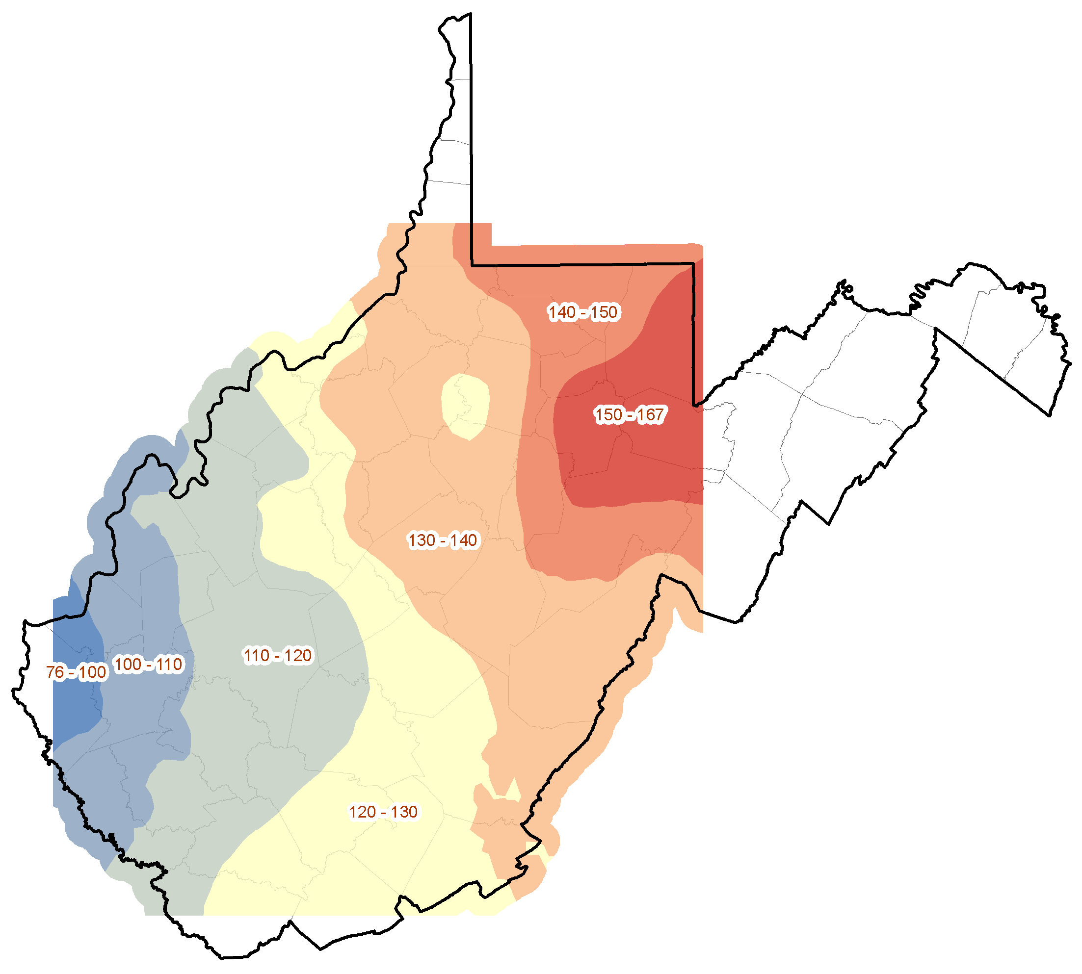
Preliminary Results:
Step 5—Characterize Reservoir
Marcellus Shale
Pressure Gradient
(in psi/ft)
from operator–reported data
Develop:
pressure and
temperature maps
Marcellus Shale
Temperature
(in degrees F)
derived from well log data

Slide 19
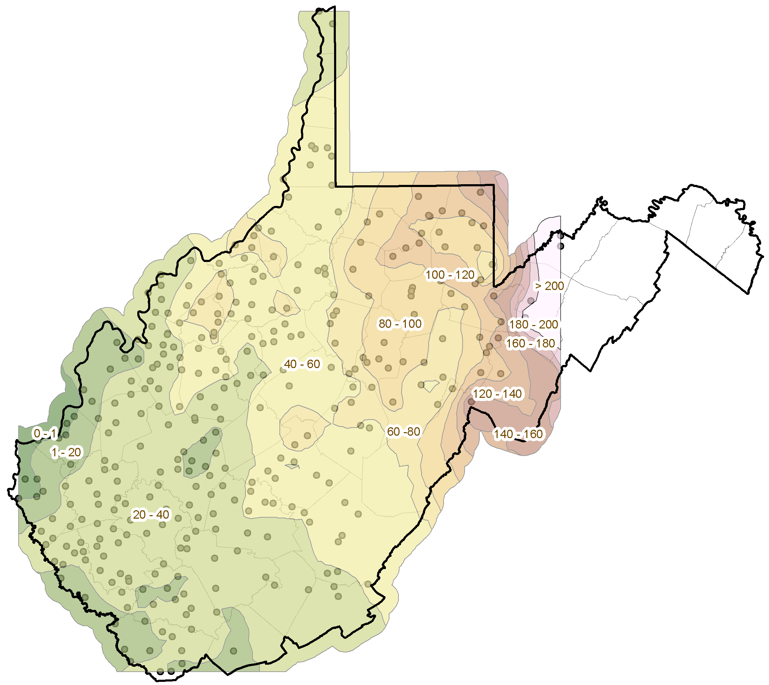
Preliminary Results:
Step 5—Characterize Reservoir
Marcellus Shale
“Upper-A”; “Upper-B” and “Lower”
Thickness (in feet)
derived from well log data
Develop:
additional basic maps such as thickness

Slide 20
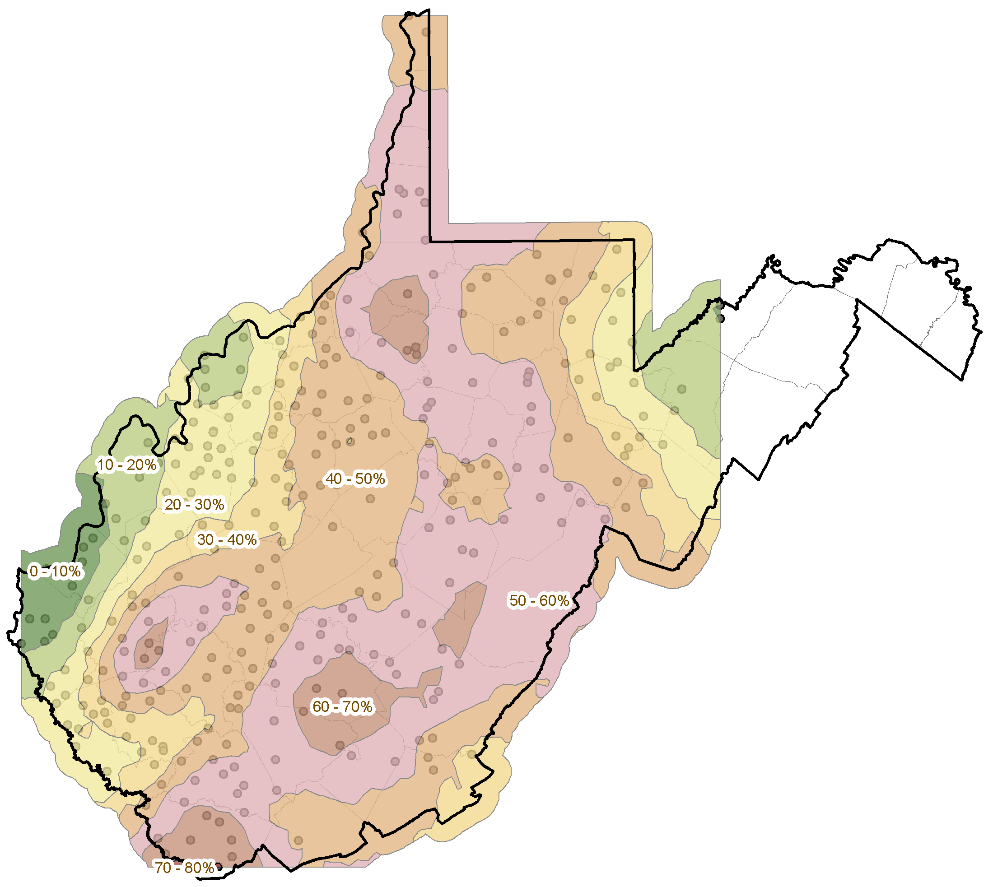
Preliminary Results:
Step 5—Characterize Reservoir
Marcellus Shale
“Upper-A”; “Upper-B” and “Lower”
Percentage of the Interval
100 API Over Gamma Ray Baseline
derived from well log data
Develop:
specializedmaps
such as high organic content

Slide 21
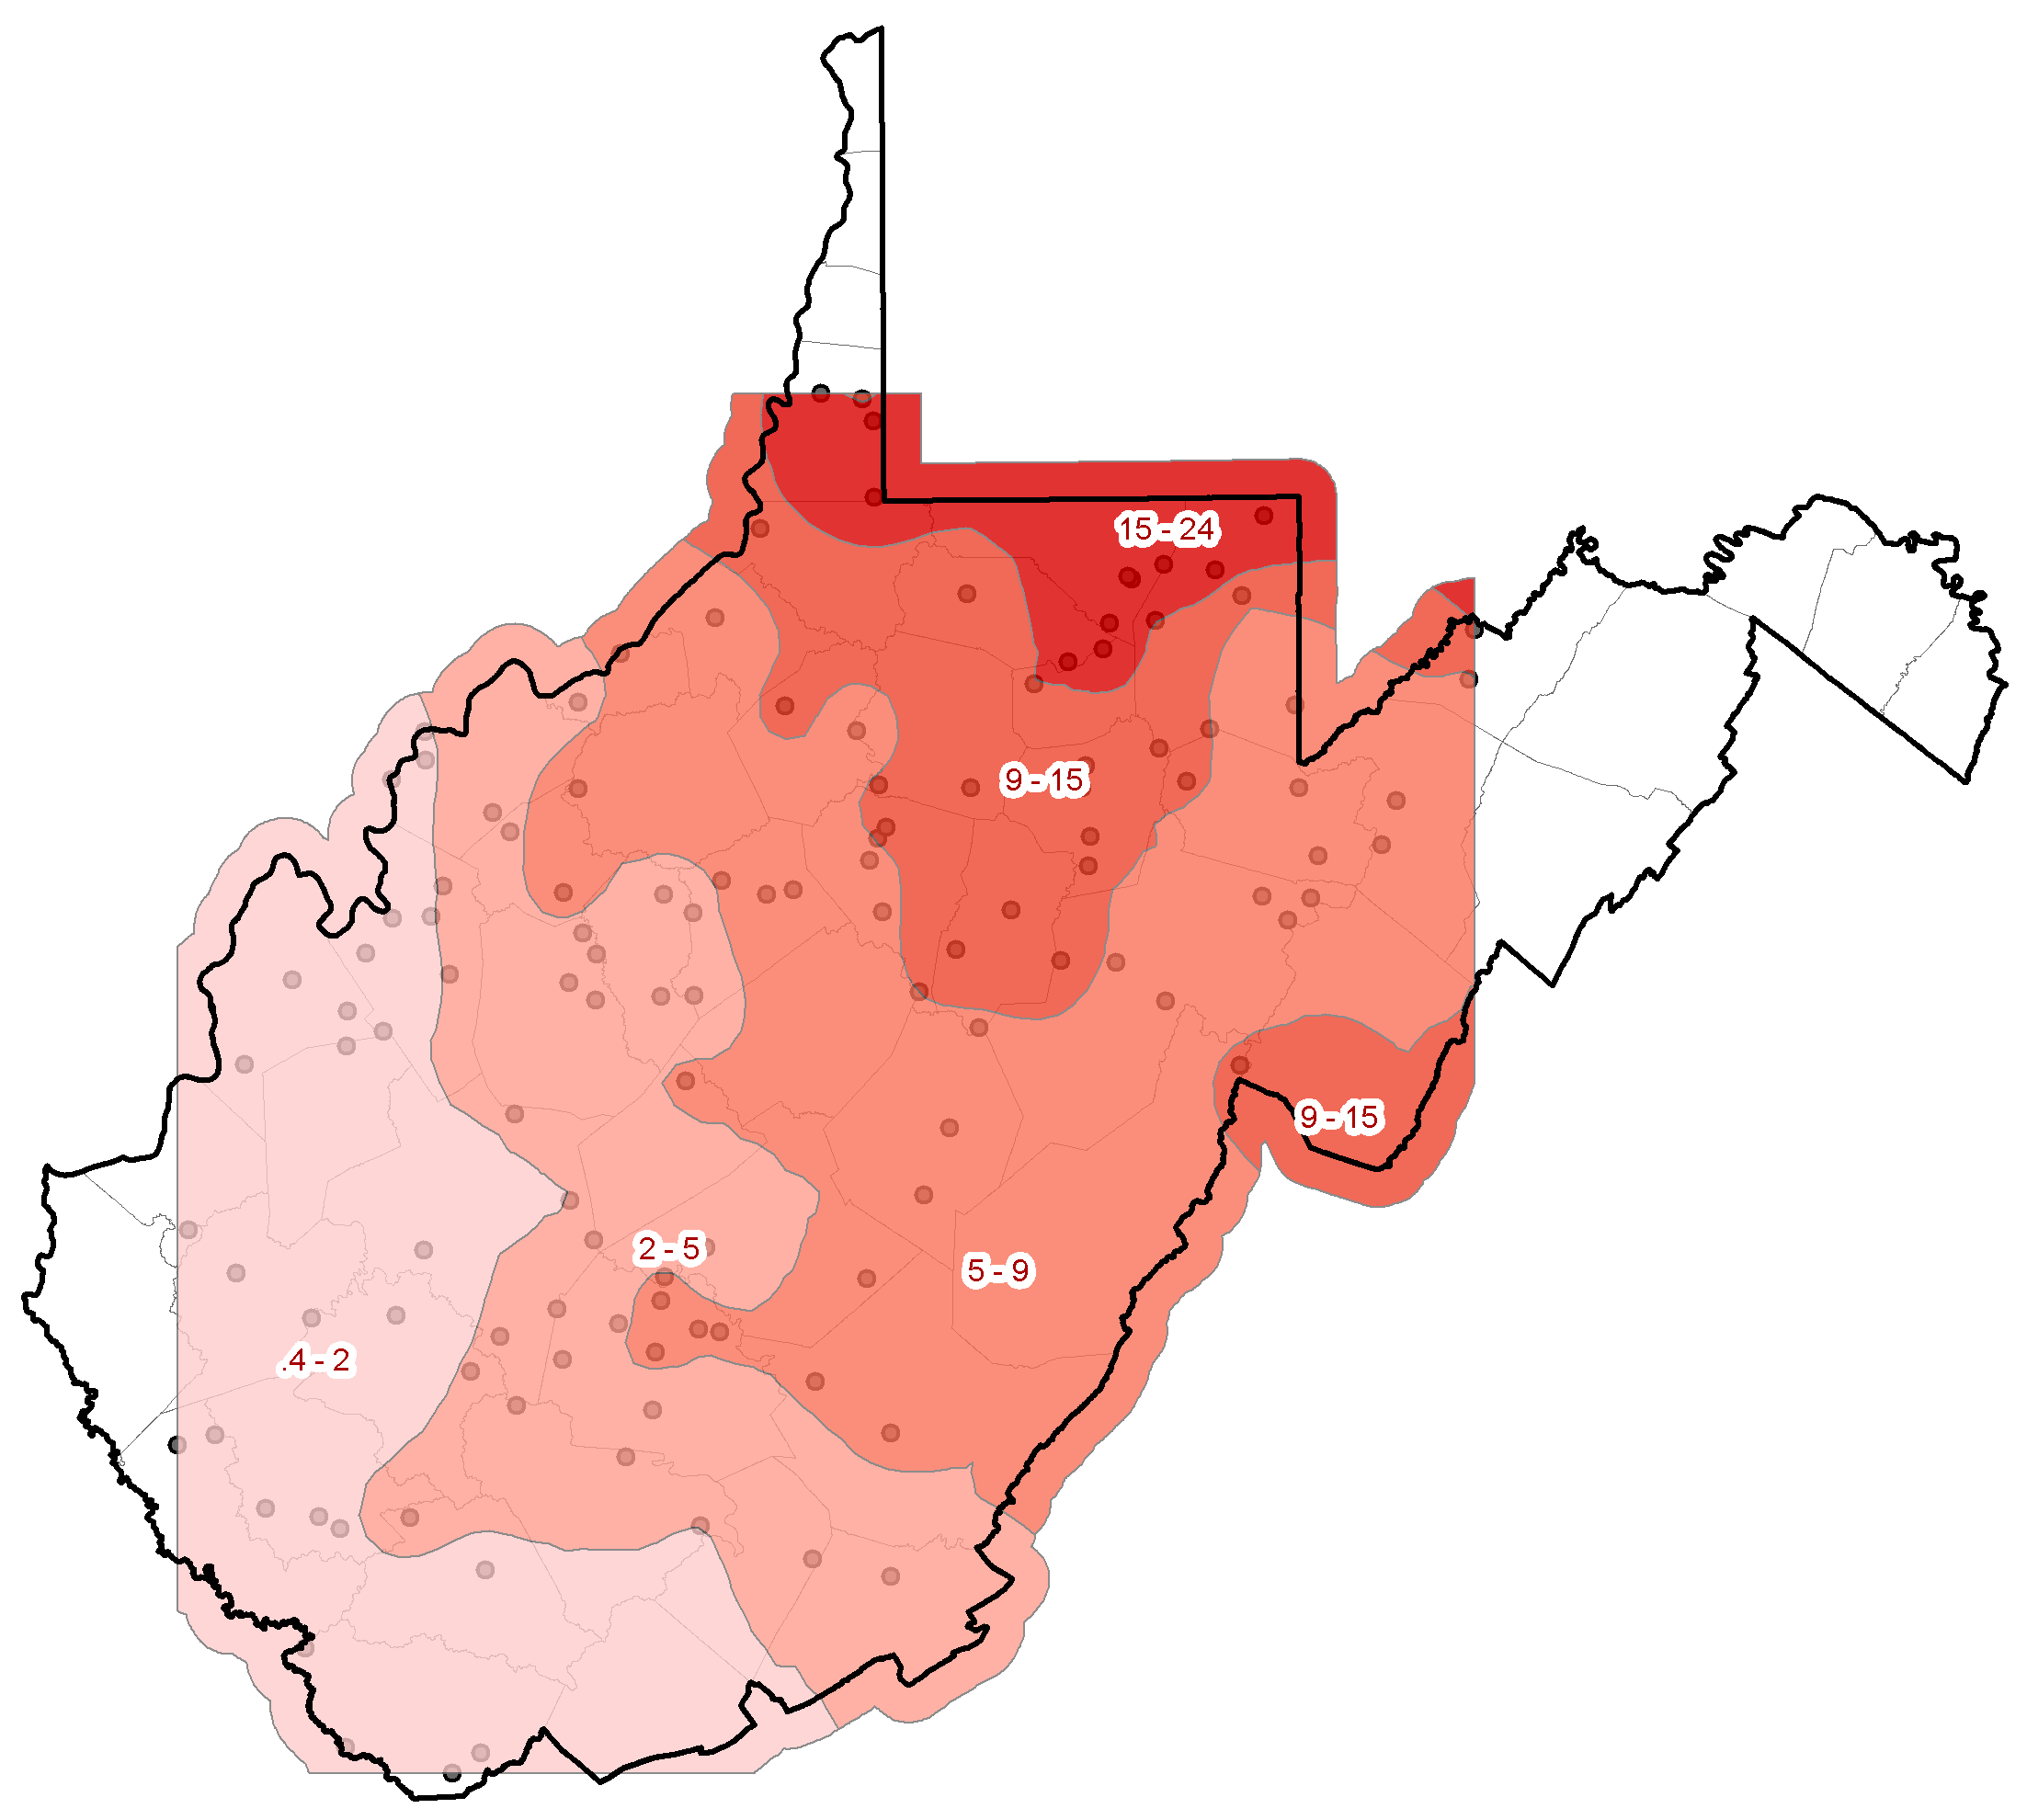
Preliminary Results:
Step 6—Estimate Volumes
Develop:
basic
map
related to volumes
Marcellus Shale
Resource Assessment
Original Gas-in-Place Estimate
(in Bcf/mi²)
Source: WVGES
Date: May 17, 2013

Slide 22
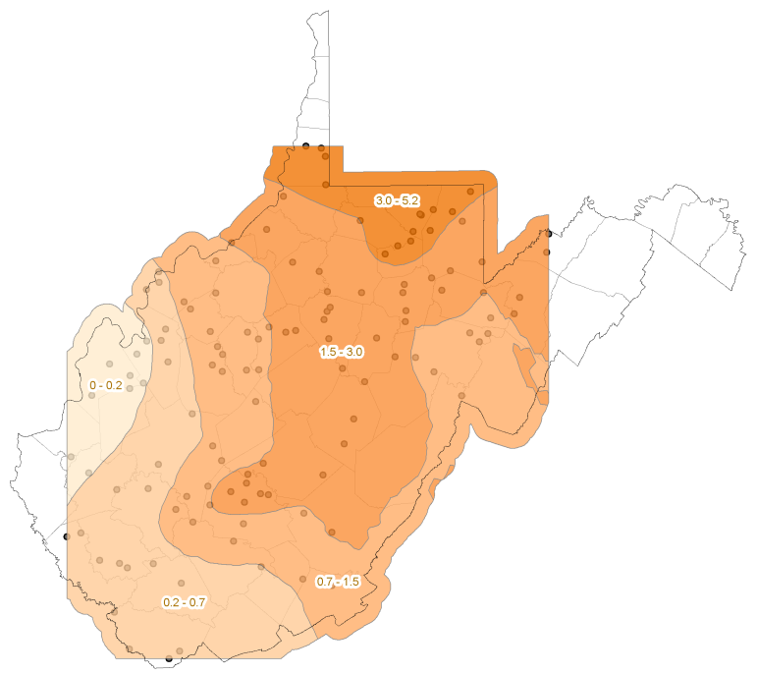
Preliminary Results:
Step 6—Estimate Volumes
“Upper Marcellus- A”
Marcellus Shale
Resource Assessment
Original Gas-in-Place Estimate
(in Bcf/mi²)
Develop:
specialized maps
related to volumes
Source: WVGES
Date: May 17, 2013

Slide 23
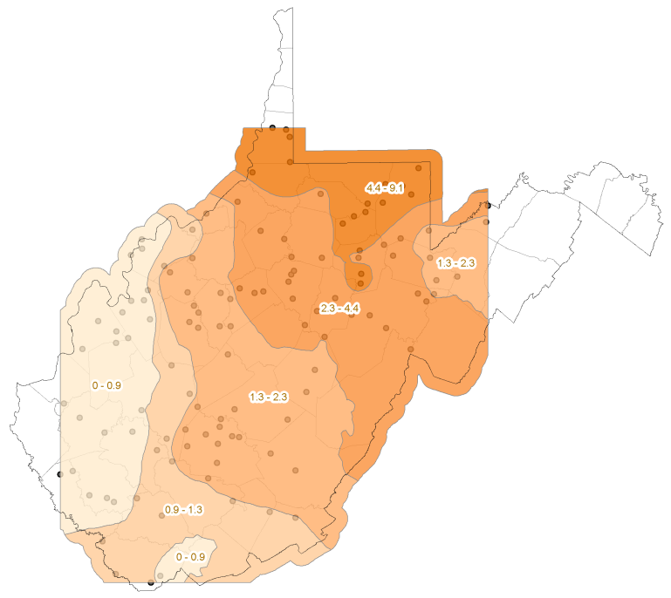
Preliminary Results:
Step 6—Estimate Volumes
“Upper Marcellus- A”
Marcellus Shale
Resource Assessment
Original Gas-in-Place Estimate
(in Bcf/mi²)
“Upper Marcellus-B”
Source: WVGES
Date: May 17, 2013

Slide 24
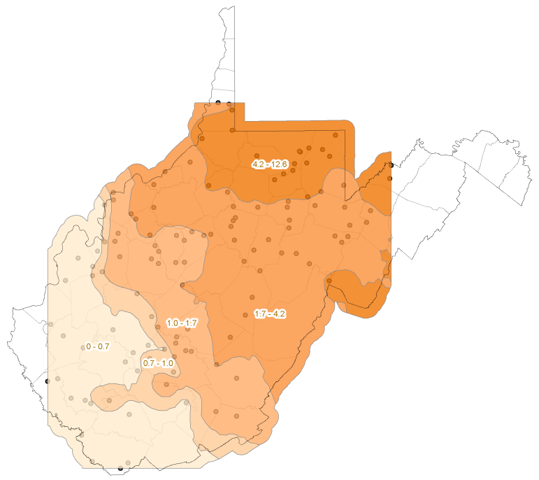
Preliminary Results:
Step 6—Estimate Volumes
“Upper Marcellus- A”
Marcellus Shale
Resource Assessment
Original Gas-in-Place Estimate
(in Bcf/mi²)
“Upper Marcellus-B”
“Lower Marcellus”
Source: WVGES
Date: May 17, 2013

Slide 25
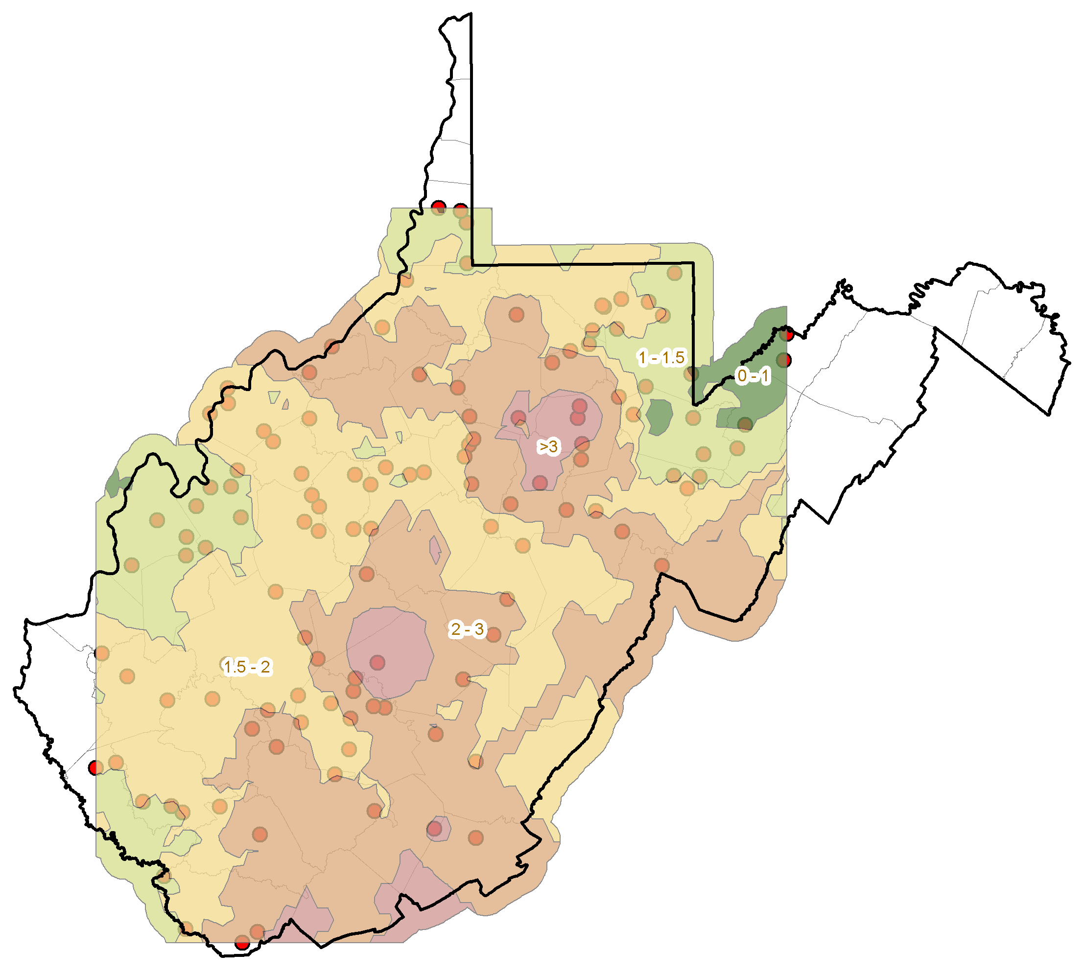
Preliminary Results:
Step 6—Estimate Volumes
Develop:
additional
specializedmaps
Marcellus Shale
“Upper-A”; “Upper-B” and “Lower”
Ratio of Adsorbed to Free Gas
derived from well log data

Slide 26
Preliminary Results:
Step 6—Estimate Volumes
And the preliminary number is:
Source: WVGES
Date: May 17, 2013

Slide 27
Preliminary Results:
Step 6—Estimate Volumes
And the preliminary number is:
122 Tcf
gas-in-place
Source: WVGES
Date: May 17, 2013

Slide 28
Future Work:
Finalize Assessment
Incorporate additional well data
Recalibrate all well data to core
Investigate further:
porosity
V_{sh}-V_{ker}
G_{c} and TOC-G_{c} functions
Refine volume estimates
Investigate production and recovery factor(s)—Phase 2 of Study

Slide 29
Future Work:
Release Results and Products
For the Marcellus Shale in West Virginia:
estimate of total original natural gas-in-place volume (refined)
estimate of current recoverable natural gas volume
cross-sections and maps including maps for:
wells, location / extent, thickness, depth, pressure, and volumes
up-to-date, publicly-accessible web-based map application

Slide 30
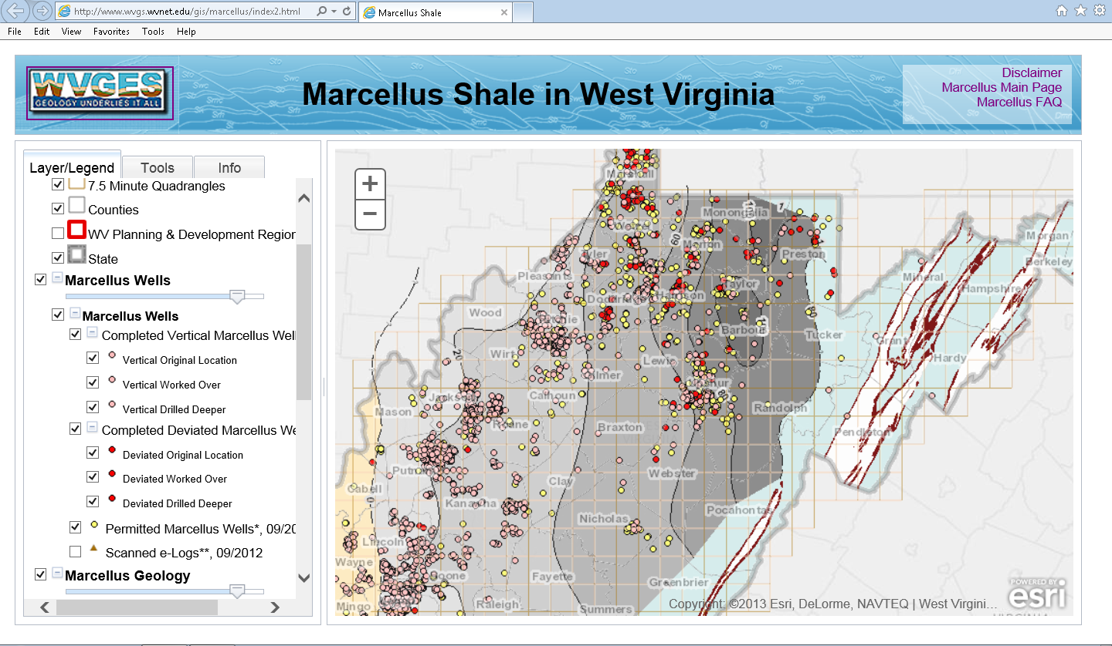
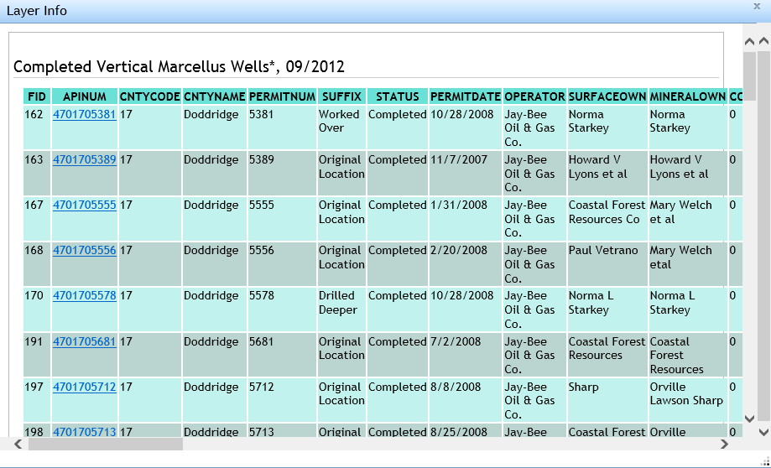
Future Work:
Release Results and Products
Data will be updated and new maps and features will be added to the
Marcellus Shale web-based map application.

Slide 31
Acknowledgements
IHS
Mike Hohn, Mary Behling, Jessica Moore, Susan Kite, Sam McCreery,
John Bocan, John Saucer, Phil Dinterman, Ron McDowell, and Tom Repine
West Virginia Geological and Economic Survey
Doug Miller, Beth King, and Kelly Moran
Penn State

Slide 32
Questions,
Comments, or Suggestions?

