Slide 1
Conducting a Preliminary Natural Gas Resource Assessment of the Marcellus Shale for West Virginia using Basic Geologic Data and GIS
Susan Pool
Penn State University MGIS Candidate
Dr. Jonathan Mathews
Penn State University Faculty Advisor
January 2011

Slide 2
Presentation Overview
Background
Purpose
Research Questions
Other Studies
Methodology and Data
Results and Products
Concerns and Potential Obstacles
Future Work

Slide 3
Background
What is a natural gas resource assessment?
What is the Marcellus shale?
How will basic geologic data and GIS be used
to conduct the study?

Slide 4
Background—Resource Assessment
What is a natural gas resource assessment?
A determination of how much natural gas is present
along with
a determination of how much natural gas can be extracted
under various conditions or scenarios.

Slide 5
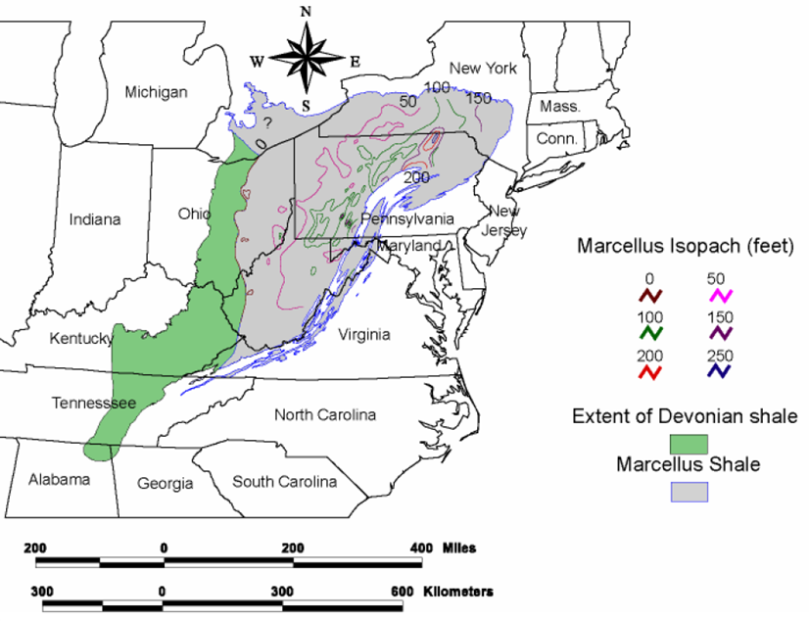
Background—Marcellus Shale
What is the Marcellus shale?
Shale is a fine-grained sedimentary rock; the Marcellus shale is a geologic formation that underlies portions of seven northeastern states. The Marcellus shale currently is of great interest because it is thought to contain a large volume of natural gas.
Gas drilling in the Marcellus shale has accelerated recently largely because of technological advances and
economic conditions.
Milici, R.C. 2005. Assessment of Undiscovered Natural Gas Resources in Devonian Black Shales, Appalachian Basin, Eastern U.S.A. Reston, Virginia: U.S. Geological Survey. On-line. Available from http://pubs.usgs.gov/of/2005/1268/2005-1268.pdf, accessed 8 December 2010.

Slide 6
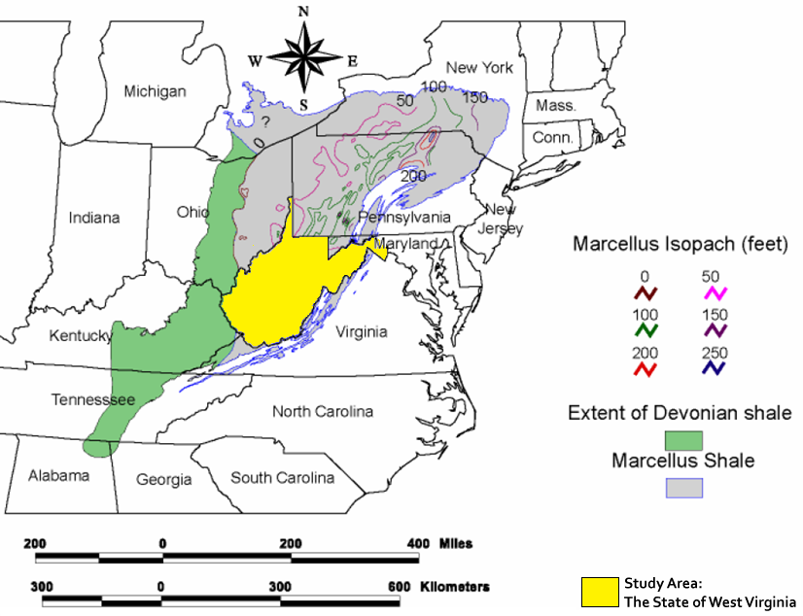
Background—Marcellus Shale
This project will focus on the Marcellus shale in West Virginia.
Milici, R.C. 2005. Assessment of Undiscovered Natural Gas Resources in Devonian Black Shales, Appalachian Basin, Eastern U.S.A. Reston, Virginia: U.S. Geological Survey. On-line. Available from http://pubs.usgs.gov/of/2005/1268/2005-1268.pdf, accessed 8 December 2010.

Slide 7
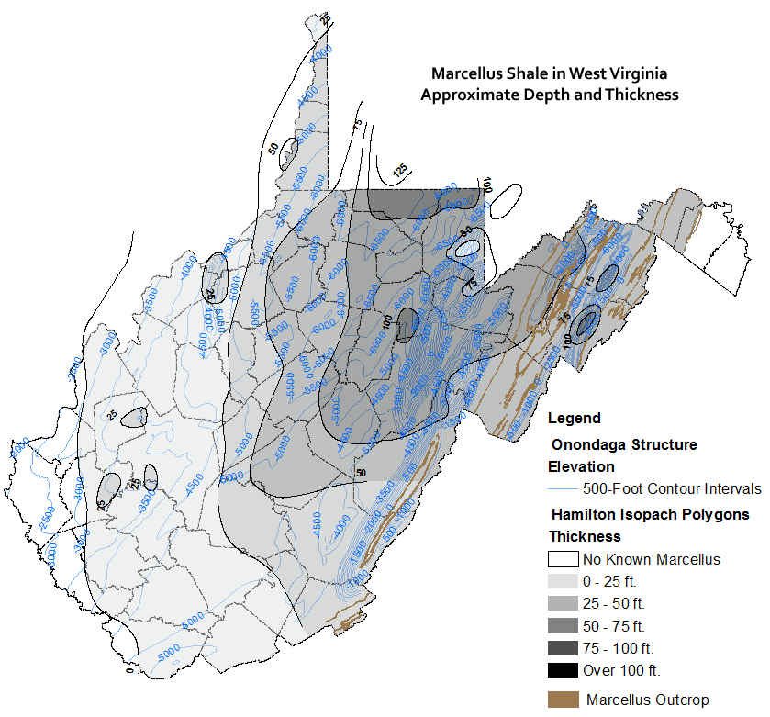
Background—Marcellus Shale
Presently in West Virginia,
Marcellus shale well depths range from about 2,000 to 9,500+ feet.
The shale can be up to approximately 100 feet thick.
Basic data will be gathered for the Marcellus shale.
For statewide maps, currently:
the depth to the base of the shale is estimated based on the depth to the top of the Onondaga Limestone (an underlying unit)
and
the thickness is for that of a selected shale within the Hamilton Group (of which the Marcellus is a part).
Both maps were created in the early 1980’s.
West Virginia Geological & Economic Survey. 2010. Selected References about Devonian Shales. Morgantown, WV: West Virginia Geological & Economic Survey. On-line. Available from http://www.wvgs.wvnet.edu/www/datastat/devshales.htm, accessed 10 December 2010.

Slide 8
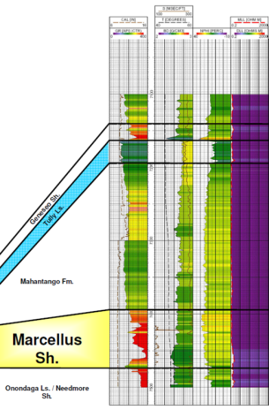
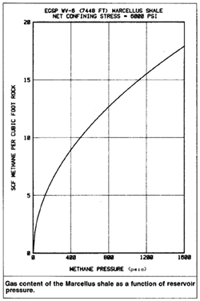
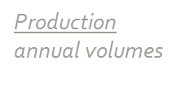
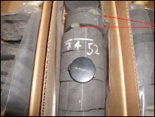
Background—Geologic Data and GIS
How will basic geologic data and GIS be used?
Basic Geologic Data
Data will be used to define characteristics of the Marcellus shale and to calculate gas volumes. Data will be obtained primarily from well logs, core, and production records.
GIS
Capture, store, and retrieve data including well log, core, and production data as well as all supplemental data required for calculations.
Manipulate and analyze data by generating maps/grids and calculating gas volumes as well as examining any possible geographic patterns.
Present data through maps/data layers as well as web-based interactive mapping.
Well logs
gamma ray
porosity
resistivity
temperature

Slide 9
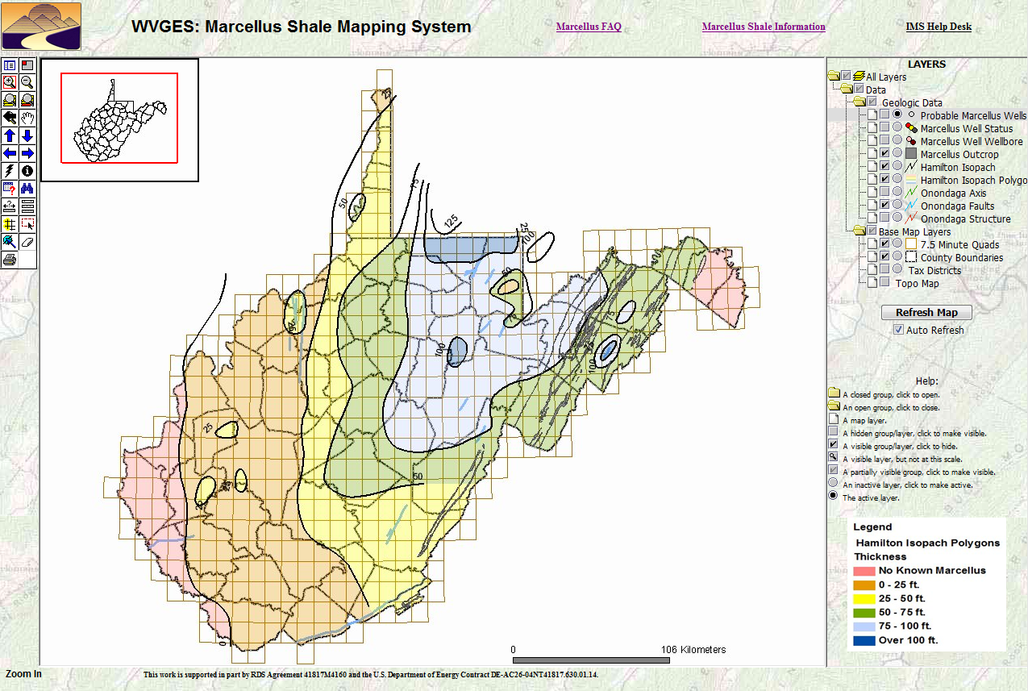
Purpose
The purpose of the project is to
collect basic geologic data, conduct a natural gas resource assessment, and
make data available through the web and a web-based GIS-driven interface.
Ultimately, the project is intended to benefit the citizens of West Virginia
by aiding in resource management.
A preliminary version of an interactive mapping system has been developed already and is publicly accessible
West Virginia Geological & Economic Survey. 2010. WVGES: Marcellus Shale Mapping System. Morgantown, WV: West Virginia Geological & Economic Survey. On-line. Available from http://ims.wvgs.wvnet.edu/mar/viewer.htm, accessed 3 December 2010.

Slide 10
Research Questions
Key research questions for the project include:
How much natural gas is likely to be contained
in the Marcellus shale underlying West Virginia?
How is the gas distributed?
How do the key parameters that affect
gas recoverability vary geographically?

Slide 11
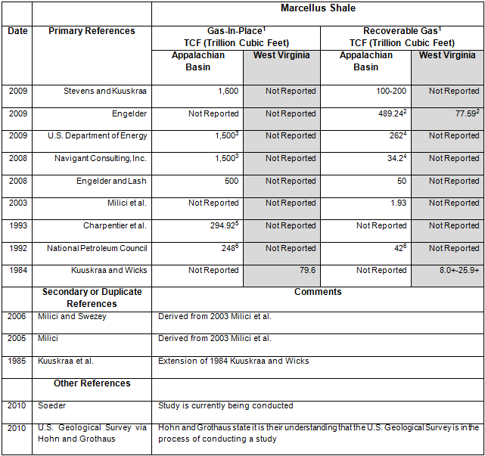
Other Studies
Studies that include Marcellus shale gas-in-place and/or recoverable gas estimates:
Very little has been published specific to West Virginia
and
estimates can vary greatly between studies

Slide 12
Methodology and Data
Various approaches can be taken in estimating natural gas recoverable resource volumes. In general, approaches can be divided into two categories for continuous unconventional* reservoirs:
those that use production data
to estimate recoverable resources directly
and
those that use geologic data
to estimate total original gas-in-place to which a recovery factor is applied to calculate recoverable resources.
*continuous = does not occur in discrete fields; unconventional = will not yield gas without extra measures such as hydraulic fracturing, depressurization, etc.

Slide 13
Methodology and Data
Production Approach
Estimate ultimate per-well recovery from production data
Determine ultimate well spacing to obtain number of wells
Calculate technically recoverable resources (TRR) where
TRR = per-well recovery * number of wells
Geologic Approach
Estimate volume of gas per unit area using basic data such as reservoir area, reservoir thickness, porosity, and water saturation
Determine recovery factor(s)
Calculate technically recoverable resources (TRR) where
TRR = original gas-in-place * recovery factor(s)

Slide 14
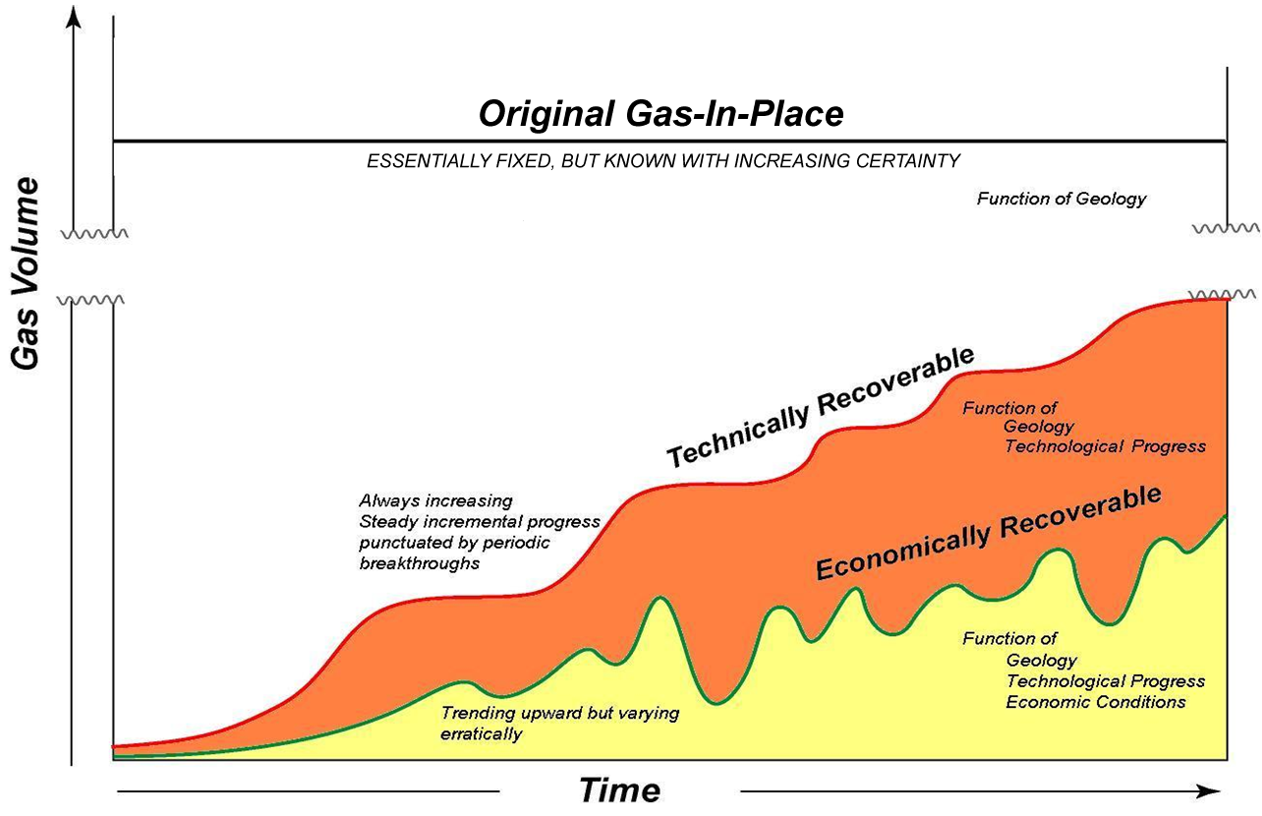
Methodology and Data
For continuous unconventional reservoirs, the production approach tends to
underestimate resources based on early well results because
productivity will generally increase dramatically with time as technology improves.
With the
geologic approach,
however,
original
gas-in-place
is estimated.
Boswell, R.M. 2003. Assessing the Technology Needs of Unconventional Gas Resources. Society of Petroleum Engineers National Capital Section Unconventional Gas Resources Assessment Symposium, May 20.

Slide 15
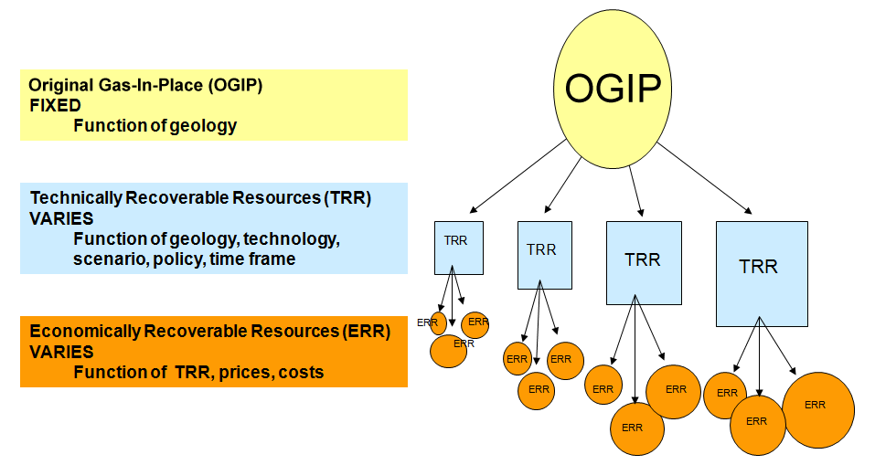
Methodology and Data
So then with the geologic approach, multiple factors can be applied to estimate both technically and economically recoverable resources.
Boswell, R.M. 2005. Natural Gas Resource Assessments at the National Energy Technology Laboratory. American Association of Petroleum Geologists Hedberg Conference, April 28.

Slide 16
Methodology and Data
Geologic Approach Chosen Because
The production approach is not ideal for the Marcellus shale because current well performance may not be representative of future productivity, particularly given the early development of the Marcellus shale gas play.
The geologic approach is a bit better because geologic parameters are essentially unchanging with time--early wells provide accurate indications of original gas-in-place and multiple determinations can be made of technically recoverable resources using both current and potential future recovery factors.

Slide 17
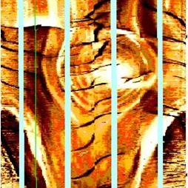
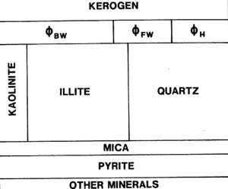
Methodology and Data
With the geologic approach one of the primary tasks is to estimate total original gas-in-place.
The total original gas-in-place equation for a shale is:
total original gas-in-place =
area * thickness * (free gas-in-place + adsorbed gas-in-place)
For Educational Purposes Only
For Educational Purposes Only
Formation MicroImager image of fractures in a gas shale
Free gas is that
in fractures and pores
Basic components of a gas shale
Adsorbed gas is that
sorbed to kerogen
Crain, E.R. 2010. Special Cases—Gas Shales. In Crain’s Petrophysical Handbook. On-line. Available from http://spec2000.net/17-specshgas.htm#b6, accessed 15 November 2010.

Slide 18
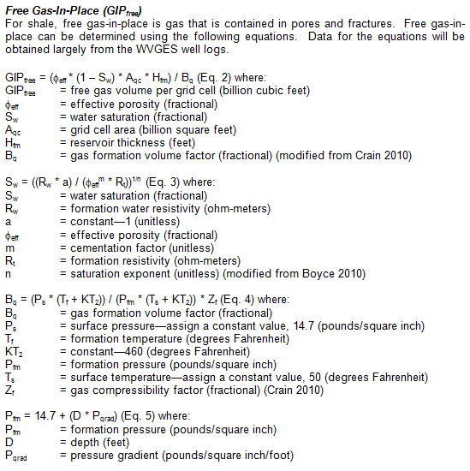
Methodology and Data
Boyce, M. 2010. Petrophysics, Stratigraphy, and Depositional Dynamics of the Middle Devonian Marcellus Interval in West Virginia and Southwestern Pennsylvania. Pittsburgh, PA: Pittsburgh Association of Petroleum Geologists. On-line. Available from http://www.papgrocks.org/boyce_papg_5-20-10.pdf, accessed 17 November 2010.
Crain, E.R. 2010. Special Cases—Gas Shales. In Crain’s Petrophysical Handbook. On-line. Available from http://spec2000.net/17-specshgas.htm#b6, accessed 15 November 2010.

Slide 19
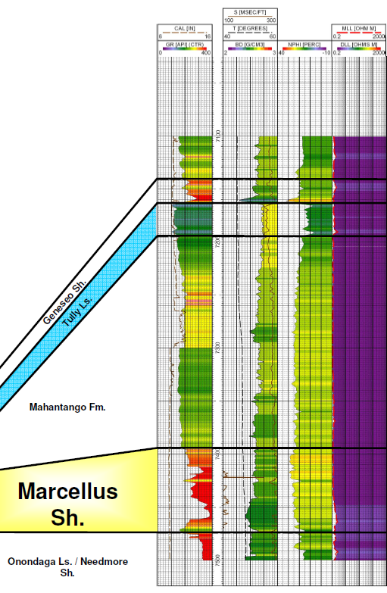
Methodology and Data
Free Gas-In-Place
GIP_{free} = (φ_{eff} * (1 – S_{w}) * A_{gc} * H_{fm}) / B_{g}
φ_{eff} is derived from porosity well logs;
S_{w} is derived from porosity and resistivity well logs;
B_{g} is derived from temperature well logs, surface temperature/pressure, formation pressure, and gas compressibility factor.
Example well logs

Slide 20
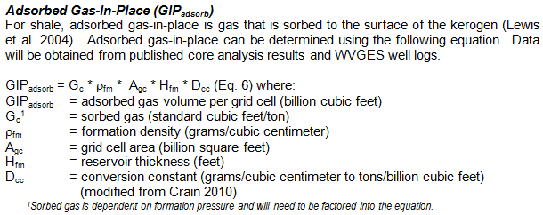
Methodology and Data
Crain, E.R. 2010. Special Cases—Gas Shales. In Crain’s Petrophysical Handbook. On-line. Available from http://spec2000.net/17-specshgas.htm#b6, accessed 15 November 2010.

Slide 21
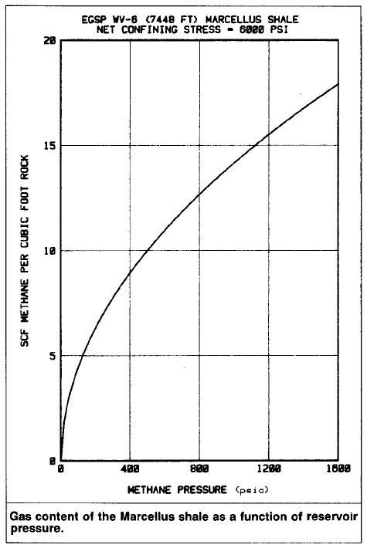
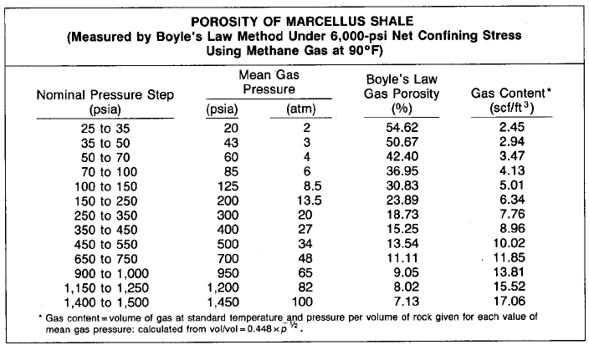
Methodology and Data
Adsorbed Gas-in-Place
GIP_{adsorb} = G_{c} * ρ_{fm} * A_{gc} * H_{fm} * D_{cc} where
G_{c} is dependent on formation pressure and
derived from an isotherm;
ρ_{fm} is derived from a porosity (bulk density) well log.
For Educational Purposes Only
For Educational Purposes Only
The table and graph show isotherm data.
Soeder, D.J. 1988. Porosity and Permeability of Eastern Devonian Gas Shale. SPE Unconventional Gas Technology Symposium. On-line. Available from http://www.pe.tamu.edu/wattenbarger/public_html/Selected_papers/--Shale%20Gas/SPE15213.pdf, accessed 15 November 2010.

Slide 22
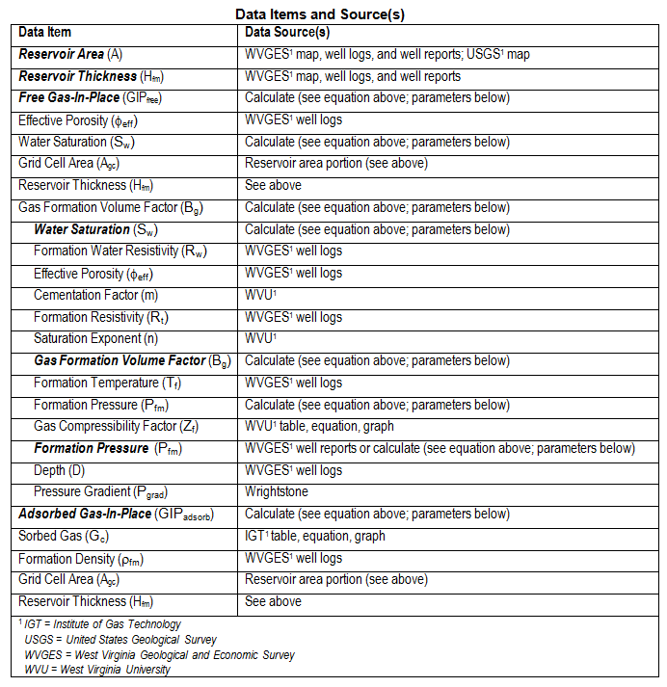
Methodology and Data
Data will be obtained from well logs, core, operator reports, maps, and literature.

Slide 23
Methodology and Data
Research Steps
Identify wells having logs at WVGES that penetrate the Marcellus shale.

Slide 24
Methodology and Data
Research Steps
Identify wells having logs at WVGES that penetrate the Marcellus shale.
Load data into ESRI ArcMap. Create an updated well log distribution map and add all data to the attribute table as it is collected.
= GIS required

Slide 25
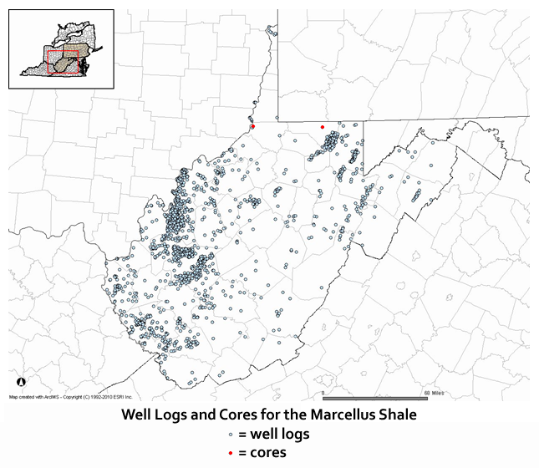
Methodology and Data
Research Steps
Identify wells having logs at WVGES that penetrate the Marcellus shale.
Load data into ESRI ArcMap. Create an updated well log distribution map and add all data to the attribute table as it is collected.
Most data will be from
well logs.
This map shows the distribution of available
well log data
from WVGES as of
February 2008.
Step 1 of the project is to identify any additional well logs.
And obtain the API number, well location, well log traces, and formation pressure.
= GIS required
West Virginia Geological & Economic Survey. 2010. Selected References about Devonian Shales. Morgantown, WV: West Virginia Geological & Economic Survey. On-line. Available from http://www.wvgs.wvnet.edu/www/datastat/devshales.htm, accessed 10 December 2010.

Slide 26
Methodology and Data
Research Steps
Identify wells having logs at WVGES that penetrate the Marcellus shale.
Load data into ESRI ArcMap. Create an updated well log distribution map and add all data to the attribute table as it is collected.
Determine appropriate sample size and distribution for representative well logs. Focus on well logs that have the following traces: gamma ray, porosity, resistivity, and temperature.
= GIS required

Slide 27
Methodology and Data
Research Steps
Identify wells having logs at WVGES that penetrate the Marcellus shale.
Load data into ESRI ArcMap. Create an updated well log distribution map and add all data to the attribute table as it is collected.
Determine appropriate sample size and distribution for representative well logs. Focus on well logs that have the following traces: gamma ray, porosity, resistivity, and temperature.
Obtain basic data not available from WVGES including: pressure gradient, adsorption isotherm, cementation factor, saturation exponent, and gas compressibility factor.
= GIS required

Slide 28
Methodology and Data
Research Steps
Identify wells having logs at WVGES that penetrate the Marcellus shale.
Load data into ESRI ArcMap. Create an updated well log distribution map and add all data to the attribute table as it is collected.
Determine appropriate sample size and distribution for representative well logs. Focus on well logs that have the following traces: gamma ray, porosity, resistivity, and temperature.
Obtain basic data not available from WVGES including: pressure gradient, adsorption isotherm, cementation factor, saturation exponent, and gas compressibility factor.
Evaluate logs for each representative well to obtain: reservoir extent / thickness, formation density, porosity, water saturation, and temperature.
= GIS required

Slide 29
Methodology and Data
Research Steps
Identify wells having logs at WVGES that penetrate the Marcellus shale.
Load data into ESRI ArcMap. Create an updated well log distribution map and add all data to the attribute table as it is collected.
Determine appropriate sample size and distribution for representative well logs. Focus on well logs that have the following traces: gamma ray, porosity, resistivity, and temperature.
Obtain basic data not available from WVGES including: pressure gradient, adsorption isotherm, cementation factor, saturation exponent, and gas compressibility factor.
Evaluate logs for each representative well to obtain: reservoir extent / thickness, formation density, porosity, water saturation, and temperature.
Determine appropriate grid size and grid all values required for calculations.
= GIS required

Slide 30
Methodology and Data
Research Steps
Calculate free gas-in-place and adsorbed gas-in-place for each grid cell.
= GIS required

Slide 31
Methodology and Data
Research Steps
Calculate free gas-in-place and adsorbed gas-in-place for each grid cell.
Calculate total original gas-in-place for each grid cell.
= GIS required

Slide 32
Methodology and Data
Research Steps
Calculate free gas-in-place and adsorbed gas-in-place for each grid cell.
Calculate total original gas-in-place for each grid cell.
Calculate the overall total original gas-in-place by adding grid cell values.
= GIS required

Slide 33
Methodology and Data
Research Steps
Calculate free gas-in-place and adsorbed gas-in-place for each grid cell.
Calculate total original gas-in-place for each grid cell.
Calculate the overall total original gas-in-place by adding grid cell values.
Identify current recovery factor(s) in literature or derive current recovery factor(s) from production data.
= GIS required

Slide 34
Methodology and Data
Research Steps
Calculate free gas-in-place and adsorbed gas-in-place for each grid cell.
Calculate total original gas-in-place for each grid cell.
Calculate the overall total original gas-in-place by adding grid cell values.
Identify current recovery factor(s) in literature or derive current recovery factor(s) from production data.
Calculate current recoverable gas using total original gas-in-place and recovery factor.
= GIS required

Slide 35
Methodology and Data
Research Steps
Calculate free gas-in-place and adsorbed gas-in-place for each grid cell.
Calculate total original gas-in-place for each grid cell.
Calculate the overall total original gas-in-place by adding grid cell values.
Identify current recovery factor(s) in literature or derive current recovery factor(s) from production data.
Calculate current recoverable gas using total original gas-in-place and recovery factor.
Document the entire process; develop metadata for all layers.
= GIS required

Slide 36
Methodology and Data
Research Steps
Calculate free gas-in-place and adsorbed gas-in-place for each grid cell.
Calculate total original gas-in-place for each grid cell.
Calculate the overall total original gas-in-place by adding grid cell values.
Identify current recovery factor(s) in literature or derive current recovery factor(s) from production data.
Calculate current recoverable gas using total original gas-in-place and recovery factor.
Document the entire process; develop metadata for all layers.
Provide selected data to the public through the web and a web-based GIS-driven interactive mapping system.
Note: A preliminary version of such a system was developed by a colleague using ESRI ArcIMS and will be redeveloped as the result of the study. The study will generate Marcellus-specific and up-to-date data that is not currently available.
= GIS required

Slide 37
Results and Products
An estimate of total original natural gas-in-place volume for
Marcellus shale in West Virginia
An estimate of current recoverable natural gas volume from Marcellus shale in West Virginia
Multiple GIS-based maps for the Marcellus shale including:
wells, location / extent, thickness, depth, pressure, total original natural gas-in-place volumes, and recoverable natural gas volumes
A publicly accessible web-based interactive mapping system for the Marcellus shale for West Virginia

Slide 38
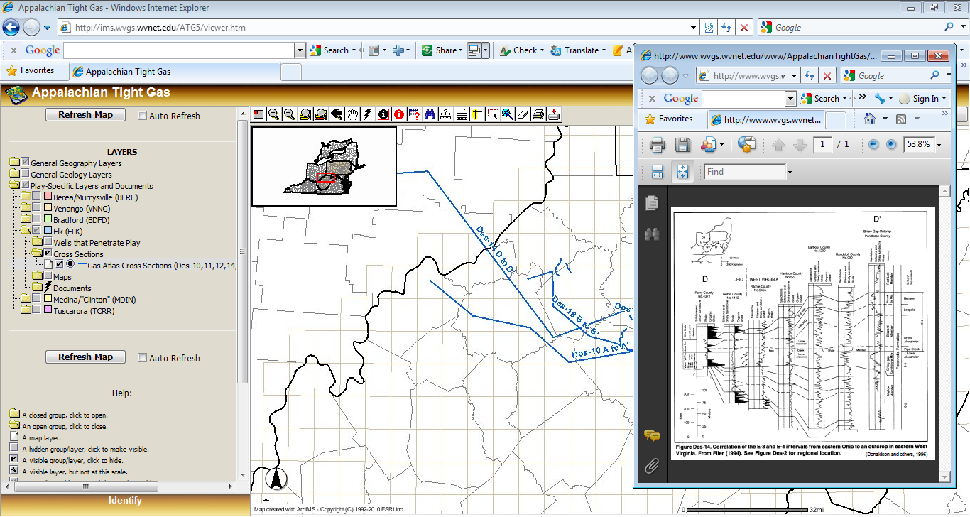
Results and Products
Features such as access to cross-sections and well logs may be added to the publicly accessible
Marcellus Shale web-based interactive mapping system.
West Virginia Geological & Economic Survey. 2010. WVGES: Appalachian Tight Gas Mapping System. Morgantown, WV: West Virginia Geological & Economic Survey. On-line. Available from http://ims.wvgs.wvnet.edu/ATG5/viewer.htm, accessed 12 December 2010.

Slide 39
Concerns and Potential Obstacles
Obtaining all data required
to conduct a meaningful resource assessment.
Using an adsorption isotherm from one core*.
Selecting appropriate sample and grid cell size.
Capturing the uncertainty inherent in the data collected and accurately portraying its impact on the reported results.
Addressing commingled production.
*Lewis et al. (2004) indicate that normally only one isotherm is needed for each basin or sub-basin; however, the one core or isotherm may be anomalous.
Lewis, R., D. Ingraham, M. Pearcy, J. Williamson, W. Sawyer, and J. Frantz. 2004. New Evaluation Techniques for Gas Shale Reservoirs. Schlumberger Reservoir Symposium 2004. On-line. Available from http://www.sipeshouston.org/presentations/Pickens%20Shale%20Gas.pdf, accessed 22 October 2010.

Slide 40
Future Work
(Short Term)
Refine research steps by working through an example.
Investigate possibility of using irregular grids for calculations.
Investigate thermal maturity and total organic content further.
Determine if the Marcellus should be broken into separate layers.
Calculate conversion constant required for adsorbed gas.
Request data from WVU.
Continue to review Marcellus resource-related studies and stay up-to-date on Marcellus news and issues.

Slide 41
Future Work
(Long Term)
Estimate remaining recoverable resources.
Assess varying conditions impact on recoverable resources.
Develop blueprint for assessing shale-based gas resources.
Build GIS-based tools for future shale resource assessments.
Extend Marcellus resource assessment geographically.
Explore conflict management.
Conduct cost-benefit analyses.
Investigate any potential spatial patterns.

Slide 42
Acknowledgements
Dr. Jonathan Mathews, Dr. Douglas Miller, and Beth King
Penn State University
Dr. Michael Hohn, Mary Behling, John Bocan, Sarah Gooding, Susan Kite, Eric Lewis, and John Saucer
West Virginia Geological and Economic Survey
Dr. Ray Boswell
U.S. Department of Energy, National Energy Technology Laboratory

Slide 43
Questions?

