Slide 1
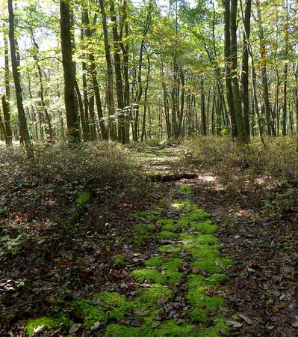
Stone Valley Forest, PA: Tree Species Inventory Using Hyperspectral Imagery and Lidar
Jennifer A. Pramuk

Slide 2
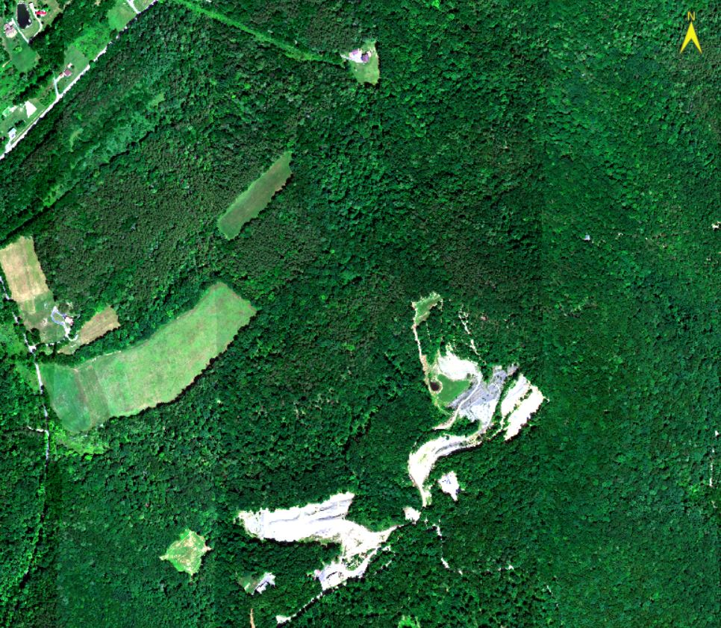
Background
Tree species information provides a resource for:
Knowledge of locations, distributions, and abundance of tree species
Sustainable forest management
Identifying and managing raw materials and resources
Preventing soil erosion
Sustaining biodiversity
Mitigating global climate change

Slide 3
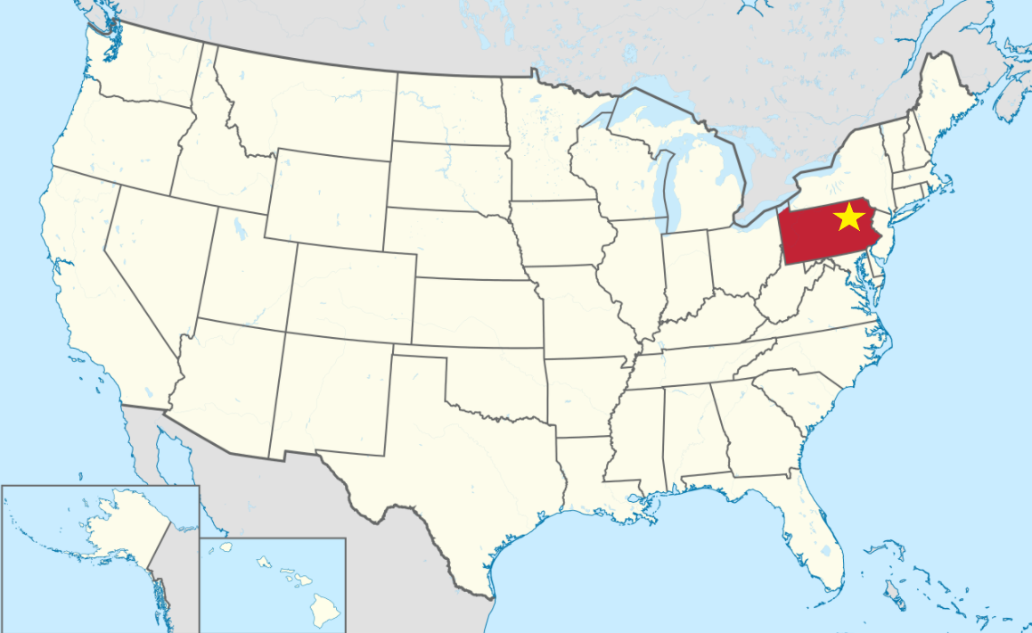
Penn State Experimental Forest
1930s farm abandonment
1950s outdoor laboratory deeded to Penn State
Late 1980s timber-cutting
7,000 acres
Heterogeneous, mixed-deciduous forest
Mainly mixed hardwoods with some conifers

Slide 4
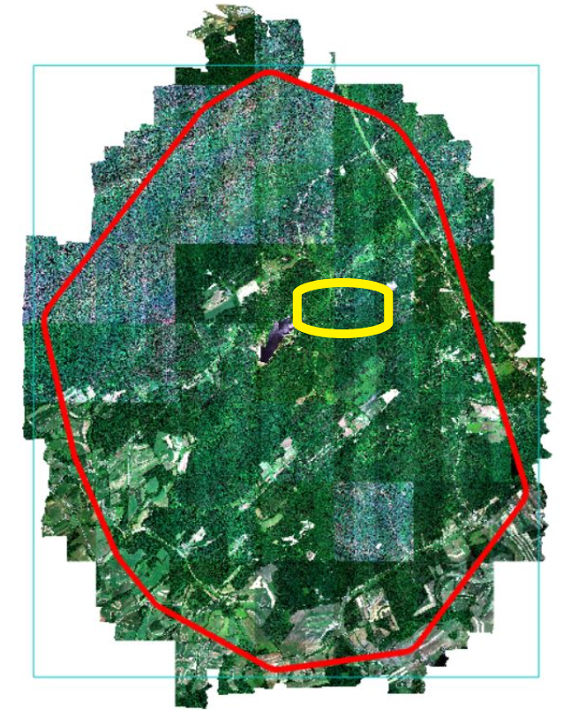
Study Area: Shale Hills
Study areas
Shale Hills: 41 acres
Leading Ridge: 303 acres
Critical zone observatory
Managed by Penn State

Slide 5
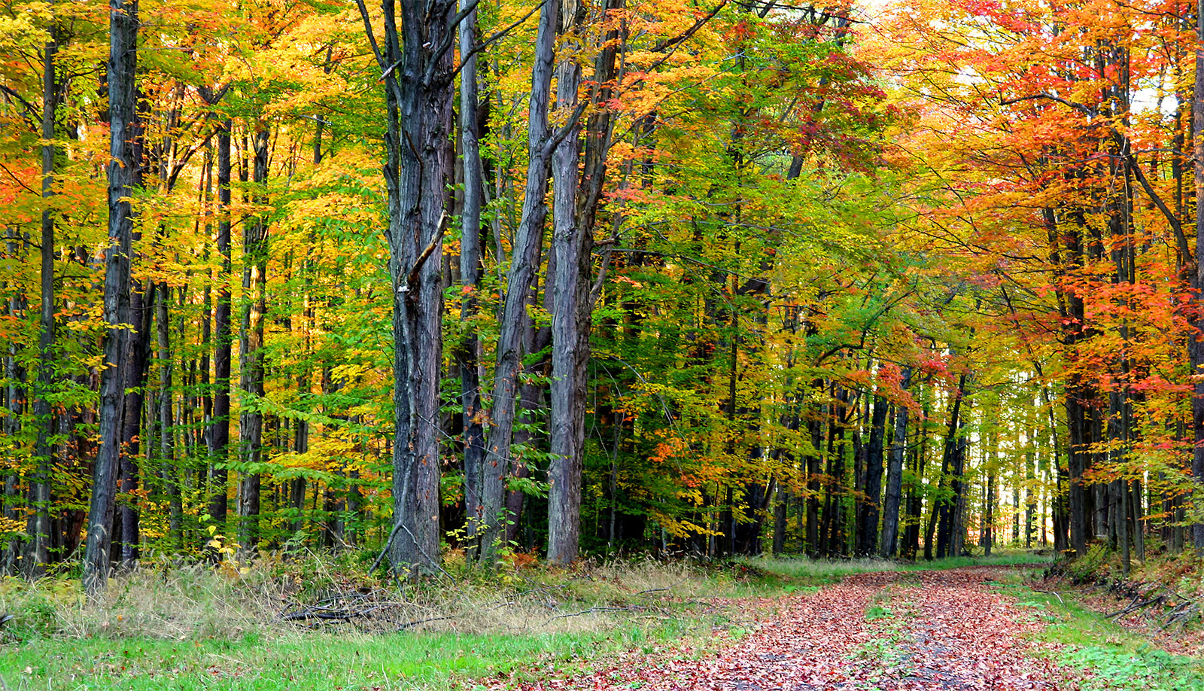
Study Objective
Forest inventory of 10 dominant, overstory trees
First step towards sustainable forest management
Building block for future research within the forest
Combine hyperspectral imagery and lidar for classification
Remotely sensed classification methods are more efficient compared to field data collection alone

Slide 6
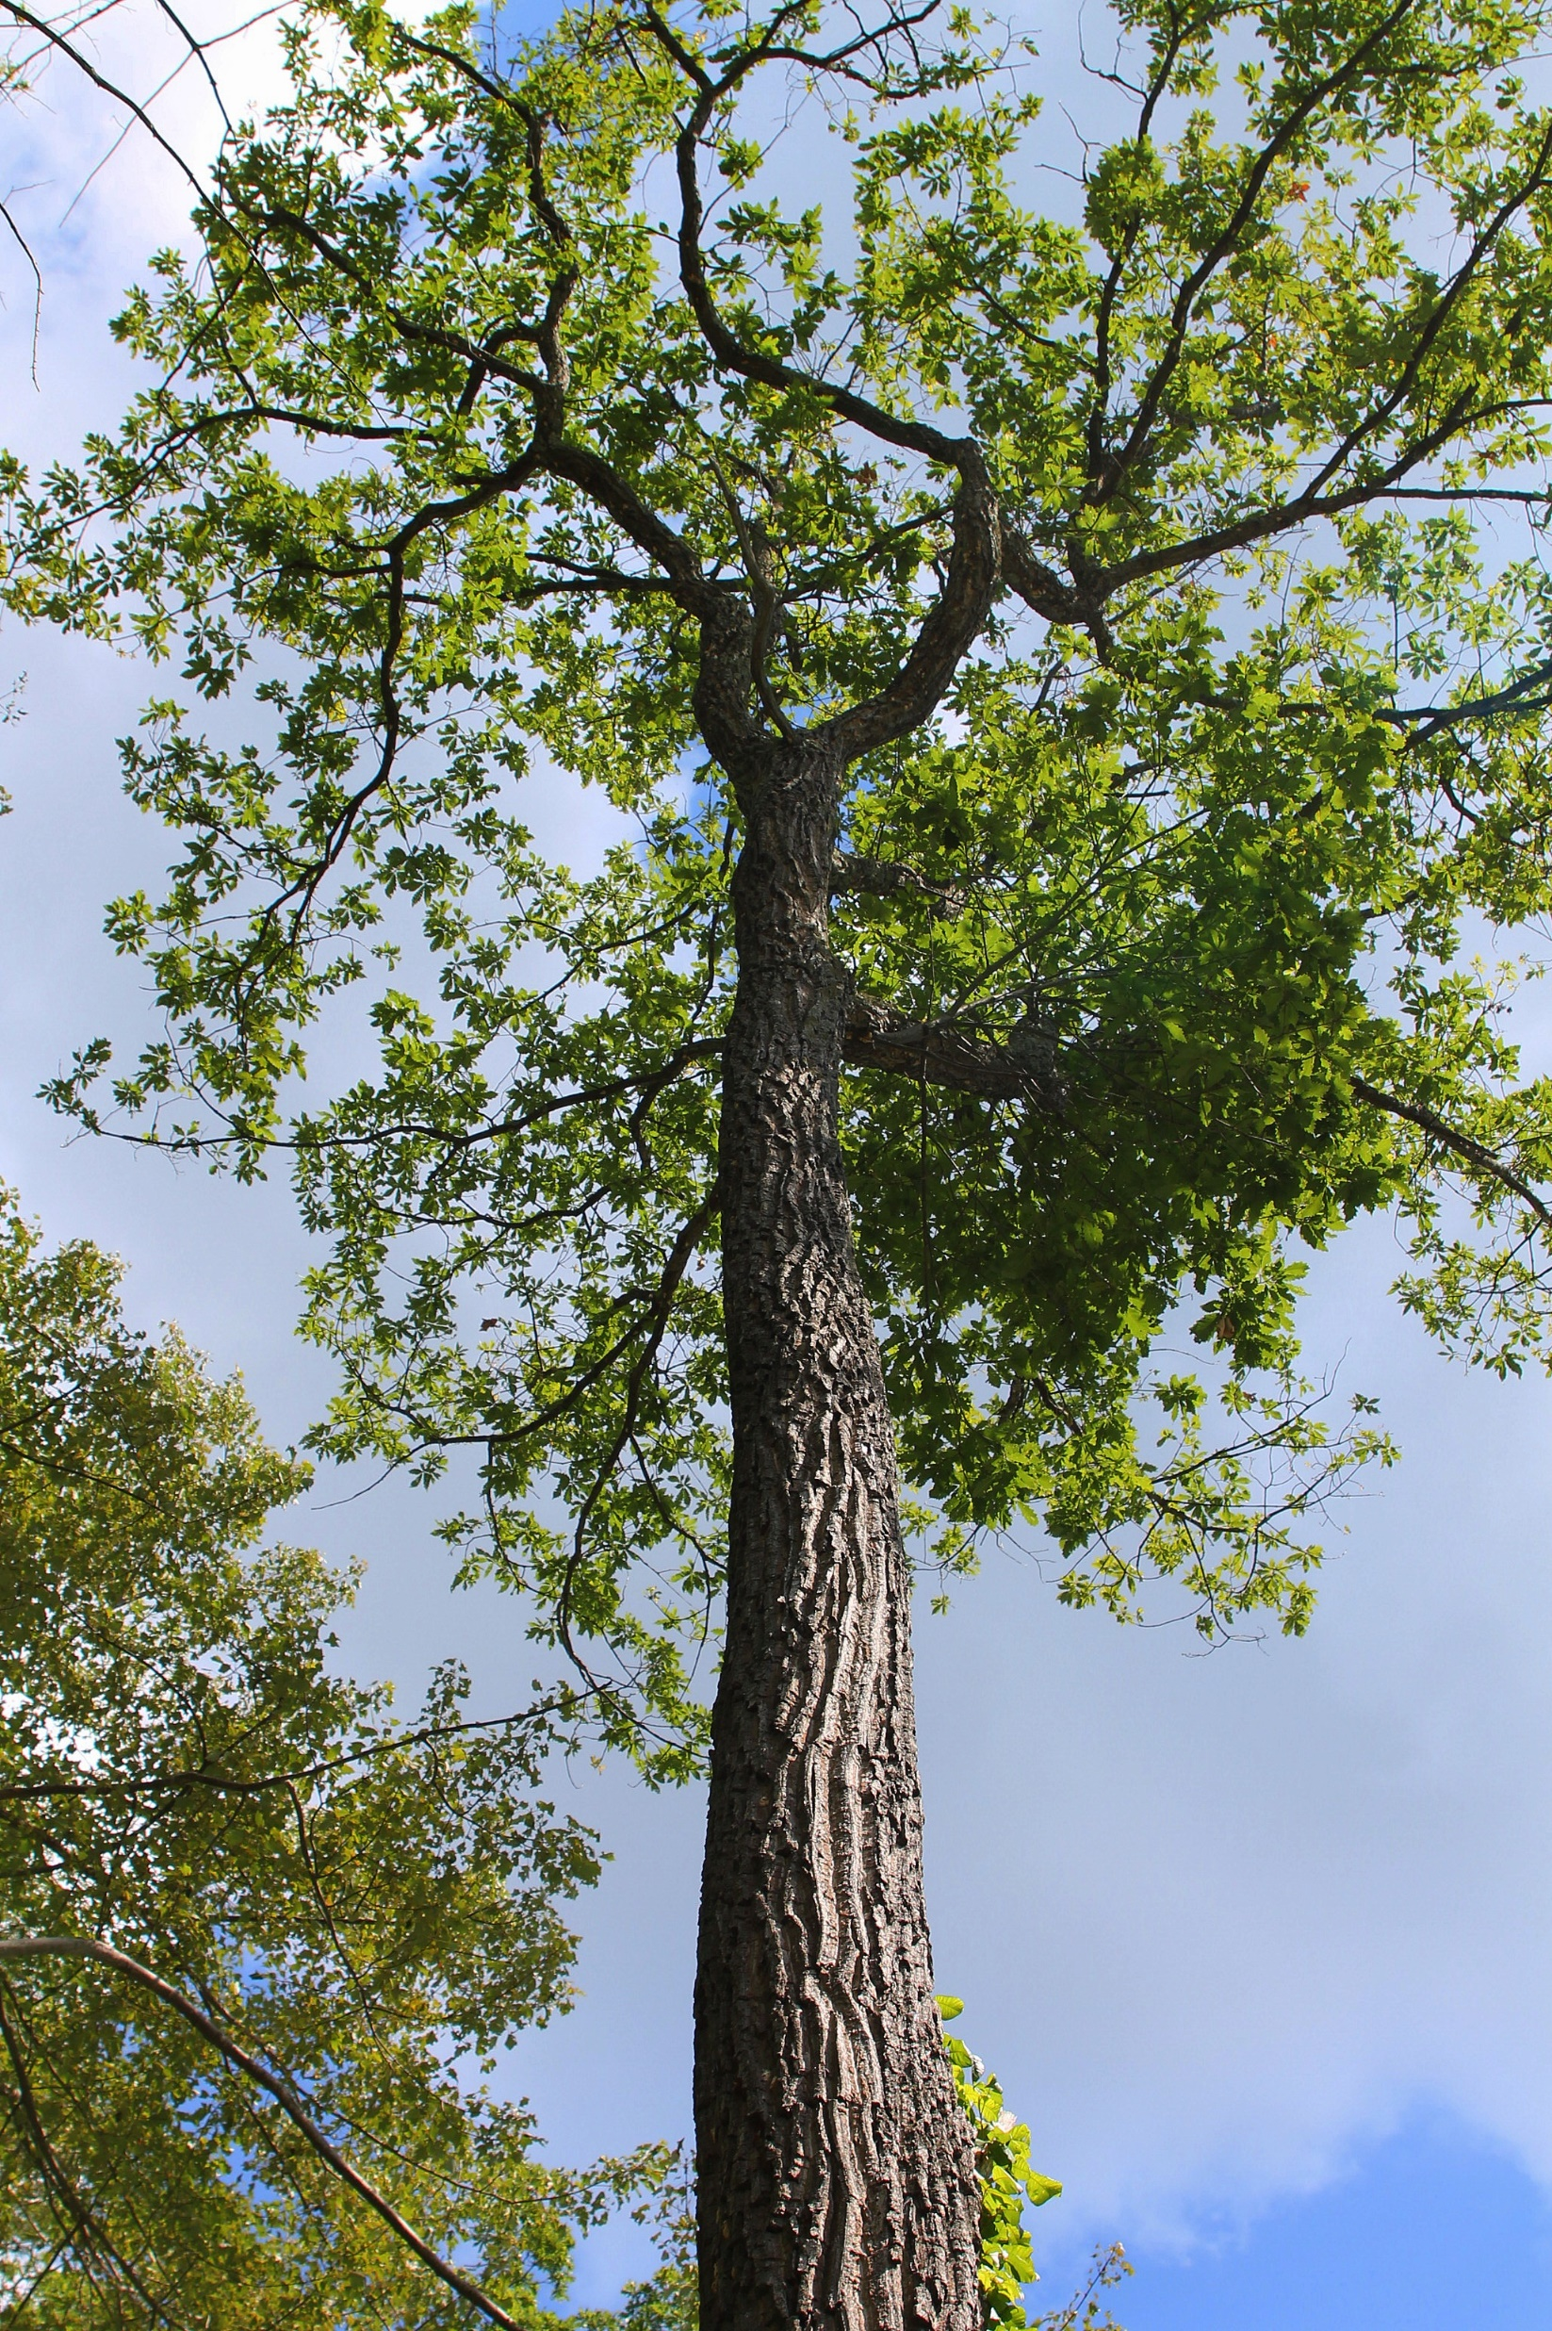
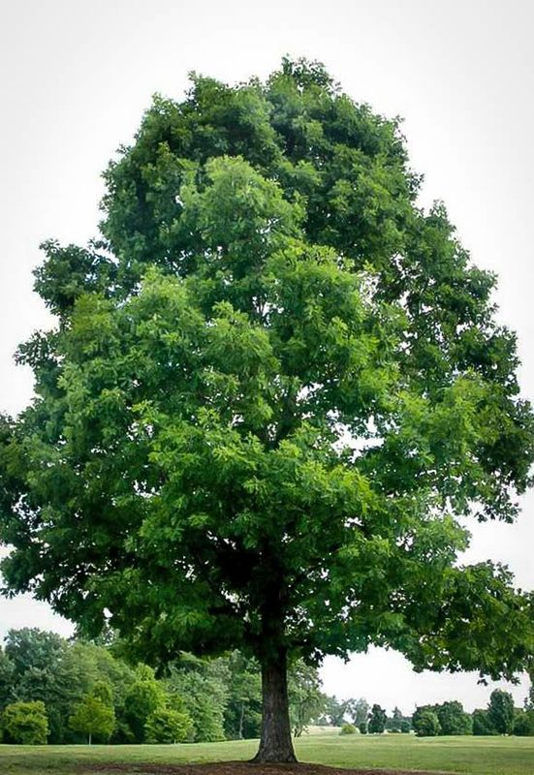
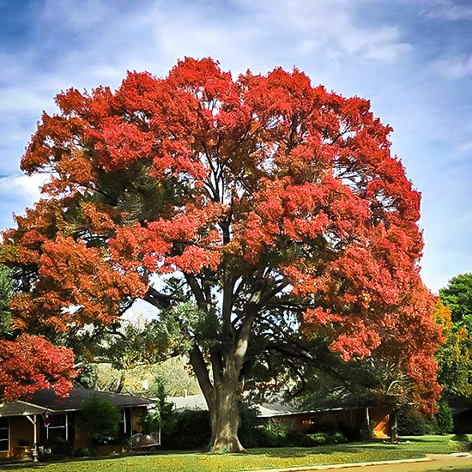
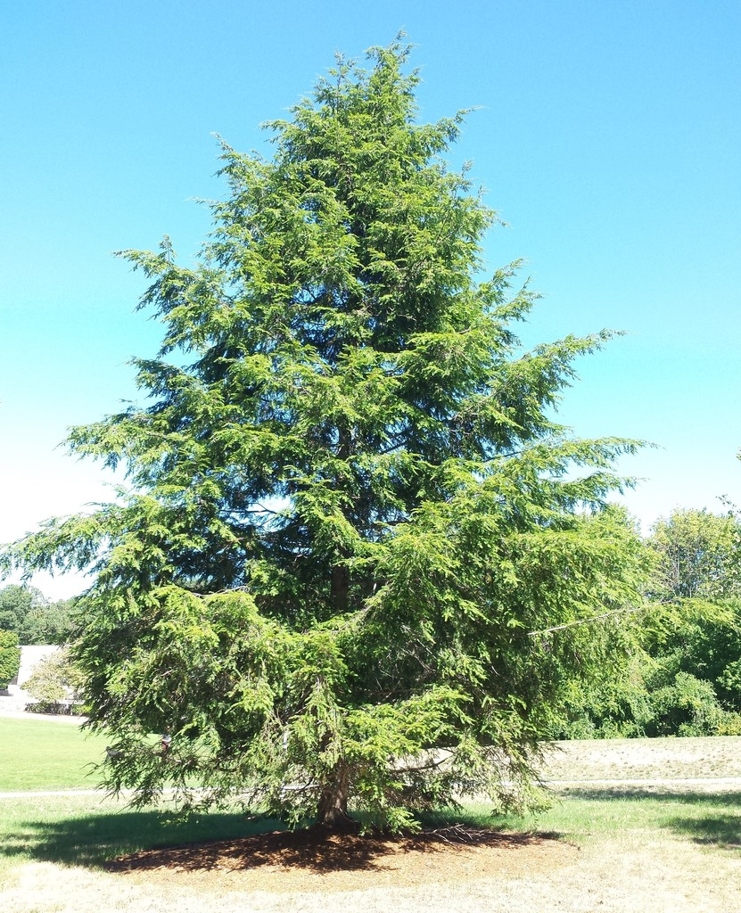
Tree Species To Be Identified
Scientific Name | Common Name
Quercus prinus | Chestnut oak
Quercus rubra | Red oak
Quercus alba | White oak
Tsuga canadensis | Eastern hemlock
Carya glabra | Pignut hickory
Carya tormentosa | Mockernut hickory
Acer saccharum | Sugar maple
Pinus virginiana | Virginia pine
Pinus strobus | Eastern white pine
Chestnut Oak
White Oak
Eastern Hemlock
Red Oak

Slide 7
Remote Sensing Data
Name | Source | Resolution | Data Type | Projection
Hyperspectral imagery (48 bands) | Quantum | 0.5 m, 1.5 ft 380 – 1050 nm | ENVI HDR | NAD 1983 (2011) StatePlane Pennsylvania South FIPS 3702 (Meters)
4-Band Orthoimagery | Quantum | 30 cm | 8-bit GeoTIFF | NAD 1983 (2011) StatePlane Pennsylvania South FIPS 3702 (Meters)
Lidar | Quantum | 30 cm | Las 1.4 | NAD 1983 (2011) StatePlane Pennsylvania South FIPS 3702 (Meters)
DEM | Quantum | 1 m, 3 ft | 32-bit ESRI Grid | NAD 1983 (2011) StatePlane Pennsylvania South FIPS 3702 (Meters)
Intensity Imagery | Quantum | .5 m, 1.5 ft | 32-bit GeoTIFF | NAD 1983 (2011) StatePlane Pennsylvania South FIPS 3702 (Meters)

Slide 8
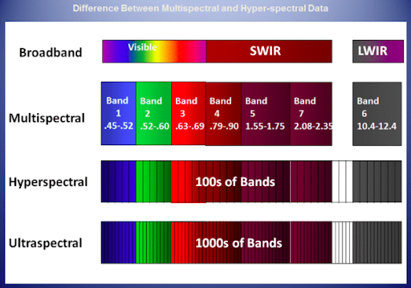
Hyperspectral Imagery (2020)
Collected by ITRES CASI 1500H VNIR sensor in 2020
Pixel resolution of 0.5 meters
48 bands
380 - 1050 nm
This imagery was a special flight mission to collect data of Stone Valley Forest specifically for Penn State

Slide 9
Field Data

Slide 10
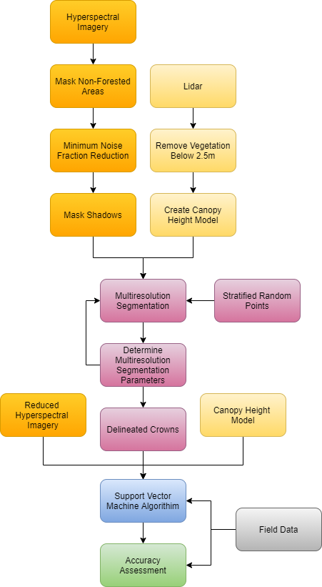
Methodology Overview
High level overview of how hyperspectral imagery and lidar will be combined in order to classify tree species

Slide 11
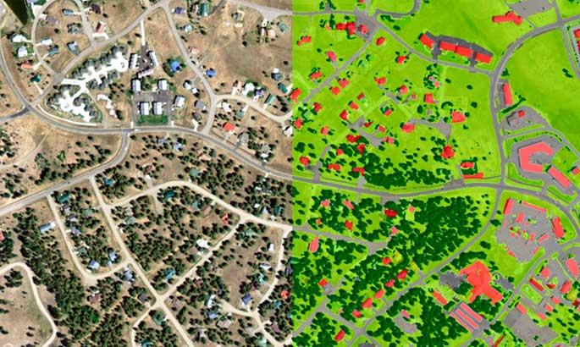
What is Object-Based Image Analysis?
Segment then classify
Involves pixels being grouping into objects based on a variety of components
Spectral similarity
Height information (lidar)
Shape
Texture
Compactness
Also segments based on relationship to surrounding pixels and other objects
Connectivity with other objects
Proximity to other objects

Slide 12
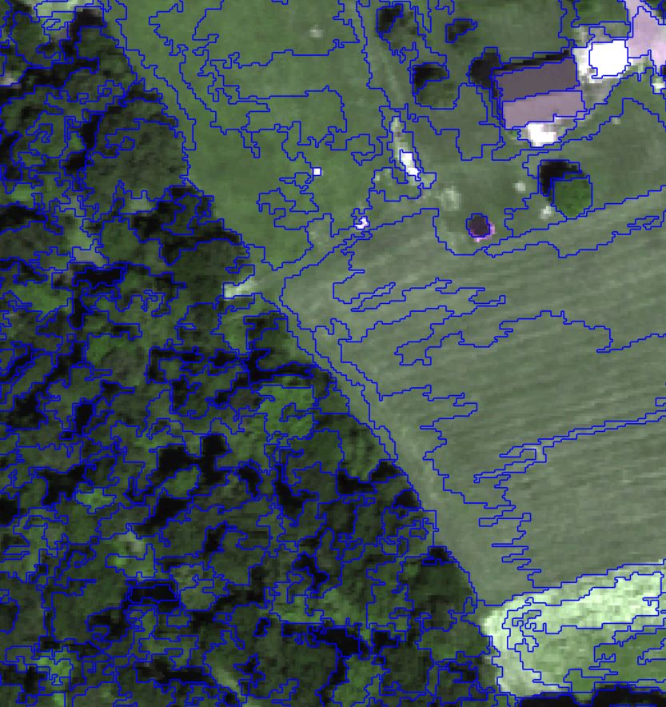
Object-Based Image Analysis
Creating objects on which to classify allows for greater classification accuracy, oftentimes reaching accuracies of at least 90%
Using pixel classification alone causes a noisy “salt-and-pepper effect”
Canopies will be aggregated
Each canopy’s collective spectral signature takes into account inherent spectral variability among trees

Slide 13
Lidar data
The following slide will outline the steps taken to create a canopy height model
Remove vegetation below 2.5 meters
Use remaining first return lidar points

Slide 14
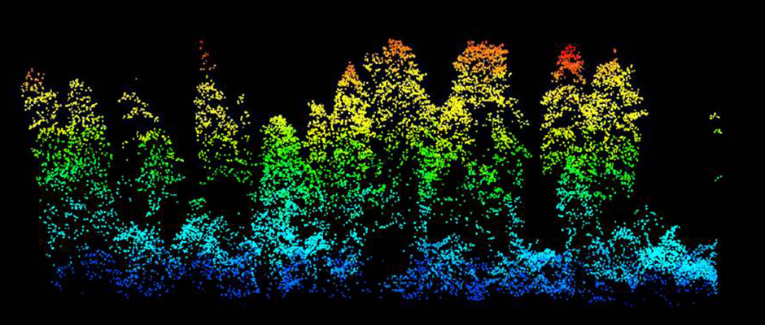
Canopy Height Model
Remove heights below 2.5 meters for DSM
DSM will be created from remaining first return points using triangular irregular network (TIN)
A canopy height model (CHM) will be generated by subtracting the DEM from the DSM
CHM gaps could affect the classification analysis, if so PFSK model will be used

Slide 15
Hyperspectral data
The following slides will outline the steps taken to clean up the hyperspectral data for analysis
Mask non-forested areas
Minimum noise fraction reduction
Mask shadows

Slide 16
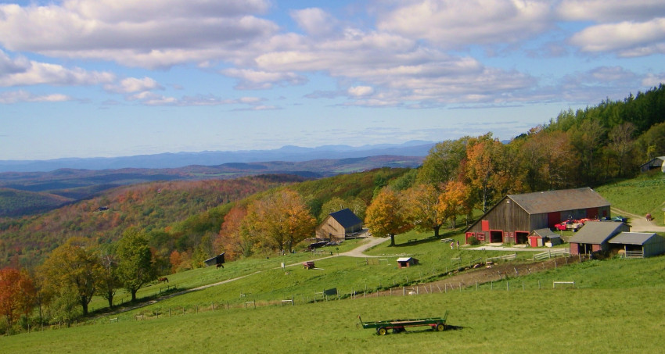
Masking Non-Forested Areas
Farmland, roads, structures
Software: eCognition
Inputs: Lidar and 4-band orthoimagery
OBIA using ground point returns and specific band combinations
Output: Polygon shapefile

Slide 17
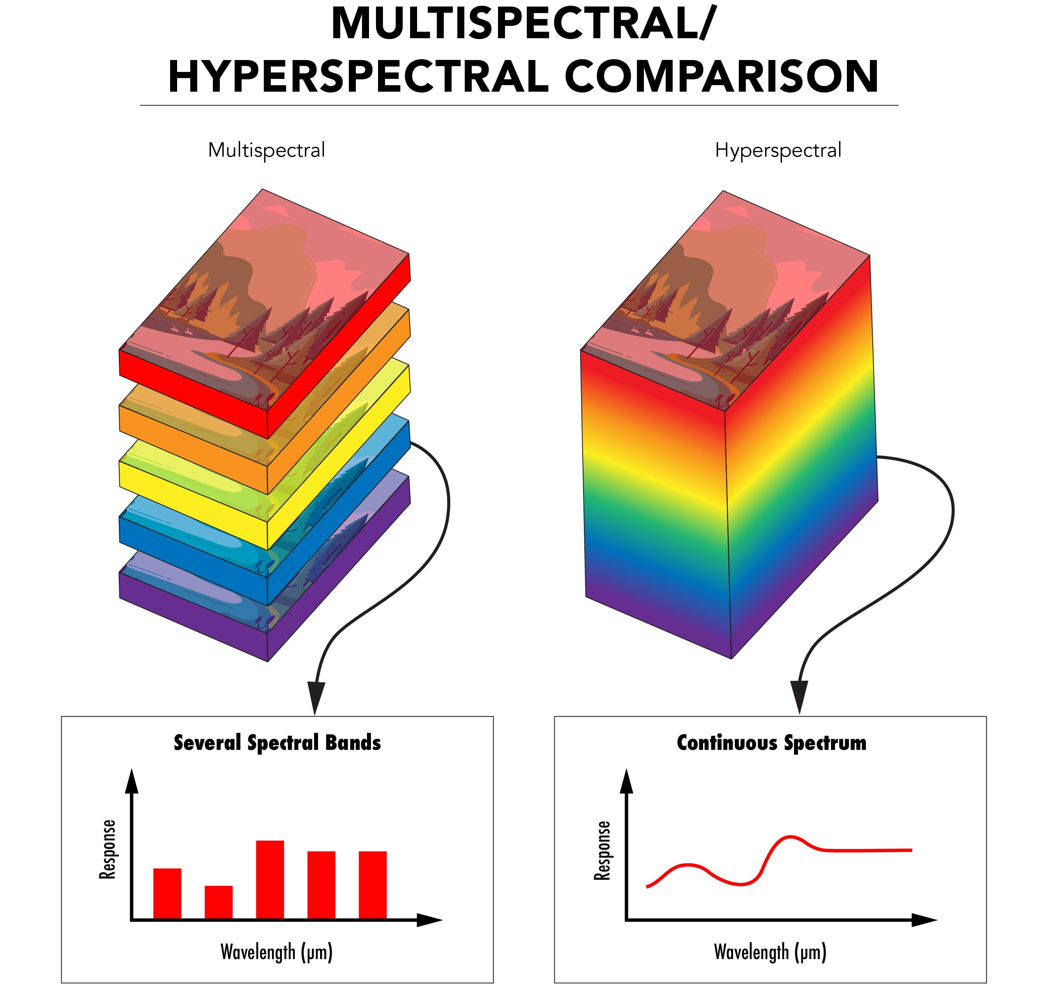
Minimum Noise Fraction Transformation
Hughes phenomenon
A forward Minimum Noise Fraction (MNF) reduction will reduce the number of bands used by defining which bands are uncorrelated
MNF is a transformation based on two principal component analysis rotations, which uses principal components to de-correlate noisy data and then uses the noise-removed principal components for a final transformation
ENVI 5.6 software
Eigen value greater than or equal to a number between 3 and 8
Will deliver less than 25 decorrelated bands

Slide 18
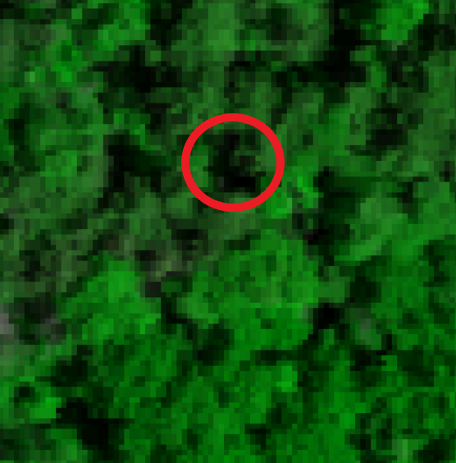
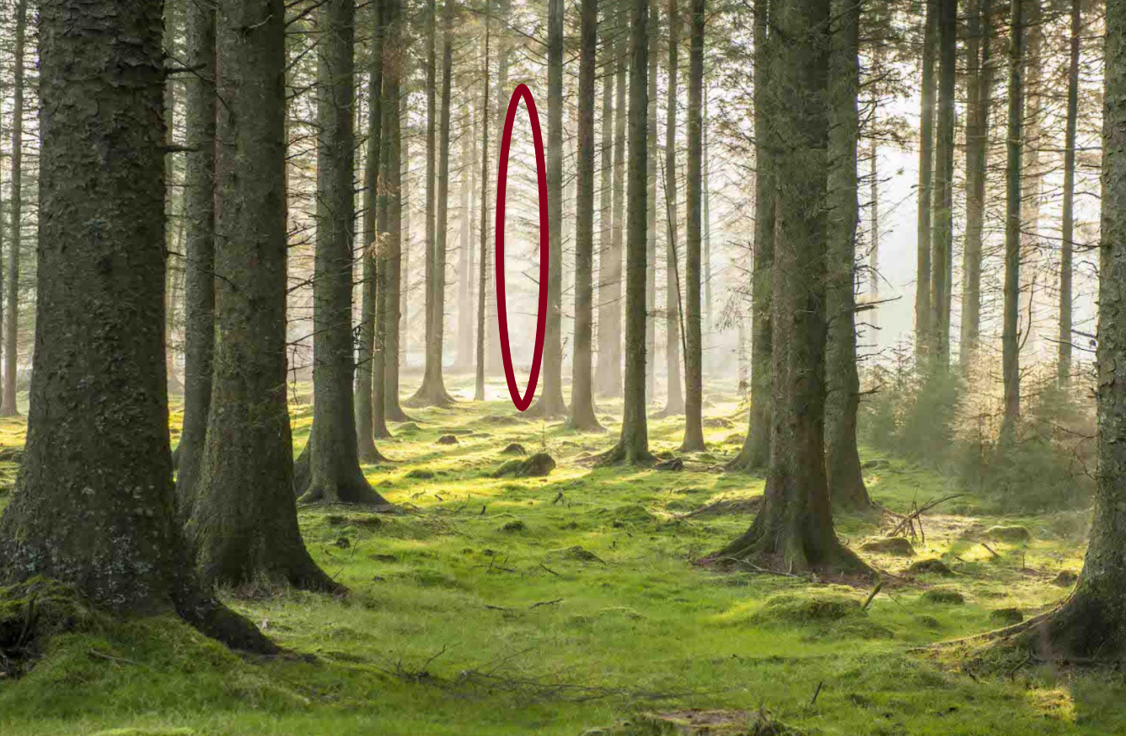
Shadows
Shadows affect classification
Shadow are inanely found within canopies due to gaps within upper story trees
Shadowing is also found within other parts of imagery
In a recent study, green-blue ratio was used to identify shadow areas
eCognition will be used to parse out shadows using OBIA

Slide 19
Crown Segmentation
The following slide will describe how crowns will be segmented
Iterative process
Inputs are the reduced hyperspectral imagery and the CHM

Slide 20
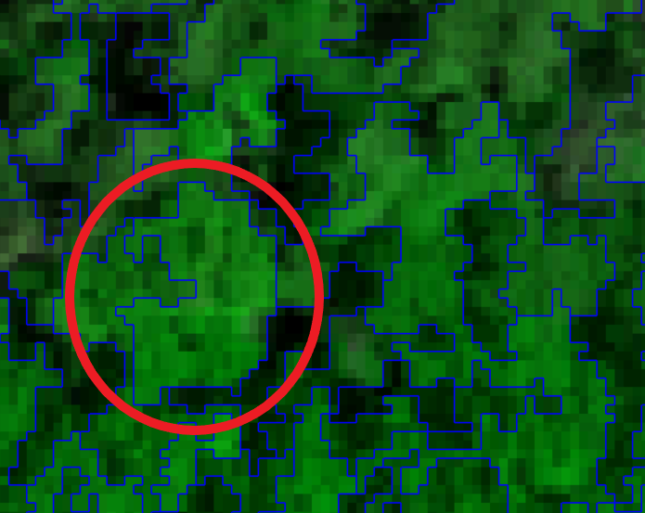
Crown Segmentation
Inputs: MNF bands and the CHM
Individual tree crowns will be delineated using multiresolution segmentation in eCognition
The parameters used will be determined by comparing segmentation outputs to a set of reference tree crowns

Slide 21
Support Vector Machine Learning
The following slides will describe support vector machine learning
The inputs for SVM are:
Reduced hyperspectral imagery
Delineated crown objects
CHM
Field Data

Slide 22
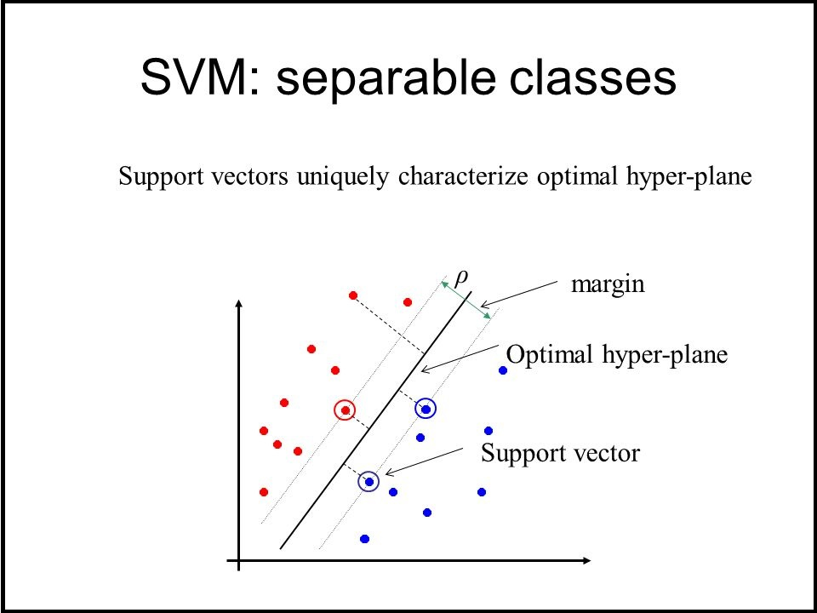
What is Support Vector Machine Learning?
Separates classes by defining an optimal hyperplane between classes, based on support vectors that are defined by training data
Good at handling complex, highly dimensional, and noisy data such as hyperspectral imagery combined with elevation data (such as CHM)
Hyperplane shows where maximum class separability falls

Slide 23
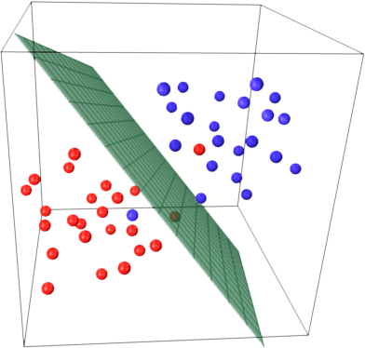
Support Vector Machine Learning
SVM is a well-known machine learning algorithm that has the capacity to classify tree species in temperate forests
Does not need nearly as much training data
Used to differentiate between tree species

Slide 24
Methodology Recap
Combination of hyperspectral imagery and lidar will be used to train this algorithm
Field sample points will be used in order to train the algorithm
Field samples will also be used for an accuracy assessment

Slide 25
Accuracy Assessment
Compare outputs of the analysis with field data
Confusion Matrix
Overall Accuracy (OA)
Producer’s Accuracy (PA)
User’s Accuracy (UA)
Kappa coefficient
 | Tree 1 | Tree 2 | Total | User’s Accuracy
Tree 1 | 45 | 5 | 50 | 90.0%
Tree 2 | 3 | 47 | 50 | 94.0%
Total | 48 | 52 | 100
Producer’s Accuracy | 93.8% | 90.4% |  | 92.0%
 |  |  |  |  | Kappa Coefficient

Slide 26
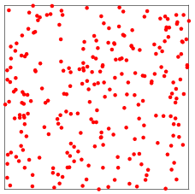
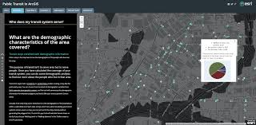
Anticipated Results
Point shapefile of classified tree locations
Confusion matrix for accuracy assessment
Report paper
Story map
 | Tree 1 | Tree 2 | Total | User’s Accuracy
Tree 1 | 45 | 5 | 50 | 90.0%
Tree 2 | 3 | 47 | 50 | 94.0%
Total | 48 | 52 | 100
Producer’s Accuracy | 93.8% | 90.4% |  | 92.0%
 |  |  |  |  | Kappa Coefficient

Slide 27
Project Timeline

Slide 28
Works Cited
Literature:
Baldeck, C. A., & Asner, G. P. (2014). Improving remote species identification through efficient training data collection. Remote Sensing, 6(4), 2682–2698. https://doi.org/10.3390/rs6042682
Ballanti, L., Blesius, L., Hines, E., & Kruse, B. (2016). Tree species classification using hyperspectral imagery: A comparison of two classifiers. Remote Sensing, 8(6), 1–18. https://doi.org/10.3390/rs8060445
Congalton, R. G. (1991). A review of assessing the accuracy of classifications of remotely sensed data. Remote Sensing of Environment, 37(1), 35–46. https://doi.org/10.1016/0034-4257(91)90048-B
Dabiri, Z., & Lang, S. (2018). Spectral-spatial dimensionality reduction of APEX hyperspectral imagery for tree species classification ; a case study of Salzach riparian mixed forest. June, 1–12. https://doi.org/10.20944/preprints201806.0188.v1
Erfanifard, Y., Stereńczak, K., Kraszewski, B., & Kamińska, A. (2018). Development of a robust canopy height model derived from ALS point clouds for predicting individual crown attributes at the species level. International Journal of Remote Sensing, 39(23), 9206–9227. https://doi.org/10.1080/01431161.2018.1508916
Fassnacht, F. E., Latifi, H., Stereńczak, K., Modzelewska, A., Lefsky, M., Waser, L. T., Straub, C., & Ghosh, A. (2016). Review of studies on tree species classification from remotely sensed data. Remote Sensing of Environment, 186, 64–87. https://doi.org/10.1016/j.rse.2016.08.013
Ghosh, A., Fassnacht, F. E., Joshi, P. K., & Kochb, B. (2014). A framework for mapping tree species combining hyperspectral and LiDAR data: Role of selected classifiers and sensor across three spatial scales. International Journal of Applied Earth Observation and Geoinformation, 26(1), 49–63. https://doi.org/10.1016/j.jag.2013.05.017
Gu, J., Grybas, H., & Congalton, R. G. (2020). A comparison of forest tree crown delineation from unmanned aerial imagery using canopy height models vs. spectral lightness. Forests, 11(6). https://doi.org/10.3390/F11060605
Hycza, T., Stereńczak, K., & Bałazy, R. (2018). Potential use of hyperspectral data to classify forest tree species. New Zealand Journal of Forestry Science, 48(1). https://doi.org/10.1186/s40490-018-0123-9
Laybros, A., Aubry-Kientz, M., Féret, J. B., Bedeau, C., Brunaux, O., Derroire, G., & Vincent, G. (2020). Quantitative airborne inventories in dense tropical forest using imaging spectroscopy. Remote Sensing, 12(10), 1–27. https://doi.org/10.3390/rs12101577
Modzelewska, A., Fassnacht, F. E., & Stereńczak, K. (2020). Tree species identification within an extensive forest area with diverse management regimes using airborne hyperspectral data. International Journal of Applied Earth Observation and Geoinformation, 84(August 2019), 101960. https://doi.org/10.1016/j.jag.2019.101960
Olson, C. E. (2008). Is 80 % Accuracy Good Enough ? The Future of Land Imaging...Going Operational, 18–21.
Shi, Y., Skidmore, A. K., Wang, T., Holzwarth, S., Heiden, U., Pinnel, N., Zhu, X., & Heurich, M. (2018). Tree species classification using plant functional traits from LiDAR and hyperspectral data. International Journal of Applied Earth Observation and Geoinformation, 73(June), 207–219. https://doi.org/10.1016/j.jag.2018.06.018
Tarabalka, Y., Chanussot, J., & Benediktsson, J. A. (2010). Segmentation and classification of hyperspectral images using watershed transformation. Pattern Recognition, 43(7), 2367–2379. https://doi.org/10.1016/j.patcog.2010.01.016
Tian, X., Zhang, X., & Wu, Y. (2020). Classification of planted forest species in southern China with airborne hyperspectral and LiDAR data. Journal of Forest Research, 00(00), 1–10. https://doi.org/10.1080/13416979.2020.1786898
Trier, Ø. D., Salberg, A. B., Kermit, M., Rudjord, Ø., Gobakken, T., Næsset, E., & Aarsten, D. (2018). Tree species classification in Norway from airborne hyperspectral and airborne laser scanning data. European Journal of Remote Sensing, 51(1), 336–351. https://doi.org/10.1080/22797254.2018.1434424
Tusa, E., Laybros, A., Monnet, J. M., Dalla Mura, M., Barré, J. B., Vincent, G., Dalponte, M., Féret, J. B., & Chanussot, J. (2020). Fusion of hyperspectral imaging and LiDAR for forest monitoring. Data Handling in Science and Technology, 32, 281–303. https://doi.org/10.1016/B978-0-444-63977-6.00013-4
Wietecha, M., Jełowicki, Ł., Mitelsztedt, K., Miścicki, S., & Stereńczak, K. (2019). The capability of species-related forest stand characteristics determination with the use of hyperspectral data. Remote Sensing of Environment, 231(May), 111232. https://doi.org/10.1016/j.rse.2019.111232
Wu, Y., & Zhang, X. (2020). Object-Based tree species classification using airborne hyperspectral images and LiDAR data. Forests, 11(1). https://doi.org/10.3390/f11010032
Yu, X., Hyyppä, J., Litkey, P., Kaartinen, H., Vastaranta, M., & Holopainen, M. (2017). Single-sensor solution to tree species classification using multispectral airborne laser scanning. Remote Sensing, 9(2), 1–16. https://doi.org/10.3390/rs9020108
Zhang, Z., Kazakova, A., Moskal, L. M., & Styers, D. M. (2016). Object-based tree species classification in urban ecosystems using LiDAR and hyperspectral data. Forests, 7(6). https://doi.org/10.3390/f7060122
Images:
https://cdn.shopify.com/s/files/1/0083/1372/files/P1120807_grande.JPG?v=1539873328
https://www.google.com/url?sa=i&url=https%3A%2F%2Fwww.britannica.com%2Fscience%2Fdeciduous-forest&psig=AOvVaw1L-qQgzJ2jQ5Ysl2KxvLeP&ust=1606076019908000&source=images&cd=vfe&ved=0CAIQjRxqFwoTCMCQ3Mq5lO0CFQAAAAAdAAAAABAD
https://gsp.humboldt.edu/OLM/Courses/GSP_216_Online/images/DEM_DSM_CHM.png
https://wildlife.org/wp-content/uploads/2017/02/lidar.png
https://slideplayer.com/slide/3869099/13/images/17/Minimum+Noise+Fraction+%28MNF%29.jpg
https://en.wikipedia.org/wiki/Pennsylvania#/media/File:Pennsylvania_in_United_States.svg
http://criticalzone.org/shale-hills/about/
https://youngforest.org/demo/penn-state-experimental-forest-central-pennsylvania
https://www.thetreecenter.com/c/uploads/Shumard_Red_Oak_1.jpg
https://cdn11.bigcommerce.com/s-2lqvsr5/images/stencil/800x800/products/801/967/oak__06015.1597180361.jpg?c=2
https://static.inaturalist.org/photos/6639392/large.jpg?1489968192
https://www.diginvt.com/assets/places/Place-Detail-Maple/Merck-Forest__FillWzg1MCw0NTNd.JPG
https://www.positive.news/wp-content/uploads/2019/03/feat-1800x0-c-center.jpg
https://www.mitosistech.com/mitosis/uploads/2020/02/SVM.jpg
https://i1.wp.com/appliedmachinelearning.blog/wp-content/uploads/2017/03/svm_logo1.png?fit=392%2C374&ssl=1
https://www.landinfo.com/images/gallery/pagosa_springs-Class.jpg
https://www.edmundoptics.com/contentassets/520f2173de1e4ec482a7be8edcdece8a/figure4.jpg
https://sites.google.com/site/3ddatavisualizationresearch/project-definition/esri-story-maps
https://www.google.com/url?sa=i&url=https%3A%2F%2Fmathworld.wolfram.com%2FSquarePointPicking.html&psig=AOvVaw0qTif4R9LDAMv_zRb0WBng&ust=1607115251872000&source=images&cd=vfe&ved=0CAIQjRxqFwoTCLig2cDZsu0CFQAAAAAdAAAAABAD

