Slide 1
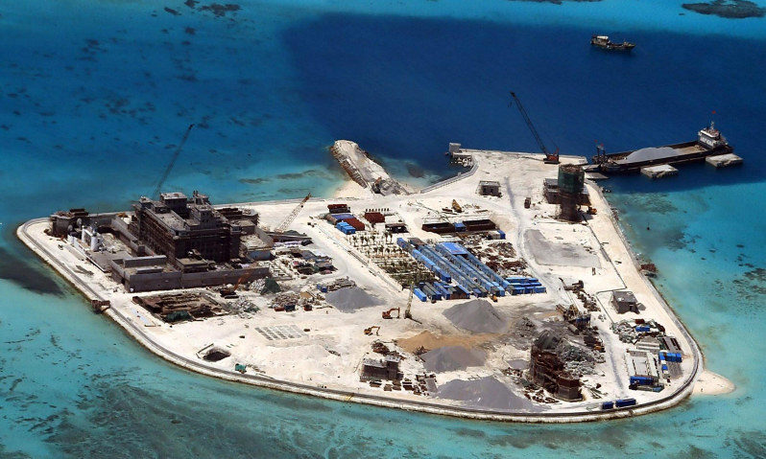
Using GIS and Open Source Information to Study Effects of China’s Reclamation Projects on Change of Regional Military Strength in the South China Sea
Construction on Johnson South Reef
Photograph: Armed Forces Of The Philippines
GEOG 596A
Robert Qi
5/13/2015

Slide 2
Agenda
Background Introduction
Research Objectives
Significances
Data Resources
Research Methods
Image Process
GIS Products Development
Pilot Research
Pre-research Preparation
Analysis Plan
Tools and Software
Research Time Line
Anticipated Results

Slide 3
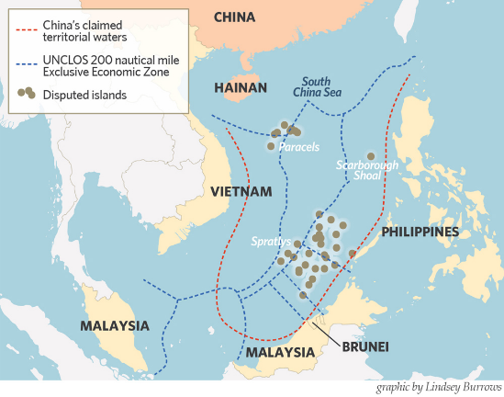
Background Introduction
South China Sea
3,500,000 square kilometers
Key International sea transportation route
Vast fishery and natural resources
Strategic significances
Disrupted Territories
Historical Issues
China’s Nine-dashed Line
Disputed zone
Countries Involved
China’s Recent Actions
Diplomatic Approaches
Militarization
Increased Law Enforcement Activities
Reclamation Projects
Disputed Islands and Boundary in the South China Sea
Source of map: The devil and the deep South China Sea, http://chinhdangvu.blogspot.com/2014/03/the-devil-and-deep-south-china-sea.html

Slide 4
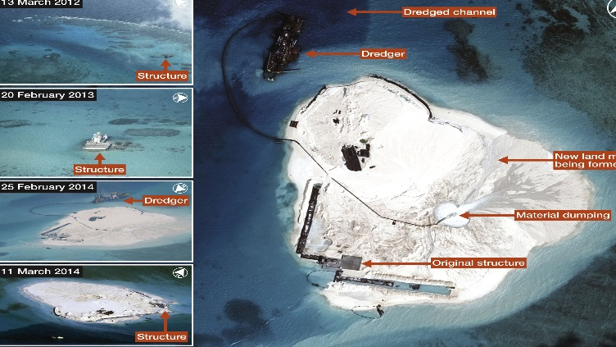
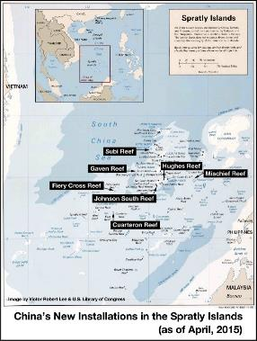
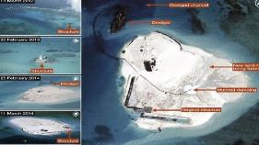
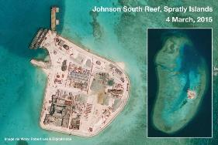
China’s Reclamation Projects
The reclamation projects started on seven disputed Reefs in the Spratly Islands since 2013
Mischief Reef
Fiery Cross Reef
Johnson South Reef
Cuarteron Reef
Hughes Reef
Subi Reef
Gaven Reef
The Construction projects include
Land extension
Living infrastructure constructions
Military infrastructure constructions
Anticipated effects of the Projects
Increased military and law enforcement capability
Strengthened control of resource exploitation and transportation routes
Enhanced political influence
Construction in Woody Island in Paracel Islands
Airstrip Extension project in 2014
Source of map: The Diplomat, April 25, 2015, http://thediplomat.com/2015/04/south-china-sea-chinas-unprecedented-spratlys-building-program/
Change of Johnson South Reef from March 2012 to March 2015
Source of map: Peace and Freedom, https://johnib.wordpress.com/tag/island-building/

Slide 5
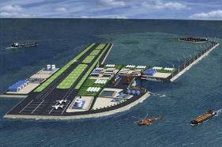
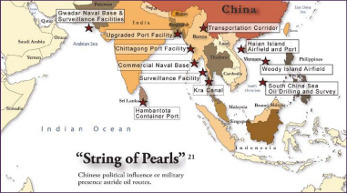
Significance of the Research
Current problems
Scant research combined spatial analysis, GIS, and open source information in open source domain
Studies heavily rely on open source information
Most of the articles only focus on a specific island
This project studies an ongoing event in one of the most complex sea areas with important strategic means
Dispute may be escalated to conflict in the near future.
A sharp downturn in geostrategic circumstances will cause long-term and extensive global effects
The reclamation project is a significant step for China’s transaction from a “land power” to “Sea power”, and “Blue Sea Navy Dream”
The research results can be used to forecast China’s further actions
Focus on the “big picture” and 1st order and 2nd order effects caused by the reclamation projects
A CGI plan of Gaven Reef shows a runway, hangars for fast jets, a port, wind turbines, and greenhouses. (China State Shipbuilding Corporation)
Source: James Hardy, IHS Jane's, http://www.janes.com/article/39716/china-goes-all-out-with-major-island-building-project-in-spratlys
Source: StratRisks , http://stratrisks.com/geostrat/13282

Slide 6
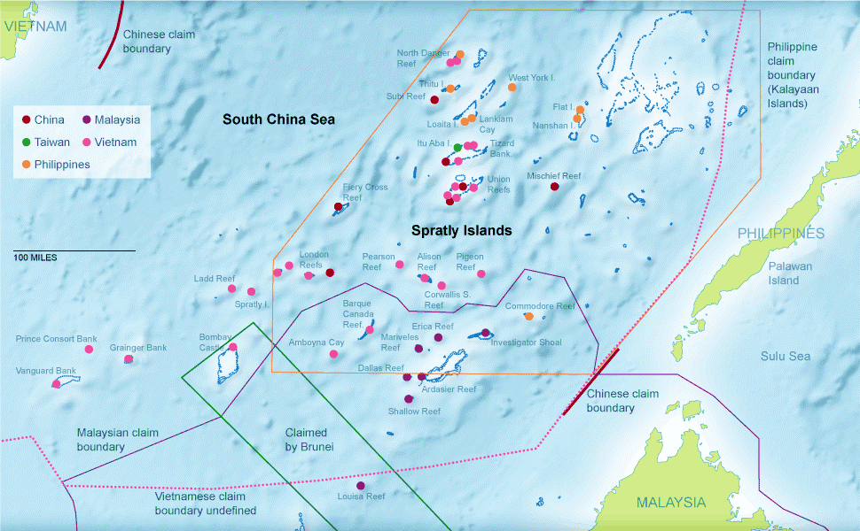
Research Objectives
Research Goal
The research focuses on the change of China’s military capability and operations in the South China Sea, completion of the reclamation projects in the future, as well as the subsequent effects caused by the change from various perspectives by using GIS overlay analysis.
Research Objectives - Answer the following questions by means of a geospatial approach:
How the reclamation projects strengthen its regional military capability in all six military functions?
What role will the strengthened military capability play in the scramble of energy and fishing resources?
How the strengthened military capability impacts operations and existence of the US military in the region?
How the change of military capability and subsequent results further affects international relationships and China’s strategies of the disrupted area?
Spratly Islands Occupation Status
By JOE BURGESS
Sources: U.S. Department of State, Office of the Geographer; GEBCO

Slide 7
Project Time Line
Task | Date
Proposal Phase | February – May 2015
Develop a draft research proposal
Conduct a pilot research
Brief the research proposal
Receive comments and finalize the research proposal
Preparation Phase | June – December 2015
Contact data providers and obtain required imaging data
Monitor and collect related information from open source
Develop and test the database set and scripting tools
Research Phase | January – March 2016
Process satellite images
Identify and create objects in the database set
Create GIS overlays
Create the combined overlays for analysis
Conduct research analysis
Write a draft research paper
Revise the research report
Publish or brief the research result
CSIS ASIA MARITIME TRANSPARENCY INITIATIVE / DIGITALGLOBE / AFP-JIJI

Slide 8
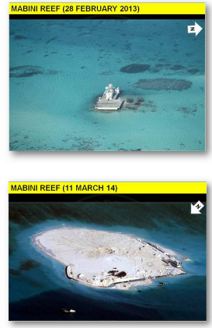
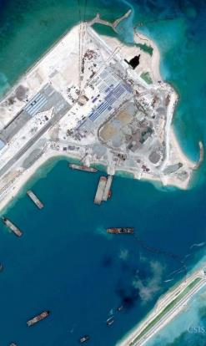
Data Resources
Sources of High-resolution Images
Commercial satellite image providers
Google Earth
Philippine Government
Images obtained Deadline - December 2015
Open Source Information
PSU Library
Internet
Army Open Source Center( Unclassified)
Source: Philippines Department of Foreign Affairs
CSIS ASIA MARITIME TRANSPARENCY INITIATIVE / DIGITALGLOBE / AFP-JIJI
Left : Aerial images of Mabini Reef, taken by Philippines Department of Foreign Affairs; right: Satellite image of the Fiery Cross reef by CSIS/DigitalGlobe

Slide 9
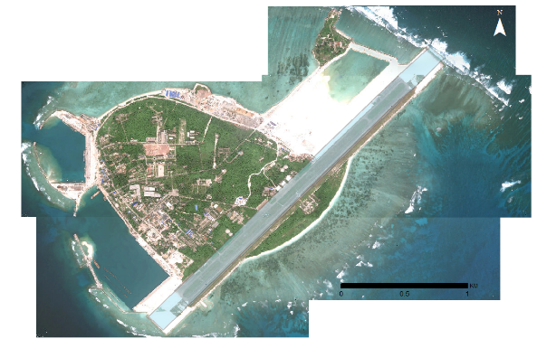
Research Methods
Image Process
Type of Images
Oblique Images- Aerial images from Philippine Government and some images from Google Earth
Orthophotos- Satellite Images and some images from Google Earth
Set up control points
Points at well-defined positions and four corners
Number of points varied for different types of image
Geo-registration in ArcGIS
1st order transformation
2nd order transformation
Horizontal accuracy assessment
15-20 well-defined reference points on each image
Meet standards of accuracy
Source: Philippines Department of Foreign Affairs
CSIS ASIA MARITIME TRANSPARENCY INITIATIVE / DIGITALGLOBE / AFP-JIJI
Woody Island, photo obtained from Google Earth, taken in August 2015.

Slide 10
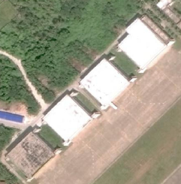
Research Methods
to
CSIS ASIA MARITIME TRANSPARENCY INITIATIVE / DIGITALGLOBE / AFP-JIJI
Four Aircraft shelters on Woody Island with dimension of 35M X35M

Slide 11
Analysis Plan
Analyze and estimate PLA’s most likely and most dangerous courses of action, as well as changes of the regional military power
Investigate the consequent effects on the scramble of resources and impact on U.S. military operations in the region
Study geopolitical changes caused by the military extension
CSIS ASIA MARITIME TRANSPARENCY INITIATIVE / DIGITALGLOBE / AFP-JIJI

Slide 12
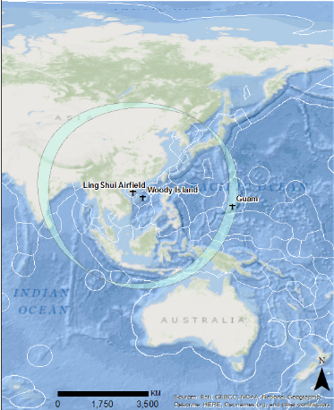
Research Methods
Effects of the Woody Island Airstrip Extension project on China’s military capability
Command and Control- capable for operation of Early-warning aircraft
Intelligence- Aerial SIGINT Platform
Fires- with increased range of H6K bombers, H6K bombers can directly fly from Woody Island to Guam without refueling
Movement and Maneuver- the extended airstrip is capable for refueling aircraft
Protection- Refueling aircraft extends range and duration time of fighters
Sustainment- Large cargo airplane can land and take off from the extended airstrip
CSIS ASIA MARITIME TRANSPARENCY INITIATIVE / DIGITALGLOBE / AFP-JIJI
Overlay in blue shows change of the H6 bomber ‘s operation range along with completion of the airstrip in Woody Island, China’s southeast airstrip. H6 bomber(operational range of 3500 KM) can directly fly to Guam from Woody Island without refueling

Slide 13
Tools and Software
ArcGIS- Student license provided by Pennsylvania State University
Google Earth Pro-Free Software
PostgreSQL-Free Software
Python-Free Software
CSIS ASIA MARITIME TRANSPARENCY INITIATIVE / DIGITALGLOBE / AFP-JIJI

Slide 14
Anticipated Result
GIS Products
Processed high-resolution aerial or satellite images of the targeted reefs
A GIS database set
Maps and combined overlays for analysis of corresponding objectives
Anticipated Analysis Result
China’s military capability and operations, and law enforcement activities at the southern end of the South China Sea will be significantly enhanced.
China will be benefited from the new forward operation bases in escorting trade fleets, surveying and exploiting natural resources.
Strengthened military power will consolidate their claim on the dispute area.
New disputes and tensions between China and other countries may emerge.
CSIS ASIA MARITIME TRANSPARENCY INITIATIVE / DIGITALGLOBE / AFP-JIJI

Slide 15
Questions?

