Slide 1
Open Source Social Media: @Russia-@Ukraine #Conflict
@tysonquink – May 17
2.7K
1.2K
…

Slide 2
Agenda
Origin of project and hypothesis
Why social media data
Real world events
Project approach and methodology
Demonstration
Questions

Slide 3
Project origins
Edward Snowden
National reaction to NSA leaks
Do our actions mirror our concerns
hypothesis
Can a spatial and temporal aggregation of geo-tagged social media posts be used to determine events over time?

Slide 4
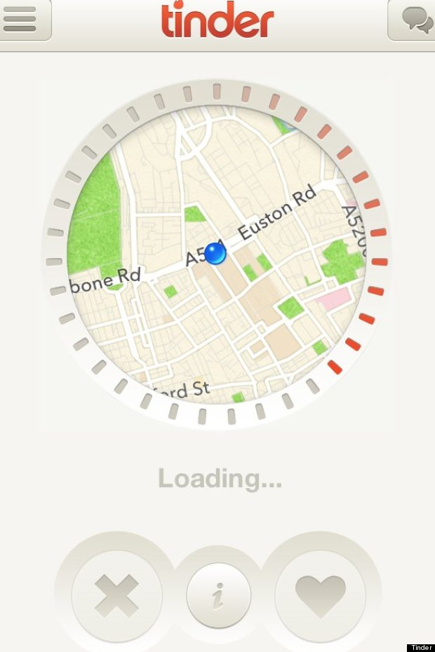
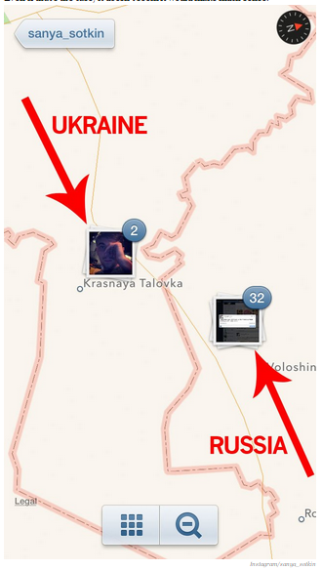
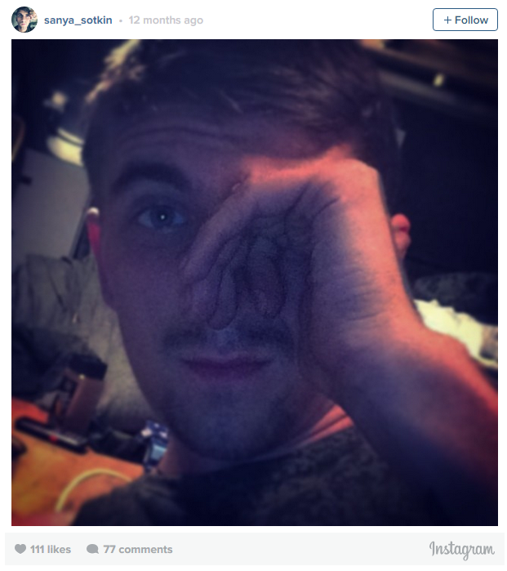
Social Media Use cases
Personal Use
Business Intelligence
Military & Intelligence
Business Insider, 2014

Slide 5
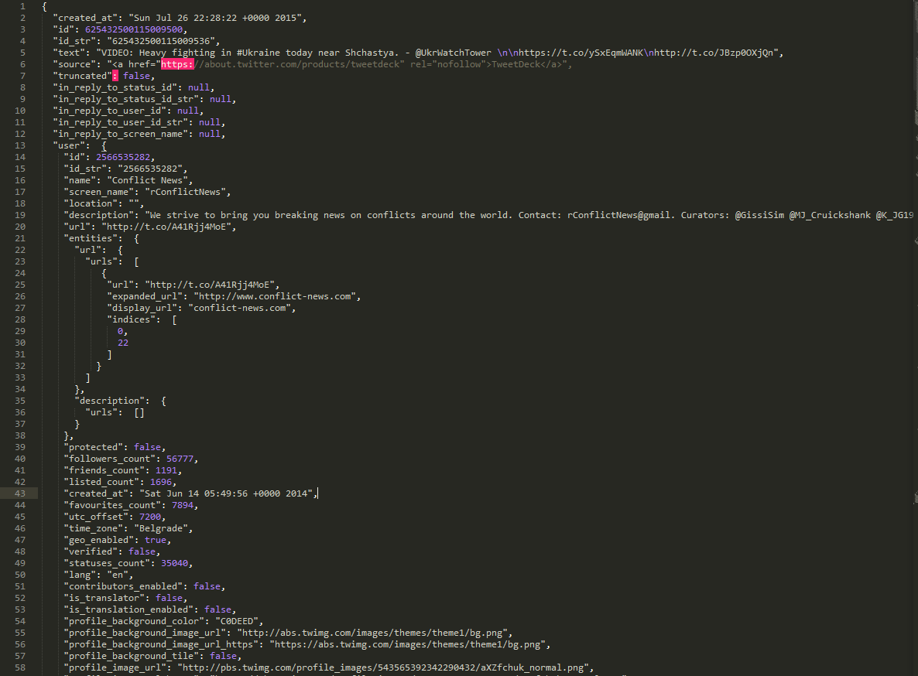
RAW SOCIAL MEDIA Data
"created_at": "Sun Jul 26 22:28:22 +0000 2015"
"id": 625432500115009500
"text": "VIDEO: Heavy fighting in #Ukraine today near Shchastya. - @UkrWatchTower \n\nhttps://t.co/ySxEqmWANK\nhttp://t.co/JBzp0OXjQn
"followers_count": 56777,
"friends_count": 1191,
"listed_count": 1696,
"created_at": "Sat Jun 14 05:49:56 +0000 2014",
"favourites_count": 7894,
"utc_offset": 7200,
"time_zone": "Belgrade",
"geo_enabled": true,
"profile_image_url": "http://pbs.twimg.com/ profile_images/543565392342290432/aXZfchuk_normal.png"
326 lines comprise this one tweet

Slide 6
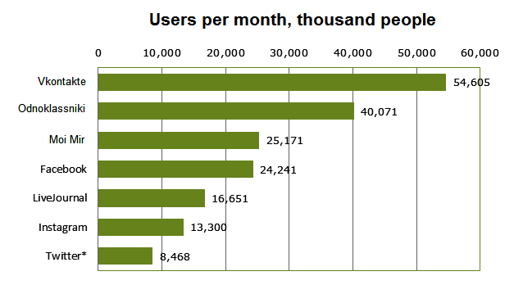
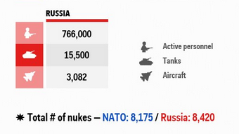
Why Russia-Ukraine?
Conflict Timeline
23 FEB-19 MAR 2014 - Annexation of Crimea by Russian Federation
26 FEB 2014 -Present – Russian Intervention in Ukraine
Military Posture
http://www.russiansearchtips.com/category/social-media-in-russia/
http://www.businessinsider.com/putin-russias-military-strength-is-unmatchable-2015-2
Russia’s Population: 146.2M
88% of Russian Twitter users are on mobile devices
Social media links to Russian’s soldiers operating in Ukraine
Commercial Cost for Tweets:
120M Tweets for $52K

Slide 7
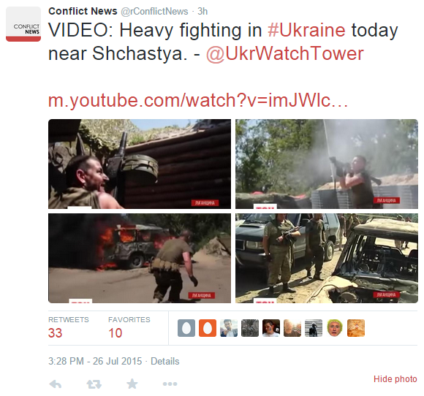
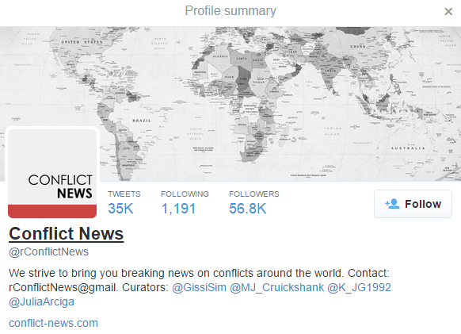
Social media

Slide 8
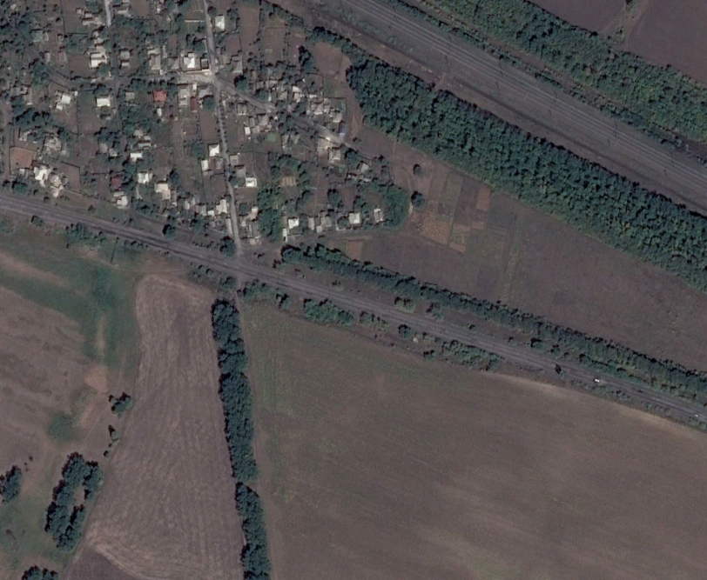
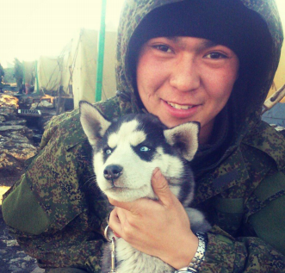
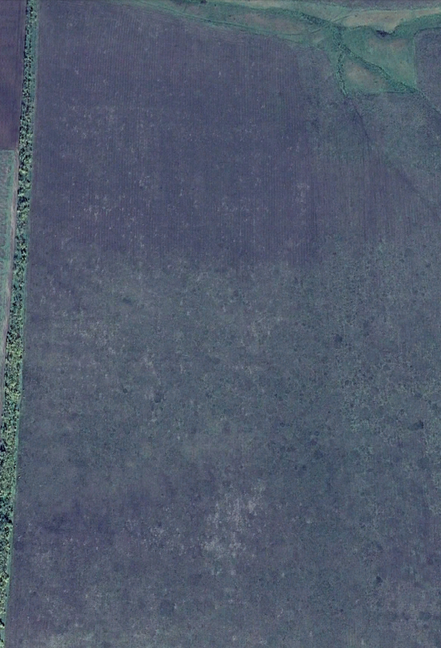
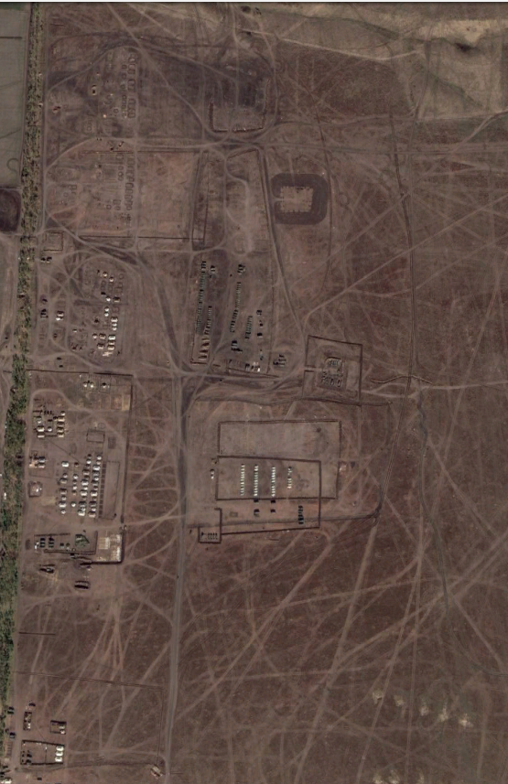
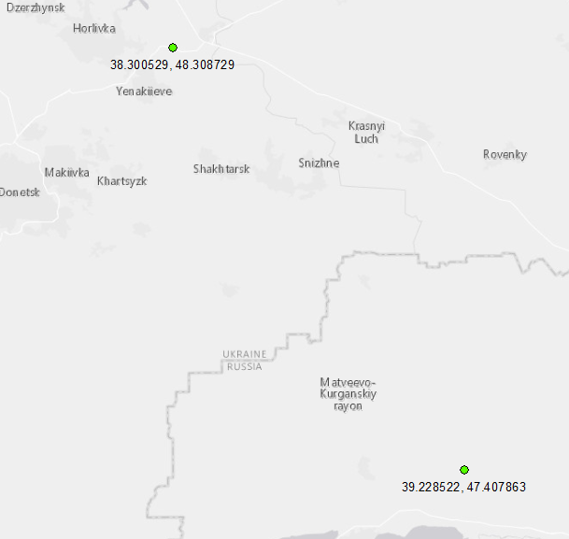
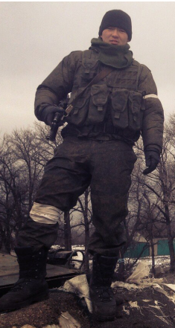
Russian Solider in Ukraine
Coordinates:
47.407863,
39.228522
Bato Dambayev
37th Motorized Infantry Brigade
October 19, 2013
October 9, 2014
2015
Coordinates:
48.308729,
38.300529
http://www.atlanticcouncil.org/images/publications/Hiding_in_Plain_Sight/HPS_English.pdf

Slide 9
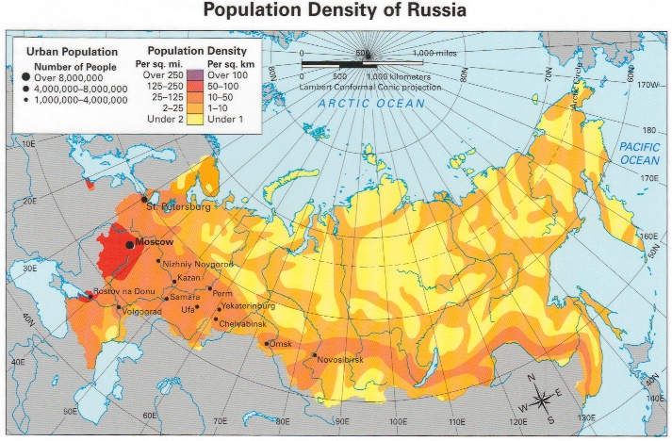
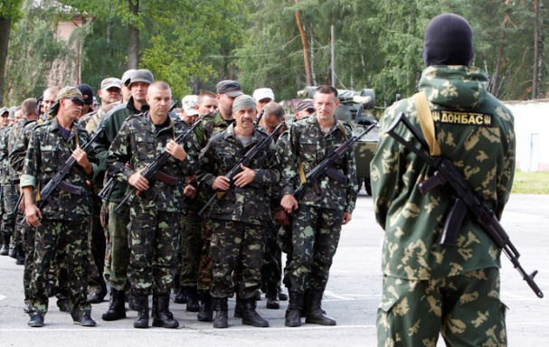
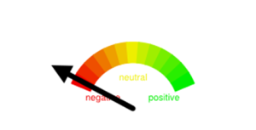
Project methodology
Spatial & Temporal Analysis
Sentiment Analysis
Text Mining
Objective
Southern US
Can military or intelligence precursors be identified through social media?
=
The Rest of US
Mapping Time
Volume
=
Time

Slide 10
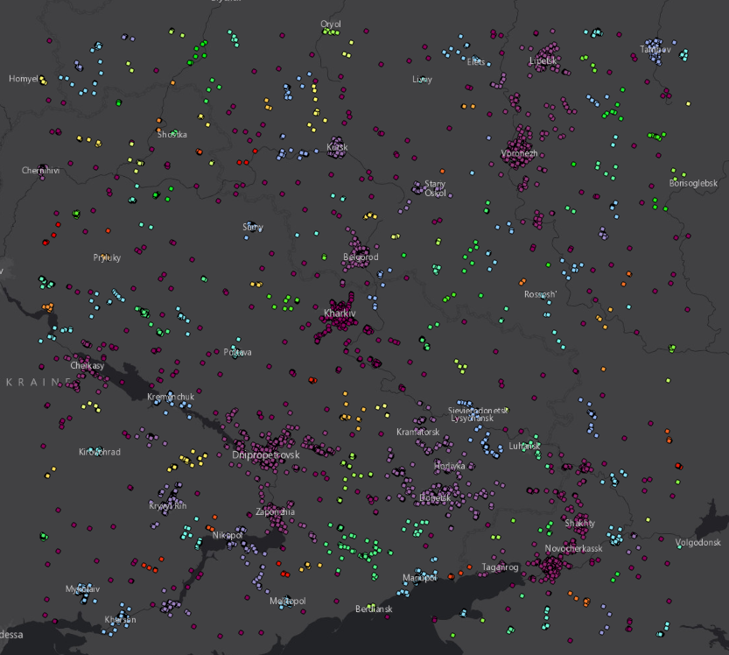
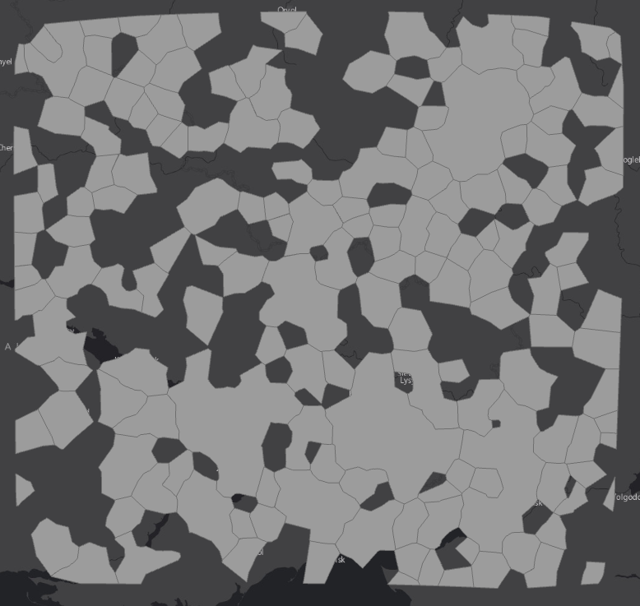
How to create “places”? Method: Density-based spatial clustering of applications with noise (DBSCAN)
http://scikit-learn.org/stable/modules/generated/sklearn.cluster.DBSCAN.html

Slide 11
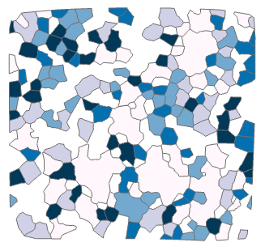
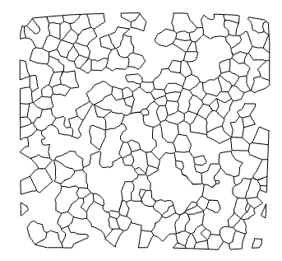
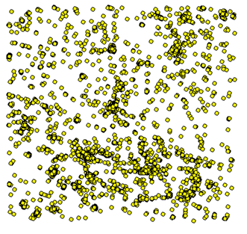
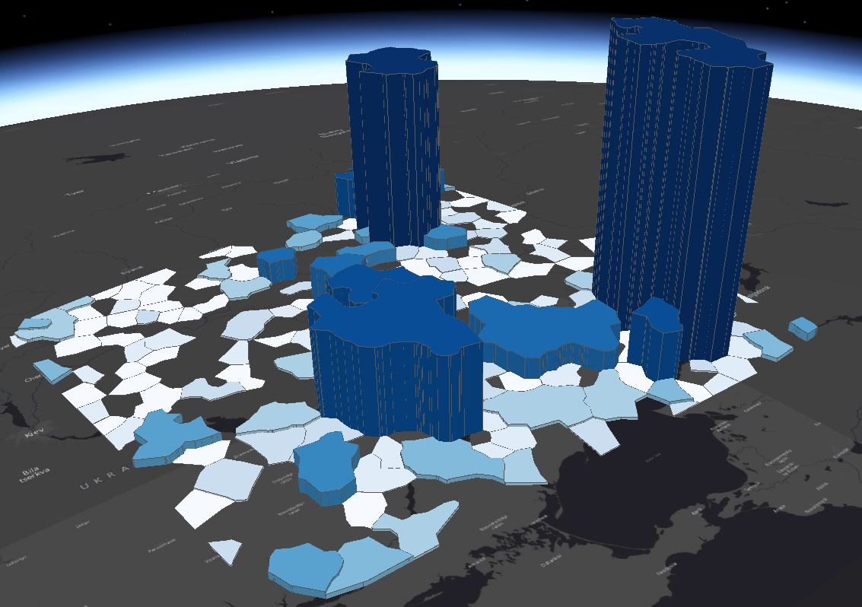
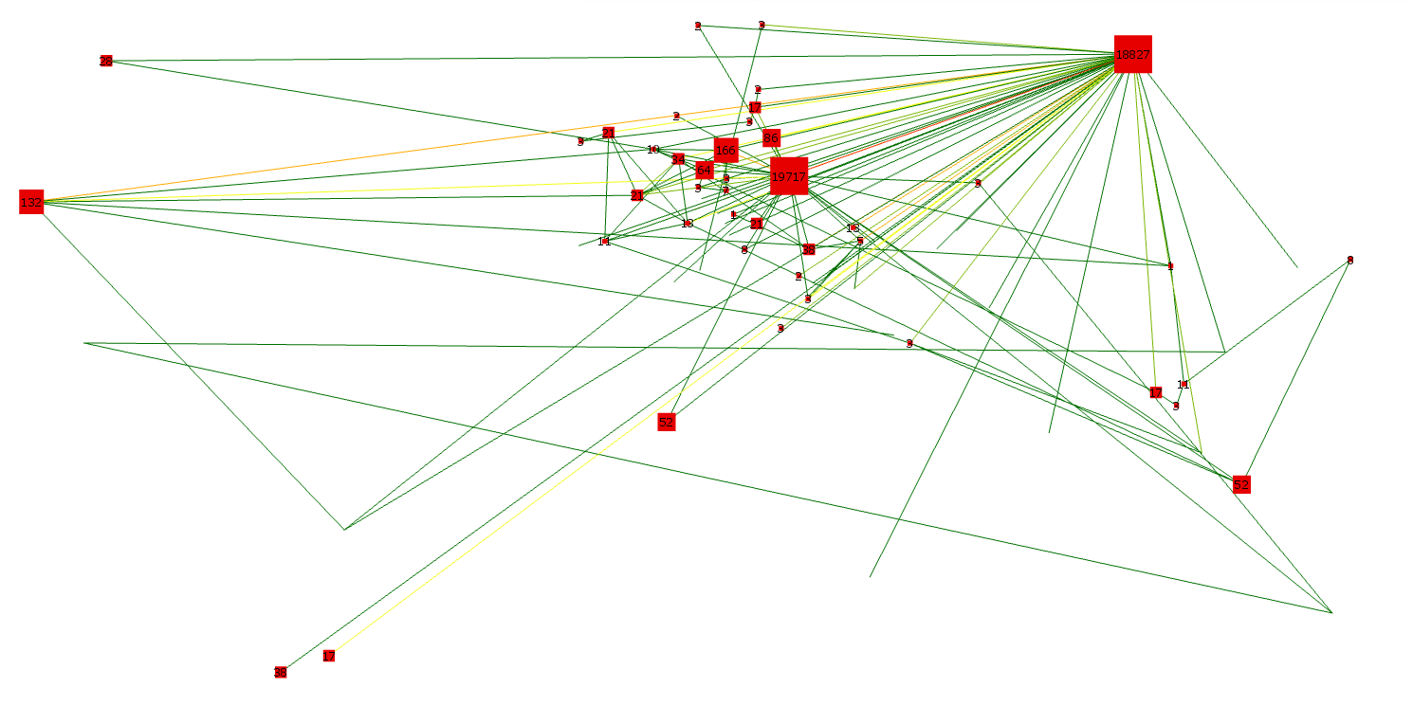
Data flow & Services
#Russia
#Ukraine
#Selfie

Slide 12
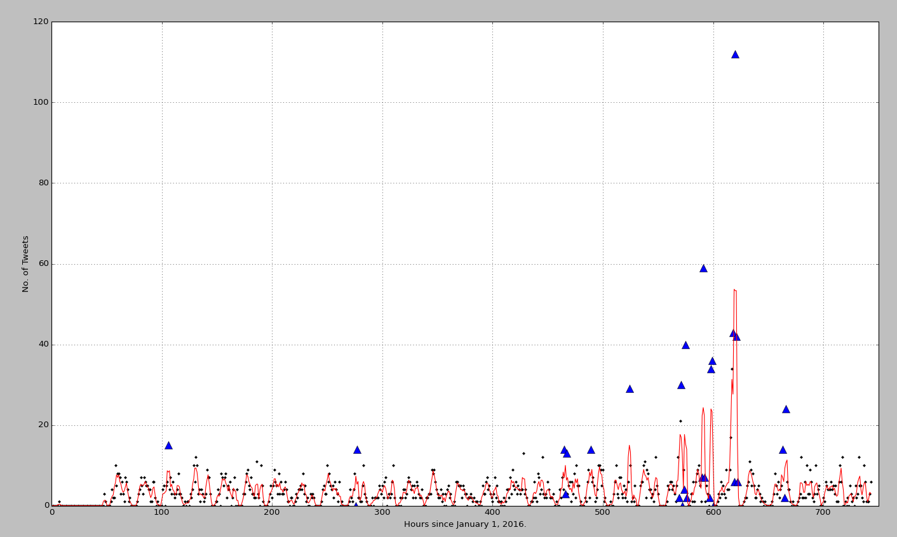
#PurposeTourToUkraine

Slide 14
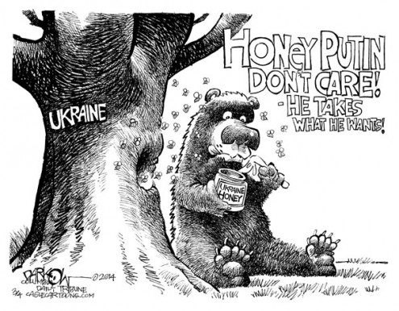
questions
Denver Post, 2014

