Slide 1
Identification of Priority Parcels for Habitat Protection on the Eastern Shore of Virginia
Jessica Rhodes
Notes:
Hello, My name is Jessica Rhodes. I am a habitat restoration biologist with the Partners for Fish and Wildlife Program of the U.S. Fish and Wildlife Service located in Gloucester, Virginia. The PFW program works on habitat restoration projects throughout the state of Virginia and occasionally in North Carolina. The Eastern Shore of Virginia has been identified as a focus area for our office and as a result, we have concentrated our efforts in this area.

Slide 2
Outline
Importance of analysis
Summary of existing conservation plans
Goals and objectives
Study area
Methods
Deliverables
Timeline
Notes:
My presentation will cover the following topics in this order:
Importance of analysis
Summary of existing conservation plans
Goals and objectives
Study area description
Methods
Deliverables
Timeline

Slide 3
Importance of Analysis
Eastern Shore of Virginia is a critical migration corridor
Numerous migratory bird species populations in decline
Numerous threats facing migratory birds
Recommendation made to acquire and protect land in a series of conservation corridors
Notes:
---The Eastern Shore is critical migration corridor for migratory birds.
---Past 40 years have shown overall decline in bird populations. Waterfowl, wetland species, and wintering coastal birds have experienced increasing populations as a result of conservation actions. This shows that conservation actions are working and could help other species groups which are still in decline.
---Threats include: habitat loss (greatest threat), fragmentation, degradation, contaminants, overharvest, nest predation, and mortality from commercial fisheries.
---Because of the numerous threats and declining populations, the ACJV made a conservation recommendation for the acquisition and protection of land in a series of conservation corridors, restoration of previously converted agricultural lands, treatment of exotic and invasive species, and future zoning of land to reduce development impacts.
---My analysis will help to achieve this goal by identifying specific parcels in order to protect the most critical areas for migratory birds and prioritize these parcels so that the limited funds that are available can be used most effectively.

Slide 4
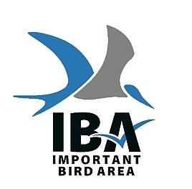
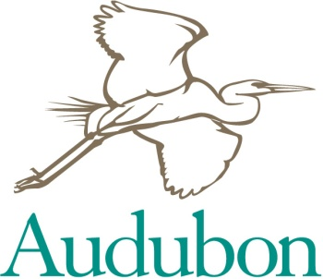
Existing Plans
Identified focus areas based on broad taxonomic groups
Coarser scale than my study area
Focused on planning versus implementation
Notes:
---There are many plans dedicated to the conservation of migratory birds. I will discuss the details of a few of them and how they selected priority areas.
---The existing plans focus on taxonomic groups, including:
Landbird
Shorebird
Waterbird
Waterfowl
---My plan will focus on response guilds. A guild is a group of species with similar requirements but may not be taxonomically related.
---Existing plans are at a coarser scale than my study area. They have multi-state, national, and global (IBAs) coverage.
---These plans identified broad geographic areas to focus efforts, but did not identify specific locations/parcels.
---They also did not determine which areas were already in conservation status.

Slide 5
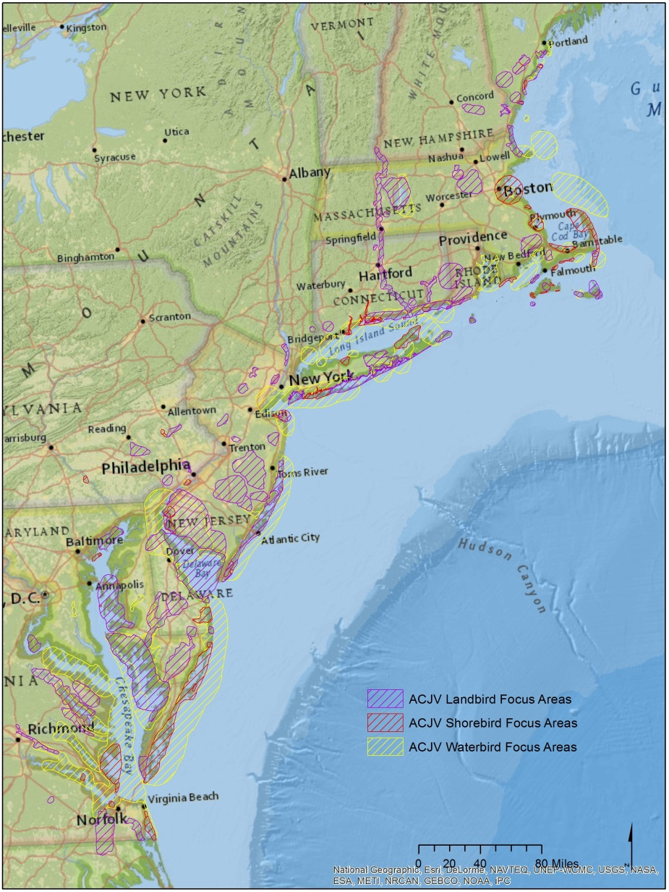
BCR 30 Implementation Plan
Designated focus areas for shorebirds, landbirds, and waterbirds within BCR 30
Discussed waterfowl focus areas developed by NAWMP
Criterion includes:
Regional importance
Developed at landscape level
Discrete and continuous habitat
Size
Notes:
---Map shows extent of New England/Mid-Atlantic Coast BCR (BCR 30).
---Criteria used to select focus areas includes:
Areas are regionally important to one or more life history stages or seasonal-use periods.
Focus areas are developed within the context of landscape-level conservation and biodiversity.
Focus areas are made up of discrete and distinguishable habitat complexes demonstrating clear ornithological importance. Boundaries are defined using ecological factors such as wetlands and/or wetland buffers.
Focus areas are large enough to supply all the necessary requirements for survival during the season for which the area is important, except where small disjunct areas are critical to survival and a biological connection is made, such as areas used by migrating shorebirds.
---Eastern Shore contains focus areas for waterbirds, shorebirds, landbirds, and waterfowl.

Slide 6
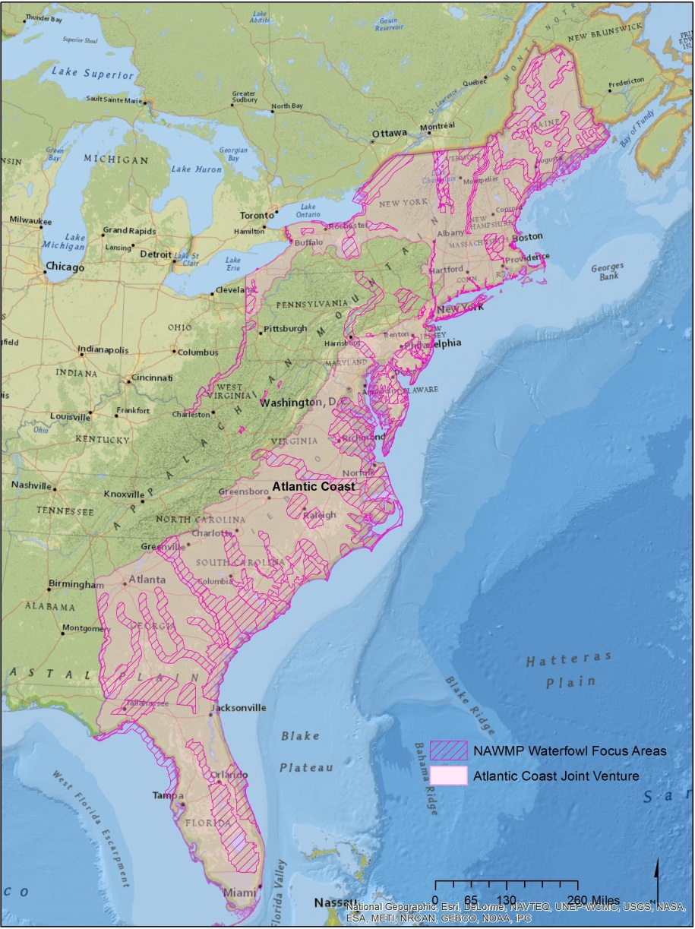
North American Waterfowl Management Plan
Developed focus area for waterfowl only
Three tiered approach
Planning area
Focus area
Sub-focus areas
Used similar approach as BCR 30
Notes:
---Original concept of focus areas not adequate to describe important areas for waterfowl habitat which is sparsely distributed over large areas or where targeted activities address other conservation issues such as water quality
---Three tiered approach includes the development of planning areas (largest of the three areas), focus areas, and sub-focus areas.
---The boundaries for planning areas were based on units used to plan waterfowl habitat conservation within a state (e.g., watershed or physiographic area). Planning areas generally contain small patches of suitable habitat interspersed throughout the area.
---Focus areas were the next tier and are defined by contiguous areas of suitable habitat. Delmarva Peninsula is a focus area.
---Sub-focus areas include specific and discrete habitat which are important to certain species. The Eastern Shore was divided into two sub-focus areas, Eastern shore – Bayside and Eastern Shore - Seaside.

Slide 7
Important Bird Areas (IBAs) in Virginia
Notes:
Goal is to develop a network of sites for the long-term viability of naturally occurring bird populations
---IBAs are potentially vulnerable places considered to have the highest global priority for bird conservation.
---IBAs are selected based on the presences of bird species of global conservation concern, assemblage of restricted range bird species, assemblages of biome restricted bird species, and globally important congregation of birds.
---IBAs are prioritized as global, continental, or state based upon thresholds of the specific criteria.
---Global IBAs originally developed by Bird Life International using locally derived data
---State level IBAs have been identified by Audubon Society for the United States based upon different criteria established by Audubon
---Boundaries designated by
Denoting habitat differences
Identifying actual/potential protected areas that can be managed as a conservation area
Provides all the requirements for the species of interest
---Two global IBAs
Barrier Island/Lagoon system
Delmarva Bayside Marshes
---Two state level IBAs
Chesapeake Bay Islands
Lower Delmarva Peninsula

Slide 8
U.S. Shorebird Conservation Plan
Eleven regional groups
Eastern Shore is within North Atlantic Planning Region
Identified goal to protect and manage sufficient areas of high priority habitats to support current populations of breeding, migrating, and wintering shorebirds
Areas in Virginia include: coastal marshes and mudflats, barrier islands, Craney Island, mainland coastal areas, and uplands on the Delmarva Peninsula
Notes:
---Eleven regional groups were formed to determine which habitats need protection and management to meet the requirements of shorebirds in each region.
---The Eastern Shore is within the North Atlantic planning region. This region is one of the most heavily populated areas in the U.S. and
is extremely important for transient shorebirds during migration.
---The regional plan identified a habitat goal to protect and manage sufficient areas of high priority habitats to support current populations of breeding, migrating, and wintering shorebirds.
---The significant areas identified in Virginia include coastal marshes and mudflats, barrier islands, Craney Island, mainland coastal areas, and uplands on the Delmarva Peninsula. Protecting these areas is crucial to the protection of shorebirds in this region.

Slide 9
NAWCA Priority Areas for Waterbirds
Developed as an interim tool
Developed criteria for breeding colonial waterbirds
NAWMP and Shorebird Plan priority areas were selected for non-colonial waterbirds and wintering waterbirds
Eastern Shore is part of Atlantic Coast Region and Florida priority area
Notes:
---The NAWCA priority areas were developed as an interim tool based on information acquired from the IBAs and information from regional working groups.
---Developed criteria for breeding colonial waterbirds.
---Criteria for breeding colonial waterbirds includes:
Species diversity
Number of species for which the BCR is considered an area of high importance
Number of high priority species (highly imperiled or high concern) for which the BCR is an area of high importance
---Priority areas from NAWMP and Shorebird Plan were selected for non-colonial waterbirds and wintering waterbirds
---Only the coastal areas from the BCRs of national importance were included in the priority areas.
---The entire Eastern Shore is part of the larger Atlantic Coast Region and Florida priority area

Slide 10
Focus Area Overlap
Notes:
---Map depicts overlapping focus areas. Because of its importance to migratory birds, the Eastern Shore includes many areas of overlap.

Slide 11
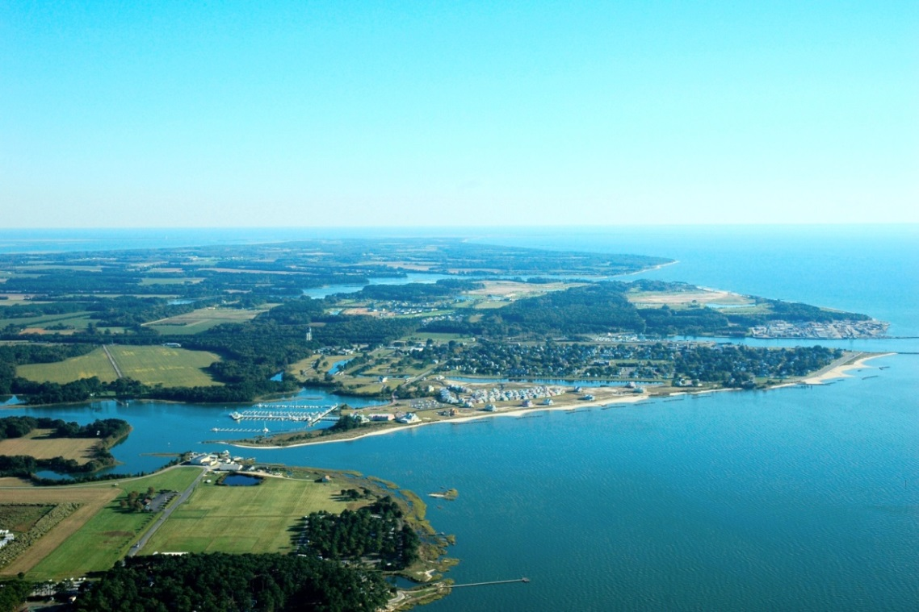
Goals
Identify and prioritize parcels for habitat protection based on importance to migratory birds
Develop an interactive web mapping application which will incorporate existing data layers with the prioritized parcels identified in my analysis

Slide 12
Analysis Objectives
Develop potential habitat distribution layer for each response guild
Identify non-protected parcels within the study area
Determine acres of currently protected lands for each guild and compare it to management goals
Calculate cost associated with habitat protection
Identify parcels vulnerable to sea level rise
Create a habitat protection prioritization strategy for non-protected parcels
Notes:
---Birds will be grouped into response guilds and I will create a habitat distribution layer for each guild.
---Using response guilds as a management strategy makes it possible to consider multiple species simultaneously to assess habitat impacts.
---All non-protected parcels on the Eastern Shore will be identified. Only non-protected parcels are going to be included in the analysis.
---Determine acres of suitable habitat that are currently protected to compare the total to management goals. Determine how much additional habitat will be needed to meet those goals.
---I plan to also calculate costs for protection activities. This information will be invaluable when setting priorities.
---Identify parcels vulnerable to sea level rise. Parcels which are especially vulnerable may be a lower priority and there may be other parcels which may be a higher priority because they will provide valuable habitat migration corridors.
---Create a habitat protection prioritization strategy for non-protected parcels.

Slide 13
Web Mapping Application Objectives
Create an interactive web map which will allow users to:
View the prioritized parcels alongside the existing data layers
Perform queries to display only the data of interest
Create printable maps
Export data layers
Compare currently protected habitat acres to acres identified in the analysis and determine if protection goals can be achieved
Notes:
---Second part of my project is to create an interactive web mapping application which will allow users to:
View the prioritized parcels alongside the existing data layers
Perform queries to display only the data of interest
Create printable maps, export data layers
Compare currently protected habitat acres to acres identified in the analysis and determine if protection goals can be achieved

Slide 14
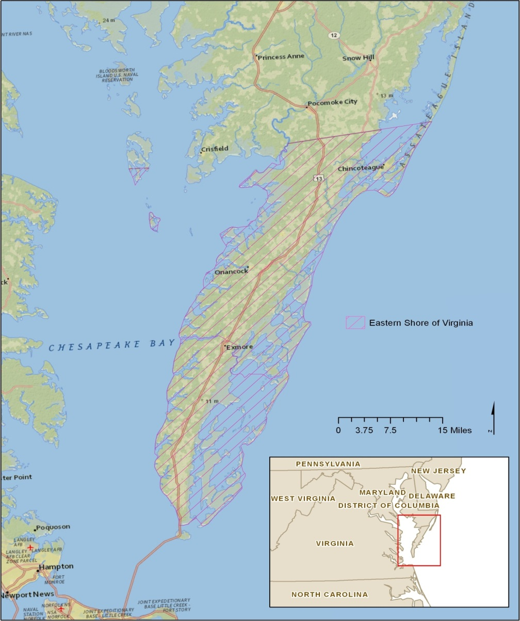
Study Area
425,505 acres
Agricultural and aquacultural community
Historically hardwood dominated forest with interspersed marshes and wetlands
International Biosphere Reserve
Western Hemisphere Shorebird Network Site
Globally important migration corridor
Insert study area map
Notes:
---Real estate parcel acreage is 425,505 acres
---Primarily agricultural and aquacultural community, supporting many oystermen, crabbers, clammers, and commercial fishermen.
---Historically hardwood dominated forest with interspersed marshes and wetlands. However, high quality soils led to clearing and draining for agriculture.
---More recently, there has been a shift from row crop production to commercial vegetable production, resulting in a loss of foraging habitat for numerous waterfowl species.
---Recognized in 1979 as an International Biosphere Reserve by the United Nations Man and Biosphere Reserve Programme due to its important natural resources.
---In 1990, seaside barrier islands and associated beach habitat were designated as a Western Hemisphere Shorebird Network Site due to the amount habitat and the overwhelming shorebird utilization of the area.
---ACJV identified three high priority waterfowl species during breeding season, 15 during migration, and 13 species as wintering habitat.
---Eastern Shore is also recognized as a globally important migration corridor for songbirds, shorebirds, raptors, seabirds, and wading birds. ---------Several high priority beach species also use the area.

Slide 15
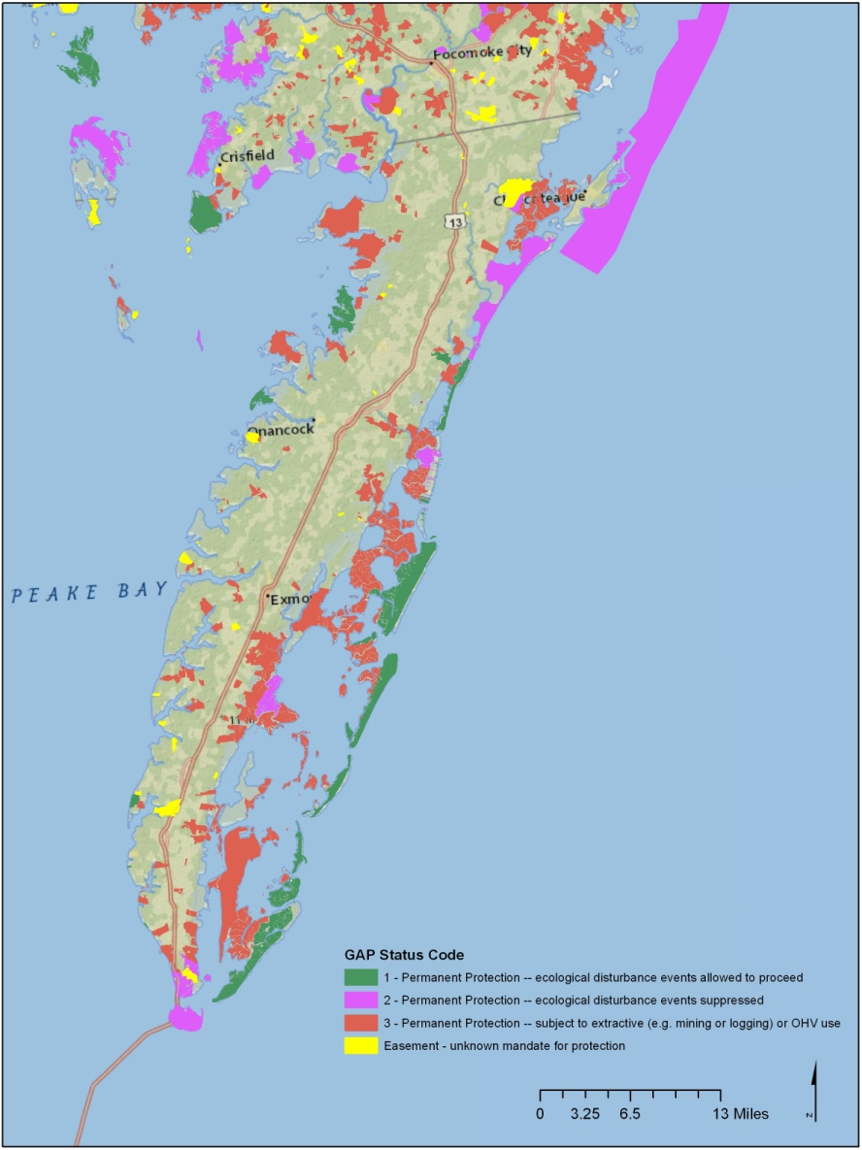
Protected Lands on the Eastern Shore
124,144 acres (29%) currently protected
21,158 acres permanently protected with ecological disturbance events allowed
26,209 acres permanently protected, ecological disturbance events suppressed
71,151 acres protected but subject to extractive uses
5,625 acres protected through easements
Notes:
---There are currently 124,144 acres of protected lands on the Eastern Shore, which is 29% if the total land.
---21,158 acres permanently protected with ecological disturbance events allowed to proceed
---26,209 acres permanently protected, ecological disturbance events suppressed
---71,151 acres protected but subject to extractive uses (look this up in the SE GAP report)
---5,625 acres protected through easements

Slide 16
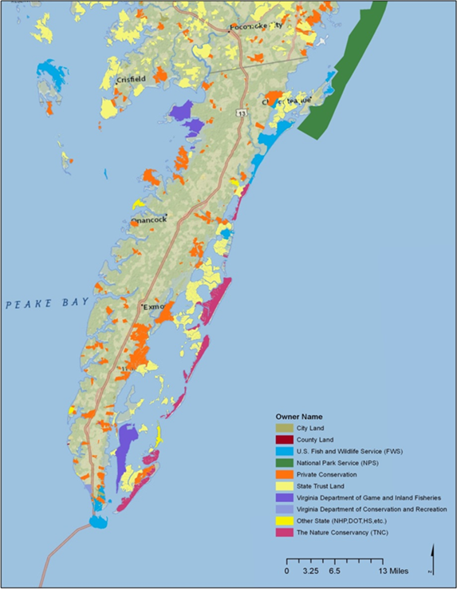
Ownership of Protected Lands
Three National Wildlife Refuges
Seaside barrier islands and seaside farms owned/managed by TNC
Four Wildlife Management Areas
One state park
Two natural areas
Barrier Island owned by Department of Conservation and Recreation
Notes:
---The map to the right displays the protected land on the Eastern Shore including three National Wildlife Refuges, seaside barrier islands and conservation easements on seaside farms owned and/or managed by The Nature Conservancy (TNC), four wildlife management areas owned by the Virginia Department of Game and Inland Fisheries, one state park, two natural areas, and one barrier island owned by Virginia Department of Conservation and Recreation.
---Private lands are the largest category of lands.
---Largest single landowner is the Nature Conservancy with a total of 81 parcels and 18,767 acres.

Slide 17
Land Cover on the Eastern Shore
SE GAP Land Cover Type | Acres | % of Total
Atlantic Coastal Plain Northern Tidal Salt Marsh | 102510.45 | 24.46
Row Crop | 97804.91 | 23.33
Atlantic Coastal Plain Northern Basin Swamp and Wet Hardwood Forest | 60943.81 | 14.54
Pasture/Hay | 41364.40 | 9.87
Atlantic Coastal Plain Dry and Dry-Mesic Oak Forest | 27418.61 | 6.54
Atlantic Coastal Plain Northern Tidal Wooded Swamp | 14460.69 | 3.45
Open Water (Brackish/Salt) | 12717.83 | 3.03
Atlantic Coastal Plain Northern Maritime Forest | 12459.58 | 2.97
Successional Shrub/Scrub (Clear Cut) | 10473.69 | 2.50
Evergreen Plantations or Managed Pine (can include dense successional regrowth) | 8463.61 | 2.02
Atlantic Coastal Plain Small Blackwater River Floodplain Forest | 6525.85 | 1.56
Developed Open Space | 4959.14 | 1.18
Low Intensity Developed | 3596.24 | 0.86
Atlantic Coastal Plain Northern Dune and Maritime Grassland | 3415.22 | 0.81
Successional Shrub/Scrub (Other) | 2739.29 | 0.65
Atlantic Coastal Plain Southern Dune and Maritime Grassland | 2693.84 | 0.64
Atlantic Coastal Plain Northern Fresh and Oligohaline Tidal Marsh | 2315.20 | 0.55
Other – Herbaceous | 1460.36 | 0.35
Medium Intensity Developed | 1364.60 | 0.33
Quarry/Strip Mine/Gravel Pit | 686.89 | 0.16
High Intensity Developed | 517.82 | 0.12
Unconsolidated Shore (Lake/River/Pond) | 257.99 | 0.06
Open Water (Fresh) | 27.67 | 0.01
Notes:
---This table displays all of the land cover classes from the Southeast GAP analysis. There are a total 24 different land cover classes. As you can see there is diversity of different land cover types on the Eastern Shore. The most common land cover types include; Atlantic Coastal Plain Northern tidal salt marsh, row crop, and Atlantic coastal plain northern basin swamp and wet hardwood forest.

Slide 18
Land Cover Summary
Modified Land Cover Type | Acres | % of Total
Agriculture | 139169 | 33
Forest | 130272 | 31
Salt Marsh | 104826 | 25
Early Successional | 20782 | 5
Open Water | 13003 | 3
Developed | 11125 | 3
Notes:
---The SE GAP has detailed land cover classes. To get a better understanding of the general land cover on the Eastern Shore, I have grouped all of the SE GAP land cover categories into generalized categories.
---Agriculture, forest, and salt marsh comprise the largest percentage (89%) of land on the Eastern Shore. Early successional habitat, open water, and developed land only account for 11 percent of the total land.

Slide 19
Methods - Guild Development
Develop a species list for response guilds based on habitat requirements during foraging and breeding
Use land cover types as a base
Whole guild approach vs. guild indicator species
Birds may be placed in multiple guilds
Sensitivity to habitat fragmentation
Based on Eastern Shore habitat, not range-wide
Bird list a subset of priority species
Notes:
---I divided my methods section into three categories; guild development, analysis, and web mapping application. I will first discuss the guild development methods.
---First I will develop a list of bird response guilds based on habitat requirements during foraging and breeding. Members of a response guild use habitat resources in a similar manner, but may not be taxonomically related.
---Members of a guild may differ in precise food requirements which allow them to cohabitate.
---The use of response guilds as a management strategy makes it possible to consider multiple species simultaneously to assess potential habitat impacts. This will be more effective than attempting to consider each species individually.
---My response guild will be based on habitat types using the SE GAP land cover classifications as a base.
---When using guild, you can use either use the whole guild response which will consider all species within the guild or the indicator species approach. When using an indicator species, one representative species is selected from the guild and the analysis is performed on that species. The assumption is that all species within the guild will respond in a similar manner. Using an indicator species approach requires more refined guild assignments to assure that all species will respond in a similar manner. I chose the whole guild approach because it will require less refined guilds than when using indicator species and the time required to refine the guilds will not likely produce significantly different results then when using the whole guild approach.
---Bird species may be based in multiple guilds, especially if they have different habitat requirements at different times of the year.
---Certain species have similar habitat requirements, but may be more sensitive to edge effects. For example, some birds are more susceptible to nest predation and brood parasitism. As a result, many sensitive species are restricted to larger habitat patches. To accommodate for this, I will have interior and edge guilds for certain habitat types.
---An important note is that habitat requirements for my analysis will be based on habitat birds utilize while on the Eastern Shore, not range-wide characteristics.
---Due to the volume of bird species which utilize the Eastern Shore throughout the year, I will create my guild assignments based upon priority bird species. The priority species were identified as birds of conservation concern by the Fish and Wildlife Service, priority 1 and 2 species from Partners in Flight, North Atlantic Landscape Conservation Cooperative priority species, and highest and high priority species from the BCR 30 Implementation Plan.

Slide 20
Methods - Analysis
Create a layer of all non-protected real estate parcels
Merge all existing focus areas into one data layer
Determine distance from non-protected parcels to other areas of suitable habitat which are protected
Identify areas of contiguous habitat
Determine minimum patch size for guild groups
Identify concentrated stopover areas
Notes:
---The next step in my analysis will be to identify all of the non-protected land parcels in Northampton and Accomack County, Virginia. The parcel layer will be compared to the Southeast Gap (SE GAP) land status layer to identify the protection status. All non-protected lands will be exported as a shapefile for further analysis.
---The BCR 30 plan recognizes the importance of areas of overlap among the different focus areas (Service 2008). I plan to merge all of the focus areas from the existing plans into one layer. Real estate parcels within overlapping focus areas will be a higher priority.
---Identifying a network of sites for protection is a cost-effective approach because those identified sites can support a large proportion of bird species and communities. In addition, the protection of a network of sites is especially important for species with a wide home-range, low natural densities, or migratory behavior for which individual sites cannot support the population. Because the connection of habitat is a critical component to conservation, I plan to incorporate the importance of adjacent conservation lands in my analysis. Parcels that are adjacent to or provide a corridor to other protected lands of suitable habitat will be considered a higher priority than parcels of suitable habitat that do not connect to other conservation lands.
---Conservation of birds requires knowledge of not only habitat type, but also the amount of habitat needed. The edge effect around a parcel may reduce the effectiveness of protecting an otherwise suitable parcel. Certain bird species, especially single-brooded and ground nesting species experience higher nest predation rates and are more sensitive to habitat fragmentation than others. I will incorporate habitat patch size and percent forest cover in my analysis. For each guild, I will determine minimum area requirements. I will then reclassify the SE GAP land cover layer to reflect interior versus edge habitat. Robbins et al (1989) determined that gaps of 100 meters or more produces isolation characteristics. Habitat with gaps larger than 100 meters will be considered separate areas. Parcels containing more interior habitat will be a higher priority for sensitive species than parcels with more edge habitat. Edge habitat will not automatically be removed from the analysis as it still may provide value for sensitive species and may be a higher priority for species that are adapted to those conditions. I will use the percent canopy cover available from the National Land cover dataset. For each guild I will determine a range of suitable percent canopy cover values and reclassify the percent canopy cover layer to reflect the suitability for each guild.
---Certain areas on the Eastern Shore provide important habitat for very high concentrations of birds during peak migration periods. These areas may be important for a single species or a group of species. Even though these areas may only be used for a short time during migration, they are highly important and loss of them could cause significant impact to species populations. Parcels within concentrated stopover habitat will be considered a high priority.

Slide 21
Methods - Analysis (ctd.)
Identify parcels vulnerable to sea level rise
Determine cost of habitat protection activities
Assign weights to input data layers to prioritize non-protected lands using a weighted overlay analysis
High
Medium
Low
Non-priority
Notes:
---In the Chesapeake Bay region sea-level is expected to rise two feet by the year 2100.
---The potential habitat losses could affect waterfowl that use the area for stopover habitat during migration or as a wintering area.
---Declines in tidal freshwater marshes could affect species such as the American black duck.
---The loss of sea grass beds associated with sea-level rise could have negative impacts on species that depend upon submerged aquatic vegetation as a food source.
---Bird species that utilize coastal marshes and beach habitat are potentially vulnerable due to the limitation of food sources and increased vulnerability to predators.
---Increasing human populations and development pressure in combination with loss of land due to sea-level rise will put habitat at risk unless proactive conservation measures are taken.
---My analysis will identify particular areas where fee-simple acquisition and easements are possible and will provide the greatest benefit. Areas which are projected to be inundated will be a lower priority than other areas, but they will still be a priority as they currently provide important habitat.
---It is also important to consider the ability of habitat to migrate inward. Habitat located adjacent to areas which may become inundated will be particularly valuable and will be considered a higher priority.
---When planning conservation activities, it is important to consider not only areas with adequate habitat, but also consider the cost-effectiveness of conservation activities. Fee-simple acquisition provides the greatest level of protection from human disturbance and is the strongest way to protect on-site resources because the owner has complete control over the land and resource protection is easier to manage. Establishment of conservation easements on certain parcels where acquisition may not be possible or cost prohibitive would be the next preferred method of habitat protection.
---I plan to use the data I have discussed in a weighted overlay analysis. For each input layer, I will assign a ranking to a range of values. The values for each input layer will be combined to assign a numeric rating for each parcel. I will then categorize all the values into four priority levels; high, medium, low, and non-priority.

Slide 22
Methods – Web Mapping Application
ArcGIS Online through USFWS account
Incorporate analysis data and input data layers
Basic web map features will be included
Additional features will include:
Creation of printable maps
Ability to export data
Ability to query data
Dashboard tool display
Notes:
---The final component of my project will be to incorporate the data I have created along with the data I have used into a web mapping application. I plan to use my ArcGIS Online organization account through the U.S Fish and Wildlife Service to host my web map. I also plan to add the map to the U.S. Fish and Wildlife Service Virginia Field Office website.
---The prioritized parcel layer for each species guild from my analysis will be available. Additional layers I plan to incorporate into the web mapping application include: priority areas for existing bird conservation plans; SE GAP land cover, conservation lands, and political boundaries.
---My web mapping application will incorporate a simple design to allow users to interact with the data. It will include a legend, an interactive table of contents, and the ability to switch between different base maps (streets, aerials, and topo). Some of the basic tools I plan to include are; zoom to location, pan, draw/measure, markup, and identify tool.
---I plan to add a feature that will allow users to create a printable map for use in reports and grant applications.
---I will also incorporate a tool that allows users to export data in shapefile format.
---Within the table of contents, I plan to have drop down menus to allow users to easily query for certain attributes.
---I also plan to use the dashboard tool to display summary information so users can understand how the data was derived.
---The web mapping application will be a very important component of my project. It will make the data from my analysis accessible to others and assist conservation groups with planning habitat protection activities.

Slide 23
Deliverables
Map for each guild depicting priority parcels
Final report explaining the analysis
Web mapping application
Presentation at ESRI Mid-Atlantic user conference and Southern Tip Ecological Partnership meeting

Slide 24
Timeline
August
Gather existing data layers
Create any needed data layers
Finalize guild assignments
Conduct preliminary data analysis
September
Submit abstract
Preliminary design of web mapping application
Create weighting system for data input layers

Slide 25
Timeline (ctd.)
October
Complete analysis
Develop results section of final report
Finalize web mapping application design
November
Prepare final presentation
Publish web mapping application
December
Present at ESRI Mid-Atlantic User Conference (December 10-11) in Baltimore, MD
Submit final project report

Slide 26
Acknowledgements
Dr. Joseph A. Bishop - Penn State Advisor
Cindy Schulz, Project Leader – USFWS
Bridgett Costanzo, Supervisor – USFWS
Herb Bergquist, Region 5 GIS Coordinator - USFWS
Notes:
I would like to thank the following people for their valuable contributions to my project:
Dr. Joe Bishop, my Penn State advisor for this project who provided valuable assistance and advice throughout the development of my project proposal.
Cindy Schulz- Project leader at my office who had been supportive throughout my entire time in the Master’s degree program.
Bridgett Costanzo- my direct supervisor at the Fish and Wildlife Service who has been supportive through the Master’s degree program but also was the encouraging force who persuaded me to go back to school for my Master’s.
Herb Bergquist- the Region 5 GIS coordinator who provided valuable assistance with planning my web mapping application and was available to answer the many questions I had.

Slide 27
References
Atlantic Coast Joint Venture (ACJV). 2005. Atlantic Coast Joint Venture waterfowl implementation plan revision. North American Waterfowl Management Plan. Hadley, Massachusetts.
Atlantic Coast Joint Venture (ACJV). 2008. New England/Mid-Atlantic Coast Bird Conservation Region (BCR 30) Implementation Plan. Laurel, Maryland.
Atlantic Coast Joint Venture (ACJV). 2009. Atlantic Coast Joint Venture strategic plan. North American Waterfowl Management Plan. Hadley, Massachusetts.
Brown, S., C. Hickey, B. Harrington, and R. Gill (ed.) 2001. The U.S. Shorebird Conservation Plan, 2nd ed. Manomet Center for Conservation Sciences, Manomet, Massachusetts.
Clark, K.E., and L. Niles. 2000. U.S. Shorebird Conservation Plan: Northern Atlantic Regional Shorebird Plan, Version 1, U.S. Fish and Wildlife Service, Woodbine, New Jersey.
Devenish, C., D.F. Diaz Fernandez, R.P. Clay, I. Davidson, and I. Yepez Zabala (ed.) 2009. Important bird areas - Americas priority sites for biodiversity conservation (BirdLife Conservation Series, No. 16). BirdLife International, Quito, Ecuador.
Notes:
I have included my full reference list. This is a lot of information available on one slide but I wanted to make sure people interested could refer back to my presentation to find citations for references they were interested in.

Slide 28
References
Fraser, J., J. Cohen, J. Berkson, E. Hallerman., and D. Hata. 2006. Factors limiting the migratory shorebird community in Delaware Bay and Coastal Virginia: Implications for the management of bird populations and the horseshoe crab fishery, 2004-present [Internet]. Blacksburg, Virginia [accessed July 21, 2013]. Available from: http://fishwild.vt.edu/faculty/karpanty/shorebirds.html.
Glick, P., A. Staudt, and B. Nunley. 2008. Sea-level rise and coastal habitats of the Chesapeake Bay: A summary. The National Wildlife Federation, Reston, Virginia.
Graaf, R.M, N.G. Tilghman, and S.H. Anderson. 2013. Foraging guilds of North American birds. Environmental Management 9(6): 493-536.0
National Audubon Society. 2013. Global and continental important bird areas [Internet]. New York, New York [accessed May 24, 2013]. Available from: http://web4.audubon.org/bird/iba/prioritizedibas.htm .
North American Bird Conservation Initiative (NABCI), U.S. Committee. 2009. The State of the Birds, United States of America, 2009. U.S. Department of Interior: Washington, D.C.
North American Bird Conservation Initiative, U.S. Committee, 2009. The State of the Birds, United States of America, 2009. U.S. Department of Interior: Washington, DC. 36 pages.

Slide 29
References
O’Connell, T.J., L.E. Jackson, and R.P. Brooks. 2000. Bird guilds as indicators of ecological condition in the central Appalachians. Ecological Applications 10(6): 1706-1721.
Pashley, D.N., C.J. Beardmore, J.A. Fitzgerald, R.P. Ford, W.C. Hunter, M.S. Morrison, and Rosenberg, K.V. 2000. Partners in Flight: Conservation of the Land Birds of the United States. American Bird Conservancy, The Plains, Virginia.
Robbins, C.S., D.K. Dawson, and B.A. Dowell. 1989. Habitat area requirements of breeding forest birds of the Middle Atlantic States. Wildlife Monographs 103: 3-34
U.S. Fish and Wildlife Service (Service). 2008. Birds of Conservation Concern 2008. United States Department of Interior, Fish and Wildlife Service, Division of Migratory Bird Management, Arlington, Virginia.
Verner, J. 1984. The guild concept applied to management of bird populations. Environmental Management 8 (1): 1-14.
Watts, B.D. 1999. Partners in Flight: Mid-Atlantic Coastal Plain bird conservation plan (Physiographic Region #44). Center for Conservation Biology, College of William and Mary, Williamsburg, Virginia.

Slide 30
Questions?
Jessica Rhodes
U.S. Fish and Wildlife Service
6669 Short Lane
Gloucester, VA 23061
Jessica_Rhodes@fws.gov
Notes:
I have a proposal report with more detail for those who are interested. Feel free to contact me if you have any additional comment or suggestions.

