Slide 1
Webmap Dashboard for Realtime Weather Hazard Analysis
By Ryan C. Johnston

Slide 2
Problem: Vulnerability to weather hazards
Region Size
Our Responsibility
Communication Issues
Current Dashboard Issues
Load time
Data Availability
Ease of use issues
Control and customization

Slide 3
Solution: Webmap Dashboard
Real time mapped data on weather hazards.
Easy to navigate
Streamlined data displayed
Access to needed weather and facility information
Internally controlled

Slide 4
System Architecture:
Database
Web Server
Webmap
Data
APIs

Slide 5
Basemap and Thematic Layers:
Basemap:
Light Grey Canvas
State Outline
Thematic Layers:
Current Wildfire Incidents
Current Wildfire Perimeters
Wildfire Impacts Buffer
NWS Watches Warnings
Facilities Layer
Potential Layers:
MODIS Hotspots

Slide 6
Data Preparation:
Querying:
Wildfire Incidents:By State, over 70,000 acres, residential impacts, less than 50% contained
NWS Warnings: By State
Locating Center and Buffering:
Compare Incidents and perimeters
Find center of perimeter
Buffer, Buffer Radius = √(Fire Acres / 640) * 1.33
Spatial Query facilities with NWS layer and wildfire buffer

Slide 7
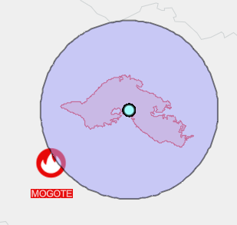
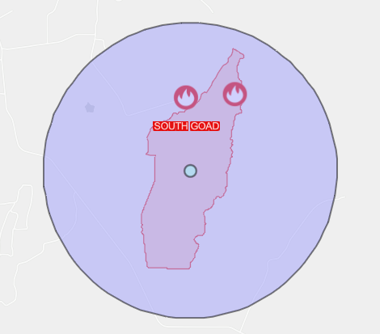
Buffer and Recalculated Center:
Image 1:
Image 2:
Mogote wildfire
Third Goat wildfire
From: https://codepen.io/RJminotaur/pen/YzeVbNK

Slide 8
Buffer and Recalculated Center:
ESRI
JavaScript API
REST Services
HTML
CSS
Dojo Tool kit
JavaScript

Slide 9
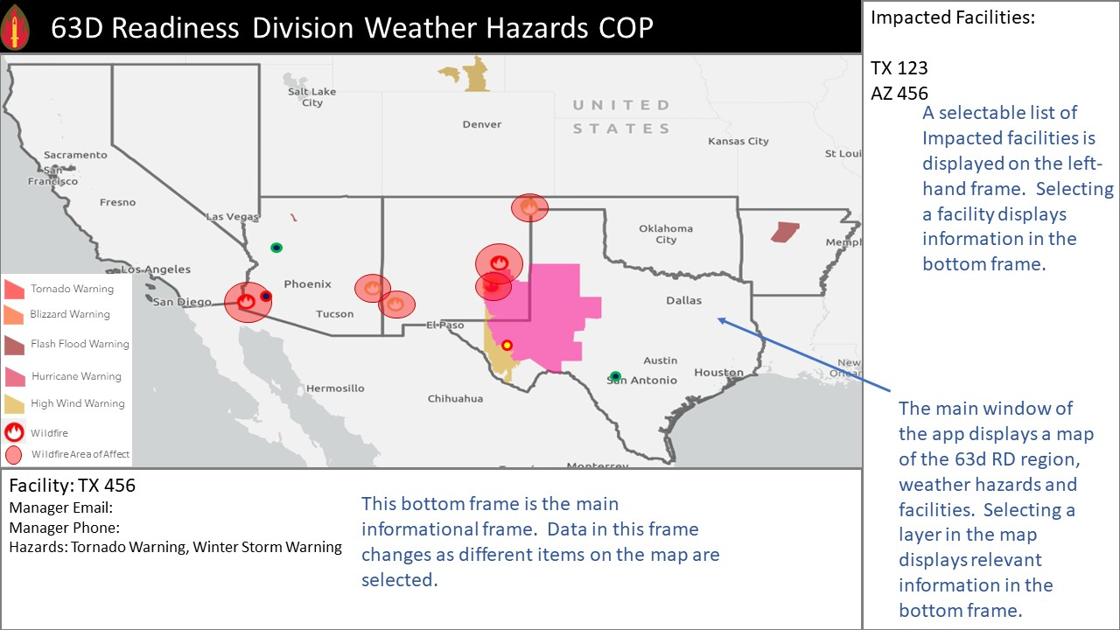
Wireframe:

Slide 10
Timeline:
Week: | Project Deliverable
Week 1 | Base webmap and layers
Week 2 | Fire layer query and buffer script
Week 3 | Facility query/CSS/Esri widgets
Week 4 | Dojo/HTML for frames
Week 5 | Completed dashboard/literature review
Week 6 | Research paper abstract/results
Week 7 | Research paper discussion/conclusion
Week 8 | Research paper formatting
Week 9 | Research paper complete
Week 10 | Conference presentation: TBD

Slide 11
Questions?

