Slide 1
Monitoring Height Growth of Vegetation surrounding Power Lines using Machine Learning
Prasanth Ramachandran
Manzhu Yu (Adviser)

Slide 2
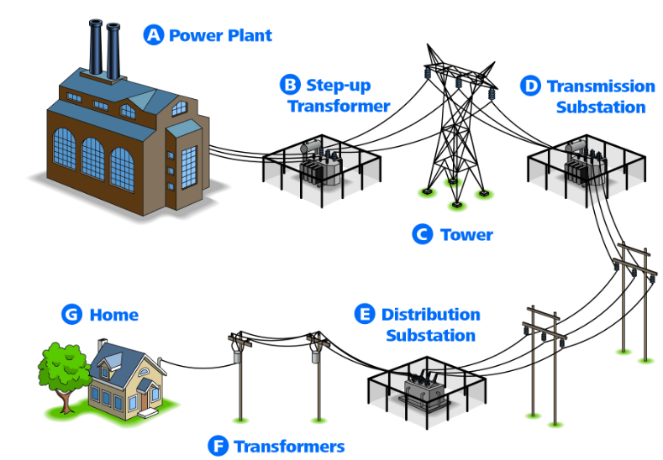
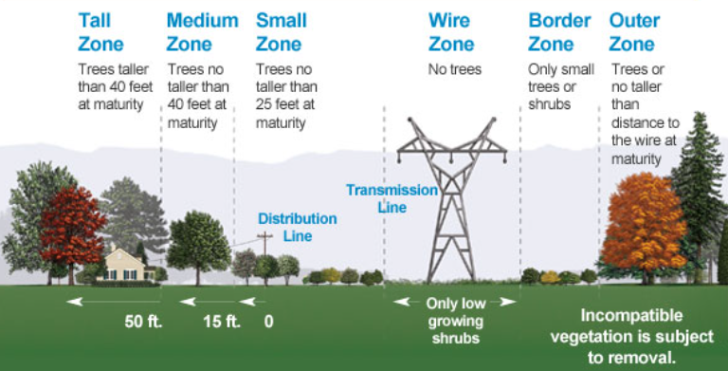
Background
Image Source - PGE Currents [2]
Image Source - Atlantic City Electric [1]
Currently I am working in a utility industry for an electricity delivery company based in Texas. Our organization has Transmission, Distribution and IT departments.
I represent transmission department in the organization.
Transmission Department manages all the activities related to moving the electricity from generation site to substation. Distribution department manages moving the electricity from substation to costumer sites.
Transmitting electricity from generation site to substations will be in high voltage (60kV to 500kV) over a long distance on power line cables.
Due to high voltage electricity on power lines, a very tight vegetation standards are applicable to transmission power lines.
Notes:
Figure 1 – power generation to Home : https://www.atlanticcityelectric.com/SafetyCommunity/Education/Pages/Infrastructure101.aspx
Figure 2 – Description of tree zones around power lines - https://www.pgecurrents.com/2012/03/29/sonoma-county-federally-mandated-tree-work-helps-ensure-electric-reliability-safety/
Removed Content :
Figure 2 - https://www.businesswire.com/news/home/20210305005105/en/Just-in-Time-for-California-Arbor-Week-PGE-Offers-New-Safety-Resource-to-Help-Customers-Plant-the-Right-Tree-in-the-Right-Place

Slide 3
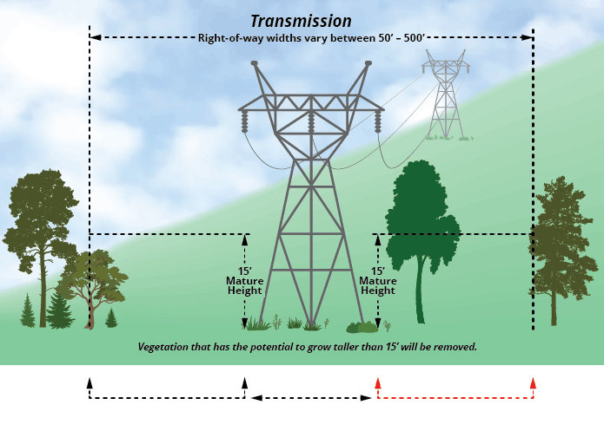
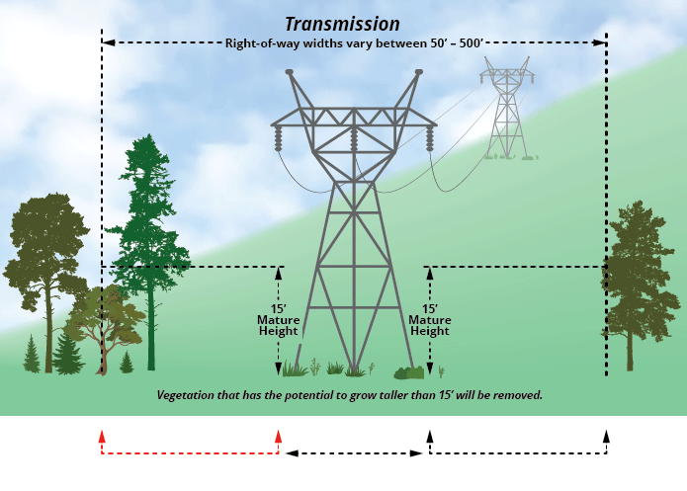
Background
Image Source - LG &E KU [3]
Image Source - LG &E KU [3]
Wire zone for transmission power lines are called Right of way or Easements which is a tree free zone
Any tree that grows above 15 feet at the maturity is an encroachment and it is a hazard to the power line which might cause outage and needs to remove or trimmed before maturity by power line companies
Utility companies regularly inspect the power lines to identity this encroachments in the easements at the early stage to avoid the risk of outage
Walking the line by human workforce, Aerial Inspection on helicopter, and Unmanned Aerial Vehicle (UAV) inspection are common types of power line maintenance.
All those options are time consuming and costly
Notes:
Image Source : https://lge-ku.com/safety/trees-power-lines

Slide 4
Background
Alternative and cost-effective solution for maintaining the line is to use satellite imagery but the use of imageries is not fulfilling most of the use cases for power line companies
One of the use cases of satellite imageries that most power line companies will be interested in, is calculating the vegetation and height of the vegetation using satellite imageries
The studies conducted for power line maintenance are finding the vegetation using satellite imagery and calculating the vegetation height using LiDAR and UAV data.
Currently, very few studies are conducted that can calculate a canopy height using high-resolution satellite imageries
The studies on deriving the canopy height using satellite images were focused majorly on forest areas not in urban area with complex features.
Calculating the canopy height of trees on the power line corridors remains to be investigated

Slide 5
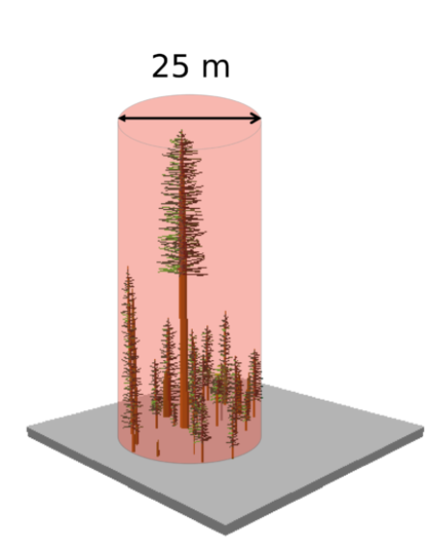
Literature Review
The studies [10 - 15] focused on using the field survey by using vehicles, aerial video surveillance, aerial multi-spectral imaging, and airborne LiDAR scanning, surveillance footage and images from those methods are processed using machine learning models on modern infrastructure to detect the encroachments and vegetation height.
The methods in these studies do provide accurate results for encroachment and vegetation height in power line corridors, but the cost associated with these methods are significant.
Implementing these aerial methods in a repetitive cycle in a year (due to the regulation) to obtain vegetation height in the power line corridor is not going to be a sustainable method for Electrical utilities due to the cost.
One of the study (Lang et al. [16]) used LiDAR data from Global Ecosystem Dynamics Investigation (GEDI) laser instrument to calculate the biomass of forest region.
The laser shots from the GEDI system are spaced 60 meters along the track and an approximately 25-meter footprint on the ground. Due to the spacing between the shots, LiDAR data does not cover every footprint of the land which makes it impossible to calculate accurate canopy height in any given area
Image Source - GEDI Ecosystem LiDAR [4]
Notes:
Figure source : https://gedi.umd.edu/mission/technology/

Slide 6
Literature Review
Wang et al. [17] study conducted to calculate the top of the canopy in the Peru region using Planet Dove Satellite imagery associating LiDAR as a ground truth and planet Dove textural features in the imagery
The limitation if this study was using 2013 LiDAR datasets for 202 conditions seems to raise concerns about the accuracy of the canopy height
Oehmcke et al. [16] study focused on generating the canopy height using multispectral imagery and LiDAR data from the ICESat-2 satellite by adapting the U-Net architecture based on 3D convolution operators
Though a deep learning approach was taken, the model was trained, tested, and experimented with in forest areas. This method was not executed in the urban area where complex features are observed to find canopy height estimates
Csillik et al. [18] study estimated the canopy height using the RGB and NIR (near-infrared) bands from satellite imagery with Arctic DEM as ground truth. The resulted estimates are verified against LiDAR-derived measurements.
The only concern in this study was that the ground truth is an Arctic DEM unavailable for the southern countries. So, this model cannot be used in any of the southern countries where Arctic DEM [19] cannot be generated.
All the above-mentioned studies are educating to use Aerial patrolling, human workforce, or robotic monitoring of power lines to get the vegetation height in power line corridor. The studies focused on canopy height estimates are experimented and results derived based on forest areas and canopy height estimation in urban areas are open for investigation. Either of the study types did not focus on generating the vegetation height power line corridor or urban. This research will focus on using high-resolution satellite imageries to calculate the tree heights in the power line corridor (mostly urban areas). The outcome of this research can be used to monitor the current vegetation and the vegetation growth trend for six months on power line corridors.

Slide 7
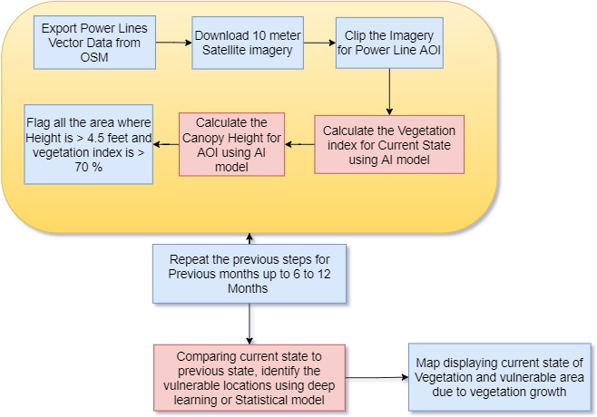
Goals and Objectives
The objective of this research is to develop a deep learning framework to derive vegetation height growth trends over six months from any given time in the power line corridor using satellite imagery and LiDAR data.
The outcome of this research can be used to monitor the current vegetation and the vegetation growth trend for six months on power line corridors.
This model has different stages to achieve the desired results. Following are the stages.
Using Deep Learning Model for Land Classification to find the vegetation
Using Deep Learning Model for canopy height from satellite imagery
Machine learning or Statistical model to identify the areas to focus on based on the last 6 months' canopy height growth data

Slide 8
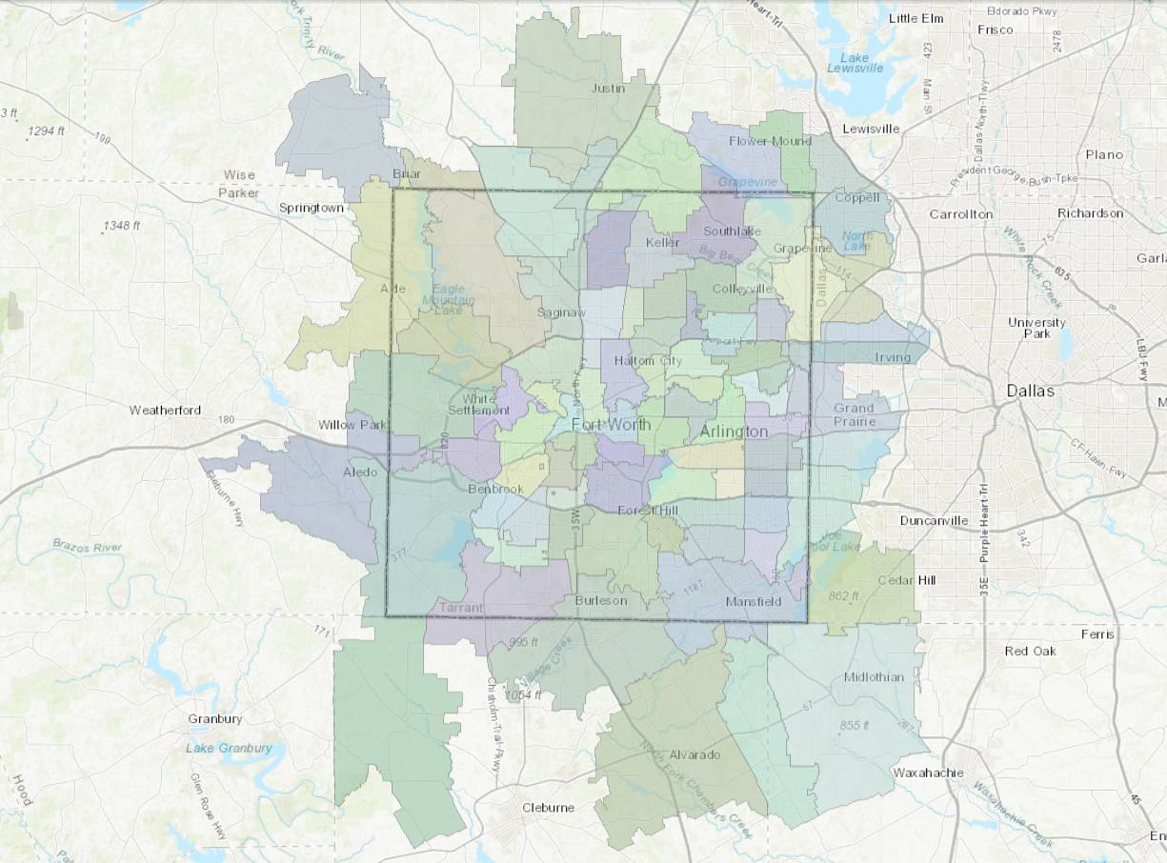
Proposed Methodology
Area of interest for this research is Tarrant county in Texas
This research has power lines data as vector layer, LiDAR cloud points as ground truth and Sentinel 2 satellite imagery for calculating the canopy height
The power line vector data will be downloaded as a shapefile from Open Street map (OSM) using https://overpass-turbo.eu/ website
The center line geometry of power line will be converted to polygon boundary as an easement of the power line which will be used for land classification
Image Source - Tarrant County GIS Map [5]
Notes:
Source - https://gisit.tarrantcounty.com/publicmapviewer/

Slide 9
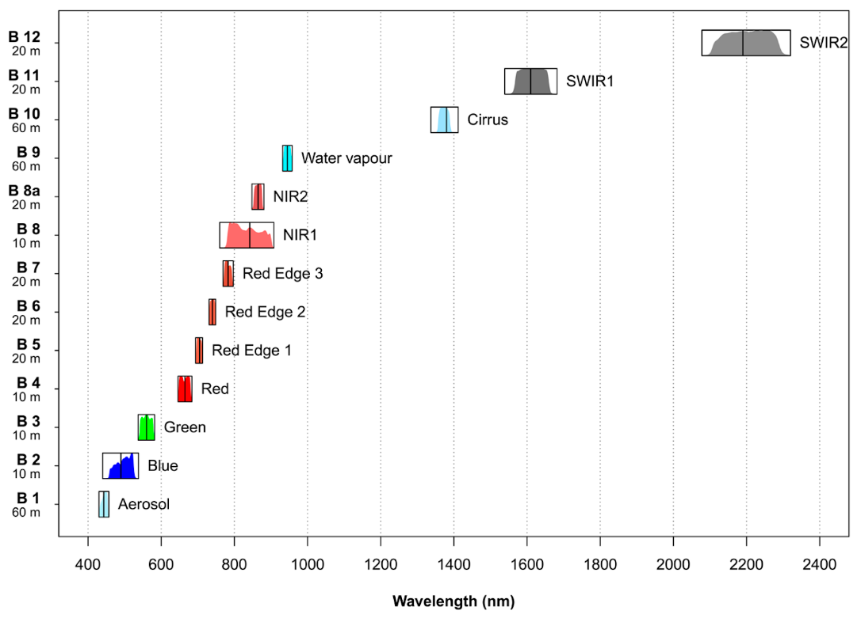
Proposed Methodology
To create a ground elevation for deep learning as a ground truth, latest LiDAR data source will used.
In this research, 2019 Texas LiDAR data acquired by United states Geological survey (USGS) for north-central and west Texas will be used and it is downloaded from TNRIS website.
LiDAR cloud points dataset are classified with following classes and in this research, class 2 (Bare-Earth Ground) points will be used.
Class 1 = Unclassified
Class 2 = Bare-Earth Ground
Class 7 = Low Noise
Class 9 = Water
Class 17 = Bridge Decks
Class 18 = High Noise
Class 20 = Ignored Ground (Break line Proximity)
In this research, Sentinel 2 with 10-meter resolution satellite imageries from European Space Agency (ESA) will be used for image analysis. Sentinel 2 imagery is a 4-band with red, blue, green and near-infrared (NIR) regions of spectrum
For the study of this research, Level 1C projected in UTM\WGS84 projection imageries is used
Image Source - UP42.com [6]

Slide 10
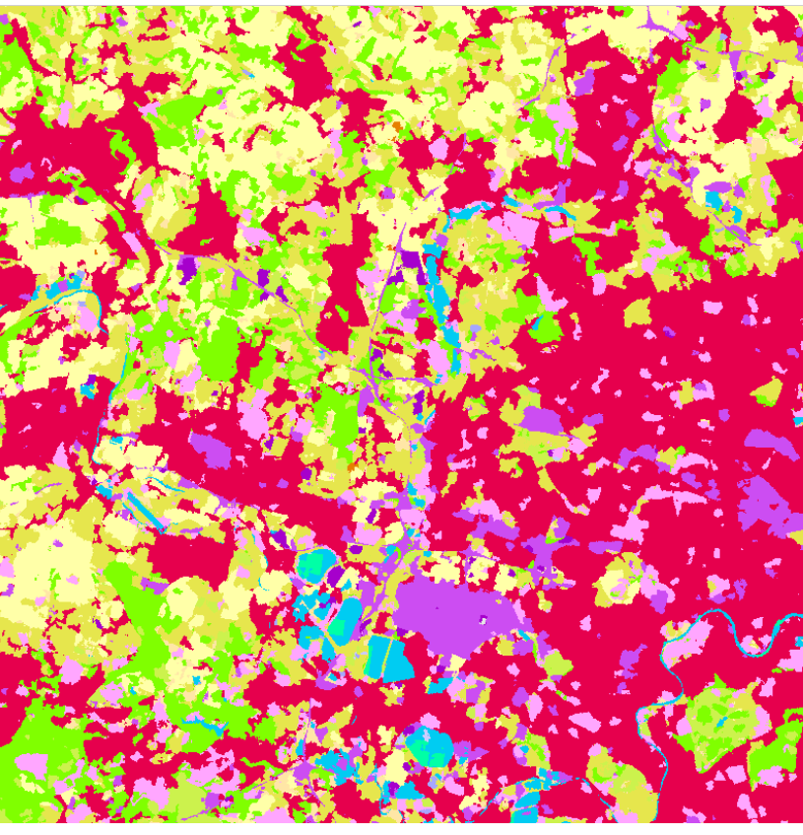
Proposed Methodology
Land Classification – ArcGIS Cover Classification deep learning package will be used for classification on sentinel 2 imagery. ArcGIS is a GIS software to create GIS applications and analyze vector, raster and LiDAR cloud point data. ArcGIS also has pre-trained deep learning package available on public domains
ArcGIS Land classification deep learning package describes the surface of the earth. For example, the package will classification the land as ground, vegetation, wetland, forests, etc.
Input to the model are raster or mosaic dataset with 10-meter cell size
Output of this model is a classified raster
This model uses the UNet model architecture implemented in ArcGIS API for Python
Image Source - ArcGIS.com [7]
Notes:
Source : https://www.arcgis.com/home/item.html?id=afd124844ba84da69c2c533d4af10a58

Slide 11
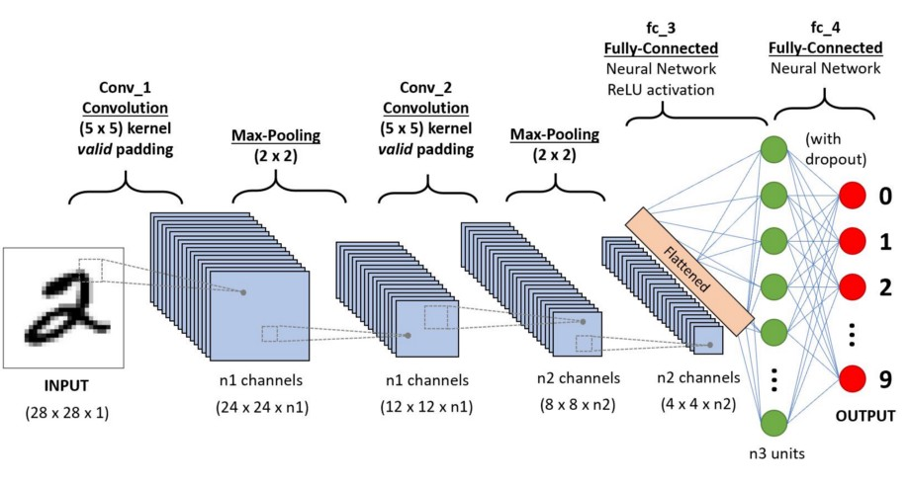
Proposed Methodology
Convolutional Neural Networks (CNNs) is a high performing deep learning algorithm taking an image as an input and assigning the weights and biases to different objects in the image and then able to differentiate the objects in the image.
This research will be experiment for regression tasks based on bellow three CNN architectures
ResNeXt-50
Inception ResNet-V2
U-Nets with ResNet Encoder
The exception from the deep learning model is to derive a canopy height from the Sentinel 2 satellite imagery in the high vegetation area derived based on ArcGIS Land Classification model
This model will be running on cloud free satellite imagery of any day in the month, and it will be repeated on last six months to generate the vegetation growth trend around power lines in AOI
Training samples (Batch size), epochs, and iterations will be determined at the time of research and experiment
Image Source - Towards Data Science [8]
Notes:
Source : https://towardsdatascience.com/a-comprehensive-guide-to-convolutional-neural-networks-the-eli5-way-3bd2b1164a53

Slide 12
Anticipated Results
The end results from this research is to show utilities companies, the vegetation growth trend around the power lines.
Final map of research will have the location along the power lines with faster growing vegetation and slowing growing vegetation based on last six months vegetation height
An ability to re-run this model every month to update the vegetation growth data in the service area of utilities companies so that vegetation management can plan for tree cutting and trimming activities
There are two potential risks, this research can run into are 10-meter resolution is not suitable and in need of very high-resolution imagery.
In that case, Planet imagery with very high resolution can be downloaded for educational purposes.
Another potential risk this research can run into is CCN deep learning model with U-Net architecture is inadequate.
The alternative approach is to identify a machine learning understanding decrease in accuracy

Slide 13
Project Timeline
 | Duration in weeks
Identifying Platform to Develop the Deep Learning Model | 1
Data gathering for study area | 1
Land Classification using ArcGIS Deep learning framework | 1
Identifying the deep learning model to generate canopy height | 2
Training the Deep Learning Model | 2
Execution of Deep Learning Model on Study Area Data | 2
Evaluation of Deep Learning model results against LiDAR | 1
Generating the 6 month of vegetation growth trend | 1
Visualizing the results in ArcGIS Story map | 0.2
Documentation | 2

Slide 14
Presentation venue
Esri Developer Summit 2023
Location – Palm Springs, California
Date : March 7 to March 10, 2023
Image Source - esri.com [9]
Notes:
Figure Link - https://www.esri.com/en-us/about/events/devsummit/agenda/proceedings

Slide 15
Reference
Atlantic City Electric, NA. [Online] Available : https://www.atlanticcityelectric.com/SafetyCommunity/Education/Pages/Infrastructure101.aspx
PGE Currents, NA. [Online] Available : https://www.pgecurrents.com/2012/03/29/sonoma-county-federally-mandated-tree-work-helps-ensure-electric-reliability-safety/
LG&E KU, NA. [Online] Available : https://lge-ku.com/safety/trees-power-lines
GEDI, NA. [Online] Available : https://gedi.umd.edu/mission/technology/
Tarrant County GIS Map, NA. [Online] Available : https://gisit.tarrantcounty.com/publicmapviewer/
UP42, NA. [Online] Available : https://up42.com/blog/tech/sentinel-2-superresolution
ArcGIS.com, [2021]. [Online] Available : https://www.arcgis.com/home/item.html?id=afd124844ba84da69c2c533d4af10a58
Towards Data Science, 2018. [Online] Available : https://towardsdatascience.com/a-comprehensive-guide-to-convolutional-neural-networks-the-eli5-way-3bd2b1164a53
ESRI.com, NA. [Online] Available : https://www.esri.com/en-us/about/events/devsummit/agenda/proceedings
Junaid Ahmad, Aamir Saeed Malik, Likun Xia, Nadia Ashikin. Vegetation encroachment monitoring for transmission lines right-of-ways: A survey, Electric Power Systems Research, ISSN 0378-7796. https://doi.org/10.1016/j.epsr.2012.07.015
M. G. M. Jardini et al., "Information System for the Vegetation Control of Transmission Lines Right-of-way," 2007 IEEE Lausanne Power Tech, 2007, pp. 28-33, DOI: 10.1109/PCT.2007.4538287

Slide 16
Reference
Leena Matikainen, Matti Lehtomäki, Eero Ahokas, Juha Hyyppä, Mika Karjalainen, Anttoni Jaakkola, Antero Kukko, Tero Heinonen. Remote sensing methods for power line corridor surveys. ISPRS Journal of Photogrammetry and Remote Sensing, ISSN 0924-2716. https://doi.org/10.1016/j.isprsjprs.2016.04.011.
J. Ahmad, A. S. Malik, and L. Xia, "Vegetation monitoring for high-voltage transmission line corridors using satellite stereo images," 2011 National Postgraduate Conference, 2011, pp. 1-5, DOI: 10.1109/NatPC.2011.6136337.
Li, Zhengrong & Walker, Rodney & Hayward, Ross & Mejias, Luis. (2010). Advances in vegetation management for power line corridor monitoring using aerial remote sensing techniques. 1 - 6. 10.1109/CARPI.2010.5624431.
Nico Lang, Walter Jetz, Konrad Schindler, Jan Dirk Wegner. A high-resolution canopy height model of the Earth, (2022). https://doi.org/10.48550/arXiv.2204.08322
S. Oehmcke, T. Nyegaard-Signori, K. Grogan and F. Gieseke, "Estimating Forest Canopy Height with Multi-Spectral and Multi-Temporal Imagery Using Deep Learning," 2021 IEEE International Conference on Big Data (Big Data), 2021, pp. 4915-4924, DOI: 10.1109/BigData52589.2021.9672018.
Wang, H.; Seaborn, T.; Wang, Z.; Caudill, C.C.; Link, T.E. Modeling tree canopy height using machine learning over mixed vegetation landscapes. Int. J. Appl. Earth Obs. Geoinf. 2021, 101, 102353. [Google Scholar] [CrossRef]
Csillik O, Kumar P, Asner GP. Challenges in Estimating Tropical Forest Canopy Height from Planet Dove Imagery. Remote Sensing. 2020; 12(7):1160. https://doi.org/10.3390/rs12071160
ArcticDem, 2020, [online] Available: https://www.pgc.umn.edu/data/arcticdem/.

Slide 17
Q & A
Thank you.

