Slide 1
MGIS Capstone
Using Aerial Imagery to Detect Oak Wilt and Differentiate from Oak Decline in the Northwest Lower Peninsula of Michigan
Fields Ratliff | GEOG 596A

Slide 2
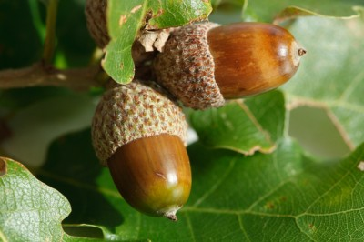
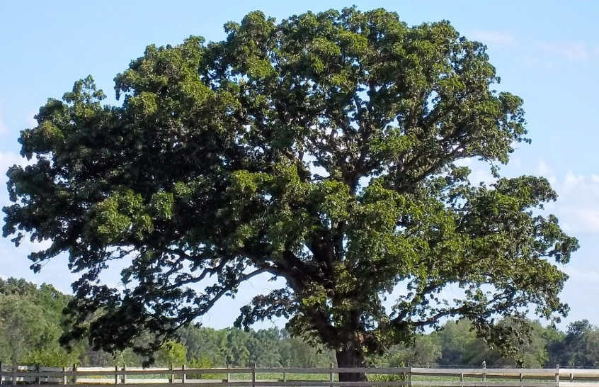
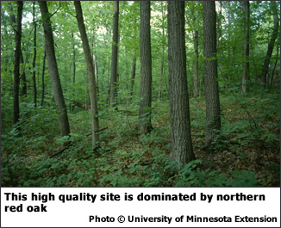
Presentation Outline:
Why Are Oak Trees Important?
Oak Wilt Fungus
Oak Decline
Research Goals
Previous Research
Data
Workflow & Methodology
Outputs & Results

Slide 3
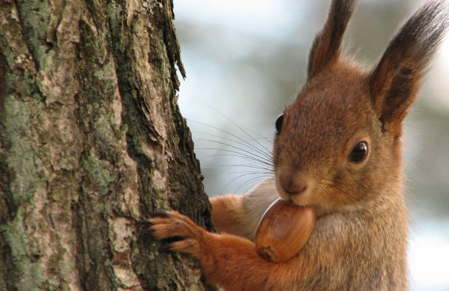
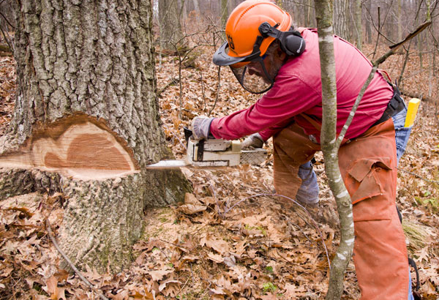
Oak Trees Benefits
Food and Habitat for Wildlife
Urban Landscapes
Timber Sales
Notes:
Benefits and Impacts
Impacts property values and neighborhood aesthetics
Increased costs with tree maintenance, removal and replacement
Loss of a valued shade tree
Negative impacts to the forestry industry and production of high value oak products (Millions in timber sales annually in Michigan)
Reduction in food source for forest animals provided by oak trees
Loss of habitat for some species
Reduction of ecological services (air and water filtering)
Safety and liability issues

Slide 4
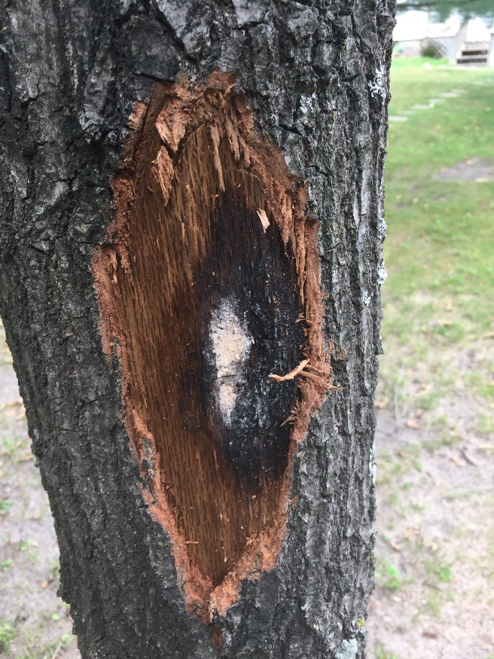
Oak Wilt Ceratocystis fagacearum
Notes:
Oak wilt is a vascular disease of oak trees, caused by the fungus Bretziella fagacearum. The fungus grows on the outer sapwood of oak trees restricting the flow of water and nutrients through the tree.
Symptoms: Leaves turn dull green, brown or yellow • Discoloration of leaves progressing from the edge of the leaf to the middle • Wilting and bronzing of foliage starting at top of the tree and moving downwards • Premature leaf fall (including green leaves) • White, grey or black fungal mats just under the bark that emit a fruity smell • Vertical bark cracks in the trunk and large branches as a result of the fungal spore mats (also referred to as pressure pads) exerting outward pressure on the bark

Slide 5
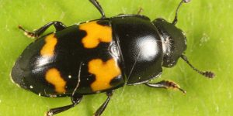
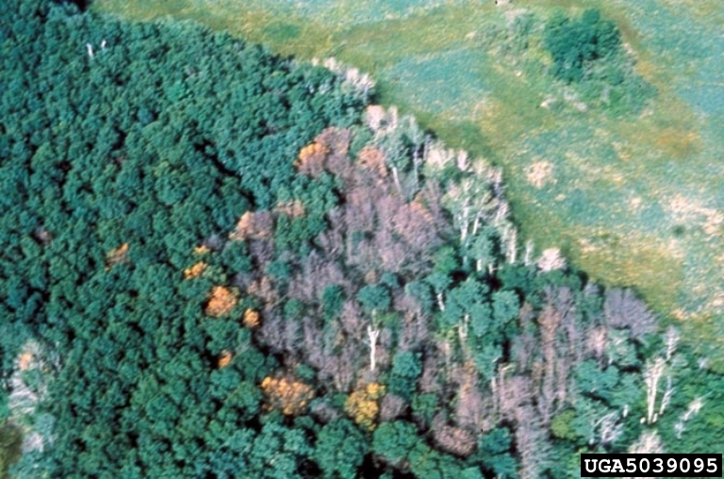
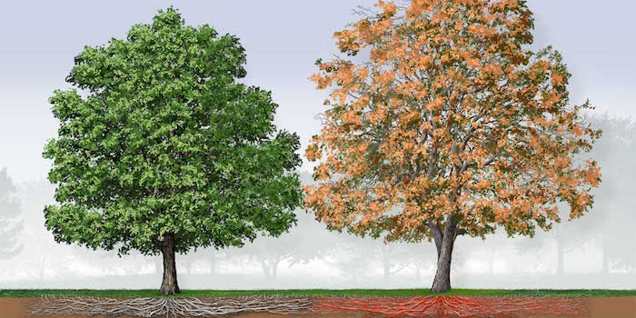
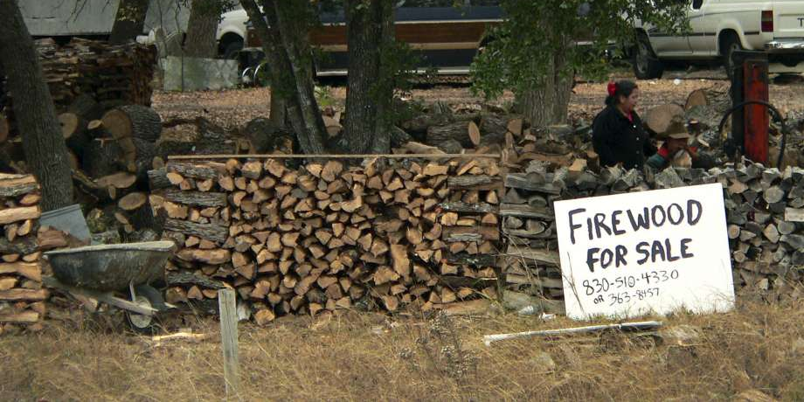
Oak Wilt
Spread
Symptoms
Mitigation

Slide 6
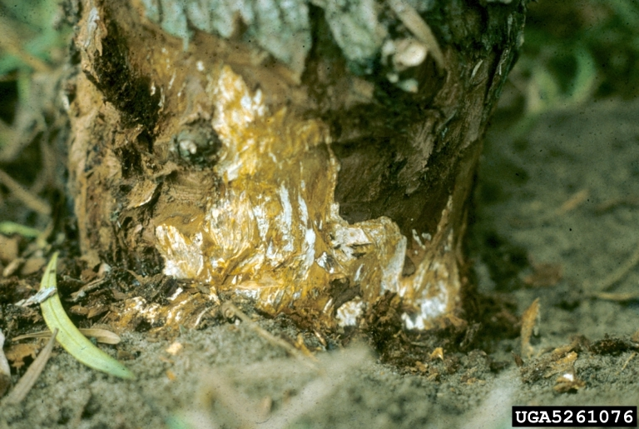
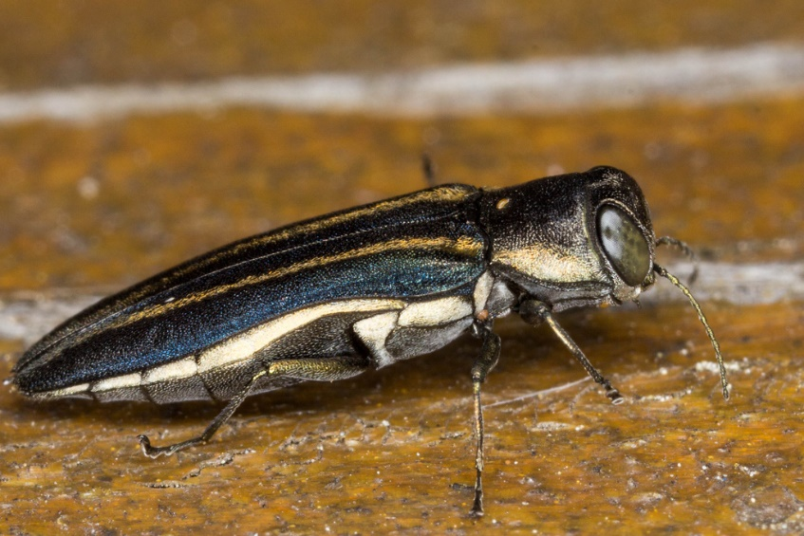
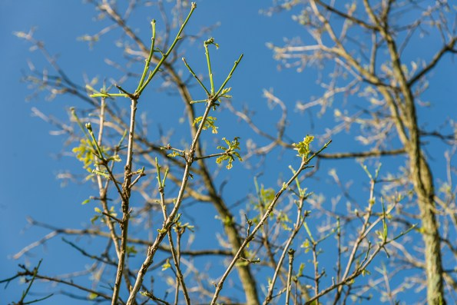
Oak Decline
Symptoms
Disease & Insects
Mitigation & Prevention
Differs from Oak Wilt:
Combination of factors for mortality
Curled & stunted leaves
Slower dieback
Mortality peaking at 2-5 years
Oak wilt attacks healthy trees too
Non-Circular patterns of mortality

Slide 7
Objectives
Prevention is the best way to manage the spread of oak wilt, but the movement of the disease is inevitable as is the onset of oak decline in certain conditions.
1
This project will use GIS analysis and explore available satellite imagery to:
Detect early signs of oak wilt
Differentiate between oak wilt and oak decline
Notes:
.Early detection of oak wilt would help to mitigate spread, improve best management practices, and prioritize of resources. Furthermore, being able differentiate between oak wilt and oak decline in the early stages will help better strategize response to the impacts on oak forest. The goal of this project is to utilize GIS analysis and explore available satellite imagery to:

Slide 8
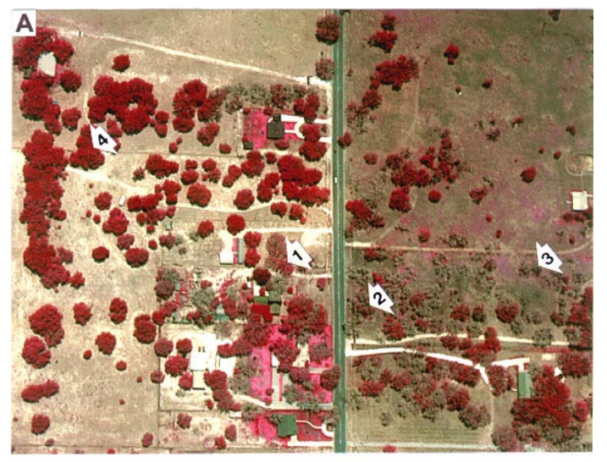
Previous Research
Using Airborne Digital Imagery for Detecting Oak Wilt Disease
A Comparison of Standard and Hybrid Classifier Methods for Mapping Affected by “Sudden Oak Death”
Using Classification Tree Analysis to Predict Oak Wilt Distribution in Minnesota and Texas
Early Detection of Oak Wilt Disease in Quercus ssp.: A Hyperspectral Approach
Notes:
Touch more on this in data section as well.
Picture (A) Color-infrared digital image and (B) color-infrared photograph of a live-oak-forested area near Pleasanton, Texas affected by oak wilt. The arrows on print A point to the following: arrow 1, live oak tree affected with early to moderate stages of oak wilt; arrow 2, live oak tree severely affected by oak wilt; arrow 3, dead live oak tree killed by oak wilt; and arrow 4, healthy live oak tree.

Slide 9
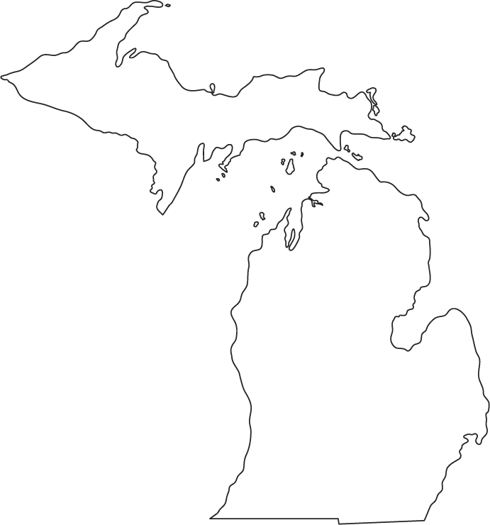
Study Area: Grand Traverse County, Michigan
Area: 296,960 acres
~70,000 acres of state land
~21,000 acres of state land contain oak forest types
144 confirmed oak wilt reports in the county from 2009-2017
5 confirmed oak decline reports in the county from 2009-2017
Notes:
Just a summation of the area of interest

Slide 10
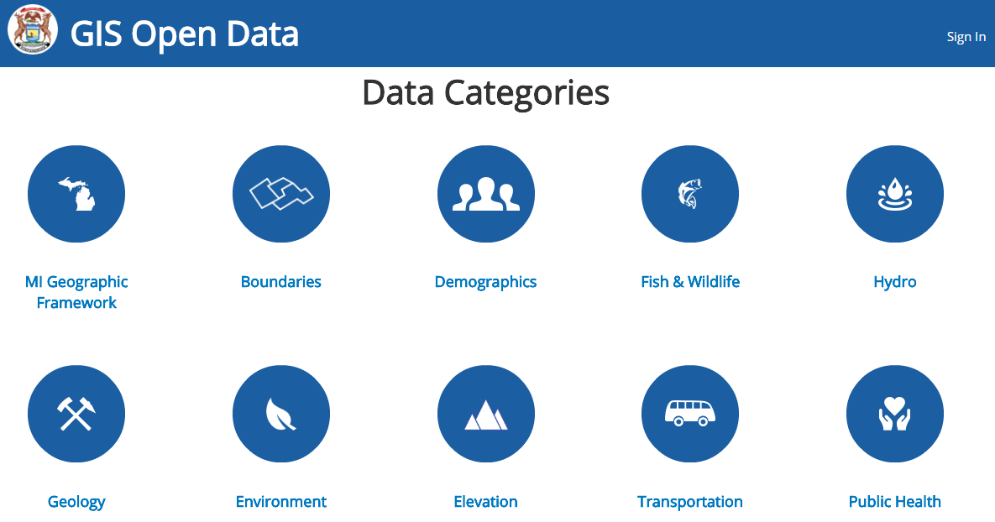
Data
Michigan GIS Portal:
Ancillary Data
Forest Health Points (DNR)
Forest Canopy Type (DNR)
Michigan Forestry Inventory System
In-house Data Collection Software used by DNR Foresters
Satellite Imagery Providers:
USGA Earth Explorer
National Agriculture Imagery Program
Landsat
MiSAIL

Slide 11
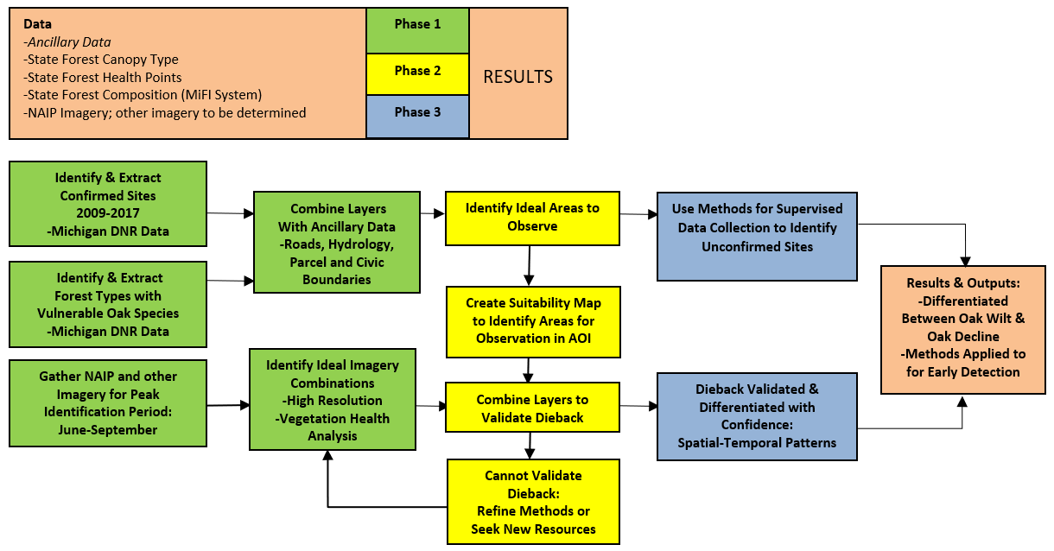
Workflow
May-July
August-September
October-November
Presentation in December

Slide 12
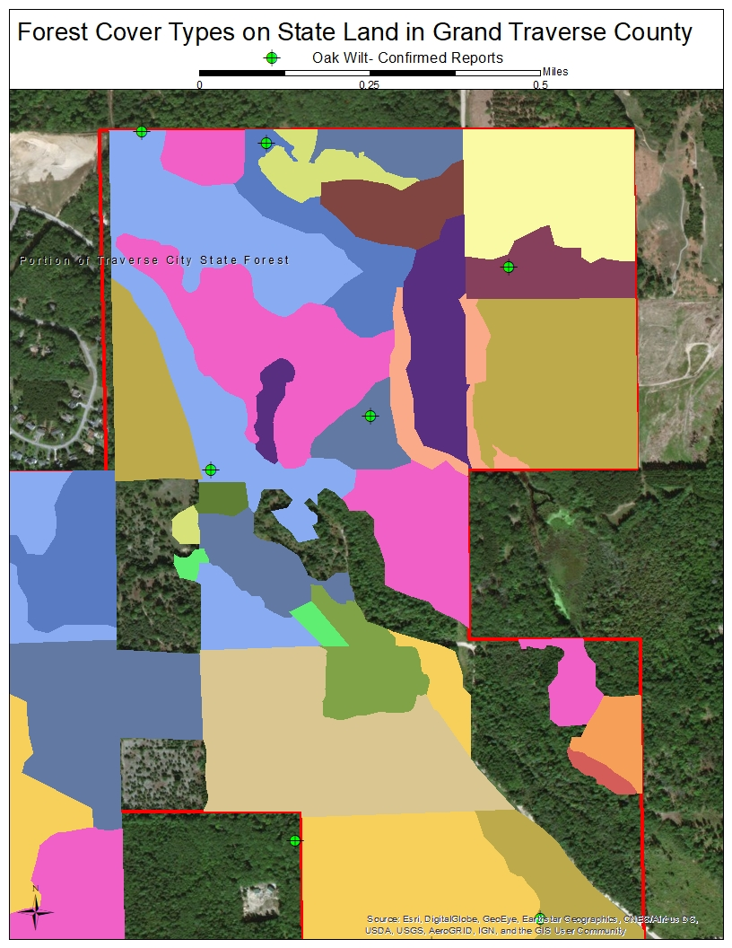
Methods: Suitability Map
Identify & Extract Confirmed Sites
(DNR Forest Health Points)
Identify & Extract Oak Forest Types
(DNR Forest Canopy Types)
Ancillary Data
Hydrology, Roads, & Boundaries

Slide 13
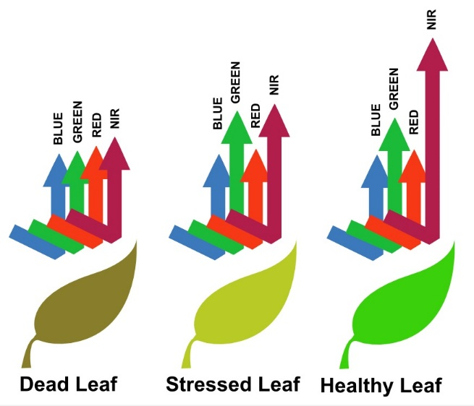
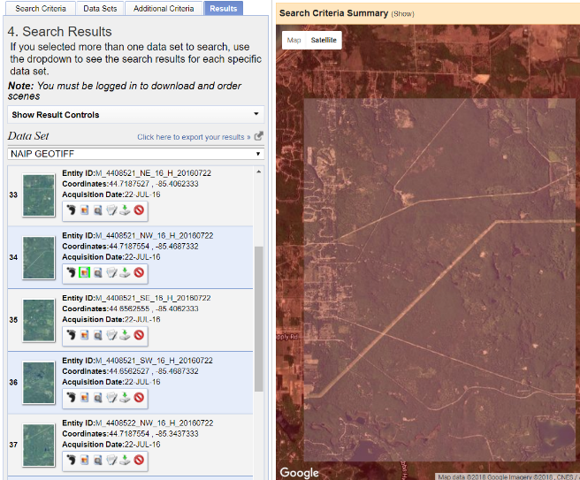
Methods: Satellite Imagery
Vegetation Health Analysis
Multispectral Indices Formulas
CIR, NDVI, NDMI, & RGI
Aerial Imagery Resources
Open Sources to Public
USGS Earth Explorer, NAIP, & Landsat
Exploring Additional Resources
Proprietary Sources
GeoEye-1, QuickBird, WorldView 1-4, IKONOS, Pléiades, & KOMPSAT
Notes:
NDVI is simply a ratio of near infrared (NIR) reflectivity minus red reflectivity (VIS) over NIR plus VIS.

Slide 14
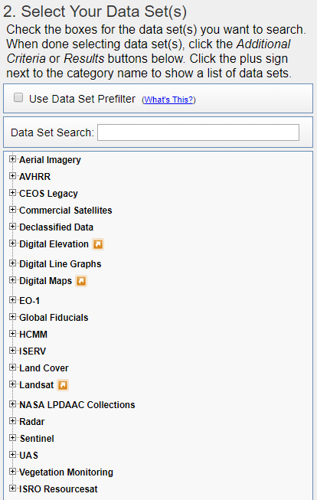
Methods: Exploring the Data
Example of Exploratory Steps
Review Historical Data
Determine Recorded Date
Explore Data For Peak Growing Season
Record Ideal Data Combinations
Develop Symptoms Timeline
Record Temporal Patterns
Record Anecdotal Observations
Develop Criteria for Identifying Mortality
Notes:
Pick existing site of oak wilt or decline to observe
Determine exact date of first observation by DNR staff and review field notes
Explore available images prior to record during peak growing season
Record satellite type, resolution, dates of images, and spectral indices best suited for site
Determine date of first sign of symptoms and develop timeline
Record temporal patterns; display with time lapse map series
Record anecdotal patterns and characteristics observed
Results will show ideal criteria for identifying mortality timing consistently

Slide 15
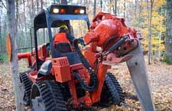
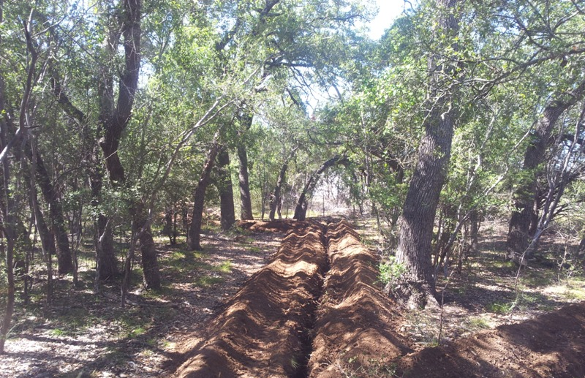
Results & Outputs
Differentiate Between Oak Wilt & Oak Decline
Methods Developed for Early Detection
Scope of Oak Wilt
Best Available Data Sets Discovered
Ground-truth Early Detection Tool for Accuracy

Slide 16
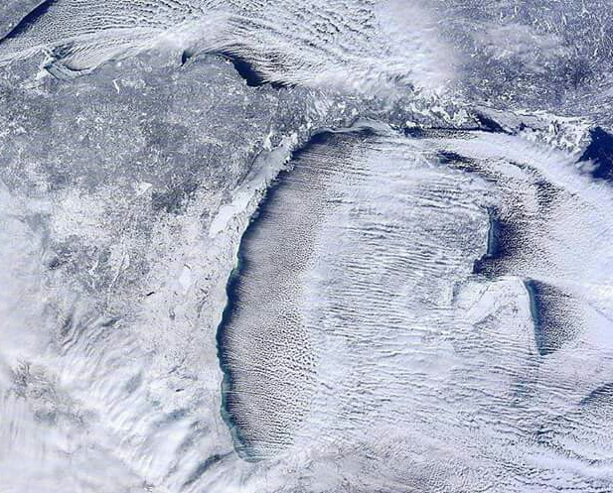
Challenges
Data Costs
Image Variability
Temporal Availability & Quality
Indistinguishability
Saturation
Small Research Sites
Notes:
A ton of text…..

Slide 17
Questions?

Slide 18
References
Cook, Bill. “Oak Wilt in Michigan’s Forest Resource.” MICHIGAN STATE UNIVERSITY EXTENSION FORESTER , E-3169, Apr. 2012, msue.anr.msu.edu/uploads/resources/pdfs/Oak_Wilt_in_Michigans_Forest_Resource_(E3169).pdf.
Isabel, Munck. “Oak Wilt in the Northeastern United States.” Pest Alert- USDA, July 2017, doi:United States Department of Agriculture.
Everitt, J. H., et al. “Using Airborne Digital Imagery for Detecting Oak Wilt Disease.” Plant Disease, vol. 83, no. 6, 1999, pp. 502–505., doi:10.1094/pdis.1999.83.6.502.
Kelly, Maggi, et al. “A Comparison of Standard and Hybrid Classifier Methods for Mapping Hardwood Mortality in Areas Affected by “Sudden Oak Death” Photogrammetric Engineering & Remote Sensing, vol. 70, no. 11, Jan. 2004, pp. 1229–1239., doi:10.14358/pers.70.11.1229.
“What Is NAIP?” NAIP Imagery, USDA, www.fsa.usda.gov/programs-and-services/aerial-photography/imagery-programs/naip-imagery/.
Survey, USGS - U.S. Geological. EarthExplorer, Earth Explorer Distribution Download, 1 Jan. 2018, earthexplorer.usgs.gov/distribution.
Survey, U.S. Geological. “Introduction to The National Map.” The National Map, 23 Feb. 2018, nationalmap.gov/about.html.
“Michigan GIS Open Data.” GIS Open Data, State of Michigan, 2017, gis-michigan.opendata.arcgis.com/.
“GIS Open Data.” ArcGIS Hub, gis-michigan.opendata.arcgis.com/datasets?q=forest%2Bcovertype.

