Slide 1
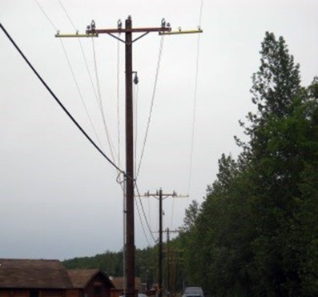
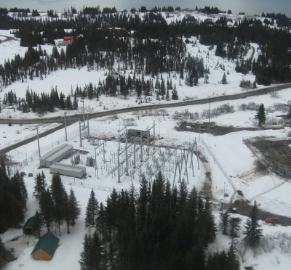
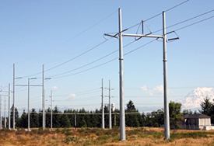
Using GIS to Make Project Data More Accessible to Employees of an Electrical Engineering Consulting Firm
Karen Rauschert
GEOG 596A
Advisor: Jim Detwiler

Slide 2
Corporate Overview
Companies
Specialties
Locations
Employees

Slide 3
Current System
Spreadsheet “Database”
Four Servers
Other
Contacts
Google Drive
Dropbox
Other Servers
Local Computers
Email
Internet
Hard Copies
Personnel
Proposals
“Current” Jobs
Archived Jobs
Photos/ROW
Access to Data
Accuracy of Data
Usefulness of Data

Slide 4
Objective:
Develop a structured means of inputting and storing relevant project information that will be robust, searchable, and reproducible.

Slide 5
Specific Aims (Overview)
Identify Relevant Information
Develop a Procedure to Normalize Data
Develop & Test Relational Database, Test Dataset
Develop a System for Data Entry
Design a User Interface

Slide 6
Specific Aim #1
Identify Relevant Information
Who
What
When
Where
Outcome
Scope & Scale

Slide 7
Develop a Procedure to Normalize Data
Specific Aim #2
People
Documents
Companies
Projects
Locations
Components
Dates

Slide 8
Specific Aim #3
Develop & Test Relational Database, Test Dataset
Relationships
Data Variability
Tests

Slide 9
Develop a System for Data Entry
Specific Aim #4
User Friendly
Built-In Flexibility
Quality Control Checks
Bulk Import

Slide 10
Conceptual Data Entry Site

Slide 11
Design a User Interface
Specific Aim #5
Technology
MySQL
PHP
Apache
Geographic
Searchable
Reproducible

Slide 12
Sample Websites
Individual Feature Maps vs. Project Maps
Display of Map Data
Display of Non-Map Data
Filters

Slide 13
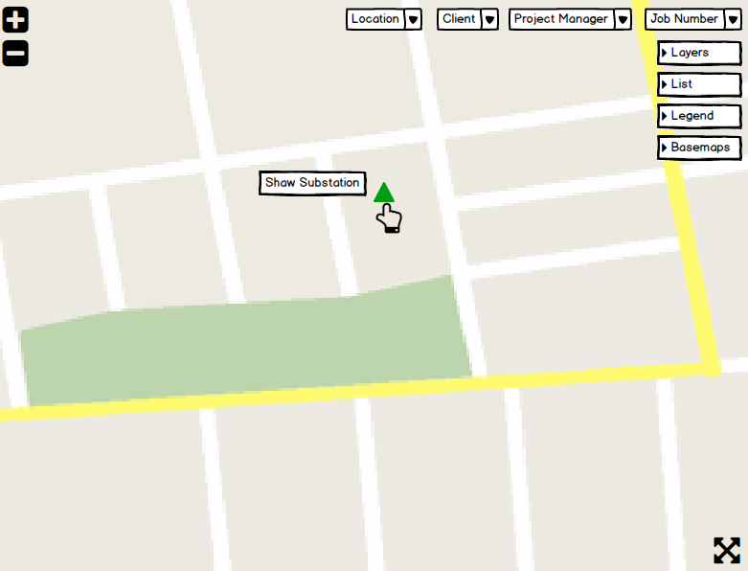
Conceptual User Interface

Slide 14
Potential Pitfalls
User Buy-In
Balancing Needs with Complexity
Scope Creep
Learning Curve

Slide 15
Tentative Timeline
~ June 2015 - Identify Relevant Information
~ July 2015 - Develop a Procedure to Normalize Data
~ October 2015 - Develop & Test Relational Database, Test Dataset
~ November 2015 - Develop a System for Data Entry
~ December 2015 - Design a User Interface
~ February 2016 - Alaska Surveying & Mapping Conference, Anchorage, AK

Slide 16
Summary
Aim #1
Aim #2
Develop a structured means of inputting and storing relevant project information that will be robust, searchable, and reproducible.
Aim #3
Aim #4
Aim #5

Slide 17
References
Bonneville Power Administration. BPA Transmission Lines. Retrieved on March 22, 2015 from http://www.arcgis.com/home/webmap/viewer.html?webmap=262e5ef1de424730b096a0eed94035a5
Datum Construction. Map of Previous Projects. Retrieved on March 22, 2015 from http://www.datumconstruction.com/#!map-of-previous-projects/ci60
EIA (U.S. Energy Information Administration). U.S. Energy Mapping System. Retrieved on March 22, 2015 from http://www.eia.gov/state/maps.cfm
Hendler, J. (2014) Data Integration for Heterogeneous Datasets. Big Data, 2(4), 205-215.
Martin, Regus. (Image) Utility Poles. Deviant Art. Retrieved on May 6, 2015 from http://regusmartin.deviantart.com/art/Utility-Poles-399804197
Montgomery County, MD. Development Projects in Montgomery County, MD. Retrieved on March 22, 2015 from http://mcatlas.org/devfinder/
NPR (National Public Radio). Visualizing the U.S. Electric Grid. Retrieved on March 22, 2015 from http://www.npr.org/2009/04/24/110997398/visualizing-the-u-s-electric-grid
NYCEDC. Interactive Map of Projects. Retrieved on March 22, 2015 from http://www.nycedc.com/projects/projects-map
Pennsylvania Department of Transportation. MPMS-IQ – Multi-modal Project MAPPING System Interactive Query. Retrieved on March 22, 2015 from http://www.dot7.state.pa.us/MPMS_IQ/Mapping#
Synbio Consulting. iGEM Synthetic Biology Ecosystem. Retrieved on March 22, 2015 from http://synbioconsulting.com/igem-synthetic-biology-map/
The World Bank. Global Reach. Retrieved on March 11, 2015 from http://maps.worldbank.org/p2e/mcmap/map.html?code=&level=&indicatorcode=0553&title=Global&org=ibrd
WFRC. WFRC 2015-2040 Regional Transportation Plan. Retrieved on March 22, 2015 from http://wfrcgis.maps.arcgis.com/apps/Viewer/index.html?appid=d4d106b5c4074233837e6fb5e9f4ee51
Wickham, H. (2014) Tidy Data. Journal of Statistical Software, 59(10), Retrieved on March 31, 2015 from http://www.jstatsoft.org/v59/i10/paper

Slide 18
Acknowledgements
Jim Detwiler
James Warner
Beth King
David Burlingame
ESG Coworkers

Slide 19
Questions?
Using GIS to Make Project Data More Accessible to Employees of an Electrical Engineering Consulting Firm
Karen Rauschert
GEOG 596A
Advisor: Jim Detwiler

