Slide 1
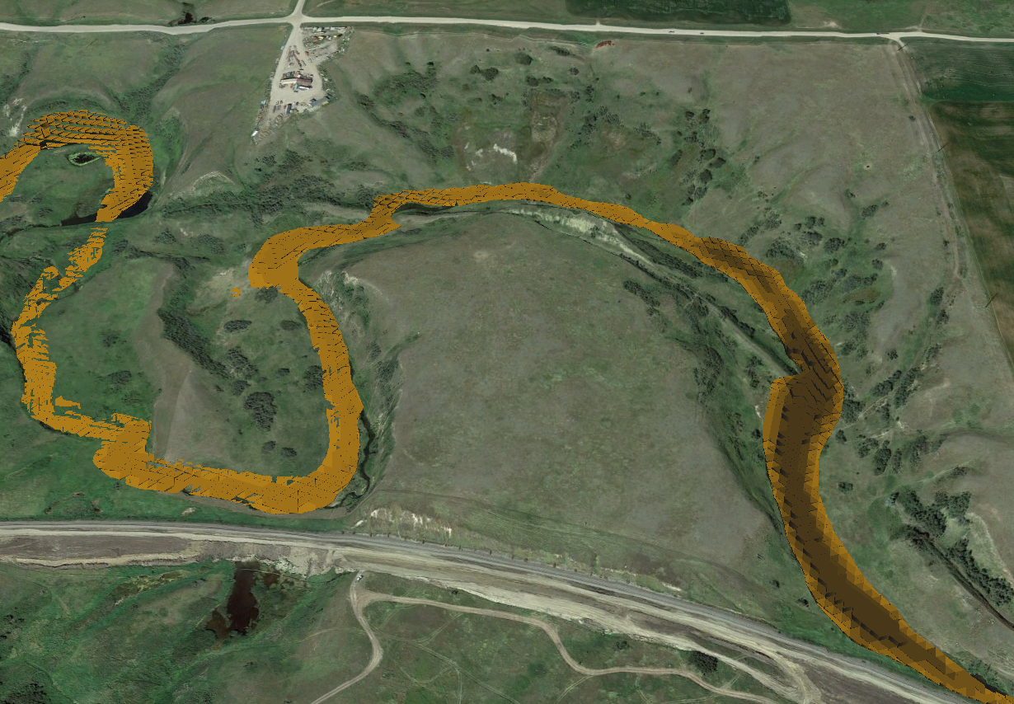
Oil Spill Cost Modeling
An Automated Approach within ArcGIS
Scott Raznoff
Geog 596A
Advisor: Joseph Bishop Ph.D.
Notes:
Hello and thank you all for attending these presentations. My Project is about attempting to use GIS to produce cost estimates for simulated oil spills from pipelines. By doing so, we can help Pipeline operators understand their risks and more effectively allocate safety resources to prevent future spills.

Slide 2

Scott Raznoff
GIS Analyst, New Century Software
  Oil and Gas Pipeline Industry
  Data Management
  Accident Analyses
Notes:
I would like to tell you a little about myself and what I do. I am a GIS Analyst at New Century Software. We serve the oil and gas pipeline industry, by offering software, services, and expertise for all things GIS and Pipeline. I started doing Data Management at NCS about 4 years ago, and now I do a little bit of that still but mostly I simulate accidents so that pipeline operators can understand what sorts of risks they are running, and ultimately work to prevent those risks.

Slide 3
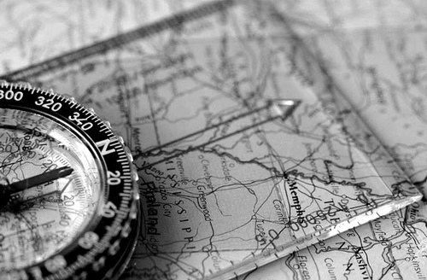
Agenda
Pipeline 101
Consequences of Oil Spills
Regulatory Environment
Integrity Management
Risk Framework
Consequence Modelling
Basic Oil Spill Cost Estimation Model (BOSCEM)
Goals & Objectives
Methods
Implications
5
Notes:
I’ll give you an overview of my presentation so we can try to avoid getting lost in the details. First I want to talk a bit about pipelines broadly so that we have a general understanding of the problem going in. I will talk about some historic accidents, and the regulatory environment that has been developing to try and prevent them. Next I will move into what pipeline operators are doing themselves to manage the integrity of their systems. We will then dive deeper into a specific paradigm of integrity management called risk management. Finally I will give some background on how pipeline accidents are simulated.
Then we will get to what I am planning to contribute for this project. We will look at one cost model and how it can be applied in ArcGIS using data that are available in the industry today. I will talk about how I am going to do that, what I expect to see, and what it will mean.

Slide 4
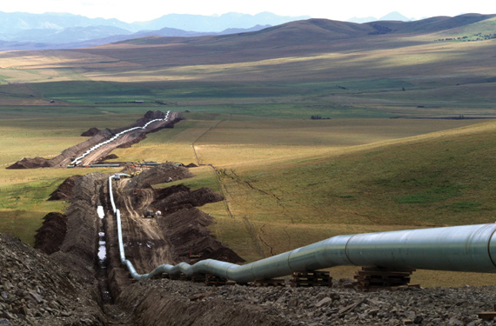
What is a Pipeline?
4
Notes:
One thing I learned when I started in the pipeline industry is how little I knew about pipelines. They are all around us but since they are usually buried and out of sight I never thought much about them. Pipelines come in many sizes, from 2” gathering and distribution pipes up to 36” behemoths like the Keystone XL pipeline that has been in the news lately. Pipelines also carry different products including natural gas, volatile liquids like propane and butane, refined products like gasoline and diesel, and heavier crude oils. Most of the high pressure transmission pipelines that I deal with are steel, but there are also cast iron, fiberglass and plastic pipelines as well. Pipelines can also operate for decades so there is an aging infrastructure out there. Some important take aways from this slide is that the variety in the age, material, and product inside pipelines, as well as the landscape they are a part of are among the many factors that need to be accounted for when considering accident scenarios. I chose this image because it is a fairly typical layout. You can see the lengths of pipe have been welded together and are ready to be lowered into the trench and buried. You can also see that the pipeline is large and where a spill happens will have a big impact on the ultimate fate of the product that is released.

Slide 5
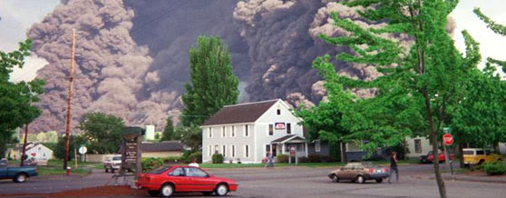
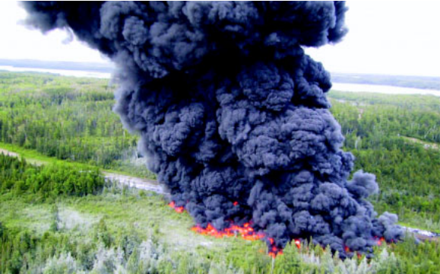
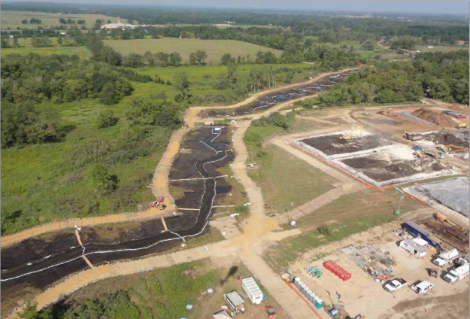
Oil Spills
[1],[2],[3]
Notes:
Some notable pipeline accidents include the Olympic pipeline disaster in 1999, where 236,000 gallons of gasoline spilled into Whatcom Creek near Bellingham, Washington. The eventual ignition of the fuel killed three boys, killed all aquatic life in three miles of the creek, and burned twenty six acres of forest. The second image is from the 4th of july, 2002 when an Enbridge pipeline spilled 252,000 gallons of crude in Minnesota. In this case the oil was intentionally ignited to prevent spread and environmental contamination, and while this was a relatively minor event in terms of cost, it’s obvious the environmental impact . The final image is from another Enbridge spill into the Kalamazoo river. You might have heard of this one on the news. It was diluted bitumen from Alberta's tar sands. This is an image of the creek that the pipeline spilled into before it reached the Kalamazoo Fiver. You can also see the staging pad where some soil and water reclamation activities are going on at the right. This shows the expense of a cleanup operation after an event like this. There are different ways to add up all the costs from these events but to give you an order of magnitude PHMSA has estimated that over 7 billion dollars of costs have been incurred in the last two decades.

Slide 6
Regulatory Environment
Legislation
Pipeline and Hazardous Materials Safety Administration (PHMSA)
Notes:
Over the years, Congress has passed a number of laws establishing minimum standards that pipeline operators must meet in order to avoid these types of accidents. It also created PHMSA in 2004 in order to oversee the enforcement of these laws[6]. This agency is part of the Department of Transportation. Having a dedicated agency has increased the pressure on operators to show that they have a suitable program in place to prevent accidents.

Slide 7
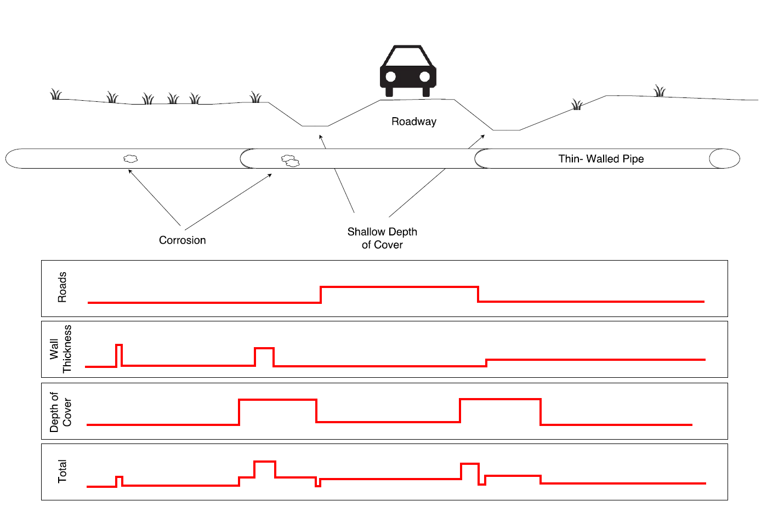
Risk Management
Risk = Probability x Consequence
Notes:
But most operators want to do the right thing anyway. One way that operators can manage their systems is by using a risk framework. The simplest risk equation is risk = probability of an event x consequence of that event. I made this graphic to illustrate this in the simplest terms. You can see a pipeline crossing underneath a roadway. Several hazards are considered in this image. The first is the impact of vehicle traffic putting stress on the pipe. In the first band, you can see that that the probability of failure due to that factor is illustrated. There is also some corrosion on the pipe, and not all of the pipe is the same wall thickness. So the probability of failure due to inadequate wall thickness is calculated in the second band. You can see it is elevated in the areas of corrosion and also where the pipe wall is thinner. Finally we have bar ditches on either side of the roads that are really reducing the depth of cover. This is important because burial depth protects the pipe from a number of above ground threats including erosion and mechanical damage from construction equipment. The final band is a combination of all of the factors resulting in a calculated probability of failure for all sections of the pipeline. In this simple example, we can see how a pipeline operator can successfully combine any number of datasources to calculate an estimated likelihood of failure for all points in their system. This is only one side of the risk equation though, probability. Understanding the consequences of failure is a little more difficult…

Slide 8
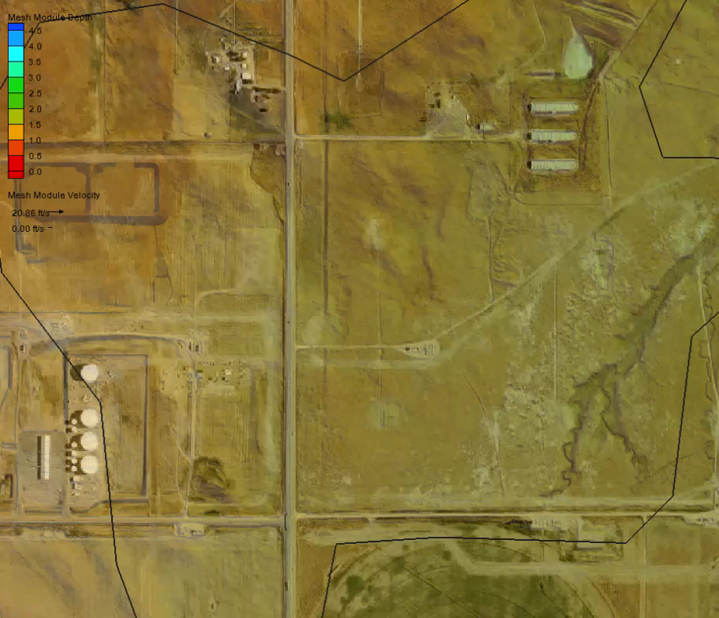
Modeling Release Scenarios
Notes:
But that is heavily dependent on GIS as well. So this is a movie that shows a GIS simulating a large oil spill. This is on the order of the size of the spills we saw slides of earlier, but this one is up on the great plains and stays out of the waterways. The basic setup is that we use a GIS to build a modeling environment meaning you define the surface, the fluid and , then pass that off to a hydraulic engine that solves the flow equations across the surface.

Slide 9
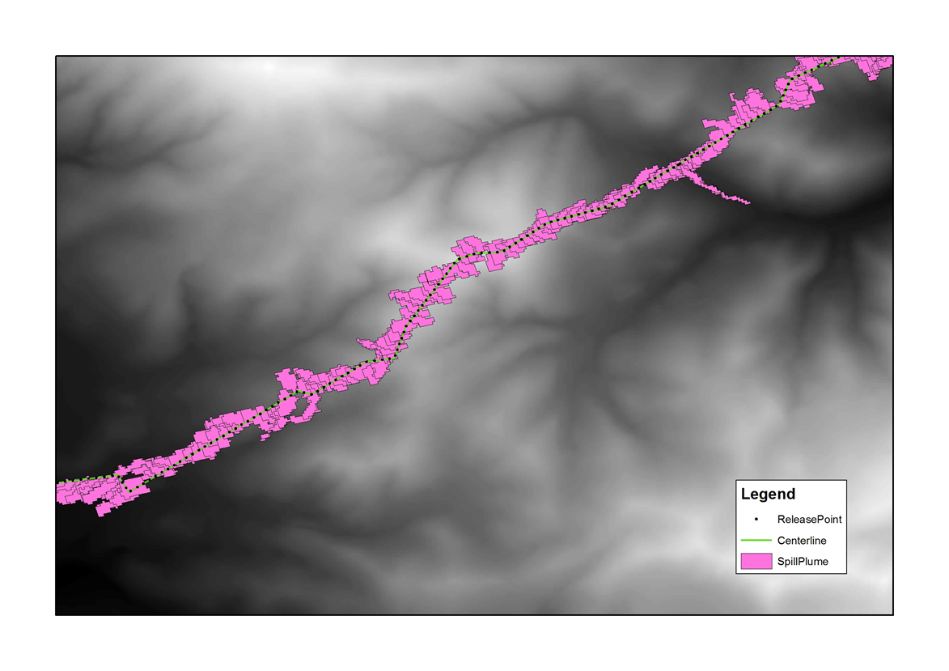
Notes:
This image just illustrates how pipelines require a lot of simulations as they cross the landscape. You can see that the trajectory and fate of the product really changes as it is released in different locations. Elevation also plays a role, as lower elevation points will release more volume due to the drain out of line fill that is up hill of the rupture.

Slide 10
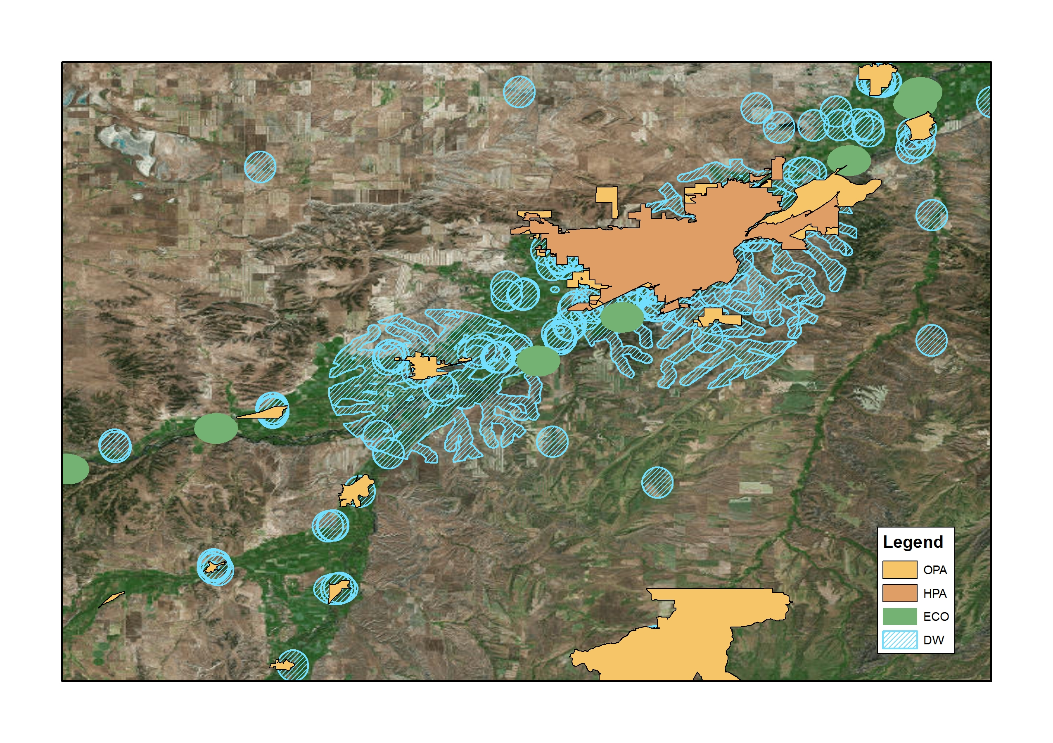
Consequence Analysis
National Pipeline Mapping System (NPMS)
High Consequence Areas
  HPA
  OPA
  CNW
  DW
  ESA
Could Affect Segments
Notes:
In addition to knowing where the product will go, it is important to understand what it will impact. The National Pipeline Mapping System has a variety of layers that they curate for this purpose. They are know as High Consequence areas or HCAs and pipelines that travel through them or can release product that might enter them are known as ‘Could Affect Segments’. *talk about the map* Legislation requires special operating measures for Could affect segments, but that is it. A problem is that there’s no guidance for how bad a could affect segment is, whether it is impacting a single drinking water intake as here or an ESA, an OPA, a HPA and a DW as a spill here could conceivably do. Various operators have developed their own schemes for getting a more nuanced view of consequence than whether a pipeline is or isn’t a Could Affect Segment, but the Holy grail would be a defendable estimated consequence cost. This is because it makes comparing a crude oil line in Texas with a gasoline line in New Hampshire and allocating prevention dollars between them possible.

Slide 11
BOSCEM
Basic Oil Spill Cost Estimation Model (Schmidt, 2004)
Total Cost = Socioeconomic Cost + Environmental Cost + Response Cost
  Response Cost = Base Response Cost x Response Cost Modifier x Spill Volume
    Base Response Cost: Dependent on Volume and product type
    Response Cost Modifier: Dependent on landscape
    Spill Volume: Given in scenario

Slide 12
Goals and Objectives
Develop a workflow for BOSCEM in ArcGIS
Automate using python in ArcGIS
Test results using historic data

Slide 13
Methods
Data: NLCD2011, NWI, NPMS

Slide 14
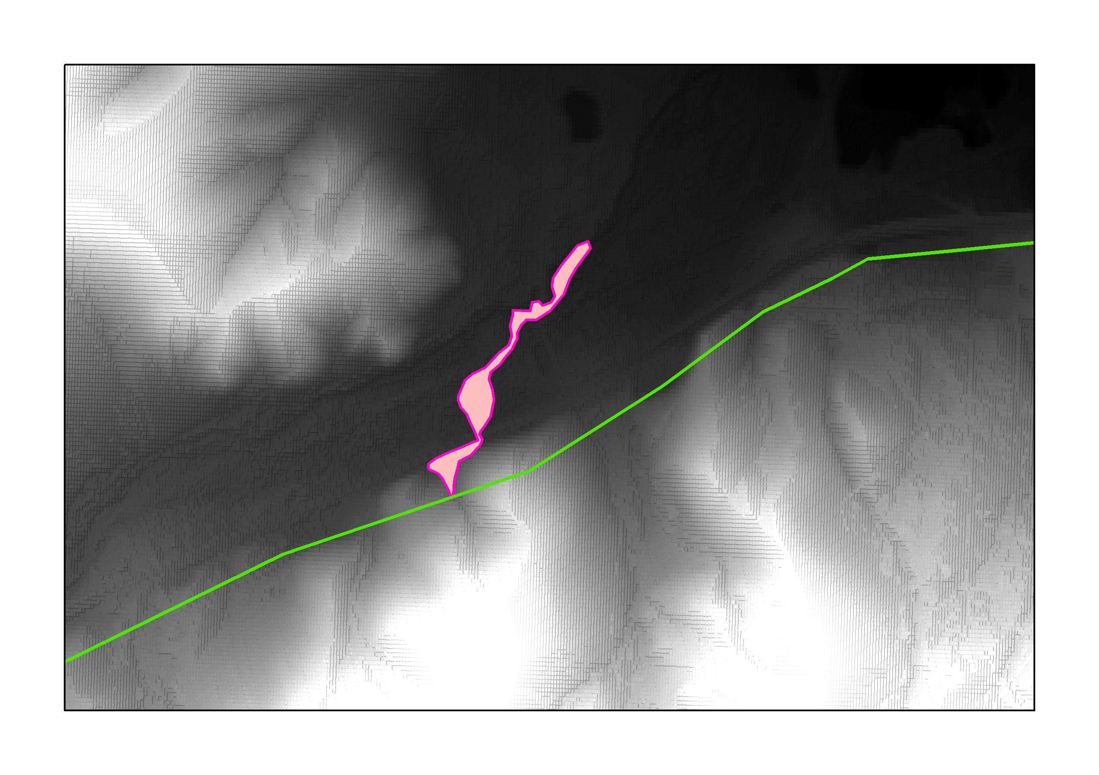
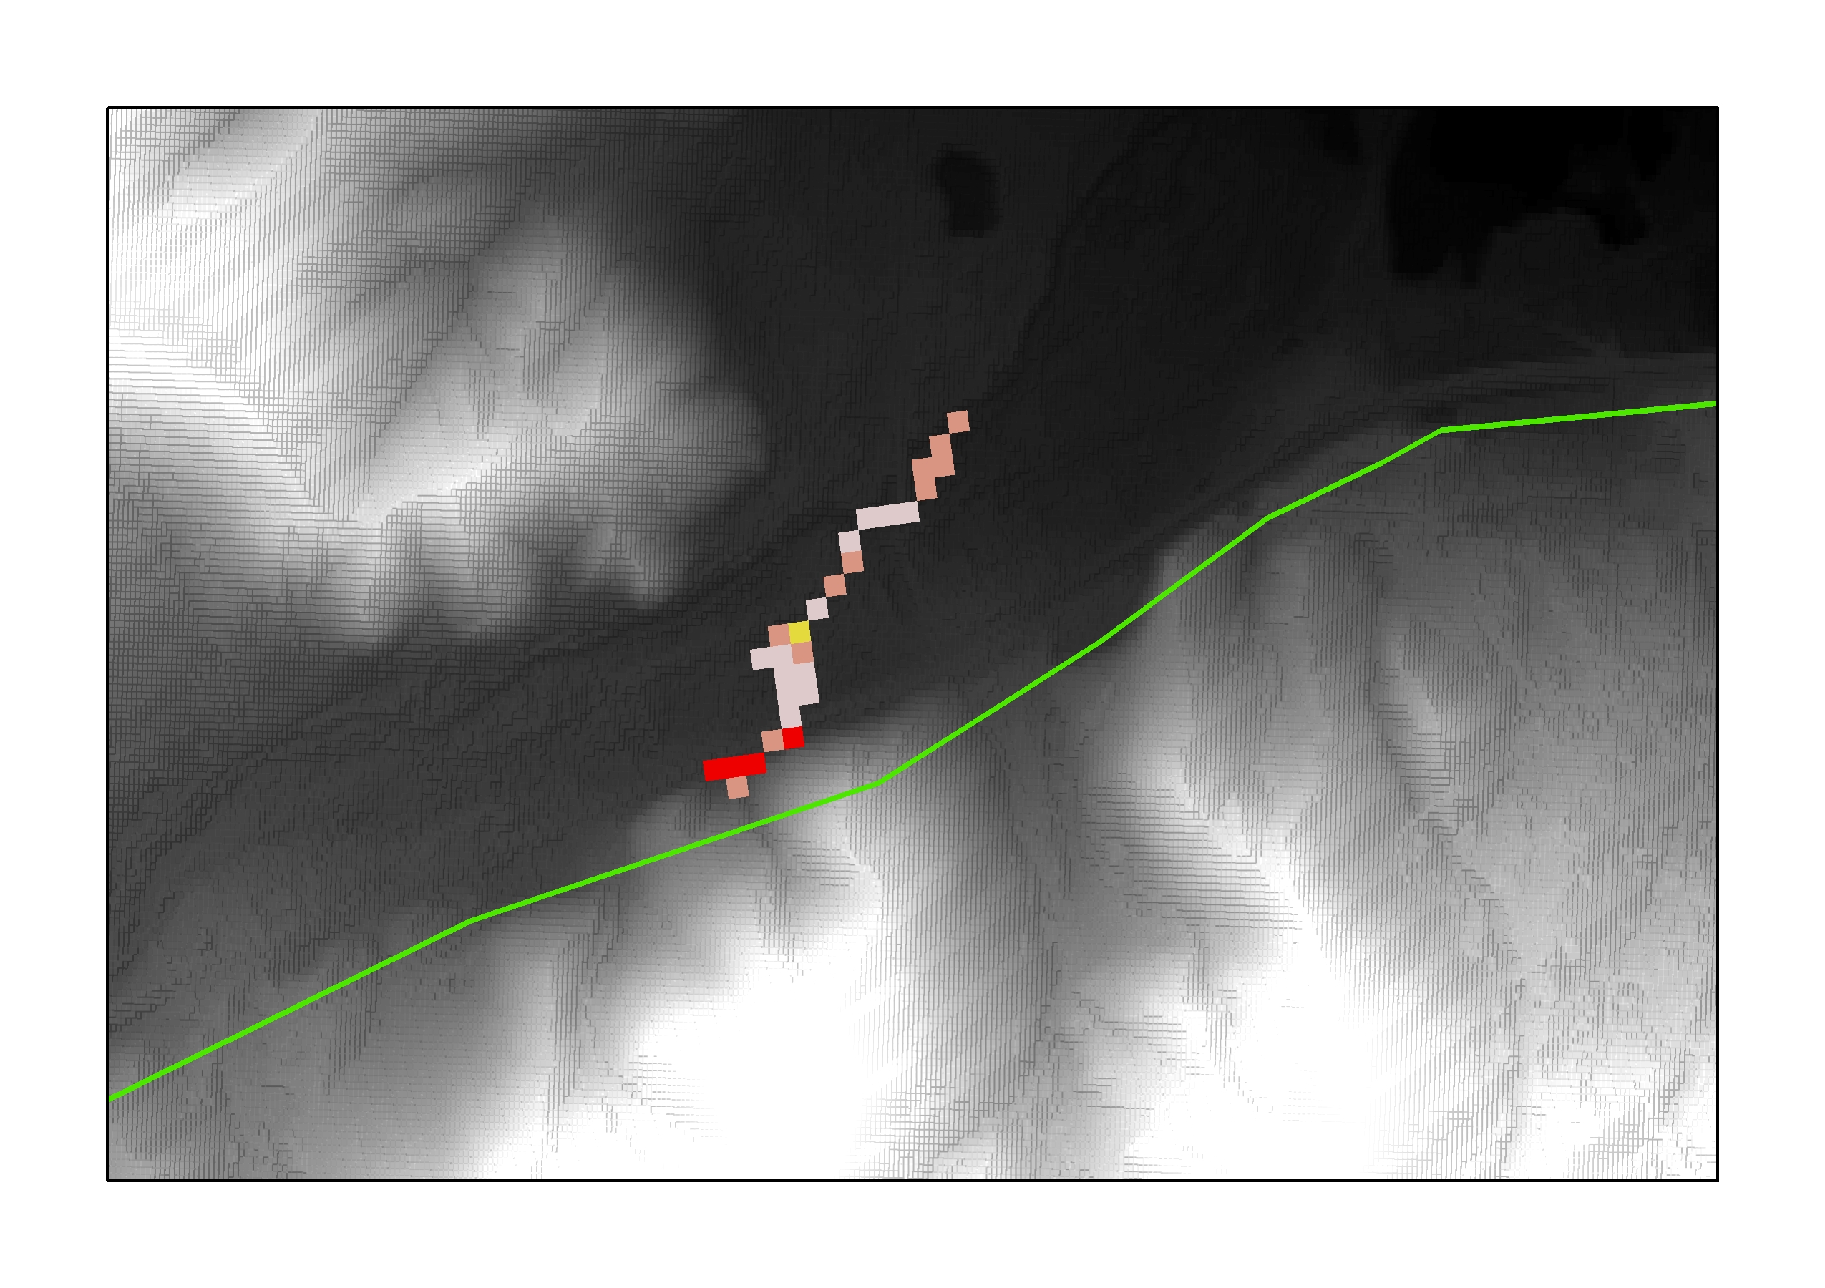
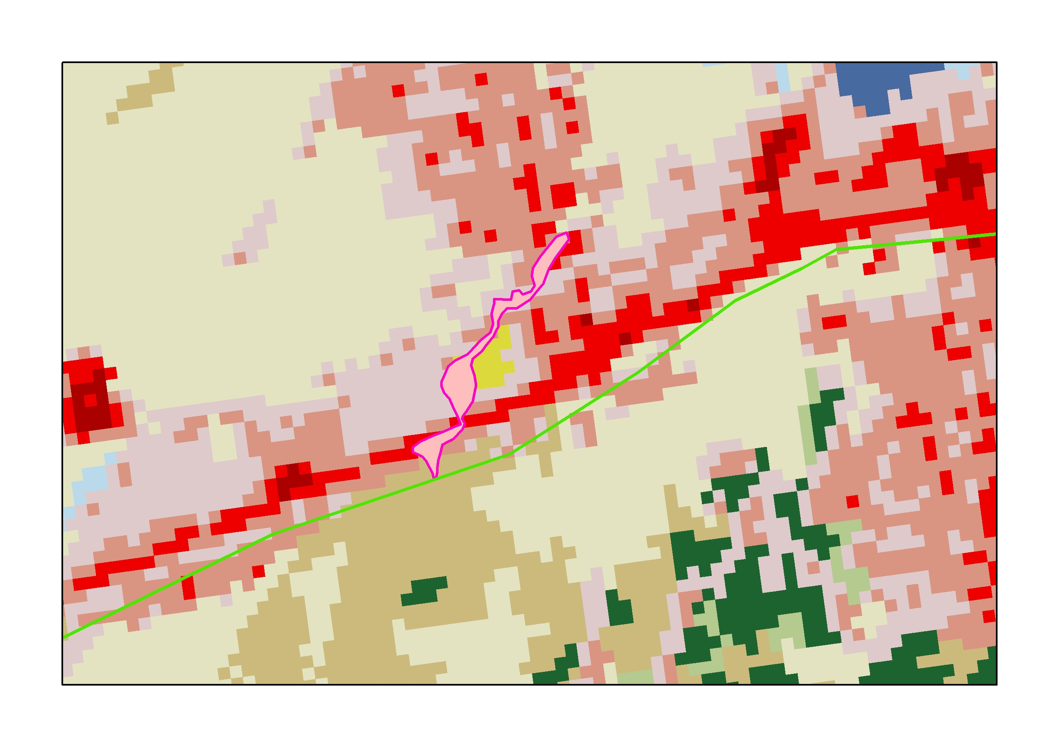
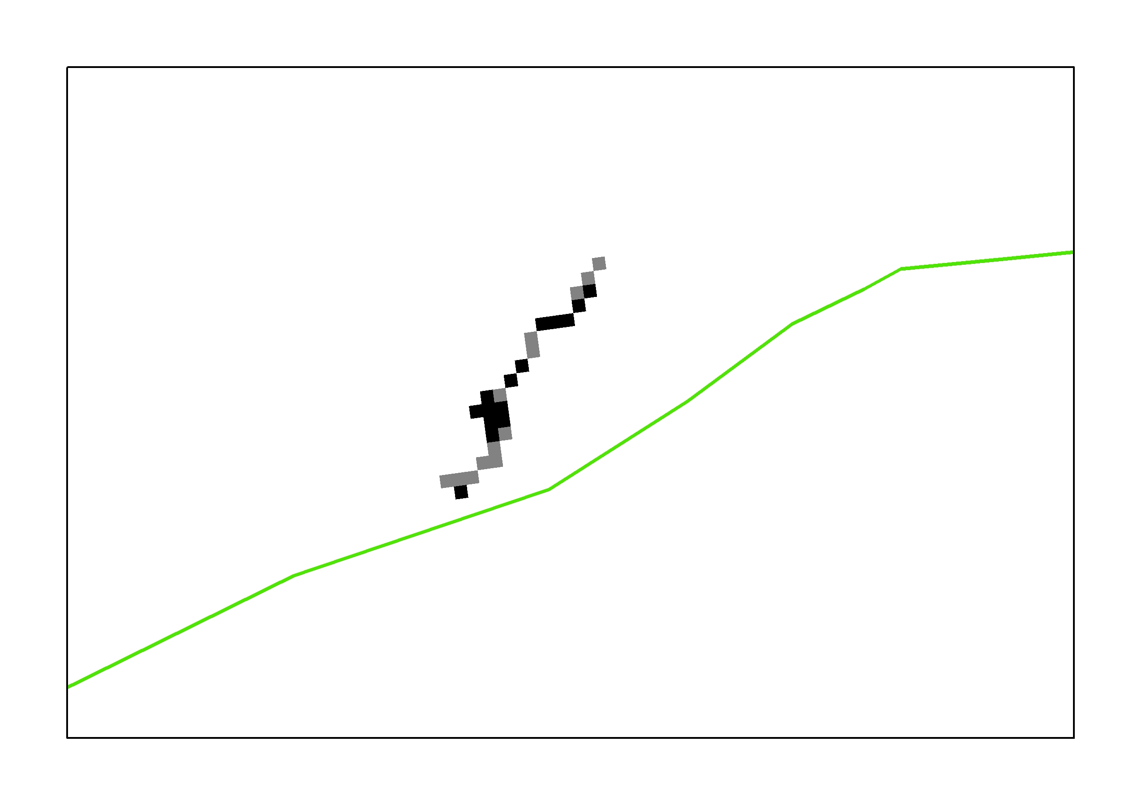
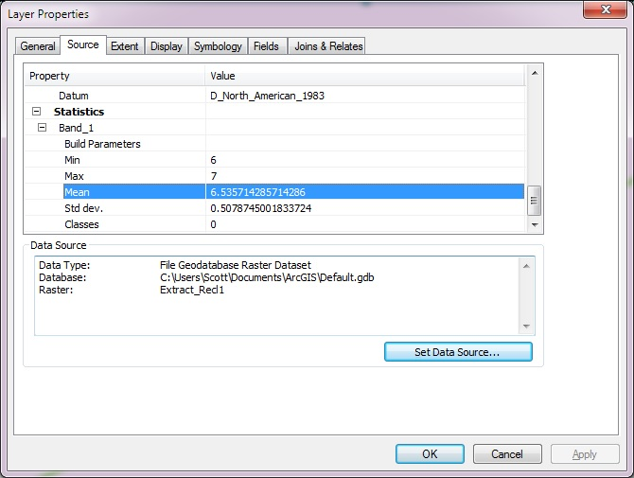
Workflow Example

Slide 15
Discussion & Implications
Cost based estimation is important
BOSCEM is one strategy
Likely not universally appropriate
Potentially Modifiable
Part of a suite of Cost Estimation tools

Slide 16
Timeline
Write Abstract 1/4/2016 – 1/8/2016
Submit Abstract 1/8/2016 (due 2/3/2016)
Script Tool 1/8/2016 – 1/29/2016
Validate on Historic Cases 2/1/2016 -2/29/2016
Prepare Presentation 3/1/2016 – 3/31/16
Intermountain GIS Conference: April 4_{th} – 7_{th} 2016, Great Falls, MT

Slide 17
Acknowledgements
Joseph Bishop Ph.D. – Advisor: Penn State University
Robin Magelky – Director: Integrity Plus
David Mangold – Risk Engineer: Integrity Plus

Slide 18
Questions?
406-570-1443
Scott.Raznoff@ncintegrityplus.com

Slide 19
Sources
[1] http://www.cob.org/services/environment/restoration/Pages/olympic-pipeline-incident.aspx
[2]http://www.ntsb.gov/investigations/AccidentReports/Reports/PAR0401.pdf
[4] http://www.istanbulpost.com.tr/wp-content/uploads/2015/03/pipeline.jpg
[5] http://mapssite.blogspot.com/2008/12/united-states-map-and-compass.html
[6] https://en.wikipedia.org/wiki/Pipeline_and_Hazardous_Materials_Safety_Administration

