Slide 1
VISUALIZING NYC SUBWAY TURNSTILE DATA
using python 3 capabilities and esri technologies
Notes:
My capstone project is about the Subway Transportation System in New York City (next slide)

Slide 2
INTRO
Peter Rechtlich
St. Louis, Missouri
MGIS Candidate
Pennsylvania State University
Adviser: Dr. James O’Brien

Slide 3
OUTLINE
BACKGROUND
OBJECTIVE
METHODOLOGY
ANTICIPATED RESULTS
TIMELINE
CONFERENCE
REFERENCES
BACKGROUND

Slide 4
PROJECT FOCUS AREA
New York City
Unsplash.com; Oliver Niblett@ojnibl
BACKGROUND
Notes:
This is Center Court, where all the great champions play. (next slide)

Slide 5
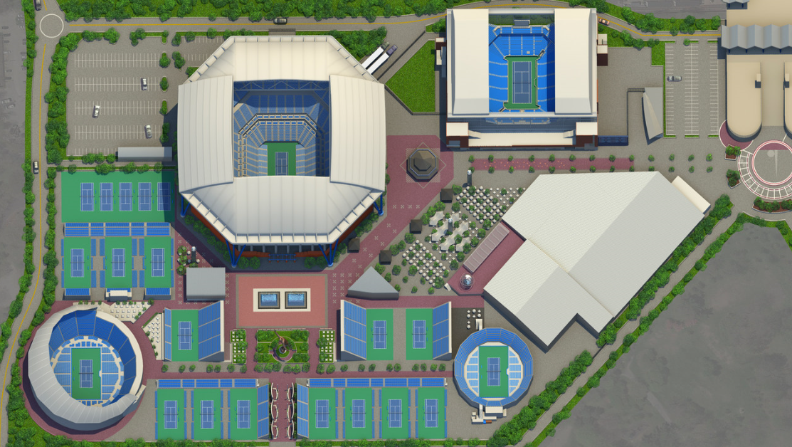
BILLIE JEAN KING TENNIS CENTER
THE DESTINATION
https://www.usopen.org/images/pics/large/b_USO-2018-2048x1152-GroundsMap.jpg
BACKGROUND
Notes:
As you can see, Subways can get pretty crowded (next slide)

Slide 6
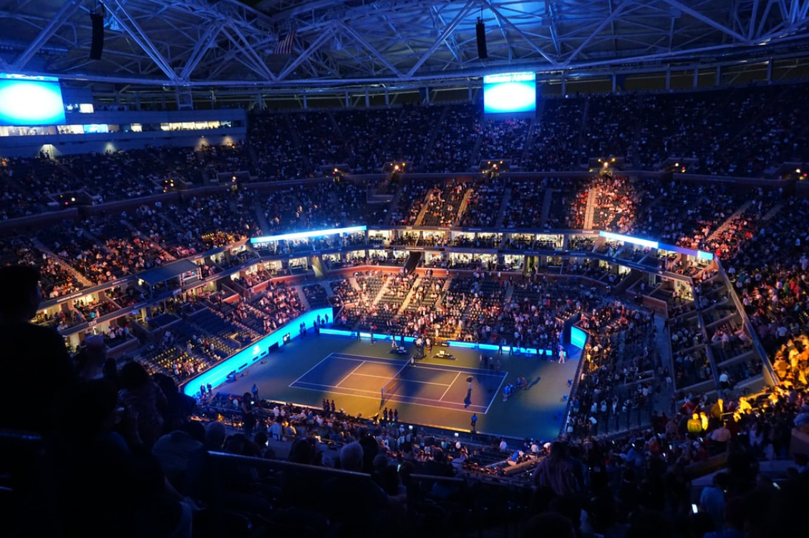
MAIN EVENT
U.S. Open
Unsplash.com; Sudan Ouyang @sdoy1995
BACKGROUND
Notes:
This is Center Court, where all the great champions play. (next slide)

Slide 7
2019 CHAMPS
https://www.usopen.org/index.html
BACKGROUND
https://www.usopen.org/index.html
Notes:
Bianca Andresque

Slide 8
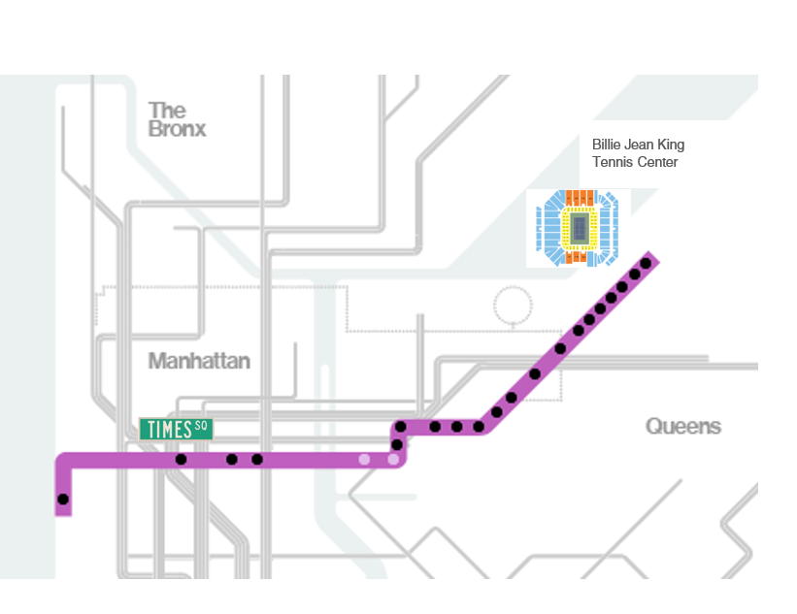
Subway Train #7
SUBWAY #7
BACKGROUND
web.mta.info/weekender.html

Slide 9
HEART OF THE BIG APPLE
Times Square
BACKGROUND
Unsplash.com; Shawn Xu @shawnxxf
Notes:
Got a taste of the Big Apple.

Slide 10
LODGING (Magical)
BACKGROUND
The Casablanca Hotel
Notes:
It’s like a small quaint bed and breakfast in the middle of the city.
Times Square – 40 steps away
Good eating on either side of the hotel
Phantom of the Opera plays 3 city blocks away

Slide 11
TRAVEL TIME
It takes about 30 minutes via the Subway to go from the Casablanca to the Billie Jean King Tennis Center
BACKGROUND

Slide 12
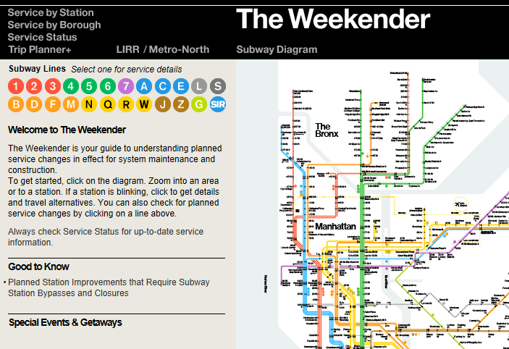
COMMUTER RESOURCE #1
BACKGROUND
web.mta.info/weekender.html

Slide 13
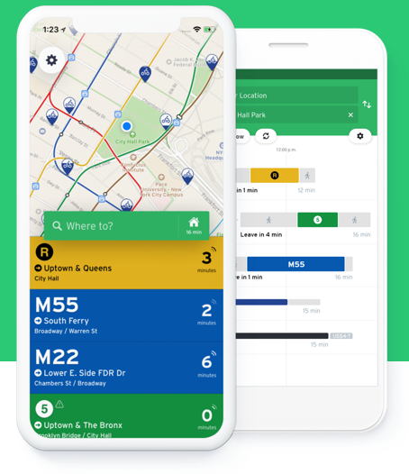
COMMUTER RESOURCE #2
BACKGROUND
https://transitapp.com/

Slide 14
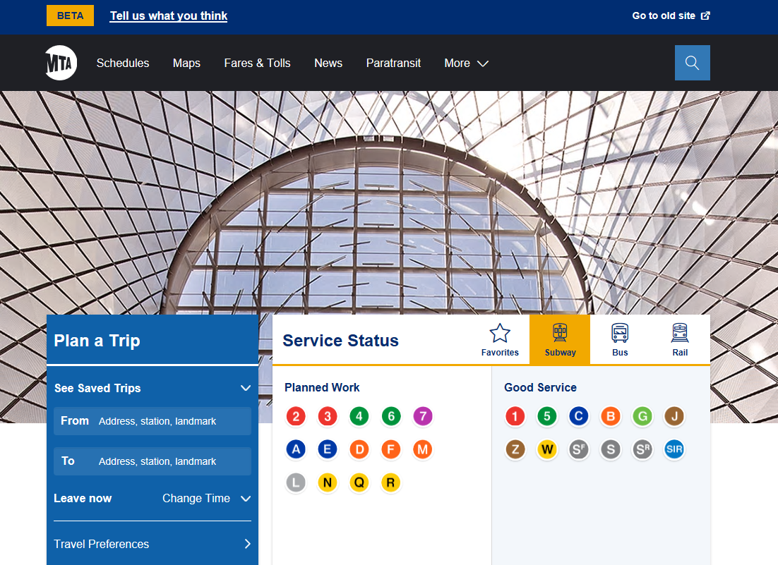
COMMUTER RESOURCE #3
BACKGROUND
https://new.mta.info

Slide 15
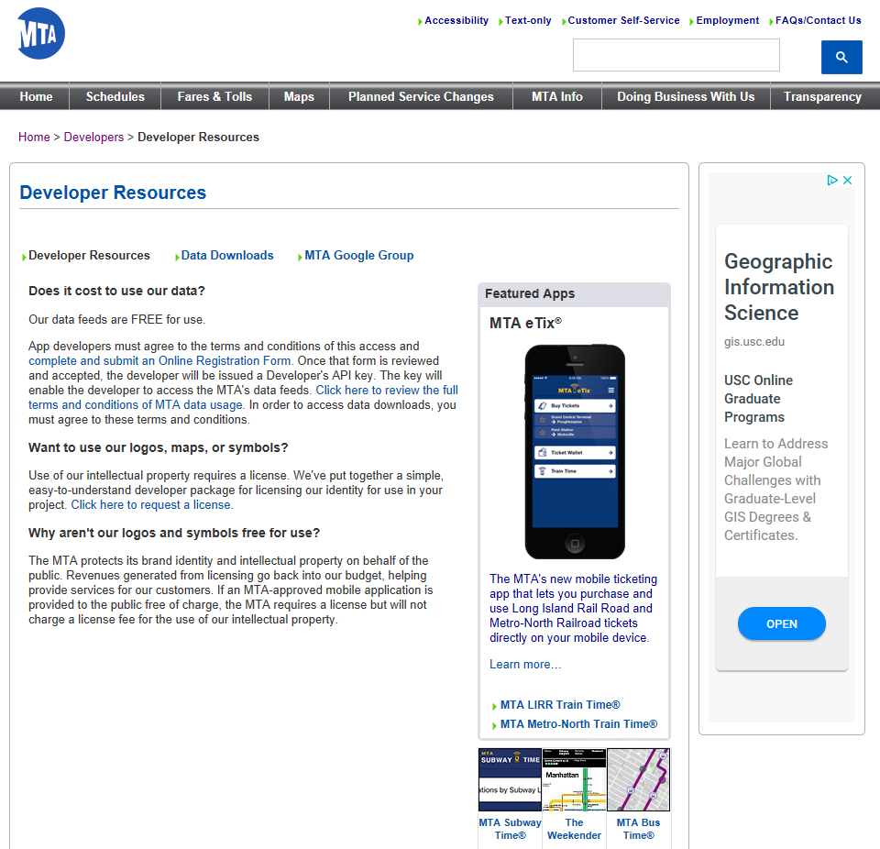
FREE DATA FEEDS
BACKGROUND
http://web.mta.info/developers/

Slide 16
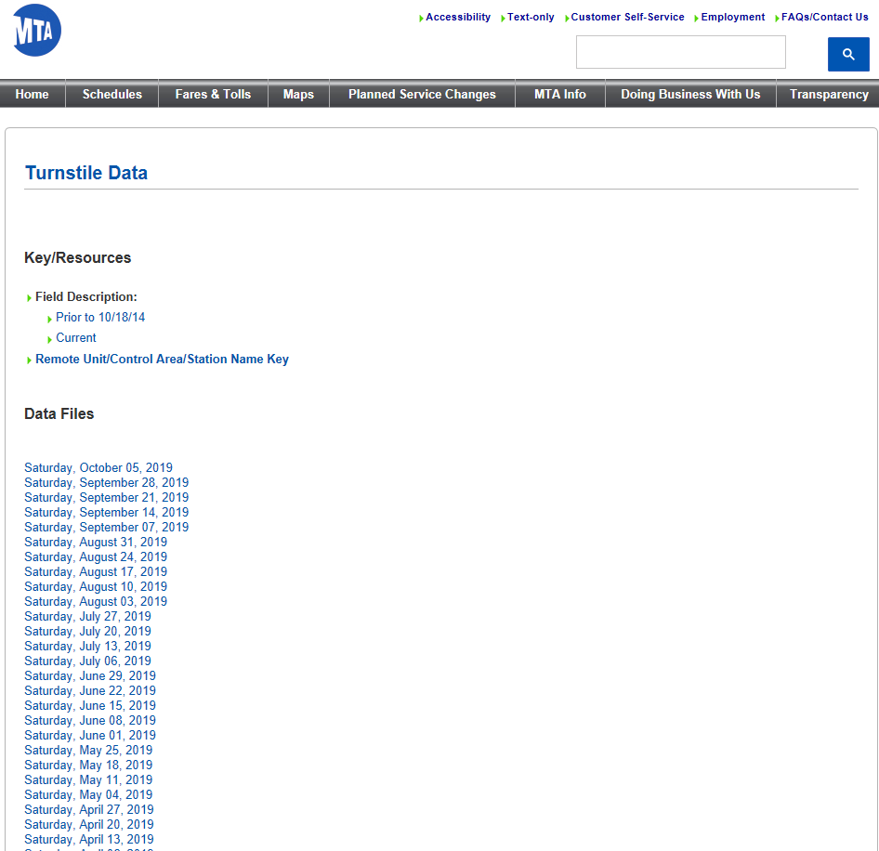
WEEKLY TURNSTILE DATA
BACKGROUND
http://web.mta.info/developers/turnstile.html

Slide 17
SUBWAY CONGESTION
BACKGROUND
Unsplash.com; Framcescp Ungaro @Francesco_ungaro
Notes:
As you can see, Subways can get pretty crowded (next slide)

Slide 18
A Turnstile analysis using ‘R’ – A Nature of Cities Project (Subway Turnstile Data)
CASE STUDY #1
BACKGROUND

Slide 19
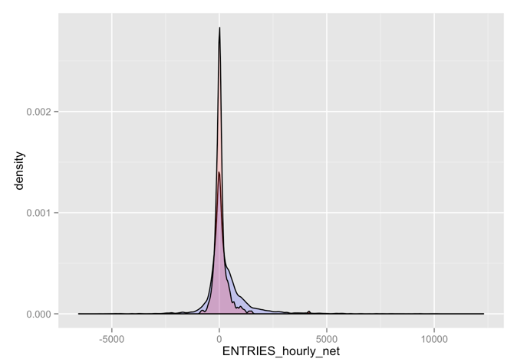
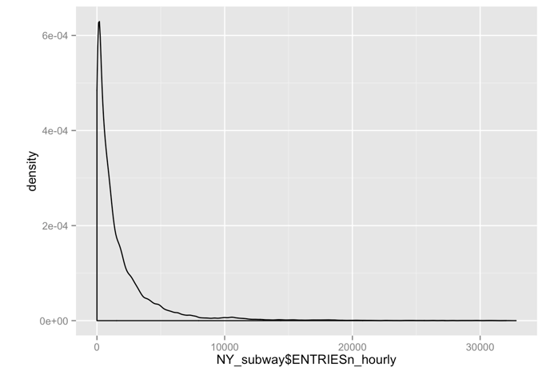
Do more people ride the subway when it's raining or not raining?
Case Study #4 – Rain Analysis
CASE STUDY
#2
BACKGROUND
Does rain affect NYC's subway ridership?

Slide 20
2018 Boot Camp Analysis about cleaning turnstile data (using Jupyter Notebooks)
CASE STUDY #3
BACKGROUND

Slide 21
CASE STUDY #4
BACKGROUND
Visualizing the MTA’s Turnstile Data

Slide 22
BACKGROUND
OBJECTIVE
METHODOLOGY
ANTICIPATED RESULTS
TIMELINE
CONFERENCE
REFERENCES
OUTLINE
OBJECTIVE

Slide 23
OBJECTIVE
To design and build an interactive web app that converts raw turnstile data into a mobile app
OBJECTIVE

Slide 24
BACKGROUND
OBJECTIVE
METHODOLOGY
ANTICIPATED RESULTS
TIMELINE
CONFERENCE
REFERENCES
OUTLINE
METHODOLOGY

Slide 25
GENERAL
PROJECT
TOOLS
General Computer Hardware
Project Management - GitHub
Project Plan - Information Product Description (IPD)
System Requirements - Master Input Data List (MIDL)
App Design – UML
Use the Cloud for data storage
METHODOLOGY

Slide 26
Data Acquisition/Storage
Data Analysis
Data Presentation
THREE
PHASES
METHODOLOGY

Slide 27
SYSTEM REQUIREMENTS
PROTOTYPING
IMPLEMENTATION
PHASE WORK EFFORTS
METHODOLOGY

Slide 28
PHASE
ONE
DATA ACQUISITION
AND STORAGE
METHODOLOGY

Slide 29
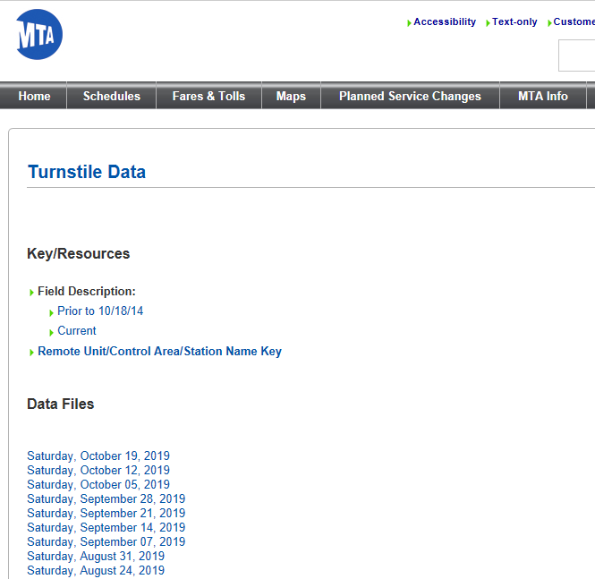
10/19/19
DATA LINK
DATA ACQUISITION
AND STORAGE
METHODOLOGY
http://web.mta.info/developers/turnstile.html

Slide 30
MTA Turnstile data is in raw comma delimited format
Dataset has a header
Data file has glitches, missing data, outliers
Weekly data file large, covers all subway lines in New York
Entry/exit field manipulation difficult
DATA CHARACTERISTICS
METHODOLOGY

Slide 31
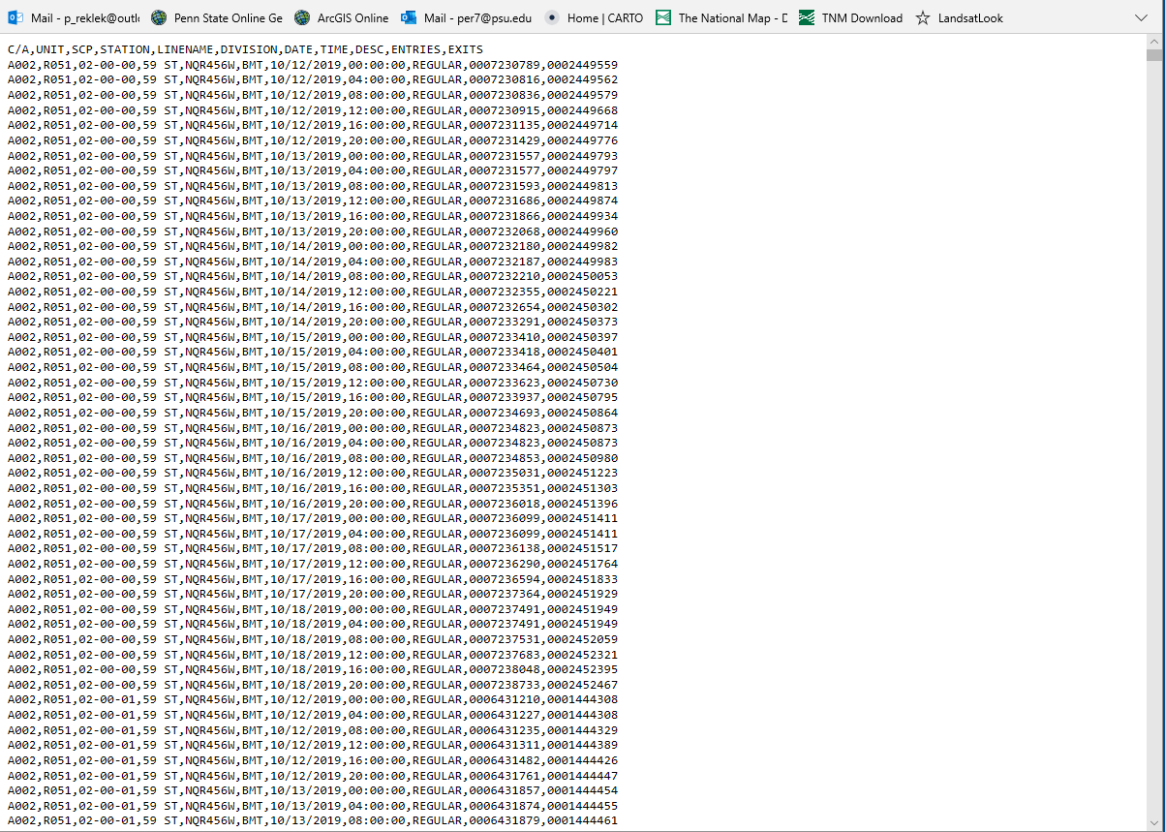
10/19/19
DATA
TEXT FILE
METHODOLOGY
http://web.mta.info/developers/data/nyct/turnstile/turnstile_191019.txt

Slide 32
# Import package
import pandas as pd
# Assign url of file: url
url = 'http://web.mta.info/developers/data/nyct/turnstile/turnstile_191019.txt'
# Read file into a DataFrame: df
df = pd.read_csv(url, sep = ',')
# Print the shape of the DataFrame
print(df.shape)
LOADING DATA INTO PYTHON PANDAS DATAFRAME
METHODOLOGY
For the 10/19/19 data feed: 206819 records, 11 attributes

Slide 33
C/A == Control Area (i.e. A002)
Unit == Unit # within Station (i.e. R051)
SCP == Specific address of device (02-00-00)
STATION == Station name the device is located at
LINENAME == Represents train lines
DIVISION == BMT, IRT, or IND
DATE == Date; format (MM-DD-YY)
TIME == Time; format (hh:mm:ss)
DESc == ‘REGULAR’ (represents recording event every 4 hours)
ENTRIES == Cumulative entry value for device
EXITS == Cumulative exit value for device
ATTRIBUTES
METHODOLOGY

Slide 34
Use Python programming language only (if possible)
Automating the process needs to be looked into (Jenkins?)
DATA ACQUISITION CONSIDERATIONS
METHODOLOGY

Slide 35
DATA STORAGE CONSIDERATIONS
Right now using panda DataFrames to capture data
Database options (i.e. MySQL, PostGRESQL, SQLite, MS SQL)
Use background map imagery via ArcGIS Online mapping or ArcGIS Pro(i.e. Living Atlas of the World)
Use yearly August/September data for feeds (U.S. Open time period)
METHODOLOGY

Slide 36
PHASE
TWO
DATA ANALYSIS
METHODOLOGY

Slide 37
Data is not real-time (data feed every Saturday)
There is over 10 years of annual turnstile data
Plan is to use older data to simulate patterns through building a neural network in Python
PHASE
TWO
METHODOLOGY

Slide 38
DATA ANALYSIS CONSIDERATIONS
Libraries for analysis: numpy, pandas, re, matplotlib, pytest, SciKit-Learn
Jupyter Notebook for prototyping
Use dataset results from past 9 years
Analyze data via corrected dataset in a database
Generate reports on percentage error loss per dataset (i.e. missing, dropped, etc. data records)
METHODOLOGY

Slide 39
REGULAR EXPRESSIONS
(RE MODULE)
Basic Patterns: Ordinary Characters
Wild Card Characters: Special Characters
Repetitions
Groups and Grouping
METHODOLOGY

Slide 40
NEURAL
NETWORKS
(SCIKIT LEARN)
Machine Learning Library for Python is SciKit Learn Database options (i.e. MySQL, PostGRESQL, SQLite, MS SQL)
Use background map imagery via ArcGIS Online mapping or ArcGIS Pro(i.e. Living Atlas of the World)
Use yearly August/September data for feeds (U.S. Open time period)
METHODOLOGY

Slide 41
PHASE
THREE
DATA PRESENTATION
METHODOLOGY

Slide 42
ESRI Story Maps
ESRI Operations Dashboard
ESRI AppStudio for ArcGIS
PRESENTATION TOOLS
METHODOLOGY

Slide 43
Map imagery to be displayed at different scales
Inspiration: Massimo Vignelli’s 1972 NYC Subway Map
ArcGIS Online and ArcGIS Pro for background maps
Adobe Illustrator, Photoshop, InDesign for detail graphics work (was going to use Open Source solution but there is more training options with Adobe)
ArcGIS Maps for Adobe Creative Cloud (as needed for background maps, potential 3-D fly-throughs)
Incorporate Helvetica typefont
ESRI Story Map(s) to outline project development (maybe)
‘Operations Dashboard for ArcGIS’ to support analysis display of data performance, error analysis, etc.
‘AppStudio for ArcGIS’ for end user mobile map app
DATA PRESENTATION CONSIDERATIONS
METHODOLOGY

Slide 44
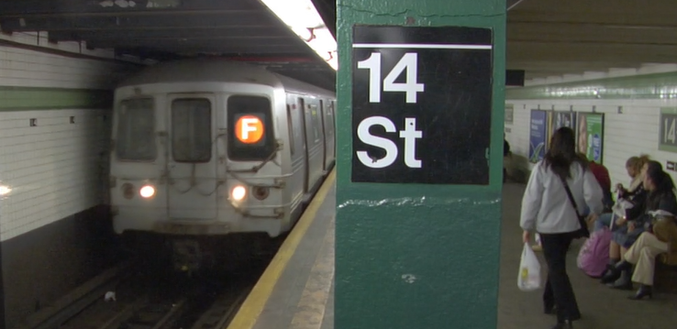
TYPEFONT CONSIDERATION
https://www.youtube.com/watch?v=wkoX0pEwSCw
METHODOLOGY

Slide 45
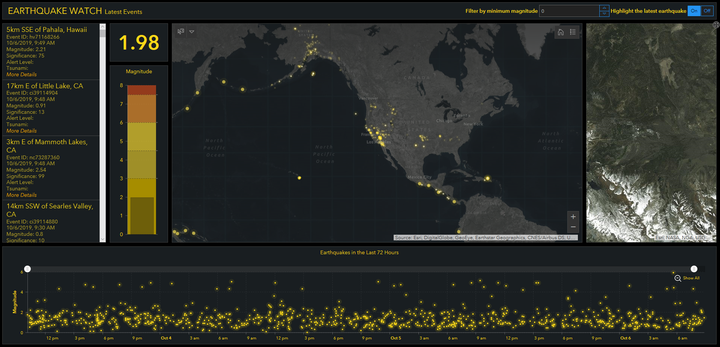
MAP PRESENTATION VIA OPERATIONS DASHBOARD
METHODOLOGY
ArcGIS Operations Dashboard

Slide 46
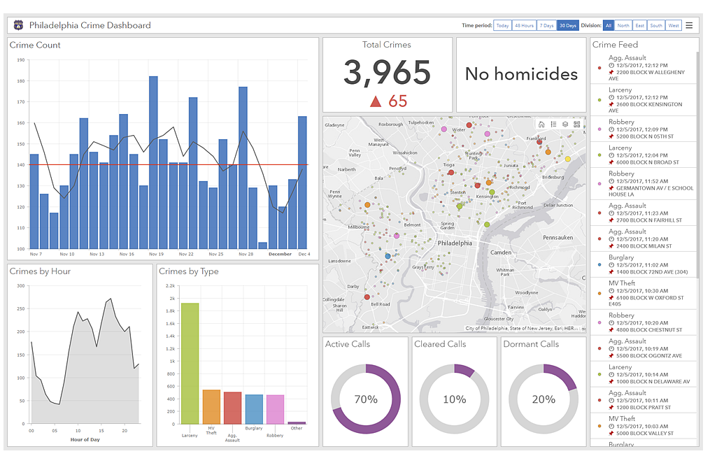
ERROR METRICS VIA OPERATION DASHBOARD
METHODOLOGY
https://doc.arcgis.com/en/operations-dashboard/help/what-is-a-dashboard.htm

Slide 47
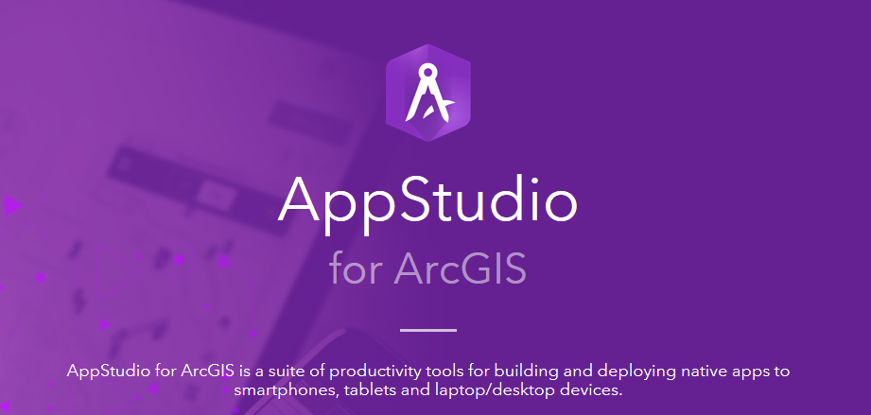
APP DEV
TOOL FOR MOBILE SOLUTION
METHODOLOGY
ArcGIS AppStudio Web App

Slide 48
BACKGROUND
OBJECTIVE
METHODOLOGY
ANTICIPATED RESULTS
TIMELINE
CONFERENCE
REFERENCES
OUTLINE
ANTICIAPTED RESULTS

Slide 49
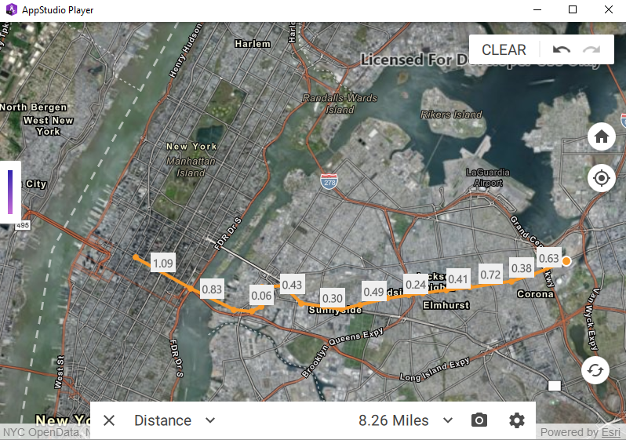
APPSTUDIO PLAYER -
MANHATTAN/QUEENS
BACKGROUND MAP
ANTICIAPTED RESULTS
Distance from Times Square to Mets-Willets Point ~ 8.26 Miles

Slide 50
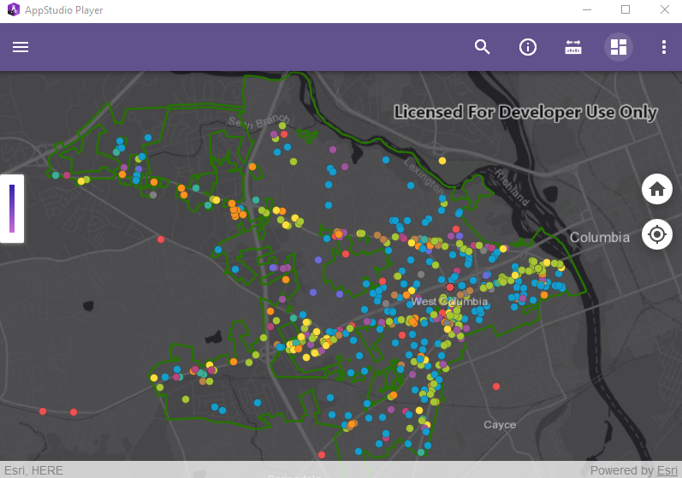
APPSTUDIO PLAYER -
EXAMPLE OF POINT DATA OVER BACKGROUND MAP
ANTICIAPTED RESULTS
Dark Gray Canvas Background option behind layer of point data

Slide 51
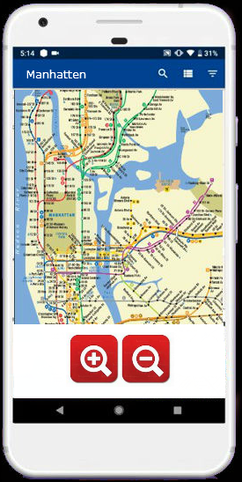
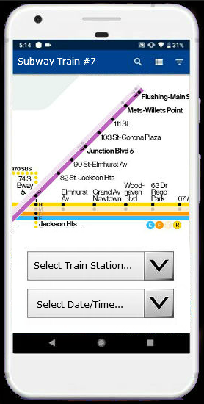
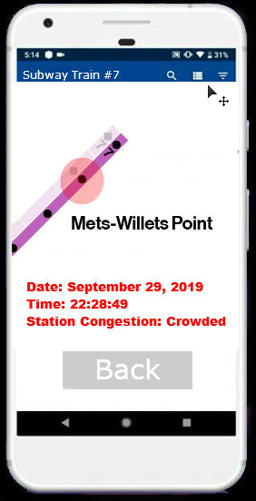
MOBILE MAP MOCKUP #1
(ILLUSTRATOR)
ANTICIAPTED RESULTS

Slide 52
MOBILE MAP MOCKUP #2
(BALSAMIC)
ANTICIAPTED RESULTS

Slide 53
The main obstacle for this project will be to get the code to work
A subset of the data will be used to make the project more manageable (Subway Train #7)
No expectation on wide distribution of this project (probably notify MTA about its availability as a courtesy)
I have played a lot of tennis in St. Louis and my wife captains a couple of tennis teams. Tennis, tennis, tennis. Word of mouth distribution of this app might be likely but opportunity to run some trial testing with the focused datasets wouldn’t be applicable till August/September 2020. Hmmm…. Thoughts?
SUMMARY
ANTICIAPTED RESULTS

Slide 54
BACKGROUND
OBJECTIVE
METHODOLOGY
ANTICIPATED RESULTS
TIMELINE
CONFERENCE
REFERENCES
OUTLINE
TIMELINE

Slide 55
TIMELINE
CHART
 | Oct | Nov | Dec | Jan | Feb | Mar | Apr
Abstract Submittal | ✓
GEOG583 |  | ✓ | ✓
Phase 1 |  | ✓ | ✓ | ✓
Phase 2 |  | ✓ | ✓ |  | ✓
Phase 3 |  | ✓ | ✓ |  |  | ✓ | ✓
Snow Mtn Ranch |  |  |  |  |  |  | ✓
TIMELINE

Slide 56
BACKGROUND
OBJECTIVE
METHODOLOGY
ANTICIPATED RESULTS
TIMELINE
CONFERENCE
REFERENCES
OUTLINE
CONFERENCE

Slide 57
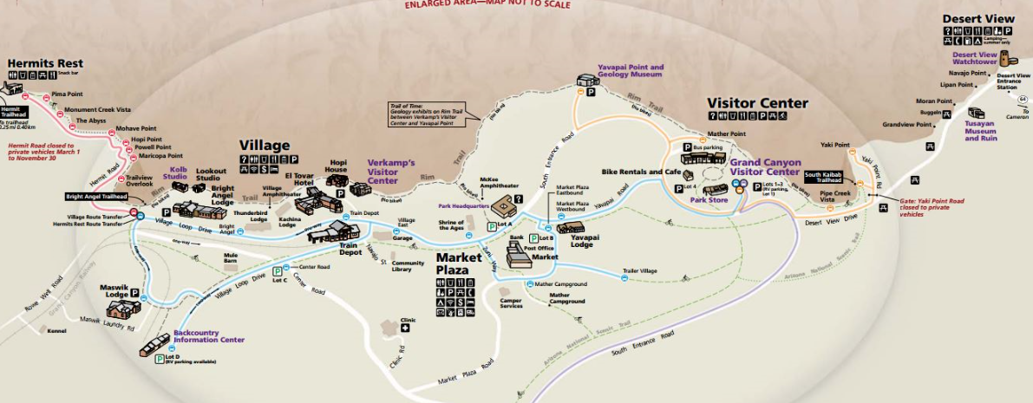
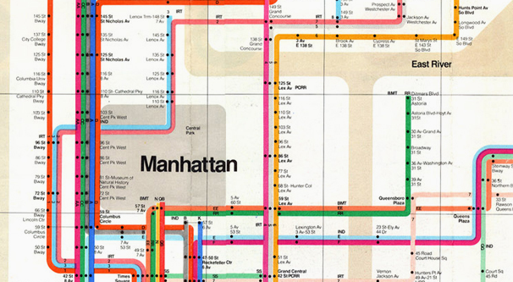
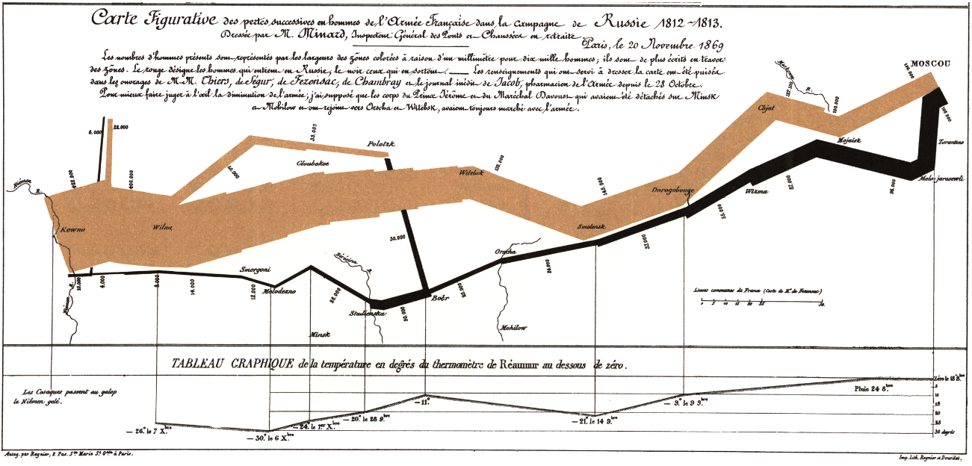
REASON FOR GOING TO SNOW MOUNTAIN
CONFERENCE

Slide 58
Venue: 12th Mountain Cartography Workshop
Location: Snow Mountain Ranch, Colorado
Date: April 14 – 18, 2020
Theme: People, Maps, and Mountains
Abstract due date: November 1st, 2019
CONFERENCE
CONFERENCE

Slide 59
ABSTRACT
(SUMMARY)
Abstract: Visualizing NYC Subway Turnstile Data (DRAFT) Presenter: Peter Rechtlich The New York City (NYC) Metro Transit Authority provides free data feeds that track subway activity across all of New York City. One feed specifically monitors commuter traffic - entries and exits - via turnstiles at all the subway train stations. In this presentation, I will discuss the process of extracting some of this raw data using the magic of Python libraries which includes cleaning/manipulation of data to produce a corrected dataset from which error analysis reporting can take place for quality assurance purposes. In the end, the data will be pushed to an ESRI end-product, making stagnant raw data a visual ‘People’ resource via mobile app technology. The turnstile data product is not real-time as it only gets distributed weekly. However, there is almost 10 years-worth of data and trends can be developed by building a neural network in Python. Want an example of approximating best times to travel by subway in New York City? Come find out.
CONFERENCE

Slide 60
BACKGROUND
OBJECTIVE
METHODOLOGY
ANTICIPATED RESULTS
TIMELINE
CONFERENCE
REFERENCES
OUTLINE
REFERENCES

Slide 61
Planning
Tomlinson, Roger. (2003). Thinking About GIS. Esri Press, The 10-stage GIS planning methodology. (p. 13 – 17). 380 New York street, Redlands, California. 10475 Crosspoint Boulevard, Indianapolis, IN 46256
REFERENCES
REFERENCES

Slide 62
Data Acquisition
Datacamp training (n.d.). Python Training. Retrieved on 10/23/19 from https://www.datacamp.com
MTA Data (n.d.). Developer page. Retrieved on 10/23/19 from https://new.mta.info/
Conda.io. (n.d.). User guide. Retrieved on 10/23/19 from https://conda.io/projects/conda/en/latest/user-guide/index.html
REFERENCES
REFERENCES

Slide 63
Data Storage
Cassell, Laura; Gauld, Alan. (2015). Python Projects. STORING DATA USING PYTHON (P.104 - 116). John Wiley & Sons, Inc.
Doc.arcgis.com. (n.d.). Understand data sources. Retrieved on 10/23/19 from https://doc.arcgis.com/en/operations-dashboard/help/understand-data-sources.htm
REFERENCES
REFERENCES

Slide 64
Data Analysis
Cassell, Laura; Gauld, Alan. (2015). Python Projects. ANALYZIING DATA USING PYTHON (P.116 - 125). John Wiley & Sons, Inc.
Cassell, Laura; Gauld, Alan. (2015). Python Projects. MANAGING DATA USING SQL (P.125 - 139). John Wiley & Sons, Inc.
Datacamp training (n.d.). Python Training. Retrieved on 10/23/19 from https://www.datacamp.com
Sprintboard.com. (March 21, 2017). A Beginner’s Guide to Neural Networks in Python. Building a Neural Network in Python. Retrieved on 10/24/19 from https://www.springboard.com/blog/beginners-guide-neural-network-in-python-scikit-learn-0-18/
datacamp.com. (n.d.). Python Regular Expression Tutorial. Retrieved on 10/24/19 from https://www.datacamp.com/community/tutorials/python-regular-expression-tutorial
REFERENCES
REFERENCES

Slide 65
Data Presentation
Fue, Pinde. (2018). GETTING TO KNOW WEB GIS (Third Edition). Esri Press, 380 New York street, Redlands, California. 10475 Crosspoint Boulevard, Indianapolis, IN 46256
esri ArcGIS Blog. (February 22, 2019). Making an Auto-Focusing Real-Time Dashboard. Retrieved on 10/23/19 from https://www.esri.com/arcgis-blog/products/ops-dashboard/real-time/making-an-auto-focusing-real-time-dashboard/
doc.arcgis.com. (n.d.). Operations Dashboard for ArcGIS. Retrieved on 10/23/19 from https://doc.arcgis.com/en/operations-dashboard/help/what-is-a-dashboard.htm
community.esri.com. (n.d.). Operation Dashboard for ArcGIS - Useful Links. Retrieved on 10/23/19 from https://community.esri.com/community/gis/applications/operations-dashboard-for-arcgis/blog/2019/03/01/operations-dashboard-for-arcgis-useful-links
mapbox.com. (n.d.) Turn-by-turn navigation. Retrieved on 10/23/19 from https://www.mapbox.com/use-cases/turn-by-turn-navigation/
REFERENCES
REFERENCES

Slide 66
Data Presentation (2)
esri.com. (n.d.) Making an Auto-Focusing Real-Time Dashboard. Retrieved on 10/23/19 from https://www.esri.com/arcgis-blog/products/ops-dashboard/real-time/making-an-auto-focusing-real-time-dashboard/
REFERENCES
REFERENCES

Slide 67
datacamp.com. (n.d.). Home page. Retrieved on 10/24/19 from https://www.datacamp.com/home
Supervised Learning with scikit-learn
Introduction to Data Visualization with Python
Python Data Science Toolbox
Importing Data in Python
Introduction to Data Visualization with Python
Pandas Foundations
Manipulating DataFrames with pandas
Deep Learning in Python
Cleaning Data in Python
Introduction to Time Series Analysis in Python
Visualizing Time Series Data in Python
REFERENCES
REFERENCES

Slide 68
Data Automation
developers.arcgis.com. (n.d.) ArcGIS for Developers -ArcGIS API for Python. Retrieved on 10/23/19 from https://developers.arcgis.com/python/guide/using-the-api/
pro.arcgis.com. (n.d.) ArcGIS Pro -ArcGIS API for Python. Retrieved on 10/23/19 from https://pro.arcgis.com/en/pro-app/arcpy/get-started/arcgis-api-for-python.htm
REFERENCES
REFERENCES

