Slide 1
Analyzing Smartphone Z-Axis Location Data: A Case Study of Trade Area Analysis in Dense Urban Areas to Track Human Movement for Site Selection
Matthew Reyes
Penn State MGIS
Advisor: Emily Rosenman
Geog 596A, Summer 2022

Slide 2
Overview
What is trade area analysis and site selection?
Existing trade analysis approaches.
Novel approach to 3-dimensional trade area analysis.

Slide 3
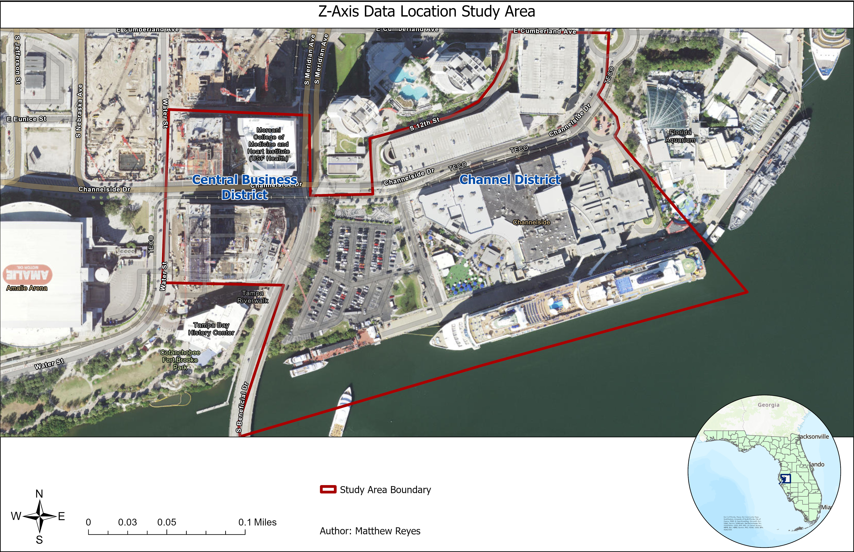
What is Trade Area Analysis and Site Selection?
Commercial site selection success is determined by reviewing consumer travel paths, analysis of preferred demographics and psychographics, traffic density, and study of physical barriers.
Consumer travel paths assists in determining visit frequency and dwell time.
2-dimensional trade area analysis provide visualization of demographic and psychographic data within a pre-determined travel distance or time.
Site selection contains obstacles when consumers reside or work in dense urban areas with multi-story buildings.
Traditional trade area analysis does not accommodate for vertical urbanism, and often displays travel to a site as opposed to within.

Slide 4
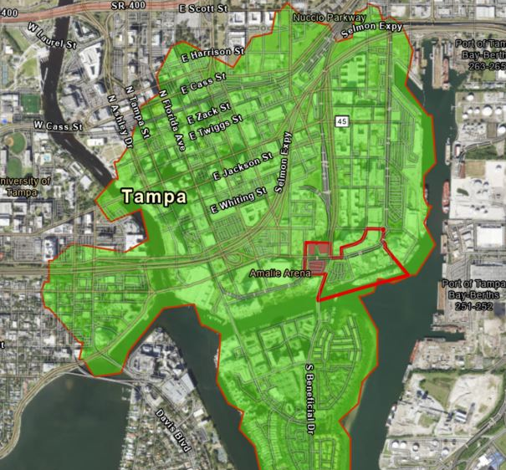
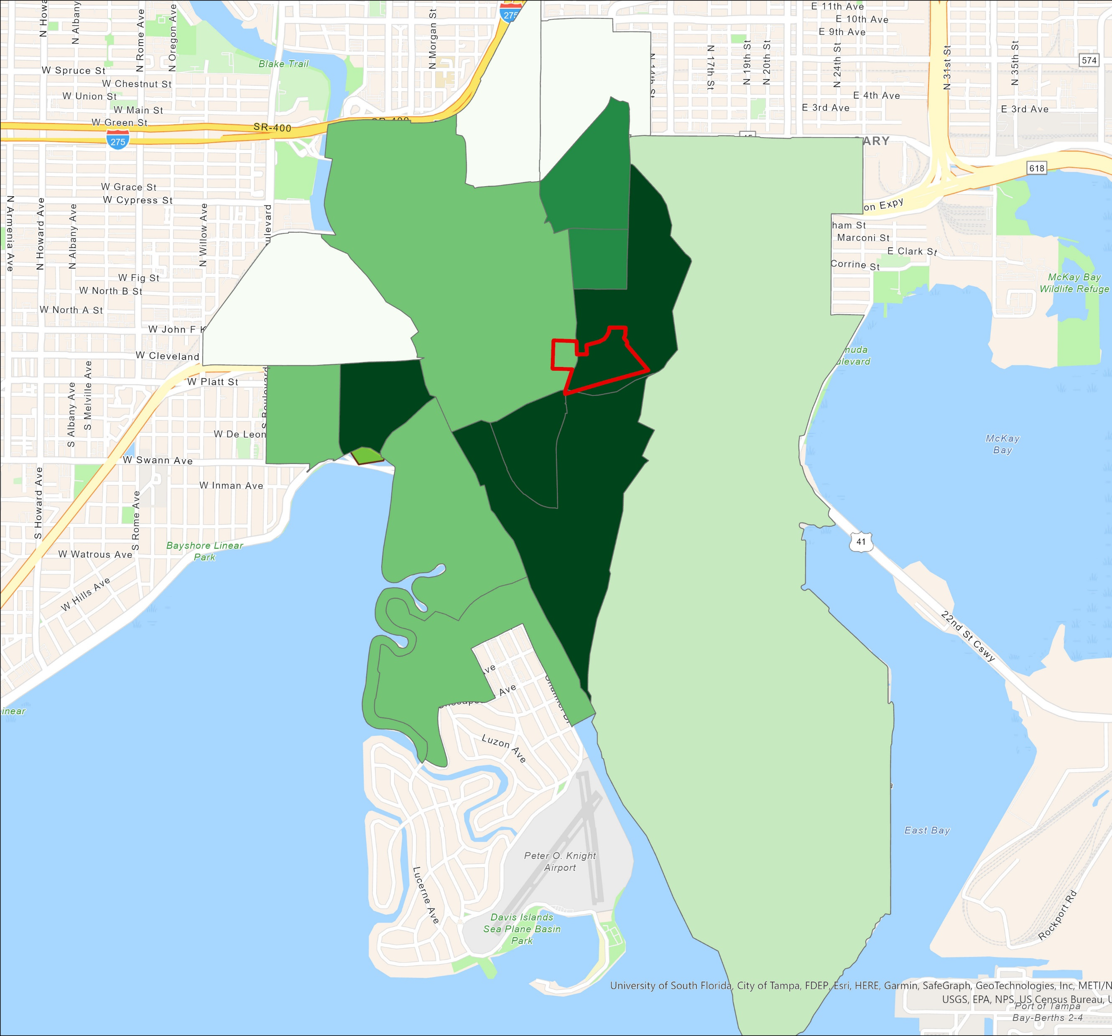
Common Existing Trade Area Analysis Approaches
Drive time (Image 1)
Driving distance or time to or from the location of interest.
Census Data (Image 2)
Data is aggregated within various census geography types including state, county, tract, and block.
Rings (Image 3)
Size dependent on pre-determined radius length.
Image 1
Image 2
Image 3

Slide 5
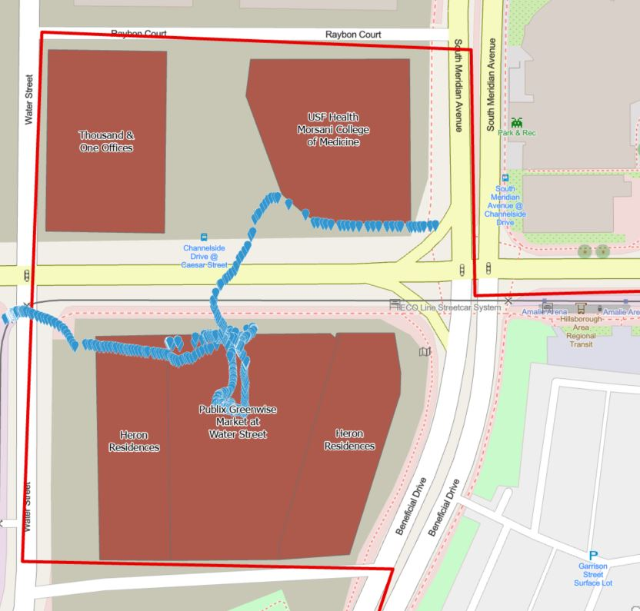
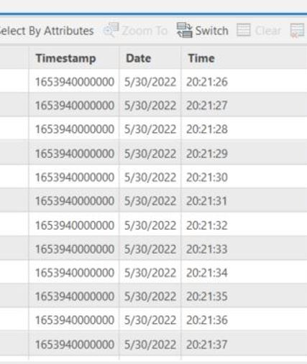
Consumer Travel Path and Dwell Time Analysis
Anonymized cell phone GPS data is used to determine paths consumers take to visit a geofenced location.
Credit card purchase data is also used but only provides consumer zip code.
Social media platform check-ins (Twitter, Facebook, Instagram, and Foursquare).
Wi-Fi access points located within buildings.
Dwell time provides insight to how long of a stay a consumer visits a site location as well as spending habits.
Consumer spending predictions are influenced by the length of dwell time (Bohl, 2014).
Travel path field study observation points and their respective dwell times.

Slide 6
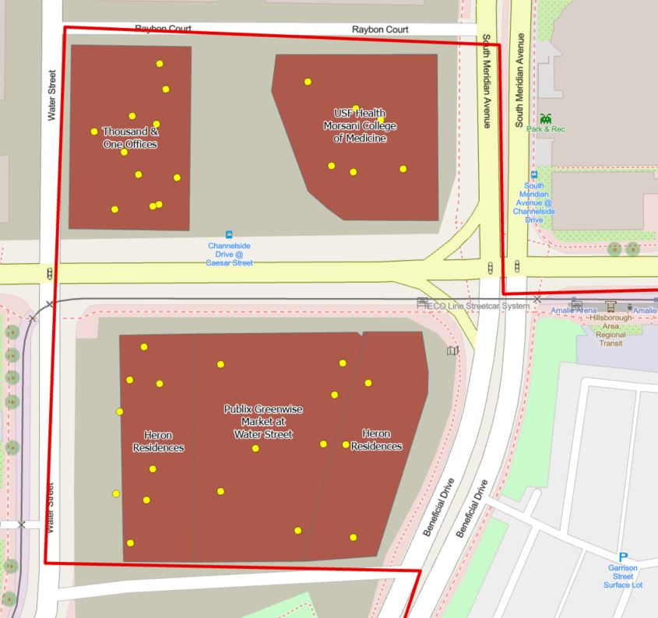
Stationary Positions
Common evening and common daytime locations are used in determining generalized consumer place of residence or work site location.
Stationary points within the study region.

Slide 7
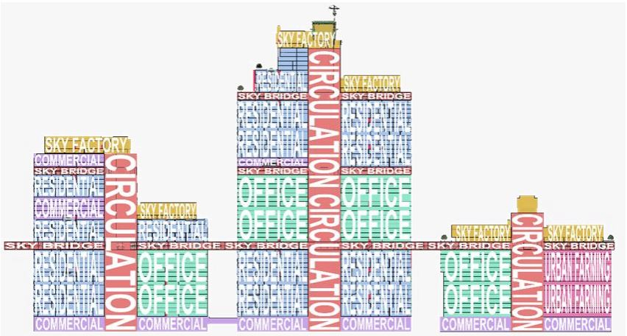
Novel Approach - Goals and Objectives
Conduct study trials to refine data gathering, interpolation methods, and parameters through use of cell phone z-axis data.
Reduce “fog of war” for commercial development and site selection ambiguity in vertical urban locations.
Represent consumer vertical travel paths in dense urban regions by use of cell phone barometric pressure sensors.
Expand voxel layer use into commercial and urban development.
Demonstrate effectiveness of interpolating consumer attributes on a z-axis scale.
Vertical urbanism complex. Reproduced here for educational purposes only. (Hu et al., 2020).

Slide 8
Novel Approach - Proposed Methodology
Methodology flow chart.

Slide 9
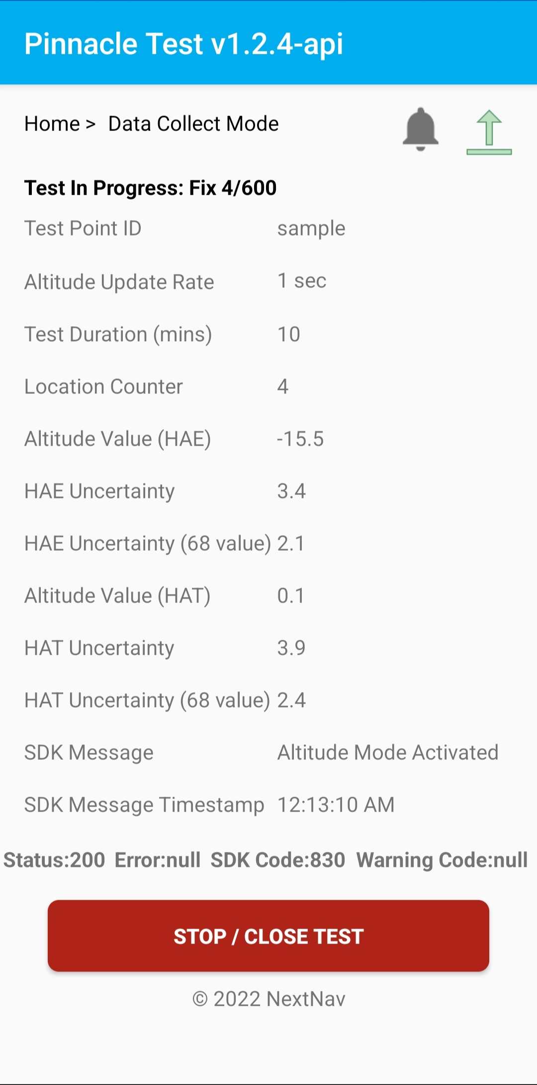
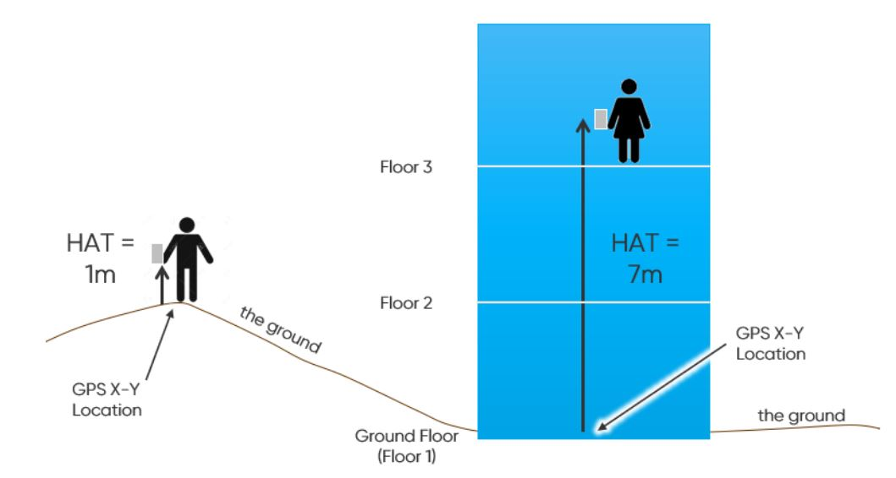
NextNav Point Data
Height above terrain can be predicted by use of barometric pressure readings and USGS sea level survey data.
Inaccuracies occur when horizontal data does not accurately represent a consumer’s location.
Corrected by use of barometric pressure reference stations (Binghao Li et al., 2013).
Height Above Terrain (HAT) miscalculation occurs with inaccurate latitude and longitude positioning; resulting in inaccurate elevation height. Image reproduced here for educational purposes only (NextNav, n.d.).

Slide 10
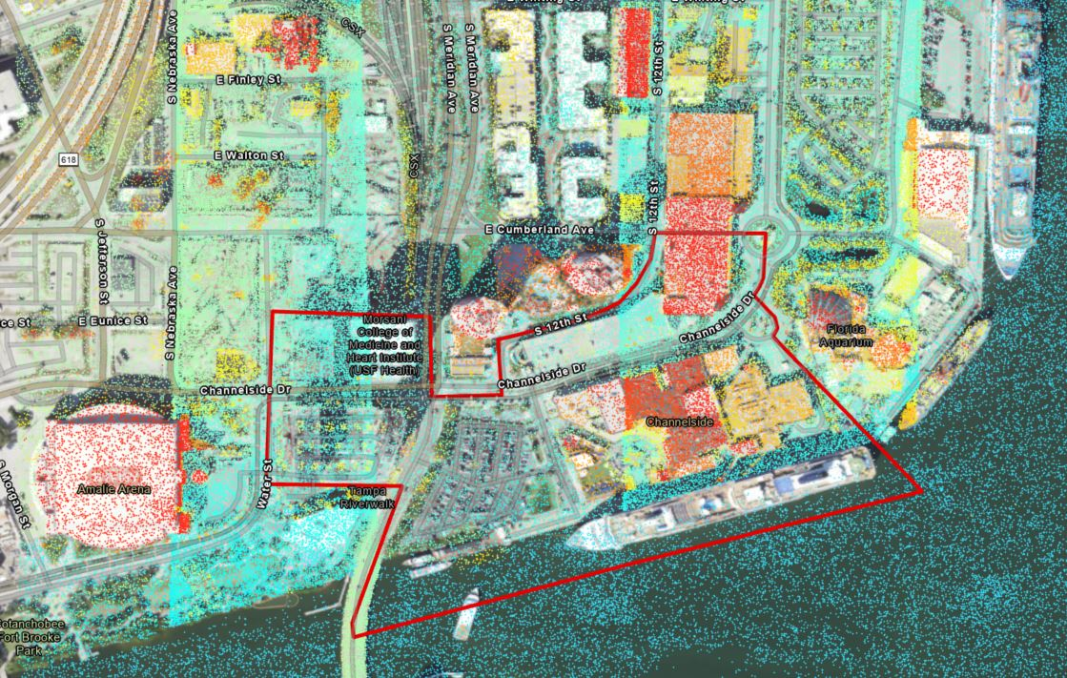
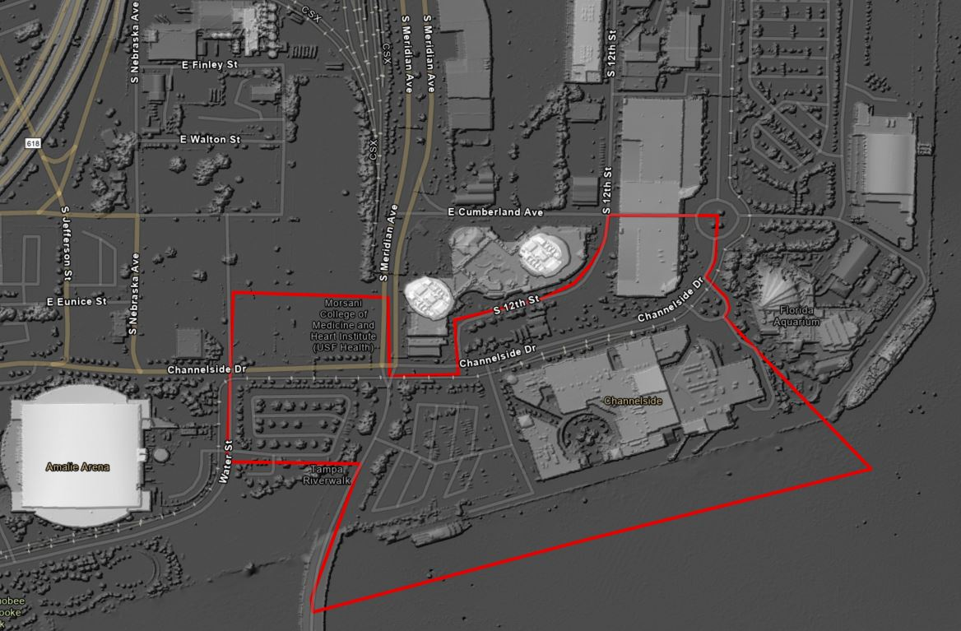
LiDAR
LiDAR data is gathered from USGS and is used to determine building height data within the study area.
Building height data is used to develop a 3-D scene representing the study area to demonstrate consumer vertical travel paths.
The City of Tampa was consulted to gather building specifications that were not gathered in LiDAR imagery.
LiDAR images of study area. Top image are all points of the LAS dataset. Bottom image is an nDSM with an applied hillshade.

Slide 11
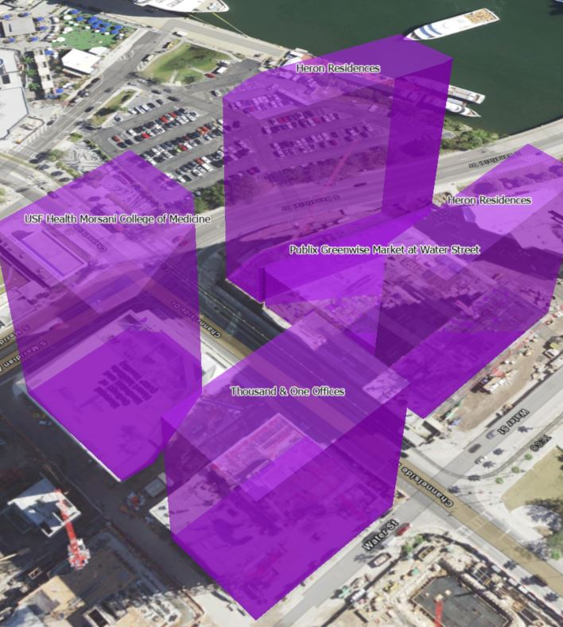
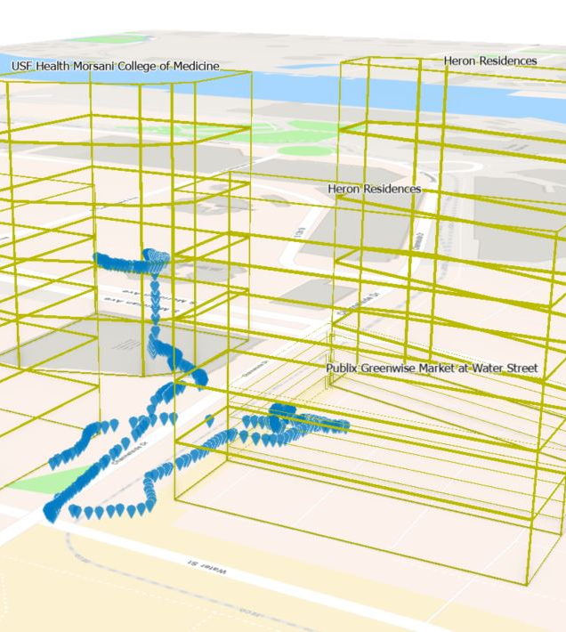
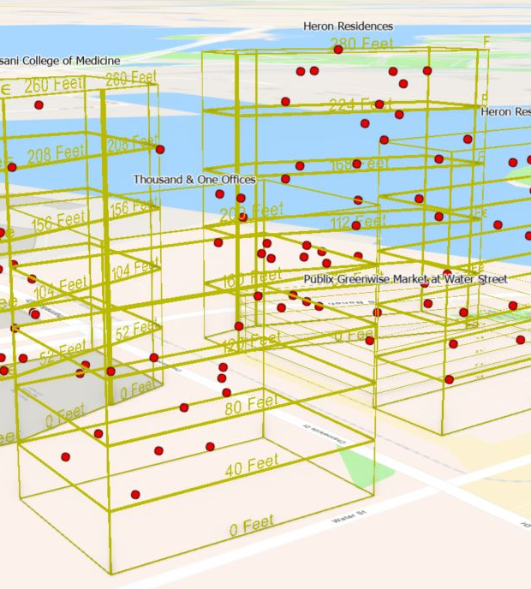
Local Scene
A local scene is used to depict the travel path a consumer follows from or to a vertical location.
Common evening or daytime locations (represented by red points) can be used to analyze the vertical trade area demographics and spending habits.

Slide 12
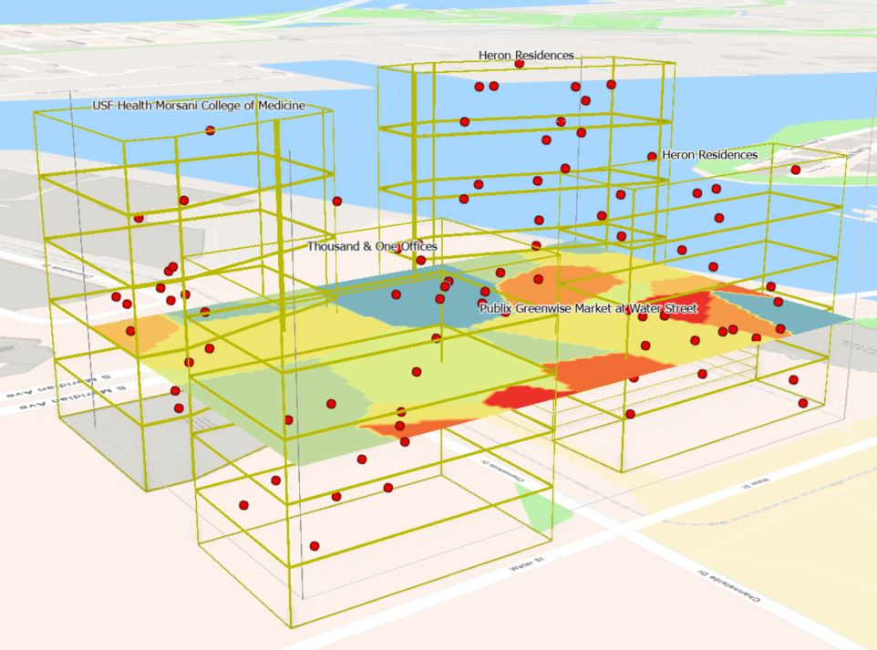
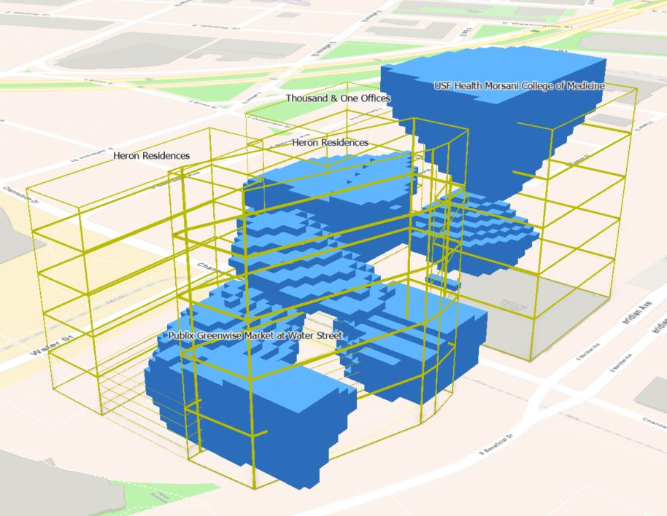
Voxel Layers
Represents multidimensional spatial and temporal data in a 3-D visualization.
Developed from Empirical Bayesian Kriging (EBK) 3-D interpolation tool.
EBK accounts for semivariogram uncertainty as well as data nonstationarity.
Symbology is adjusted to visualize categorical variable predictions in a 3D scene.

Slide 13
Project Timeline
Week 1 - 2
August 22 – September 4: Conduct field test to gather z-axis point data with NextNav API
Week 3
September 5 - 11: Review point data and determine any discrepancies or inaccuracies.
Week 4
September 12 - 18: Generate 2-dimensional trade area analysis within census blocks and generate consumer profiles. Determine profile variable median values and dominant categories.
Week 5
September 19 - 25: Manipulate point data with arbitrary demographic and tapestry data gathered from week 4.
Week 6
September 26 – October 2: Develop building footprints with attribute data. Use LiDAR nDSM and city data to determine building height.
Week 7
October 3 - 9: Create 3-D model of study region.
Week 8
Conduct Empirical Bayesian Kriging interpolation and voxel layers for all variables of interest.
Week 9
October 10 - 16: Develop 3-D trade area analysis displaying all variables of interest.
Week 10 - 11
October 17 - 30: Complete final research paper.

Slide 14
Possible Presentation Venue
December 9 - 10: International Conference on Urban Environmental Degradation and Urban Planning, Virtual Presentation.

Slide 15
Anticipated Results and Concerns
Develop a pilot program for future 3-dimensional trade area analysis.
Create accurate consumer vertical consumer profile representations.
Ethical concerns regarding consumer privacy.

Slide 16
References
Arora, D., Neville, S. W., & Li, K. F. (2013). Mining WiFi Data for Business Intelligence. 2013 Eighth International Conference on P2P, Parallel, Grid, Cloud and Internet Computing. https://doi.org/10.1109/3pgcic.2013.67
Binghao Li, Harvey, B., & Gallagher, T. (2013). Using barometers to determine the height for indoor positioning. International Conference on Indoor Positioning and Indoor Navigation. https://doi.org/10.1109/ipin.2013.6817923
Bohl, P. (2014). The impact of airport shopping environments and dwell time on consumer spending. Vezetéstudomány / Budapest Management Review, 11–24. https://doi.org/10.14267/veztud.2014.11.02
Hu, R., Pan, W., & Bock, T. (2020). Towards Dynamic Vertical Urbanism. International Journal of Industrialized Construction, 1(1), 34–47. https://doi.org/10.29173/ijic208
M. Viana, C., Abrantes, P., & Rocha, J. (2019). Introductory Chapter: Geographic Information Systems and Science. Geographic Information Systems and Science. https://doi.org/10.5772/intechopen.86121

Slide 17
References
NextNav. (n.d.). Location Apps. Retrieved June 16, 2022, from https://nextnav.com/location-apps/
Pipelidis, G., Rad, O. R. M., Iwaszczuk, D., Prehofer, C., & Hugentobler, U. (2017). A novel approach for dynamic vertical indoor mapping through crowd-sourced smartphone sensor data. 2017 International Conference on Indoor Positioning and Indoor Navigation (IPIN). https://doi.org/10.1109/ipin.2017.8115902
Tachikawa, M., Maekawa, T., & Matsushita, Y. (2016). Predicting location semantics combining active and passive sensing with environment-independent classifier. Proceedings of the 2016 ACM International Joint Conference on Pervasive and Ubiquitous Computing. https://doi.org/10.1145/2971648.2971684
Tampa Bay Economic Development Council. (2019, April 10). Game Changer: How Billionaire Jeff Vinik is Helping to Remake Tampa. https://tampabayedc.com/news/game-changer-how-billionaire-jeff-vinik-is-helping-to-remake-tampa/
Xia, H., Wang, X., Qiao, Y., Jian, J., & Chang, Y. (2015). Using Multiple Barometers to Detect the Floor Location of Smart Phones with Built-in Barometric Sensors for Indoor Positioning. Sensors, 15(4), 7857–7877. https://doi.org/10.3390/s150407857

