Slide 1
GIS and Cyber Security Events
Using GIS and Geovisualization to Reveal Trends and Patterns in Cyber-Security Events Over the past 20 years
Alexandra Richardson
Capstone Proposal

Slide 2
Overview
Statement……………………………………………………………………………………3
Background………...……………………………………………………………………….4
Why…………………………………………………………………………………………….4
Terminology used…………………………………………………………………………….7
Methods of attributing geographic data to Cyber-Attacks……..……………...…..9
Goals and Objectives……………………………………………………………….…...13
Methodology of Database Creation……………………………………………………...14
Methodology of Analysis…………………………………………………………………...16
Methodology of Geovisualization..………………………………………………………..18
Anticipated Results…………………………………………………………………….19
Questions?....................................................................................................................21
References………………………………………………………………………………..22

Slide 3
Statement
GIS can be used to aggregate and analyze past cyber-security events. This will reveal actionable trends and patterns that can predict details about future harmful cyber activity.

Slide 4
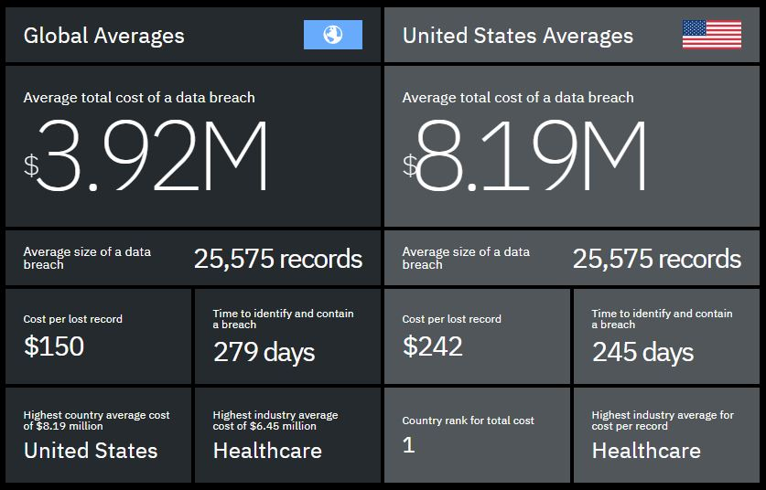
Why Analysis of Cyber-Security Events is Needed
Cyber-warfare is an extension of political policy of governments. (Ex. Stuxnet)
Cyber-crime, done for personal gain and can be performed by groups or a single person.
(Fig 1. - IBM & Ponemon, "Cost of a Data Breach Report“ 2019)

Slide 5
Why Analysis of Cyber-Security Events is Needed
Virtual and real spaces of life, commerce, and government have become intertwined through the internet.
4.5 billion internet users as of December 2019, 58.7% of the world’s population (Internet World Stats 2020). Cybertechnology routinely outpaces policy.

Slide 6
Why Analysis of Cyber-Security Events is Needed
There are millions of cyber-attacks per day(Rouse 2016).
An analysis of a large amount of data (two decades) can identify trends of future activity.
GIS technology has unique capabilities allowing it to perform this collection, aggregation, and analysis.

Slide 7
Background - Terminology
Cyber Security Event
Cyber Security Event - “a change in the everyday operations of a network or information technology service indicating that a security policy may have been violated or a security safeguard may have failed” (Middleton 2017).
State-Actor – “In United States law, a state actor is a person who is acting on behalf of a governmental body” (US Supreme Court cases 362 U.S. 17, 100 U.S. 339, 346 )
Non-State Actor – An NSA is “an individual or organization that has significant political influence but is not allied to any particular country or state” (Oxford Dictionary 2020)
Cyber-Terrorism
Cyber-Attacks
Cyber-Crime
Cyber-Warfare

Slide 8
Background - Terminology
ICANN (Internet Corporation for Assigned Names and Numbers – “ICANN is a multi-stakeholder group and nonprofit organization responsible for coordinating the maintenance and procedures of several databases relating to namespaces and numerical spaces of the Internet, ensuring the network's stable and secure operation.” (ICANN 2014)
Internet Protocol – “The set of rules that govern how devices communicate over the Internet. The Internet Protocol specifies the format of the packets that devices use to transmit messages through the network.” (ICANN 2014)
Internet Protocol Address – “A numeric value that uniquely identifies a device attached to the Internet. The Internet Protocol (IP) uses IP addresses to route message packets to their intended destinations.” (ICANN 2014)
Routing System – “The organized collection of protocols, addressing schemes, and processes that enable the efficient transmission of data packets between and within networks.” (ICANN 2014)

Slide 9
Methods of Attributing Geographic Data to Cyber Security Events
Physical Topology – ”refers to the interconnected structure of a local area network (LAN). The method employed to connect the physical devices on the network with the cables, and the type of cabling used, all constitute the physical topology” (ICANN 2014)
Logical Topology – “a concept in networking that defines the architecture of the communication mechanism for all nodes in a network. Using network equipment such as routers and switches” (ICANN 2014)

Slide 10
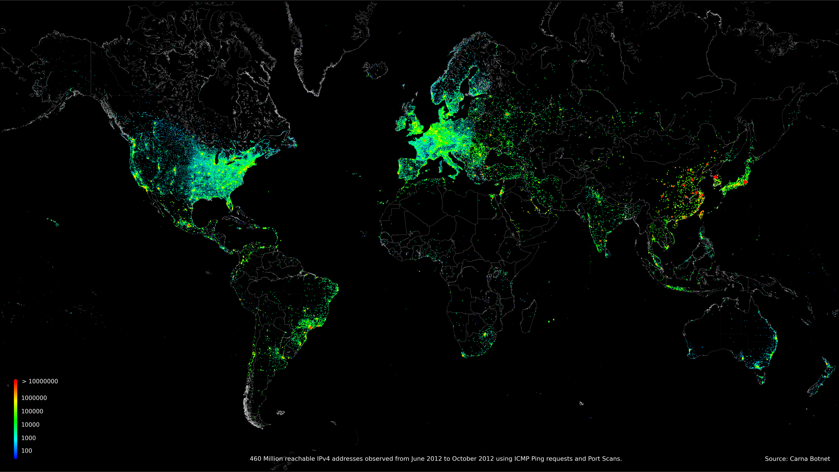
Methods of Attributing Geographic Data to Cyber Security Events
Fig 2. - 460 Million reachable IPv4 addresses observed, using ICMP Requests and Port Scans (Internet Census 2012)

Slide 11
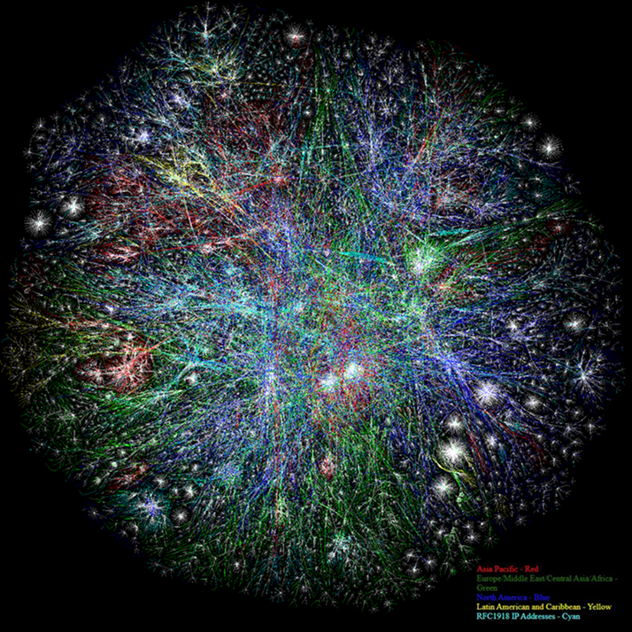
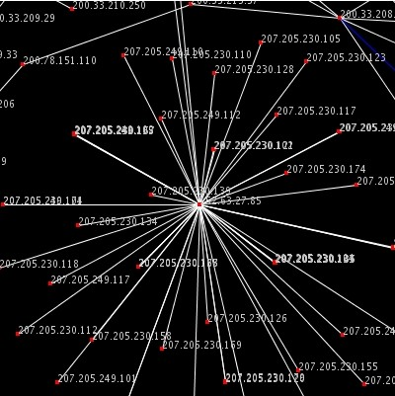
Visualization of the Internet by the Opte Project
Fig 3 - The OPTE project, the entirety of the internet was visualized using IP addresses and their routes, also known as the ‘Logical Network’ or ‘Logical Topology’ (ICANN 2014).

Slide 12
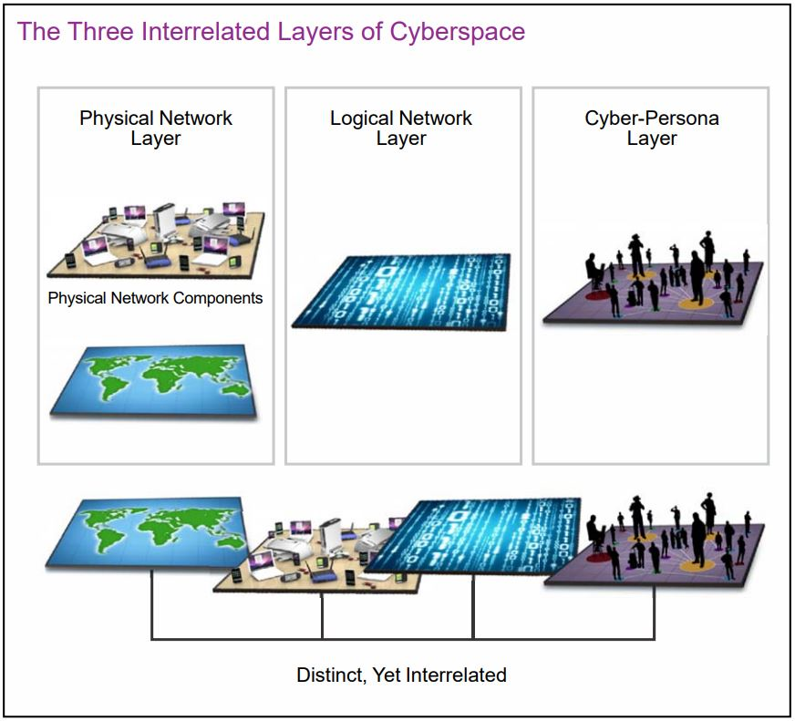
Methods of Attributing Geographic Data to Cyber Security Events
Geolocation of IP addresses
Country and Region Shapefiles
Fig. 4 - (The United States Army, "Cyberspace Operations Concept Capability Plan 2016-2028")

Slide 13
Goal and Objectives
Goal – Use GIS to identify trends and patterns in cyber security events over the past 20 years.
Objectives
Develop a geodatabase structured to classify and organize cyber attack data. Populate this geodatabase with collected data.
Use the geodatabase and ArcGIS Desktop capabilities to perform analysis on the collected data.
Port most impactful findings into webmaps for dissemination of data via a Geovisualization format.

Slide 14
Obj 1. Methodology - Geodatabase
File Geodatabase using ArcGIS 10.6.1
Use ICANNS glossary and Acronyms of terms.
Use domains and picklists during the collection process to ensure consistent metadata.
Collect data using standards and framework created.
G
D
B

Slide 15
Obj 1. Methodology - Geodatabase
Data to be collected
Country of Origin
Country attacked
(B)State Actor
(B)Non-State Actor
(B)Active or Passive
Overall Category of attack type
Specific Type of Attack
Industry Targeted
Country
Name of Attack
Description
Attacking Year
Duration of attack
NSA Name
IP Address
Geolocated IP Address
Sources of Data
Cyber security white papers
Academic publications
Papers
Books
FBI IC3 Annual Report
IBM Annual Data Breach Report
Cyber Security Company Datasets (e.g. Symantec WINE dataset)
DISA (Defense Information Service Agency) Datasets
“Have I been pwned” and similar websites

Slide 16
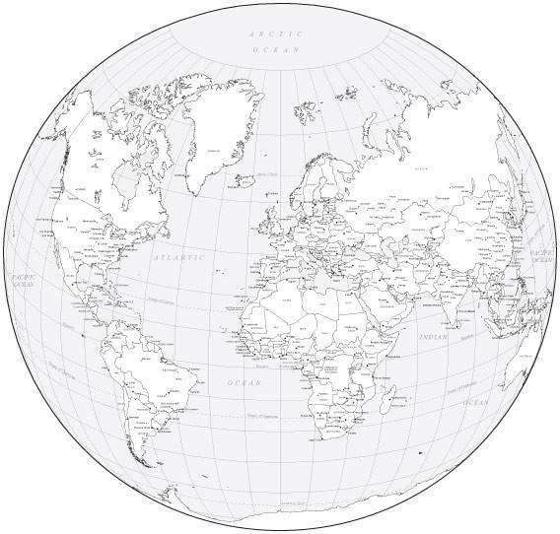
Obj 2. Methodology - Analysis
Distribution of cyber security events across the world by:
Type of attack
State Actor
Non State Actor
Industry targeted
Occurrence rate
Country

Slide 17
Obj 2. Methodology - Analysis
Correlation
Wealth
Industry
Internet usage
Corruption
Physical infrastructure
QOG (Quality of Government) Datasets

Slide 18
Obj 3. Methodology – Geovisualization via Website
Purchase a domain and hosting service.
WordPress for website set-up and design. Its modular ready for plug-ins etc.
Create web maps using ArcGIS Online
Embed maps via ArcGIS online.
My Website

Slide 19
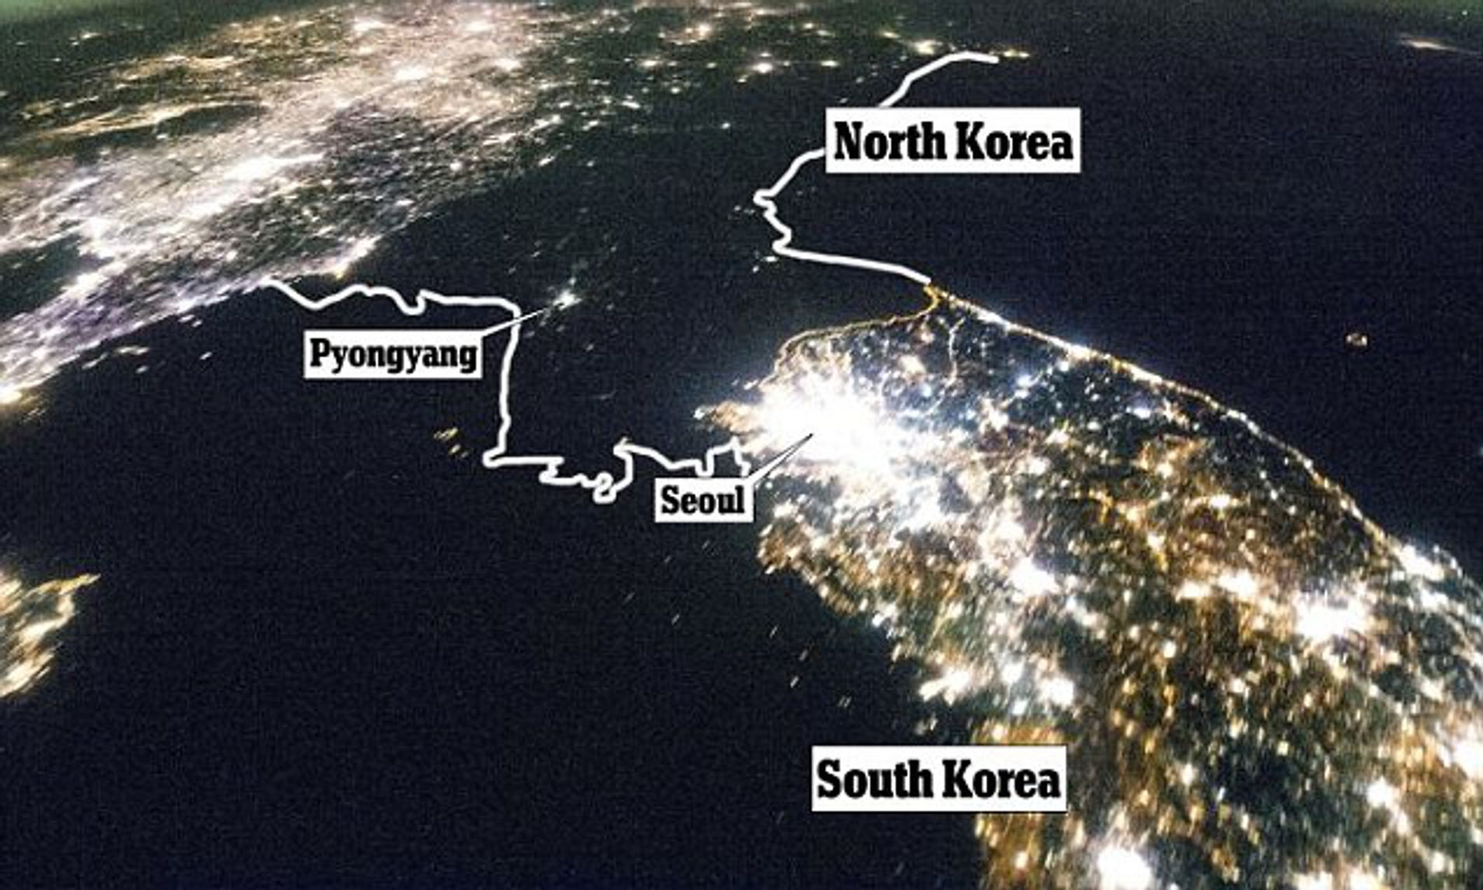
Anticipated Results
Correlation between Country Wealth and rate of cyber-attacks
North Korea will be an outlier.
What cyber attacks are/will be the most popular in the next few years

Slide 20
Anticipated Results
The ratio of cyber attacks between state and non-state actors and its change over time.
Trends in the most likely industry to be targeted by cyber attacks within the next few years.

Slide 21
Questions?
" information is the only asset that is stolen by replication"
- Dr (Lt Col Ret) Mike Thomas)

Slide 22
References
Bearing Witness: Uncovering the Logic Behind Russian Military Cyber Operations. Booz Allen Hamilton, 2019.
Biesecker, B., & Mitchell, K. (2018). 2018 Esri Federal Gis Conference. 2018 ESRI Federal GIS Conference. Washington DC.
Boucher, Marc. “The Emerging Space Cyberwarfare Theatre.” SpaceRef, 29 Mar. 2013, spaceref.com/military-space/the-emerging-space-cyberwarfare-theatre.html.
Cai, Guoray, Stephen Hirtle, and James Williams. "Mapping the geography of cyberspace using telecommunications infrastructure information." The First international workshop on telegeoprocessing. 1999.
"ICANN Bylaws". July 30, 2014. Retrieved April 12, 2020.
Green, James A. Cyber Warfare a Multidisciplinary Analysis. Routledge, Taylor & Francis Group, 2016.
Internet Census 2012. (2012, October). Retrieved May 1, 2020, from http://census2012.sourceforge.net/paper.html
IBM, & Ponemon. (n.d.). Cost of a Data Breach Report. IBM.
Kaplan, Fred M. Dark Territory: the Secret History of Cyber War. Simon & Schuster Paperbacks, 2017.
Middleton, Bruce. A History of Cyber Security Attacks: 1980 to Present. CRC Press, 2017.

Slide 23
References
Nakashima, Ellen, and Joby Warrick. “Stuxnet Was Work of U.S. and Israeli Experts, Officials Say.” The Washington Post, The Washington Post, 2 June 2012, www.washingtonpost.com/world/national-security/stuxnet-was-work-of-us-and-israeli-experts-officials-say/2012/06/01/gJQAlnEy6U_story.html.
Rouse, Margaret. “What Is Security Event? - Definition from WhatIs.com.” WhatIs.com, TechTarget, 4 Nov. 2016, whatis.techtarget.com/definition/security-event-security-incident.
Sciarrone, Marie. “Cyber Warfare: The New Front.” Cyber Warfare: The New Front | Bush Center, Apr. 2017, www.bushcenter.org/catalyst/modern-military/sciarrone-cyber-warfware.html.The Geospatial
Approach to Cybersecurity: Implementing a Platform to Secure Cyber Infrastructure and Operations. ESRI, 2015.
"The Opte Project - FAQ". www.opte.org. LyonLabs LLC, Barrett Lyon. Retrieved April 20, 2020.
Top 10 Cyber attack maps to track cybersecurity incidents. (2019). Retrieved March 16, 2020, from https://securitytrails.com/blog/cyber-attack-maps
Warf, Barney. “Geographies of Global Internet Censorship.” GeoJournal, vol. 76, no. 1, 2010, pp. 1–23., doi:10.1007/s10708-010-9393-3.
“World Internet Users Statistics and 2020 World Population Stats.” Internet World Stats, Miniwatts Marketing Group, Mar. 2020, www.internetworldstats.com/stats.htm.
Valeriano, Brandon, and Ryan C. Maness. “The Dynamics of Cyber Conflict between Rival Antagonists, 2001–11.” Journal of Peace Research, vol. 51, no. 3, May 2014, pp. 347–360, doi:10.1177/0022343313518940.
The United States Army. (n.d.). Cyberspace Operations Concept Capability Plan 2016-2028. Cyberspace Operations Concept Capability Plan 2016-2028. TRADOC Pamphlet 525-7-8.

