Slide 1
Where to Work: Comparing quality of life across metropolitan areas based on locality pay differentials
By: Andrew Riesenberger

Slide 2
Agenda
Background
Overview of federal locality pay and why I chose this topic
Goals and Objectives
Understand the main drivers behind relocation
Develop an index that accounts for compensation, cost of living, and quality of life for localities determined by the federal government
Compare how this index relates to population change within localities
Identify specific macro localities that offer residents favorable combinations of these metrics.
Determine particular micro communities within larger localities that are most desirable based on prescribed metrics
Literature Review
Use research to describe the primary factors that drive migration from one locality to another and from one community to another within localities

Slide 3
Agenda (cont.)
Methodology
Discuss planned methods of analysis and data sources I’ll be using
Two different tiers of analysis: macro and micro level
Steps taken in order to reach a conclusion
Expected Results
Anticipated Timeline
Presentation Venue

Slide 4
Background (overview of federal locality pay and why I chose this topic)
The Federal pay scale for regular employees is broken down into a table of 15 grades with 10 steps in each grade.
Progressing from grade to grade often entails taking on a new position or role with a given organization and can be quite lucrative, especially in comparison to moving from step to step within a grade.
Moving from grade to grade entails keeping the same position you’re in and being compensated more with each step (as one becomes more experienced and perfects their craft), but compensation increases at a more gradual rate than moving up in grades.

Slide 5
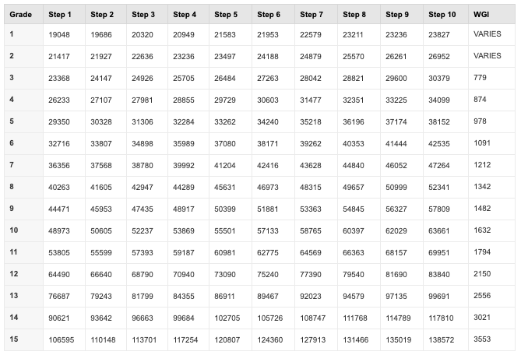
SALARY TABLE 2019-GS, INCORPORATING THE 1.4% GENERAL SCHEDULE INCREASE EFFECTIVE JANUARY 2019 www.opm.gov
Annual Rates by
Grade & Step

Slide 6
Federal Locality Pay
Locality pay is set by comparing regular Federal and non-Federal pay in each locality pay area, based on salary surveys conducted by the Bureau of Labor Statistics (BLS).
There are 52 separate metropolitan locality pay areas. All other employees in the contiguous 48 States are included in the "Rest of U.S." (RUS) locality pay area, which makes the 53rd locality pay. BLS conducts a number of small-scale surveys in the RUS area and combines the results for setting the RUS locality pay rate.

Slide 7
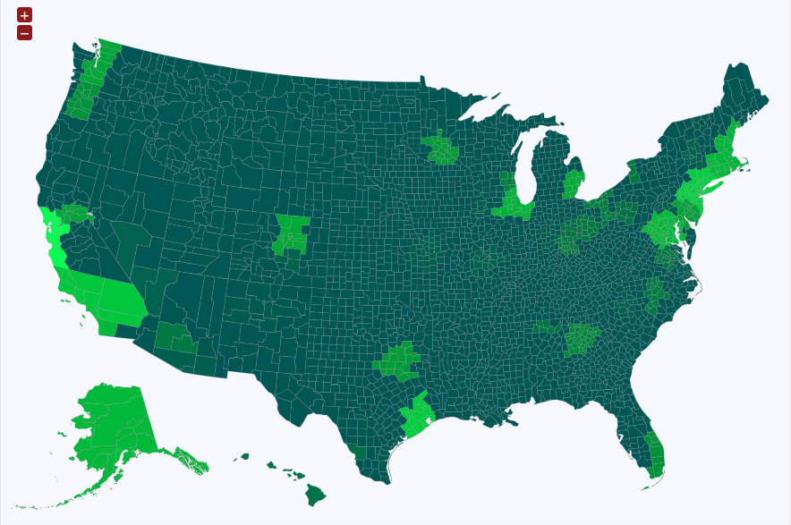
Federal Locality Pay Areas. Each locality is composed of counties. Brighter localities are paid higher differentials than darker areas. www.federalpay.org
Highest Locality Pay Area:
San Jose – San Francisco – Oakland – 40.37%
Lowest Locality Pay Area:
Rest of US Designation – 15.37%

Slide 8
Project Motivation
I am a Federal employee
Many find themselves in situations where moving up in grades in or around their current location isn’t quite so easy or plausible so they may be forced to relocate for a promotion – this likely will pertain to me.
I’m Interested in drivers of migration – there are countless reasons why people move, I wanted to determine what the most prominent reasons are.

Slide 9
Goals & Objectives
Understand what factors typically motivate relocation
Accomplished through literature review
Develop an index that allows me to compare compensation with cost of living components in order to determine where Federal pay is relatively strong and relatively weak.
Use data from a variety of sources and determine a method how they can be combined in a manner that reflects a certain pay to cost of living ratio..
Compare how this index relates to population change within Federally designated pay differential localities
Which areas are growing/shrinking and how might population change trends be related to the quality of life index in that locality.
Identify specific metropolitan localities that offer residents favorable combinations of these metrics.
Where is population change occurring at the largest rate among the localities that have the most favorable quality of life metrics and what is special about these places?
Determine particular micro communities within localities that are most/least desirable based on prescribed metrics
Where are specific neighborhoods within a larger locality that offer the best characteristics
Where are less desirable localities and how do they differ internally than more desirable locations

Slide 10
Literature Review Macro Migration Motivations
People “vote with their feet” > move to the areas that best suit their preferences
Two types of movements: temporary and permanent
Going away to school vs. moving for good
Relocation tends to be a behavior exhibited more often by the affluent. They can afford to go away to school. This creates a ripple affect.
What are primary drivers of relocation from one region to another?
Job search and opportunity to earn more
Align oneself ideologically/politically with others who share common beliefs
Consume less (spend less/downsize)
55% of individuals in a particular study identified this as their main cause of moving
Millennials tend to relocate more often (mid/late twenties, some post-high school education, not home owners, marital status of “separated”)

Slide 11
Literature Review Micro Migration Motivations
Community selection and satisfaction are multi-dimensional
The environment one grew up in is positively correlated to the type of environment one prefers
Younger individuals tend to be more open to moving than the elderly
Accessibility to amenities is a huge factor
Proximity to recreation, (better) schools, shopping, and hospitals
A “sense of community”
People want to engage with neighbors but still have their own privacy
A connection with natural landscapes
Lower crime
Proximity to large cities
Suburbs tend to be the eventual destination of choice as it offers a favorable balance

Slide 12
Proposed Methodology
Utilize data from the Census Bureau (Decennial Census, American Community Survey) and MIT in order to capture cost of living metrics.
Develop an index that provides a ratio of cost of living metrics against federal pay in Federally defined localities.
Main factors that I’ll be using to develop index: housing costs (average rent/median home price), commute times, crime frequency, income data.
Compare localities in terms of their ratio values on a national scale and measure this against population change (macro level)
Examine a subset of selected localities with varying ratio values and evaluate community characteristics on a tract level.
Create a series of maps that help visualize how these different factors compare with population change across and within federally-defined localities

Slide 13
Proposed Methodology (cont.)
Determine specific communities within the larger localities provide the residential option in terms of costs and salaries by using data from the ACS at the tract level.

Slide 14
Challenges Faced
I believe the biggest challenge I will face is developing a certain index for how the different costs of living metrics are weighted in relation to one another.
People value things differently than others, so it may be hard to account for these variances.

Slide 15
Anticipated Results
I believe the localities that provide the most favorable value in terms of costs incurred and salary earned will not be the localities that offer the highest salaries
I believe better value will be found in neighboring areas that have similar locality differentials but much more affordable housing prices, even if their index figure may suffer from longer commute times.
I believe that some of the localities that boast the highest population increases (in part by attracting new residents) will have some of the poorer ratio figures.

Slide 16
Project Timeline
Between now and my conference presentation (November 23-26, 2019)
Synthesize all applicable spatial and tabular data and conduct analysis
Generate an index that accounts for costs of living, income, quality of life metrics
Create maps, describe analysis and conclusions, and be prepared to present my methods and my results at the conference.
Plan to have all analysis and deliverables completed by the end of August, 2019.

Slide 17
Presentation Venue
Southeastern Division of the American Association of Geographers conference
November 23-26, 2019 – UNC Wilmington, North Carolina
Submittals for project abstracts will be due in early summer

Slide 18
Questions

