Slide 1
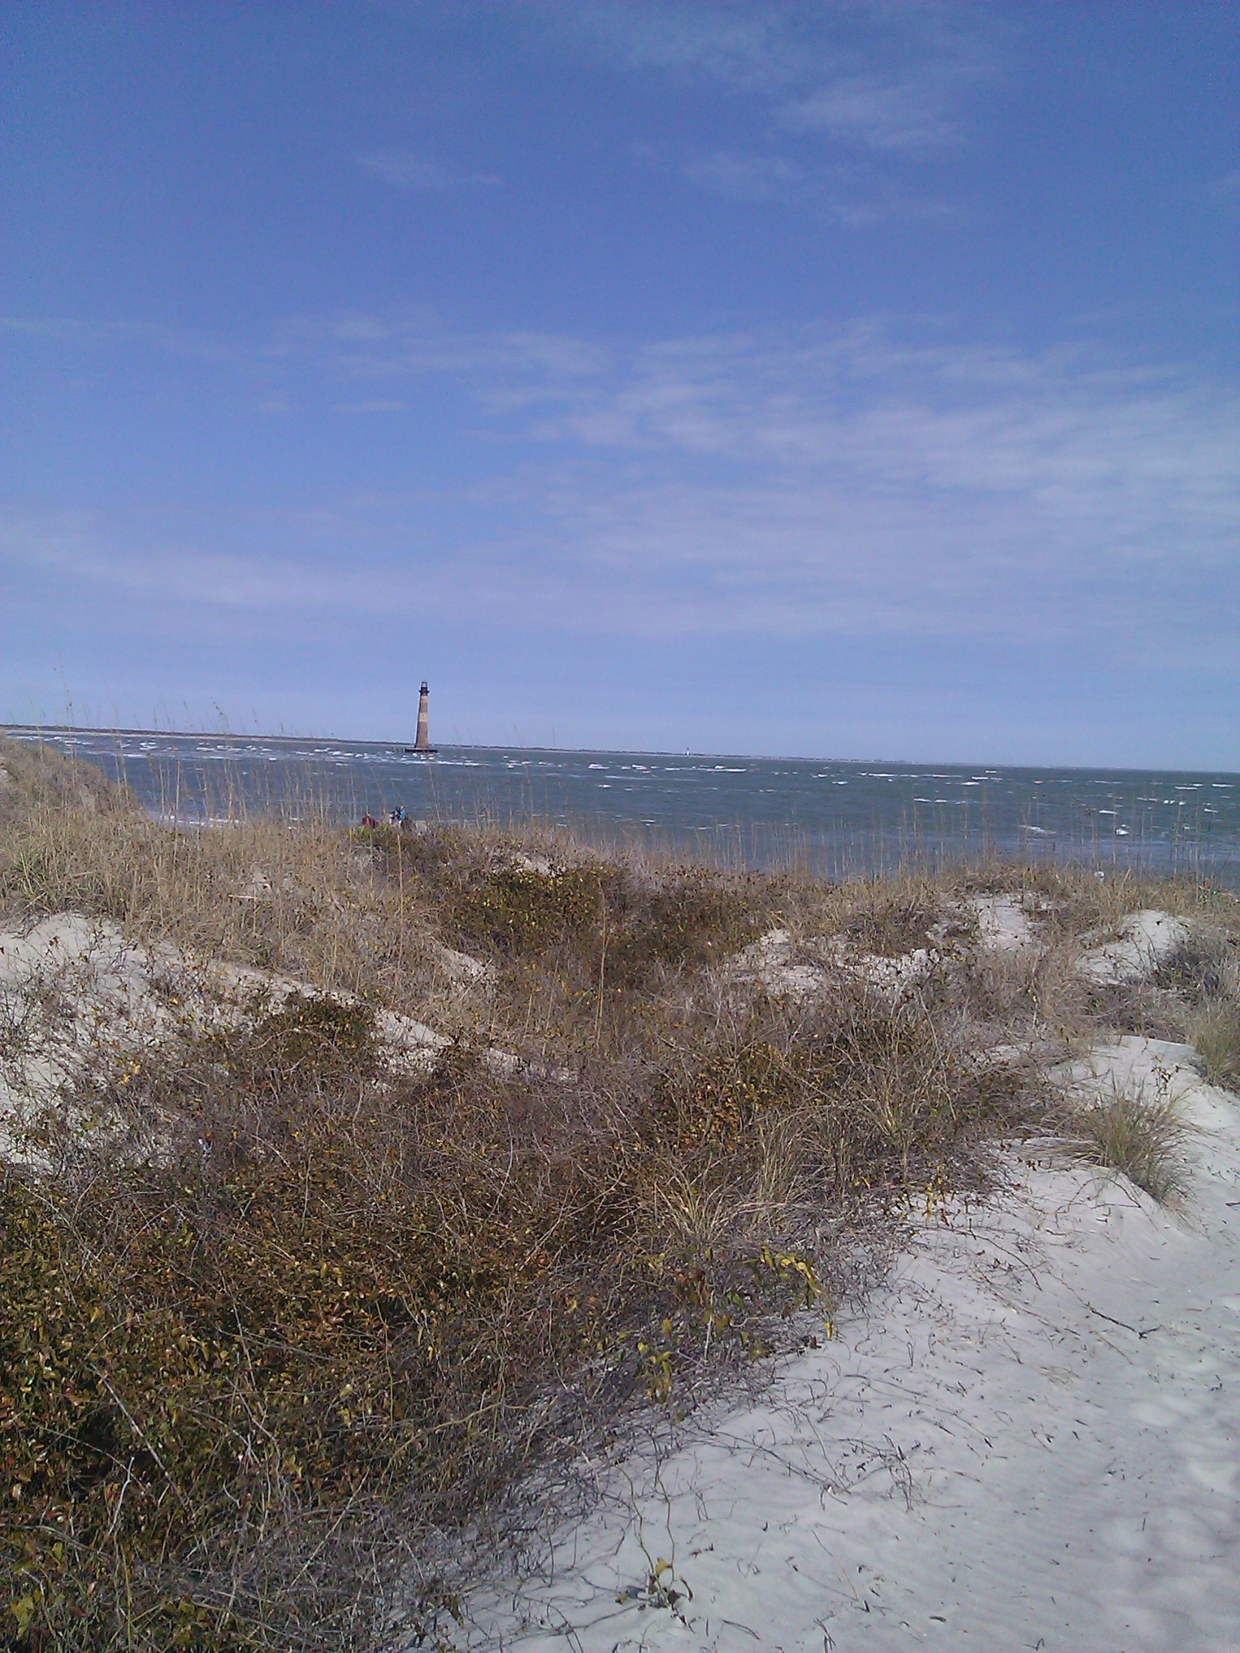
A Long-term Shoreline Change Study of Morris and Folly Islands, SC Michael Rink – GISP Masters in GIS Program Pennsylvania State University Advisor: Professor Peter Guth Oceanographer – US Naval Academy

Slide 2
Summary of Capstone Project
Public-domain data exists that spans a long-term shoreline record
New GIS tools now ensure an accurate comparison of historic vs. modern shoreline surveys
New technology exists that now lets researchers develop shoreline change regression analysis

Slide 3
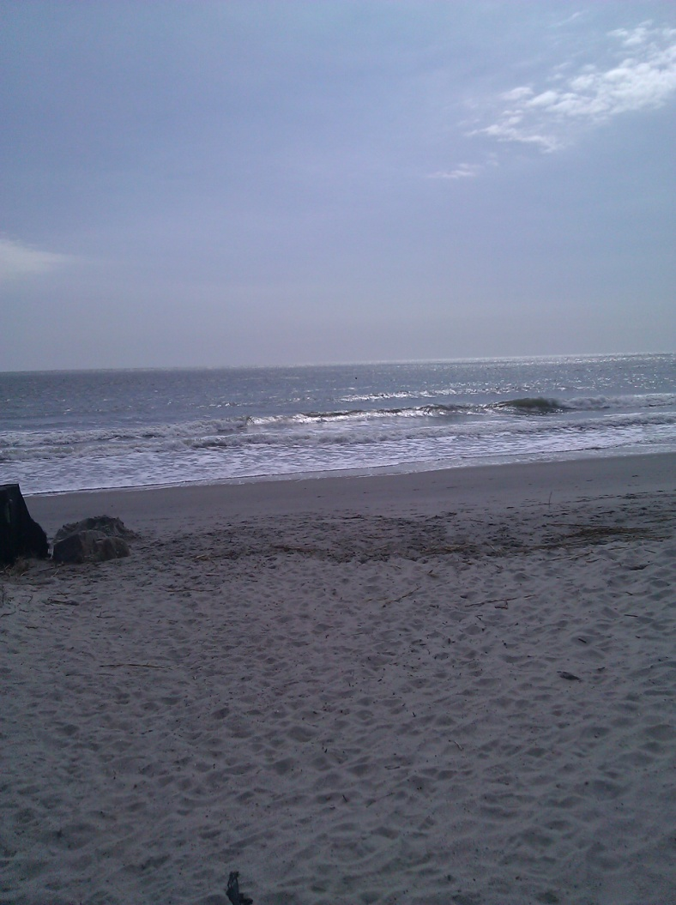
Outline
Introduction
Available Spatial Data
Access to Spatial Data
Converting Spatial Data
Analysis of the Spatial Data
Conclusions

Slide 4
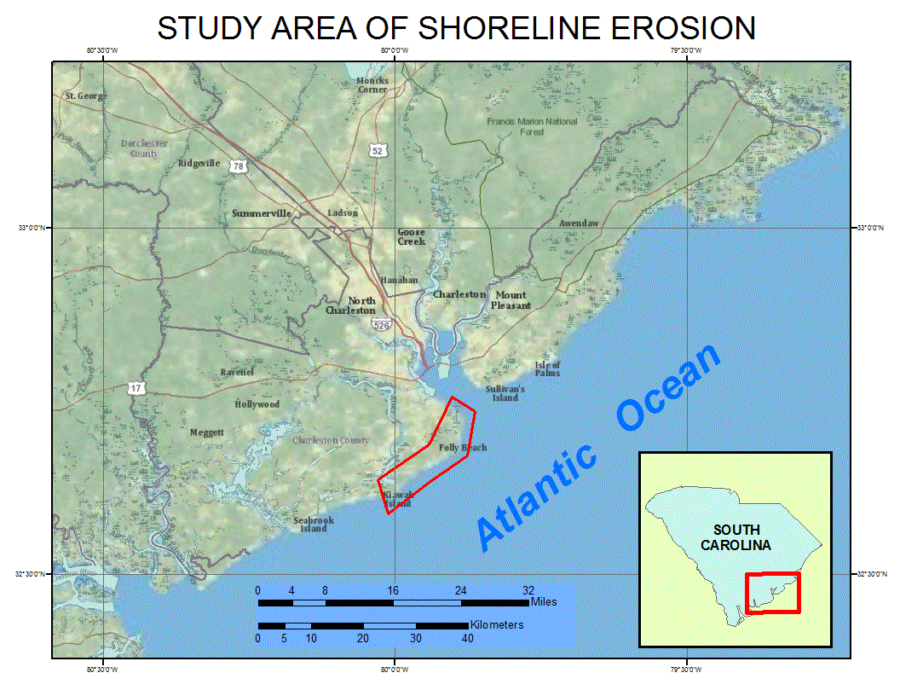
Study Area
Part of South Carolina’s barrier island network
Affected by Charleston Harbor Jetties

Slide 5
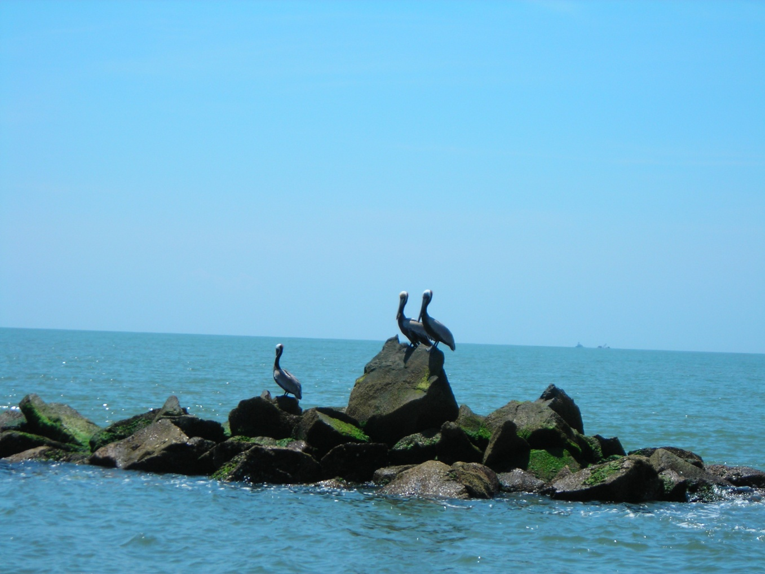
Charleston Harbor Jetties
Constructed 1905 by USACE to keep channel open
Changed longshore drift

Slide 6
Long-term Survey
NOAA shoreline maps (T-Sheets) from the 1840s

Slide 7
Raster to Vector T-Sheets

Slide 8
T-Sheet Inventory in Study Area

Slide 9
Comparing Morris Island
T-Sheet Projects

Slide 10
Comparing Folly Island
T-Sheet Projects

Slide 11
Lidar Inventory

Slide 12
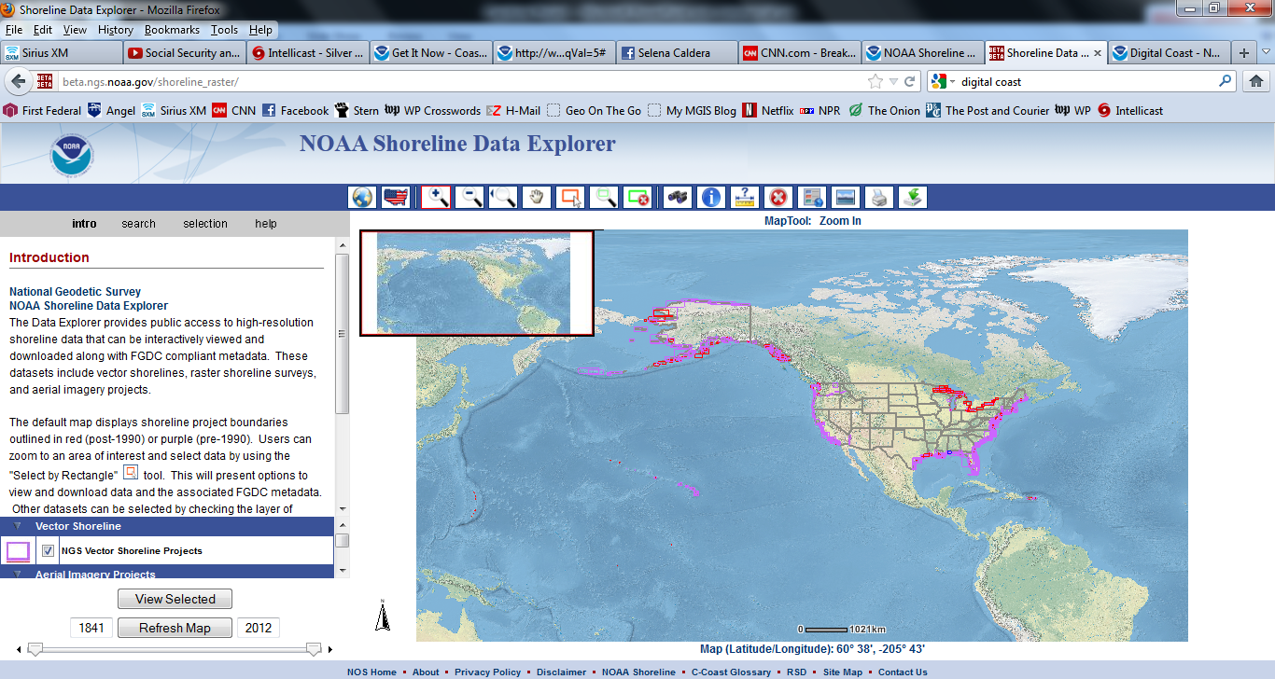
Access to T-Sheets
Available from NOAA’s Shoreline Data Explorer site:
Georeferenced Vector and Raster products
FGDC-Compliant metadata
Data are in Mean High Water tidal datum

Slide 13
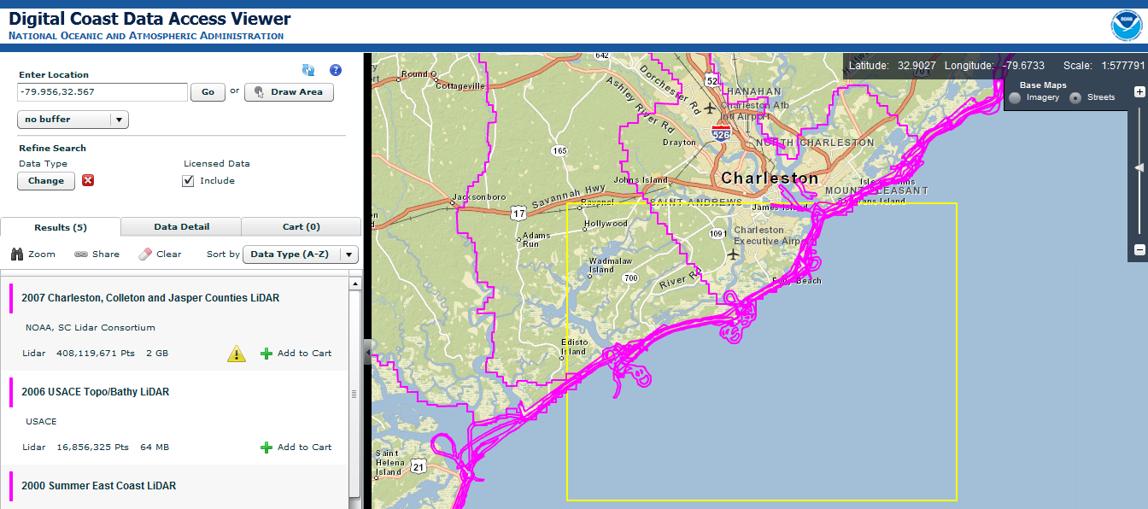
Access to Lidar Data
Lidar data are available from NOAA’s Digital Coast site: http://www.csc.noaa.gov/digitalcoast/
Multiple formats of Lidar data available
User-defined spatial reference
FGDC-Compliant metadata
Data are in orthometric datum (NAVD88)

Slide 14
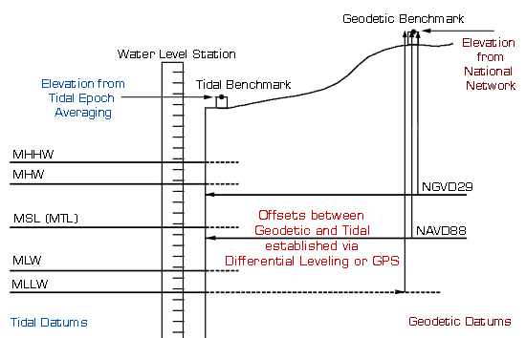
Datum Differences

Slide 15
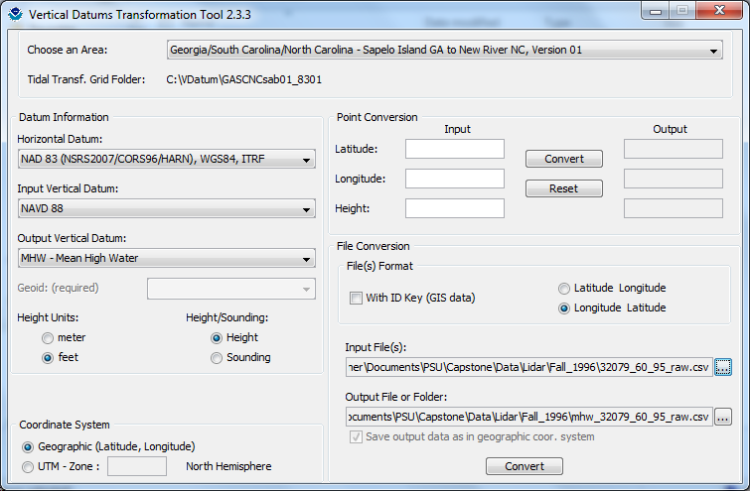
Use of VDatum
VDatum converts spatial data from orthometric to tidal datums: http://vdatum.noaa.gov
Developed by NOAA’s National Geodetic Survey
Converts ASCII text files with X,Y,Z data

Slide 16
Lidar Data Processing
Download Lidar
From Digital Coast
in ASCII format
Create Contours
Save ASCII to
CVS Format
Select Zero Elevations
Compare Lidar and
T-Sheet shorelines in DSAS
Use VDatum to convert CVS points (NAVD88 to MHW)
Create DEMs
in ArcGIS
Develop regression analysis

Slide 17
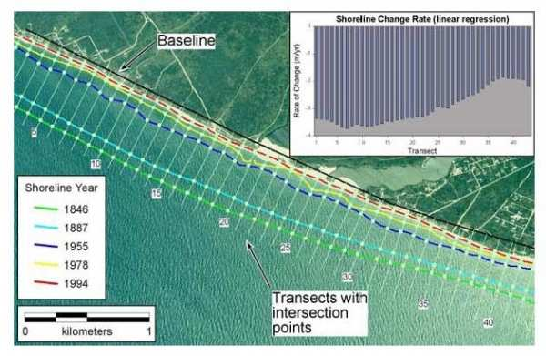
Use of DSAS
“Digital Shoreline Analysis System”
Developed by U.S. Geological Survey
Compares multiple vector shorelines
Creates shoreline regression analysis
Determines areas of erosion & accretion
Source: Morton, R.A. and Miller, T.L.

Slide 18
Conclusions
Recent advances allow for shoreline change analysis:
spatial data rescue
long-term survey
free spatial data
datum conversion tools
GIS software for analysis
combining old and new technologies
Coastal resource managers can now predict shoreline
change in their study area using free public data
and GIS analysis tools.

Slide 19
Citations
Morton, R.A. and Miller, T.L., 2005, “National
Assessment of Shoreline Change: Part 2: Historical
Shoreline Changes and Associated Coastal Land Loss
Along the U.S. Southeast Atlantic Coast,”
U.S. Geological Survey Open-File Report 2005-1401.
Thieler, E.R., Himmelstoss, E.A., Zichichi, J.L., and
Ergul, Ayhan, 2009, Digital Shoreline Analysis
System (DSAS) version 4.0 – An ArcGIS extension
for calculating shoreline change: U.S. Geological
Survey Open-File Report 2008-1278.

Slide 20
Contact Information
Michael Rink
mdr232@psu.edu
843-278-0524 - Work

