Slide 1
Using LiDAR Point Data to Analyze the Potential Effects of Rising Sea Levels on Public Transportation in Boston
Andrew Rizoli | GEOG 596A, Summer 2022 | Advisor: Kimberly Van Meter

Slide 2
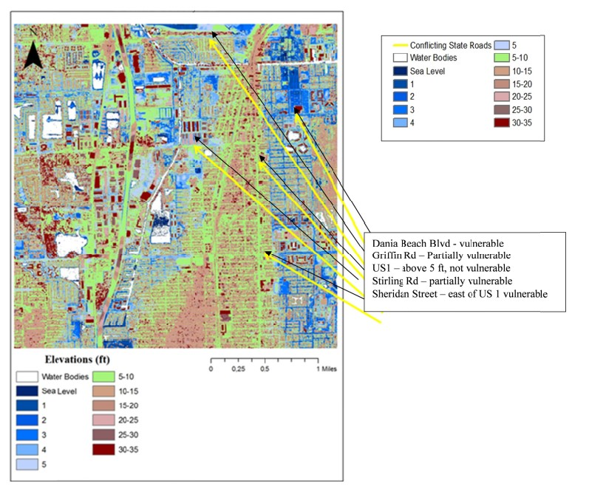
Global Warming and Coastal Flooding
Rising temperatures lead to the melting of polar ice caps and glaciers, which in turn lead to rising sea levels on the coasts (Lindsey, 2017)
By 2100, New York City could be inundated by up to twenty-nine centimeters of flood waters (Sallenger et al, 2012)
Venice could lose twenty-three centimeters to the Adriatic Sea by 2100 (Lionello, 2012)
Cities such as Dania Beach, Florida, have already taken the initiative to identify transportation nodes at risk (Bloetscher et al, 2012)
A map showing elevations in Dania Beach, Florida derived from LiDAR data, as well as vulnerable transportation segments (Credit: Bloetscher et al, 2012. Reproduced here for educational purposes only).

Slide 3
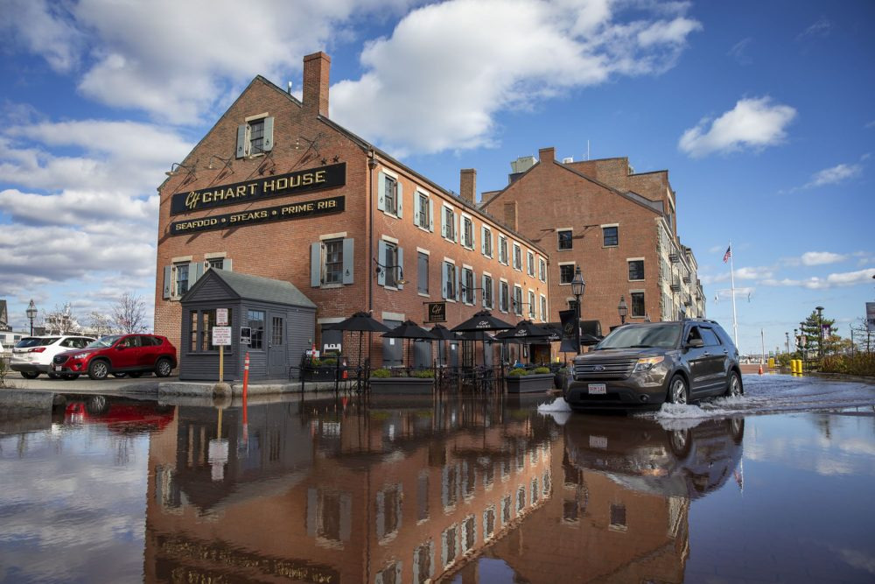
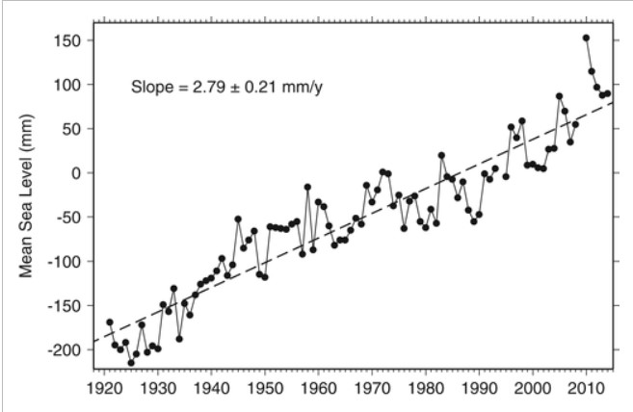
Observations in New England
Instances of ‘nuisance flooding’ in Boston are expected to intensity in the coming years (Ray et al, 2016)
Since the mid-19th century, tides in Boston have risen by twenty-eight centimeters (Talke et al, 2018)
Between 1900 and 2020, temperatures in New England rose by an average of 1.5 degrees Celsius (Young et al, 2021)
Rising temperatures are causing some marshes to accrete faster than normal (Carey et al, 2015)
Top left: The Charles River Esplanade park. (Credit: Acitelli, T, 2020. Reproduced here for educational purposes only).
Top right: High tide flooding in Boston. (Credit: Lubbock, R, 2021. Reproduced here for educational purposes only).
Bottom: A straight-line-to-fit graph showing the mean sea levels in Boston from 1920 to 2015. (Credit: Ray et al, 2016. Reproduced here for educational purposes only).

Slide 4
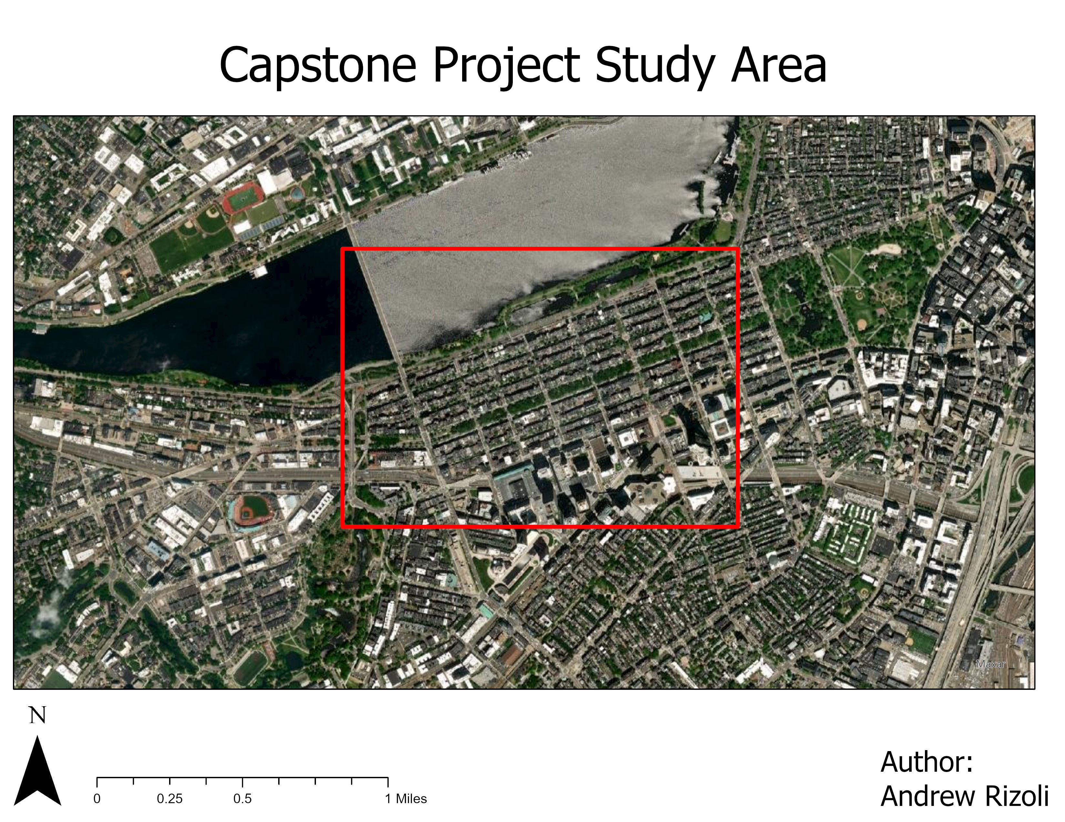
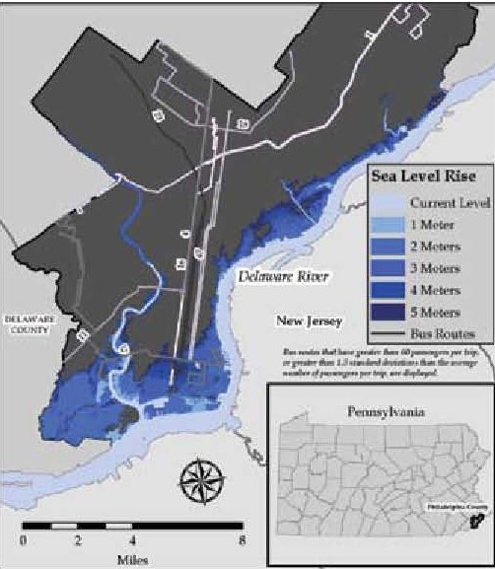
Left: A map layout showing my study area in bright red. | Right: A map from a previous study showing levels of sea level rise and how they could impact Philadephia bus routes. (Credit: Oswald et al, 2013. Reproduced here for educational purposes only.)

Slide 5
Goals and Objectives
Primary goal: Determine how nuisance flooding caused by climate change can impact public transportation in Boston
Sub-objectives
Create a model that accurately depicts elevation in Kenmore and Back Bay
Determine which parts of the study area contribute to projected flooding patterns
Identify transportation routes that are most susceptible to nuisance flooding

Slide 6
Proposed Methods, Part One: LP360
Load point cloud data into LP360 and ensure that all points are correctly classified
Draw polygon around the Charles River and assign it to ‘ground’ class
Extract all elevations from the polygon
Create a buffer of ‘ignored’ points around the polygon
Remove the ‘water’ class from the study
Export hydroflattened digital elevation model (DEM)

Slide 7
Proposed Methods, Part Two (ArcGIS Pro)
Use flood hazard layer to create three separate layers of one-, three-, and five-foot inundation projections
Lay these layers on top of DEM to understand how geographic patterns contribute to flood projections
Convert bus and subway layers to rasters
Create three separate maps with bus and subway routes and one of the three flood layers
Classify routes as either ‘one’ or ‘zero,’ depending on whether they lie in the flood area
Add all three scenarios together to generate a scale from ‘zero’ to ‘three’
Create map layouts to show which routes are most vulnerable

Slide 8
Data Sources
Data Description | Data Compilers | Coordinate System | Cell Size
ESRI shapefile of all Massachusetts Bay Transportation Authority (MBTA) Rapid Transit subway lines | Central Transportation Planning Staff, Massachusetts Bay Transportation Authority, and Massachusetts Department of GIS | NAD 1983 Massachusetts State Plane Coordinate System | N/A
ESRI shapefile of all Massachusetts Transportation Bay Authority (MBTA) bus routes and stops | Central Transportation Planning Staff, Massachusetts Bay Transportation Authority, and Boston Region Metropolitan Planning Organization | NAD 1983 Massachusetts State Plane Coordinate System | N/A
Flood layer showing predicted inundated areas based on a tidal height one to ten feet higher than mean higher high water (MHHW) | Department of Commerce, National Oceanic and Atmospheric Administration Office for Coastal Management, and National Ocean Service | NAD 1983 Massachusetts State Plane Coordinate System | 7.29 feet
LiDAR point data encompassing study area | National Oceanic and Atmospheric Administration Office for Coastal Management | NAD 1983 Massachusetts State Plane Coordinate System | 3 feet

Slide 9
Project Timeline
2022
July: Present proposal and begin analysis
August: Complete analysis and begin final report
September: Complete final report
October-December: Final program course
2023
February: Begin preparations for presentation
March: Present project at AAG 2023 in Denver

Slide 10
Proposal Value
Potential stakeholders
City planners: refer to flood patterns when considering major developments
Engineers: find out how current structures hold up against nuisance flooding and determine if improvements are needed
Transportation planners: determine if there is a need to divert current routes to avoid getting caught in flooded areas
Climatologists: compare flood patterns in Boston to other coastal cities like New York, Baltimore, and Miami to better comprehend how Atlantic climate patterns have changed
Broader sense: this project could serve as a guide for analyses in other cities designed to strengthen existing infrastructure and better plan new ones
Personal significance
My specific interests are using GIS for transportation and climate resiliency purposes
This project can prove that I can assist with projects at the professional level

Slide 11
Expected Results
Major factors at play
Distance: routes closer to the shoreline will likely be submerged first
Topography: areas where elevation gradually increases, such as streams, could provide a gateway for substantial flooding
Elevation: because climate change is causing increased global rainfall (Dunning et al, 2018), low-elevation areas farther away from the river cannot be ignored

Slide 12
Works Cited
Acitelli, R. (3 March 2020). 10 perfect Boston strolls for warmer weather. Retrieved 13 July 2022, from 10 perfect Boston strolls for warmer weather (curbed.com)
Bloetscher, F., Romah, T., Berry, L., Hern, N., Hammer, E., and Cahill, M.A. (27 November 2012). Identification of Physical Transportation Infrastructure Vulnerable to Sea Level Rise. Journal of Sustainable Development, 5(12), pp. 40-51. Retrieved 28 May 2022, from citeseerx.ist.psu.edu/viewdoc/download?doi=10.1.1.921.1882&rep=rep1&type=pdf
Carey, J.C., Moran, S.B., Kelly, R.P., Kolker, A.S., and Fulweiler, R.W. (20 May 2015). The Declining Role of Organic Matter in New England Salt Marshes. Estuaries and Coasts, 40(3), pp. 626-639. Retrieved 29 May 2022, from The Declining Role of Organic Matter in New England Salt Marshes | SpringerLink
Dunning, C.M., Black, E., and Allan, R.P. (1 December 2018). Later Wet Seasons with More Intense Rainfall over Africa under Future Climate Change. Journal of Climate, 31(23), pp. 9719-9738. Retrieved 29 May 2022, from Later Wet Seasons with More Intense Rainfall over Africa under Future Climate Change in: Journal of Climate Volume 31 Issue 23 (2018) (ametsoc.org)
Lindsey, R. (11 September 2017). Climate Change: Global Sea Level. Retrieved 28 May 2022, from Climate Change: Global Sea Level (arizonaenergy.org)
Lionello, P. (25 February 2012). The climate of the Venetian and North Adriatic region: Variability, trends and future change. Physics and Chemistry of the Earth, Parts A/B/C, 40-41, pp. 1-8. Retrieved 28 May 2022, from The climate of the Venetian and North Adriatic region: Variability, trends and future change – ScienceDirect
Lubbock, R. (14 July 2021). NOAA Predicts Up To 18 Days of High Tide Flooding in Boston Next Year. Retrieved 13 July 2022, from NOAA Predicts Up To 18 Days of High Tide Flooding In Boston Next Year | WBUR News
Oswald, M.R., and Treat, C. (1 March 2013). Identifying Sea Level Rise Vulnerability using GIS: Development of a Transit Inundation Modeling Method. International Journal of Geoinformatics, 9(1). Retrieved 10 July 2022, from View of Identifying Sea Level Rise Vulnerability using GIS: Development of a Transit Inundation Modeling Method (sfu.ca)
Ray, R.D., and Foster, G. (25 October 2016). Future nuisance flooding at Boston caused by astronomical tides alone. Earth’s Future, 4(12), pp. 578-587. Retrieved 28 May 2022, from Future nuisance flooding at Boston caused by astronomical tides alone (wiley.com)
Sallenger, A.H., Doran, K.S., and Howd, P.A. (24 June 2012). Hotspot of accelerated sea-level rise on the Atlantic coast of North America. Nature Climate Change, 2(12), pp. 844-888. Retrieved 3 June 2022, from Hotspot of accelerated sea-level rise on the Atlantic coast of North America | Nature Climate Change
Talke, S.A., Kemp, A.C., and Woodruff, J. (1 June 2018). Relative Sea Level, Tides, and Extreme Water Levels in Boston Harbor from 1825 to 2018. Journal of Geophysical Research: Oceans, 123(6), pp. 3895-3914. Retrieved 28 May 2022, from Relative Sea Level, Tides, and Extreme Water Levels in Boston Harbor From 1825 to 2018 (wiley.com)
Young, S.S., and Young, J.S. (6 December 2021). Overall Warming with Reduced Seasonality: Temperature Change in New England, USA, 1900-2020. Climate, 9(12), pp. 176. Retrieved 29 May 2022, from Climate | Free Full-Text | Overall Warming with Reduced Seasonality: Temperature Change in New England, USA, 1900&ndash;2020 (mdpi.com)

