Slide 1
Tracking Pluvial-Related Expansion and Contraction of Water Bodies in the South Dakota Prairie Pothole Region Using the Landsat Record with an Object-Based Image Analysis Approach
MGIS Capstone Proposal
Nathan Roberts
Notes:
Good.

Slide 2
Presentation Outline
Background
Study Area
Project Goals and Objectives
Methodology
Initial Results
Future Directions

Slide 3
Background: Prairie Pothole Region (PPR)
Land Area: 900,000 km²
Landscape includes depressions and low spots formed by glaciers
90% of private land classified as agriculture
Important habitat and flyway for birds
Landscape and land use susceptible to changes in climate especially to extreme changes in precipitation

Slide 4
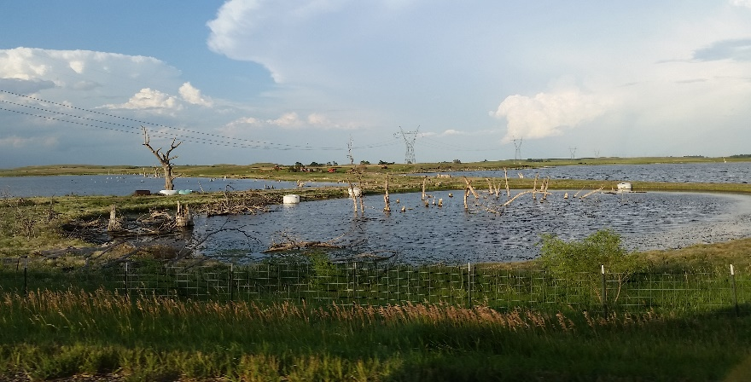
Background: Climate Pluvial Years
Pluvial Month: precipitation exceeds 40% of monthly average (Findell and Delworth 2010)
PPR experienced pluvial precipitation during early 1990s
Resulted in formation and expansion of waterbodies
Flooded farmland, roads, and towns
Past studies have examined PPR response to pluvial precipitation but at smaller scales

Slide 5
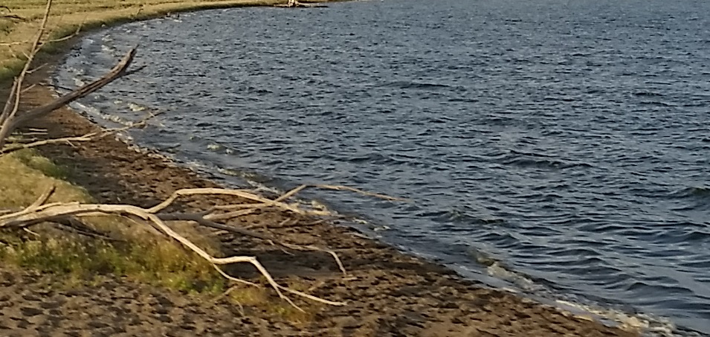
Background: Current Climate Conditions
Climate data proposes PPR is now experiencing dry conditions
Current year to date precipitation amounts indicate PPR is in drought conditions
Field inspection suggests water bodies are retreating

Slide 6
Study Area: South Dakota PPR
South Dakota PPR: ~65,107 km²
Dominated by row crop and pasture land
Composes almost all the suitable row crop production ground in the state
Agriculture has a $25 billion dollar annual impact on the state
Any disruption to agriculture or new means of management can have a profound effect

Slide 7
Research Question
Are areas that have been reclaimed from water bodies being farmed and if so what is being grown?

Slide 8
Project Goals and Objectives
Quantify farmland lost or gained to pluvial water bodies within the South Dakota PPR from 1986 to 2016
Quantify spatial/temporal relationships between the expansion and contraction of pluvial water bodies and precipitation received from 1986-2016
Determine what crops are currently being produced in areas that have seen pluvial water body retreat
Develop an automated framework for future studies involving large datasets within the PPR

Slide 9
Methods: Data Required
Landsat scenes from 1986 to 2016 used to construct an annual Landsat time series for the AOI
Scenes captured in June, July or August to correspond with peak growing season
Less than 10% cloud cover required
Dates | Spacecraft | Sensor | Resolution | Coordinate System
1986 to 1999 | Landsat 5 | TM | 30 Meters | UTM Zone 14N
2000 to 2012 | Landsat 7 | ETM+ | 30 Meters | UTM Zone 14N
2013 to 2016 | Landsat 8 | OLI | 30 Meters | UTM Zone 14N
Sample Landsat Image

Slide 10
Methods: Data Required
Additional Datasets
Dataset | Description | Resolution | Years Available | Type | Source
NASS CDL | Crop Cover | 30 Meters | 2006 to 2016 | Grid | USDA
NLCD | Land Cover | 30 Meters | 2011 | Grid | MRLC
PRISM Climate Data | Climate | 800 Meters | 1895-2016 | Grid | PRISM Group

Slide 11
Methods: Pre-Processing
Create Composite Band Rasters TM/ETM+
Mosaic Rasters into 1 image
Clip to AOI
Create Clipped Composite Raster
Acquire Landsat scenes
Create Composite Band Rasters OLI
Mosaic Rasters into 1 image
Clip to AOI
Create Clipped Composite Raster
Acquire NLCD
Clip to AOI
Reclassify:
Open Water, Crops, Wetlands, Developed, Grassland/Pasture
Create Clipped Reclassified NLCD
Acquire NASS CDL
Clip to AOI
Create Clipped CDL

Slide 12
Methods: Object Based Image Analysis
Segments image into objects based on like pixels
Used extensively to detect change in forest and crop lands
Source Image
Segmented Image
Objects classified into groups

Slide 13
Methods: Landsat Water Index Calculations
Water bodies identified using Normalized Difference Water Index (NDWI) (McFeeters 1996)
Calculated as:
$$NDWI =\frac{(Green−Near Infared)}{(Green+Near Infared)}$$
Objects with NDWI < zero = no water
Objects with NDWI > Zero = water
Water classified objects merged into region

Slide 14
Methods: Landsat Classification
Acquire Landsat scenes
Classification
Visual inspection and correction
Segmentation
Compare NDWI Values
Bin water bodies to classes perm/seasonal
Create composite band raster for each Landsat scene
Accuracy Assessment
Calculate NDWI
Merge Objects “Water”)
Export Shapefile
Clip composite band raster to AOI
Field Ground Truth
Assign Objects w/ NDWI > 0 “Water”
Assign Objects w/ border >. 5 “Water”
Green: Data Acquisition
Blue: ArcGIS
Tan: eCognition
Yellow: Fieldwork
Final Classification
Water body extraction workflow

Slide 15
Methods: Data Integration
CDL
Over lay
Calculate Crop Types Present in water areas
Water Body Polygons
NLCD
Over lay
Calculate Land Area Changes
PRISM Climate Data
Correlate water Body with precip. data
Notes:
Fix Arrows. 20 minute mark

Slide 16
Initial Results: Landsat Classification
Example digitized slough over three years near Langford, South Dakota as depicted in 1986, 1995 and 2016.

Slide 17
Initial Results: Accuracy Assessment
Year | Correctly Classified Water Pixels | In Correctly Classified Water Pixels | Correctly Classified Non-Water Pixels | In Correctly Classified Non-Water Pixels | Users Accuracy Water Class (Com) | Users Accuracy Non-Water Class (Com) | Producers Accuracy Water Class (OM) | Producers Accuracy Non-Water Class (OM) | Total Accuracy
1986 | 3 | 0 | 46 | 1 | 100% | 98% | 75% | 100% | 98%
1995 | 4 | 3 | 39 | 4 | 57% | 91% | 50% | 93% | 86%
2016 | 1 | 2 | 47 | 0 | 33% | 100% | 100% | 95% | 95%
Notes:
Build out the the slide
Users=Error of Commission
Producer error of ommission

Slide 18
Initial Results: Waterbody Advance and Retreat
Test area near Langford, South Dakota
Surface area was calculated as 318 hectares, 1,315 hectares and 518 hectares respectively
Precipitation time series diagram

Slide 19
Initial Results: Crop Distribution
Crops now grown in previously flooded areas in 1995
10 km study area
Crop | Hectares (ha)
Soy Beans | 24
Hay | 23
Corn | 20
3,568 of 41,756 ha flooded
998 ha re-claimed

Slide 20
Future Directions
Refine methods
Mask cloud pixels
Automate processing
Correlate water body advance/retreat to climate data
Predict crop distribution

Slide 21
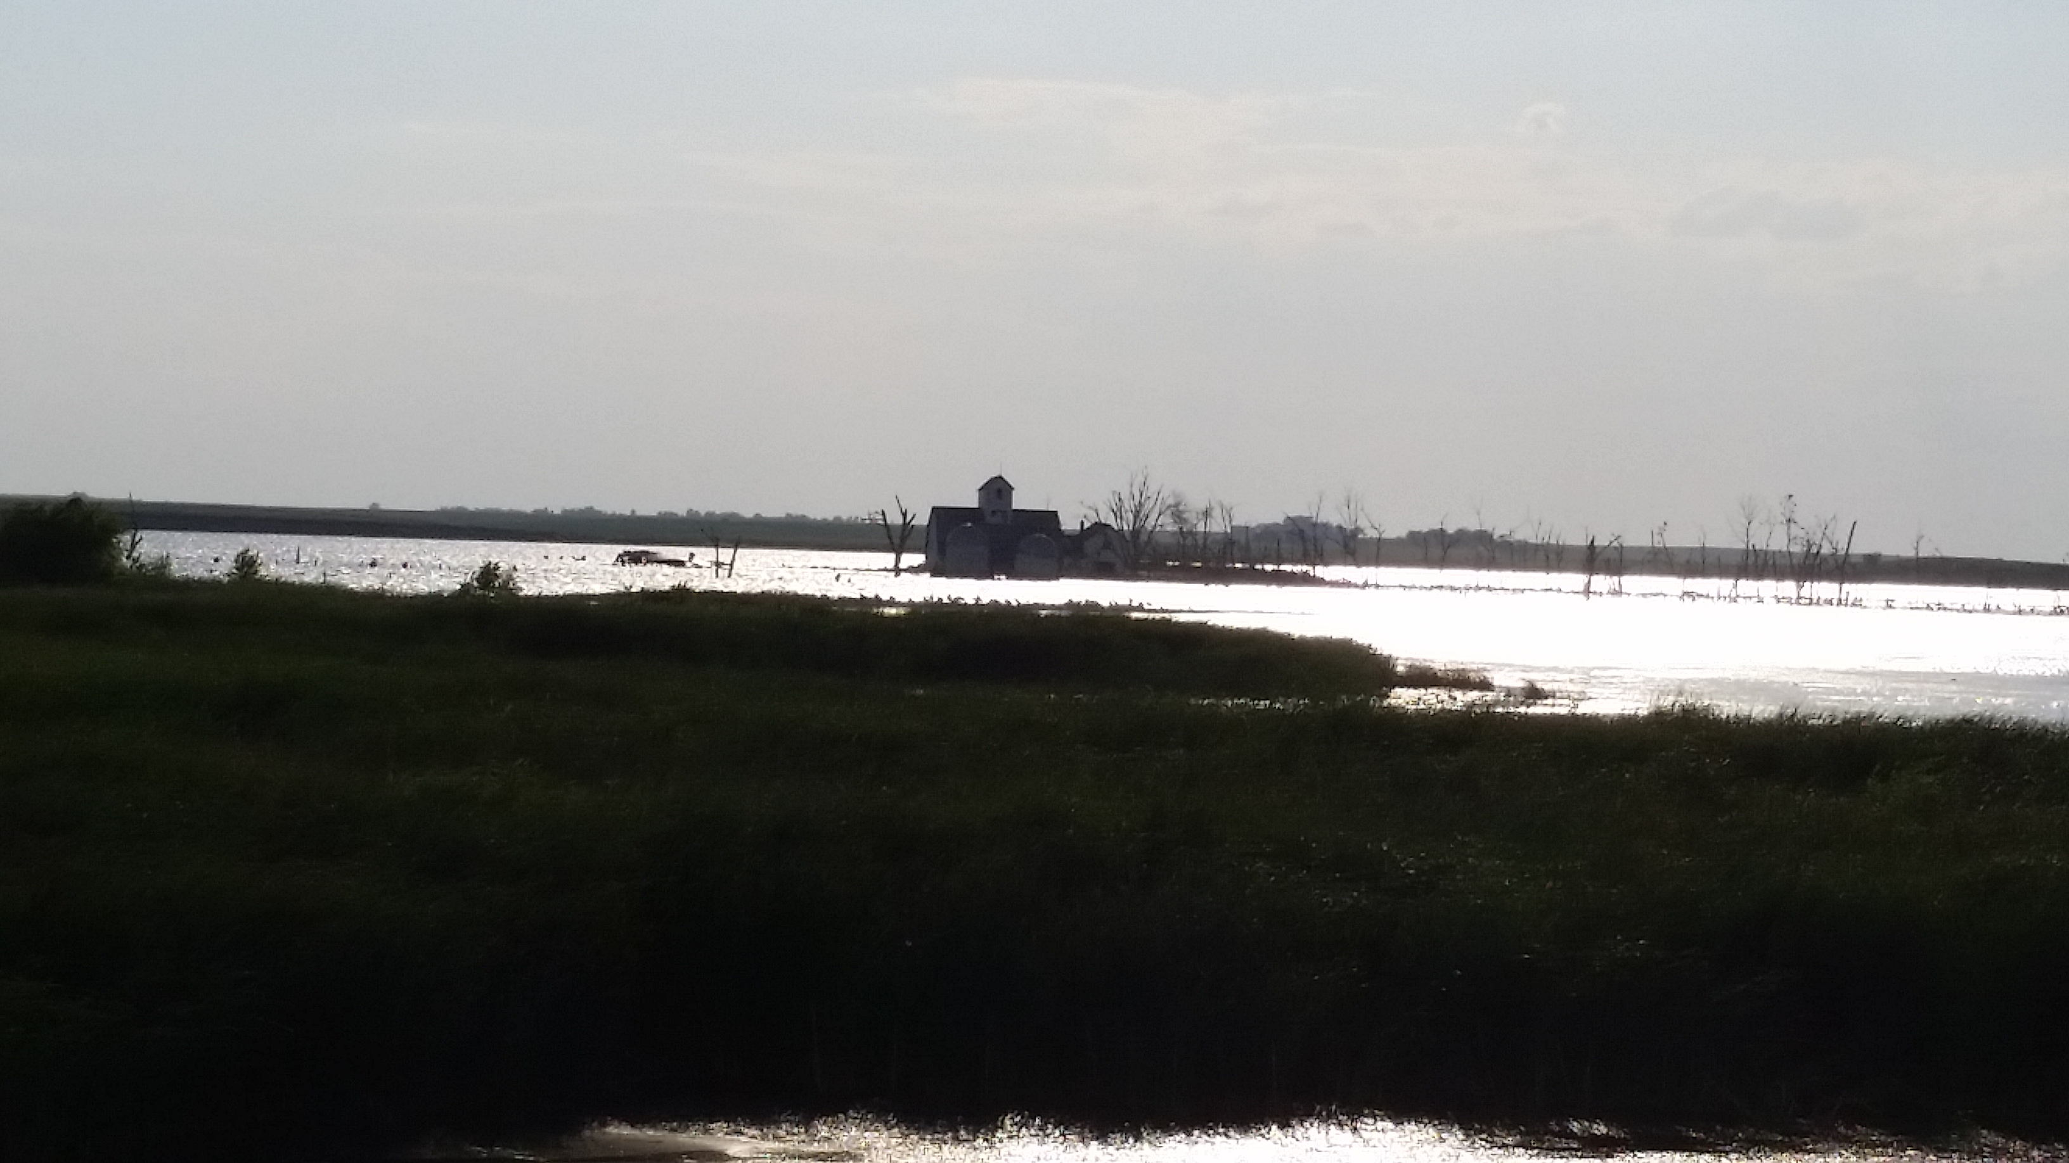
Questions?

