Slide 1
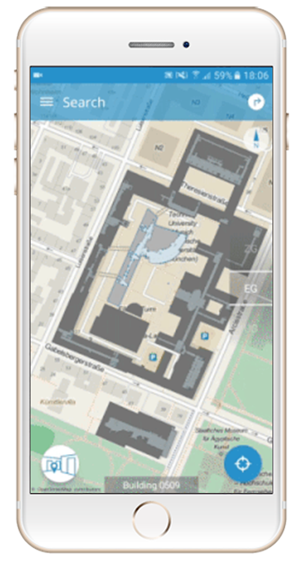
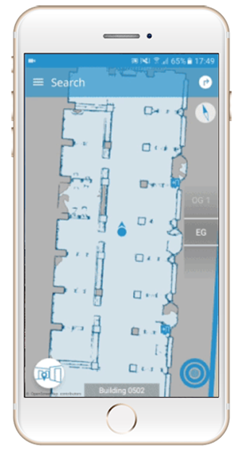
Interior Navigation Technologies: A Survey
Case Robertson
MGIS Program
Advisor Dr. Fritz Kessler
Pennsylvania State University

Slide 2
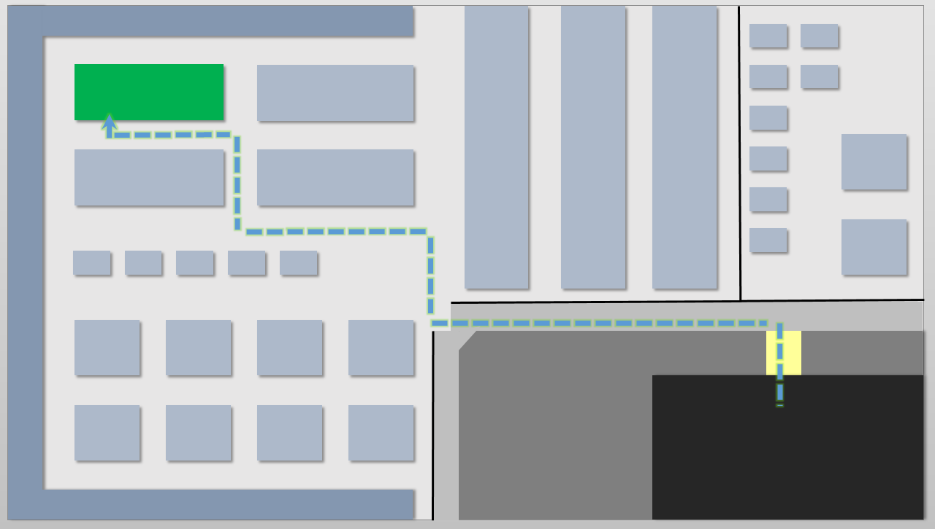
Overview
Introduction
A Navigation Example
Interior Navigation Technologies (INT) Requirements
Current INTs
Limitations of Current INTs
Types of INTs
Objectives and Proposed Methodology
INTs to be Evaluated
Project Timeline
Conclusion
Shopping Item
Isles
Navigation Path
Crosswalk
Parking Lot
Example navigation from parking lot to shopping item.

Slide 3
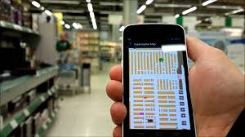
Introduction
Interactions between interior spaces and spatial behavior
Where people are, what is around them, and how to get from one location to the other
Consumers, businesses and governments create a financial value ($ billions) [1]
No preferred positioning technology standard for interior navigation [2]
An assessment of Interior Navigation Technologies
Example indoor navigation [5]

Slide 4
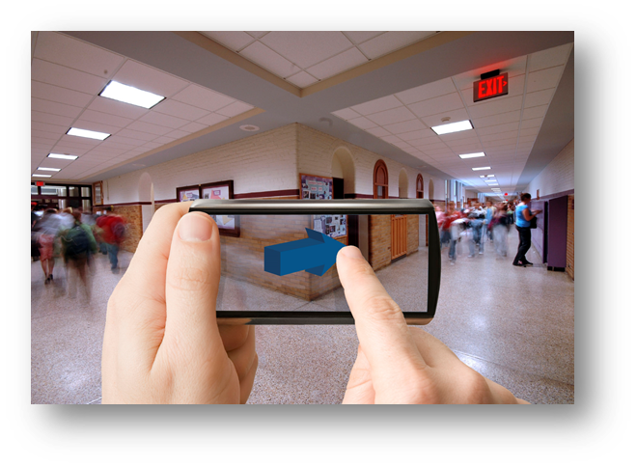
A Navigation Example
Imagine using an app on your smartphone to get driving directions to a hospital:
Use a map to enter the hospital’s address
Input the destination (a hospital’s room number)
Driving directions navigates you to the optimal parking area
Directions seamlessly switch from driving to walking
Directed to the most convenient hospital entrance
Once inside the building, interior navigation technologies directs you to the appropriate room
Example indoor navigation [4]

Slide 5
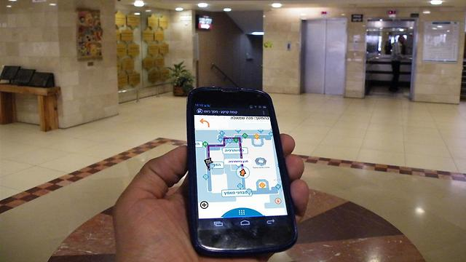
Interior Navigation System Requirements
Technological Requirements
Utilize the included smartphone sensors
Continuously stay connected to a network
Access current and accurate interior location, tracks, and points of interest
Seamless navigation
User Requirements
A dynamic and interactive interface that guides the user
See current location on 2D or 3D maps
Clearly marked navigation paths with a symbol
Optional Features
Location of people within a user’s social network
Integration with tasks and shopping list apps
Proximity notifications [5]
Example indoor navigation [4]

Slide 6
Current Interior Navigation Technologies
Current interior navigation systems are tied to smartphones
These technologies use different locational sensors:
Acoustic Signals
Geomagnetic Positioning
High-Resolution Cameras
Inertial Navigation
LIDAR (Light Detection and Ranging)
RF (Radio Frequency) Based (Cellular, Bluetooth, Radio-Frequency Identification, Wi-Fi) [2]

Slide 7
Limitations of Current Smartphone Technology
Some smartphones lack necessary sensors
iOS or Android operating systems
Access to location data of the area to navigate
Limited memory and processing power
Utilize cloud services for processing
Availability of interior positions and points of interest

Slide 8
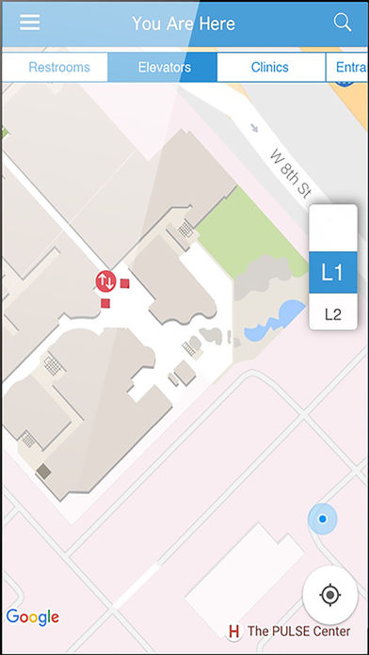
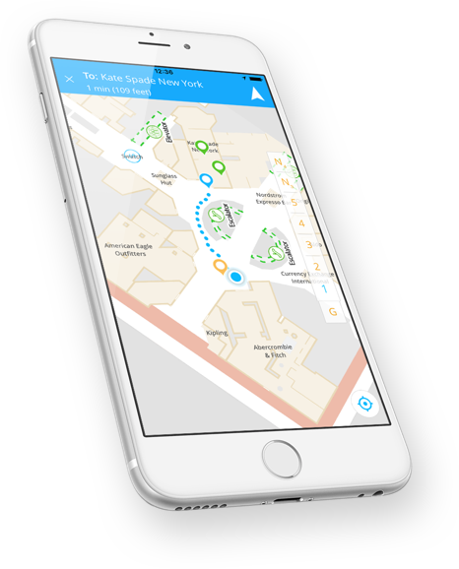
Types of Interior Navigation Systems
Acoustic Signals
Geomagnetism
Inertial Navigation
LIDAR
QR Codes and High-resolution Cameras
RF-Based
Example Mobile Apps
IndoorAtlas
SPREO
NavVis

Slide 9
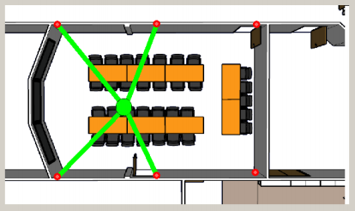
Acoustic Signals
Smartphones detect or emit sound [8]
Requires line of sight [7]
To transmit, some smartphones need hardware modifications [7]
Location is determined based on TDoA (Time Difference of Arrival)
Estimating position using sound [15]

Slide 10
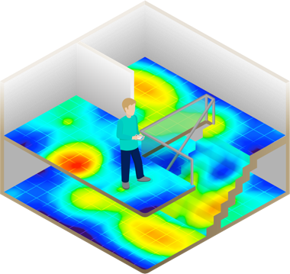
Geomagnetism
Utilizes the built-in magnetic sensor
Anomalies in the Earth’s magnetic field can be detected [3] (Figure 1)
These anomalies are used for indoor positioning [6]
Figure 1

Slide 11
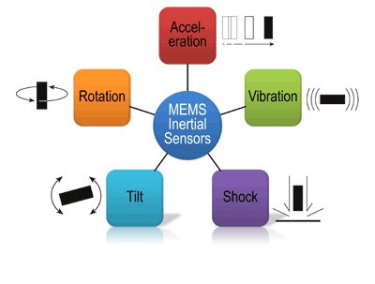
Inertial Navigation
Micro electromechanical systems (MEMS) inertial sensors
Provides high accuracy but for only a short time
The error produced grows cubically
Initial accuracy is appealing to hybrid systems
Example of MEMS [16]

Slide 12
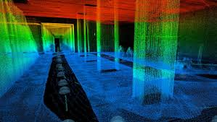
LIDAR
Interior navigation in 2D or 3D based on very accurate digitizing (Figure 2) [4]
Uses laser scanners and high-resolution cameras
Can provide centimeter-accurate position estimates [4]
Figure 2

Slide 13
QR Codes and High-Resolution Smartphone Cameras
Recognize QR (Quick Response) codes (Figure 3)
Provides encoded geospatial information [10]
Capture the users’ location by matching images to landmarks [9]
Recognizes distinct places or signage
No continuous tracking
Figure 3

Slide 14
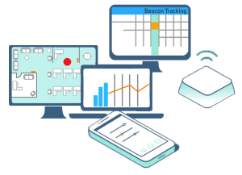
RF-Based
Provides continuous network coverage
Cost effective, energy efficient, reliable, and achieves accuracy up to one meter [5]
The venue can expect:
Accurate map of the interior and outdoor spaces
Installation of beacons
Example RF-Based navigation [5]

Slide 15
Objectives and Proposed Methodology
Identify available interior navigation technologies
Develop criteria to evaluate these technologies
Evaluate interior navigation technologies
Present results
Notes:
Example: “Hold your phone upright to show it what’s around you. The app will then determine your localization automatically by using the camera’s view [4].”

Slide 16
Evaluated Technology: Geomagnetism
Indoor Atlas - Geomagnetism
IndoorAtlas pioneered geomagnetic indoor positioning technology
The mobile app can accurately track a person’s location indoors
Magnetic fingerprints can be developed for most buildings
IndoorAtlas’ interior navigation app uses dynamic 2D maps (Figure 4) [3]
Figure 4

Slide 17
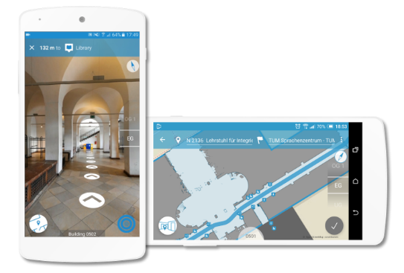
Evaluated Technology: LIDAR
NavVis - LIDAR
NavVis has a mobile app in beta with 2D or 3D views (Figure 4)
Mapping trolley
Combine LIDAR, high-resolution cameras, inertial navigation and SLAM (simultaneous localization and mapping)
Provides centimeter-accurate position estimates [4]
Figure 5

Slide 18
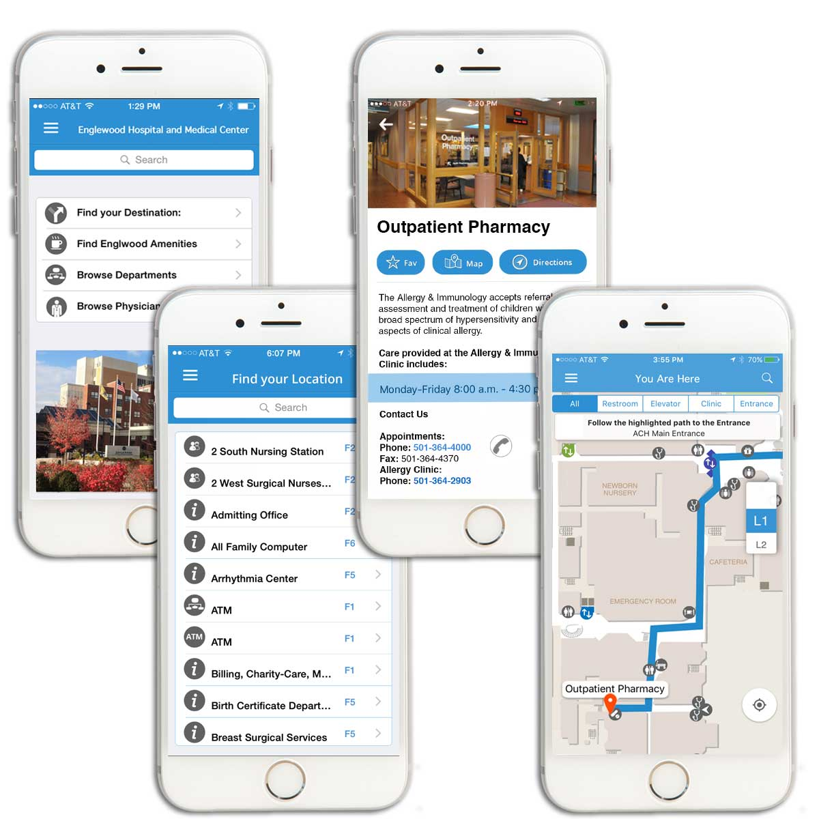
Evaluated Technology: RF-Based
SPREO - RF-Based
SPREO uses BLE beacons and Wi-Fi signal fingerprinting as its base
Achieves interior position accuracy to one meter [5]
Using the mobile app (Figure 6) [5], users can:
See their location on a map
Navigate interior spaces
Receive proximity notifications
Share their location
Figure 6

Slide 19
Project Timeline
1 Month
Develop evaluation criteria
1 Month
Evaluate IndoorAtlas, NavVis, and SPREO mobile applications
2 Months
Write evaluation
Provide recommendations
2 Months
Research interior navigation technologies to document changes since April 2017
Taking GEOG 596B in Spring 2018

Slide 20
Conclusion
The use of smartphones for outdoor navigation applications is based on GPS, yet 90% of people’s time is spent indoors where GPS loses signals [12].
Eventually, a preferred positioning technology standard for interior navigation will make its way to the forefront
Until then hybrid methodologies combined with various location sensors are the best approach for navigating interior spaces

Slide 21
References
[1] Research and Markets. Location Based Services. Indoor Location Market by Component (Technology, Software Tools, and Services), Application, End User (Transportation, Hospitality, Entertainment, Shopping, and Public Buildings), and Region - Global Forecast to 2021, October 2016, http://www.researchandmarkets.com/reports/3947594/indoor-location-market-by-component-technology. Accessed 3/18/2017.
[2] Karimi, Hassan A. (2015). Indoor Wayfinding and Navigation. Boca Raton: CRC Press.
[3] IndoorAtlas. How It Works, January 1, 2017, http://www.indooratlas.com. Accessed March 4, 2017.
[4] NavVis. Navigation App. Under Development: Next-generation Indoor Navigation, January 1, 2017, http://www.navvis.com. Accessed March 4, 2017.
[5] SPREO. Wayfinding & Indoor Navigation Mobile App, January 1, 2017, http://spreo.co/. Accessed March 3, 2017.
[6] B. Gozick, K. P. Subbu, R. Dantu and T. Maeshiro. "Magnetic Maps for Indoor Navigation." IEEE Transactions on Instrumentation and Measurement, vol. 60, no. 12, December 2011, pp. 3883-3891, http://ieeexplore.ieee.org.ezaccess.libraries.psu.edu/document/5773083/?reload=true. Accessed April 8, 2017.
[7] Hai Yang, Rui Zhang, Joan Bordoy, Fabian Höflinger, Wei Li, Christian Schindelhauer, Member, IEEE, and Leonhard Reindl, Senior Member, IEEE. “Smartphone-Based Indoor Localization System Using Inertial Sensor and Acoustic Transmitter/Receiver.” IEEE Sensors Journal, vol. 16, no. 22, November 15, 2016, pp. 8051-8061, http://ieeexplore.ieee.org.ezaccess.libraries.psu.edu/stamp/stamp.jsp?arnumber=7556316&tag=1. Accessed April 17, 2017.
[8] Fabian Hoflinger, Joachim Hoppe, Rui Zhang, Alexander Ens, Leonhard Reindl, Johannes Wende berg, and Christian Schindelhauer. “Acoustic Indoor-Localization System for Smart Phones.” 2014 IEEE 11th International Multi-Conference on Systems, Signals & Devices (SSD14), Barcelona, 2014, pp. 1-4. http://ieeexplore.ieee.org.ezaccess.libraries.psu.edu/document/6808774/. Accessed April 19, 2017.
[9] Harlan Hile and Gaetano Borriello. “Positioning and Orientation in Indoor Environments Using Camera Phones.” IEEE Computer Graphics and Applications, vol. 28, Issue 4, July 9, 2008, pp. 32-39, http://ieeexplore.ieee.org.ezaccess.libraries.psu.edu/document/4557953/. Accessed April 19, 2017.
[10] Barberis, Claudia, Bottino, Andrea, Malnati, Montuschi, Paolo. “Experiencing Indoor Navigation on Mobile Devices.” IEEE IT Professional, vol. 16, Issue 1, January 2014, pp. 50-57, http://ieeexplore.ieee.org.ezaccess.libraries.psu.edu/document/6560013/. Accessed March 14, 2017.
[11] E. Foxlin, "Pedestrian tracking with shoe-mounted inertial sensors," IEEE Computer Graphics and Applications, vol. 25, no. 6, Nov.-Dec. 2005, pp. 38-46, http://ieeexplore.ieee.org.ezaccess.libraries.psu.edu/document/1528431/references. Accessed April 21, 2017.
[12] Railway-technology.com. The World’s Busiest Train Stations. January 2017. http://www.railway-technology.com/features/featureworlds-busiest-train-stations. Accessed April 29, 2017.
[13] Kai-Wei Chiang, Jhen-Kai Liao, Shih-Huan Huang, Hsiu-Wen Chang, and Chien-Hsun Chu. “The Performance Analysis of Space Resection-Aided Pedestrian Dead Reckoning for Smartphone Navigation in a Mapped Indoor Environment,” International Journal of Geo-Information, vol. 6, Issue 2, February 14, 2017, http://www.mdpi.com/2220-9964/6/2/43/htm. Accessed April 29, 2017.
[14] Niu, X., Li, M., Cui, X., Liu, J., Liu, S., & Chowdhury, K. R. “WTrack: HMM-based walk pattern recognition and indoor pedestrian tracking using phone inertial sensors.” Personal and Ubiquitous Computing, vol. 18, no. 8, December 2014, pp. 1901-1915, http://dx.doi.org.ezaccess.libraries.psu.edu/10.1007/s00779-014-0796-x. Accessed April 27, 2017.
[15] Rishabh, Ish, Kimber, Don, Adcock, John. “Indoor localization using controlled ambient sounds.” 2012 International Conference on Indoor Positioning and Indoor Navigation, November 2012, https://www.fxpal.com/publications/indoor-localization-using-controlled-ambient-sounds.pdf. Accessed April 27, 2017.
[16] Pinimg.com. Mems Sensor. January 2017. https://s-media-cache-ak0.pinimg.com/736x/e0/bd/1c/e0bd1c61ea1f0412631f7f5f83766528.jpg. Accessed April 27, 2017.

Slide 22
Any Questions? Thank You!
Acknowledgement
Dr. Fritz Kessler
Contact Information:
Case Robertson
car332@psu.edu

