Slide 1
3D Archaeological Survey Modeling as a Compliment to Traditional Excavation Methods for Enhanced Visualization, Comprehension, and Documentation
By
Paul Roddy
Pennsylvania State University
GEOG 596 A, Spring 2016
Dr. Alexander Klippel Advisor
Notes:
Hello, my name is Paul Roddy and I will be presenting my capstone project entitled:
My inspiration for this project came not only from my interest in archaeology and preservation, but an article I read where a 3D model of an archaeological site in San Diego was created using ArcGIS. I thought the final product was an incredible way to visualize an excavation by placing it on it’s side, which was my initial capstone idea, then Dr. Klippel was assigned as my advisor and through his experience with VR and his vision to go beyond the ArcGIS model, my project has evolved into a VR model of Mayan ruins.

Slide 2
Westcott and Brandon declared that GIS as a research tool may have as profound of an effect on archaeological field work as the introduction of carbon dating did in the 1950s (Westcott and Brandon, 2000).
Notes:
This statement says a lot about how archaeology has embraced technology.

Slide 3
Introduction
Goals and Objectives
Methodology
Light Detection and Ranging (LiDAR) GIS Software Platforms
Anticipated Results
Notes:
As far as the data goes, Airborne LiDAR for creation of shapefiles and images.
Ground based laser scanners are another option.

Slide 4
Introduction
Apply 3D GIS model as a compliment to 2D methods
Virtual preservation
Public access via web based platforms
Educational opportunities and public awareness
Notes:
By creating 3D models, archaeologists can have a contemporary method of documentation and visualization which in conjunction with standard practices (photo, sketching, measurements) could provide better understanding of archaeological sites, as well as preservation methods.
This process also allows for review of the site where archaeologists can “re-live” the day’s excavations.
During my Lit review I discovered this is already occurring.
For my project data was collected via a remote sensing platform after the site has undergone decades of excavation.
Virtual preservation would allow for public access via the WWW giving citizens, teachers, and students affording them the opportunity to learn about Cahal Pech. Such awareness could ensure preservation for the actual site.
Diachronic evolution of the excavation can be observed.

Slide 5
Goals & Objectives
Create a virtual model of an archeological site
Cahal Pech
Develop workflow that can be easily replicated
Create an accompanying web site
Notes:
A workflow that could be applied to any other archaeological significant site.
For this study, and through collaboration with PSU Dept of Anthropology PhD candidate Claire Ebert Cahal Pech.

Slide 6
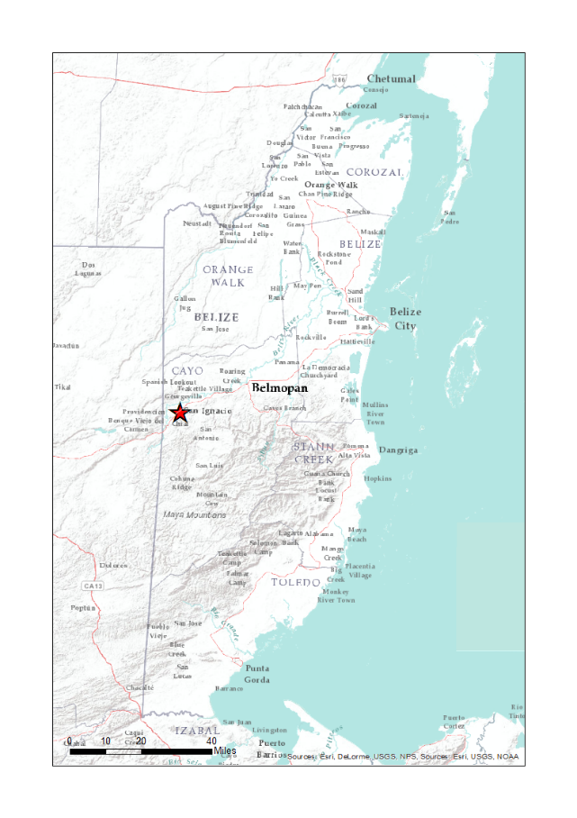
Cahal Pech
Image: (Archaeological Institute of America, April 2016).
Mayan early pre-classic (1200-900 BC) continually occupied until 800 AD
Situated on an acropolis on the southern edge of the city of San Ignacio
Considered a medium size Mayan occupation
Site core contains 34 structures
Dozens of occupations on the outskirts
Notes:
Cahal Pech is an early pre-classic Mayan occupation in Western Belize situated located on an acropolis overlooking the Belize river valley within the limits of the city of San Ignacio.
Archaeologists consider this a medium size occupation where the site core consists of 34 structures (pyramids and plazas), with dozens of small occupations in the outskirts, but my focus for now is the Site Core.
a settlement, especially a citadel, built upon an area of elevated ground—frequently a hill with precipitous sides, chosen for purposes of defense. In many parts of the world, acropoleis became the nuclei of large cities of classical antiquity,

Slide 7
San Ignacio and Site Core Temple
Image: http://www.belizeadventure.ca/an-afternoon-at-cahal-pech-ruins/
Image: Google Earth Pro, May 2016.
Notes:
The city of San Ignacio with Cahal Pech site core in red square.
One of the temples that will be transformed.

Slide 8
Cahal Pech Southern View
Notes:
The site core as seen from the south atop the acropolis.

Slide 9
Methodology
LiDAR data collected via aircraft
ESRI ArcGIS 10.3.2
ArcScene extension
ESRI CityEngine
Procedural Rule
Unity Game Engine (down the road)
Notes:
LiDAR data processed using ArcGIS and ArcScene for rendering 3D. Then CityEngine for enhancement where the texture or façade can be created. Ultimately Unity Game Engine would bring the site to life and give us the VR effect we are looking to achieve.

Slide 10
Standard Archaeological Methods
Seek human activity relative both horizontally or “where” the activity took place, and vertically or “when” the activity took place.
Destructive by nature
Gridded layout
3D by nature having X, Y, and Z factors
Painstaking procedure with every excavation unit removed typically via trowel at 10cm increments
Provenience of artifacts are recorded X, Y, and Z
Excavated meter pits
Bulk earth
Image: https://en.wikipedia.org/w/index.php?title=Archaeology&oldid=715698599
Notes:
Archaeologists explore human activity using processes that are already 3D by nature.
The process is destructive and a painstaking process. Each excavation unit is removed most of the time using a trowel at 10 cm increments or until change.
The site has both horizontal and vertical attributes as seen in the figure. These can be plugged into ArcGIS as x, y, and z or negative z factors for constructing 3D models of a excavation units.
Once documented in this manner, archaeologists can go back and diachronically review each excavation unit and with attribute tables, archaeologists can be selective in the sense where artifacts from a specific era can be viewed or a specific soil type, etc.

Slide 11
Standard Documentation Methods
Photograph recording of feature
Sketch of same feature
Images: The Belize Valley Archaeological Reconnaissance Project 2014.
Notes:
One standard practice of archeological fieldwork is to photograph and sketch features and artifacts “before” they are removed.

Slide 12
Past 3D Models
3D models for reconstruction date back to the 18th century
Cork, wood, or plaster were used to make detailed reconstructions
State model of Pompeii at the 1:100 scale created by Giuseppe Fiorelli. State models represent the “state” of the item as it was at the time of reproduction.
National Archaeological Museum, Naples.
Image: National Archaeological Museum, Naples (Frischer, 2005).
Notes:
Read straight from slide.
State is reference to the state the settlement is in at the time of creating the model.

Slide 13
LiDAR
Aircraft equipped with instruments which include: laser scanner, GPS, and Inertia Measurement Unit
400,000 pulse/second in the near infrared spectrum
Time for each return in relation to the A/C determines surface
Buildings/vegetation
Point cloud data in ASCII format
Digital Surface Model (DSM) with vegetation and Digital Terrain Model (DTM) (sometimes called DEM) bare earth with vegetation removed
Image: https://www.metabunk.org/n22387-zig-zig-flight-path-near-sacramento-lidar-data-collection.t4307/
Notes:
As the aircraft (in this case) passes over the target (which is a large swath) I read up to 20 sq Km/hr.
The aircraft’s attitude (pitch, yaw, roll) is measured via the IRS Inertial Reference System.
Laser shoots up to 400K pulse/sec where pulses are reflected back. The first returns are buildings, trees, etc and the final returns are ground.
The files are in ASCII format and delivered on disk as a DSM with veg, and a DTM or bare earth. Sometimes referred to as a DEM.
LiDAR unlike radar is light energy in the near infrared spectrum and is therefore subject to weather conditions (can’t measure through clouds).

Slide 14
LiDAR Images
Point Cloud Images of Main Campus
Images: Alex Klippel PSU Dept. of Geography
Notes:
PSU main campus as point cloud images.
Creates a realistic environment.
The photo on the left you can easily make out buildings and vegetation.

Slide 15
Hillshade Images
Images and Shapefile in collaboration with Claire Ebert PSU Dept. of Anthropology
Notes:
Hillshades: CP images on the left the Digital Surface Model (DSM) and on the right the bare earth model or Digital Terrain Model (DTM).

Slide 16
City Engine
Stand alone software
Uses Computer Generated Architecture or CGA rule files
Procedural Modeling is a process of creating 3D models through the use of specific rules and algorithms
Creates detailed 3D architecture out of simple shape grammar
Geometric production is iterative
Shape
Block model
Facades
Roof
Façade is textured for realism
Image: Christiane Radies, 2013.
Notes:
Shape can be point, line, or polygon.

Slide 17
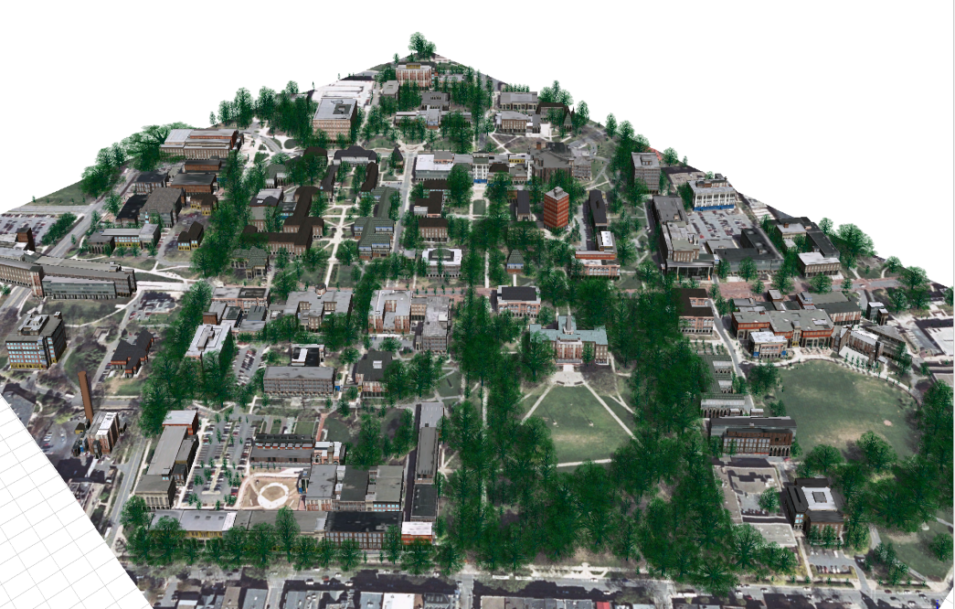
Procedural Model
Images in collaboration with Mahda Bagher PSU Dept. of Geography

Slide 18
Anticipated Results
3D virtual reality model
Historical model
Current model
Enhance scientific research
Perception for decision making
Diachronic evolution of a site can be observed
Preservation of Cahal Pech
Education and research opportunities
Posterity
Image: http://www.cahalpech.com/blog/exploring-cahal-pech-in-san-ignacio-belize
Notes:
Why bother, what could be gained?

Slide 19
Timeline
May 2016
Integrate peer review suggestions and finalize to some extent my “living” document
June – October 2016
Process data and develop VR
Data has been acquired through collaboration with Claire Ebert
Work around anticipated computing setbacks
Need for extreme computing power
One option may be to develop a virtual machine through the VR lab at PSU
Possible need for photogrammetry
For realistic texture photography is necessary
Digital SLR and overcast are optimum but must be deployed
October 2016
Find a journal for publication
Notes:
Immediately upon completion of these peer reviews I will look at all the suggestions presented and make decisions as to what I believe would enhance my project.
Present my final “living” document to my advisor, however this document will continue to evolve throughout the entire process.
Data acquisition has already occurred – I received a large amount of data from a PhD candidate.
The necessity for computer power is paramount. One idea is to create a virtual portal to a PSU system.
Good photos are a requirement for realistic texture but another option is to texture the model as it “was” during occupation.

Slide 20
References
3D Archaeology. (2014). Journal of Eastern Mediterranean Archaeology & Heritage Studies, 2(1), 1-29.
About Cahal Pech - Archaeological Institute of America. (n.d.). Retrieved April 22, 2016, from https://www.archaeological.org/interactivedigs/cahalpechbelize/about
Archaeology. (2016, April 17). In Wikipedia, The Free Encyclopedia. Retrieved 12:46, April 19, 2016, from https://en.wikipedia.org/w/index.php?title=Archaeology&oldid=715698599
ARCGIS VIDEOS. (March, 2013). Retrieved May 03, 2016, from http://video.arcgis.com/watch/2207/building-smart-cities-with-esri-cityengine
ArcMap. (n.d.). Retrieved April 22, 2016, from http://desktop.arcgis.com/en/arcmap/latest/tools/conversion-toolbox/ascii-to-raster.htm
Auer, M., Agugiaro, G., Billen, N., Loos, L., & Zipf, A. (2014). Web-based Visualization and Query of semantically segmented multiresolution 3D Models in the Field of Cultural Heritage. ISPRS Ann. Photogramm. Remote Sens. Spatial Inf. Sci. ISPRS Annals of Photogrammetry, Remote Sensing and Spatial Information Sciences, II-5, 33-39.
Billen,N., Loos, L., Auer, M., Zipf, A., Richards-Rissetto, H., Reindel, M. & von Schwerin, J.: Development of a 4D-webgis for archaeological research, Workshop on integrating 4D, GIS and cultural heritage, 16th AGILE 2013, Leuven.
Bill Whittaker at English Wikipedia, CC BY-SA 3.0, Retrieved May 3, 2016, from https://commons.wikimedia.org/w/index.php?curid=6795426
CyArk, 2011. Archaeological Areas of Pompeii. (n.d.). Retrieved April 22, 2016, from http://www.panoramio.com/photo/58703055 Uploaded on September 9, 2011.
D., & Dell'Unto, N. (2015, March/April). The Use of 3D Models for Intra-Site Investigation in Archaeology. Retrieved April 13, 2016, from https://www.youtube.com/watch?v=O0Ea9IY58DM Universita Di Siena, Creative Commons Attribution license (reuse allowed).
Davis, Oliver 2012. Processing and working with LiDAR data in ArcGIS: a practical guide for archaeologists. [Technical Report]. Cardiff: Royal Commission of the Ancient and Historical Monuments of Wales.
3D Cities. (n.d.). Retrieved May 03, 2016, from http://desktop.arcgis.com/en/3d/3d-cities/3d-city-base-layers/add-elevation-data.htm
Esri CityEngine. (n.d.). Retrieved April 22, 2016, from http://www.esri.com/software/cityengine.

Slide 21
References Cont.
Frischer, B., 2005. "The Digital Roman Forum Project: Remediating the Traditions of Roman Topography," in Acts of the 2nd Italy-United States Workshop, Rome, Italy, November 3-5, 2003, Berkeley, USA, May, 2005 edited by M. Forte, BAR International Series 1379 (Oxford 2005) 9-21.
Hitchborne, D. Image Copyright. This work is licensed under the Creative Commons Attribution-Share Alike 2.0 Generic Licence. http://creativecommons.org/licenses/by-sa/2.0/
Kimball, J. L., (2016). 3D Delineation: A modernization of drawing methodology for field archaeology. Archaeopress and JJL Kimball. ISBN 978 1 78491 305 2.
May, N. and Beardall, A. (2014). Excavations of Structures B1 and B7 at Baking Pot, Belize. The Belize Valley Archaeological Reconnaissance Project, 13, 109-143.
National Oceanic and Atmospheric Administration (NOAA) Coastal Services Center. 2012. “Lidar 101: An Introduction to Lidar Technology, Data, and Applications.” Revised. Charleston, SC: NOAA Coastal Services Center.
Peer reviewed proceedings of Digital Landscape Architecture 2013 at Anhalt University of Applied Sciences (pp. 175-184). (2013). Berlin: Wichmann.
Remondino, F., Campana, S., & Dell'Unto, N. (2014). 3D recording and modelling in archaeology and cultural heritage: Theory and best practices. Oxford, England: Archaeopress.
Renfrew, C., & Bahn, P. G. (1991). Archaeology: Theories, methods, and practice. New York, NY: Thames and Hudson.
Tsipidis, S., Koussoulakou, A., Kotsakis, K., (2008). 3D Visualization of Archaeological Excavation Data. Journal of Archaeological Science, 35 (3), 655-667.
United States Geologic Survey (USGS) Light Detection and Ranging (LIDAR). (n.d.). Retrieved April 22, 2016, from https://lta.cr.usgs.gov/lidar_digitalelevation
Wescott, K., & Brandon, R. J. (2000). Practical applications of GIS for archaeologists: A predictive modeling toolkit. London: Taylor and Francis.

Slide 22
Thank You Alex Klippel Claire Ebert Mahda Bagher

Slide 23
Questions?

