Slide 1
Spatial Relationships of Hunting-Themed Rock Art­
Kendra Rodgers
GEOG 596A
Research Proposal
Notes:
Introduce yourself
Thank Larry

Slide 2
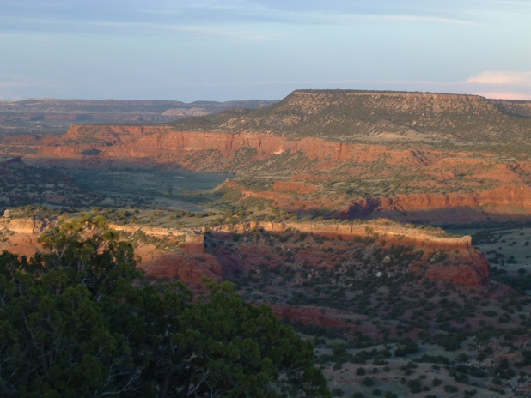
Highlights
Study Area
Rock Art
Hunting Themed Rock Art
Goals
Methodology
Sensory Perception
Spatial Relationships
Anticipated Results
Significance

Slide 3
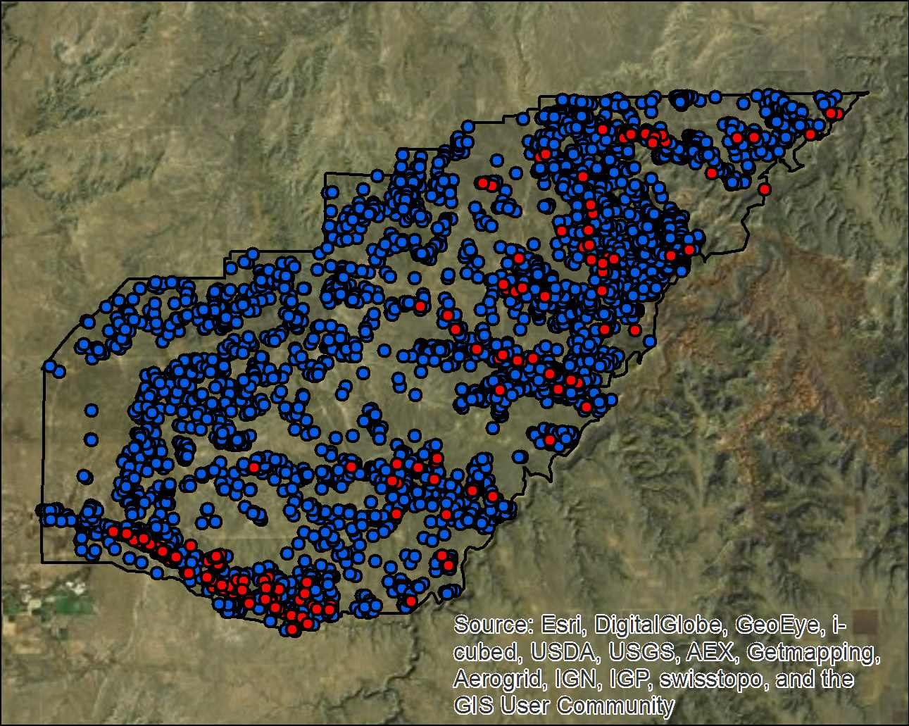
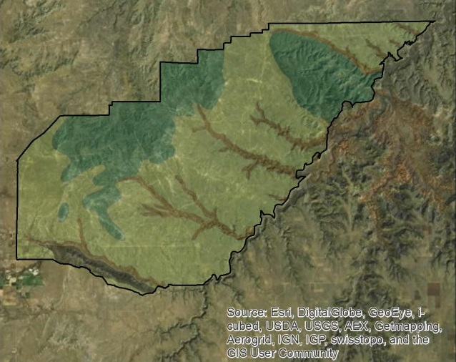
Piñon Canyon Maneuver Site
Military Training Land
Established 1983
235,000 Acres – 367 square miles
92 % Surveyed
Systematic Survey
Manual of Fieldwork 30+ years
6,200 Sites
195 prehistoric rock art sites

Slide 4
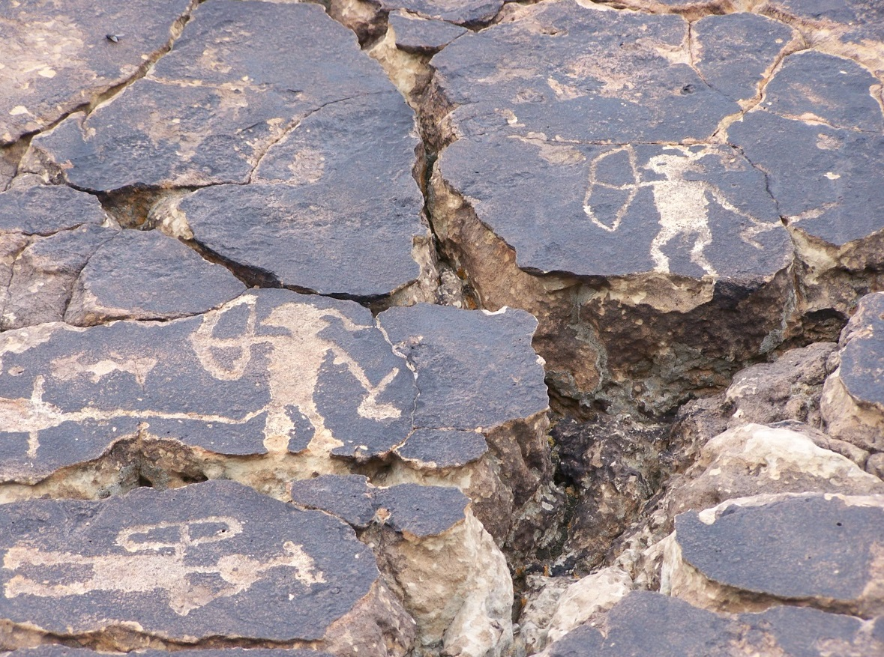
What is rock art?
Why is it important?
Notes:
Carved, painted, pecked.
Part of cultural lands
Leave no Trace
PIT projects – Local Archaeological Chapters

Slide 5
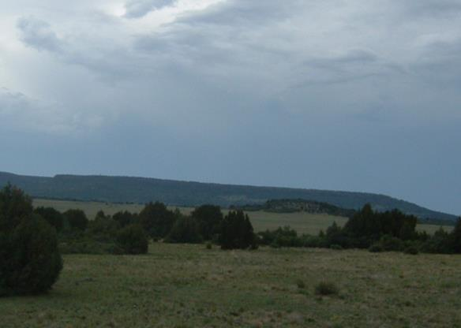
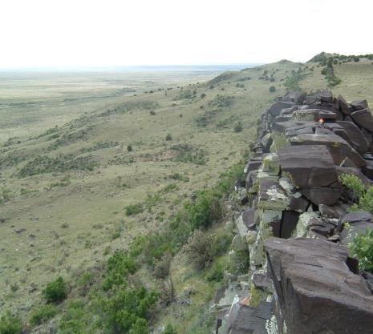
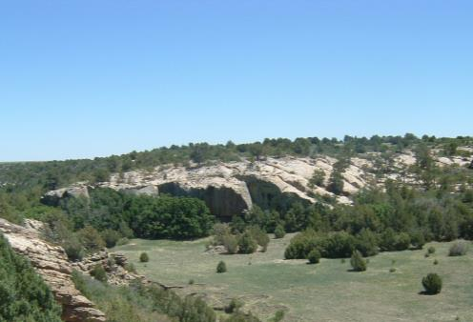
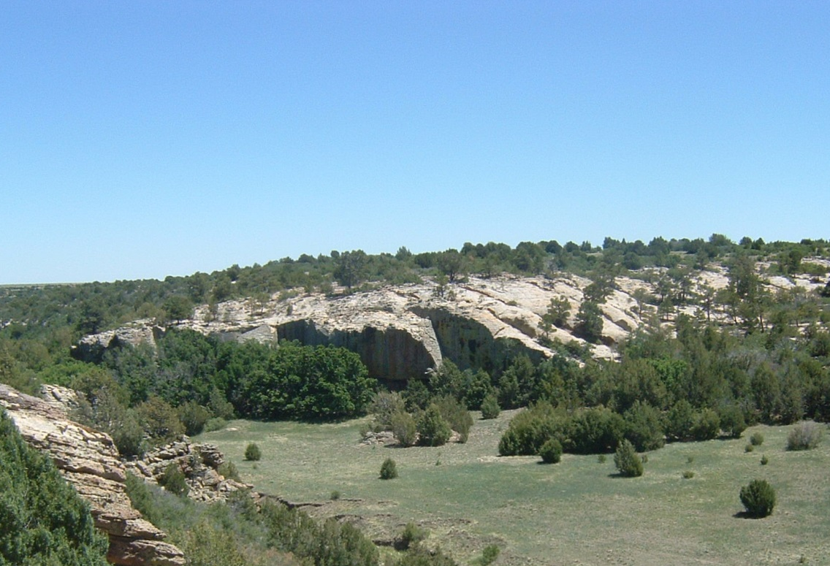
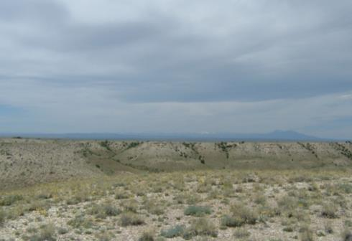
Steppes to Hills
Hogback
Canyons
Hills
Notes:
Landscape Units

Slide 6
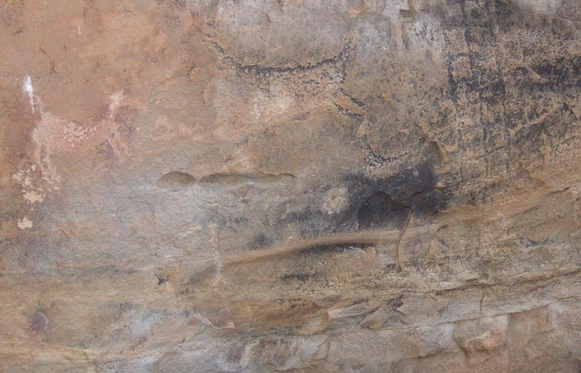
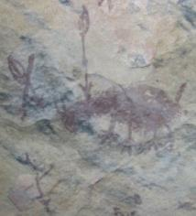
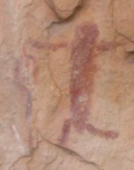
Rock Art
Geographic Traditions
Temporal Challenges
Academic Focus – 1980s
Context and Content

Slide 7
Rock Art Analysis Levels
Rock Art Site A
Rock Art Site B
Settlement Analysis - compares functional sites at a smaller scale to identify how the sites and the activities at them related
Quarry
Cairn
Types of Images
Number of Images
Rock Art Site C
Panel Analysis - documents variables of each rock art panel on a site
Rock Art
Paint, Carved
Regional Analysis - compares motifs from different sites to define regional styles or traditions
Notes:
Middle Range Analyis

Slide 8
Rock Art
Content of Images
Landscape Context
Social Context
Intra-site Context
Type of Images
Notes:
Rock Art Centric focus of research
Primary indicator
Not supplemental evidence

Slide 9
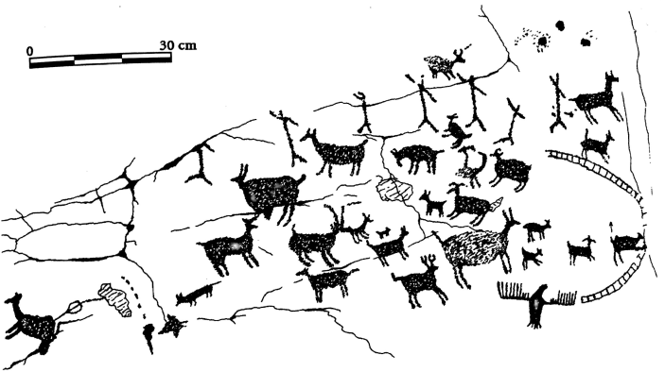
Theoretical Stances Hunting-Themed Rock Art
Hunting Magic
Ritual Use
Markers
Teaching Tools

Slide 10
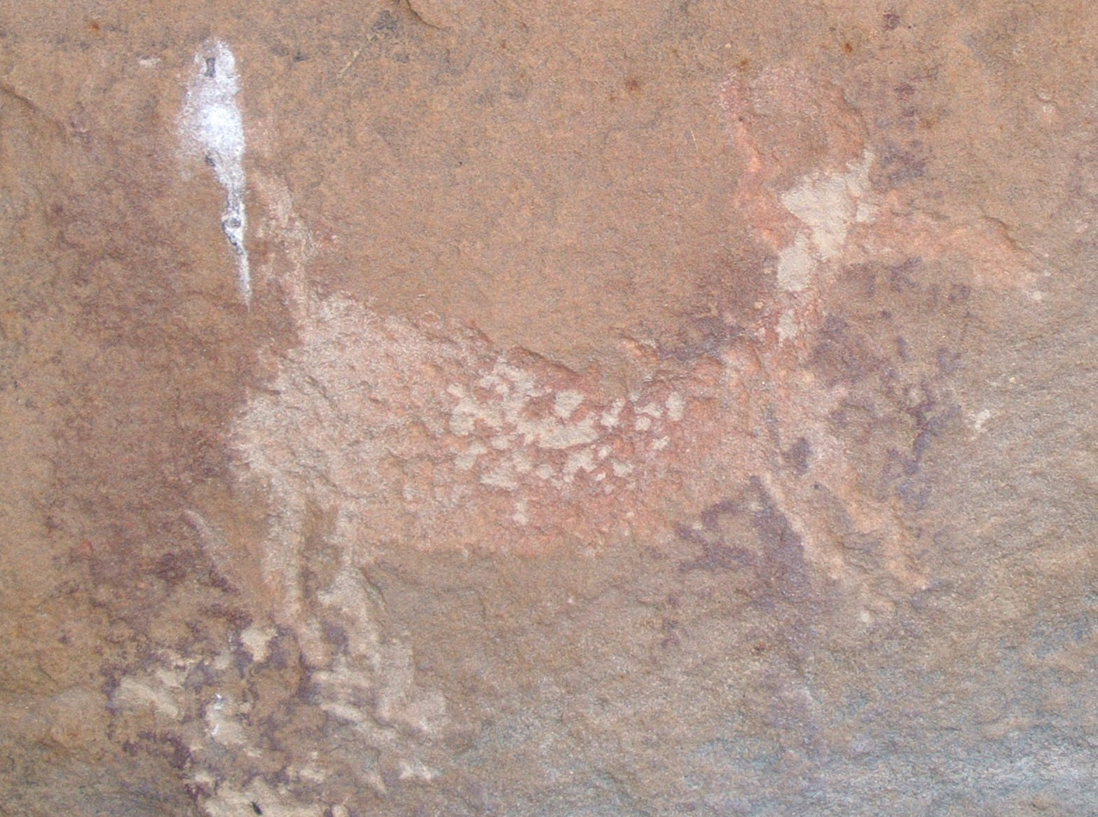
Notes:
Superimposition – time depth
Revisiting – behavior, hunting magic

Slide 11
Goals
Broaden the comprehension on the role of rock art in cultural traditions.
Broaden the comprehension of rock art in relationship to settlement patterns.
Approach rock art quantitatively – with qualitative backing.
Can rock art be the key identifier of a behavior?
Notes:
Broaden the comprehension on the role of rock art in cultural traditions.
How does location change meaning? Does it?
Why was rock art made?
How did people interact with it?
Did everyone interact with it?
Broaden the comprehension of rock art in relationship to settlement patterns.
Push analysis beyond case studies.
Approach rock art quantitatively – with qualitative backing.
Can rock art be the key identifier of a behavior?

Slide 12
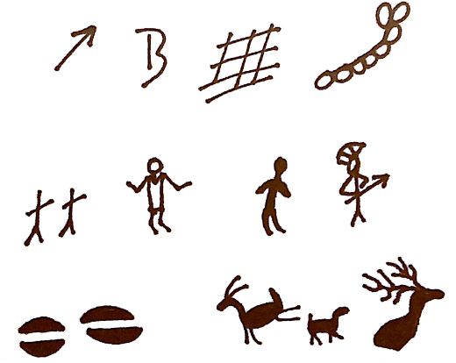
Methodology
Technical Definition of Sample
Notes:
Content
buffers

Slide 13
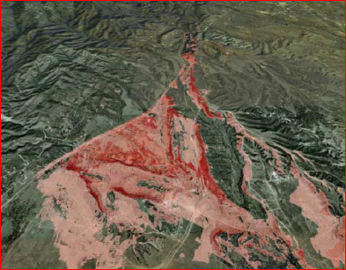
Methodology – cont.
Data Compilation
Ethnographic Research
Geospatial Analysis
Viewshed Analysis
Travel Time Analysis
Distribution in Landscape Units
Notes:
Data Compilation
-File Review
-linking reports from databases to GIS
-Fieldwork
Ethnography
Viewshed
-pattern of sites visible
-model / test large sample
Travel Time
-to and from
-water
-hunting sites

Slide 14
Significance
Archaeology is a finite resource.
Sites are active centers of cultural importance. Reconnect places with people.
Tribal Historic Preservation Officers and Tribal Leaders have limited time. Make trips count.
Insight into placement will lead to insight on interpretation allowing for cultural resources to receive proper attention and funding.
Notes:
Vance Prehistoric Story if time.

Slide 15
Thank You
Larry Gorenflo
Larry Loendorf
Linda Olson
Ms. Pamela Miller
Fort Carson Cultural Resources Management Program Team

