Slide 1
Geovisualizing Collections of Penn State University Libraries: a geographical and statistical perspective of use, age, and relevancy
Sherry Roth
MGIS Candidate
Advisor: Dr. J. Blanford
Penn State University

Slide 2
Overview
Background
Objectives
Methods
Pilot Study and Results
Future Plans
Possible Conferences
Timeline

Slide 3
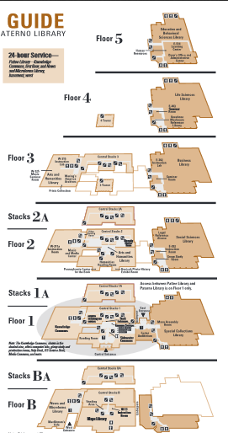
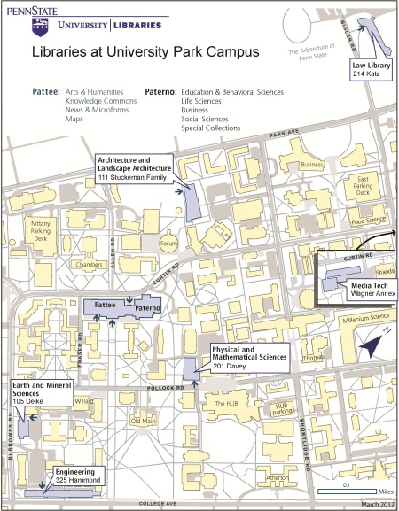
Background
Notes:
For those of you who have not been on campus, we have five libraries on campus, the largest is the PatteePaterno complex. There are five floors on the Paterno (East) side and 3 floors on the Pattee (West) side and seven floors of books in the Central Pattee area. Life Sciences Library is on the 4th floor of Paterno.

Slide 4
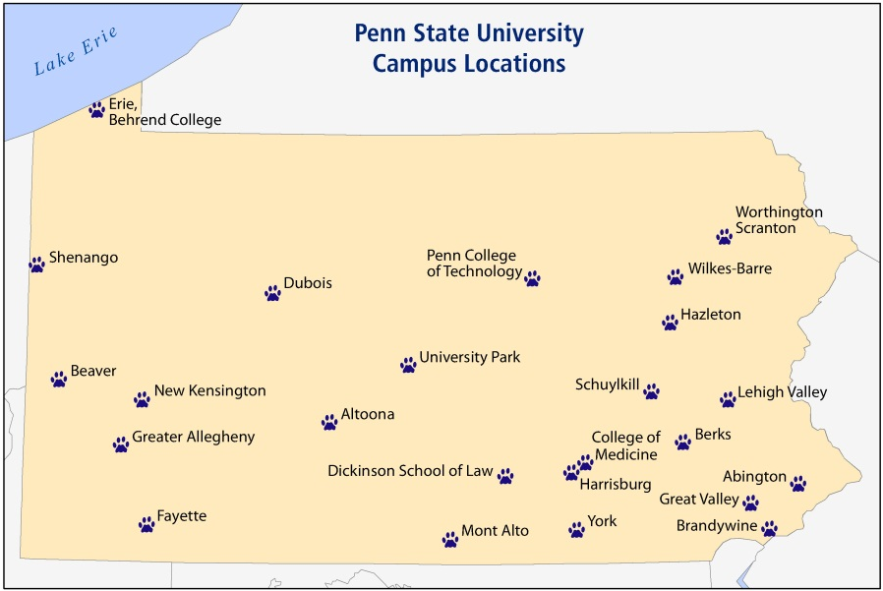
Background
Notes:
We also have libraries at more than 20 other campus locations throughout the state of Pennsylvania. There are seven million books located in these libraries and in storage. Books travel throughout the state (and throughout the world for World Campus students) when requested.

Slide 5
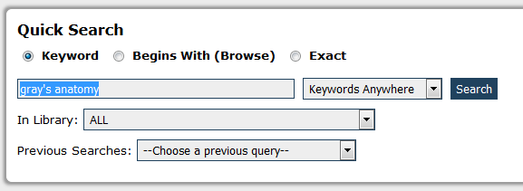
Background
Notes:
You can search for a book in our catalog of books on the library website. Let’s take Gray’s anatomy to illustrate. You see here in the middle graphic that the 39th edition is located in multiple places throughout the system – it is at Altoona, Erie, Brandywine campuses and in Life Sciences. Life Sciences houses call numbers starting with Q, R, or S in our general stacks area. The bottom graphic shows the range of call numbers on our floor.

Slide 6
Background
LIBRARY OF CONGRESS CLASSIFICATION OUTLINE
CLASS Q - SCIENCE
Q – Science (General)
QA – Mathematics, computers, computer software
QE – Geology
QM – Human anatomy
QP – Physiology
QR – Microbiology
Notes:
The Library of Congress Classification system breaks all knowledge into classes using the alphabet. Here are several of the Q’s, a class that represents general science, further divided into the sub-classes like computers, geology, and anatomy.
QM’s are a sub classification of the Q’s and represent human anatomy. Books are shelved in call number order.
Now that you are familiar with specific books and their locations, we have to also look at trends in academic libraries.

Slide 7
Background
Libraries experiencing transformational changes
Print to digital
Book repository to “libraries as place”
Solitude to collaboration
Information gathering to information synthesis
Notes:
Libraries are experiencing transformational changes.
They are moving away from print assets to digital assets or eBooks.
The library used to be thought of as a book repository, but it has transitioned into a place, a destination point for students, but not necessarily to get books.
We see patrons coming to the libraries to work collaboratively on team projects.
We MGIS students have all experienced assignments with group projects. That is very typical on campus as well, and where do the students meet to work collaboratively? At the libraries of course. We have the technology- and media-rich working spaces that they need.

Slide 8
Background
Universities (and libraries) want sustainability – it is a foundational value in our strategic plan
Fiscal
Environmental
Sustainability: The University Libraries support the simultaneous pursuit of human health, happiness, environmental quality, and economic well being for current and future generations.
Notes:
Universities and their libraries are looking at sustainability as a foundational value of their strategic plans. Working towards sustainable environmental resources is not a new concept but fiscal sustainability is being discussed more often now.
Library budgets are tightening as digital resources and technological capabilities are added to the services found within libraries.
Located in the heart of the university campus, libraries take up prime real estate space, space that many land-locked universities find appealing. So, libraries have to justify their use of this real estate and their use of finite budget monies.

Slide 9
Background
University Libraries responds
Store unused items offsite
Digitize where possible
Collaborate through consortial agreements
Recent removal of duplicate copies
Notes:
University Libraries are responding to the need to find space for these new services. In this picture, you can see the high-density, compact shelving that can be collapsed into a small space and rolled apart to retrieve books.
1.5 million infrequently-used items are stored in these off-site shelving facilities about 4 miles from campus. We allowed Google to scan digitally 400,000 books and these have the potential to free even more shelf space.
In addition, consortial agreements with other libraries to store and share a single collection among partner institutions and that will continue to free shelf space. Georgia Tech and Emory University in Atlanta are moving most of their collections out of the libraries to one shared high-density location.

Slide 10
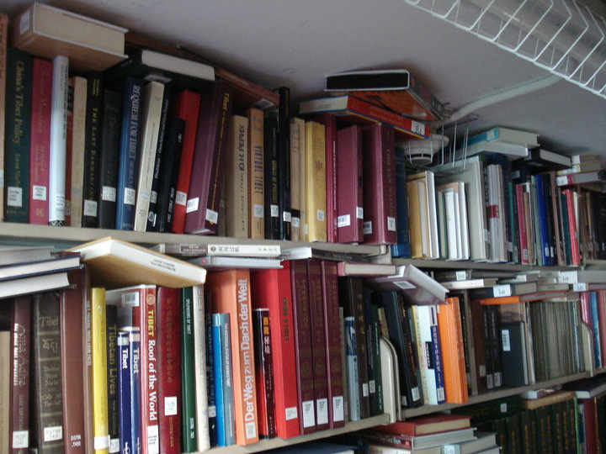
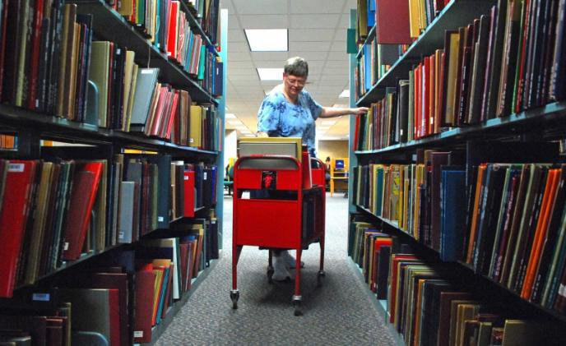
Background
Stacks of Pattee Library, 2012
Notes:
We still have a long way to go though. The pictures here show our working environment in 2012.
We had books spilling out of the shelves and stacked at the ends of the rows and on student carrels in that first picture.
In the second picture, you can see Janell, now retired who spent many years working in the stacks.
Do you think that this environment is sustainable? It was not and is not.
In 2012, we moved 100,000 inches of infrequently used books from open stacks on campus to an off-site location. You can still check these books out, but there is a slight delay.
It took three, almost semi-sized trucks to move those inches and we used contracted people to do it.

Slide 11
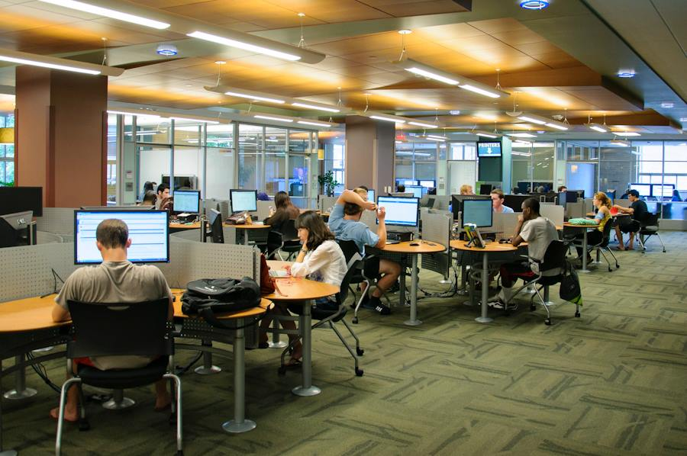
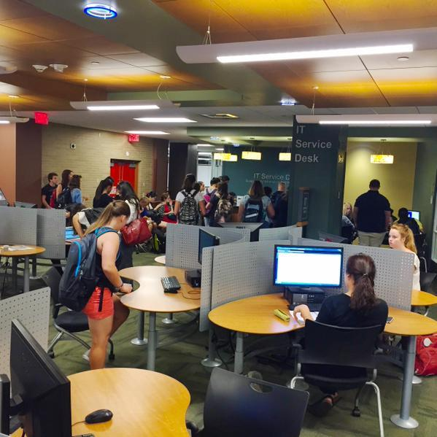
Background
Knowledge Commons, Fall 2012
Notes:
Penn State Libraries are now re-evaluating their roles and optimizing their spaces to find the right balance of housing and lending books and providing new services. They are moving away from past collection-based models to create user-centered buildings where people connect with each other and with the services and resources provided and increasingly work collaboratively.
Also in 2012, University Libraries was opening the newly constructed Knowledge Commons filled with computers, several media- capable group collaboration rooms, an ITS stop for tech help and a one-button studio for recording and practicing presentations of the kind that we are presenting today. In 2016, we will open a maker space room with 3-D printing and littleBits, which treats electronics components like Lego bricks to be snapped together. We are making things in the library, synthesizing data. The Knowledge Commons is the most heavily used space in the libraries and the only print books in the room are those found in the students’ backpacks. No books there.
So if we are moving the books out, how do we decide what to move?

Slide 12
Background
Removing Books – how?
Use – number of checkouts
Relevancy – last date of checkout
Age – publication date
Notes:
Remember the subtitle of my presentation “a geographical and statistical perspective of use, age, and relevancy” ?
These three characteristics are attributes found in the library’s database. Number of checkouts shows cumulative use of that book,
last date of the checkout shows its relevancy now,
and publication date indicates the age of material. As you might suspect, in some of the sciences, age is critical. Genetics 30 years ago is not the genetics of today.
So, we’ve talked about the role of the libraries changing from keepers of books to makers of spaces and things within those spaces. But there are more reasons to move those books out.

Slide 13
Background
Removing books – why?
Cost
Yearly cost of a book in open stacks = $4.68 in 2015 $
Space
Average width of Penn State book = 1.5 inches
Opportunity Cost
Using prime real estate as book storage
Using $ to keep an unused book
But, not having information readily available
Notes:
There is the cost of keeping a book on a shelf.
My Penn State MBA degree kept nudging me to identify the cost associated with keeping all those books, sometime old books, on a shelf.
I found that researchers have gone to great lengths to incorporate the cost of heating and air conditioning, moving books from building to building, moving books within the building, and personnel and maintenance cost. Remember Janelle. Janelle costs. So, two researchers have quantified this cost as $4.46, yearly expense.
Books on open shelves also take a lot of floor space. The average width of a Penn State book is 1.5 inches. That leads us into opportunity cost. Could that space be better utilized and dollars spent on keeping an unused book on campus be put to better use?
But what about the flip side? What happens if a piece of crucial information that you need right now is not available right now?
We have coined a term for that situation and a question as well: is “just in time” information good enough in today’s library or do we continue with the old habit of having print information in an open stack “just in case” it is needed by someone sometime?

Slide 14
Objective
Explore the potential of geographic information systems (GIS) to evaluate appropriate library space allocations for balancing book occupancy and patron occupancy.
Notes:
And that’s the dilemma and why I want to find a way to assess the best use of library space, a sustainable use for current as well as future researchers.
Academic libraries have to perform a formidable balancing act: protecting tangible intellectual assets that cost overhead dollars against freeing that space for alternative, but much needed, intellectual pursuits – teaching, learning, and collaboration for information synthesis.
So, my goal is to explore the potential of geographic information systems (GIS) to evaluate appropriate library space allocations - to balance book occupancy and patron occupancy. I would like to create a visualization that would help make this balancing act easier, perhaps create a decision support system using GIS as a foundation.

Slide 15
Methods
Retrieving the data
Locating the books
Analyzing the attributes
Notes:
In terms of the methods I will use: I will retrieve the use, relevancy, and age data,
will place the books in a geographic location,
and then analyze their attributes by their location.

Slide 16
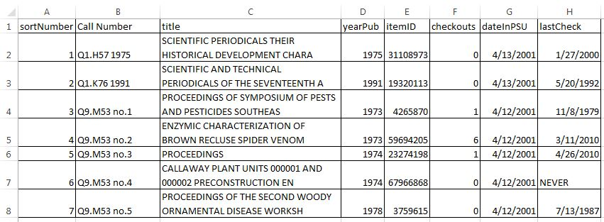
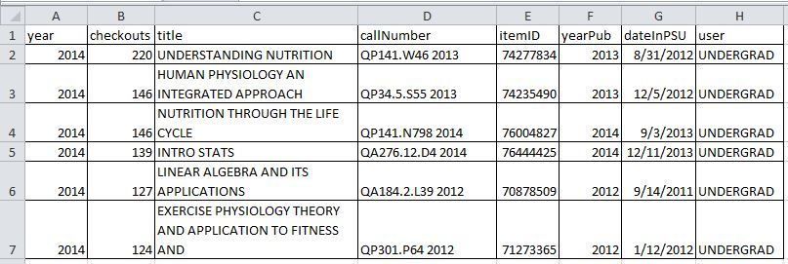
Methods – Retrieving the data
Cumulative since 1978
Annual since mid-2001
Notes:
I have cumulative data from 1978 for each book – and that is when we became computerized.
Book attributes are easy to retrieve and include the title, call number, year published, number of accumulated checkouts, the last checkout date, the year the book entered our system (which might be different from the publish date), and each book’s unique ID based on the barcode on the cover.
I also have the number of checkouts broken out for each year starting in mid-2001. That was the year that we changed to a different library database system.
So what did I do with that data?

Slide 17
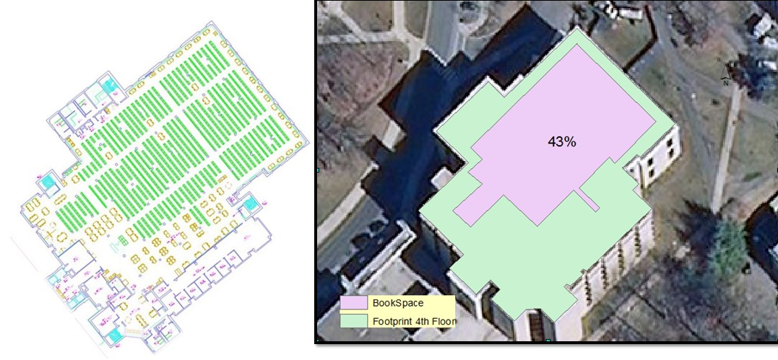
Methods – Locating the books
Notes:
Here in the CAD rendering of the library, the green lines represent the rows of shelving units. Each green rectangle is double-sided with book shelving units facing into the aisles between them. Each shelving unit has six to seven shelves.
Getting the data for each book was easy; locating each book on the floor, not so much. You can theoretically locate each book by lat-lon and vertical height, but that takes a massive amount of time, more than I had available for the pilot study or will ever have available. So, I started looking for another way to locate each book. Also, you should know that the stacks are a dynamic entity. New books are added almost daily, old books are moved offsite or disposed of. Some areas grow more quickly than other areas, so where a book is today might very well not be where the book is tomorrow. 43% of the floor space is taken up with the stacks area. The little peninsulas here and there are not part of the study because they are reference books and periodicals that we generally do not check out to patrons, so what we are talking about is essentially the rectangle of the footprint which is represented by the fishnet.

Slide 18
Methods – Workflow
create csv table
load into gdb table
truncate call nos.
run
summary statistics
reverse alternate rows
load into fishnet
join
create
subject shapefile
download PASDA basemap
create stacks footprint
create fishnet
Python scripting
Notes:
First, I downloaded a georectified basemap with the campus and library from PASDA, created the footprint of 4th floor Paterno Library and a footprint of the stacks area specifically. Then I created a fishnet to represent each book in the library in their general actual location. So, I did not have to locate each book laboriously. I downloaded as a csv, the book attributes from the library’s database. I ran Python scripts to load the records into a geodatabase table and to truncate the LC call number down to two alpha characters.
Remember I pointed out the long call number of Gray’s Anatomy. That number is now just QM. Because for this study I am only interested in the subject areas and the first two alpha characters are all that I need.
In any library, books are placed on the shelves in call number order from left to right, turn the near corner and then right to left. The fishnet loads from left to right, goes back to left and loads left to right, so I have to force the rows to look like library rows. I am working on a Python script to do this but initially used a formula in Excel. With the truncated call number I can run summary statistics on the books and get average use, age, and last date used for each subject area in the library. I simply joined the summary table to the shapefile that I created for each subject area and now we are ready to start analyzing.

Slide 19
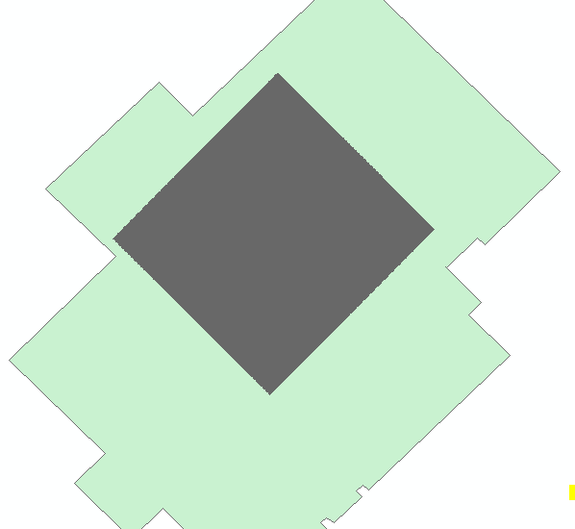
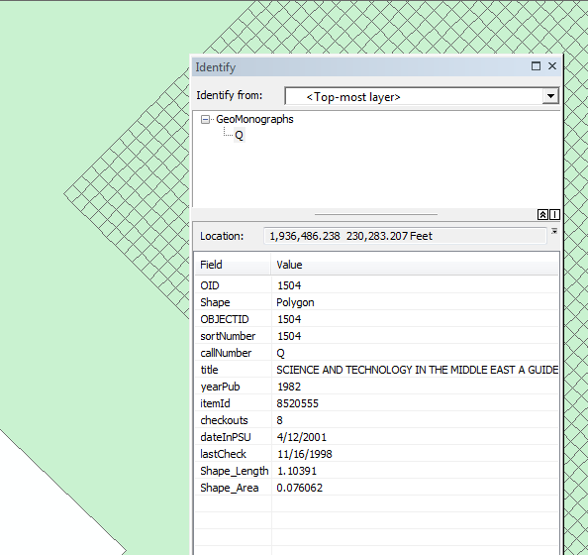
Pilot Study
Notes:
So I have some preliminary results of this effort that you might be interested in seeing. The fishnet itself is pretty unimpressive and looks like a solid block on the floor footprint when zoomed out, but when we zoom in and look at one book, we can see how the fishnet has created a virtual bookshelf, 375 books across each row.
With the books properly shelved in our fishnet, the fun can begin.

Slide 20
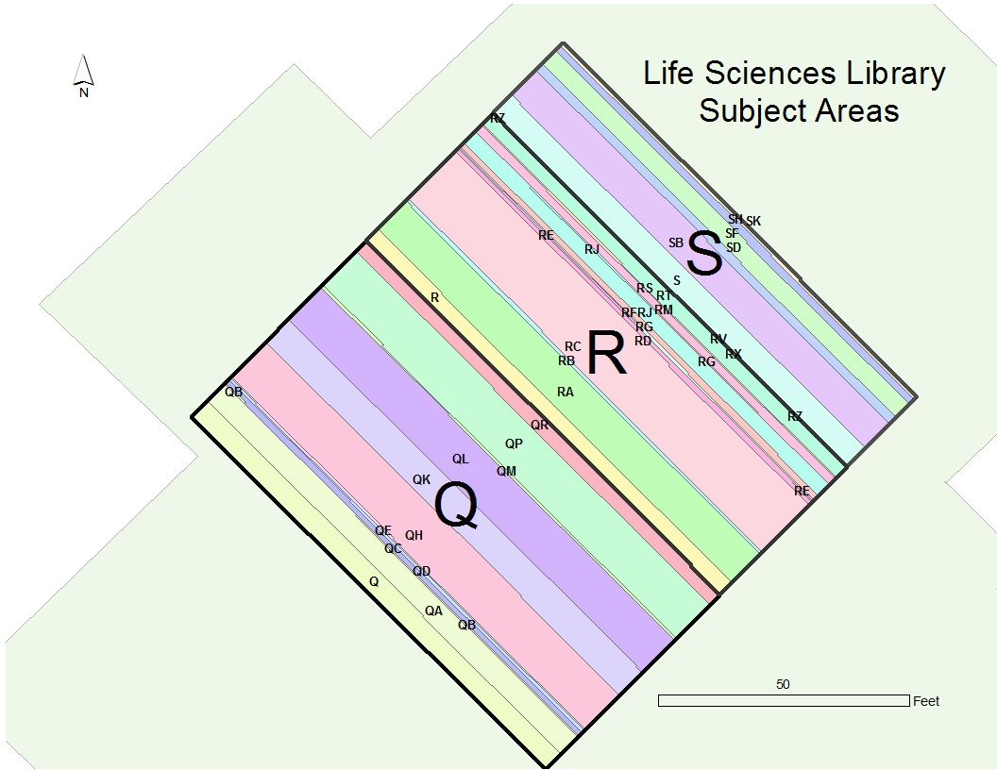
Pilot Study
Notes:
The three major subject areas that fill the library become more evident. General science Q’s include biology, microbiology, and others. R’s include the medical sciences, physiology, alternative medicines. S’s include agricultural areas like forestry and the hunting sports.

Slide 21
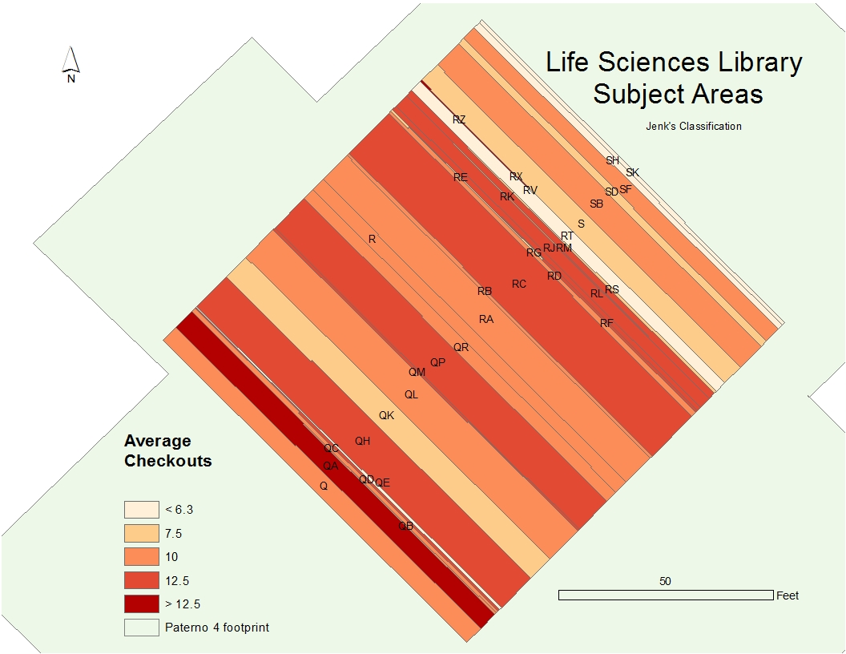
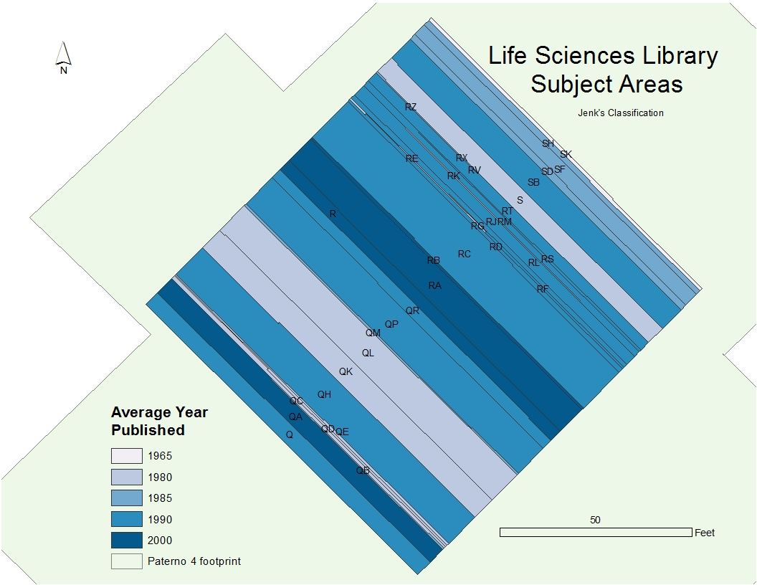
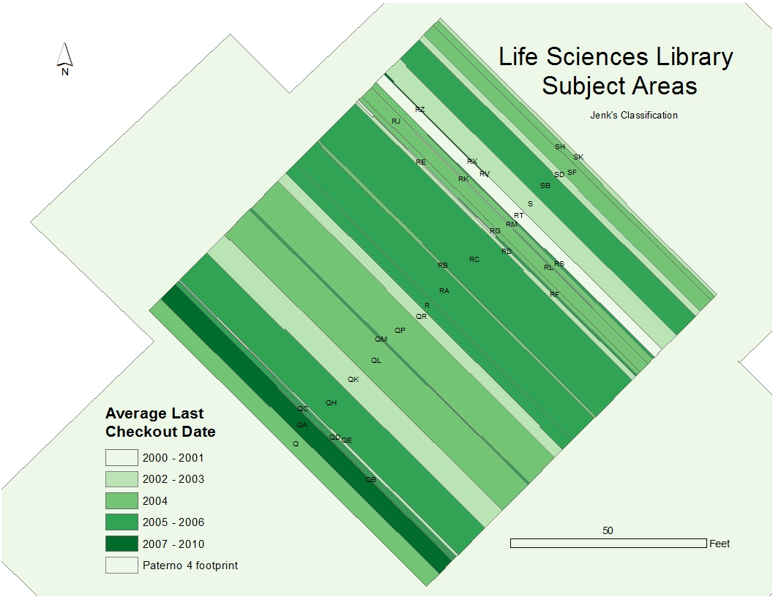
Pilot Study
Notes:
Once I had the books placed in a virtual bookshelf, I could start to analyze the three characteristics of age, use and relevancy to see if there is value to this endeavor.
One thing that became immediately apparent were the QA’s -- the intense color band close to the front of the library. QA’s are computers and programming and they stand out right away as being the newest, most checked out and the most recently checked out.
Another general pattern is the lighter bands toward the rear of the library in the agricultural section. They haven’t been used much, are older, and some haven’t been checked out recently.

Slide 22
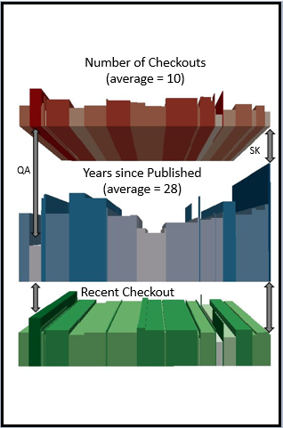
Pilot Study
Notes:
Moving that same information into a 3-D format seems to make more clear certain patterns and relationships. Look at how heavily used the QA’s, computers and programming languages, are in comparison to the hunting sports at the extreme rear of the library.

Slide 23
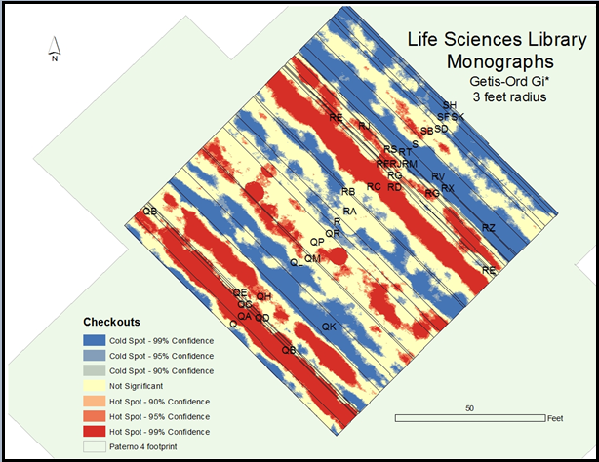
Pilot Study
Notes:
A preliminary run of a hot spot test, the Getis-Ord Gi* confirms what the previous two slides indicated: the agriculture section is for the most part infrequently used, the computer and computer programming area has been actively checked out in recent years and too the RC’s, internal medicine.
If you are wondering why I chose a 3 feet radius, each fishnetted book so to speak is .26 inches in length so I’m really capturing many more books than a non-virtual bookshelf would capture within three feet.
This information is nice to know and we can visualize a bit of the subject area strengths and weaknesses from these maps, but how does that relate to sustainability and to appropriate use of precious university space?

Slide 24
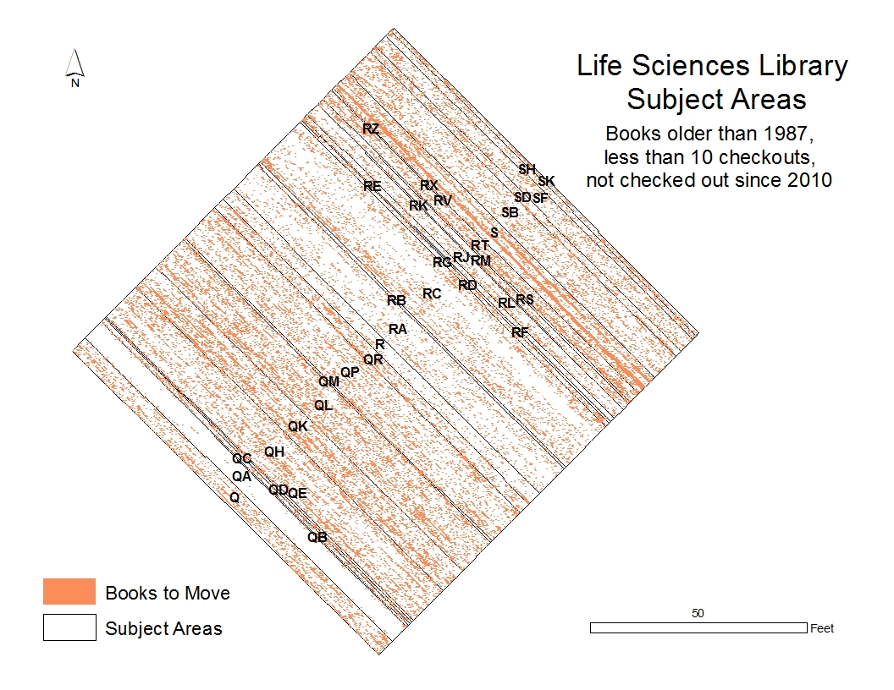
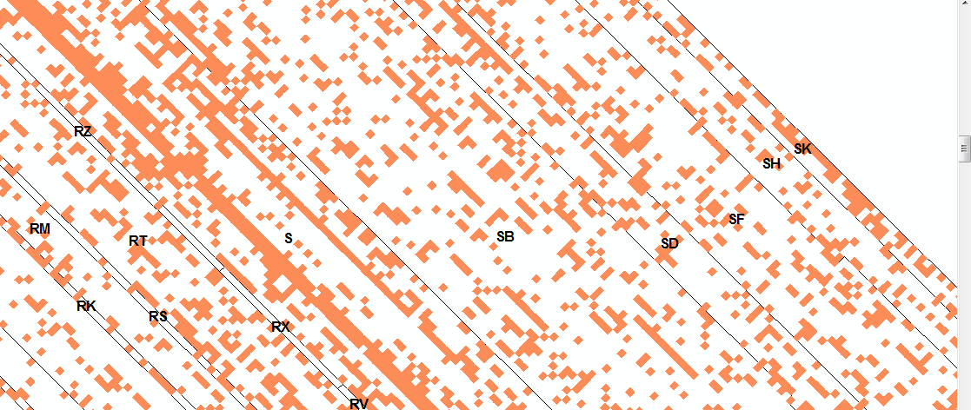
Pilot Study
Notes:
One criterion used most often by librarians to identify relevancy of the books to patrons – has this book been used in the last five years?
Let’s add the other two criteria –Let’s look for books older than the average 28 years and books with less than average total checkouts. To me that is a generous metric – below average for each subject area.
We can combine all three in an overlay – intersection to find the books that might need to be moved out of the library into storage or eliminated. 32,163 or 23 % are candidates for relocating or disposing. At $4.68 yearly cost per book, that’s approximately $150,000. Quite a few of those could be moved to high-density storage and that cost is projected to be around $1 each book.
Using the average of 1.5 inches for a University Libraries’ book, almost 230 shelving units could be removed from the floor freeing a minimum of 750 square feet, and this figure is the minimum, since it does not include the aisle square footage that runs between the rows of unit

Slide 25
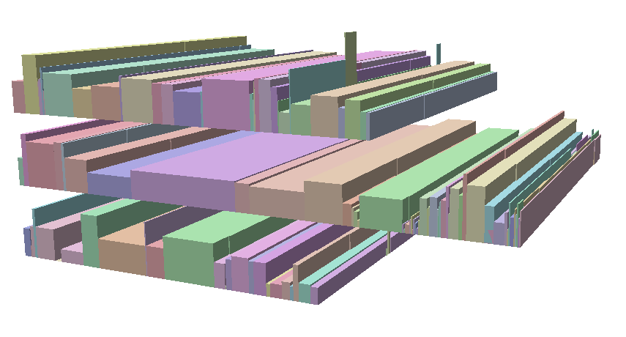
Pilot Study – Conclusion reached
This model
Can be effective in visualizing strengths and weaknesses of collections
Can be used to evaluate cost factors
Can be used to evaluate space allocations
Total Checkouts
Notes:
The conclusions I reached from the pilot study is that visualizing the collections is worthy of further investigation and refinement. Seeing the contrasting attributes of the subject areas is much more understandable and meaningful than it is when reading it from an Excel table. Look at those tiny subject areas that are sticking their little heads up into the air, screaming, “Look at me.”
This model is expandable - visualizing additional floors is entirely possible and you can see that I have added the two floors below mine. This model is flexible – when the library develops a way to capture use statistics on digital books, the eBooks can be incorporated into this model and analyzed. This model quickly assigns perceptible ownership by subject areas, by floors (elevation), by building, and by campuses across the state. It can set the stage for future space planning and cost savings across the system.

Slide 26
Future Plans
Present to librarians
Survey them
from http://biemrac.blogspot.com/
Notes:
That’s what I think, but what about the librarians in University Libraries. I’d like to present this to a group of librarians and get their input on their perception of its usefulness, the visualizations that they would find most useful and the criteria most beneficial to visualize the collections for decision-making. My next step then would be to survey them and I hope that they will provide direction for further analyses.

Slide 27
Expected Results
Generally: show utility for decision making
Specifically: show correlation
between age and use
between age and relevancy
Notes:
Generally, I expect that these visualizations will have utility in finding areas in the library that need to be evaluated for what we call weeding or deaccession, that is disposing of the old books or moving them offsite. Simple 3-D visualizations had some surprising outcomes for me and actually highlighted better some troublesome subject areas that had just a few books, areas that were lost in the 2D choropleth maps.. That is the type of surprise results that makes doing this worthwhile. Learning more about the collections.
When I start to run more statistical analyses than a mere hot-spot analyses, I think that we will confirm some of the correlations that seem to be bubbling up in this initial pilot test. I expect to see that the publish age of these old science books correlates, most likely in the negative direction, with use and with recent use or relevancy to patrons.

Slide 28
Conferences
Digital Humanities
digital technology
humanities
Geodesign
spatial knowledge
environmental design
Notes:
By now, you have realized that this isn’t one of the typical uses of GIS in the outdoors for environmental analyses, emergency management, site selection and such. I moved it indoors and have stumbled into the realm of the digital humanities and geodesin. I haven’t had time to look at the temporal data, checkouts across years, but looking at subject-area size and use across time is probably an indicator of the culture and initiatives of those times and I am researching at the intersection of digital technology and humanities. I have wandered also unexpectedly into the realm of geodesign, Justine tells me. So, I am using spatial knowledge and evolving technologies to address environmental design problems like how to best use the finite space within university libraries.
And that brings me to my conferences.

Slide 29
Conferences
Digitorium Digital Humanities Conference
Thursday, March 3rd – Saturday, March 5th, 2016
University of Alabama, Tuscaloosa, AL
Proposal Deadline: December 10, 2015
Texas Conference on Digital Libraries
Tuesday, May 24th – 26th, 2016
The Commons Learning Center, Austin, TX
Proposal Deadline: February 7, 2016
Notes:
Digitorium Digital Humanities Conference – “a large-scale, international Digital Humanities conference”
Texas Conference on Digital Libraries – “covers topics relevant to the creation, promotion and preservation of research, scholarship and cultural heritage digital materials”

Slide 30
Timeline
 | 2015 |  |  | 2016
Task - Geog596a | Oct | Nov | Dec | Jan | Feb | Mar | Apr | May
Finalize Topic
Idenitfy Conferences
Verify Accuracy of Cumulative Data
Identify, Clean, and Load Annual Data
Conduct Literature Search
Analyze Data, Choose Statistical Methods
Rough Draft of Full Paper
Submit Proposal to Digitorium
Draft Presentation
Peer Review Presentation
Task - Geog596b
Incorporate peer suggestions
Complete Analysis
Confirm Digitorium Conference
If rejected, submit proposal to Texas Conference on Digital Libraries
Complete Paper
Attend and present at Digitorium
Attend and present at TCDL

Slide 31
References
About the Annex (2015). Penn State University Libraries. Retrieved from http://www.libraries.psu.edu/psul/annex/abouttheannex.html.
Bradley, W. B., & Mandel, L. H. (2010). Utilizing geographic information systems (GIS) in library research. Library Hi Tech, 28(4), 536-547. doi:http://dx.doi.org/10.1108/07378831011096213.
Brundin, M. R. (2007). Using a geographic information system to analyze public library performance measures.
CPI Tables (2015). Consumer Price Index. Bureau of Labor Statistics. Retrieved from http://www.bls.gov/cpi/tables.htm.
Courant, P. N., Henry, C., Henry, G., Nielsen, M., Schonfeld, R. C., Smith, K. Council on Library and Information Resources. (2010). The idea of order: Transforming research collections for 21st century scholarship. Washington, D.C: Council on Library and Information Resources.
Coyle, A. (2011). Interior library GIS. Library Hi Tech, 29(3), 529–549. doi:http://dx.doi.org.ezaccess.libraries.psu.edu/10.1108/07378831111174468

Slide 32
References continued
ESRI 2014. ArcGIS Desktop: Release 10.2.2. Redlands, CA: Environmental Systems Research Institute.
Given, L. M., & Archibald, H. (2015). Visual traffic sweeps (VTS): A research method for mapping user activities in the library space. Library & Information Science Research.
Latimer, K. (2011). Collections to connections: Changing spaces and new challenges in academic library buildings. Library Trends, 60(1), 112-133. Retrieved from http://search.proquest.com.ezaccess.libraries.psu.edu/docview/903206239?accountid=13158
Murphy, S. A. (2015). How data visualization supports academic library assessment: Three examples from the Ohio State University libraries using tableau. Chicago: Association of College and Research Libraries./j.lisr.2009.12.004.

Slide 33
References continued
Ward, S. M. (2015). Rightsizing the academic library collection. Chicago: ALA Editions, an imprint of the American Library Association.
Xia, J. (2004a), Library space management: a GIS proposal, Library Hi Tech, 22(4), 375 – 382.
http://dx.doi.org/10.1108/07378830410570476.
Xia, J. (2004b). Using GIS to measure in-library book-use behavior. Information Technology and Libraries, 23(4), 184-191.
Xia, J. (2005). Visualizing occupancy of library study space with GIS maps. New Library World, 106(5), 219-233. Retrieved from http://search.proquest.com.ezaccess.libraries.psu.edu/docview/229577836?accountid=13158.
Notes:
Note to self: Sherry, add references for the geodesign slide if Justine thinks this fits.

Slide 34
Questions?

Slide 35
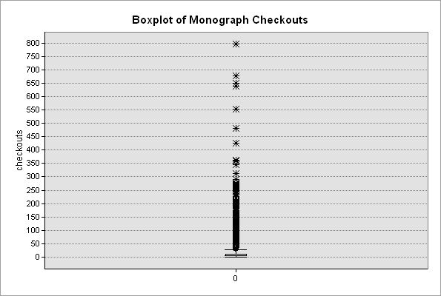
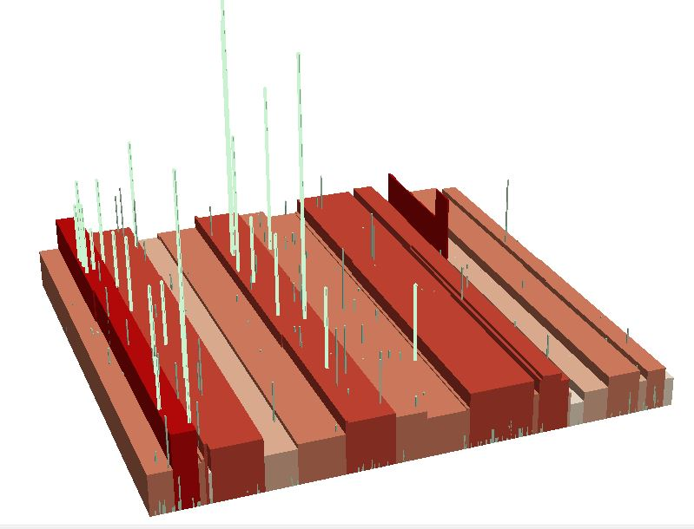
Notes:
Outliers…..Which is more sense to a lay person?

